Slide 1




Proposal 310036
Remote Detection of Radioactive Materials Using Long Wavelength Infrared Laser Driven Avalanche Breakdown
Robert M. Schwartz¹, S. Waczynski¹, A. Zingale^{1,2}, E. Rockafellow¹,
H. M. Milchberg (PI)¹, R. Lakis (co-PI)², J. Sears (co-PI)³
¹University of Maryland ²Los Alamos National Laboratory ³Lawrence Livermore National Laboratory
Funding Source: NNSA
Funding: Received
24th Annual
Accelerator Test Facility (ATF) Users' Meeting
January 17-21 2022

Slide 2

Experiment Goals
Year 1: Perform proof-of-concept scaling experiments for detection of radioactive materials at 10m standoff distance.
  Characterize avalanche breakdowns with the 9.2µm long pulse beam line.
  Optimize diagnostics
  Test Po-210 (5.4MeV ⍺), Fe-55 (6keV 𝛾), and Cs-137 (622keV 𝛾)
Years 2-3: Extend technique to 30m detection distance.
  Characterize effect of long propagation paths on sensitivity
  Improve diagnostic sensitivity and resolution
  Characterize effects of turbulence and aerosols

Slide 3
Background: Short Pulse IR Avalanche Breakdowns
Avalanche breakdowns are local
  Centered around seed electrons
  Bounded by diffusion during pulse
Discrete plasma “blobs”
  Discontinuous plasma density
  Each blob has its own plasma density surrounded by neutrals

Slide 4
Background: Short Pulse IR Avalanche Breakdowns
Avalanche breakdowns are local
  Centered around seed electrons
  Bounded by diffusion during pulse
Discrete plasma “blobs”
  Discontinuous plasma density
  Each blob has its own plasma density surrounded by neutrals
What if?
Short λ
  Enough unwanted MPI seed electrons that their separation is smaller than the diffusion length
Long τ_{p}
  Enough time that the diffusion length is greater than the seed separation.

Slide 5
Background: Short Pulse IR Avalanche Breakdowns
Avalanche breakdowns are local
  Centered around seed electrons
  Bounded by diffusion during pulse
Discrete plasma “blobs”
  Discontinuous plasma density
  Each blob has its own plasma density surrounded by neutrals
What if?
Short λ
  Enough unwanted MPI seed electrons that their separation is smaller than the diffusion length
Long τ_{p}
  Enough time that the diffusion length is greater than the seed separation.
Discrete model necessary for:
  λ>2µm
  τ_{p}<1ns

Slide 6





Background: Avalanche as Plasma Diagnostic
Low seed density
Electron motion is limited by diffusion, leading to discrete countable sites
$r_{d}\sim \sqrt{2k_{B}T/mν_{en}}$=$≈0.3 \sqrt{τ\left[ps\right] T_{e} [eV]) } μm$
What this looks like experimentally:
$$r_{d}$$
$$r_{d}<N_{e}^{−\frac{1}{3}}$$
θ = 0º
Breakdown region
$$I>I_{threshold}$$
100 μm

Slide 7

Background: Avalanche as Plasma Diagnostic
High seed density
Once seed electrons are close enough that individual sites overlap ($r_{d}\sim N_{e}^{−\frac{1}{3}}$), breakdowns are no longer countable
For moderate densities, more seeds means higher chance that a seed will be near the laser focus, where intensities are higher, and breakdowns are driven faster. Statistics on breakdown timing measures seed density.
For very high densities, back to classic model of an exponentially growing plasma. Higher initial seed densities mean fewer doubling periods to reach a measurable plasma density.
`

Slide 8
Background: Modeling
Radioactive materials deposit energy in air creating an enhanced population of seed electrons
Our model includes energy deposition, air ion formation rates, collisional energy transfer, and loss rates to calculate a steady-state seed density for air in the presence of a radioactive source
We then add laser heating to model avalanche ionization
Simulations for fixed intensity reproduces time advance results reasonably well
Modeling random placement of charges in volume gives statistical spread of timing

Slide 9
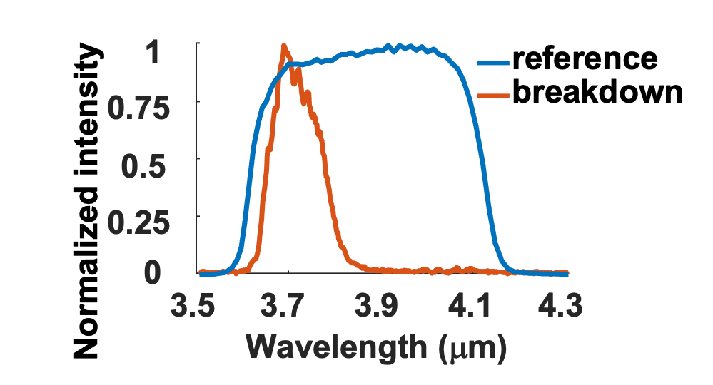
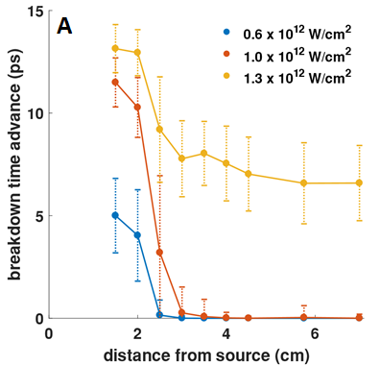
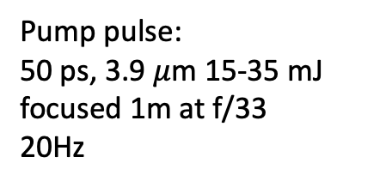
Background: Proof-of-Concept Experiments
Breakdown time advance from backscattered spectra
Shot-by-shot spectra of the backscattered pulse
Pump pulse:
50 ps, 3.9 $μ$m 15-35 mJ focused 1m at f/33
20Hz
R. M. Schwartz, D. Woodbury, J. Isaacs, P. Sprangle, and H. M. Milchberg, Sci. Adv. 5, eaav6804 (2019)
D. Woodbury R. M. Schwartz, and H. M. Milchberg, Optica 6 (6) (2019)

Slide 10
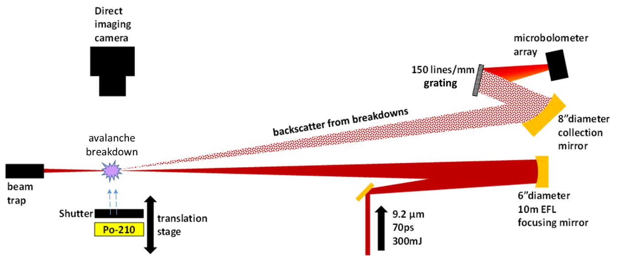
Experiment Layout
Expected time advance for breakdowns driven by the uncompressed ATF beam line.
Sensitivity can be shifted with intensity and focusing geometry.
Video of breakdowns driven at 3.9µm.
Each spot is a breakdown seeded by a single electron.

Slide 11
Experiment Schedule
Experiment | Goals/milestones
Year 1 Demonstrate detection of radioactive material at ~10 m range (2-3 weeks) | Optics setup for 10 m range experiments Determine breakdown threshold and background seed density in the absence of a radioactive source (this can be done with direct imaging of breakdown sites) Calibrate and optimize the backscatter spectrum diagnostic Demonstrate on/off detection using shuttered Po-210 alpha source Measure seed density as a function of source distance and validate models Repeat experiments with Fe-55 and Cs-137 x-ray/gamma sources
Year 2 Demonstrate detection of radioactive material at ~30 m range (2-3 weeks) | Optics setup for 30 m range experiments Same technical goals as above Characterize effects of turbulence and aerosols on long propagation paths

Slide 12
Publications
R. M. Schwartz, D. Woodbury, J. Isaacs, P. Sprangle, and H. M. Milchberg, “Remote detection of radioactive material using mid-IR laser-driven electron avalanche,” Sci. Adv. 5, eaav6804 (2019).
D. Woodbury R. M. Schwartz, and H. M. Milchberg, “Measurement of ultralow radiation-induced charge densities using picosecond mid-IR laser-induced breakdown,” Optica 6 (6) (2019).
D. Woodbury R. M. Schwartz, E. Rockafellow, J. K. Wahlstrand, and H. M. Milchberg, “Absolute Measurement of Laser Ionization Yield in Atmospheric Pressure Range Gases over 14 Decades,” Phys. Rev. Lett. 124, 013201 (2019).
R. Lakis, J. Sears, A Favalli, T. Stockman “Concept of Operations for Mid-IR Laser Driven Ion Detection,” LA-UR-21-21282.
D. Woodbury, A. Goffin, R. M. Schwartz, J. Isaacs, and H. M. Milchberg, “Self-Guiding of Long-Wave Infrared Laser Pulses Mediated by Avalanche Ionization,” Phys. Rev. Lett. 125, 133201 (2020).

Slide 13
Electron Beam Requirements
Parameter | Units | Typical Values | Comments | Requested Values
Beam Energy | MeV | 50-65 | Full range is ~15-75 MeV with highest beam quality at nominal values | -
Bunch Charge | nC | 0.1-2.0 | Bunch length & emittance vary with charge | -
Compression | fs | Down to 100 fs (up to 1 kA peak current) | A magnetic bunch compressor available to compress bunch down to ~100 fs. Beam quality is variable depending on charge and amount of compression required. NOTE: Further compression options are being developed to provide bunch lengths down to the ~10 fs level | -
Transverse size at IP (σ) | μm | 30 – 100 (dependent on IP position) | It is possible to achieve transverse sizes below 10 um with special permanent magnet optics. | -
Normalized Emittance | μm | 1 (at 0.3 nC) | Variable with bunch charge | -
Rep. Rate (Hz) | Hz | 1.5 | 3 Hz also available if needed | -
Trains mode | --- | Single bunch | Multi-bunch mode available. Trains of 24 or 48 ns spaced bunches. | -

Slide 14
CO₂ Laser Requirements
Configuration | Parameter | Units | Typical Values | Comments | Requested Values
CO₂ Regenerative Amplifier Beam | Wavelength | μm | 9.2 | Possible usage for alignment | -
 | Peak Power | GW | ~3 |  | -
 | Pulse Mode | --- | Single |  | -
 | Pulse Length | ps | 2 |  | -
 | Pulse Energy | mJ | 6 |  | -
 | M² | --- | ~1.5 |  | -
 | Repetition Rate | Hz | 1.5 |  | -
 | Polarization | --- | Linear |  | -
CO₂ CPA Beam | Wavelength | μm | 9.2 |  | 9.2
Note that delivery of full power pulses to the Experimental Hall is presently limited to Beamline #1 only. | Peak Power | TW | 2 |  | ~10GW
 | Pulse Mode | --- | Single |  | Single
 | Pulse Length | ps | 2 |  | 70ps
 | Pulse Energy | J | ~5 |  | ~500mJ
 | M² | --- | ~2 |  | ~2
 | Repetition Rate | Hz | 0.05 |  | 0.05Hz
 | Polarization |  | Linear |  | Linear

Slide 15
Other Experimental Laser Requirements
Ti:Sapphire Laser System | Units | Stage I Values | Stage II Values | Comments | Requested Values
Central Wavelength | nm | 800 | 800 | Stage I parameters are presently available and setup to deliver Stage II parameters should be complete during FY22 | -
FWHM Bandwidth | nm | 20 | 13 |  | -
Compressed FWHM Pulse Width | fs | <50 | <75 | Transport of compressed pulses will initially include a very limited number of experimental interaction points. Please consult with the ATF Team if you need this capability. | -
Chirped FWHM Pulse Width | ps | ≥50 | ≥50 |  | -
Chirped Energy | mJ | 10 | 200 |  | -
Compressed Energy | mJ | 7 | 100 |  | -
Energy to Experiments | mJ | >4.9 | >80 |  | -
Power to Experiments | GW | >98 | >1067 |  | -
Nd:YAG Laser System | Units | Typical Values | Comments | Requested Values
Wavelength | nm | 1064 | Single pulse | -
Energy | mJ | 5 |  | -
Pulse Width | ps | 14 |  | -
Wavelength | nm | 532 | Frequency doubled | -
Energy | mJ | 0.5 |  | -
Pulse Width | ps | 10 |  | -

Slide 16
Special Equipment Requirements and Hazards
Electron Beam
  N/A
CO₂ Laser
  Access to uncompressed (70ps) pulse with energies <5J.
Ti:Sapphire and Nd:YAG Lasers
  N/A
Hazards & Special Installation Requirements
  Geometry: Long, minimally obstructed laser beam path
  Equipment: Routing and focusing optics
  Hazards: Radioactive materials

Slide 17
Experimental Time Request
CY2022 Time Request
Capability | Setup Hours | Running Hours
Electron Beam Only | - | -
Laser* Only (in Laser Areas) | 50 | 150
Laser* + Electron Beam | - | -
Time Estimate for Full 3-year Experiment (including CY2022)
Capability | Setup Hours | Running Hours
Electron Beam Only | - | -
Laser* Only (in Laser Areas) | 150 | 450
Laser* + Electron Beam | - | -
* Laser = Near-IR or LWIR (CO₂) Laser

Slide 18
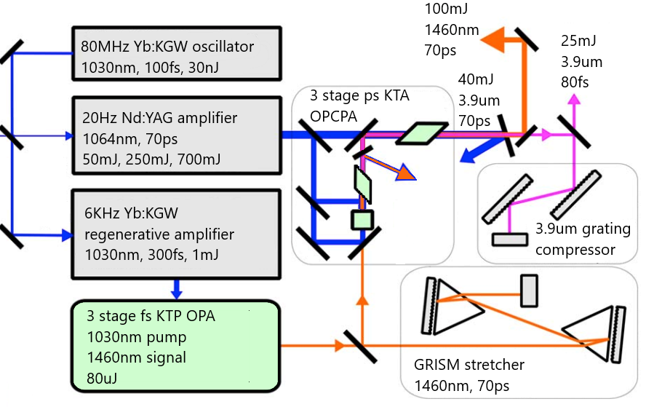
UMD 3.9µm OPCPA
    25 mJ, ~80 fs, λ=3.9 μm pulses, 0.3 TW
    Bypassing compressor produces chirped 70 ps pulses
      (adapted from G. Andriukaitis et al., Optics Lett. 36, 2755 (2011))

Slide 19
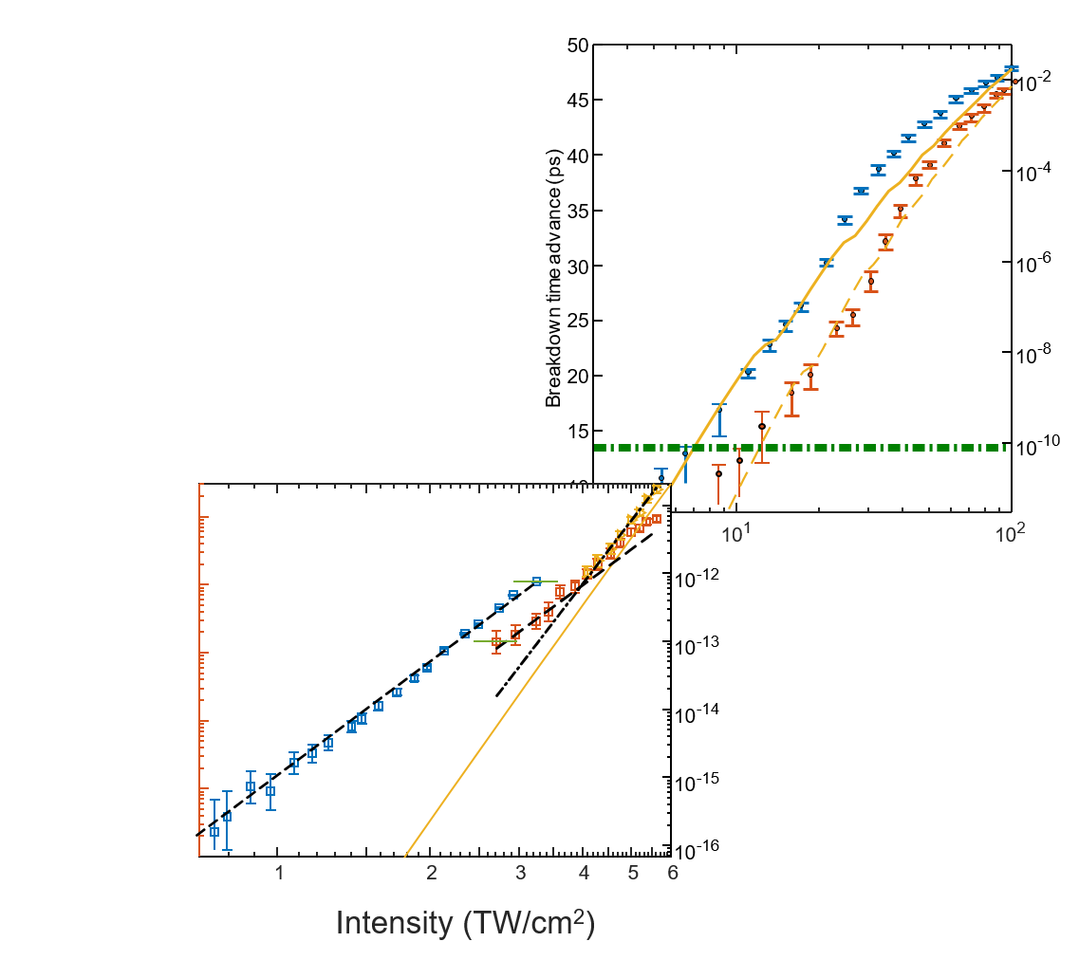
MPI measurements
Ionization yields at 1µm and 3.9µm have been measured at significantly lower intensities and at atmospheric pressure.
Good match to tunneling model
  Presence of ~6eV contaminant was universally seen at ~10¹⁰/cm³
Combined dynamic range of 14 orders of magnitude in ionization yield
  10³ to 10¹⁷ cm⁻³ electron density
D. Woodbury R. M. Schwartz, E. Rockafellow, J. K. Wahlstrand, and H. M. Milchberg, Phys. Rev. Lett. 124, 013201 (2019).

Slide 20
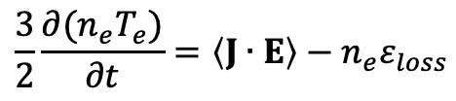
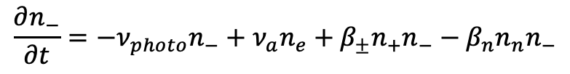
Radiation + Avalanche Model
$$\frac{∂n_{e}}{∂t}=\frac{1}{E_{ion}}Q_{rad}+ν_{photo}n_{−}+ν_{coll}n_{e}−ν_{a}n_{e}−β_{e+}n_{e}n_{+}+β_{n}n_{n}n_{−}$$
$$\frac{∂n_{−}}{∂t}=−ν_{photo}n_{−}+ν_{a}n_{e}+β_{±}n_{+}n_{−}−β_{n}n_{n}n_{−}$$
$$\frac{3}{2}\frac{∂{(n}_{e}T_{e})}{∂t}=\left\langle J∙E\right\rangle −n_{e}ε_{loss}$$
n_{e}: electron number density
E_{ion}: average ionization energy of air
ν_{photo}: photo-detachment rate
ν_{coll}: collisional ionization rate
ν_{a}: e + O₂ -> O₂⁻ attachment rate
β_{e+}: ﻿electron-ion dissociative recombination rate
β_{n}: ﻿negative ion detachment rate due to collisions with molecular nitrogen
β±: ﻿﻿ion-ion recombination rate
T_{e}: ﻿﻿electron temperature
<J⋅E>: ohmic heating rate
ε_{loss}: electron energy loss rate in air
Note: almost all of these have temperature dependence!
J. Isaacs, “The physics of high-intensity laser-matter interactions and applications” Thesis (2019)

Slide 21
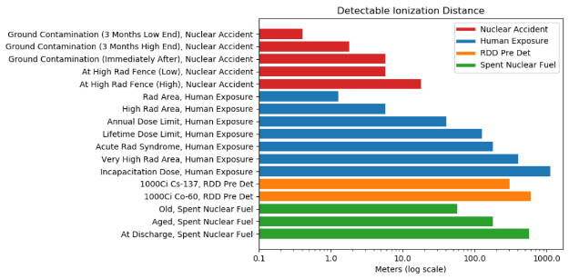
Detectable Sources
R. Lakis, J. Sears, A Favalli, T. Stockman LA-UR-21-21282.

