Slide 1
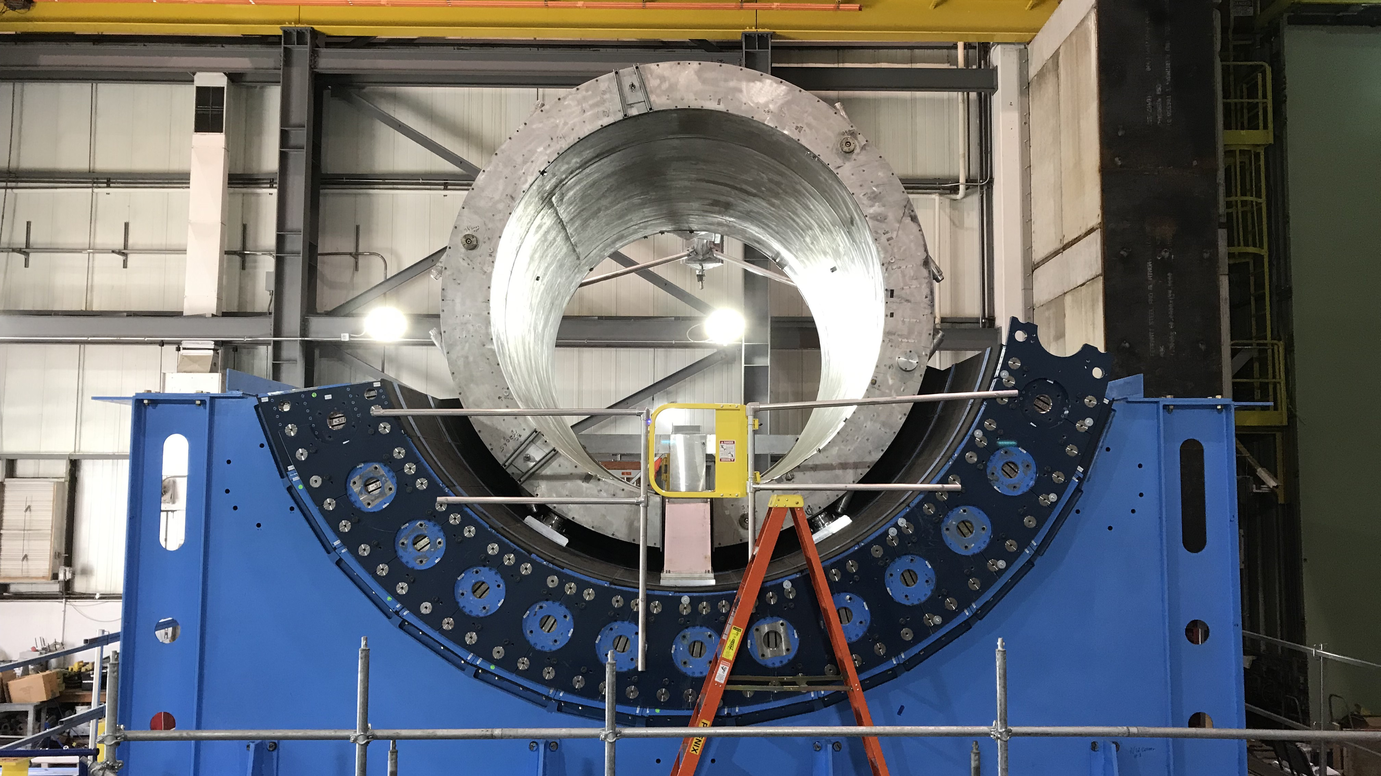

Slide 2
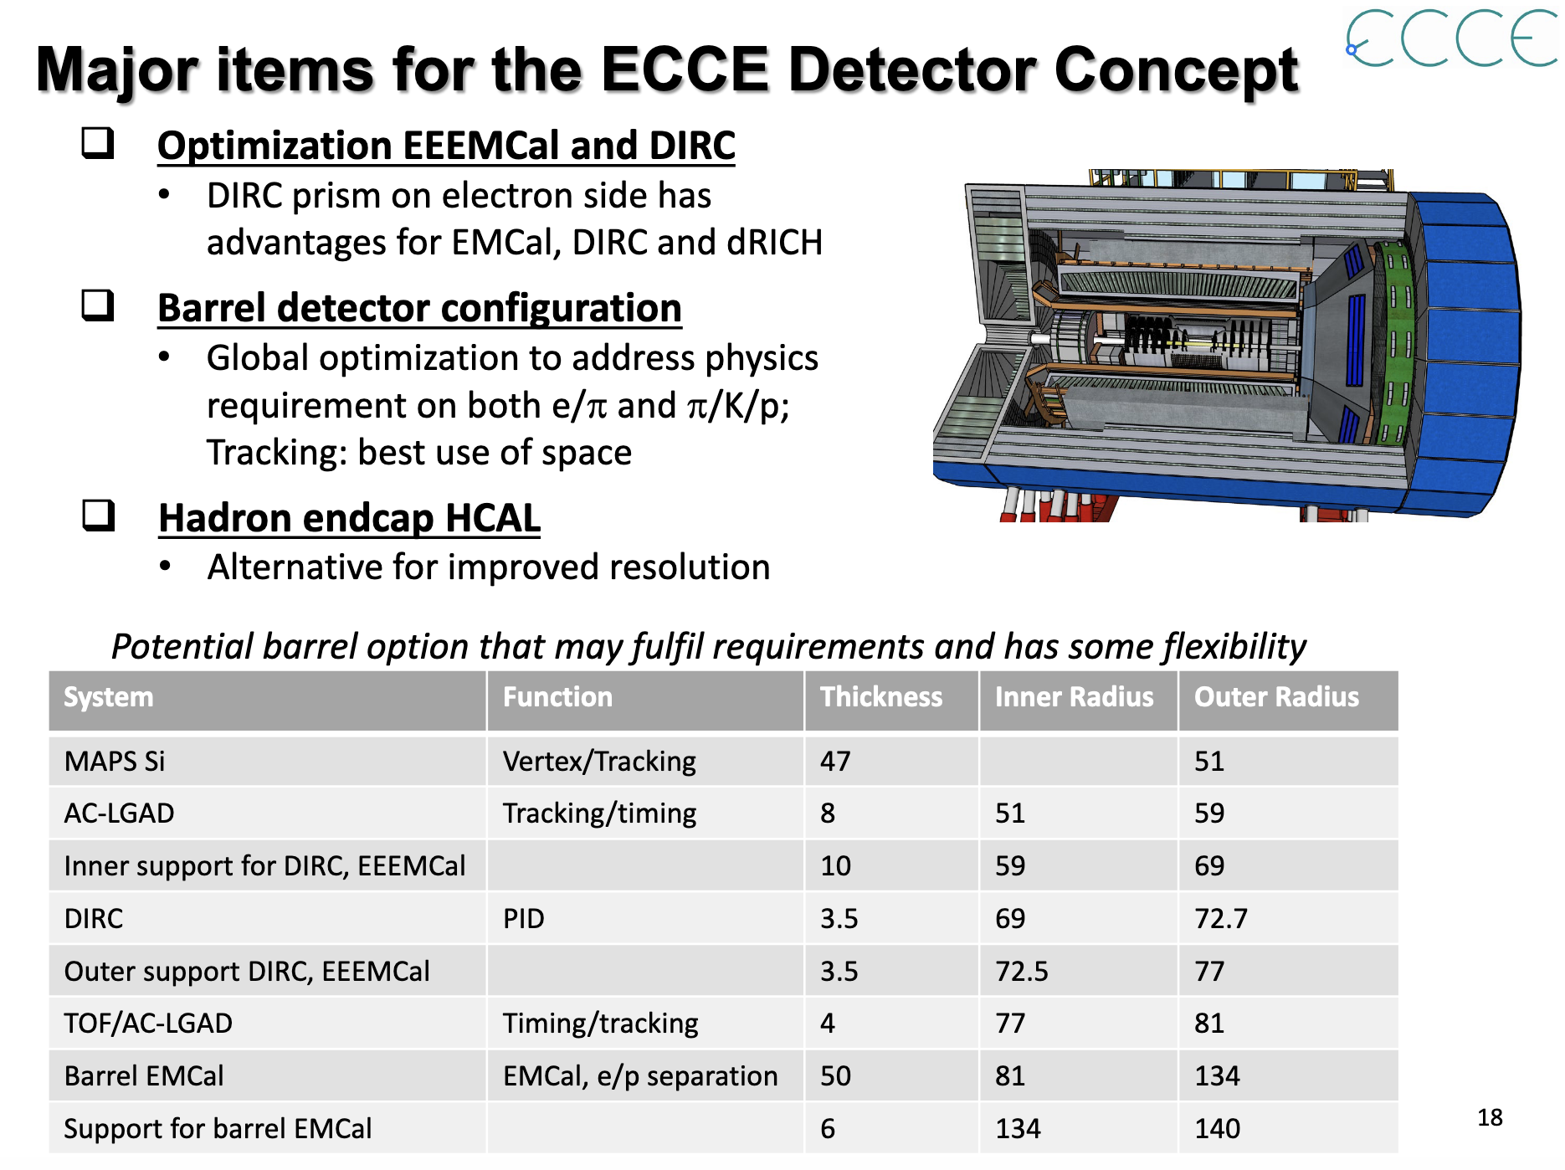
July 19th ECCE Consortium Meeting
https://indico.bnl.gov/event/11522/contributions/48836/attachments/36007/59039/ECCE-Bi-Weekly-Meeting-07192021.pdf
One example of a location
where different technologies have been proposed, yet the space is really tight.

