Slide 1
ATHENA DAQ
Integration meeting
October 6th 2021
Alexandre Camsonne

Slide 2
Integration start discussion
Where is electronics located
Cabling routing : LV, signal , optical fiber
Location of subcrates and crates

Slide 3
More details from DWG
Sensor
Readout
Cabling routing
Subcrate / Crates
Cabling to DAQ

Slide 4
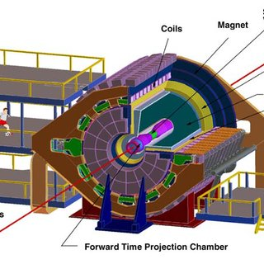
STAR detector layout

Slide 5
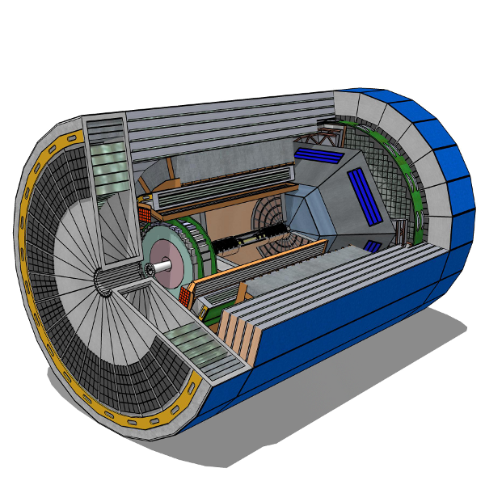
Layout detector from detector menagerie

