Slide 1


end cap and barrel MRPC ToF geometry (Tracking performance with mRPC ToF+ mRwell/GEM) Sourav Tarafdar

Slide 2
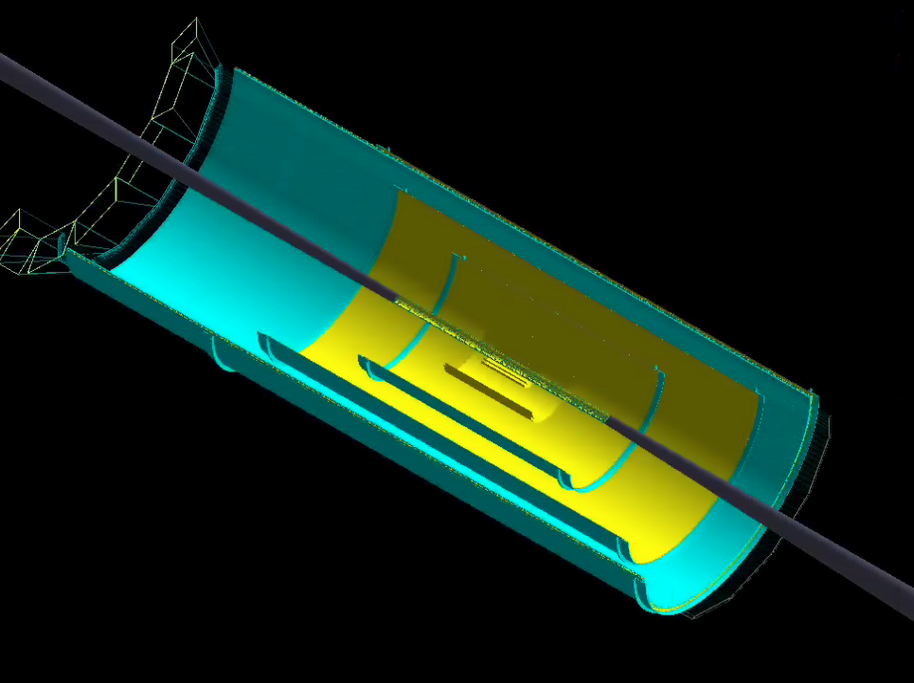
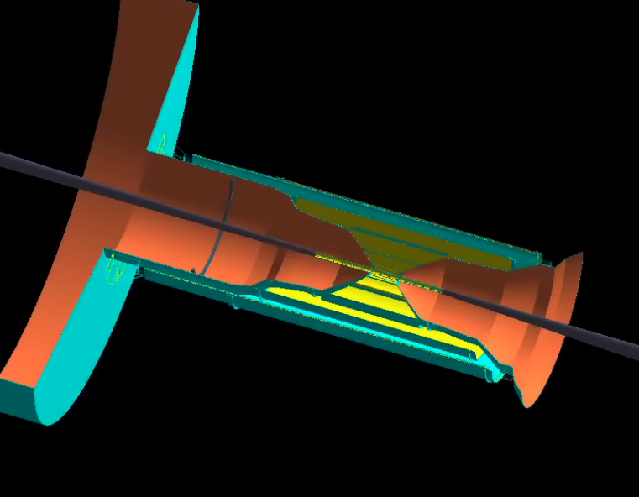
Barrel mRPC ToF
mRPC ToF @ R = 79 cm without frames .
length = 400 cm with z offset = -50 cm.
Material scan for 0<phi<360 at theta ~ 0.1 degree Radiation length ~ 10%
Material scan for -60 < theta < +60 at phi ~ 1 degree Radiation length ~ 10.0%

Slide 3
Barrel mRPC ToF
Subsystems in the current configuration :
Si + mRwell (@ R =44.2, 64, 82 cm) + DIRC + mRPC ToF @ R = 79 cm with tracking services
Generated particle phase space
5 pions per event with 0.1 < p < 20 GeV , |eta| < 1.5 and 0-2*pi phi
Length of each layer of mRwell : 140 , 250, 300 cm
Length of barrel mRPC ToF = 400 cm with z offset = -50 cm

Slide 4
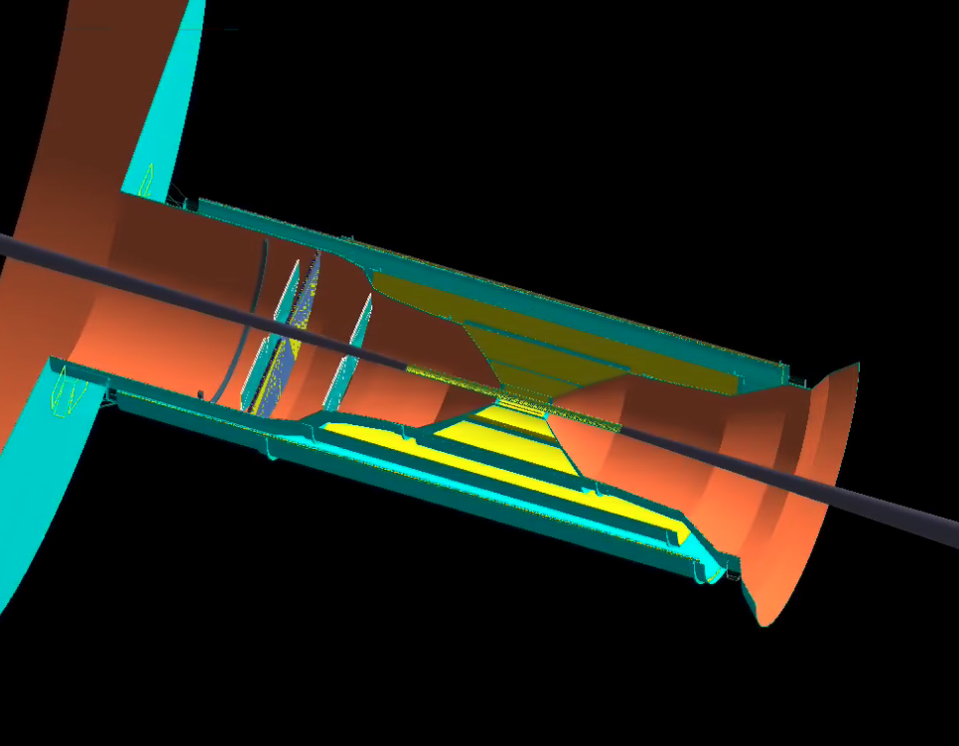
Electron end cap mRPC TOF (single layer thickness with 12 gas gaps ~ 2.716 cm)
Electron end cap detector locations:
1st GEM @ z = -120 cm
mRICH @ z = -125 cm
mRPC ToF @ z = -162.3 cm , R = (6.5 – 68 cm)
2nd GEM @ z = -173.0 cm
Material scan of Electron end cap mRPC TOF only

Slide 5
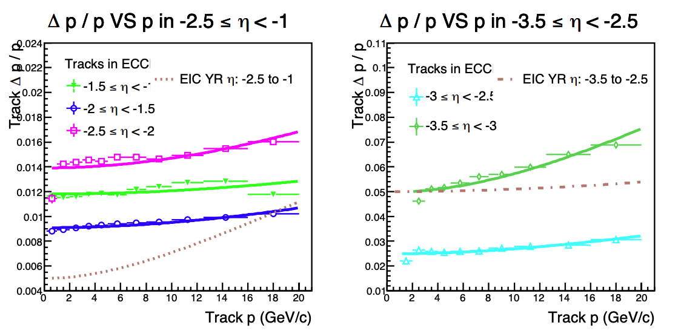
Electron end cap mRPC TOF (single layer thickness with 12 gas gaps ~ 2.716 cm)
Electron end cap detector locations:
1st GEM @ z = -120 cm
mRICH @ z = -125 cm
mRPC ToF @ z = -162.3 cm , R = (6.5 – 68 cm)
2nd GEM @ z = -173.0 cm
Generated particle phase space
1 pion/event with 0.1 < p < 20 GeV , -3.5 < eta < -1.5 and 0-2*pi phi
2nd simulation campaign tracking evaluation
(uses LGAD ToF) by Xuan Li

Slide 6
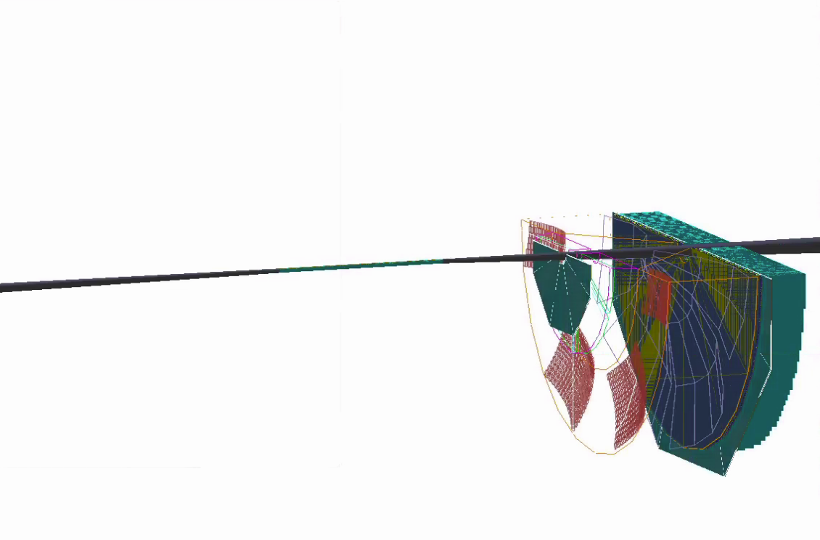
Hadron end cap mRPC TOF
GEM
ToF
Tracking performance study in Hadron End cap
EMCAL
5 pions per event with 0.2 <pT < 20 GeV in 1.2 < eta < 3.5 and 2.*pi in phi(eta coverage according to the last GEM eta coverage)
Susbsystems used according to the figure on left in addition to magnet and Si disks at hadron end cap
dRICH
GEM
Hadron end cap detector locations without tracking services:
1st GEM @ z = 175 cm
dRICH @ z = 185 cm with length = 100 cm
mRPC ToF @ z = 287.0 cm , R = (13.0 – 180 cm)
2nd GEM @ z = 292.0 cm
EMCAL @ z = 305.0 cm
Hadron end cap MRPC ToF will have same material budget as that on electron end cap

Slide 7
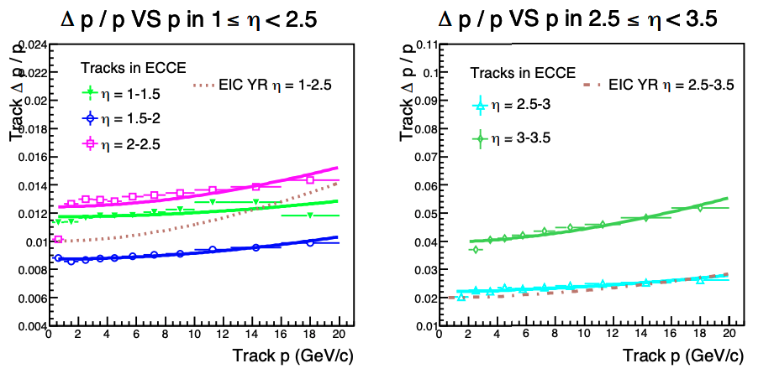
Comparison between current result and from 2nd simulation campaign
Tracking performance study in Hadron End cap
2nd simulation campaign tracking evaluation
(uses LGAD ToF) by Xuan Li
Very low statistics in different eta bins.
Will make pull request for end cap mRPC ToF.

