Slide 1
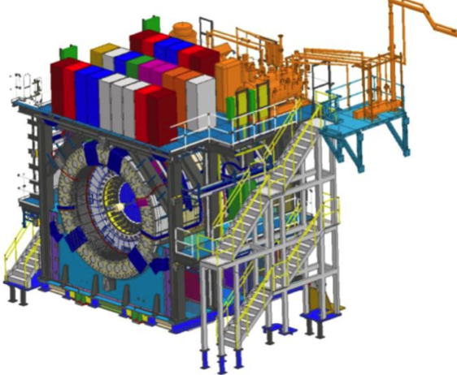
sPHENIX MIE Project Overview
TPC | Project Director | Last CD Achieved | % Complete | CPI | SPI
$27.0M | Edward O’Brien | PD-2/3 | 87.1% BCWP/BAC @ 9/30/2021 | 1.02 | 0.89
Scope
  Detector systems produced, tested and ready for installation: Time Projection Chamber w/ electronics, Electromagnetic Calorimeter w/ electronics, Hadronic Calorimeter w/ electronics, DAQ/Trigger, Minimum Bias Detector, Project Management
Not in scope
  SC-Magnet, Bldg/Det Infrastructure, Installation and System Commissioning
Schedule
  CD-0 received Sept 2016
  CD-1/3A received Aug 2018
  PD-2/3 received Sept 2019
  Early completion mid-Feb 2022 based on P6
  Early completion based on Sept status end of March 2022
  PD-4 Dec 2022
Cost
  $27.0M AY TPC 54.8% contingency on an ETC of $3.92M
96.9% Costed & Committed
Commitments = $2.89M

Slide 2
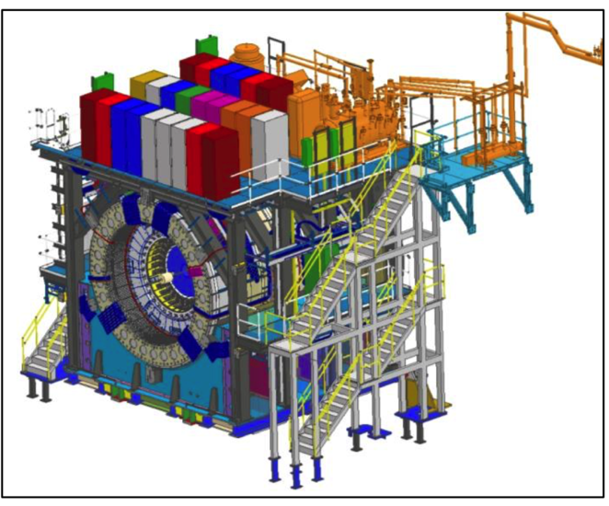
1008 Infrastructure & Facility Upgrade
TPC | Project Director | % Complete | CPI | SPI
$33.4 M AY | Edward O’Brien | 65.8% BCWP/BAC @ 9/30/2021 | 0.98 | 0.85
Scope
  SC-Magnet support including the Flux Return, Cryogenics into Bldg 1008, Detector Carriage/Cradle, other Bldg 1008 Infrastructure improvements
  sPHENIX Installation, Integration and Commissioning of each Subsystem is part of the scope
Not in Scope
  PreOps prior to RHIC collisions
Schedule
  sPHENIX Ready for Operations (Early Completion) 11/22/22
  First RHIC run of sPHENIX Feb 1, 2023
  2.5 months float in schedule between sPHENIX ORR and
  nominal start of RHIC 2023 run.
Cost
  $33.4 M AY Total Project Cost with 17.2% contingency on ETC of $11.02M
79.9% Costed and Committed
Commitments = $4.02M

Slide 3
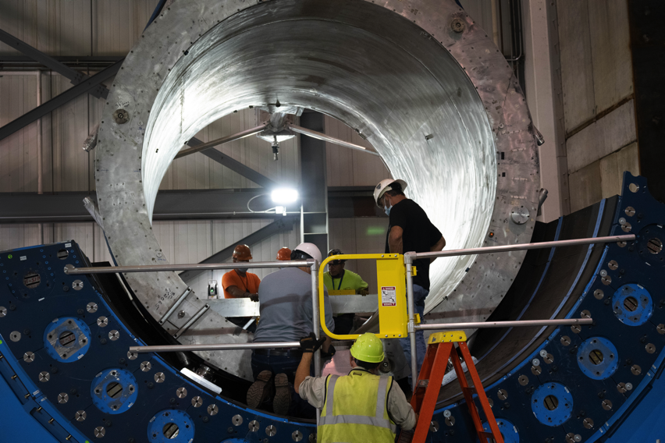
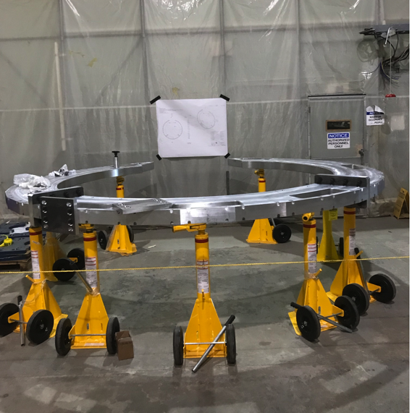
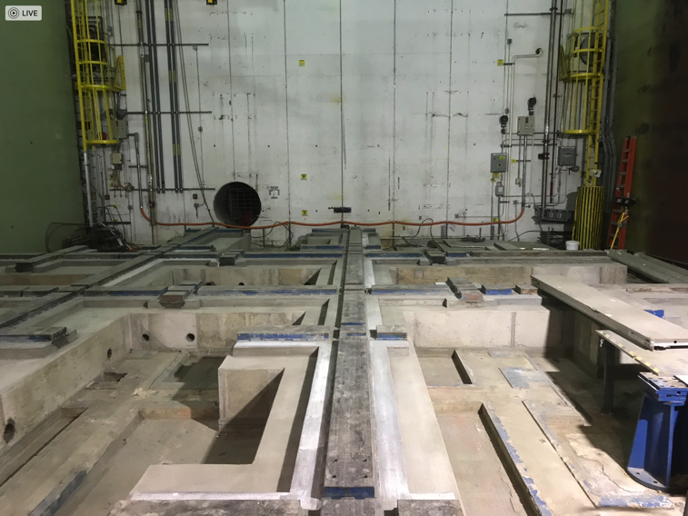
Status of sPHENIX Installation in 1008
sPHENIX 2021 RHIC shutdown work complete. Preparing the 1008 IR for RHIC Run-2022
SC-Magnet installed in sPHENIX
Large Support Rings @ BNL
Track Reinforcement complete

Slide 4
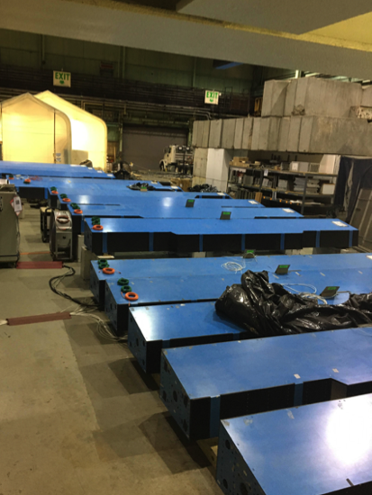
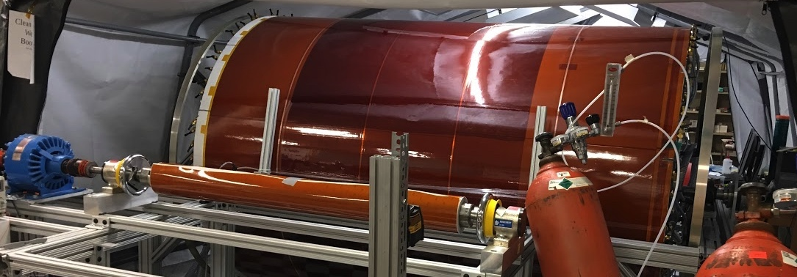
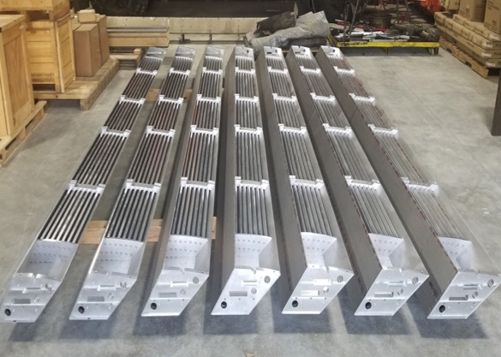
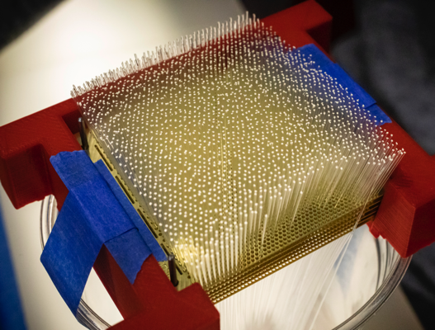
sPHENIX MIE Status
sPHENIX Assembly continues in the 1008 Assembly Hall
The Outer HCAL Sectors are complete. All sectors burned-in and ready to install.
EMCal blocks 90% complete at UIUC. Fab of all remaining MIE blocks are started. EMCal Sectors 62.5% (40/64) complete at BNL.
All TPC ASICs complete, tested and at BNL. First production TPC Fee board assembled and tested good. Assembly house stuffing 1st articles of 700 boards. All FELIX boards assembled and ready to test.
All EMCal and OHCal on-detector electronics received at BNL. Calorimeter digitizer components continue to arrive at Columbia University (>90% received to date)
All GEM framing for TPC complete except for spares. Spare framed GEM production ongoing at WSU, WIS, Vanderbilt, Temple. GEM module assembly about to start at SBU
Inner HCal mechanical sectors 75% complete. Final 25% expected in November. All tiles delivered
Major DAQ/Trigger orders: Large switch, DAQ computers and Buffer Boxes a delivered to BNL.
Outer HCal sectors going through final testing/burn-in
TPC Outer field cage at SBU
Inner HCal sectors at vendor
EMCal block fab @ UIUC

Slide 5
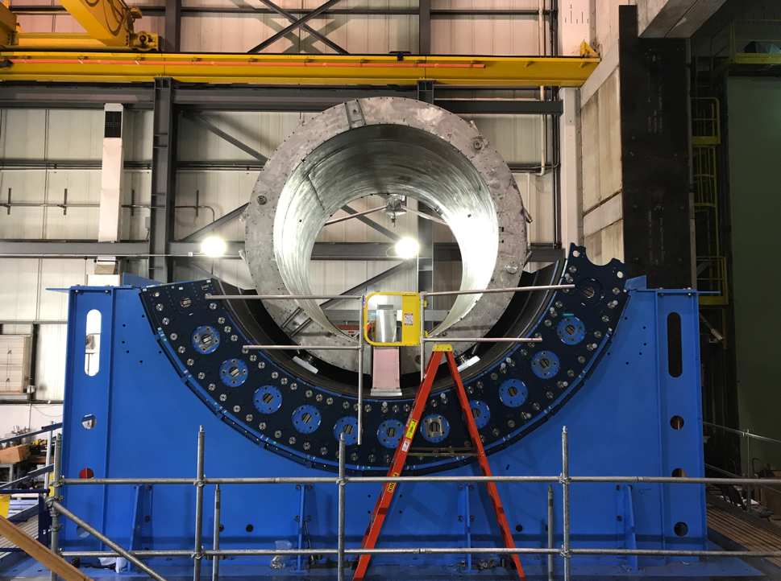
1008 Infrastructure and Facility Upgrade Status
Carriage/Cradle assembled in 1008
XY Carriage tables, Carriage Hydraulics installed
SC- Magnet installed in 1008
EMCal Installation fixture completed at SBU
IR track reinforcement complete.
Large Support Rings fabbed, assembly started at BNL
LHe cryo components part delivered installation begun
LN2 & warm piping part delivered installation begun
Magnet flux return Pole tip/end cap in production
sPHENIX Beam Pipe at vendor for modification.
Rack Platform in production at vendor
90% of IHCal assembly installations fixtures awarded and in fab. Remaining 10% submitted to BNL.
Significant cost increases on raw materials.

Slide 6
Key Remaining Orders
DAQ/Trigger: DCMII’s/crates/backplanes/controllers ( submitted to PPM)
DAQ/Trigger: GL1/GTM boards (parts order started)
TPC: Laser light pipes (line laser)
TPC: Laser fiber splitters (diffuse)
TPC: Laser servomotors and mechanics (line laser)
TPC: optical fibers
TPC: Fiber sort-out box
TPC: JACK board (parts orders started)

Slide 7
Key Remaining Orders I&F
Remaining IHCal Stanchions (2 orders submitted: 1 w/ PPM, 1 w/ PO)
TPC installation fixtures and bracketry
Beam pipe + MBD + sEPD supports + N&S platforms
Magnet Mapping
Fiber Optics trunk cables
HVAC Improvements (1008 IR portion started)
MVTX+INTT brackets and installation fixtures
Seismic restraints
Pipes, hangers, gas/water manifolds

Slide 8
High Priority Issues
Keep the EMCal and IHCal on schedule.
Increase workforce, particularly techs, working in 510, 1008.
  Borrowing techs from STAR, CAD and IO. Req out for replacement of tech that left sPHENIX in Sept.
Keep 1008 installation progressing forward. We need to temporarily stop installation and prepare 1008 for RHIC Run-2022
Complete TPC Fee slice test, begin TPC Fee production board assembly and prep for testing 700+ production boards.
Keep Nevis electronics on schedule (Cal Digitizers, LL1, MBD D/S, extra DCMIIs)
Continue monthly an EAC for the MIE
Complete remaining engineering design tasks and order components
  We must finish the designs and move our attention to assembly, installation and testing.
Place Remaining procurements

Slide 9
sPHENIX Operations During the Pandemic
sPHENIX FTE threshold approved at 45 FTEs with the total including sPHENIX visitors. We have ~80% of our workforce approved to be on site. However managers, engineers and designers that can work remotely continue to do so.
We typically have 35 people on site (Physics Dept + Visitors) on any one working day.
COVID mitigation plans continue to be implemented
sPHENIX has assigned a Task Coordinator to optimized the personnel on site and tasks performed each day.
We’re in daily communication with BNL safety personnel to make sure that all continues to go smoothly.
All institutions with sPHENIX fab responsibilities have reopened with low density labor practices implemented.

Slide 10
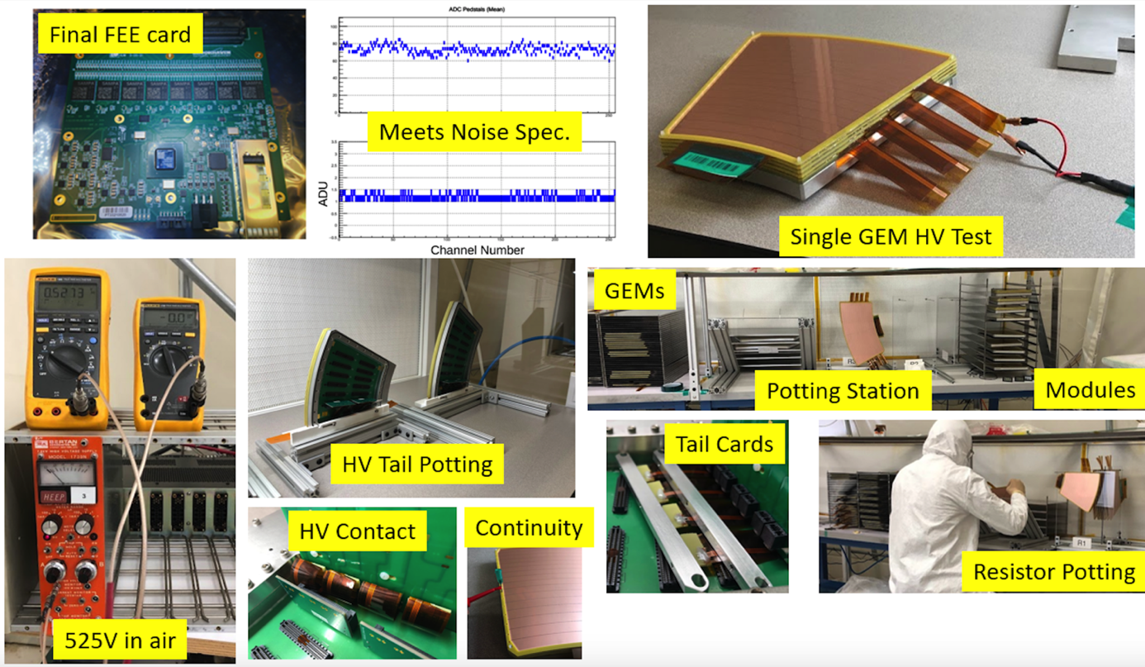
TPC Status
Production TPC Front End Electronics card
Bench test noise results of TPC Fee card
HV testing of single GEM layer
Quad GEM module fab station
Potting of GEM module resistors
GEM tail cards for HV distribution
GEM module continuity tests
GEM HV tail potting
HV connection to GEM tails
GEM HV tests in air.
Quad-GEM assembly & testing started at SBU
Production TPC Fee first article testing ongoing at BNL
  Parts for assembly of 700 TPC Fee boards shipped to vendor
All FELIX/DAM boards assembled and initial testing done. All good.
Orders for laser calibration parts ongoing

Slide 11
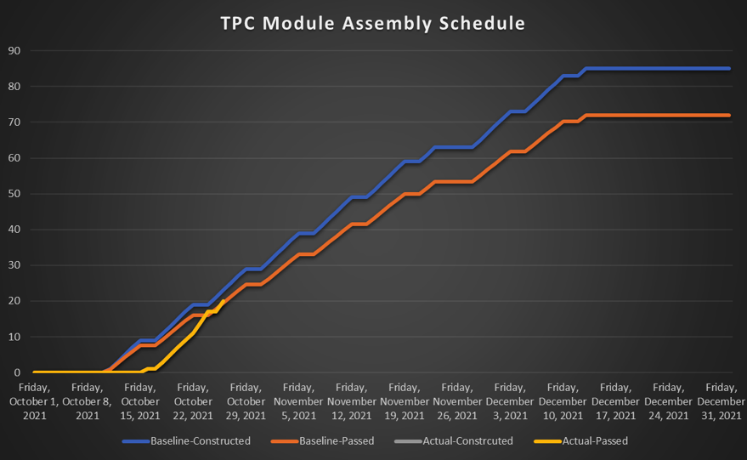
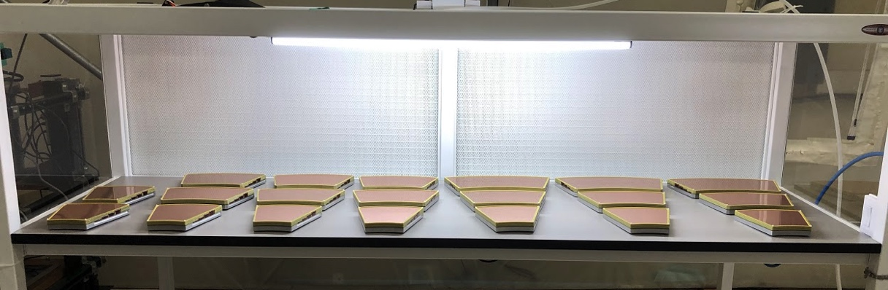
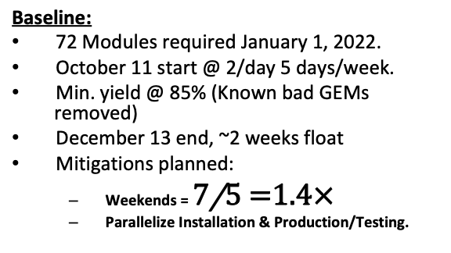
TPC Module Assembly
Thanksgiving
float
3 modules/day
2 modules/day
Actual:
72 Modules required January 1, 2022.
October 16 start (5 days late)
  Mitigation: Prakhar Garg made extra tooling allowing 3 modules/day!
Status:
  20/72 passed modules (~28% of goal).
  Matches Baseline-Passed Yield
  Present yield @ 100%
SBU will meet that date
Baseline:
72 Modules required January 1, 2022.
October 11 start @ 2/day 5 days/week.
Min. yield @ 85% (Known bad GEMs removed)
December 13 end, ~2 weeks float
Mitigations planned:
  Weekends =
  Parallelize Installation & Production/Testing.
NOTE: “Module assembly” means stacking & testing known-good framed GEMs

Slide 12
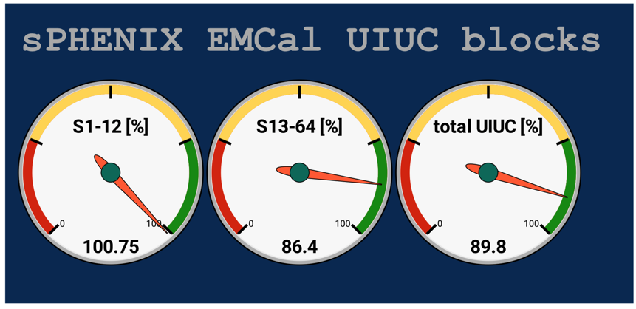
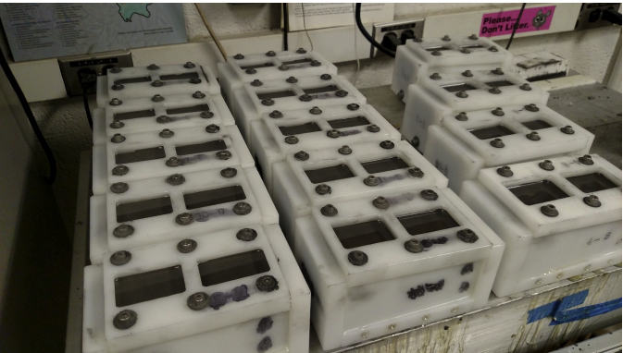
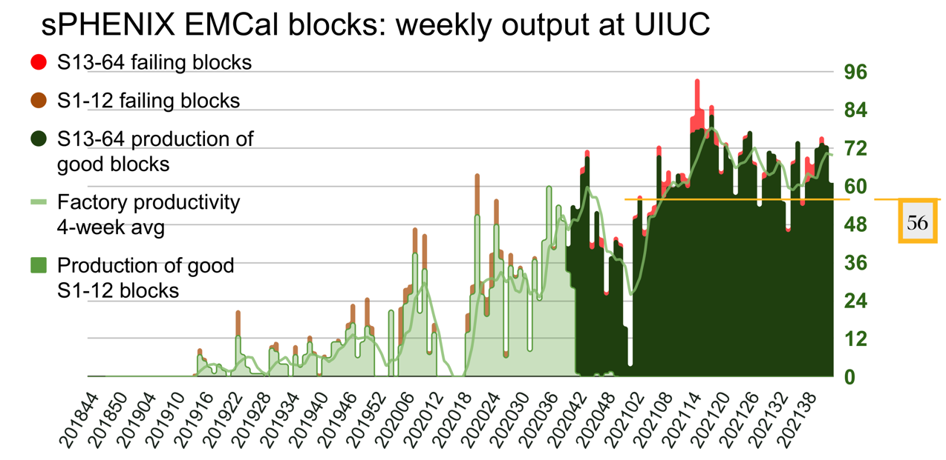
EMCal Block Production
Block in molds at UIUC
89.8% Good blocks produced at UIUC
96.8% of blocks produced pass acceptance tests
All blocks started
Issue with epoxy supply, Epotek-301-1. May run out by late Nov. UIUC is looking for a supply of Epotek from all sources
Need to avg 56 blocks/wk rate to be done w/ block production by end of CY

Slide 13
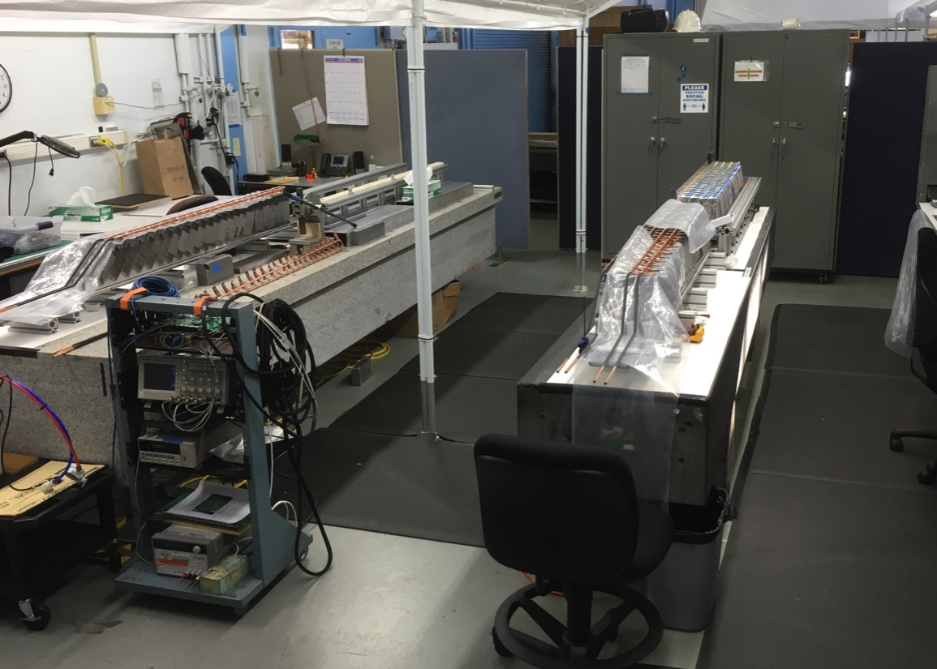
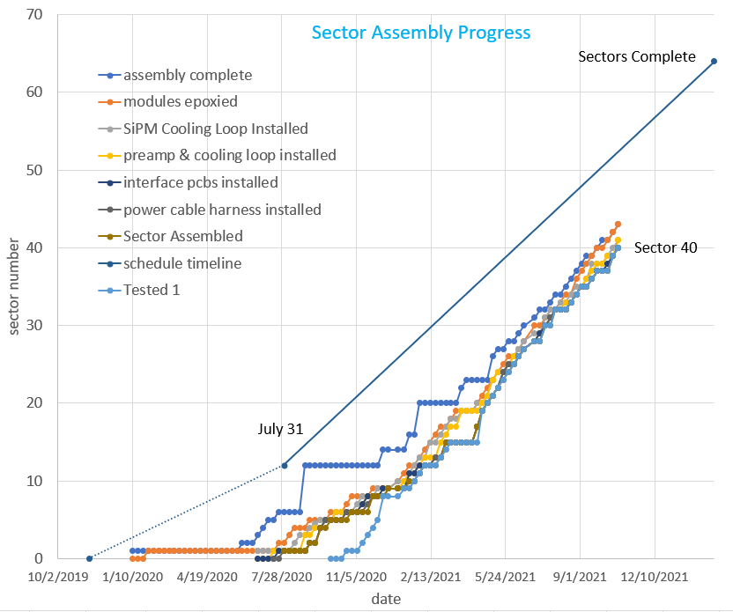
EMCal Sector Assembly 62.5% Complete as of 10/22/21
Sector 43
Sector 42
Sector 41
Sector 32
Sectors 1-40 complete
Sectors 41-43 being assembled
Modules for Sector 44, 45 being prepared
Right now we’re down 2 FTEs in the factory (6 to 4 FTEs). Adding 2 additional mech techs this week plus a requisition out for one more.

Slide 14
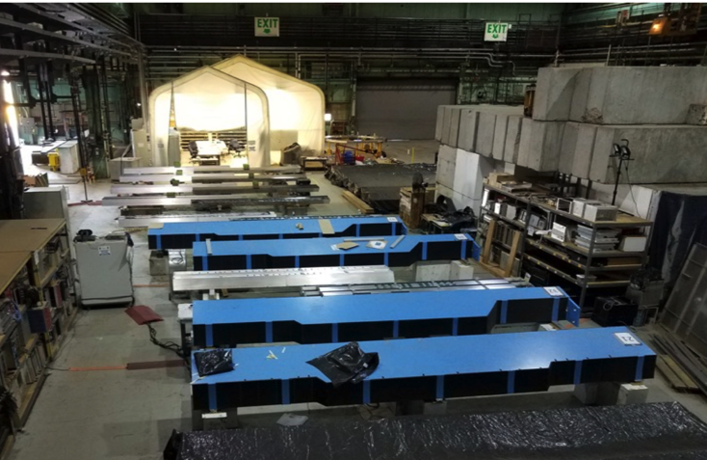
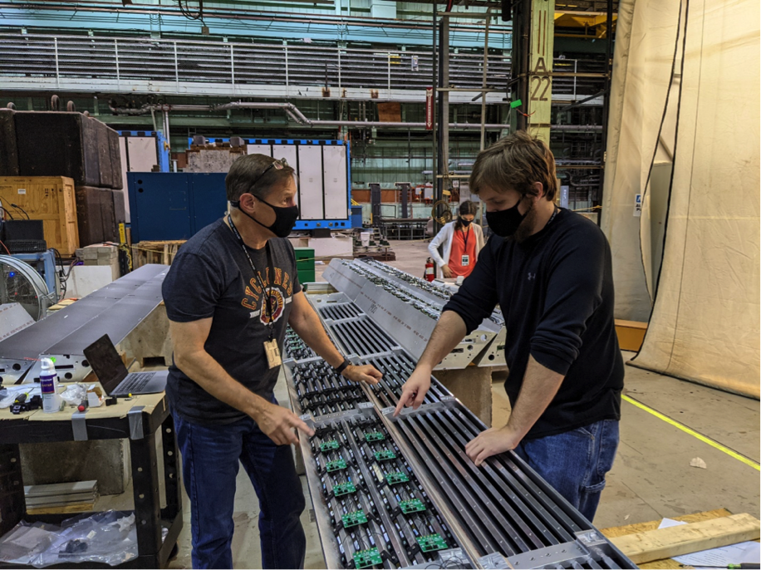
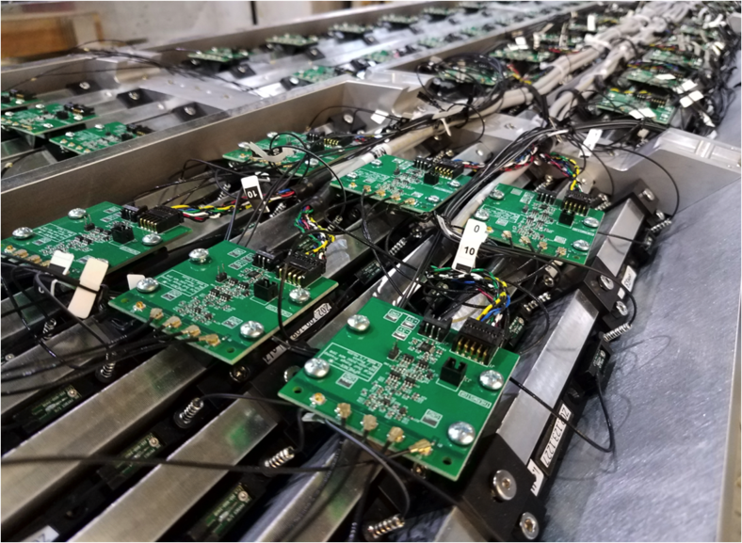
HCal Progress
All OHCal sectors complete. 13/32 installed on sPHENIX carriage.
Burn in of all OHCal sectors complete. Small percentage of electronics(~1%) failed burn-in and were replaced.
24/32 IHCal mechanical sectors at BNL. Prep for building the IHCal barrel ongoing at BNL. Final 8 sectors will be delivered to BNL from vendor by mid -November.
IHCal sectors
OHCal sectors
IHCal Assembly in 912
IHCal
OHCal Burn-in

Slide 15
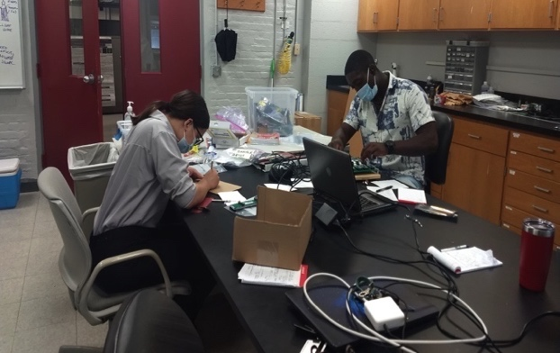
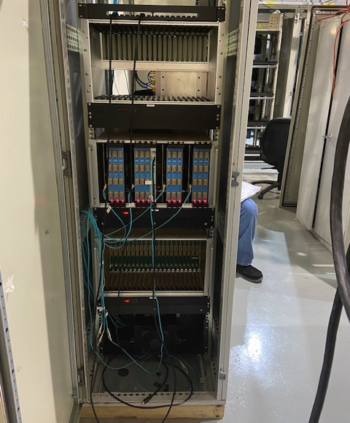
Calorimeter Electronics
All on-detector electronics and cables for the EMCal and HCal have received.
Testing of EMCal SiPM daughterboards+ preamps continues at high yield rate.
Testing of 95% of EMCal SiPM daughter boards and preamps complete. Testing ongoing at BNL and Lehigh. Testing rate meets the EMCal delivery schedule.
All major components for the EMCal and HCal Bias and LV distribution systems delivered to BNL. Work now focused on final assembly and installation into the Power and Control racks for the EMCal and HCal.
EMCal and HCal signal cables in BNL procurement awarded in August. Delivery before the end of the CY.
Columbia University has ordered parts for fab of the full digitizer electronics with 95% of parts received. Delivery of the remaining parts are on schedule to be delivered over the next 2 months.
The Univ Colorado group has tested five crates worth of digitizer boards. Two additional crates of digitizers will be tested this month.
Electronic rack assembly ongoing and on schedule.
Students testing EMCal preamps @ Lehigh
Cal Digitizer rack in 1008

Slide 16
sPHENIX PEMP Notable for 2022
2022 key sPHENIX milestones associated with PEMP notable:
  IHCal mechanical sectors complete Jan 1, 2022
  EMCal sectors complete May 15, 2022
  DAQ/Trigger GL1/GTM production complete June 1, 2022
  Calorimeter electronics complete July 1, 2022

Slide 17
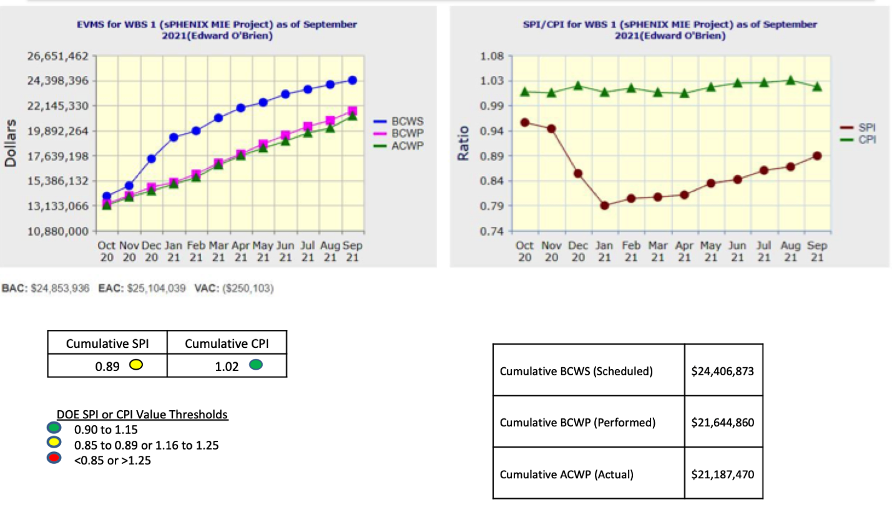
Performance Indices – sPHENIX MIE

Slide 18
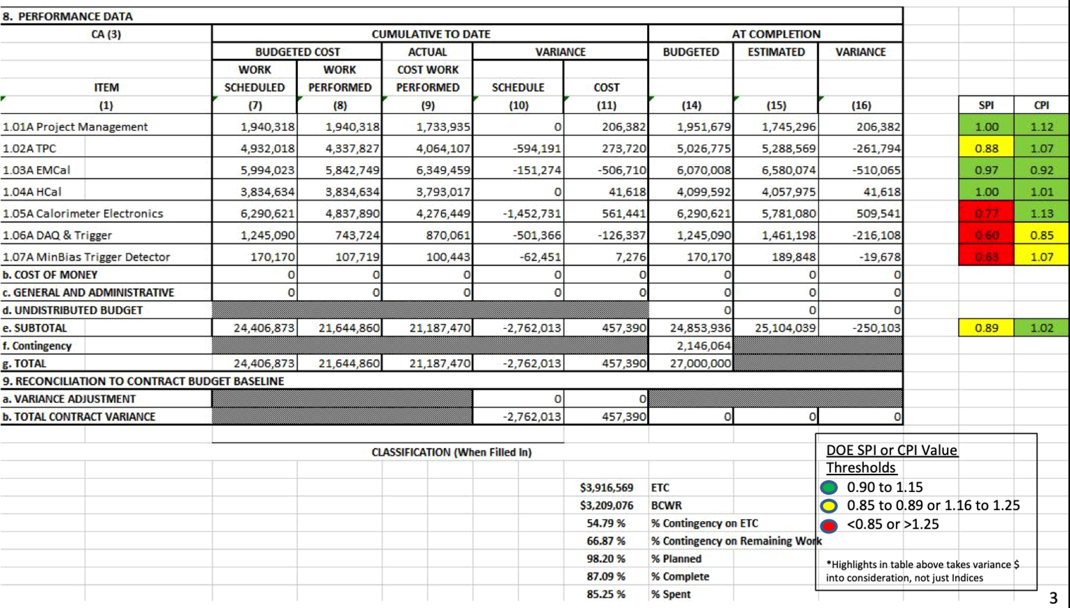
Cost Performance Report (CPR) – sPHENIX MIE

Slide 19
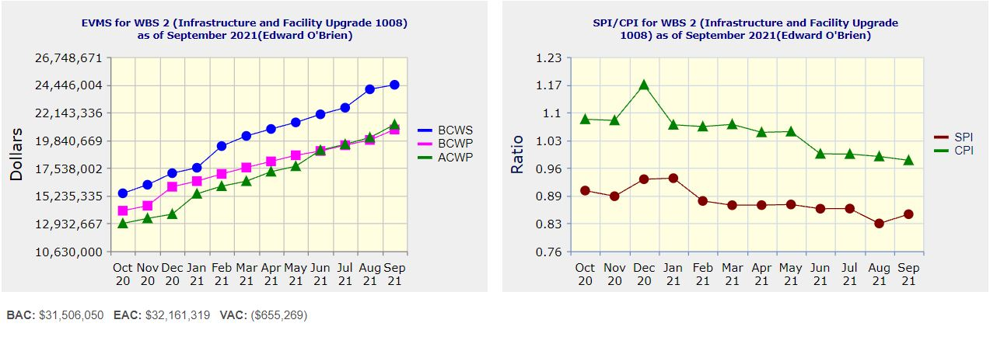
Performance Indices – 1008 Infra and Facility Upgrade
Cumulative SPI | Cumulative CPI
0.85 | 0.98
Cumulative BCWS (Scheduled) | $24,449,273
Cumulative BCWP (Performed) | $20,734,174
Cumulative ACWP (Actual) | $21,143,800
DOE SPI or CPI Value Thresholds
0.90 to 1.15
0.85 to 0.89 or 1.16 to 1.25
<0.85 or >1.25

Slide 20
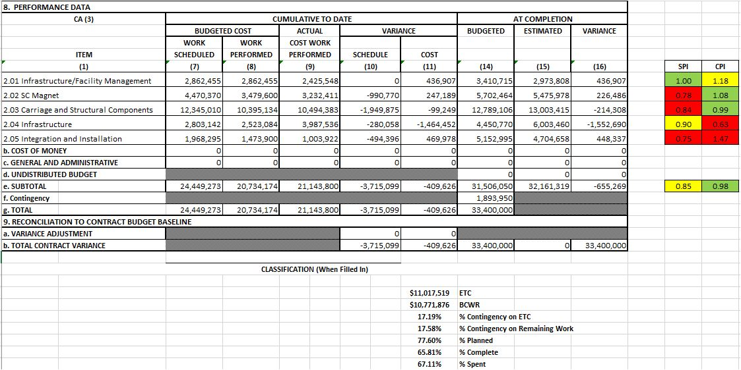
Cost Performance Report (CPR) – 1008 Infra and Facility Upgrade
DOE SPI or CPI Value Thresholds
0.90 to 1.15
0.85 to 0.89 or 1.16 to 1.25
<0.85 or >1.25
*Highlights in table above takes variance $ into consideration, not just Indices

Slide 21
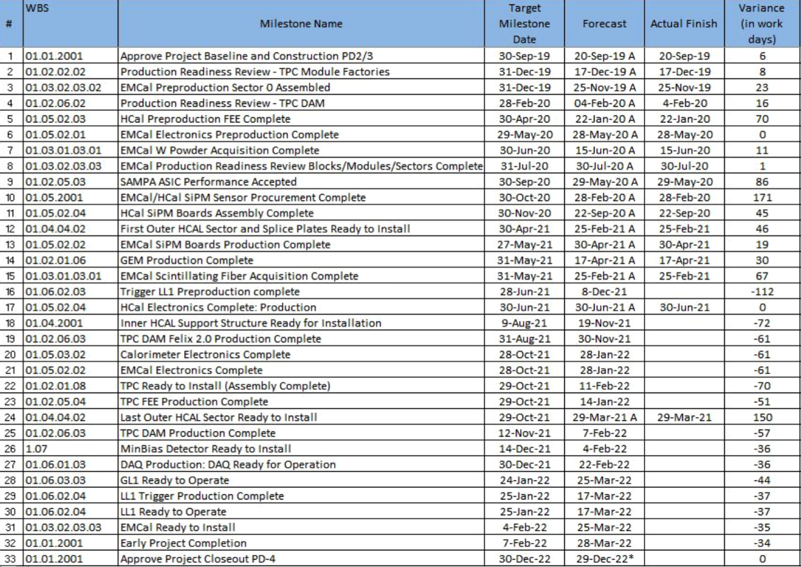
Milestones Status – sPHENIX MIE

Slide 22
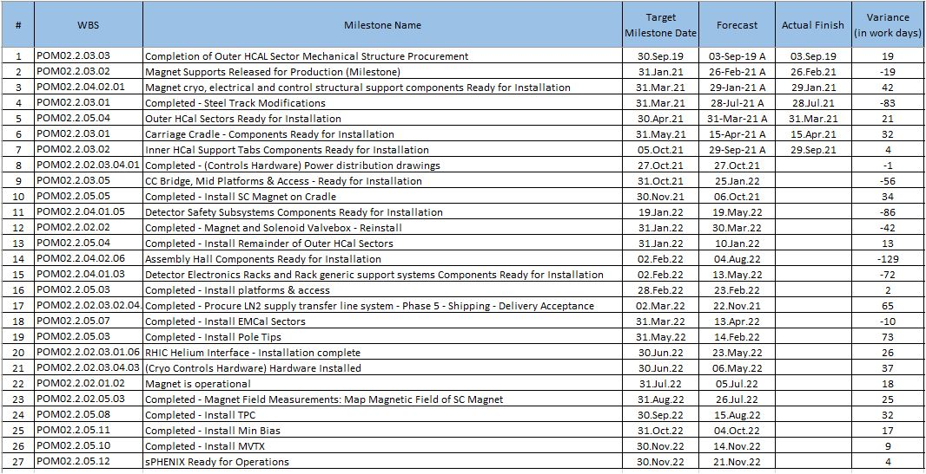
Milestones Status – 1008 Infra and Facility Upgrade

Slide 23
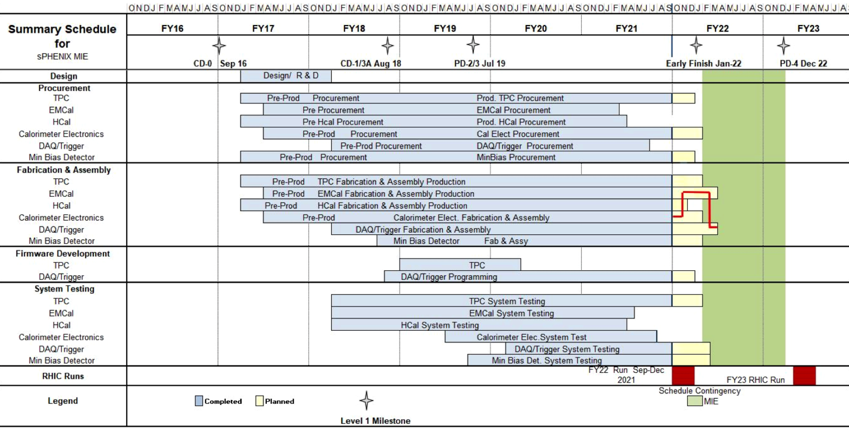
Summary Schedule – sPHENIX MIE

Slide 24
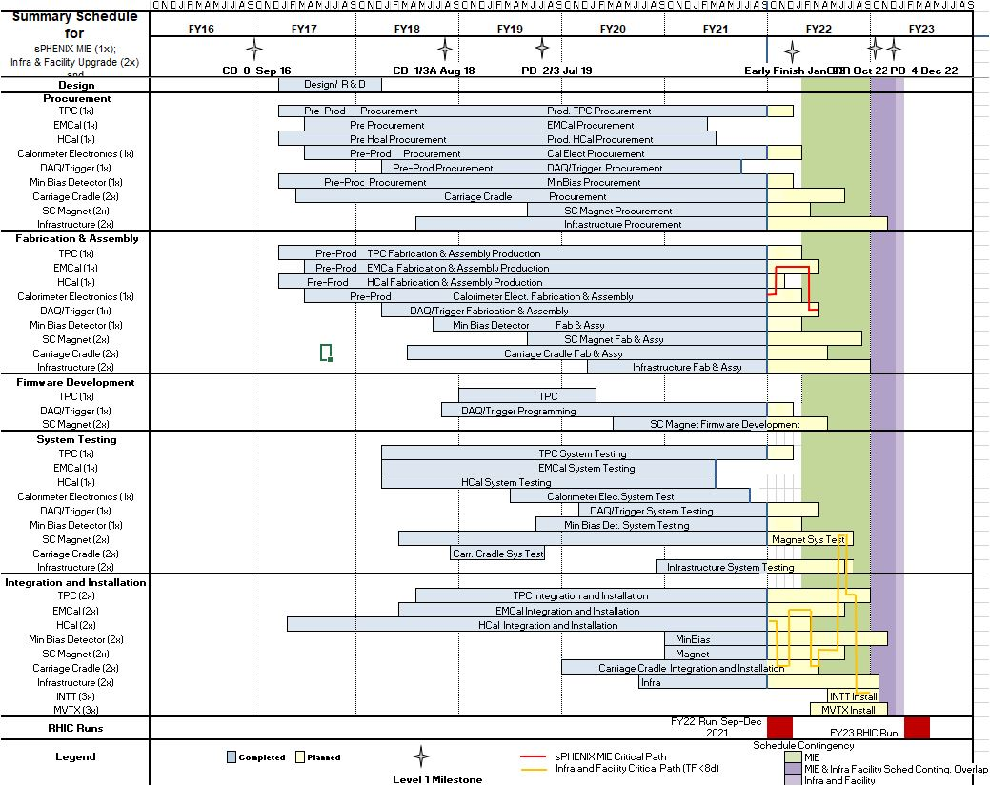
Summary Schedule – sPHENIX MIE and 1008 Infra and Facility Upgrade

Slide 25
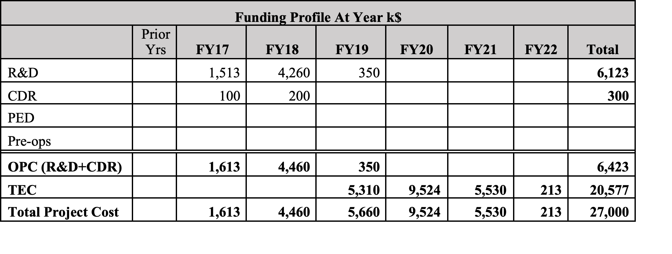
Budget Profile

Slide 26
Summary
sPHENIX Installation continues to make good progress in sPHENIX Assembly Hall (Bldg 1008)
  SC-Magnet successfully installed into sPHENIX in October.
  Major 2021 shutdown tasks for sPHENIX successfully completed
The sPHENIX CPI continues to be very good at 1.02. The SPI is 0.89 improving as orders arrive. The MIE is 96.9% Costed and committed. Contingency 54.8%.
The 1008 I&F CPI good at 0.98. The SPI improving at 0.85. I&F is 79.9% Costed and Committed. 17.2% contingency.
Construction is proceeding on sPHENIX final detector components at a wide variety of sites.
Continued great progress in sPHENIX factories: OHCal sectors complete, 90% of EMCal blocks and 62.5% EMCal sectors complete. Assembly of TPC Fee production boards started. TPC quad-GEM fab started. All MVTX staves complete and half barrel construction begun at LBNL. Electronic, DAQ/Trigger, MBD, INTT, IHCal all making good progress.
Concern remains about staffing levels, particularly our need for mech and electrical techs at BNL.
  September status has a slip in the EMCal sector completion date to the end of March. We will try to recover some schedule with infusion of techs to the EMCal sector factory.
  We are gradually increasing our staff working on sPHENIX completion by borrowing from other departments and replacing recent departures.
Concern about delivery dates for electrical and electronic components. Concern about availability of epoxy. Delays may pushback the Early Completion date but will not affect the PD-4 date.

Slide 27
Back Up

Slide 28
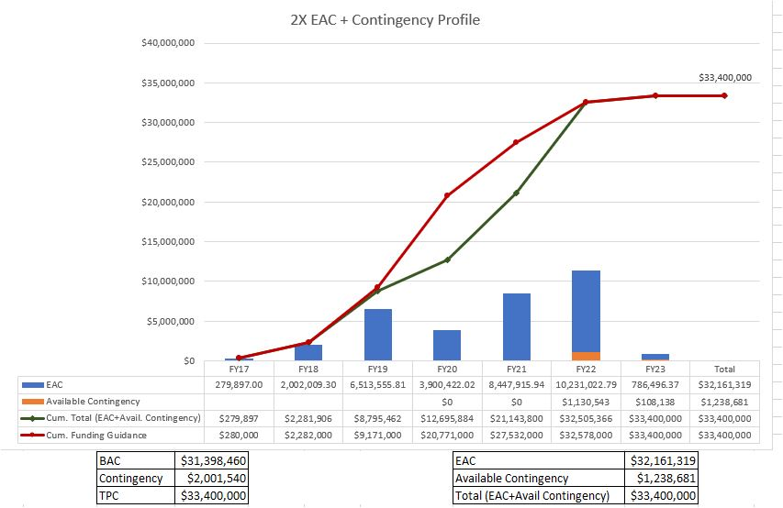
EAC and Contingency Profile – 1008 Infra and Facility Upgrade

Slide 29
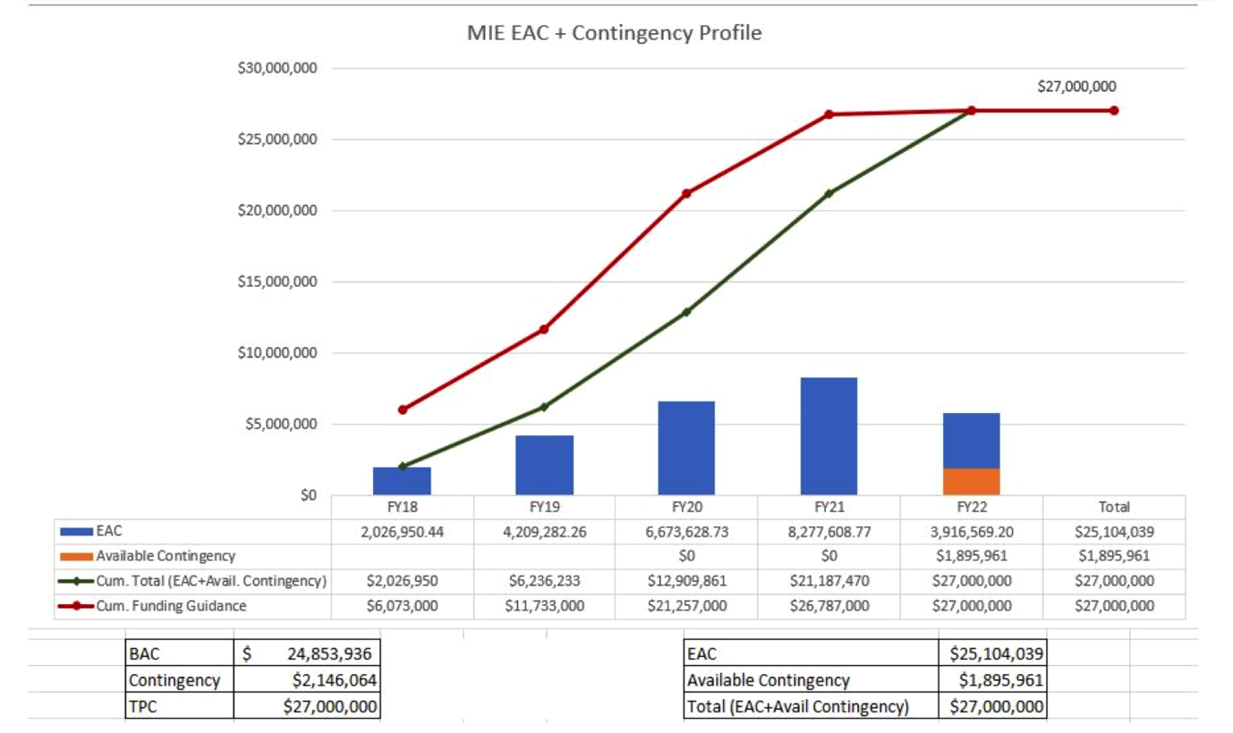
EAC and Contingency Profile – sPHENIX MIE

Slide 30
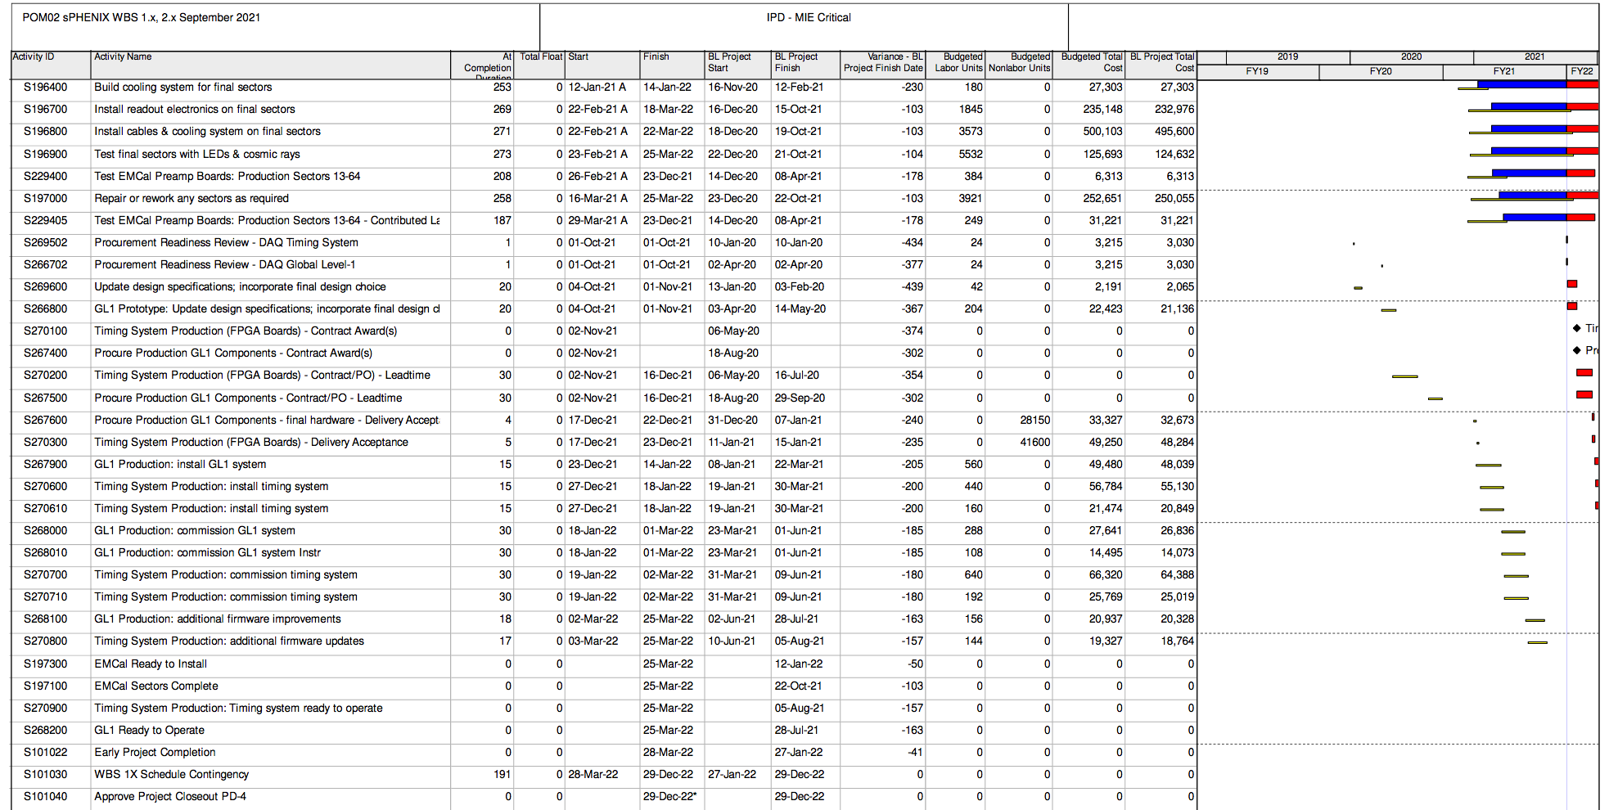
Critical Path – September 2021

Slide 31
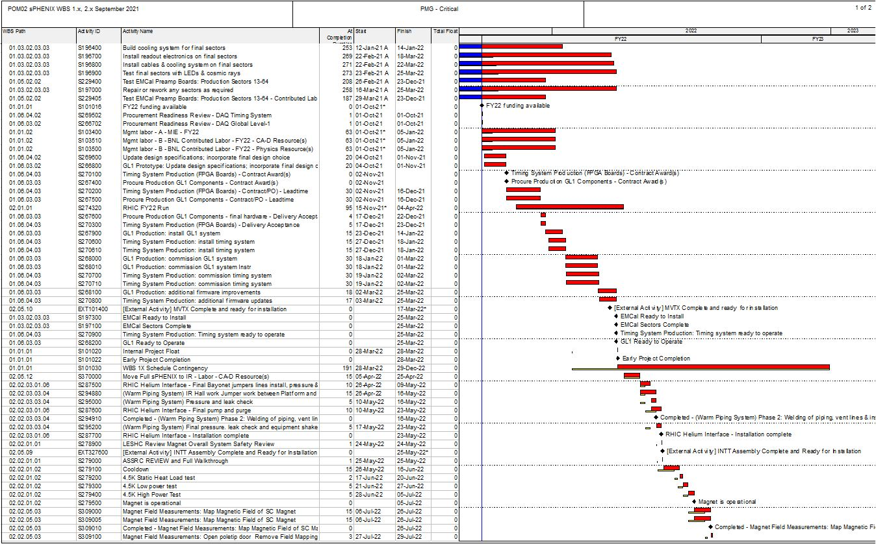
Critical Path (1x, 2x and 3x Combined)

Slide 32
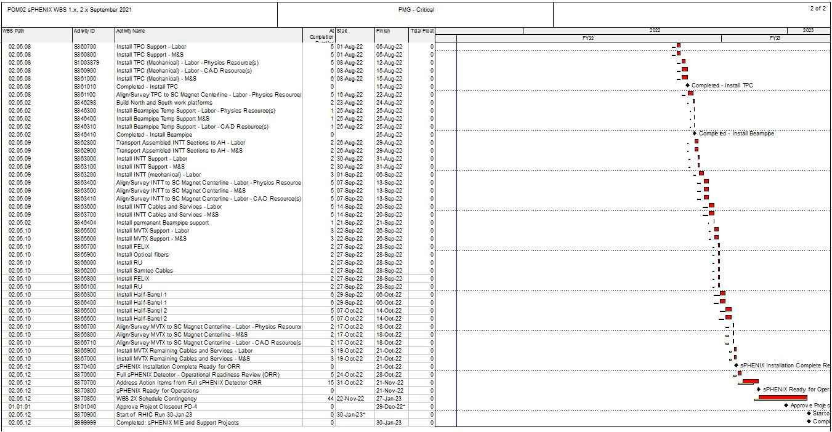
Critical Path (1x, 2x and 3x Combined)

Slide 33
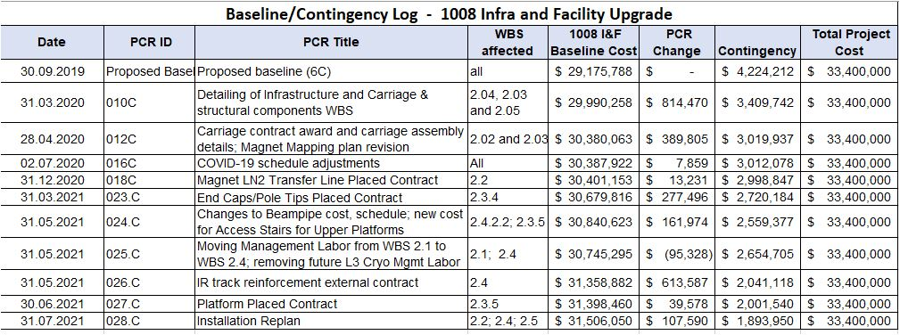
Baseline/Contingency Log and ETC adjustment Log – 2.X
ETC Adjustments
Control Account | Sep’21
2.3 | $90,775
2.4 | $70,160

Slide 34
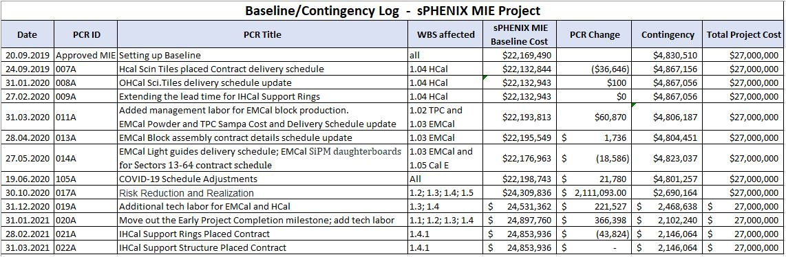
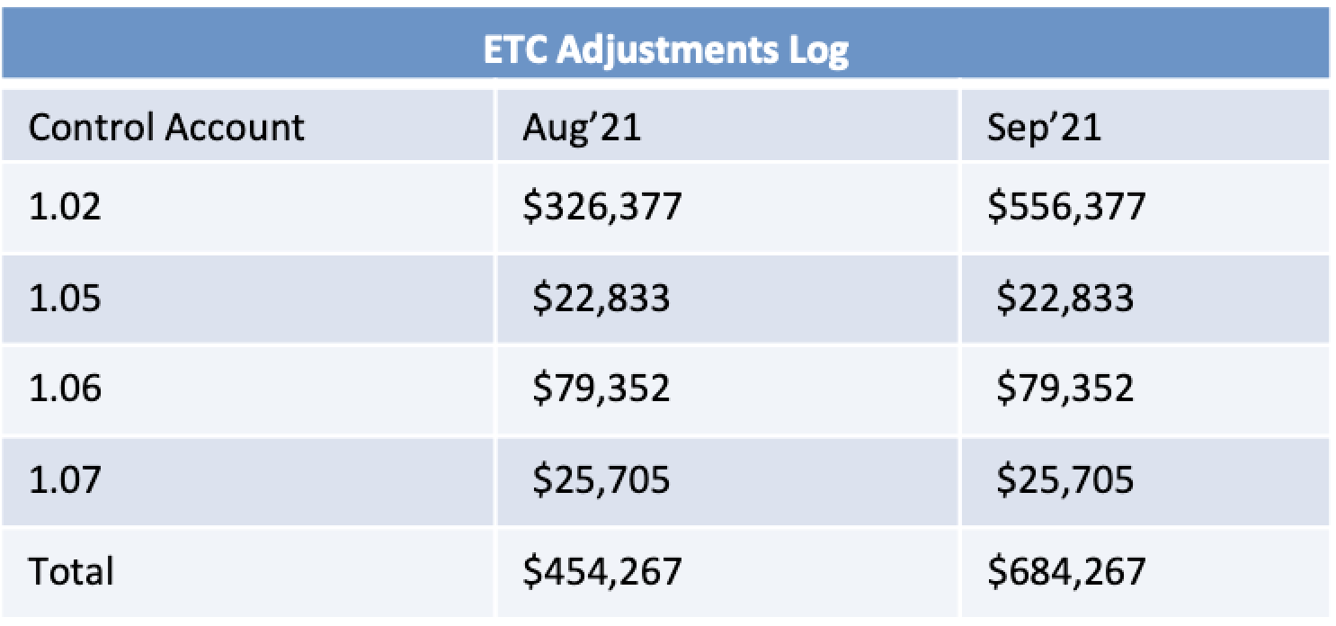
PCR Log and EAC Log
EAC

Slide 35
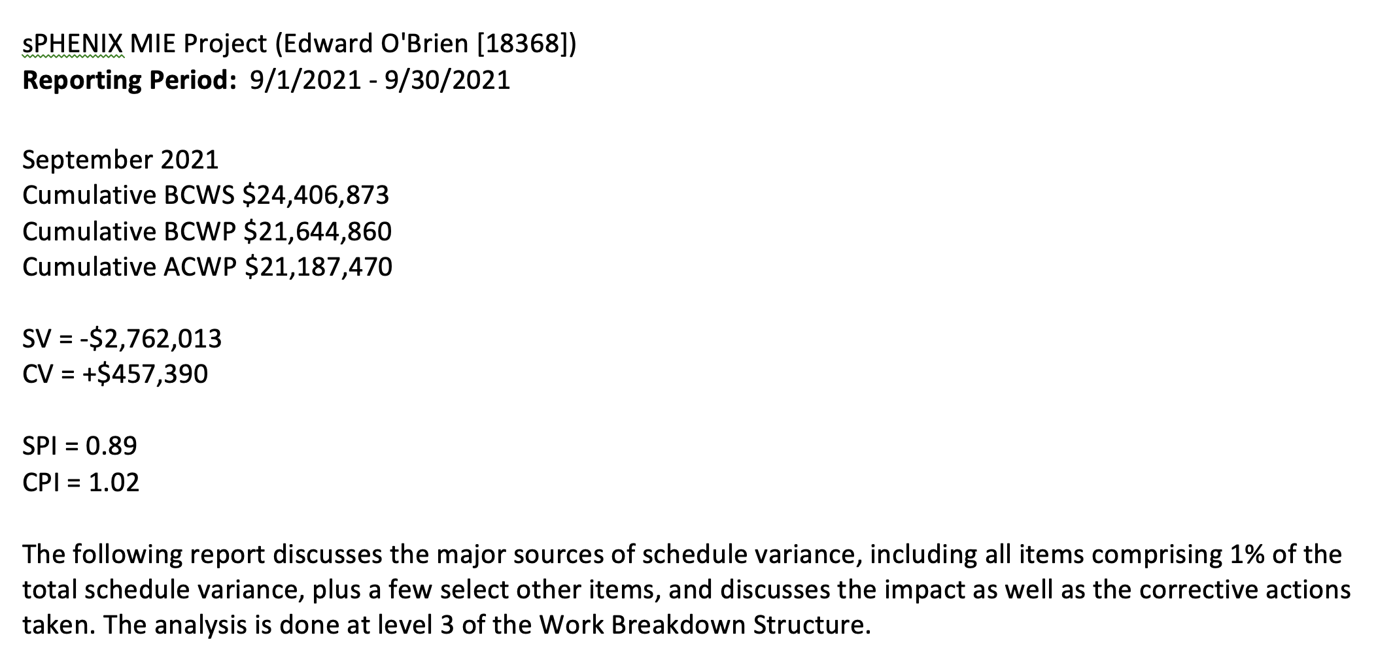
MIE Variance Report

Slide 36
MIE Variance Report
WBS 1.2.1 TPC Mechanics
Description – None. The activity, S120100 Production of GEM foils, which has had prior SV, is now complete.
Impact – None.
Corrective – None. The order is complete.
WBS 1.2.2 TPC GEM Modules R1
Description – Two activities were delayed by late arrival of TPC R1 padplanes. These are S125500 TPC R1 modules build, with SV = -$18,320 and S125600 TPC R1 Modules test, with SV = -$18,320. The total SV resulting is -$36,641. The R1 padplane, the smallest of the three types, were all delivered last month.
Impact – None as yet. The rest of R1 module construction is proceeding. Pad planes are to be attached to the modules as a late step in the module assembly sequence. Positive float remains.
Corrective – The R1 pad planes have been delivered. The two above activities are now proceeding and will not impede overall TPC construction.
WBS 1.2.5 TPC Front End Electronics.
Description – There are six activities with significant SV. They are:
activity S136500 TPC FEE Cooling System, SV = -$57,393,
activity S141500 TPC FEE Production components (optical transceivers), SV =-$22,999,
activity S141800 TPC FEE Production Components, SV = -$46,432
activity S142500 TPC FEE Low Voltage Power system, SV = -$123,533,
activity S143200 TPC FEE Production boards and assembly, SV = -$175,244,
and
activity S143250, TPC FEE components, SV = -$116,301.
The net SV is -$541,901.
Impact – None as yet.
Corrective – All the items covered by these activities are being ordered, with one exception, the optical transceivers. The manufacturer announced in February that it is replacing this part with a newer and less expensive version; the new variant will have to be the one purchased by sPHENIX and thus also will need to be tested in magnetic field, although no issues are expected based on technical input from the manufacturer. The required design and procurement reviews are complete. The cooling system requires a series of machined parts, for which the procurement is placed, and manufacturing is ongoing. The TPC FEE production components are on order and around 80% in hand. The TPC FEE Low Voltage power supplies are under contract and partially delivered, with the vendor scheduling all remaining deliveries over the next month. The TPC production board and assembly procurement is progressing, with a vendor identified. The TPC FEE components, mostly the quad transceivers, will be ordered later in the spring because they are added to the assembled boards by hand after the automatic board assembly is complete, thus their delivery schedule does not impede that for the boards.
WBS 1.2.5 TPC Front End Electronics
Description – There are three activities with significant SV. They are: activity S141800 TPC FEE Production Components, SV = -$9,286, activity S142500 TPC FEE Low Voltage Power system, SV = -$30,883, and activity S143200 TPC FEE Production boards and assembly, SV = -$175,244. The net SV is -$215,413
Impact – None
Corrective Action – All the items covered by these activities are on order. The TPC FEE production components are on order and around 97% in hand; a specific timing crystal remains to be acquired but is on allocation and may require several months to obtain in bulk. Sample crystals each operating at a different frequency have been obtained and are being evaluated to see if the board can use a frequency for which an adequate supply of crystals can be obtained quickly. Fortunately, this is a simple 6-pad part that could be added later to otherwise assembled boards. The TPC FEE Low Voltage power supplies are delivered, with the remaining work being procurement of conductor wire and connectors and the fabrication of the cable assemblies for the LV system, all of which are on order. The contract for the TPC board production and assembly is awarded. The first revised boards built under this contract have arrived and have been tested and found to work properly. A review of the performance of these first articles is being scheduled in order to release the series production of these boards.

Slide 37
MIE Variance Report
WBS 1.2.1 TPC Mechanics
Description – None. The activity, S120100 Production of GEM foils, which has had prior SV, is now complete.
Impact – None.
Corrective – None. The order is complete.
WBS 1.2.2 TPC GEM Modules R1
Description – Two activities were delayed by late arrival of TPC R1 padplanes. These are S125500 TPC R1 modules build, with SV = -$18,320 and S125600 TPC R1 Modules test, with SV = -$18,320. The total SV resulting is -$36,641. The R1 padplane, the smallest of the three types, were all delivered last month.
Impact – None as yet. The rest of R1 module construction is proceeding. Pad planes are to be attached to the modules as a late step in the module assembly sequence. Positive float remains.
Corrective – The R1 pad planes have been delivered. The two above activities are now proceeding and will not impede overall TPC construction.
WBS 1.2.5 TPC Front End Electronics.
Description – There are six activities with significant SV. They are:
activity S136500 TPC FEE Cooling System, SV = -$57,393,
activity S141500 TPC FEE Production components (optical transceivers), SV =-$22,999,
activity S141800 TPC FEE Production Components, SV = -$46,432
activity S142500 TPC FEE Low Voltage Power system, SV = -$123,533,
activity S143200 TPC FEE Production boards and assembly, SV = -$175,244,
and
activity S143250, TPC FEE components, SV = -$116,301.
The net SV is -$541,901.
Impact – None as yet.
Corrective – All the items covered by these activities are being ordered, with one exception, the optical transceivers. The manufacturer announced in February that it is replacing this part with a newer and less expensive version; the new variant will have to be the one purchased by sPHENIX and thus also will need to be tested in magnetic field, although no issues are expected based on technical input from the manufacturer. The required design and procurement reviews are complete. The cooling system requires a series of machined parts, for which the procurement is placed, and manufacturing is ongoing. The TPC FEE production components are on order and around 80% in hand. The TPC FEE Low Voltage power supplies are under contract and partially delivered, with the vendor scheduling all remaining deliveries over the next month. The TPC production board and assembly procurement is progressing, with a vendor identified. The TPC FEE components, mostly the quad transceivers, will be ordered later in the spring because they are added to the assembled boards by hand after the automatic board assembly is complete, thus their delivery schedule does not impede that for the boards.
WBS 1.2.6 TPC Data Aggregator Modules
Description – One activity contributes to the SV: activity S147370 FELIX 2.0 board optical components, SV =-$93,719.
Impact – None
Corrective Action – The FELIX optical components are fiber optics and specialized connectors to group and route signals from the TPC FEE cards (WBS 1.2.5) to the FELIX boards. The topology of these connectors must accommodate a board used to reprogram the FEE cards in case of radiation-induced single event upsets (SEUs); this board’s architecture was determined at the beginning of March and the board’s layout is now complete. The fiber topology was updated, the bill of materials for the fiber optic components was revised, and submissions started to Procurement in April. This production will require first articles be built and tested prior to releasing the full production. A first article arrived at the beginning of August and is being tested. This is a harness of multiple fiber optic cables of over 50m length because it must reach from the Interaction Region to the Rack Room. This length has been checked as part of the acceptance of this first article.

Slide 38
MIE Variance Report
WBS 1.2.1 TPC Mechanics
Description – None. The activity, S120100 Production of GEM foils, which has had prior SV, is now complete.
Impact – None.
Corrective – None. The order is complete.
WBS 1.2.2 TPC GEM Modules R1
Description – Two activities were delayed by late arrival of TPC R1 padplanes. These are S125500 TPC R1 modules build, with SV = -$18,320 and S125600 TPC R1 Modules test, with SV = -$18,320. The total SV resulting is -$36,641. The R1 padplane, the smallest of the three types, were all delivered last month.
Impact – None as yet. The rest of R1 module construction is proceeding. Pad planes are to be attached to the modules as a late step in the module assembly sequence. Positive float remains.
Corrective – The R1 pad planes have been delivered. The two above activities are now proceeding and will not impede overall TPC construction.
WBS 1.2.5 TPC Front End Electronics.
Description – There are six activities with significant SV. They are:
activity S136500 TPC FEE Cooling System, SV = -$57,393,
activity S141500 TPC FEE Production components (optical transceivers), SV =-$22,999,
activity S141800 TPC FEE Production Components, SV = -$46,432
activity S142500 TPC FEE Low Voltage Power system, SV = -$123,533,
activity S143200 TPC FEE Production boards and assembly, SV = -$175,244,
and
activity S143250, TPC FEE components, SV = -$116,301.
The net SV is -$541,901.
Impact – None as yet.
Corrective – All the items covered by these activities are being ordered, with one exception, the optical transceivers. The manufacturer announced in February that it is replacing this part with a newer and less expensive version; the new variant will have to be the one purchased by sPHENIX and thus also will need to be tested in magnetic field, although no issues are expected based on technical input from the manufacturer. The required design and procurement reviews are complete. The cooling system requires a series of machined parts, for which the procurement is placed, and manufacturing is ongoing. The TPC FEE production components are on order and around 80% in hand. The TPC FEE Low Voltage power supplies are under contract and partially delivered, with the vendor scheduling all remaining deliveries over the next month. The TPC production board and assembly procurement is progressing, with a vendor identified. The TPC FEE components, mostly the quad transceivers, will be ordered later in the spring because they are added to the assembled boards by hand after the automatic board assembly is complete, thus their delivery schedule does not impede that for the boards.
WBS 1.2.7 TPC Support Systems
Description – There are three areas of effort. The TPC Lasers delivery has started but only the first articles have been delivered, SV =-$241,035. The TPC Gas System has procured and received some 60% of the components but still needs to place requisitions for the balance, SV =-$44,121. The total SV for these key items is -$285,156
Impact – These are all items being procured well ahead of their needed installation to allow for more time to test them on the bench and adjust settings
Corrective Action – The Final Design Reviews are complete. The Procurement Readiness Reviews for the lasers and gas systems are complete. Operation of the first Line laser under the necessary field conditions was demonstrated. The remaining line lasers are on order and promised by the vendor for late CY 2021. A contract for the six Diffuse Lasers was awarded in September. The delivery schedule for these six units will stretch into summer 2022, with one unit expected to be delivered every 2 months.

Slide 39
MIE Variance Report
WBS 1.2.1 TPC Mechanics
Description – None. The activity, S120100 Production of GEM foils, which has had prior SV, is now complete.
Impact – None.
Corrective – None. The order is complete.
WBS 1.2.2 TPC GEM Modules R1
Description – Two activities were delayed by late arrival of TPC R1 padplanes. These are S125500 TPC R1 modules build, with SV = -$18,320 and S125600 TPC R1 Modules test, with SV = -$18,320. The total SV resulting is -$36,641. The R1 padplane, the smallest of the three types, were all delivered last month.
Impact – None as yet. The rest of R1 module construction is proceeding. Pad planes are to be attached to the modules as a late step in the module assembly sequence. Positive float remains.
Corrective – The R1 pad planes have been delivered. The two above activities are now proceeding and will not impede overall TPC construction.
WBS 1.2.5 TPC Front End Electronics.
Description – There are six activities with significant SV. They are:
activity S136500 TPC FEE Cooling System, SV = -$57,393,
activity S141500 TPC FEE Production components (optical transceivers), SV =-$22,999,
activity S141800 TPC FEE Production Components, SV = -$46,432
activity S142500 TPC FEE Low Voltage Power system, SV = -$123,533,
activity S143200 TPC FEE Production boards and assembly, SV = -$175,244,
and
activity S143250, TPC FEE components, SV = -$116,301.
The net SV is -$541,901.
Impact – None as yet.
Corrective – All the items covered by these activities are being ordered, with one exception, the optical transceivers. The manufacturer announced in February that it is replacing this part with a newer and less expensive version; the new variant will have to be the one purchased by sPHENIX and thus also will need to be tested in magnetic field, although no issues are expected based on technical input from the manufacturer. The required design and procurement reviews are complete. The cooling system requires a series of machined parts, for which the procurement is placed, and manufacturing is ongoing. The TPC FEE production components are on order and around 80% in hand. The TPC FEE Low Voltage power supplies are under contract and partially delivered, with the vendor scheduling all remaining deliveries over the next month. The TPC production board and assembly procurement is progressing, with a vendor identified. The TPC FEE components, mostly the quad transceivers, will be ordered later in the spring because they are added to the assembled boards by hand after the automatic board assembly is complete, thus their delivery schedule does not impede that for the boards.
WBS 1.3.1 EMCal Blocks
Description – There are four main items causing the SV. The S171800 Epoxy is only 85% complete, SV =-$15,783. Molds S172500 are now 95% complete, SV =-$1,522. The S177000-S178100 Blocks for Sectors 53-64 are not complete, SV =-$61,952, nor is their shipping to BNL, SV =-$20,165. The total SV for these items is -$99,422
Impact – None. The EMCal block production remains near but over one month ahead of the critical path. We note that the fiber filling task, which was the most demanding of student labor at UIUC, is now complete.
Corrective Action – The Epoxy must be bought within a few weeks of use, due to shelf-life issues. It is a commodity item and is purchased on an as-needed basis. The delayed Blocks were caused by personnel absences in Spring 2020 due to the COVID-19 pandemic. Block production resumed over the summer of 2020 and returned to planned production rates in the Fall of 2020. This particular SV will persist until about 1 month before the Project is complete, at which time Block production will be complete. The needed epoxy is affected by the February 2021 winter freeze in Texas, where the companies producing needed precursor chemicals are located. The national supply for these chemicals has still not recovered, leading to concerns going forward about obtaining these needed supplies of epoxy to complete this work. We are putting effort into searching for possible sources of the required epoxy, which is used to mold the blocks.

Slide 40
MIE Variance Report
WBS 1.2.1 TPC Mechanics
Description – None. The activity, S120100 Production of GEM foils, which has had prior SV, is now complete.
Impact – None.
Corrective – None. The order is complete.
WBS 1.2.2 TPC GEM Modules R1
Description – Two activities were delayed by late arrival of TPC R1 padplanes. These are S125500 TPC R1 modules build, with SV = -$18,320 and S125600 TPC R1 Modules test, with SV = -$18,320. The total SV resulting is -$36,641. The R1 padplane, the smallest of the three types, were all delivered last month.
Impact – None as yet. The rest of R1 module construction is proceeding. Pad planes are to be attached to the modules as a late step in the module assembly sequence. Positive float remains.
Corrective – The R1 pad planes have been delivered. The two above activities are now proceeding and will not impede overall TPC construction.
WBS 1.2.5 TPC Front End Electronics.
Description – There are six activities with significant SV. They are:
activity S136500 TPC FEE Cooling System, SV = -$57,393,
activity S141500 TPC FEE Production components (optical transceivers), SV =-$22,999,
activity S141800 TPC FEE Production Components, SV = -$46,432
activity S142500 TPC FEE Low Voltage Power system, SV = -$123,533,
activity S143200 TPC FEE Production boards and assembly, SV = -$175,244,
and
activity S143250, TPC FEE components, SV = -$116,301.
The net SV is -$541,901.
Impact – None as yet.
Corrective – All the items covered by these activities are being ordered, with one exception, the optical transceivers. The manufacturer announced in February that it is replacing this part with a newer and less expensive version; the new variant will have to be the one purchased by sPHENIX and thus also will need to be tested in magnetic field, although no issues are expected based on technical input from the manufacturer. The required design and procurement reviews are complete. The cooling system requires a series of machined parts, for which the procurement is placed, and manufacturing is ongoing. The TPC FEE production components are on order and around 80% in hand. The TPC FEE Low Voltage power supplies are under contract and partially delivered, with the vendor scheduling all remaining deliveries over the next month. The TPC production board and assembly procurement is progressing, with a vendor identified. The TPC FEE components, mostly the quad transceivers, will be ordered later in the spring because they are added to the assembled boards by hand after the automatic board assembly is complete, thus their delivery schedule does not impede that for the boards.
WBS 1.3.2 EMCal Modules and Sectors
Description – The S187400 Production Light Guide contract is only 92% complete, SV = -$19,210. The S196100 Cooling System for Final Sectors is only 75% complete, SV = -$20,571. The total of these SVs is -$39,781.
Impact – None. The EMCal sector production remains the critical path for the MIE.
Corrective Action – The light guide vendor has continued to have several outside machine shops supplying him to maintain his delivery rate. This contract is now over 90% complete. The cooling system components are being manufactured by a local small company at a pace about 2 months ahead of need-by date. Labor to complete sectors remains a key aspect of holding the critical path schedule. Recent retirement of a technician has slowed the rate of sector production to the point that completion of the EMCal sectors only by late March 2022 appears now likely. A request to hire a replacement technician is being processed and other groups at BNL are being contacted for possible technician help.

Slide 41
MIE Variance Report
WBS 1.2.1 TPC Mechanics
Description – None. The activity, S120100 Production of GEM foils, which has had prior SV, is now complete.
Impact – None.
Corrective – None. The order is complete.
WBS 1.2.2 TPC GEM Modules R1
Description – Two activities were delayed by late arrival of TPC R1 padplanes. These are S125500 TPC R1 modules build, with SV = -$18,320 and S125600 TPC R1 Modules test, with SV = -$18,320. The total SV resulting is -$36,641. The R1 padplane, the smallest of the three types, were all delivered last month.
Impact – None as yet. The rest of R1 module construction is proceeding. Pad planes are to be attached to the modules as a late step in the module assembly sequence. Positive float remains.
Corrective – The R1 pad planes have been delivered. The two above activities are now proceeding and will not impede overall TPC construction.
WBS 1.2.5 TPC Front End Electronics.
Description – There are six activities with significant SV. They are:
activity S136500 TPC FEE Cooling System, SV = -$57,393,
activity S141500 TPC FEE Production components (optical transceivers), SV =-$22,999,
activity S141800 TPC FEE Production Components, SV = -$46,432
activity S142500 TPC FEE Low Voltage Power system, SV = -$123,533,
activity S143200 TPC FEE Production boards and assembly, SV = -$175,244,
and
activity S143250, TPC FEE components, SV = -$116,301.
The net SV is -$541,901.
Impact – None as yet.
Corrective – All the items covered by these activities are being ordered, with one exception, the optical transceivers. The manufacturer announced in February that it is replacing this part with a newer and less expensive version; the new variant will have to be the one purchased by sPHENIX and thus also will need to be tested in magnetic field, although no issues are expected based on technical input from the manufacturer. The required design and procurement reviews are complete. The cooling system requires a series of machined parts, for which the procurement is placed, and manufacturing is ongoing. The TPC FEE production components are on order and around 80% in hand. The TPC FEE Low Voltage power supplies are under contract and partially delivered, with the vendor scheduling all remaining deliveries over the next month. The TPC production board and assembly procurement is progressing, with a vendor identified. The TPC FEE components, mostly the quad transceivers, will be ordered later in the spring because they are added to the assembled boards by hand after the automatic board assembly is complete, thus their delivery schedule does not impede that for the boards.
WBS 1.5.2 Calorimeter Front End Electronics
Description – Four separate activities contribute substantially to this SV. All consist of cable orders. The electronics board orders are all complete. They activities are: activity S233200 EMCal external cables are not complete, SV = -$72,049, activity S233250 EMCal trunk signal cables are not complete, SV = -$770,066, activity S244400 HCal External cables are only 50% complete, SV = -$50,970, and activity S244450 HCal trunk signal cables are not complete, SV =-$147,817. The total SV for these activities is -$1,040,902.
Impact – None
Corrective Action – The remaining cables are catalog items built to order to a custom length. The largest of the procurements for these were finally placed the first week of August. These remaining cables are all for installation external to the calorimeters and thus do not impact the progress in the rest of the MIE project. The vendor indicates delivery by the end of CY2021 is planned now that they have contracts and confirmation in hand from their own vendors.

Slide 42
MIE Variance Report
WBS 1.5.3 Calorimeter Digitizers
Description – There are three activities contributing to this SV. They are: activity S252700 Digitizer Parts, now 90% complete, SV = -$67,854, activity S252800 Digitizer Boards, now 10% complete, SV = - $134,807, and activity S252900 Digitizer Assembly, also now 10% complete, SV = -$207,959, for a total SV = -$410,620, a 29% improvement over the prior month.
Impact – None presently. The EMCal and OHCal sector production lines have an adequate number of digitizers to perform all needed QA during remaining detector construction. Therefore, the remaining digitizers are only needed by the completion of the MIE project
Corrective Action – The contract for the production digitizers is placed. The vendor indicates they are placing orders for production quantities of all parts but that world-wide supply chains have led to more lead time than foreseen pre-COVID. Supply chains for electronics parts continue to experience 6-9 months delays in parts availability. Parts arrivals have now reached 90% of required deliveries. The parts vendors used by the digitizer vendor now have accepted all remaining parts orders. Board orders are now placed with PCB vendors. Full assembly kits have been delivered to electronics assembly houses for three of the seven required board types.

Slide 43
MIE Variance Report
WBS 1.2.1 TPC Mechanics
Description – None. The activity, S120100 Production of GEM foils, which has had prior SV, is now complete.
Impact – None.
Corrective – None. The order is complete.
WBS 1.2.2 TPC GEM Modules R1
Description – Two activities were delayed by late arrival of TPC R1 padplanes. These are S125500 TPC R1 modules build, with SV = -$18,320 and S125600 TPC R1 Modules test, with SV = -$18,320. The total SV resulting is -$36,641. The R1 padplane, the smallest of the three types, were all delivered last month.
Impact – None as yet. The rest of R1 module construction is proceeding. Pad planes are to be attached to the modules as a late step in the module assembly sequence. Positive float remains.
Corrective – The R1 pad planes have been delivered. The two above activities are now proceeding and will not impede overall TPC construction.
WBS 1.2.5 TPC Front End Electronics.
Description – There are six activities with significant SV. They are:
activity S136500 TPC FEE Cooling System, SV = -$57,393,
activity S141500 TPC FEE Production components (optical transceivers), SV =-$22,999,
activity S141800 TPC FEE Production Components, SV = -$46,432
activity S142500 TPC FEE Low Voltage Power system, SV = -$123,533,
activity S143200 TPC FEE Production boards and assembly, SV = -$175,244,
and
activity S143250, TPC FEE components, SV = -$116,301.
The net SV is -$541,901.
Impact – None as yet.
Corrective – All the items covered by these activities are being ordered, with one exception, the optical transceivers. The manufacturer announced in February that it is replacing this part with a newer and less expensive version; the new variant will have to be the one purchased by sPHENIX and thus also will need to be tested in magnetic field, although no issues are expected based on technical input from the manufacturer. The required design and procurement reviews are complete. The cooling system requires a series of machined parts, for which the procurement is placed, and manufacturing is ongoing. The TPC FEE production components are on order and around 80% in hand. The TPC FEE Low Voltage power supplies are under contract and partially delivered, with the vendor scheduling all remaining deliveries over the next month. The TPC production board and assembly procurement is progressing, with a vendor identified. The TPC FEE components, mostly the quad transceivers, will be ordered later in the spring because they are added to the assembled boards by hand after the automatic board assembly is complete, thus their delivery schedule does not impede that for the boards.
WBS 1.6.1 Data Acquisition
Description – Three activities contributed to this SV, including: activity S255900 Production Boards not complete, SV = -$121,503, activity S256700 Crates not complete, SV = -$74,284, and activity S258700 jSEB Slow Control Boards not complete, SV = -$19,181, for a total SV = -$214,968.
Impact – None. These items do not affect the production schedule for any other MIE items
Corrective Action – Procurement documents are being prepared but are not yet complete although a Statement of Work is now agreed upon. These activities construct more of existing designs from the PHENIX experiment thus needed no development or preproduction cycle.

Slide 44
MIE Variance Report
WBS 1.6.2 Local Level-1 Trigger
Description – Activity S263600 Preproduction Local Level-1 trigger, is not complete, SV = -$69,641, and activity S264900 Production LL1 trigger is not complete, SV = -$135,800, for a total SV = -$205,441
Impact – None
Corrective Action – The prototype Local Level-1 trigger board has been under full-speed testing for several months. Results to date indicate it will meet all requirements, completing the first above activity i.e. the prototype activity. A review held in late February determined that a few small revisions to the board are needed. These revisions are proceeding. The production manufacture is still expected during 2021 based on the existing board assembly house and Bill of Materials. That production will complete this level-3 WBS. The contract with the vendor was finally placed in August. There is now some concern about electronics parts availability to complete this order by the Early Finish date.
WBS 1.6.3 Global Level-1 Trigger
Description – Activity S267600 Production of final GL1 is not complete, SV =-$32,673.
Impact – None
Corrective Action – The prototype Global Level-1 Trigger is being used as part of an extended test of electronics for sPHENIX. This test requires multiple front-end cards to operate, respond to triggers and timing signals, and send data to the production DAQ computers correctly over an extended period. This test is continuing as of the end of July. The basic real-time board at the core of the Global Level-1 Trigger was ordered in September. The circuit schematic for the fanout board needed was reviewed and approved to proceed to final layout.

Slide 45
MIE Variance Report
WBS 1.6.4 Timing System
Description – Activity S270300 Production of Timing System is not complete, SV =-$48,284.
Impact – None
Corrective Action – The prototype Timing system is being used as part of an extended test of the electronics for sPHENIX. This test requires multiple front-end cards to operate, respond to triggers and timing signals, and send data to the production DAQ computers correctly over an extended period. This test is continuing as of the end of September. The basic real-time board at the core of the Timing system was ordered in September. The circuit schematic for the fanout board that we require was reviewed and approved to proceed to final layout.
WBS 1.7 Min Bias Trigger Detector
Description – Activity S273500 Min/Bias production digitizers is not complete, SV = -$8,572, and activity S273600 MBD Shaper/Disc Board is not complete, SV = -$53,879, for a total of -$62,451.
Impact – None
Corrective Action – The digitizers needed for the MBD are part of the larger digitizers order noted above for WBS 1.5.3 A final design review and production readiness review were held for the MBD shaper/discriminator board in February, no required changes were identified, and the board approved for production procurement. This procurement is placed with the vendor who prepared and tested the prototype versions. Completion by December 2021 is anticipated.

Slide 46
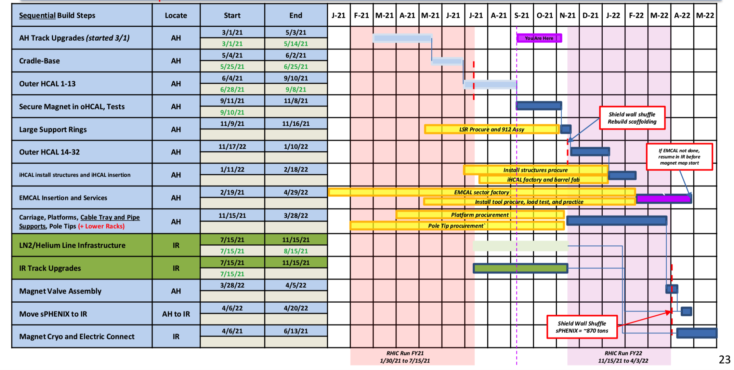
sPHENIX Installation Schedule

