Slide 1


ATHENA Barrel HCal Update
Henry Klest
Calo WG Meeting 10/11/21

Slide 2
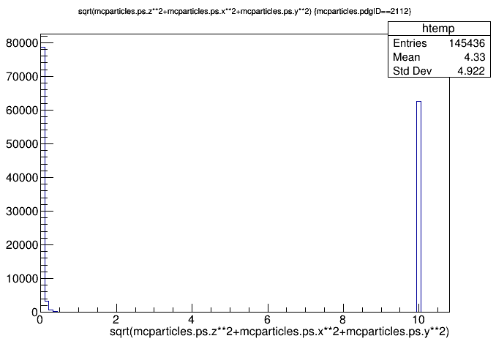
Preface: Neutron Event Sample
Note: Magnet in the iteration I’m analyzing is ~2.2 λ, surprisingly no improvement in clustering efficiency seen, still 8% for 10 GeV n
In 10 GeV neutron barrel sample, some non-neutrons, some particles with small momenta
Need to put in some qualifiers to make sure that particles I’m looking at are actually 10 GeV neutrons
Possible that this is somehow biasing things, not sure what else I can do to make sure I’m looking at the right particles

Slide 3
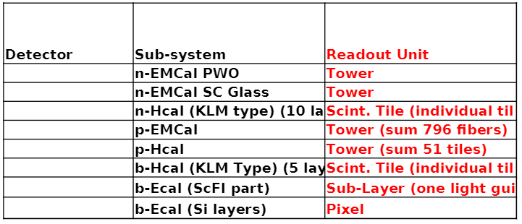
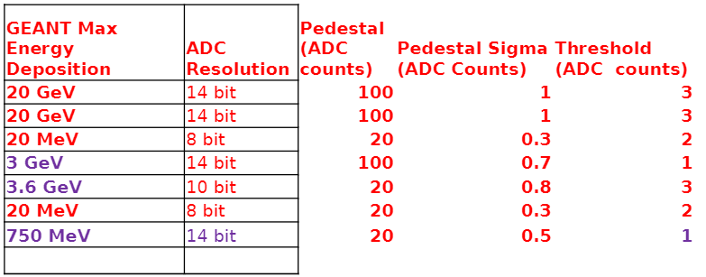
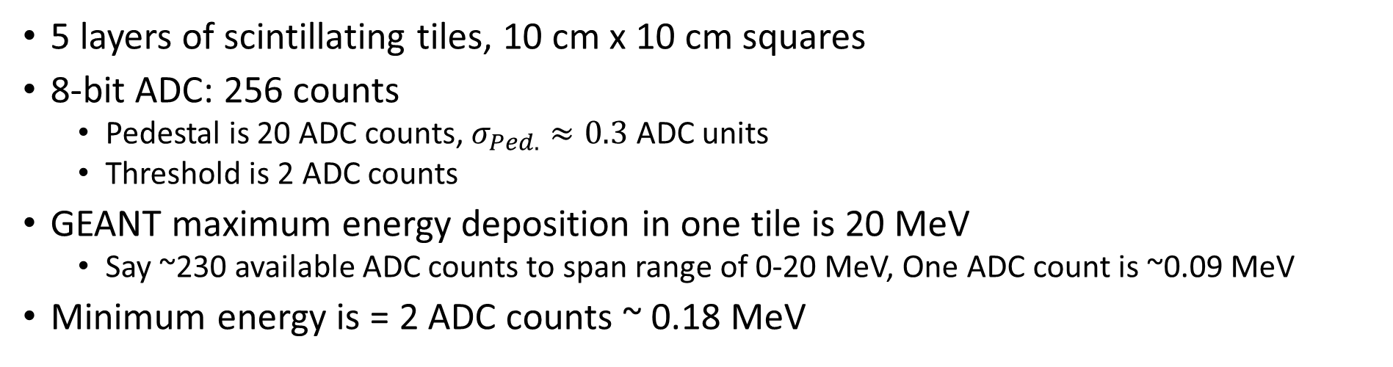
HCal Hits – Info from Oleg/Calo Readout Table
5 layers of scintillating tiles, 10 cm x 10 cm squares
8-bit ADC: 256 counts
  Pedestal is 20 ADC counts, $σ_{Ped.}≈0.3$ ADC units
  Threshold is 2 ADC counts
GEANT maximum energy deposition in one tile is 20 MeV
  Say ~230 available ADC counts to span range of 0-20 MeV, One ADC count is ~0.09 MeV
Minimum energy is = 2 ADC counts ~ 0.18 MeV

Slide 4
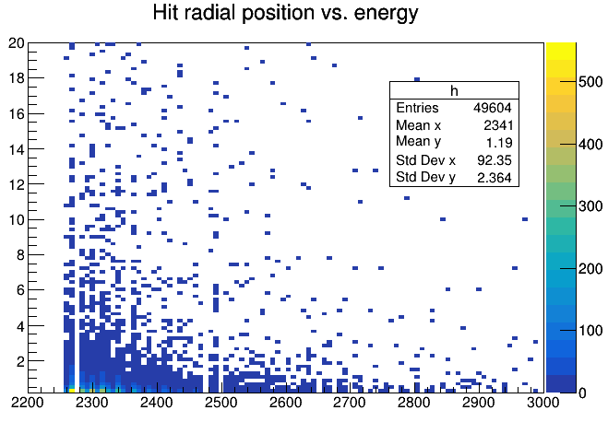
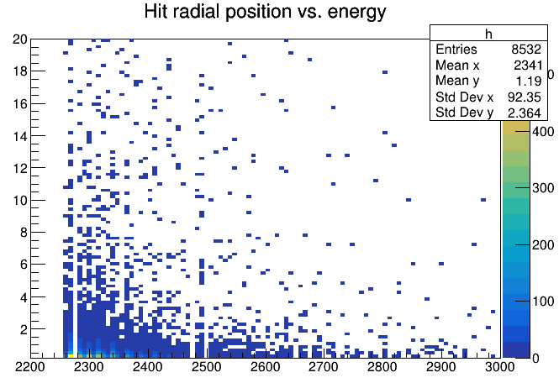
HCal Hits
MeV
No Threshold
N_{hits}/N_{thrown} ~ 1
Event sample is 49k 10 GeV neutrons
  Multiple hits allowed per event
  Couldn’t figure out a good way to access N_{hits} per particle thrown
17% is maximum possible hit above threshold rate, if only 1 hit/event
  Reco clusters were roughly correct?
Peak energy deposit is at very beginning of Hcal
Number of hits seems low based on prior study of reco-level clusters
mm in R
MeV
0.18 MeV Threshold
N_{hits}/N_{thrown} ~ .17
mm in R

Slide 5
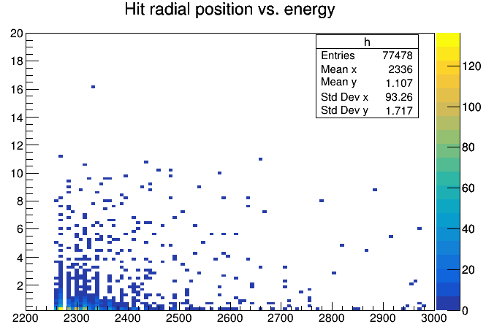
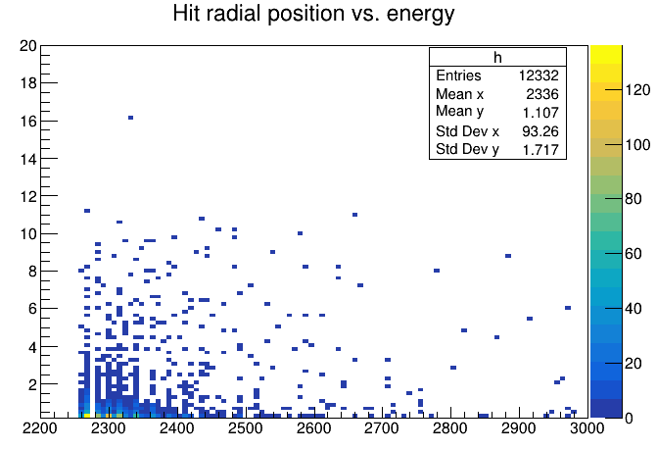
HCal Hits
MeV
No Threshold
N_{hits}/N_{thrown} ~ .7
Event sample is 110k 2 GeV neutrons
Fewer hits observed, as expected
  Not so much less
After magnet shift, forward angles now open for “barrel” neutrals to hit HCal more directly?
mm in R
MeV
0.18 MeV Threshold
N_{hits}/N_{thrown} ~ .11
mm in R

Slide 6
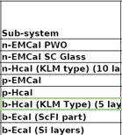
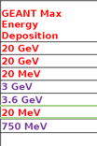
Dynamic Range
Small sample size here, but not so many hits out to 20 MeV
  Large majority of hits < 1 MeV
    Majority < 0.18 MeV Threshold
Decrease 20 MeV maximum?

Slide 7
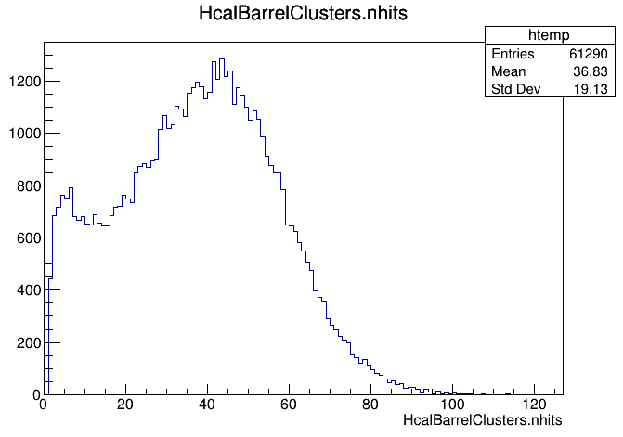
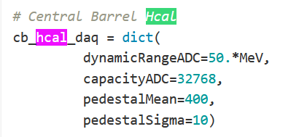
Reco to Full Comparison
RECO: 596679 10 GeV neutrons fired, 48025 clusters reconstructed
  ~8% cluster reconstruction rate
  ~40 hits/cluster?
  How is a “hit” defined in reco files?
FULL: 49622 10 GeV neutrons fired, 49604 total hits measured
  8532 hits above threshold, max of 17% in 1 hit/event limit
Has Hcal readout been updated yet?
From: https://eicweb.phy.anl.gov/EIC/benchmarks/reconstruction_benchmarks/-/blob/master/benchmarks/clustering/options/full_cal_reco.py

Slide 8
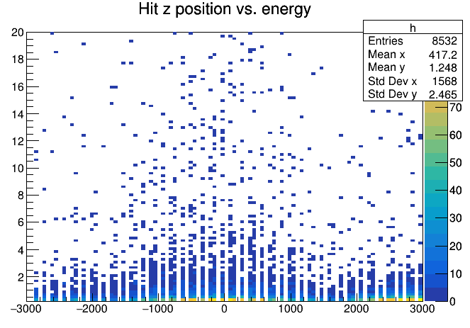
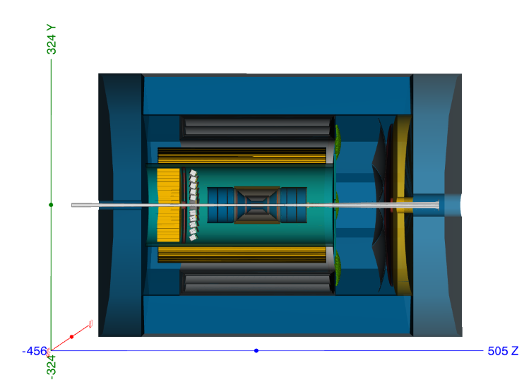
Increase in N_{hits} to high Z, but not low Z
From angle beyond magnet? Beyond Ecal?
10 GeV Neutrons 0.18 MeV Threshold
N_{hits}/N_{thrown} ~ .17

Slide 9
Summary
Based on hit data, seems like the cluster data for the barrel HCal is in the right order of magnitude
  Still needs some double checking
Some inconsistency between reco and full sim, namely N_{hits} in a cluster
  Lower threshold?
With magnet movement, forward angles should now have better HCal efficiency for neutrals, including lower energy neutrals

Slide 10
Backup

Slide 11
“Efficiency” (Fraction with > 0 Clusters)
Neutron efficiency even lower than K_{L} except at 20 GeV
  Less likely to interact in the Ecal at lower energies
  K_{L} Decays easier to detect
Sanity Check: e⁻⁴ ~ .02, e⁻² ~.14
  Showers in magnet can still leave energy in Hcal
  If a shower can longitudinally extend by 2 λ₀, then results are sensible
  Would naively expect even less coming out of magnet than seen here
Species | Hcal | Ecal SciFi | Ecal Imaging | Hcal+SciFi | SciFi+ Imaging | Total fraction with > 0 clusters
500 MeV neutron | 0.00001 | 0.14 | 0.0004 | 0 | 0.000006 | 0.140394
1 GeV neutron | 0.0016 | 0.393 | 0.001229 | 0.00001 | 0.000678 | 0.395141
5 GeV neutron | 0.028 | 0.76 | 0.1 | 0.078 | 0.1 | 0.71
10 GeV neutron | 0.08 | 0.79 | 0.25 | 0.031 | 0.25 | 0.839
20 GeV neutron | 0.175 | 0.81 | 0.31 | 0.087 | 0.31 | 0.898
Low energy hadrons are surprising

