Slide 1
Short report on 26th Geant4 Collaboration meeting
Makoto Asai (SLAC)
10/12/2021 @ eAST developers meeting
[virtual] Geant4 collaboration meeting
Parallel sessions 9/13 ~ 9/17
Plenary sessions 9/20 ~ 9/24
https://indico.cern.ch/event/1052654/
All presentations are publicly visible.

Slide 2
Highlighted topics
Major release (Version 11.0) on December 10th.
Task-based event parallelism is default
Two tasking mechanisms available : PTL (Parallel Tasking Library : default) or TBB (Tasking Building Blocks)
Sequential (single thread) and conventional multithreading also available
Detailed stack trace will be printed if G4Exception occurs
C++17 required, GNUmake dropped
Linux CentOS8
>=gcc-8.3.1, >=gcc-9.3.0, >=gcc-10.3.0, gcc-11.2.0 64 bits
MacOS
Big Sur 11.6, Apple clang-13.0 (LLVM/clang-12), 64 bits
Monterey 12.0, Apple clang-13.0 (LLVM/clang-12), 64 bits
Windows 10
Visual C++ 14.29 (Visual Studio 2019), 64 bits
Also tested:
CentOS7, CentOS8 > icc-20.2.X, LLVM/clang-10.0/clang-11.0 – Catalina 10.15, Apple clang-12.0 (LLVM/clang-11), 64 bits
Ubuntu 20 > gcc-9.3.0

Slide 3
Highlighted topics
VecGeom solids become default
Expect performance improvements, but there may be glitches for corner cases
Prototype of a new navigator optimized for VecGeom
Introduction of templated field integration stepper
Option to switch field integration steppers
Introduction of light hyper-nuclei and anti-hyper-nuclei
Up to a = 5 (hyper-helium5, i.e. p-p-n-n-Λ⁰)
EM physics (i.e. ionization) only for version 11.0.
Hadronic physics will be added later (hopefully in version 11.1)
Alternative EM physics process specialized to high-energy e⁺/γ shower simulation
Stripping out all the flexibilities / generalizations
Requires dedicated TrackingManager/SteppingManager
G4OpticalParameters class is introduced
Usability improvements, but need migration
Pre-defined optical material parameters
Ideally user does not need to defined optical parameters for “standard” materials

Slide 4
Highlighted topics
Major design changes in hadronic processes
Both model classes and cross-section classes
Changes are invisible for packaged physics lists (e.g. QGSP_BERT) but migration is required for user-written physics lists (including eAST physics list)
FTF model is extended to charm- and bottom-quark interactions
Half-life threshold for isomer production is changed from 1 μs to 1 ns
A G4Track object is created for isomers with lifetime longer than the threshold
Introduction of new cut for “very-late” radioactive decay at rest
If sampled decay time is longer than the cut value (by default 10^27 ns), the ion is killed without decay
New data library G4TENDL-1.4 based on TENDL-2019 for ParticleHP
562 isotopes
Enhancement of gamma-nuclear interaction, in particular Quasi-elastic channel, won’t be included in 11.0
JLab/EIC user requirement
Large development that requires resources

Slide 5
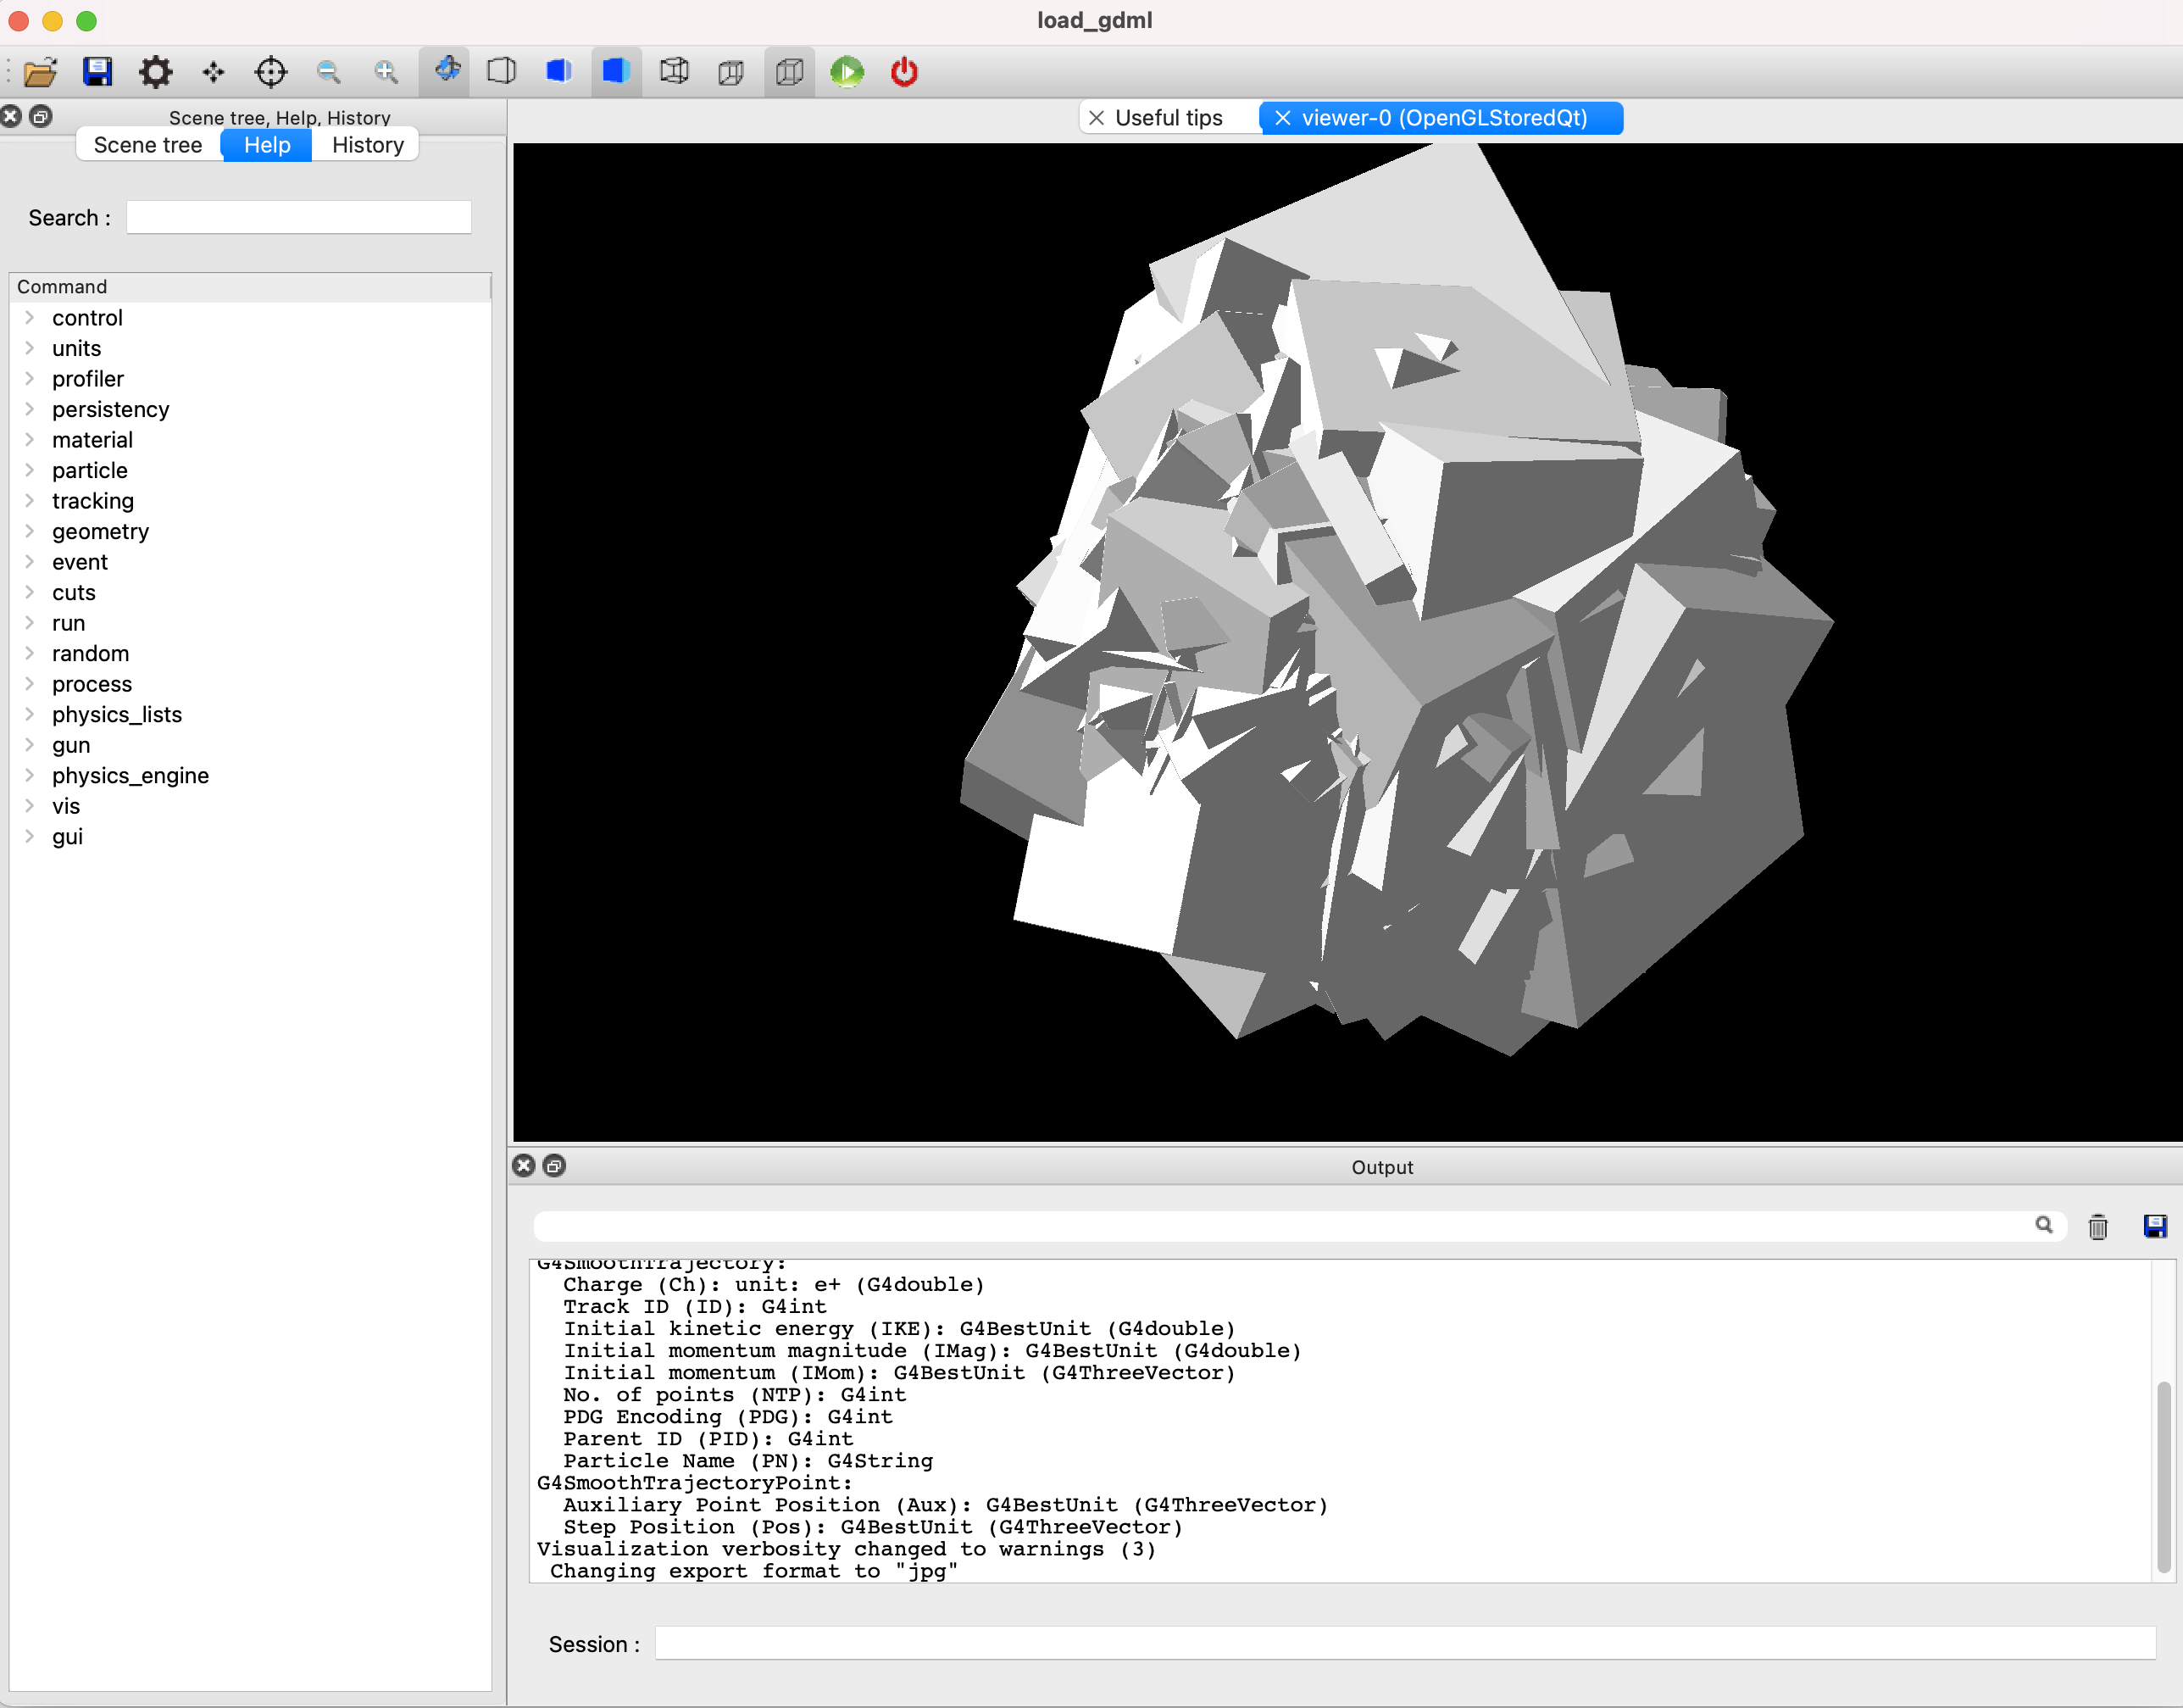

Highlighted topics
New CGAL (Computational Geometry Algorithms Library) Boolean engine
New VTK visualization driver
Interactive 3D in PowerPoint!

