Slide 1
dRICH costing
What you find in current version (20211015):
300K sensors (same area as in JLEIC) but new design might increase area. This introduces a significant uncertainty in the whole budgeting exercise
improved detailed breakdown of costs for material (i.e. power supply, mirror aligement system, etc..)
electronic cost is aggregated (2.4 M$) but it assumes behind (for "segmentation", i.e. SiPM tiles, cards mounting ASIC, concentrator cards) a realistic model (that it has to be totally validated however) and ASIC production including MWP for prototyping before production. The model entails 300 links to DAQ, with some data reduction at concentrator level
labour costs: improved modelling for R&D + assembly costs
inputs collected from commercial companies + expert opinions based on previous ASIC production, expertise from CLAS12, DarkSide, COMPASS
Note 1: the model is based on an assumption (SiPM as photosensors for a RICH) that we still need to prove with R&D.
Note 2: Sharing costs between project and in-kind (for material/direct costs) caps in-kind to INFN EoI envelope communicated to Olga ("somewhere between 5-6 M$") → this translates currently directly in request to project about certain items (mirrors & mechanics mainly).
P. Antonioli/on behalf of dRICH

Slide 2
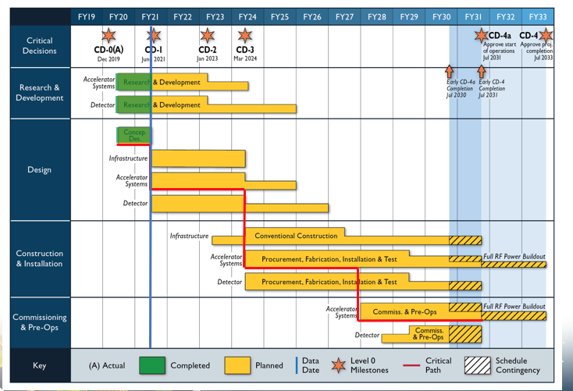
Current overall numbers:
Total material direct costs: 8.3 M$
Total labour costs: 4.4 M$
Cost to project: 3.4 M$ (2.6 M$ material, 0.8 M$ labour costs)
What you don't find in current version (20211015) or it has preliminary flag:
cooling costs ($500000 TBC)
timing: projected start date and duration is fixed to 1-Jan-2022 and 540 d everywhere (just cut&paste)
prototyping of mechanical structure not costed (hopefully included in envelope for procurement)
shipping costs not coste
labour costs associated to procurement are not in separate lines as requested recently (can we simplify?)
what you will not at this meeting (thanks in advance for spotting ;-))
time schedule: end of R&D, expected assembly start etc. current schedule leaves many ambiguities and there is no detail on when detector installation can start. Your guess?

