Slide 1
MRPCs in the hadron endcap
R&D is needed, but part of it will be shared with barrel
  Test different gas mixtures
  Test different geometry configurations
  Design and test readout electronics
  Test chain readout to reduce number of channels
Gas system will be shared with barrel with some additional valving and tubing
HV is additional cost in endcaps
MRPC construction will be in-kind contribution from China
Design and manufacture the support structure
Assembly and testing of detectors in the US
Two proposed configurations : Lego and Pizza designs

Slide 2
Hadron Endcap mRPC-TOF Pizza
Gas pipes, HV cables, signal cables
1
2
3
50 cm
40 cm
40 cm
4
40 cm
50 cm
10 cm
Gas pipes, HV cables, signal cables
170 cm
Each mRPC Super-Module:
Divide the total disk into 22 sectors
Each sector contains a super-module with 4 individual mRPC modules with different sizes
For each mRPC module, read the signal from both ends along the radius direction
Readouts
Readouts

Slide 3
Hadron Endcap mRPC-TOF Pizza
Gas pipes, HV cables, signal cables
1
2
3
50 cm
40 cm
40 cm
4
40 cm
50 cm
10 cm
Gas pipes, HV cables, signal cables
170 cm
Chain readout strips of two or more module?
Each mRPC Super-Module:
Divide the total disk into 22 sectors
Each sector contains a super-module with 4 individual mRPC modules with different sizes
For each mRPC module, read the signal from both ends along the radius direction
Alternatively: Chain the strips of two (or all four) neighboring mPRCs to save more readouts → How much timing resolution will be lost?
Readouts
Readouts

Slide 4
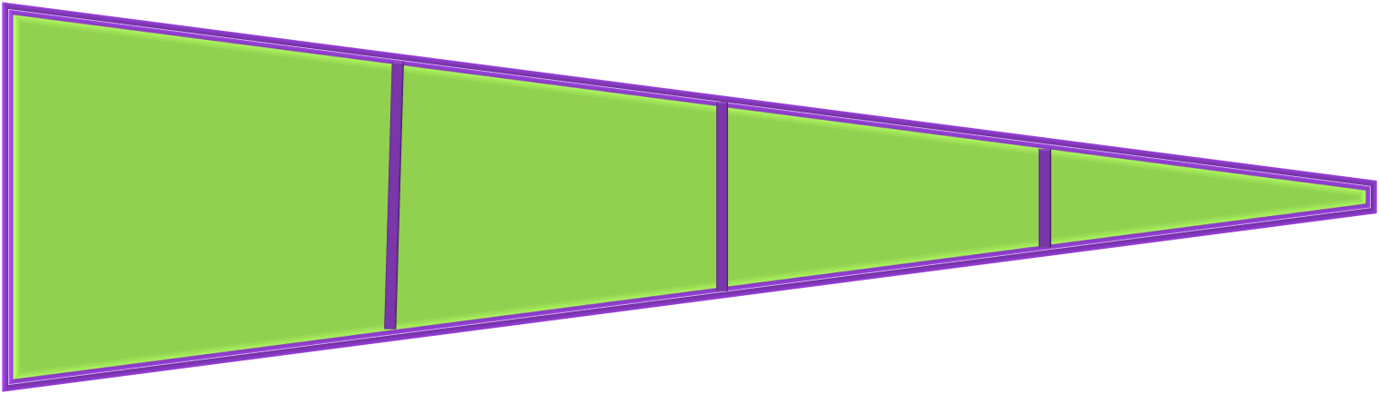
Hadron Endcap mRPC-TOF Pizza Cost
mRPC Modules:
$30K per m² for 32 gas-layers with regular low-resistive glasses
For a 180cm outer radius and 10cm inner radius disk, it takes 10m² of mRPC
Total cost: $0.3M
Readout Electronics:
1cm for each channel, read from both ends along the radial direction
  Module#1: 51 x 2 channels
  Module#2: 37 x 2 channels
  Module#3: 25 x 2 channels
  Mudule#4: 14 x 2 channels
Total channels of each sector: 254 channels
Total 22 sectors → 5588 channels ~ 5600 channels
Total cost: $500 for each channel → $2.8M for readout electronics
HV Supplies:
CAEN AG524P → 6 HV outputs, quote $6K for each board
Two module power one sector (positive + negative polarity)
Total 44 HV channels
Need two mainframes that house the HV boards → $15K for each
Cables: $400 x 50 = $20 K

Slide 5
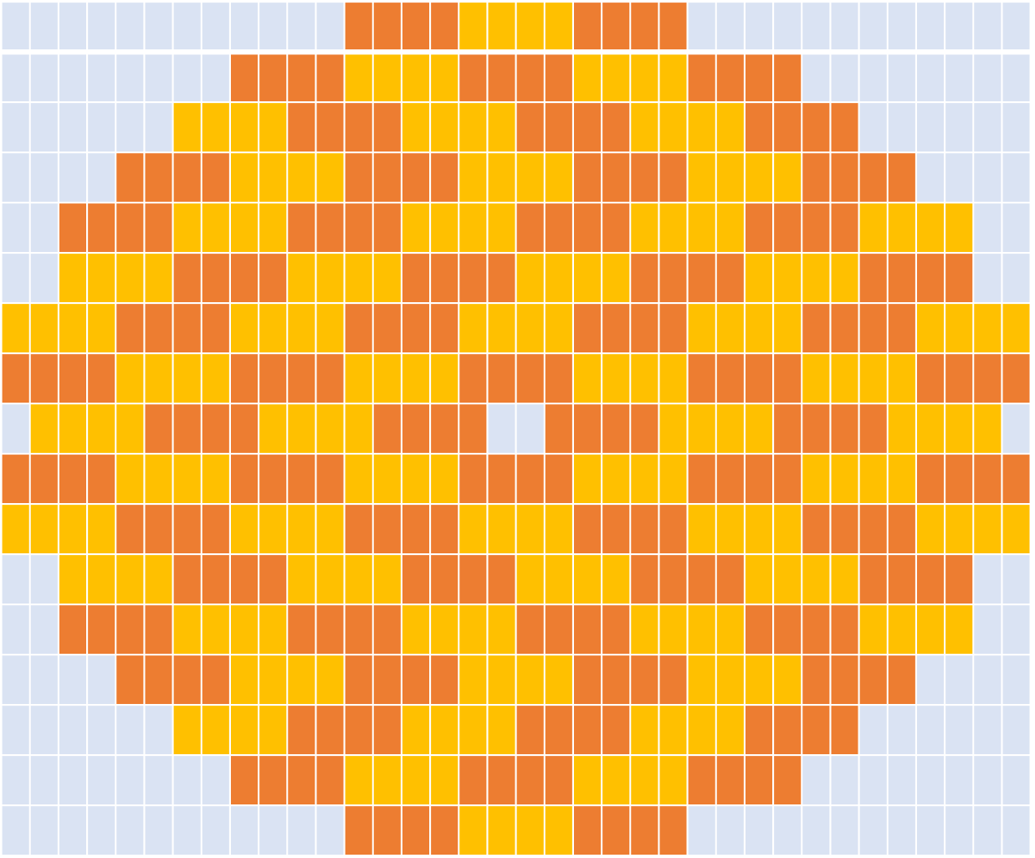
Hadron Endcap mRPC-TOF Lego
Basic unit 20 x 40 cm² active area
mRPCs arranged in horizontal trays staggered to avoid dead area
Trays staggered in and out in z in two layers
Total: 118 mRPCs ; 4720 readout channels → $ 2.36 M
HV distributed to each tray: 18 ch of each polarity + 2 mainframes
....
20 strips

Slide 6
Cost summary
item | Pizza | Lego | notes
Readout | $2.8 M | $2.4 M
HV | 30+44+20 = $94k | 30+36+15 = $81 k | 2 mainframes + channels + cables
Gas system | $20 k | $20 k | Valves, tubing, controller
Support structure | $5 k | $5 k | Materials ( Al frame estimated)
mRPC | $0.3 M | $0.3 M | Could be in-kind contribution from China
Total | $3.219 M | $2.806 M
Additional:
4 weeks tech labor for gas system
20 weeks design of support structure (tech + engineer)
30 weeks fabrication and assembly ( tech + students)
MRPC production
Beam tests, travel, shipping
R&D - post doc and 2 students

