Slide 1
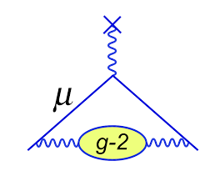
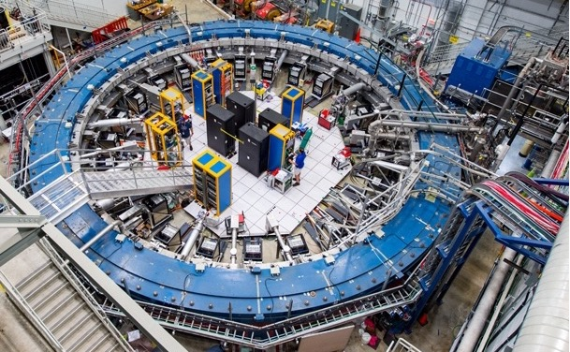
Fermilab
Status and
Prospect of the
Fermilab Muon g-2 Experiment
Hogan Nguyen
Fermilab
DWQ@25 Workshop
December 14th, 2021

Slide 2
Muon g-2
>200 collaborators
35 Institutions
7 countries
experimentalists
accelerator physicists
... and theorists

Slide 3
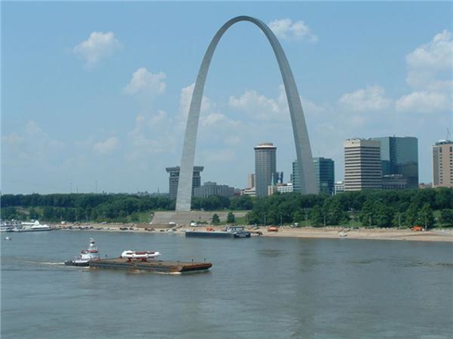
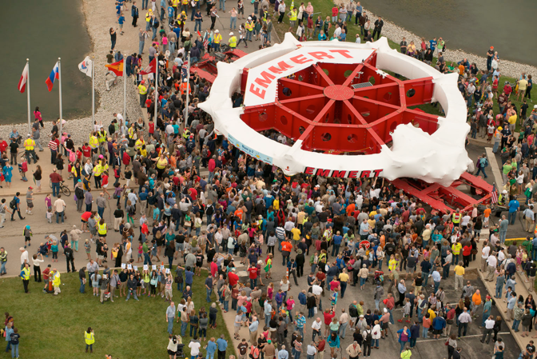
g-2 Apparatus Moved From BNL to Fermilab in July 2013

Slide 4
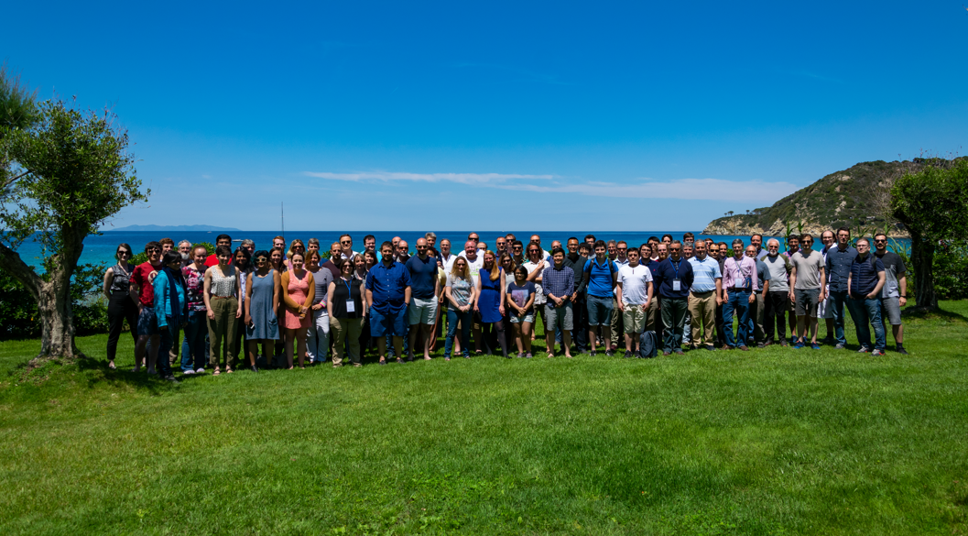
On April 7th 2021, we announced our first result.
First new measurement in nearly 20 years !

Slide 5
3.7 σ
We agree with BNL !
3.3 σ

Slide 6
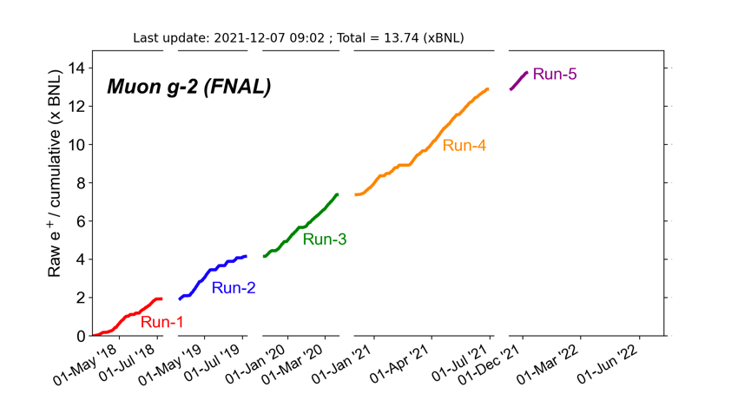
Status and Prospect
Our first data set (RUN1 ~ 2x BNL) was difficult to analyze
Recently surpassed 14 BNL data sets
(goal is 20x BNL)
Fully remote shifts
underway
Huge improvements
in Runs 2-5 making
data significantly easier to analyze !
$$Planning for$$
$μ^{−}$ beam
in Run 6

Slide 7
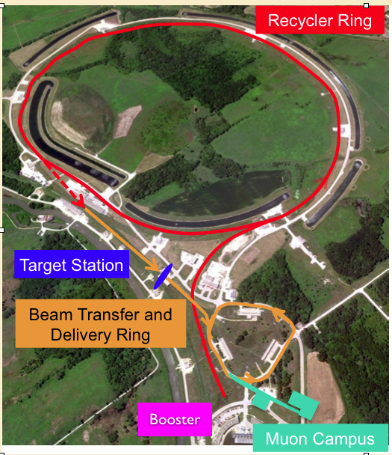
Clean Source of Intense
and >90% Polarized 3.1 GeV Muons
Tight Beam line Magnet
spacing (w.r.t. BNL) Long Decay Line Kicker for Proton removal

Slide 8
Beam Time Structure
16 fills every 1.4 seconds
~ 10,000 muons per fill
~ 700 $μsec$ fill duration (~ 10 muon lifetimes)

Slide 9
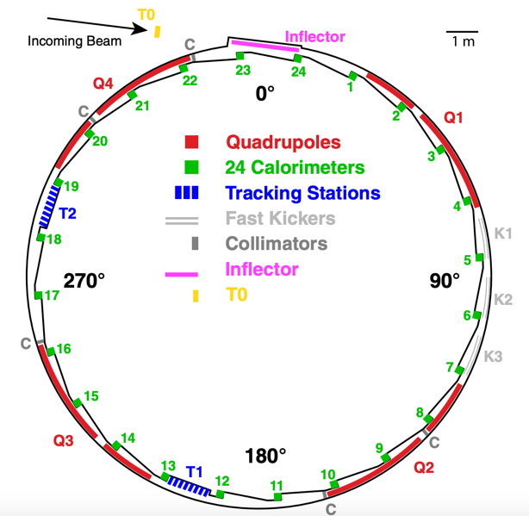
Ring Anatomy
1.45 Tesla Magnet
14.2 meter Diameter Ring
~5 cm diameter beam
in an evacuated volume

Slide 10
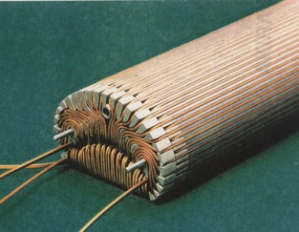
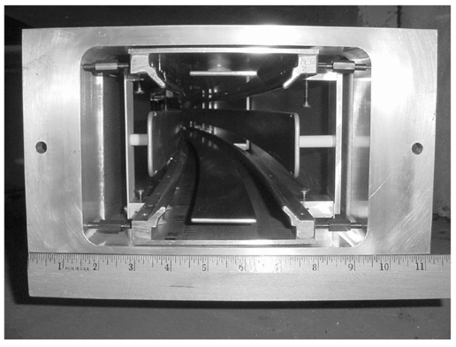
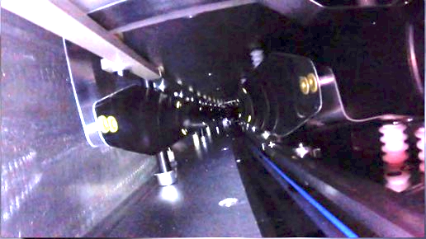
Superconducting Inflector
Beam Storage Components
8 Quads for vertical focusing
(43% Coverage)
10 mrad Magnetic Kicker

Slide 11
Positron Detectors
1/12 of the ring

Slide 12
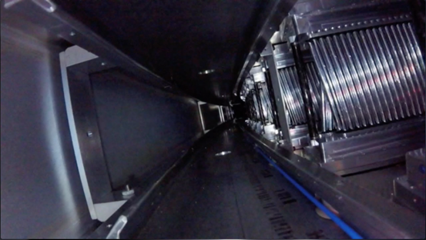
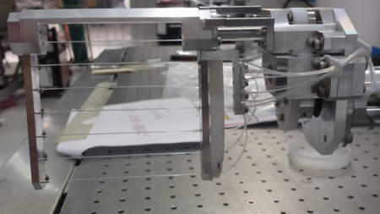
Particle Detectors
24 stations of PbFl2 Xtals
2 in-vacuum non-destructive
positron tracking stations
destructive fiber beam
profile monitors and beam-entrance
detectors

Slide 13
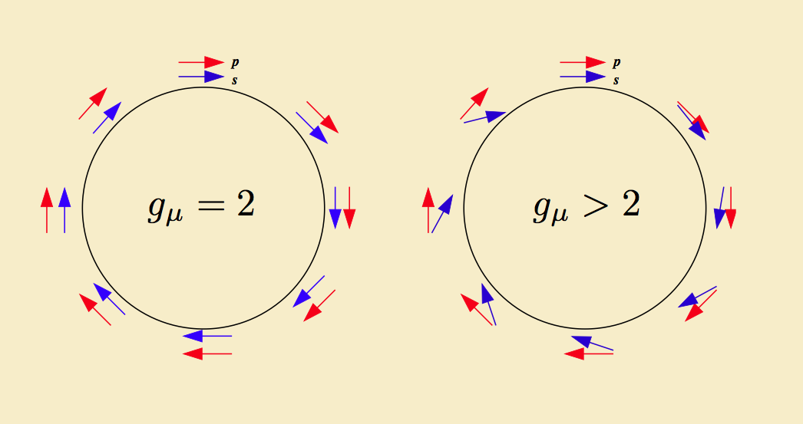
Spin and Momentum Precession in a Storage Ring
Bargmann-Michel-Telegdi Equation (1954)
The difference frequency is
$$ω_{s}−ω_{c}≡ω_{a}$$
$ω_{a}$is the rate of change of
longitudinal polarization

Slide 14
Spin and Momentum Precession in a Storage Ring
for an ideal planar circular orbit in a pure B field,
there is an amazing simplification:
$$ω_{s}−ω_{c}=ω_{a}={−\frac{q}{m_{μ}}\left(a_{μ}B\right) }_{ }$$
True for any momentum (i.e. Any Ring Size)
Can be done on a table top !
”All” we must do is measure $ω_{a}$ and $B$
See Backup slide for our master formula

Slide 15
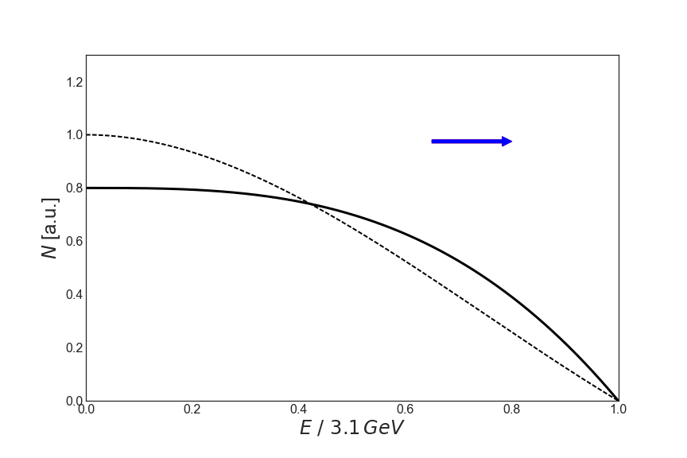
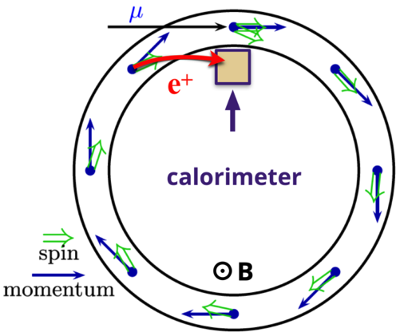
Measuring $ω_{a}$ (rate of change of longitudinal polarization)
Tagging high energy positrons
Select

Slide 16
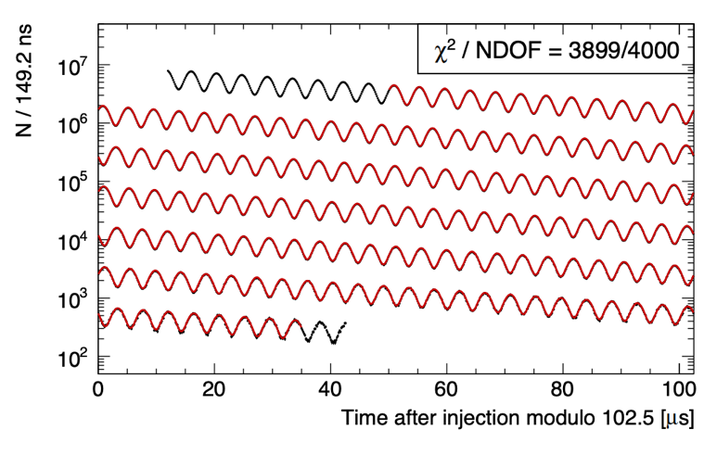
Main Analysis Plot
Number of
Positrons
Above 1.7 GeV
versus
Time in Fill
The frequency
is $ω_{a}$
Pretty close to a
5 parameter fit

Slide 17
The Magnet
and
Measuring the Magnetic Field

Slide 18
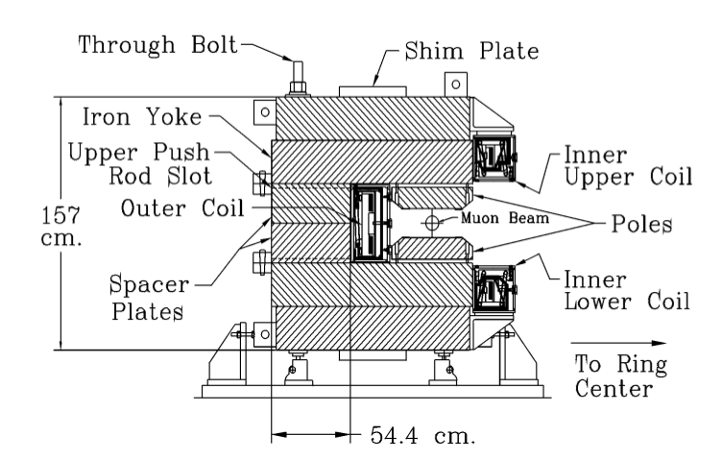
Gordon Danby’s (BNL)
Ingenious Magnet Design
Super Conducting Technology allowed
for low heat load
6 Mega Joules of stored EM
Energy
~10000 Adjustment Knobs
Dipole
1 Magnet Current
Outer Shim Plates
~8500 Thin shim foils
Quadrupole
864 Wedge Shims
Sextupole
144 Edge Shims
Radial Field
~20 Trim Coils
Built by BNL in the mid 1990’s

Slide 19
Measuring the B Field with Proton NMR
$$a_{μ}=\frac{ω_{a}}{B}\frac{m_{μ}}{e}$$
For protons at rest in the magnetic field, their spin also precesses:
$$ω_{p}=\frac{g_{p}e}{2m_{p}}B$$
Measure the proton Larmor
Frequency and extract B
using external constants $\frac{g_{p}e}{2m_{p}}$
(Larmor Frequency)

Slide 20
Measuring the B Field with Proton NMR
$a_{μ}=\frac{ω_{a}}{B}\frac{m_{μ}}{e}$ = $\frac{ω_{a}}{{\tilde{ω}}_{p}^{′}(T_{r})}\frac{μ_{p}^{′}\left(T_{r}\right)}{μ_{e}\left(T_{r}\right)}\frac{μ_{e}\left(H\right)}{μ_{e}}\frac{m_{μ}}{m_{e}}\frac{g_{e}}{2}$
In practice, external constants come from:
H-maser, Muonium HFS, and Penning
Trap experiments, and QED Theory.
Known to ~ 24 ppb

Slide 21
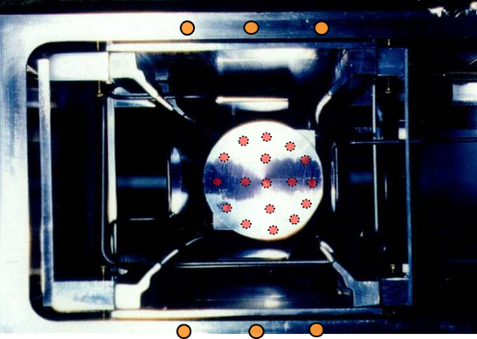
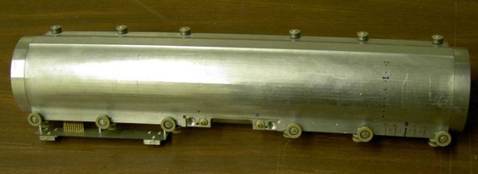
NMR Probes
“Fixed” NMR probes
(monitors B during muon storage)
"Trolley” measures 2D profile (must turn OFF beam)

Slide 22
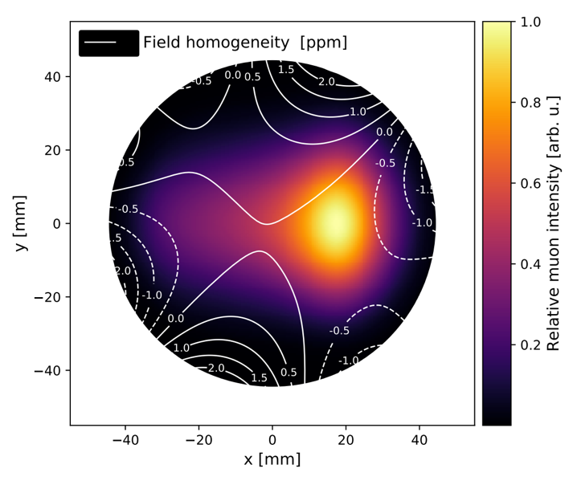
Main Worries
What is the Field value
in between trolley runs ?
How do we know $ω_{p}$is correct ?
Transients Magnetic
Fields ?

Slide 23
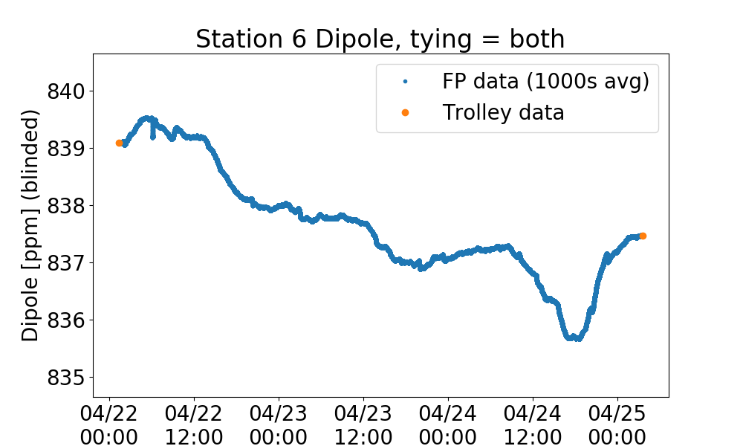
Typical Magnet Stability for Run 1 (publication)
Order Few ppm drift over 3 days
Related to hall temperature stability

Slide 24
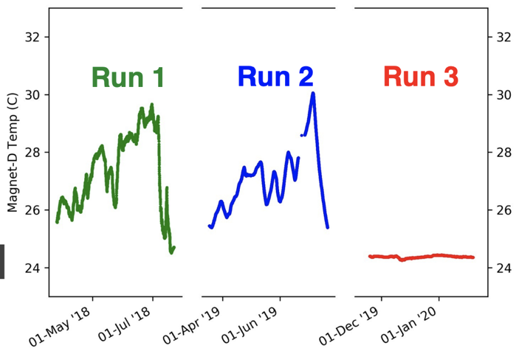
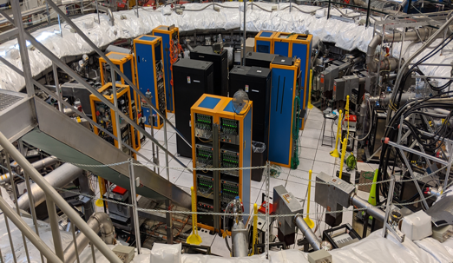
Insulate Magnet Iron and Improve Hall HVAC
Stabilizes the magnetic field

Slide 25
Bargmann Michel Telegdi Equation (in detail)
$$\frac{dβ}{dt}=\frac{e}{γm}\left(E+β x B−β\left(β∙E\right)\right)$$
$$\frac{d}{dt}\left(\hat{β}∙s\right)=−\frac{e}{mc}s_{⊥}∙\left[ a_{μ}\hat{β} x B+ \left(\frac{gβ}{2}− \frac{1}{β}\right)E \right]$$
Use “Magic”
Momentum Muons (3.1 GeV/c)
Our Experimental Observable
Electric Field Perturbation

Slide 26
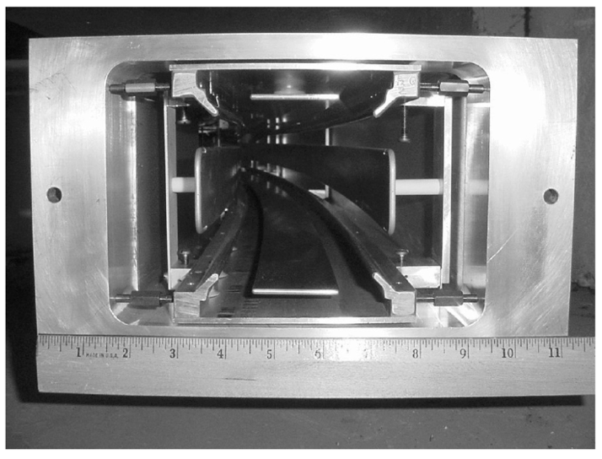
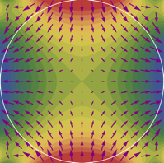
The Magic Momentum Technique
$$+18 KV$$
Can use Electrostatic Quadrupoles
with only a
small penalty
Vertical Focusing
Horizontal Defocusing
$$−18 KV$$
$$−18 KV$$
$$+18 KV$$

Slide 27
5 Parameter Fit
Does not work !
Detector Gain Stability
Pileup Background to $e^{+}$
Finite Detector Acceptance
Imperfect Beam !
We must use a 22
parameter fit

Slide 28
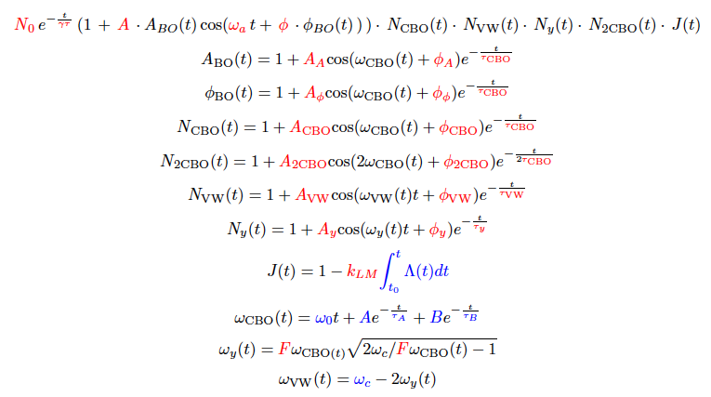
22 Parameter Fit

Slide 29
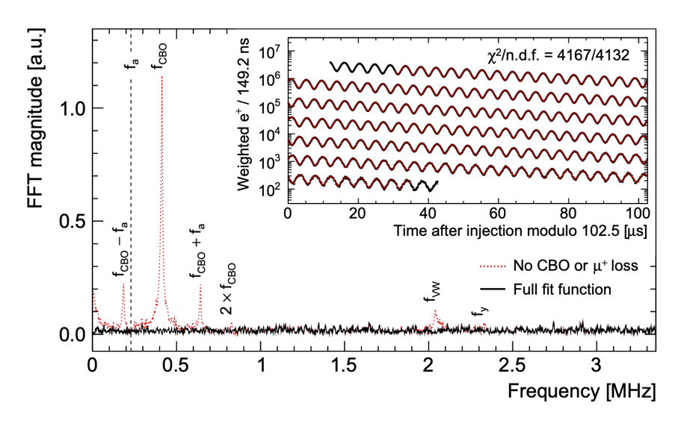
Final Result from a 22 parameter fit (“Run 1d”)

Slide 30
Finite Detector Acceptance
and Imperfect Beam
made Run 1 difficult to analyze
Huge effort went into improving
the stored beam for runs 2-5.

Slide 31
Finite Calorimeter Acceptance
Since calorimeter size is finite,
we are sensitive to decay vertex position

Slide 32
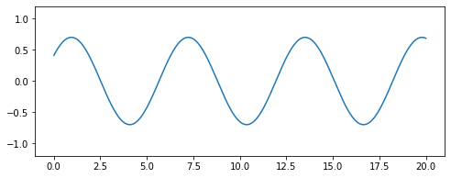
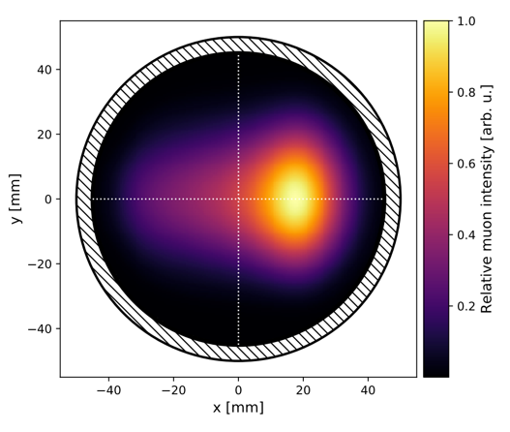
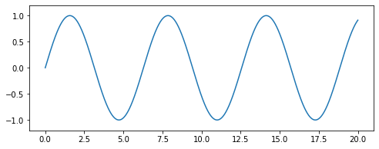
”Wiggle” Phase and Asymmetry has a 2D dependence
Phase
Difference
Asymmetry
Difference
The $ω_{a}$plot is the ensemble average. The beam profile must be
well-understood during measurement period.

Slide 33
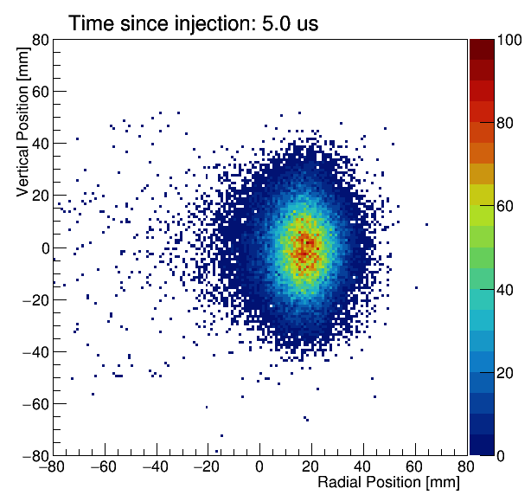
2d profile of beam
(see by trackers)
Stored Beam Imperfections in Run 1 Publication
Motion caused primarily by damaged
electrostatic quadrupole components and
imperfect kick
`Stored Muons’:
Muons that would remain stored for all time
(if they didn’t decay)
`Partially stored muons’ (aka lost muons):
Muons that would eventually
hit apertures (if they didn’t decay).
These are a contamination that makes
analysis difficult.

Slide 34
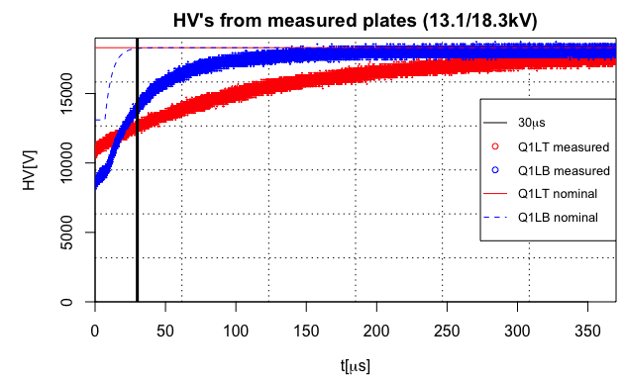
2 damaged Quad Resistors caused Beam Instability in Fill
$$+18.2 KV$$
beam
$$−18.2 KV$$
$$−18.2 KV$$
$$+18.2 KV$$
Two (out of 32) Quad Electrode Voltages were unstable.
Correction for this took 1 year to pin down.
This has been fixed.

Slide 35
Ideal Injection
and Kick
Muon Injection
Injection Orbit
~200 Gauss Kick
~ 5000 Amps
~ 200 nsec pulse
Ideal Stored Orbit

Slide 36
Kick not strong enough
“Horizontal Betatron
Oscillation”
Actual Orbit
~ 1 cm
Ideal Stored Orbit
< 200 Gauss Kick

Slide 37
Quads
decreases Horizontal Betatron tune
$$ν_{x}<1$$

Slide 38
Horizontal Coherent Betatron Motion (due to $ν_{x}<1$)
View seen by a the trackers
(similar effect in vertical direction)

Slide 39
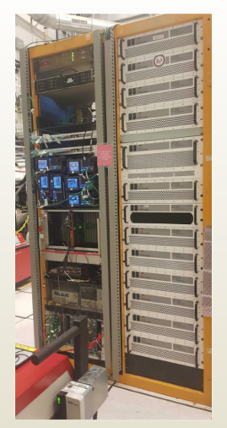
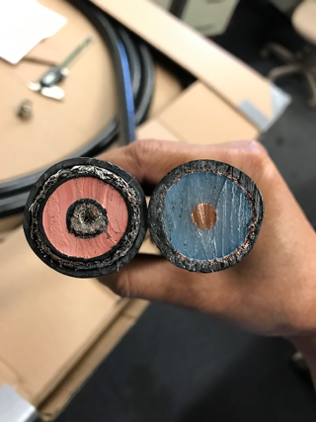
Two Major
Upgrades
Run 4: Stronger Kick allowed by new
cable technology to withstand
pulsed high voltage required (55 KV & 5000 amps).
Resolved Sparking issues.
Old
Cable
New
Cable
Run 5: System to apply RF Electric fields to reduce the stored beam phase space before measurement window
(BNL E821 idea from Yuri Orlov and Yannis Semertzidis)

Slide 40
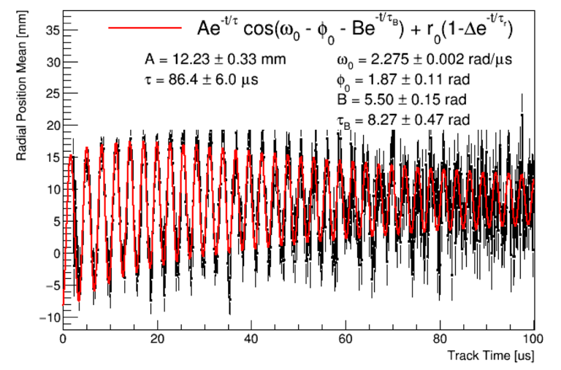
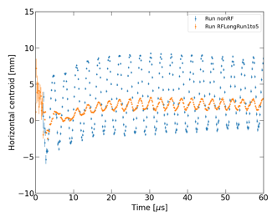
Run 2-3
Reduction in
Horizontal Beam
Motion
~ 10 mm amplitude
Run 4 (~6 mm)
Run 5
(~1 mm)
Reduces the size of the extra 17 fit parameters
Contamination from partially stored muons (aka lost muons) now negligible.

Slide 41
Uncertainties for Run 1 publication
434 ppb statistical
157 ppb systematic
Two large errors are from magnetic transients due to
kicker and quads pulsing.
They are very difficult to measure.
They can only be measured
during our summer shutdown.

Slide 42
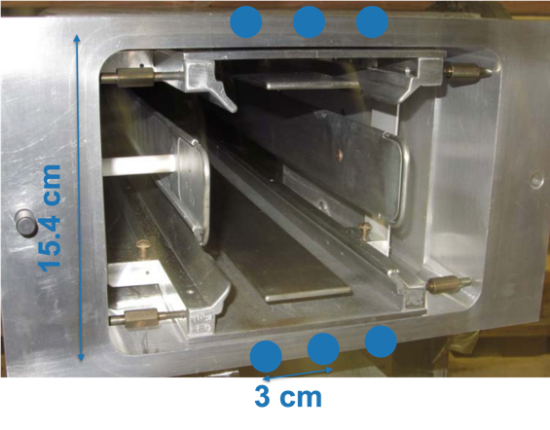
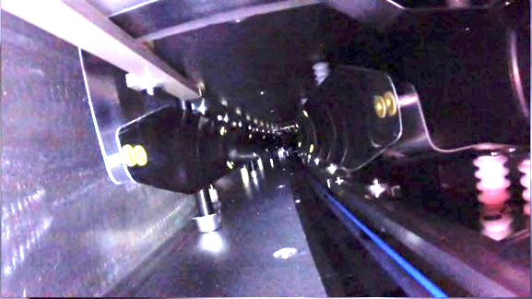
B-field Transients from Kickers and Quads
Large Currents Required to Kick the Muons
Reaction Eddy Currents and Impedance mismatch currents
Mechanical Motion due to Lorentz Forces
Mechanical Motion due brief impulse of
Electrostatic forces.
Vibration of metals in a magnetic field

Slide 43
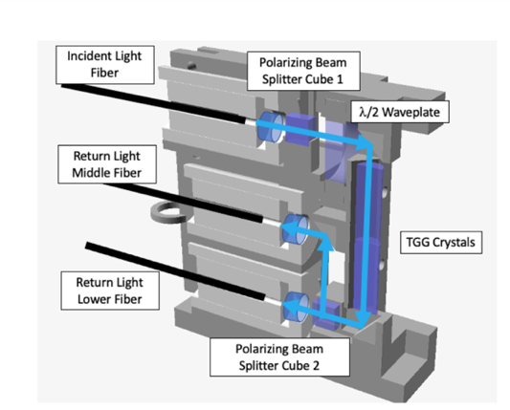
Faraday Magnetometer to measure
very fast kicker magnetic transients
Special NMR trolley to measure quad-induced magnetic transients
These devices reside inside the kickers and quads during pulsing.

Slide 44
Summer 2021 Kicker Transient Measurement Summer
Primary kicker pulse
Blumlein charging pulse
Kicker transient field
(what we care about)

Slide 45
In Conclusion:
Currently at ~ 14x BNL statistics
Greatly improved the beam dynamics !
Magnetic Transients are well understood !
We aim to release Run 2 + Run 3 as a single publication
in 2022
Planning for Run 6 (2022) to be $μ^{−}$

Slide 46
Back up

Slide 47
Muons: A Great Tool for Experimentalists
Can be produced copiously in proton collisions and pion decays
Can select momentum and polarization
Lucky Combination of lifetime, mass, and charge
Decays are very simple
Self-Analyzing Weak Decay
We use a precision magnetic field to
continuously probe the muon spin for
at least 10 lifetimes.

Slide 48
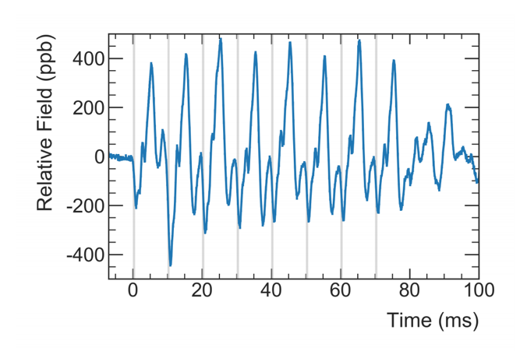
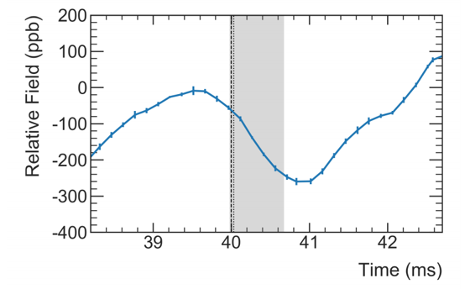
B-field Transients from the Quad System
Train of 8 Pulses of the Quad system
Transient during Muon Fill
Small Correction with large error

Slide 49
Master Formula
Hardware Blinded Clock
Beam Dynamics Corrections
Absolute Field Calibration
Spatial Convolution with muon
beam
Magnetic Transient Corrections

Slide 50
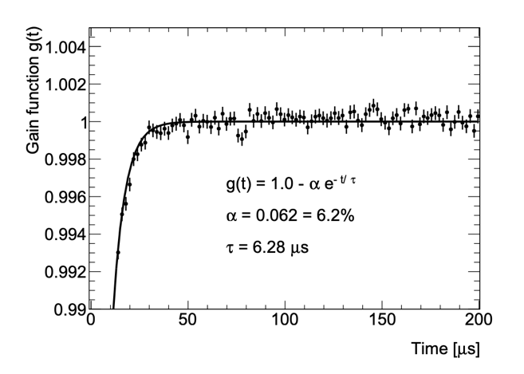
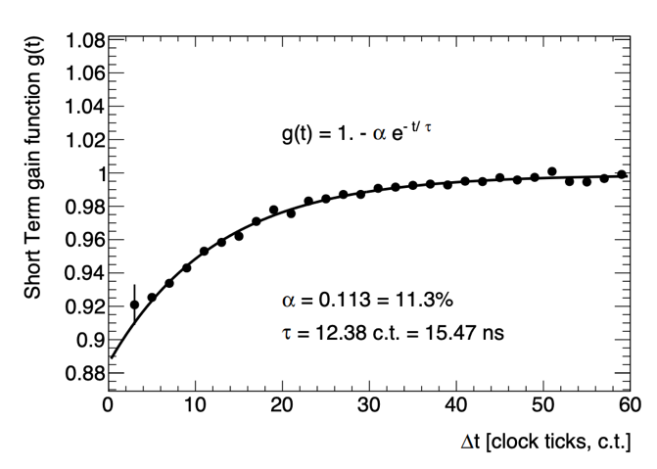
Gain Stability: Mapped with Laser System
Gain Drop from initial beam
flash at injection
Gain Drop from
consecutive hits

Slide 51
Comparisons
We essentially used the BNL magic momentum storage ring technique. But newer technology
allowed us to scrutinize further and discovered new effects. We dedicated more time for special runs.
Jparc g-2 uses a low energy storage ring technique (no quads, no kickers, no inflector). But there are trade offs with rate and material and beam emittance.

Slide 52
Acknowledgements
Department of Energy (USA),
National Science Foundation (USA),
Istituto Nazionale di Fisica Nucleare (Italy),
Science and Technology Facilities Council (UK),
Royal Society (UK),
European Union's Horizon 2020
National Natural Science Foundation of China,
MSIP, NRF and IBS-R017-D1 (Republic of Korea),
German Research Foundation (DFG)

