Slide 1
Gaia Data
T. Throwe
20 October 2021

Slide 2
Gaia
Satellite managed by the European Space Agency
Launched in December 2013
Positioned at the L2 Lagrange point 1.5 million km from Earth
Three data releases
Data cited in papers we have examined
What is involved in using the data?

Slide 3
Gaia Early Data Release 3
The Gaia collaboration is making the third release of their data in two parts. Early Data Release 3 (EDR3) was released on 3 December 2020 and the final release will be sometime in early 2022.
EDR3 contains
1,811,709,771 sources
1,467,744,818 sources with the full astrometric solution (position, parallax and proper motion)
Radial velocities are not yet available, but 7,209,831 from DR2 are included
Parameter table on next slide

Slide 4
EDR3 Main Source Table – 99 Columns, including
ra : Right ascension (double, Angle[deg])
dec : Declination (double, Angle[deg])
parallax : Parallax (double, Angle[mas])
pm : Total proper motion (float, Angular Velocity[mas/year]
pmra : PM in right ascension direction (double, Angular Velocity[mas/year])
pmdec : PM in declination direction (double, Angular Velocity[mas/year] )
dr2_radial_velocity : Radial velocity from Gaia DR2 (float, Velocity[km/s])
l : Galactic longitude (double, Angle[deg])
b : Galactic latitude (double, Angle[deg])
Associated errors and correlations of the above

Slide 5
Data Availability
Websites where you can do interactive searches and visualizations
https://www.cosmos.esa.int/web/gaia/early-data-release-3
Overview
https://gea.esac.esa.int/archive/
Download data files - Gaia source 616GB
Interactive search
https://gea.esac.esa.int/archive/visualization/
Visualization of the data set
Programing API

Slide 6
API
There is a web API for the data using something called TAP or Table Access Protocol
To make things really simple, there is a Python module called astroquery which contains interfaces to many astronomical data sources including Gaia. It is used as:
from astroquery.gaia import Gaia
Gaia.load_tables(only_names=True) # retrieve table names from database
Gaia.launch_job_async("SELECT * FROM gaiaedr3.gaia_source WHERE gaiaedr3.gaia_source.parallax > 150.0;",dump_to_file=True, output_format='csv', output_file='150mas.csv')

Slide 7
Parallax
In the previous example, the query selected sources with a parallax greater than 150 mas or within about 22 light years
Results were returned almost immediately, a nice feature of databases
There were 113 sources returned by the query and stored in a 96kB csv file
From the returned data, used pandas to load into python and then one can then plot the position of the 113 objects

Slide 8
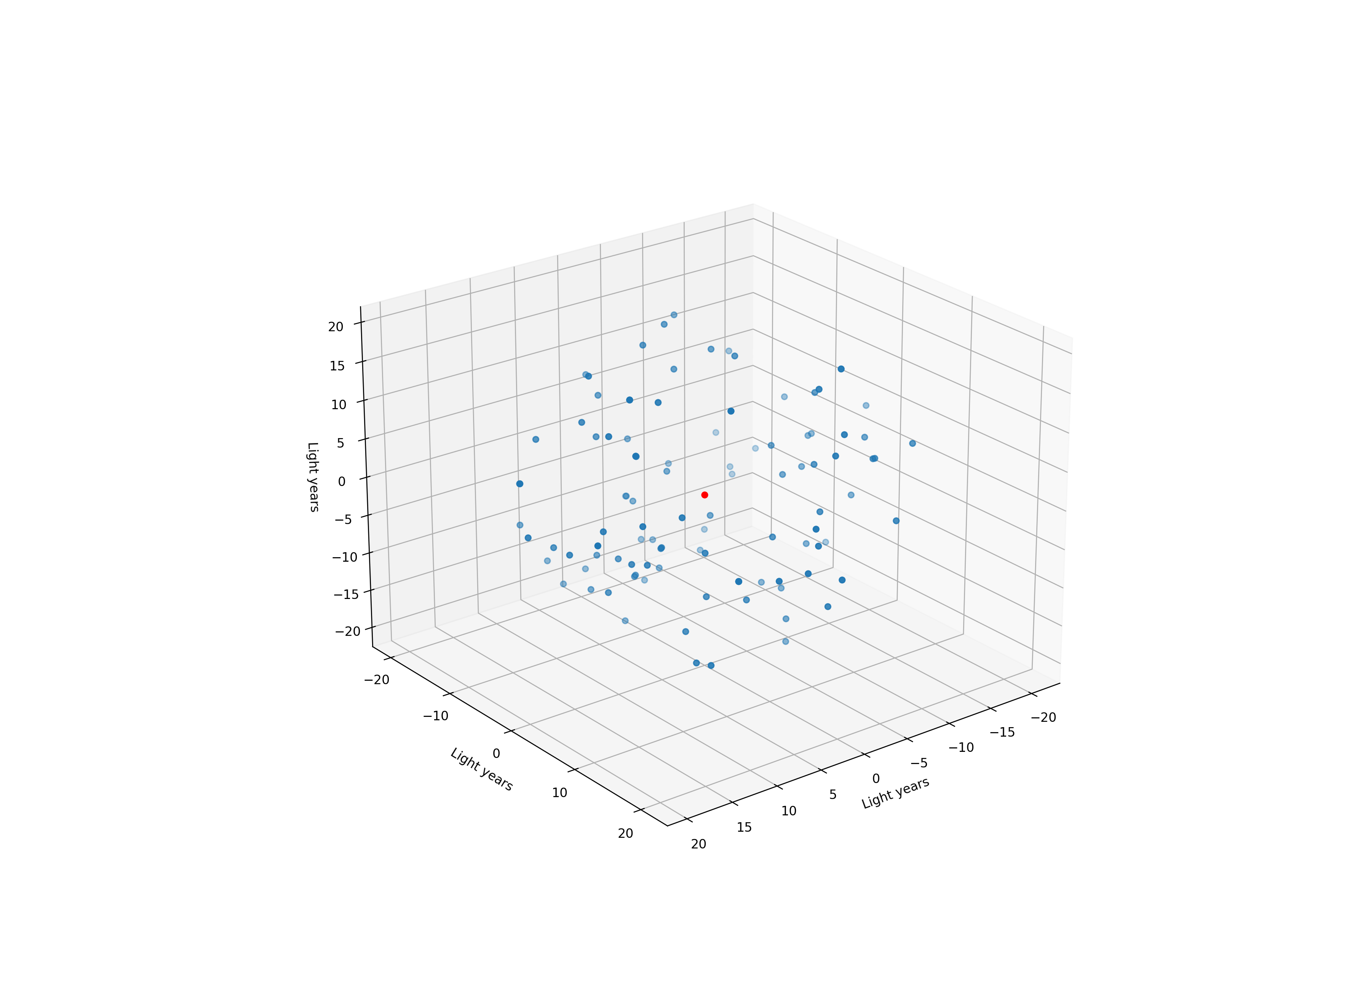

Slide 9
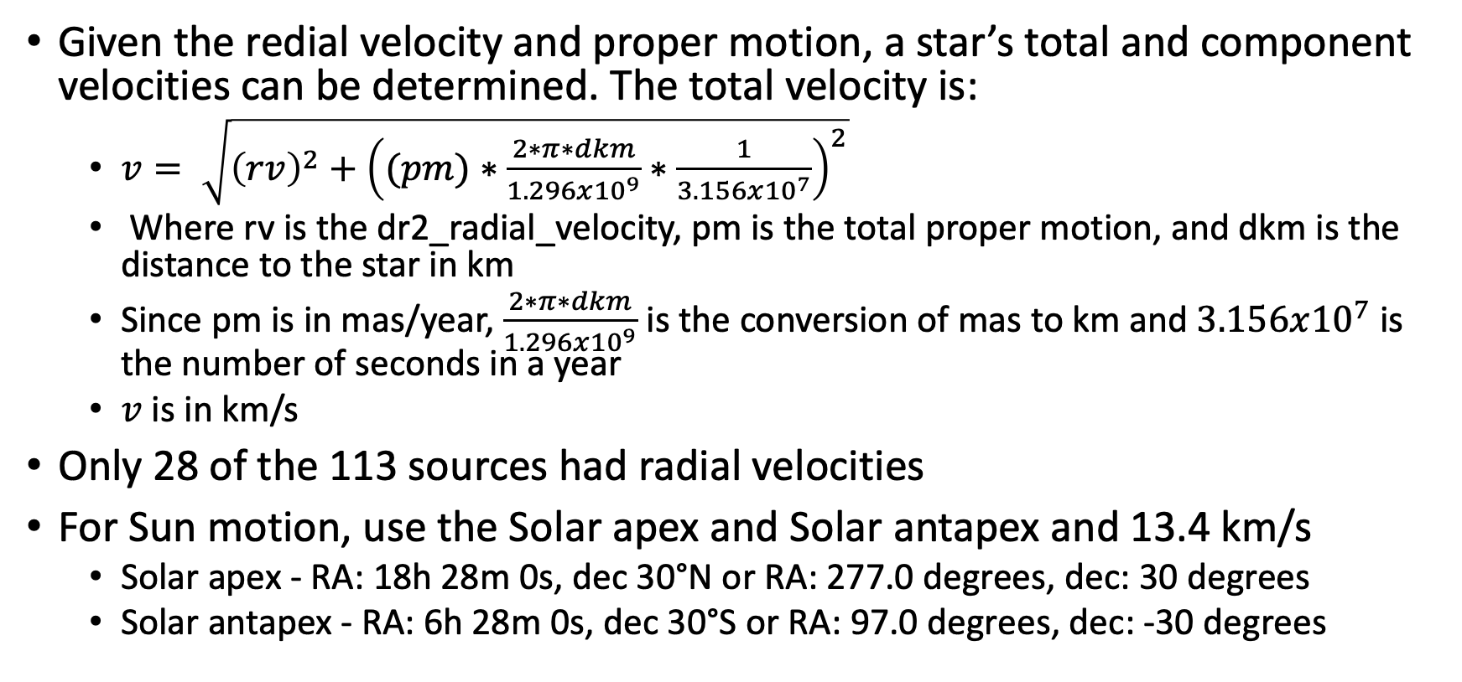
Stellar Velocity
Given the redial velocity and proper motion, a star’s total and component velocities can be determined. The total velocity is:
$v= \sqrt{{\left(rv\right)}^{2}+{\left((pm)∗\frac{2∗π∗dkm}{1.296x{10}^{9}}∗\frac{1}{3.156x{10}^{7}}\right)}^{2}}$
Where rv is the dr2_radial_velocity, pm is the total proper motion, and dkm is the distance to the star in km
Since pm is in mas/year, $\frac{2∗π∗dkm}{1.296x{10}^{9}}$ is the conversion of mas to km and $3.156x{10}^{7}$ is the number of seconds in a year
$v$ is in km/s
Only 28 of the 113 sources had radial velocities
For Sun motion, use the Solar apex and Solar antapex and 13.4 km/s
Solar apex - RA: 18h 28m 0s, dec 30°N or RA: 277.0 degrees, dec: 30 degrees
Solar antapex - RA: 6h 28m 0s, dec 30°S or RA: 97.0 degrees, dec: -30 degrees

Slide 10
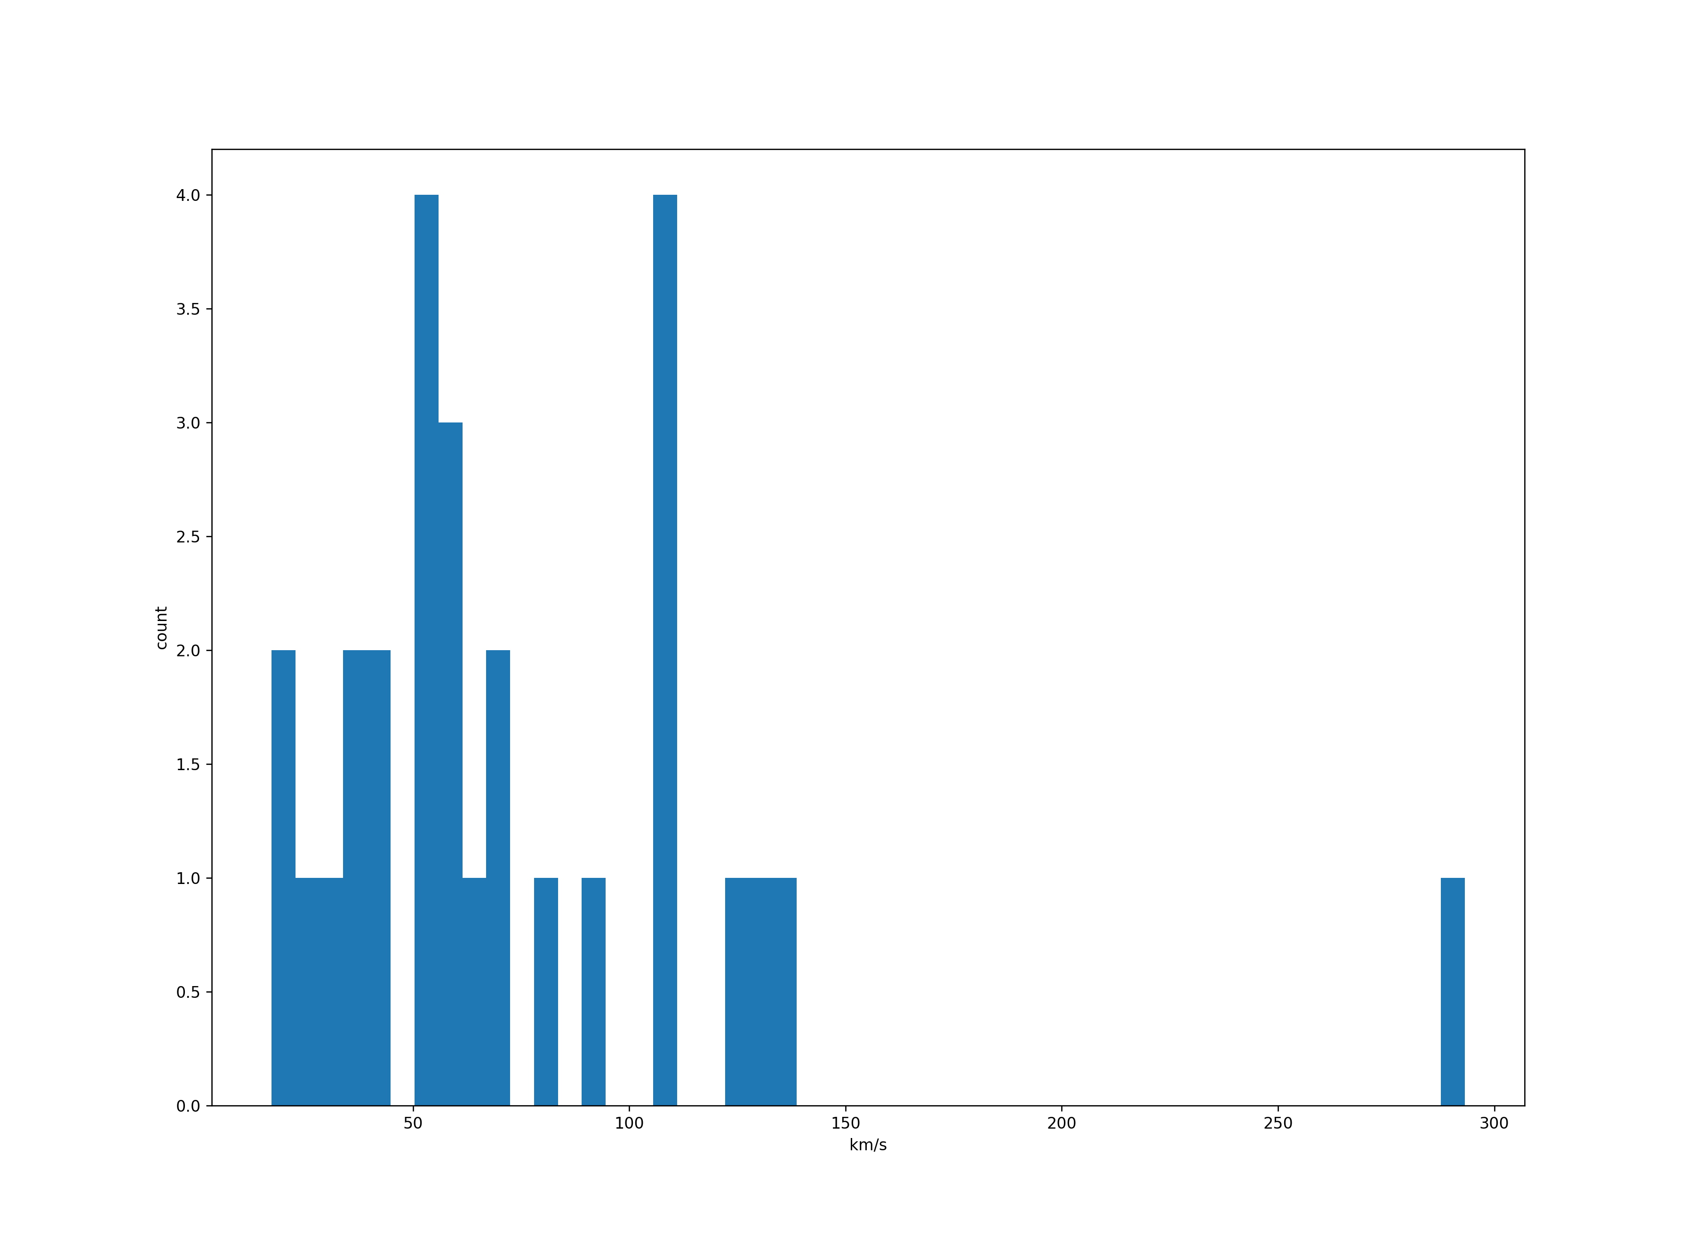
Distribution of Radial Velocities

Slide 11
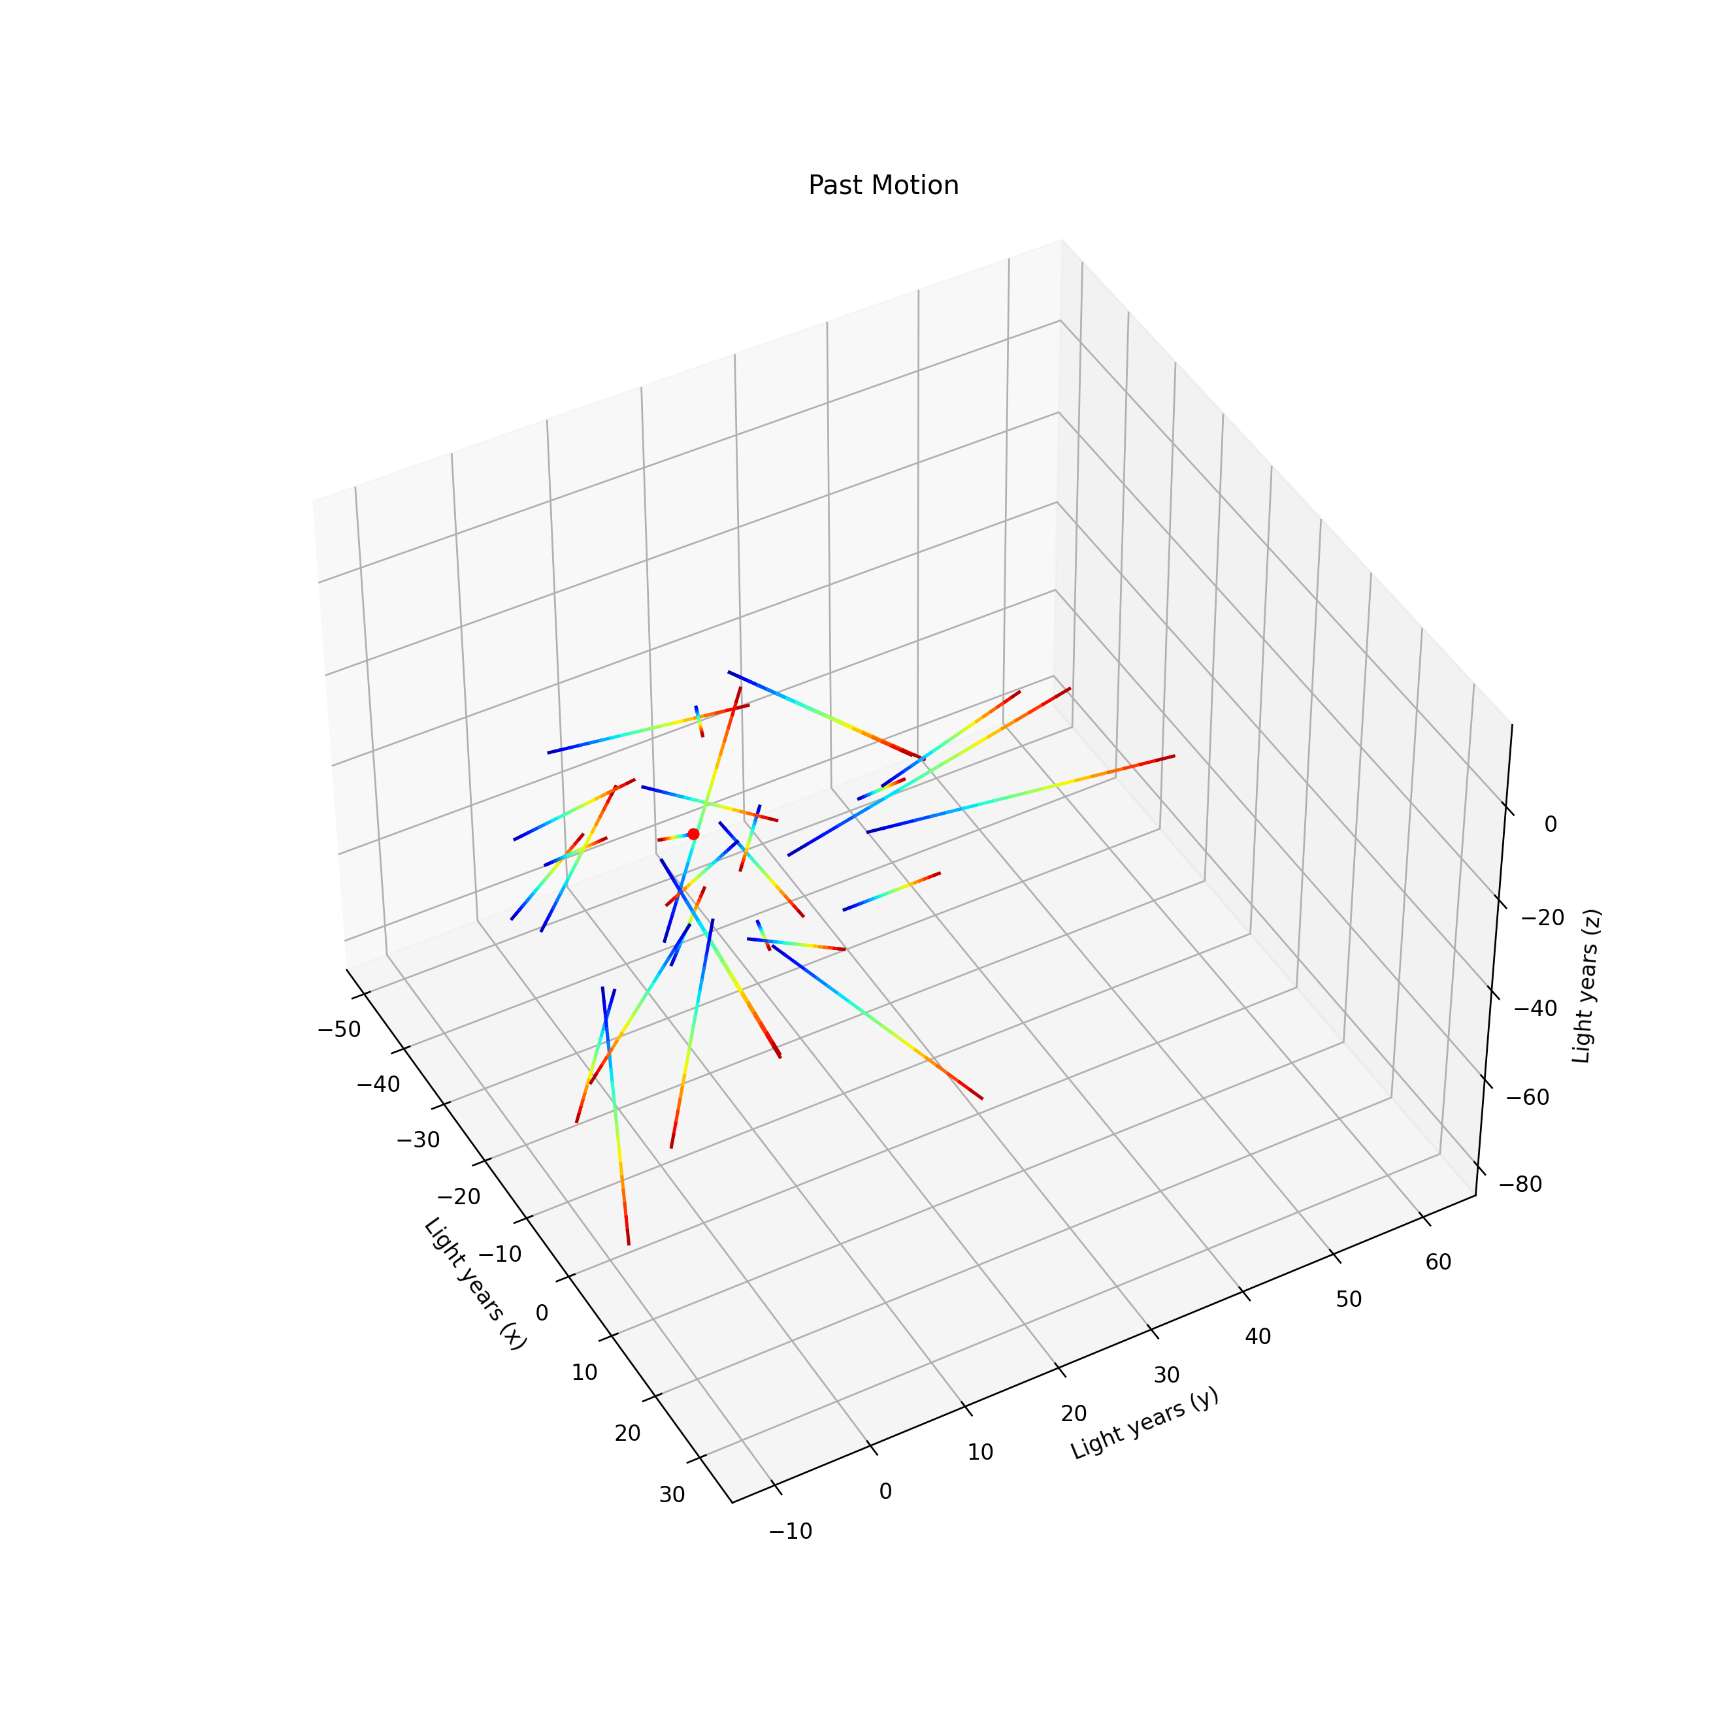

Slide 12
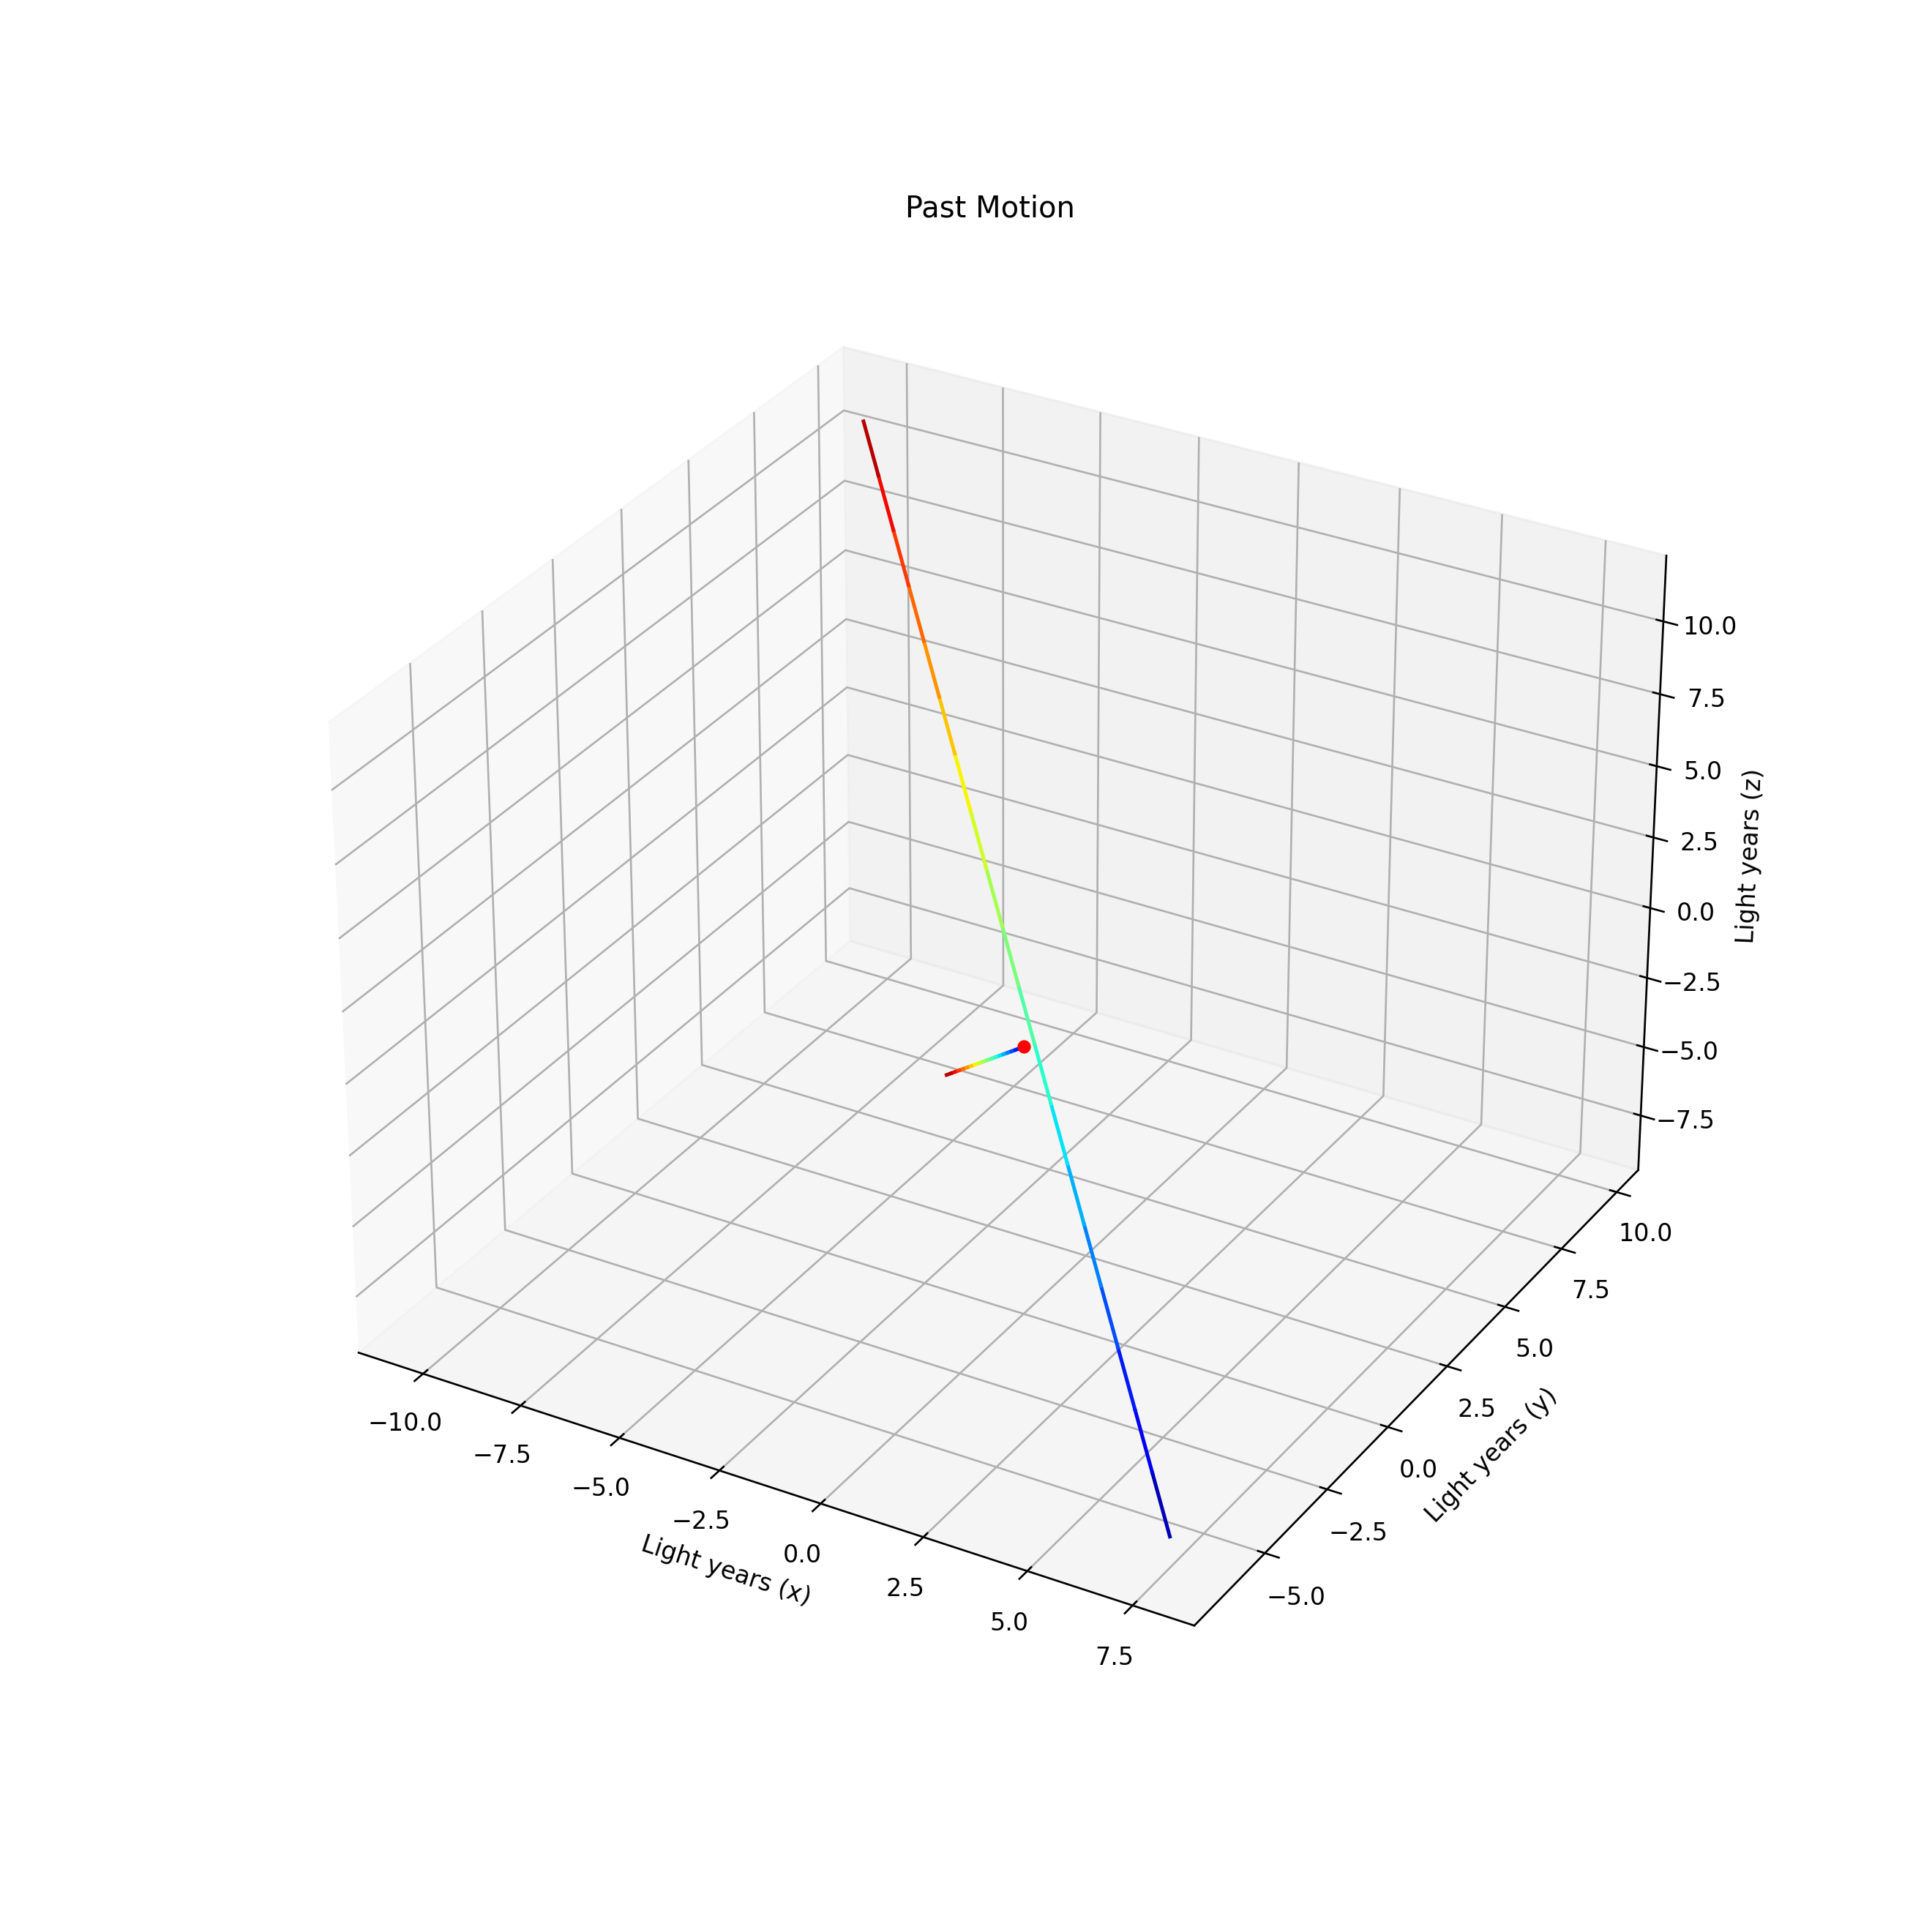

Slide 13
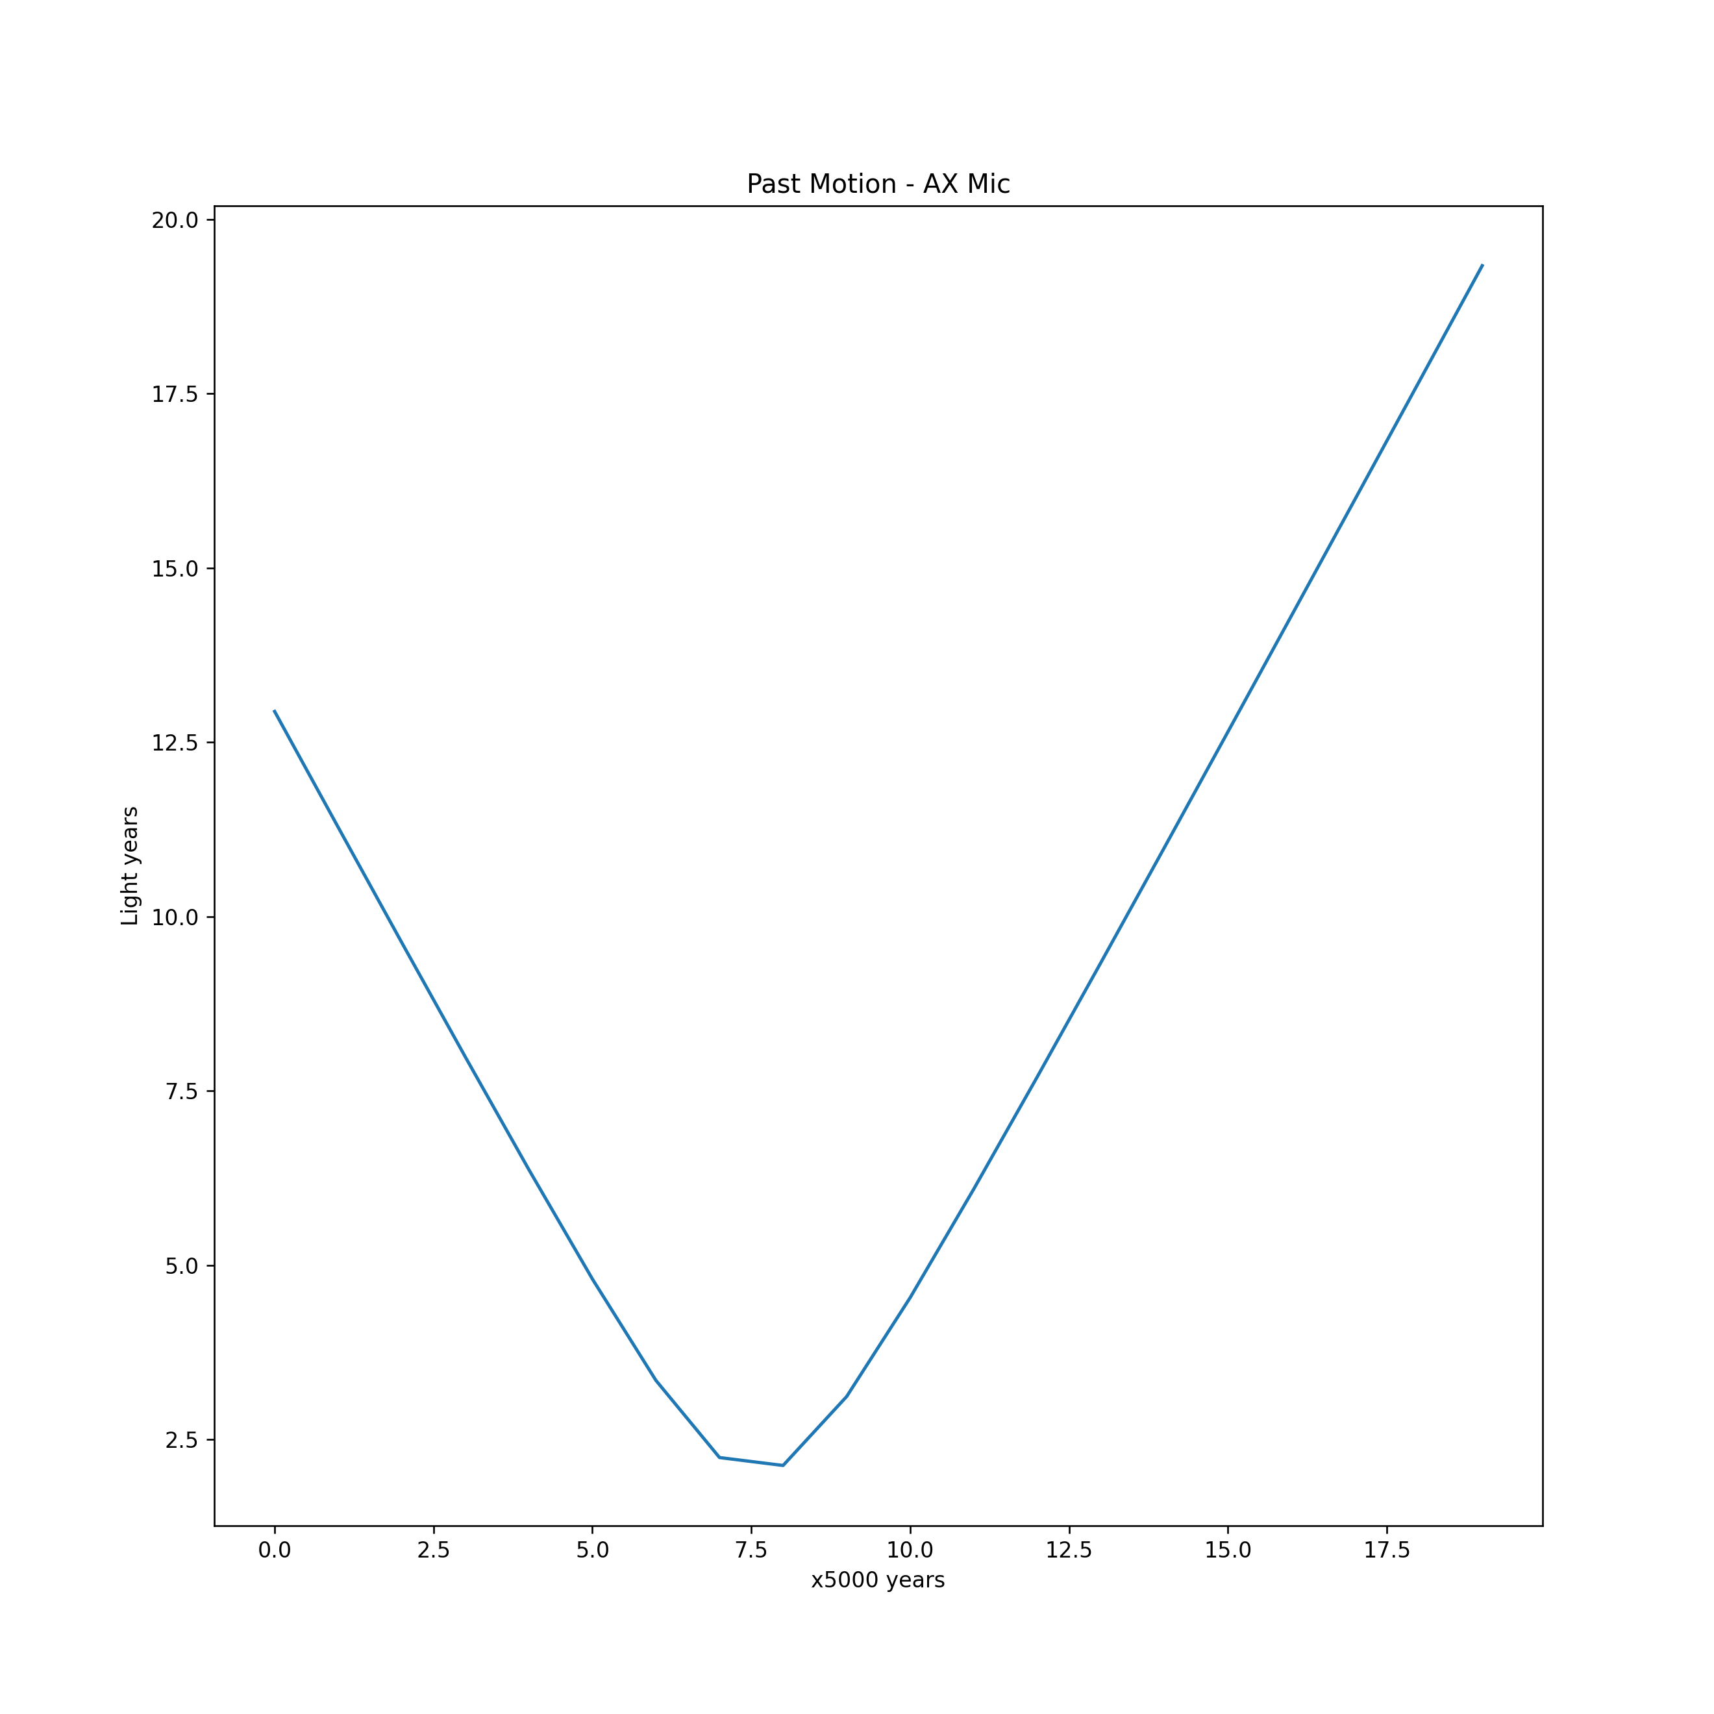

Slide 14
Located Star with Stellarium
ra: 21^{h} 17^{m} 15.2697^{s} , dec: −38° 52′ 02.502″
In the constellation Microscopium
Lacaille 8760, AX Mic, HIP 105090, SAO 212 886, HD 202560
Red Dwarf
12.9 light years away
rv = 20.56 km/s, pmra = -3258.97 mas/yr, pmdec = -1145.86 mas/yr
Came within 12 ly of sun 20,000 years ago
Plot shows a much closer approach, so missing something

Slide 15
Hertzsprung–Russell diagram
Gaia data also includes
phot_g_mean_mag : G-band mean magnitude (float, Magnitude[mag])
phot_bp_mean_mag : Integrated BP mean magnitude (float,[mag])
phot_rp_mean_mag : Integrated RP mean magnitude (float, Magnitude[mag])
bp_rp : BP - RP colour (float, Magnitude[mag])
bp_g : BP - G colour (float, Magnitude[mag])
g_rp : G - RP colour (float, Magnitude[mag])
So plot phot_g_mean_mag vs. g_rp

Slide 16
Messier 13
For Messier 13
ra: 16^{h} 41^{m} 41.24^{s} = 16.6948
dec: +36° 27′ 35.5″ = 36.460
Apparent dimension: 20 arcminutes = 0.333 degree
Gaia data query
job1 = Gaia.launch_job_async("SELECT * FROM gaiaedr3.gaia_source WHERE CONTAINS(POINT('ICRS',gaiaedr3.gaia_source.ra,gaiaedr3.gaia_source.dec), CIRCLE('ICRS',16.6948,36.460,0.333))=1;", dump_to_file=True, output_format='csv', output_file='m13.csv’)
ICRS is “International Celestial Reference System”
Returned 2972 sources

Slide 17
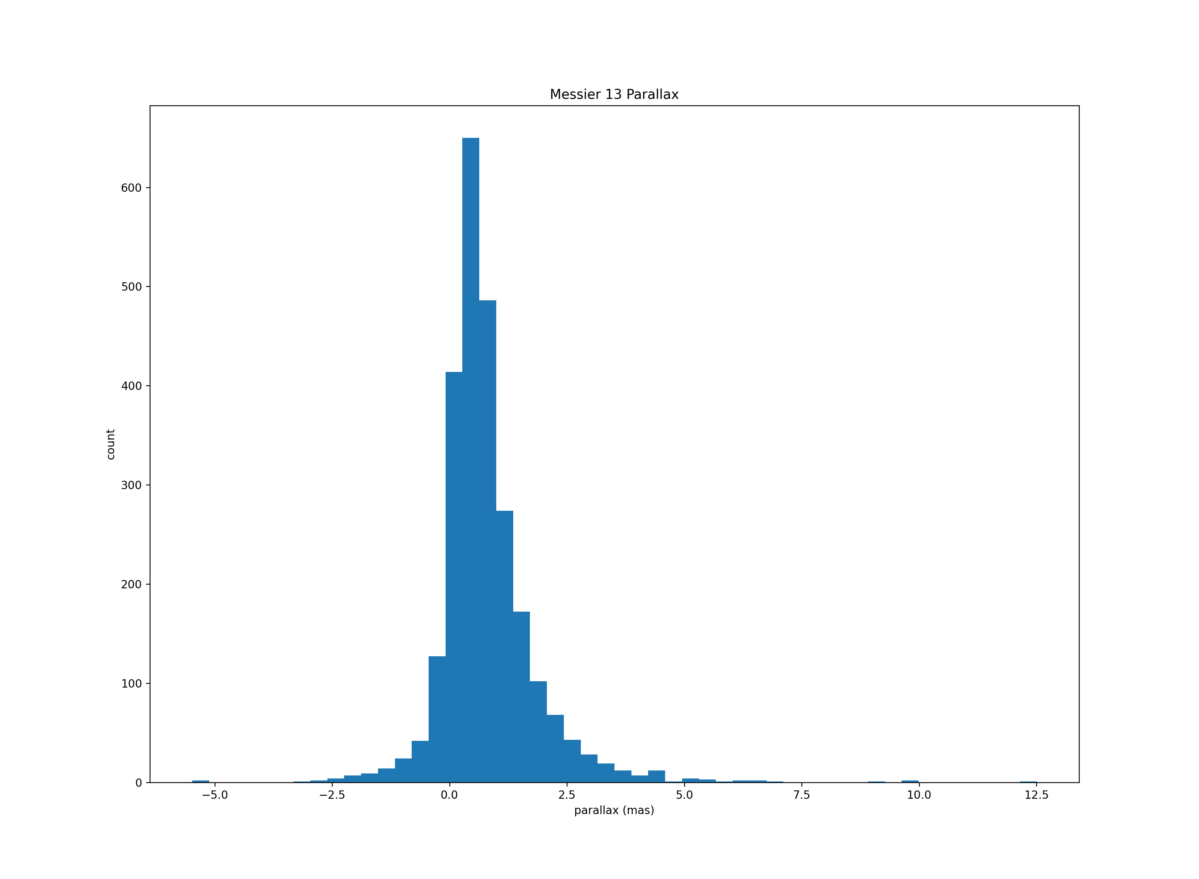

Slide 18
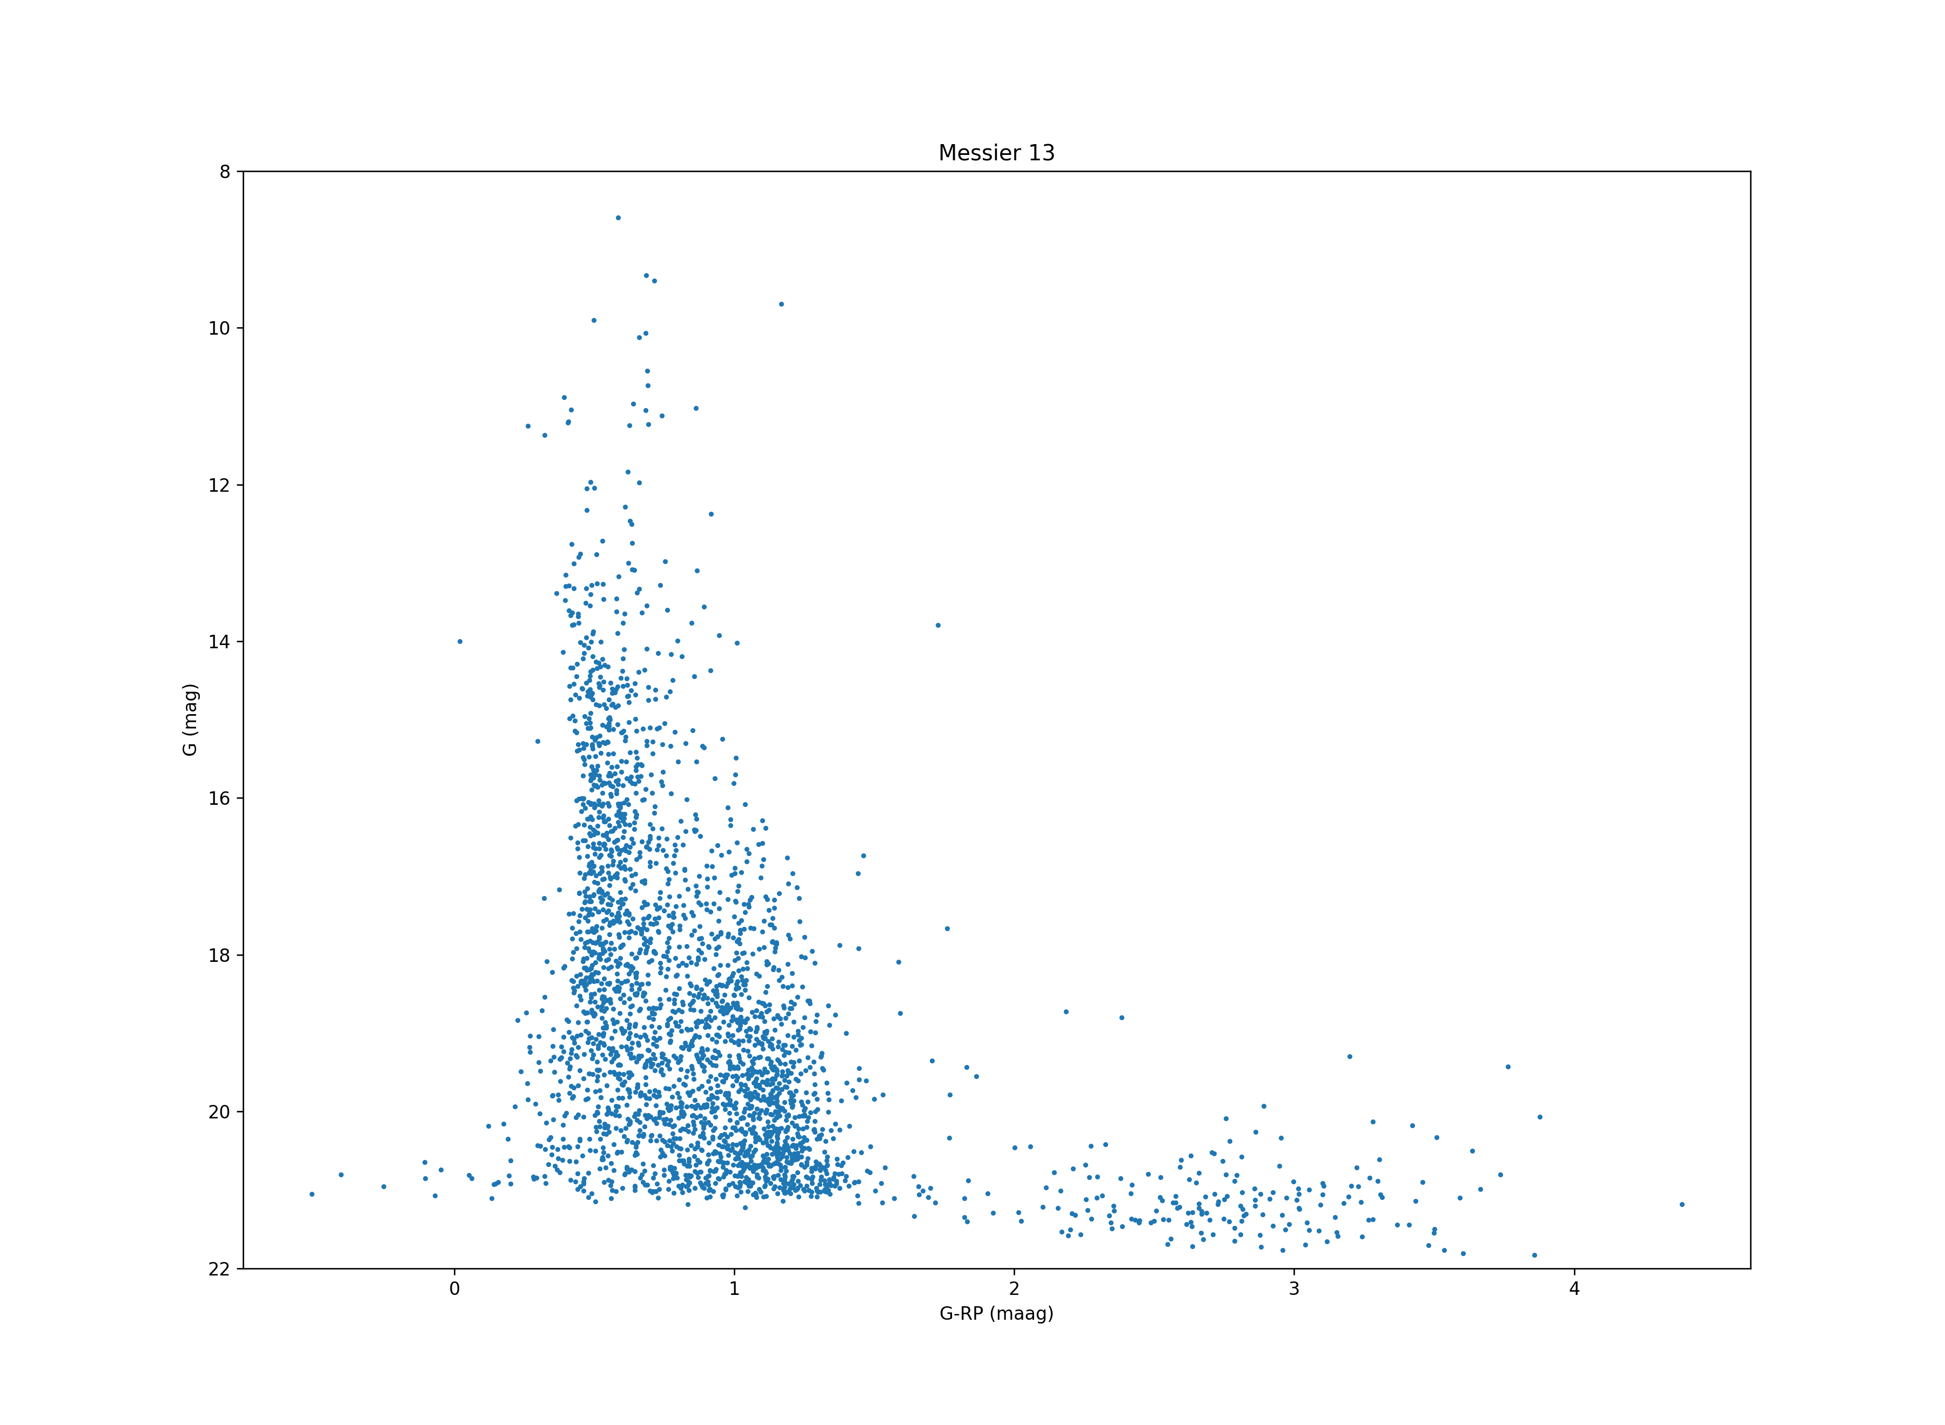

Slide 19
Problems
Distance to M13 is 22.2 kly (6.8 kpc) or parallax of 0.15 mas
Most of the Gaia sources returned are not part of M13

Slide 20
NGC 869 – Recent Astronomy Picture of the Day
ra: 02h 19.1m = 34.775 degrees
dec: +57° 09′ = 57.15 degrees
distance: 7.6 kly or 2.3 kpc (0.435 mas)
apparent dimension: 30′ = 0.5 degrees
Query
job = Gaia.launch_job_async("SELECT * FROM gaiaedr3.gaia_source WHERE CONTAINS(POINT('ICRS',gaiaedr3.gaia_source.ra,gaiaedr3.gaia_source.dec),CIRCLE('ICRS',34.775,57.15,0.5))=1;" , dump_to_file=True, output_format='csv', output_file='NGC869.csv’)
Returns 55687 sources

Slide 21
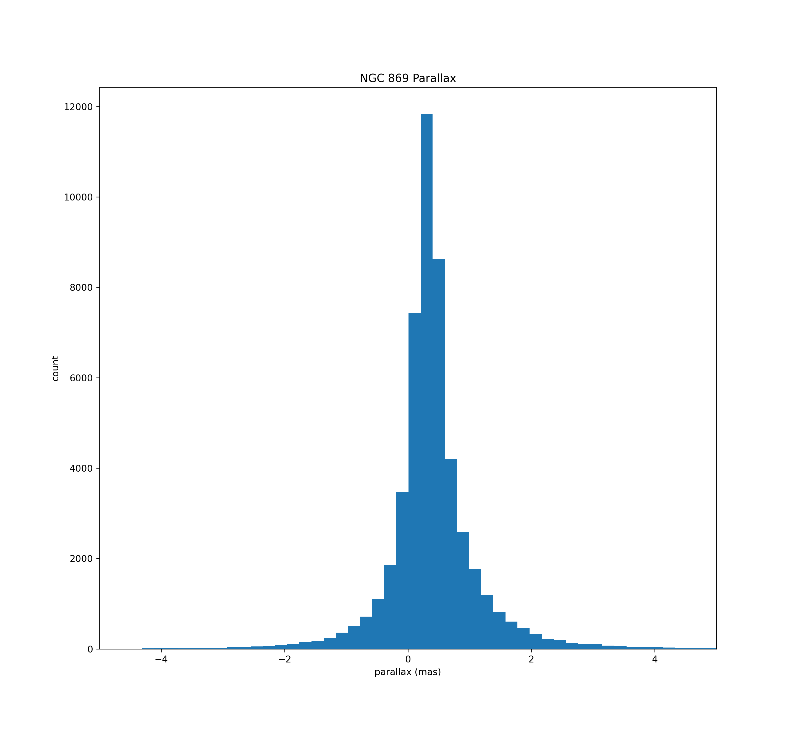
NGC 869 Parallax

Slide 22
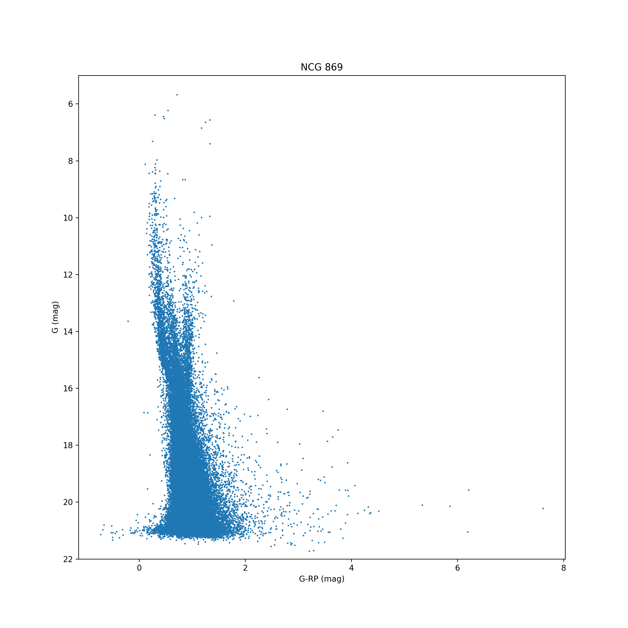
H-R Full

Slide 23
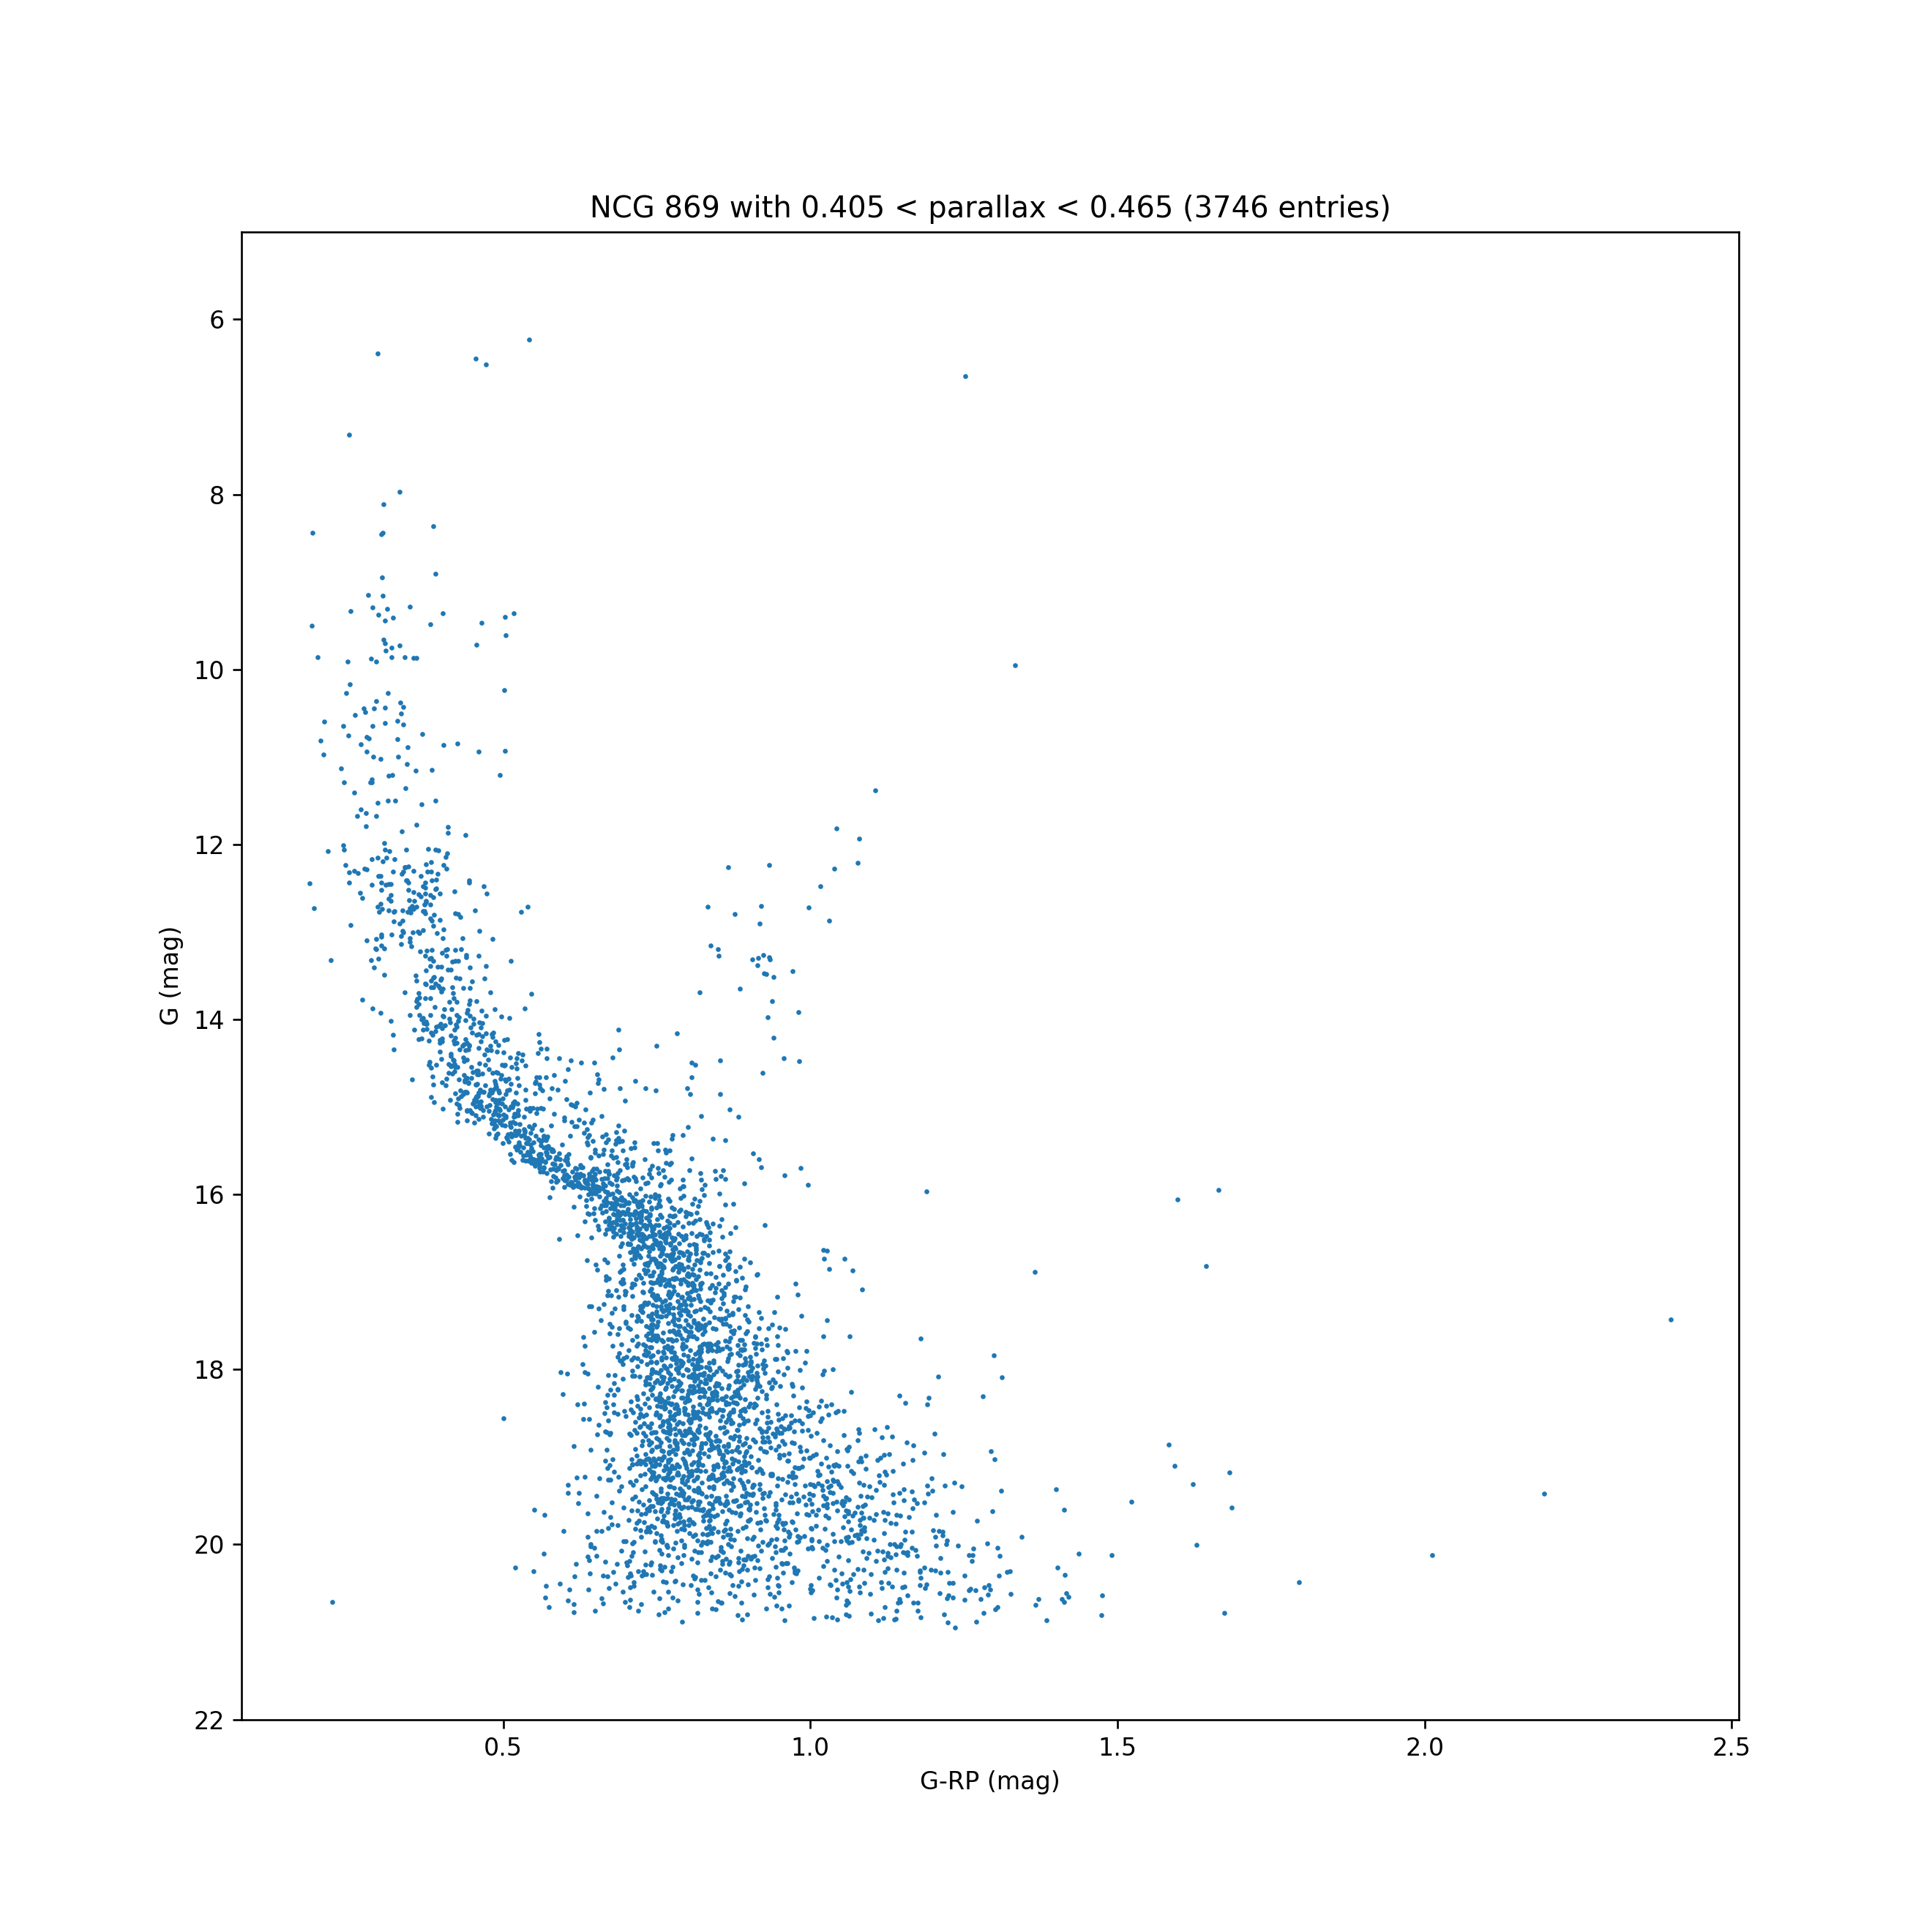
H-R Cut
around 0.435

Slide 24
GaiaEDR3 gaia_source Table Columns
solution_id | designation | source_id | random_index | ref_epoch
ra | ra_error | dec | dec_error | parallax
parallax_error | parallax_over_error | pm | pmra | pmra_error
pmdec | pmdec_error | ra_dec_corr | ra_parallax_corr | ra_pmra_corr
ra_pmdec_corr | dec_parallax_corr | dec_pmra_corr | dec_pmdec_corr | parallax_pmra_corr
parallax_pmdec_corr | pmra_pmdec_corr | astrometric_n_obs_al | astrometric_n_obs_ac | astrometric_n_good_obs_al
astrometric_n_bad_obs_al | astrometric_gof_al | astrometric_chi2_al | astrometric_excess_noise | astrometric_excess_noise_sig
astrometric_params_solved | astrometric_primary_flag | nu_eff_used_in_astrometry | pseudocolour | pseudocolour_error
ra_pseudocolour_corr | dec_pseudocolour_corr | parallax_pseudocolour_corr | pmra_pseudocolour_corr | pmdec_pseudocolour_corr
astrometric_matched_transits | visibility_periods_used | astrometric_sigma5d_max | matched_transits | new_matched_transits
matched_transits_removed | ipd_gof_harmonic_amplitude | ipd_gof_harmonic_phase | ipd_frac_multi_peak | ipd_frac_odd_win
ruwe | scan_direction_strength_k1 | scan_direction_strength_k2 | scan_direction_strength_k3 | scan_direction_strength_k4
scan_direction_mean_k1 | scan_direction_mean_k2 | scan_direction_mean_k3 | scan_direction_mean_k4 | duplicated_source
phot_g_n_obs | phot_g_mean_flux | phot_g_mean_flux_error | phot_g_mean_flux_over_error | phot_g_mean_mag
phot_bp_n_obs | phot_bp_mean_flux | phot_bp_mean_flux_error | phot_bp_mean_flux_over_error | phot_bp_mean_mag
phot_rp_n_obs | phot_rp_mean_flux | phot_rp_mean_flux_error | phot_rp_mean_flux_over_error | phot_rp_mean_mag
phot_bp_n_contaminated_transits | phot_bp_n_blended_transits | phot_rp_n_contaminated_transits | phot_rp_n_blended_transits | phot_proc_mode
phot_bp_rp_excess_factor | bp_rp | bp_g | g_rp | dr2_radial_velocity
dr2_radial_velocity_error | dr2_rv_nb_transits | dr2_rv_template_teff | dr2_rv_template_logg | dr2_rv_template_fe_h
l | b | ecl_lon | ecl_lat

