Slide 1
EIC Project Update
Jim Yeck, EIC Project Director
EIC Users Group Fall Quarterly Meeting
October 28, 2021

Slide 2
Outline
U.S. Department of Energy (DOE) Project Milestones
Project Requirements
Management and Organization
Cost and Funding Plans
CD-2/3A Preparation
Key Challenges and Governance
DOE Review October 19-21
Summary

Slide 3
DOE Project Planning Process*
EIC
*
Operating* Funds
PED
Funds
Construction & PED
Funds
Operating Funds
Initiation
Definition
Execution
Closeout
Conceptual Design
Preliminary Design
Final Design
Construction
Critical
Decisions
CD-0
Approve Mission Need
CD-1
Approve Alternative Selection
and Cost
Range
CD-2
Approve Performance Baseline (PB)
CD-3
Approve Start of Construction or Execution
CD-4
Approve
Start of Operations or Project Completion
EIC Critical Decision Plan
CD-2/3a April 2023
CD-3 July 2024
CD-4a early finish July 2030
CD-4a July 2031
CD-4 early finish July 2031
CD-4 July 2033
Assumption:
3 Months Continuing Resolution (CR)
Project typically receives 1/12 per month during CR
Request
PED Funds
Receive/Spend
PED Funds
* Example
Calendar Year
2019
2020
2021
2022
2023
2024
2025
2026

Slide 4
EIC Recent History and Plans
Event | Date
Mission Need Statement Approved | January 22, 2019
CD-0, Mission Need Approved | December 19, 2019
DOE Site Selection Announced | January 9, 2020
FY2020 Budget Includes EIC TEC and OPC Funding | 1st Quarter FY2020
BNL - TJNAF Partnership Agreement Approved | May 2020
Conceptual Design Review | November 2020
DOE Independent Cost Review (ICR) | Jan. 4 – Feb. 4, 2021
DOE CD-1 Review Date | January 26-29, 2021
CD-1, Alternative Selection and Cost Range, Approved | June 29, 2021
DOE OPA Review and ICR | January 2023
CD-2/3A, Performance Baseline/Long Lead Procurement | April 2023

Slide 5
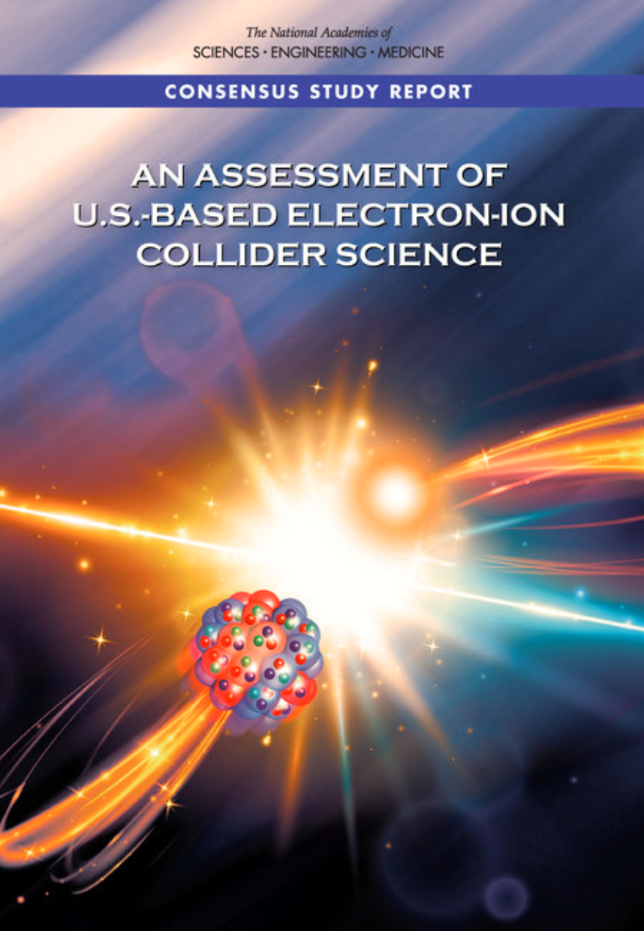
Project Requirements
Project Design Goals
High Luminosity: L= 10³³ – 10³⁴cm⁻²sec⁻¹, 10 – 100 fb⁻¹/year
Highly Polarized Beams: 70%
Large Center of Mass Energy Range: E_{cm} = 20 – 140 GeV
Large Ion Species Range: protons – Uranium
Large Detector Acceptance and Good Background Conditions
Accommodate a Second Interaction Region (IR)
Conceptual design scope and expected performance meets or exceed NSAC Long Range Plan (2015) and the EIC White Paper requirements endorsed by NAS (2018)

Slide 6
BNL/TJNAF Special Partnership
BNL/JLab partnership established in early 2020
Serve together as hosts for the EIC experimental program
Integrated project scope responsibilities recently defined

Slide 7
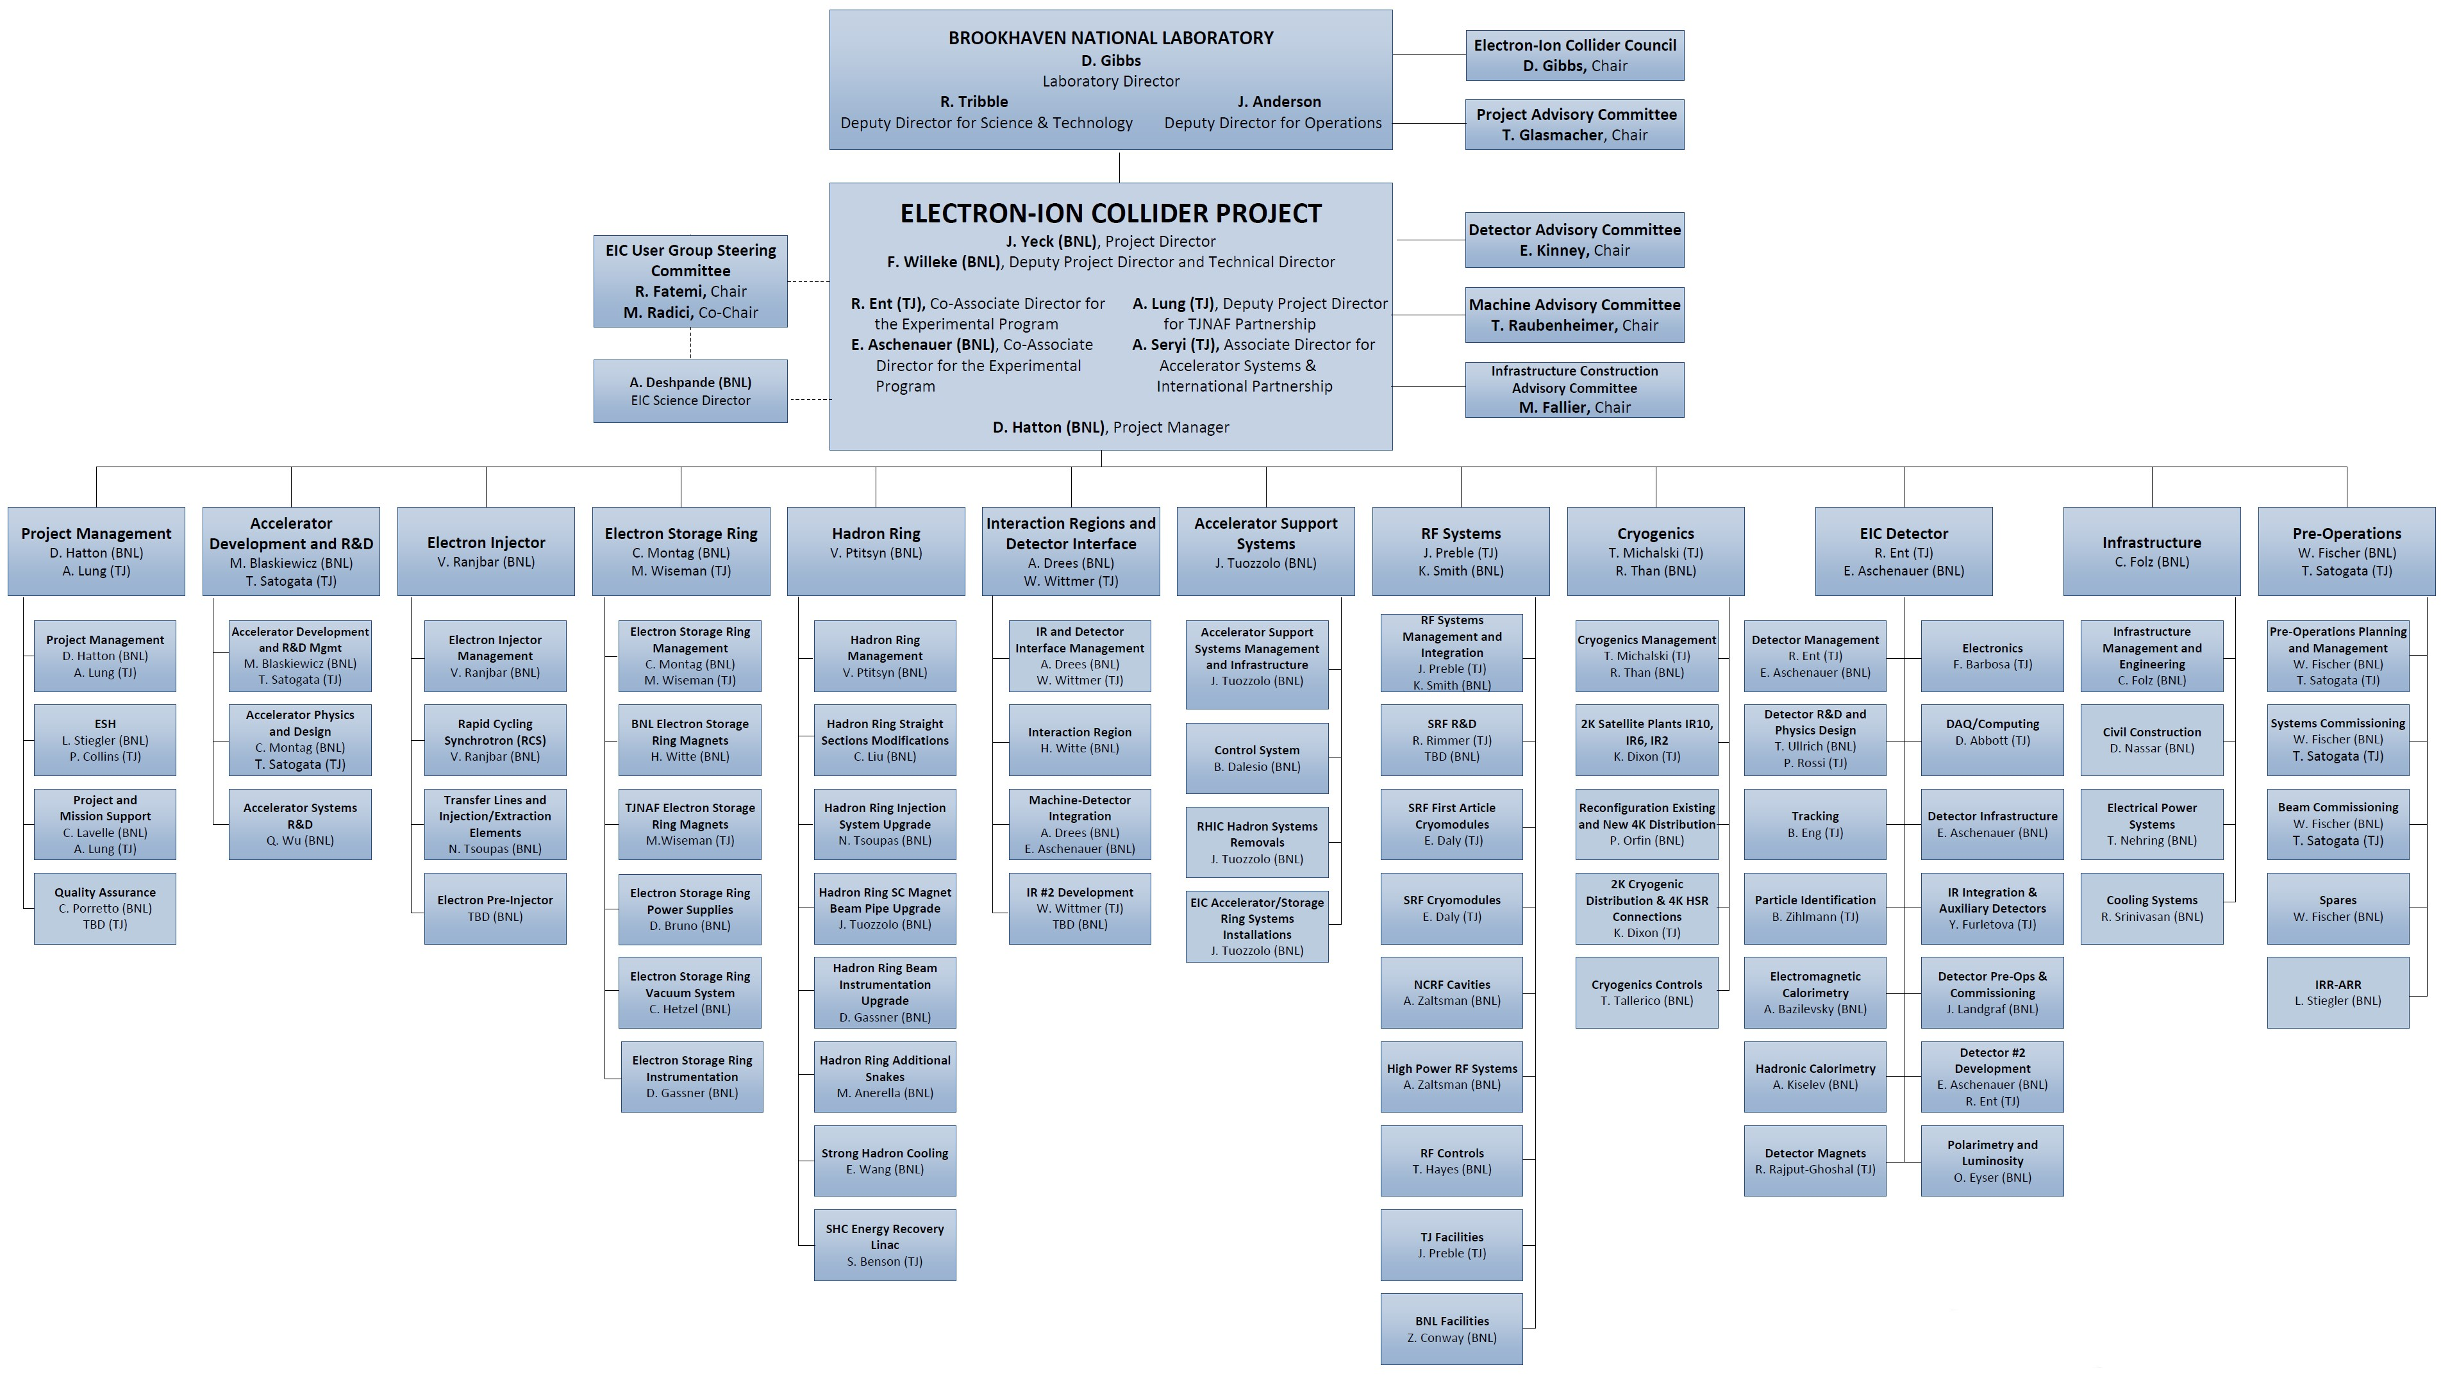
TJNAF Roles and Responsibilities
Responsibilities tied to expertise

Slide 8
EIC Partnerships
New York State
Empire State Development (ESD) Corporation will provide $100M for EIC infrastructure
Critical path infrastructure work can commence with the availability of the NYS funding
NYS ready to proceed
NYS, BNL, and DOE working together to resolve final details on the ESD grant agreement
Architecture and Engineering contract will be awarded in early 2022

Slide 9
EIC Partnerships
International and Domestic Partners
International and domestic partners are being pursued. Bi-lateral meetings with potential partners are underway to discuss opportunities in the accelerator and experimental areas.
Accelerator Partnership (Assuming ~5% In-kind, pursuing 10% goal).
In-kind contributions to the accelerator design and hardware are being pursued and were discussed at the “EIC Accelerator Partnership Workshop” this week
BNL and TJNAF will also engage U.S. domestic partners
Experimental Program Partnership Activities (Assuming ~30% In-kind)
Expressions of Interest (EoI) submitted in 2020
Call for Collaboration Proposals for Detector(s) - March 2021
Collaboration Proposals Due – December 2021
EIC Project Detector Defined – March 2022

Slide 10
EIC Project Organization

Slide 11
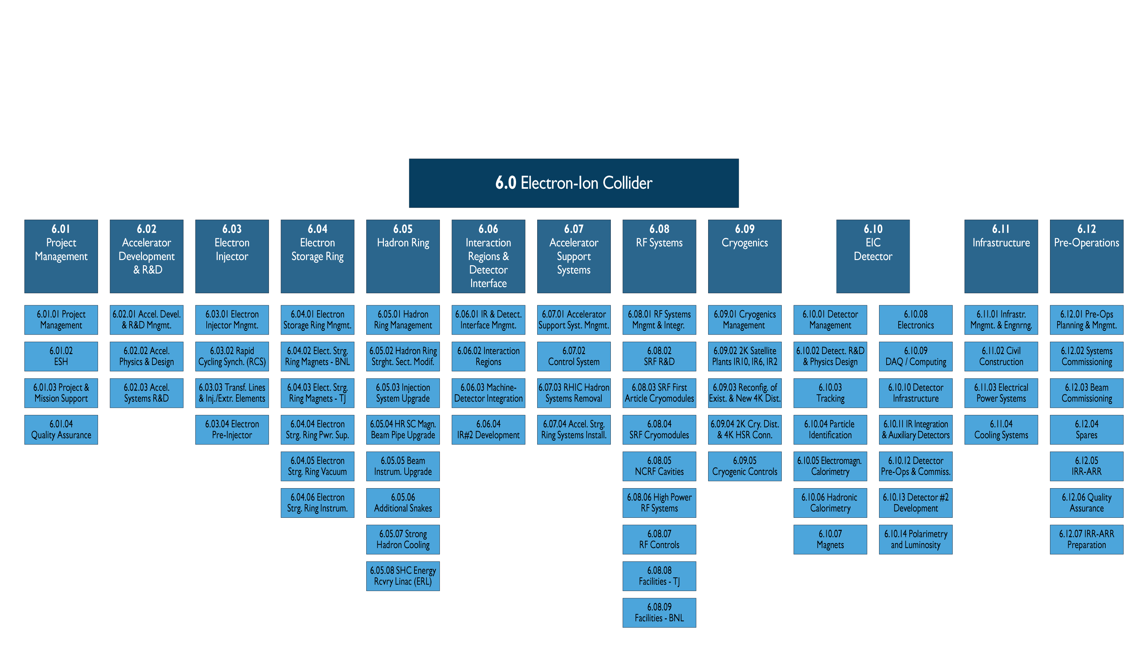
EIC Project Scope
Two new WBS Level 2 Elements led by JLab, RF Systems and Cryogenics Systems

Slide 12
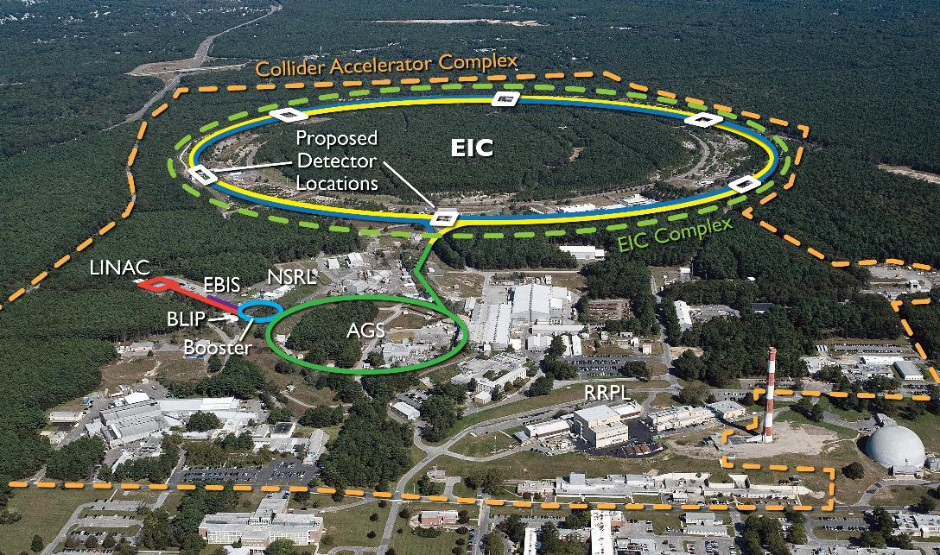
EIC benefits from $B class investments at BNL and the highly successful RHIC program.
RHIC will conclude operations in 2025. EIC installation will begin after RHIC ops concludes.

Slide 13
Total Project Cost @ CD-1
WBS | Description | WBS Manager | Total M$ | DOE M$
6 | Electron-Ion Collider | J. Yeck | $ 1,751 | $ 1,509
6.01 | Project Management | D. Hatton | $ 97 | $ 97
6.02 | Accelerator Dev & R&D | M. Blaskiewicz | $ 66 | $ 66
6.03 | Electron Injector | V. Ranjbar | $ 186 | $ 161
6.04 | Electron Storage Ring | C. Montag | $ 293 | $ 268
6.05 | Hadron Ring | V. Ptitsyn | $ 187 | $ 187
6.06 | Interaction Regions & Detector Interface | G. McIntyre | $ 183 | $ 183
6.07 | Accelerator Support Systems | J. Tuozzolo | $ 216 | $ 216
6.08 | Infrastructure | C. Folz | $ 203 | $ 103
6.09 | Pre-Operations | W. Fischer | $ 75 | $ 75
6.10 | EIC Detector | R. Ent | $ 245 | $ 152
$100M contribution from New York State
$ ~93M anticipated detector in-kind
$ ~49M anticipated accelerator in-kind
Additional Contingency $~640M (40%)

Slide 14
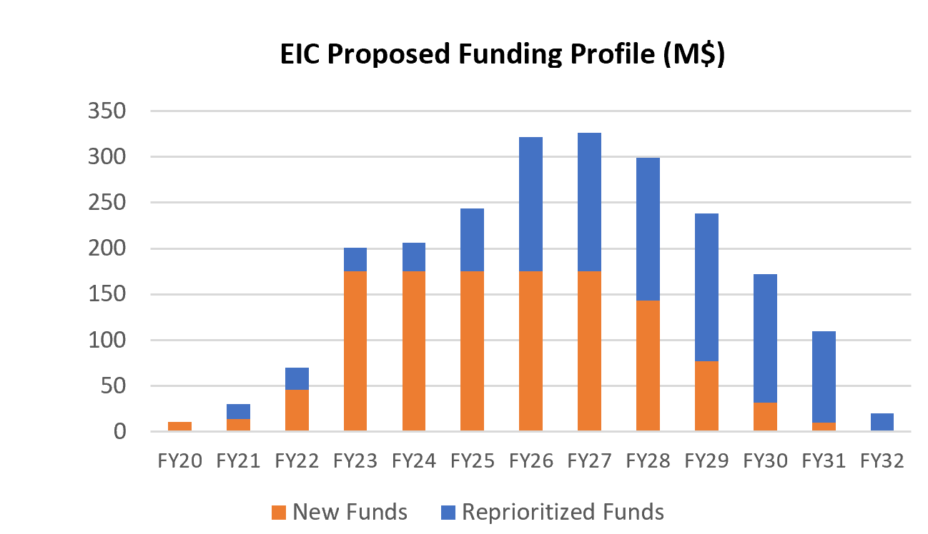
DOE Funding Profile

Slide 15
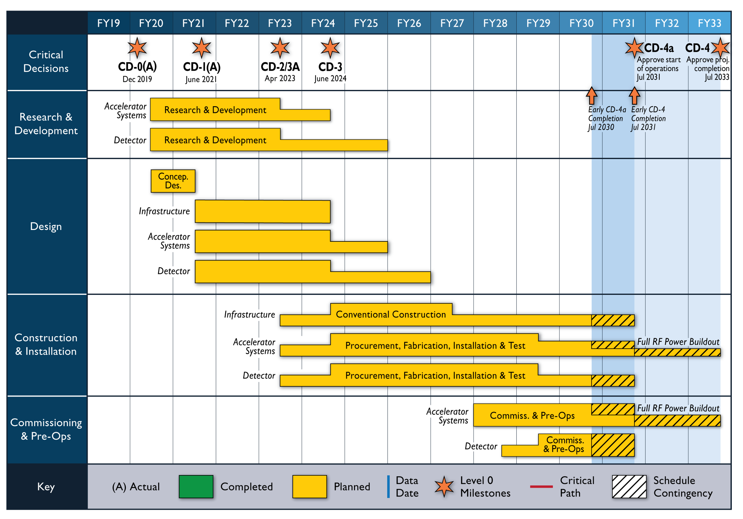
Reference Schedule

Slide 16
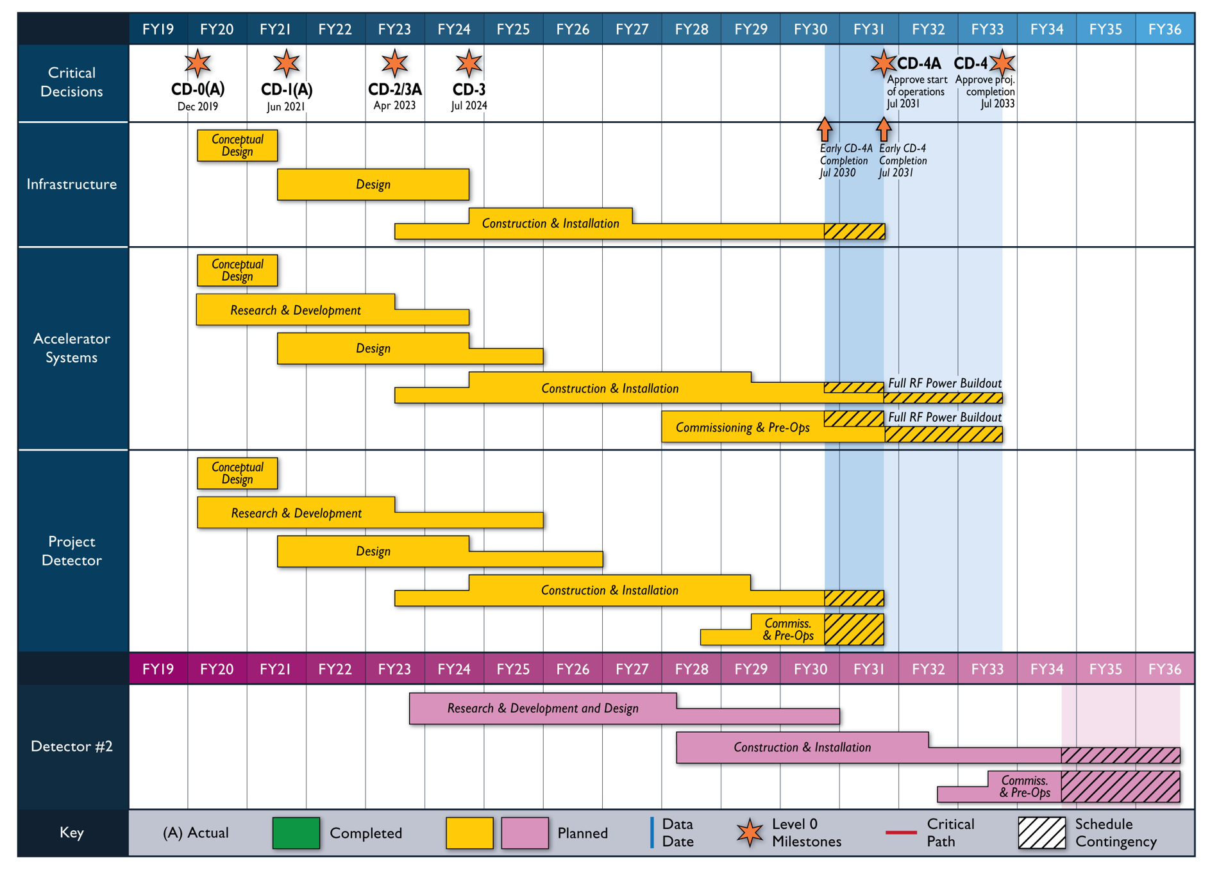
Reference Schedule
Notional Schedule
2nd IR and
Schedule
Generic Detector R&D

Slide 17
CD-2/3A Preparation
Assumptions
DOE FY2022 funding is $70 million (possibilities range from $30M to $806M!)
CD-2/3A approval in April 2023
Schedule
DOE Status Review (confirm CD-2/3A goals) October 19-21, 2021
DOE Status Review (confirm OPA/ICR review plans) April (TBD) 2022
Preliminary Design Complete November 2022
Final Design/Maturity Readiness for CD-3A Items November 2022
Preliminary Design Review November 2022
Director’s Review December 2022
DOE OPA Review and ICR January 2023
$$√$$

Slide 18
DOE Review Charge Questions
Is risk planning adequate and comprehensive given the project’s current stage of development? Is R&D, and are design efforts, yielding sufficiently advanced designs and mitigating technical risks, particularly in strong hadron cooling?
Is the project properly managed? Is the progress made integrating scope between BNL and TJNAF appropriate and sufficiently advanced for the project to attain CD-2/3A as planned?
Is the project on a path to successfully realize the expected international in-kind contributions to both the accelerator and detector?
Is the plan to develop the performance baseline, and to complete a final design for long lead procurement items, reasonable? Is the project on track to attain CD-2/3A according to its schedule?
Has the project satisfactorily addressed recommendations from previous reviews?
$$√$$
$$√$$
$$√$$
$$√$$
$$√$$

Slide 19
DOE Review Recommendations
Evaluate the lessons learned from each CeC Pop run, including the role of the EIC project input to the experiment, and develop an EIC project path forward that includes a timely PoP demonstration of SHC. This should be presented at the next OPA review.
Assess the requirements for pre-cooling at a lower energy both to complement SHC and to offer contingency in case the SHC performance falls below expectation; report by the next OPA review.
Pursue commitments on accelerator in-kind contributions before CD-2/CD-3A.Develop a mitigation plan - with cost and schedule - to support Rutherford cable production in house by CD2-CD3A.
Pursue formal commitments for in kind contributions before CD-2. (Detector SubCommittee)
By the end of January 2022 to support the start of preliminary design, validate the scope of CD-3a to ensure it includes the long lead electrical procurements (LLP), electrical overhead line and electrical substation installation.
Award the A/E design contract by end of January 2022.
Complete evaluation of the impacts of revised escalation rates and provide an update at the April 2022 status review.
By the CD-2 review, develop and present a technical maturation plan which highlights technical status at each critical decision, the residual risks after the Critical Decisions, and supports why those risks are manageable. It would be advisable to present progress on this at the next IPR.
At the next review, present the expectations for status of international agreements (binding and planning documents) at the time of CD-2.

Slide 20
Key Project Challenges
Affordability and DOE Funding Profile
Project cost control must remain a priority
Accelerator Science and Technology
Complex machine requiring a collaborative approach to identify and address the technical issues
BNL and JLab are working to engage international and domestic partners in these efforts
Infrastructure Schedule
Initial pacing scope for the project with significant NYS funding
Requires EIC technical teams to deliver timely requirements
Project Detector Baseline
Need clarity in the next six months on the detector scope, cost, schedule, collaboration and institutional responsibilities, and a commitment to engage the EIC user community

Slide 21
EIC Governance
EIC is a DOE project, with traditional DOE accountability structure
DOE and BNL/JLab vision is a facility for the world and fully international in character
DOE continues meetings and discussion with international funding agencies on cooperation and collaboration and is pursuing government to government agreements
BNL established an EIC Council (BNL and JLab Directors as founding members) and ready to include potential partners
The governance of the experimental program requires input from the EICUG, the collaborations, the host labs, and the funding agencies. My perspective is that it should be similar to the CERN RRB model which has many benefits.
We need to define the governance model within a year.

Slide 22
Summary
CD-1 approval was a major accomplishment!
CD-2 and CD-3A approval will be an even bigger challenge, and dependent on funding, design progress, further development of the organization including in-kind partners, and effective implementation of risk mitigation strategies.
Plans for the project detector must mature rapidly to support CD-2/3A goals. Keep up your good work!

Slide 23
Backup Slides

Slide 24
Project Advisory Committee (PAC)
Name | Affiliation
Halina Abramowicz | Tel Aviv University
Thomas Glasmacher (Chair) | MSU/FRIB
Barbara Jacak | LBNL/UCB
Jay Marx | Caltech/LIGO-retired
Lia Merminga | FNAL
Elmie Peoples-Evans | ANL
Mark Reichanandter | SLAC-retired
Meetings: August 17, 2021, April 29-30, 2021, December 1, 2020, August 27, 2020

Slide 25
Machine Advisory Committee (MAC)
Name | Affiliation | Focus Area
Desmond Barber | DESY | Electron Polarization
Manuela Boscolo | Frascati Lab, LNF INFN | High Luminosity Colliders
Fabio Casagrande | FRIB | Cryo
Elena Chapochnikoa | CERN | RF Impedance
Frank Gerigk | CERN | SCRF
Oide Katsunobu | CERN- retired | Collider-Accelerator Physics
Sergei Nagaitsev | FNAL | Cooling
Soren Prestemon | LBNL | Magnets
Tor Raubenheimer (Chair) | SLAC | Collider-Accelerator Physics
David Rubin | Cornell University | Collider-Accelerator Physics
Frank Zimmermann | CERN | Collider-Accelerator Physics
Meetings: September 21-23, 2021, August 26, 2020

Slide 26
Detector Advisory Committee (DAC)
Name | Affiliation
Etiennette Auffray | CERN
Edward Kinney (Chair) | University of Colorado
Peter Kriẑan | University of Ljubljana
Ana Amelia Machado | University of Campinas
Greg Rakness | Fermilab
Werner Riegler | CERN
Ewa Rondio | National Centre for Nuclear Research
Heidi Schellman | Oregon State University
Brigitte Vachon | McGill University
Andrew Vachon | University of Texas at Arlington
Chi Yang | Shandong University
Glenn Young | BNL
Meetings: March 24-26, 2021, December 18, 2020, September 28-29, 2020

Slide 27
Infrastructure Construction Advisory Committee (ICAC)
Name | Affiliation
Steve Cannella | BNL
Peggy Caradonna | BNL
Marty Fallier (Chair) | BNL-retired
Elaine McCluskey | FNAL
Jack Stellern | ORNL-retired
Meetings: September 20, 2021

Slide 28
EIC Council
Name | Affiliation
Doon Gibbs | Brookhaven National Laboratory
Stuart Henderson | Thomas Jefferson National Accelerator Facility
The purpose of the EIC Council is to address issues affecting scope and/or resource allocation for the EIC project at BNL and at Partner institutions. The EIC Council advises the BNL Director on areas such as organization, scope, schedule, collaboration, and international engagement.
EIC Council meets nominally twice per year
Meetings: 26 April 2021, 1 December 2020, 25 June 2020

