Slide 1
EIC Solenoidal Magnet Design
Progress
V.Calvelli
Contributors
CEA : V. Calvelli, C. Berriaud, C.Mayri, M. Segreti, F. Stacchi, L. Quettier
JLAB : R. Rajput-Ghoshal, R. Fair, G.Probir, E. Sun, R. Ent BNL : E. Aschenauer, A. Kiselev
27th OCTOBER 2021
Notes:
Saisir les champs « Titre », « P. Nom » et « Date.
Laisser ou retirer le bandeau.

Slide 2
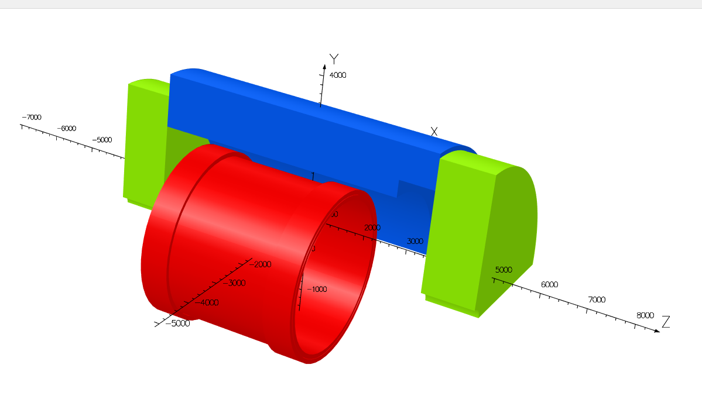
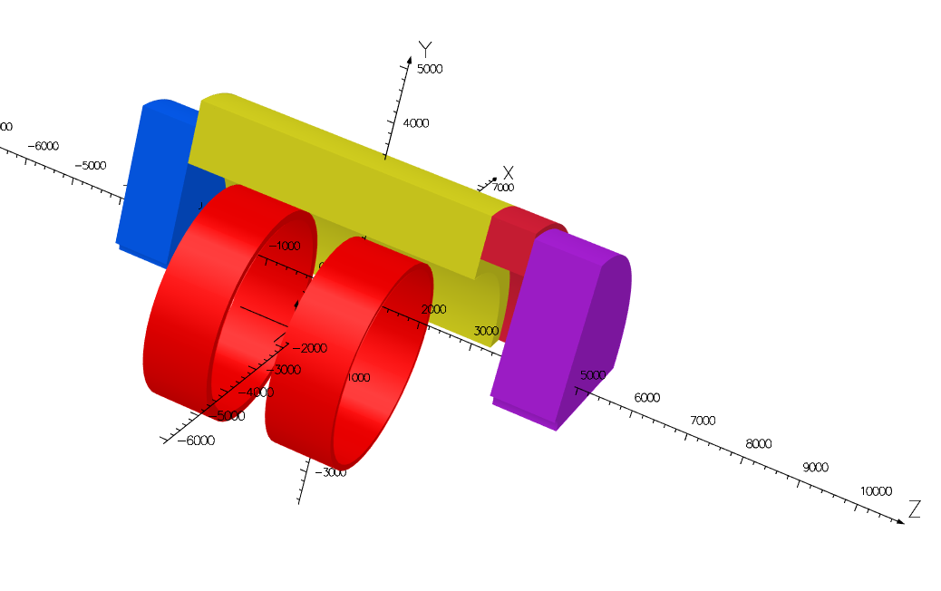
Open questions from summer 2021
Solenoidal configuration
Helmholtz configuration
Open questions:
Which magnet design? - Solenoidal Configuration - Helmholtz Configuration
What kind of conductor? - NbTi Rutherford with Al stabilizer - NbTi Rutherford with Cu stabilizer
What is the impact of the calorimeters?
How to reduce the asymmetrical forces (1.3 MN)?
BS
CS
FS
BS
FS
25.3 tons
73.1 tons
Parameter | Values
B_{IP} (T) | 3.15
B_{peak} (T) | 4.35
Coil thickness (mm) | 200
Energy (MJ) | 183.9
H TCP 2 (%) | 6.61
H FLAT 1 (%) | 25.12
Projectivity (T/Amm²) | 14.82
Parameter | Values
B_{IP} (T) | 2.97
B_{peak} (T) | 4.84
Coil thickness (mm) | 200
Energy (MJ) | 235.7
H TCP 2 (%) | 4.83
H FLAT 1 (%) | 16.37
Projectivity (T/Amm²) | 17.51
Easier to wind
Lighter & more transparent
Few producers in the world
Magnetic field map released 07/05/2021
Magnetic field map released 28/05/2021
SOLENOID
ATHENA Proposal Committee-detector concept&integration sub-group – October, 27 2021
DIRC

Slide 3
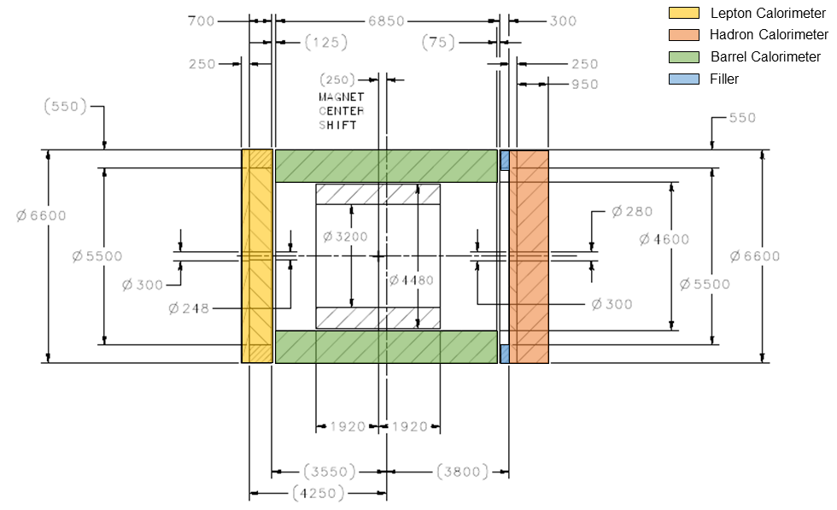
ANSWERS
Solenoidal configuration
Re-arrangement of the calorimeters material composition
Adjustment of the magnet position
Adjustment of the calorimeters position
BS
CS
FS
Parameter | Values
B_{IP} (T) | 3.15
B_{peak} (T) | 4.35
Coil thickness (mm) | 200
Energy (MJ) | 183.9
H TCP 2 (%) | 6.61
H FLAT 1 (%) | 25.12
Projectivity (T/Amm²) | 14.82
To balance the forces between the calorimeters and the magnet
SOLENOID
ATHENA Proposal Committee-detector concept&integration sub-group – October, 27 2021
DIRC

Slide 4

SOCRATE
SOlenoidal Coils with Rutherford cAble in nbTi for the EIC
SOLENOID
ATHENA Proposal Committee-detector concept&integration sub-group – October, 27 2021
DIRC

Slide 5
THE ENVIRONMENT OF SOCRATE – THE CALORIMETERS
Respect to the version of July
Total length is now 9500 mm
Barrel Hcal is:
Symmetric respect to the IP
50 cm longer
Magnet is shifted
of Z = -25 cm respect to IP
to give more space to the RICH
SOLENOID
ATHENA Proposal Committee-detector concept&integration sub-group – October, 27 2021
DIRC

Slide 6
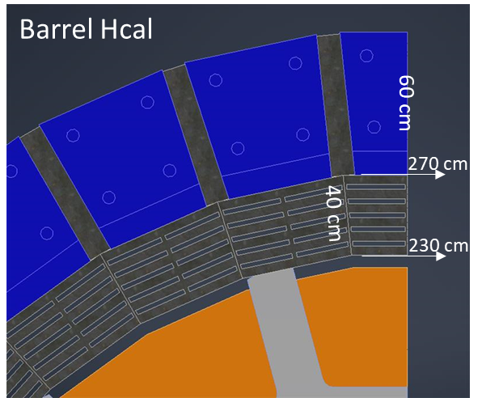
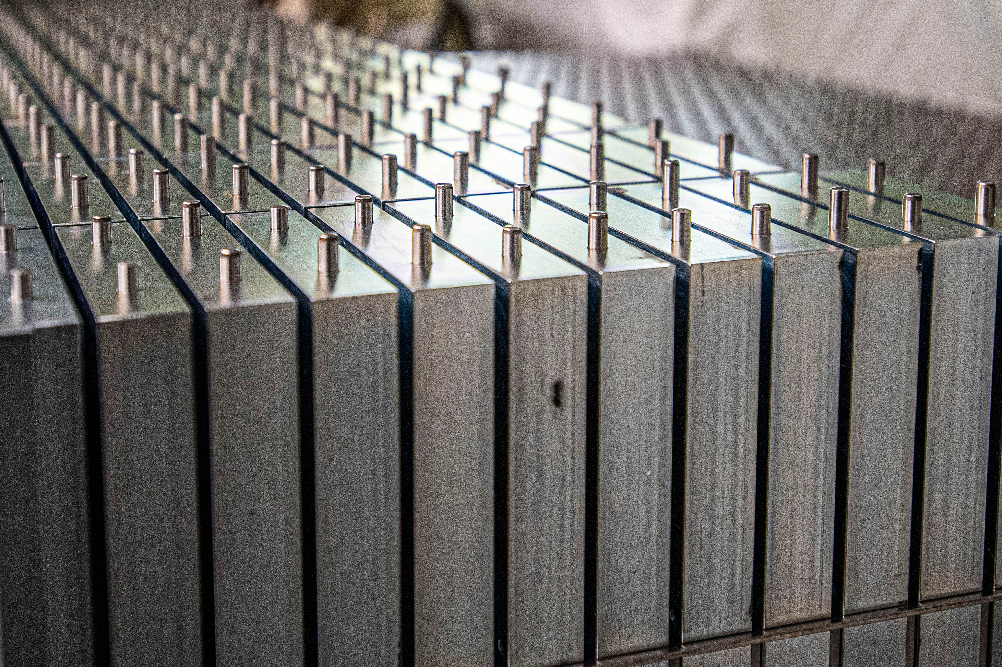
THE ENVIRONMENT OF SOCRATE – THE CALORIMETERS
Respect to the version of July
IRON / Volume fraction
85 %
85 %
Barrel Hcal has:
2 different structure (Inner / Outer)
83 % / 70 %
83 %
Endcaps Hcal are made of:
51 layers of 2 cm steel and 50 x 3.5 mm gap,
the gaps are 3 mm scintillator and 0.5 mm air
Layers can be made in:
Iron → impact on the fringe field / forces
Stainless steel → no magnetic interaction
83 %
70 %
85 %
85 %
Starting point
Optimization of the iron in the endcaps to balance the axial forces
ATHENA Proposal Committee-detector concept&integration sub-group – October, 27 2021

Slide 7
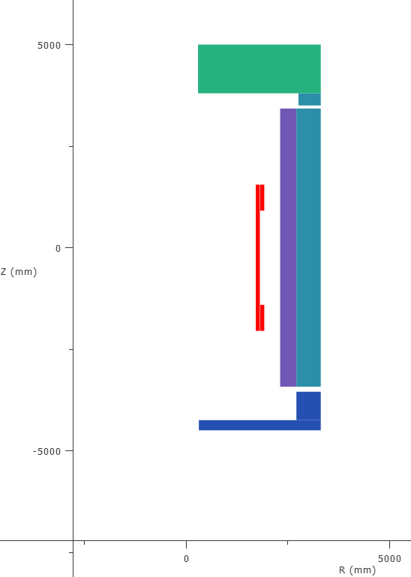
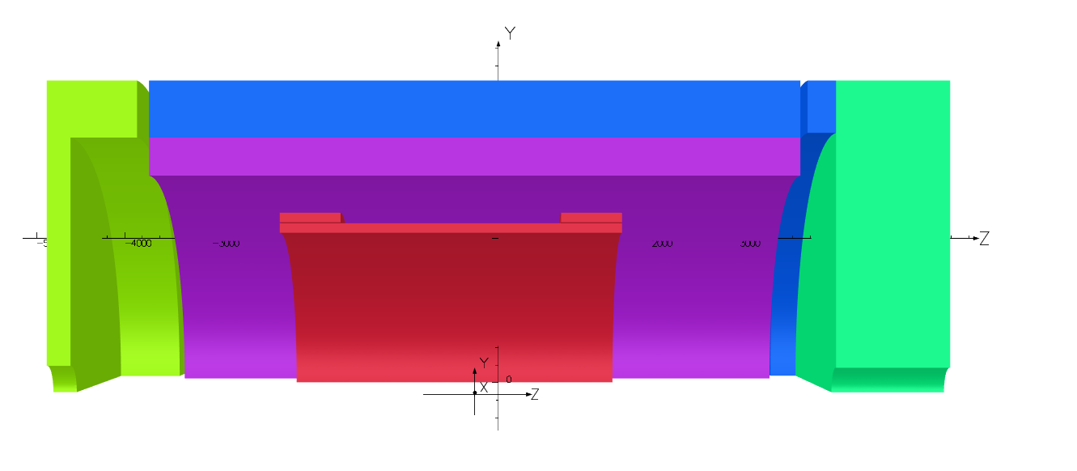
THE ENVIRONMENT OF SOCRATE – THE CALORIMETERS
2D model
3D model
Hadron Hcal
Lepton Hcal (70 cm)
Filler
Inner Barrel
Filler
Outer Barrel
Inner Barrel
Outer Barrel
Hadron Hcal
Lepton Hcal
(SS)
Flux Plate
(25 cm)
25 cm
Flux Plate
(100% iron)
Only ferromagnetic parts are shown
ATHENA Proposal Committee-detector concept&integration sub-group – October, 27 2021

Slide 8
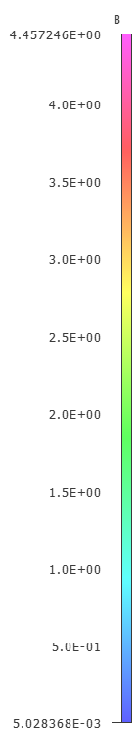
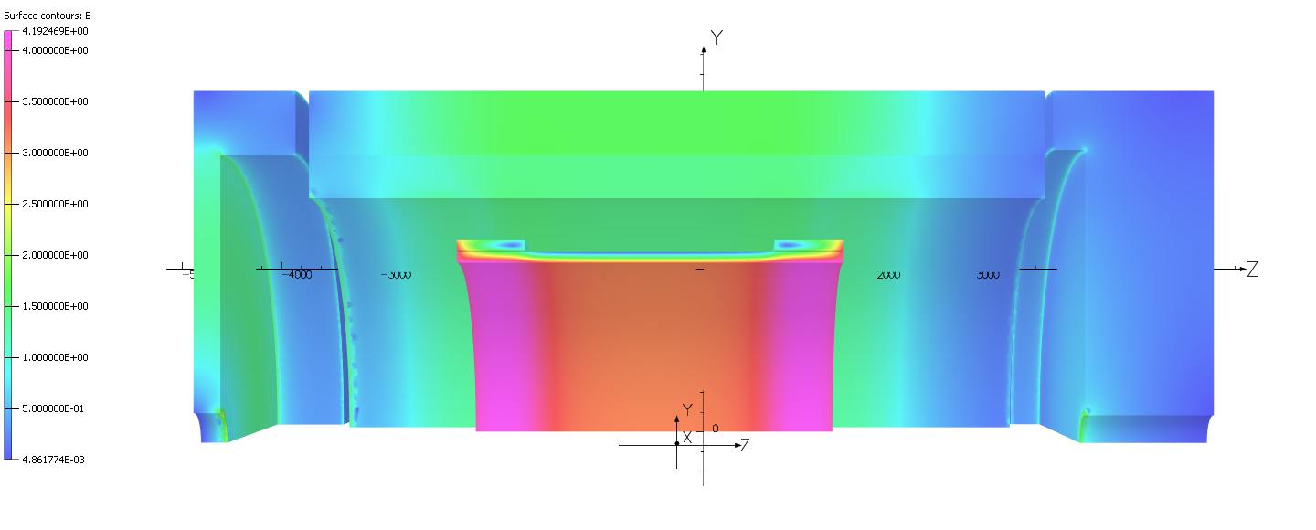
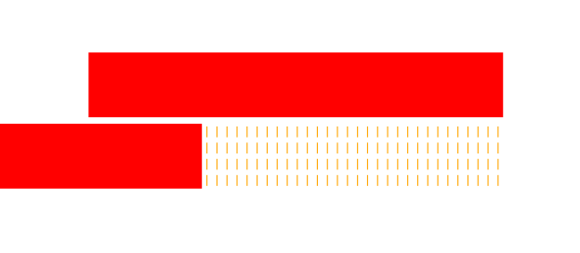
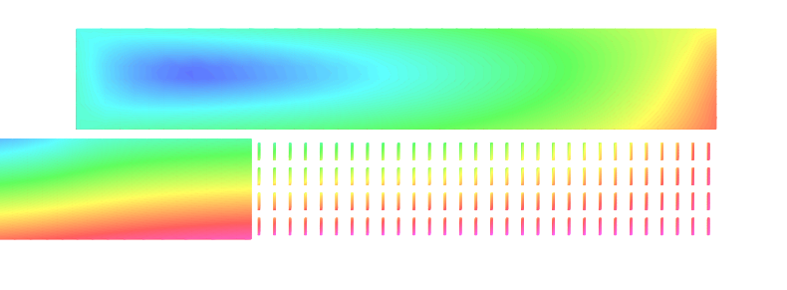
Preliminary MAGNETIC RESULTS & DESIGN
Parameter | Value | Old version | Units
B₀ | 3.02 | 3.13 | T
B peak | 4.19+0.27 | 4.35+0.27 | T
Energy | 175.5 | 183.9 | MJ
B @ Z = -5.6 m | 10.5 | - | mT
B @ Z = 7.2 m | 5.2 | - | mT
B @ R = 3.4 m | 24.8 | - | mT
H TPC 1 | 16.2 | 6.61 | %
H FLAT 1 | 27.5 | 25.12 | %
Proj | 10.4 | 14.8 | T/Amm²
Fz | 37 | 13500 | kN
4.45 T
ATHENA Proposal Committee-detector concept&integration sub-group – October, 27 2021

Slide 9
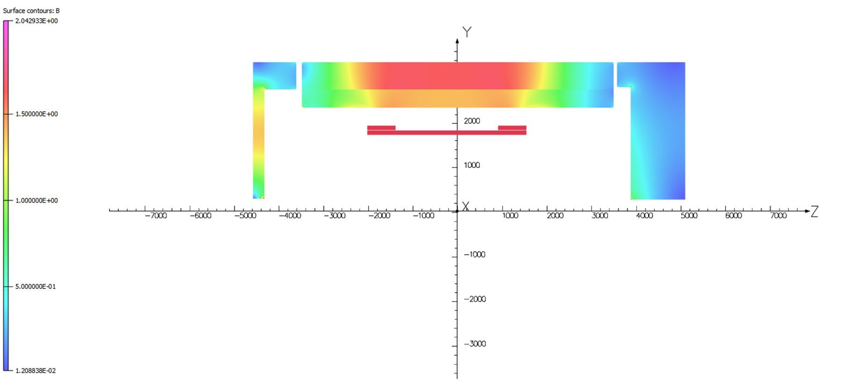
Iron saturation & fringe field
Barrel is saturating → fringe field outside the magnet comes from here
No more margins in dimensions →
Check with the other equipment / experiments possible solutions
ATHENA Proposal Committee-detector concept&integration sub-group – October, 27 2021

Slide 10
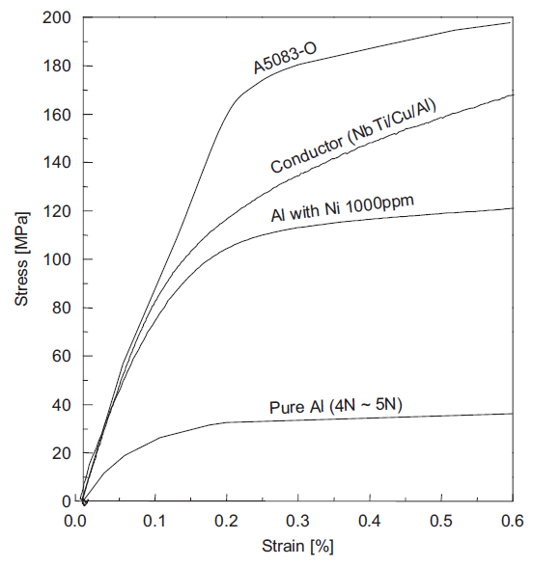
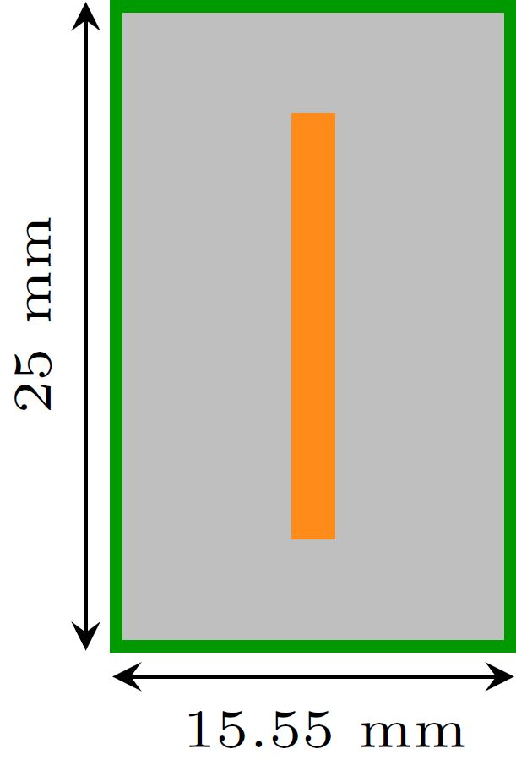
Preliminary CONDUCTOR DESIGN
J_{E}=I_{op}/A_{cond} = 24.7 A/mm²
A_{cond} = 389 mm²
Easier to fabricate and wind respect to the old version
4 layers in the solenoids
Yield strength @ 4.2K → 110 MPa
(Atlas, Mu2e conductor Al stabilizer)
ATHENA Proposal Committee-detector concept&integration sub-group – October, 27 2021

Slide 11

Preliminary CONDUCTOR DESIGN
Stabilizer input
5N AlNi_{0.1%} | Micro-alloying CW 20%
Current density | 24.7 | A/mm²
Nb layers | 4
RRR Al | 500
Insulation thickness | 0.5 | mm
Design input
Temperature | 4.5 | K
Max field (+ self field) | 4.18+0.3 | T
Margin of load line | 35%
Dump voltage | 1000 | V
Cable input
J_{c}(T,B) | Bottura fit*
N° strands | 40
Cu/Sc ratio | 1.3
RRR Cu | 100
Conductor output
I_{op} | 9.6 | kA
J_{c} | 987 | A/mm²
Ø_{st} | 0.84 | mm
Temperature Margin | 1.96 | K
Aspect ratio | 1.6
Hot spot temperature | 50.5 | K
35% margin is the same of CMS → good for operating safely
Bc20 | 14.5 [T] | α | 0.57
Tc0 | 9.2 [K] | β | 0.9
n | 1.7 | γ | 1.9
C0 | 73000 [TA/mm²]
*parameters for the fit (C.R. Spencer)
ATHENA Proposal Committee-detector concept&integration sub-group – October, 27 2021

Slide 12
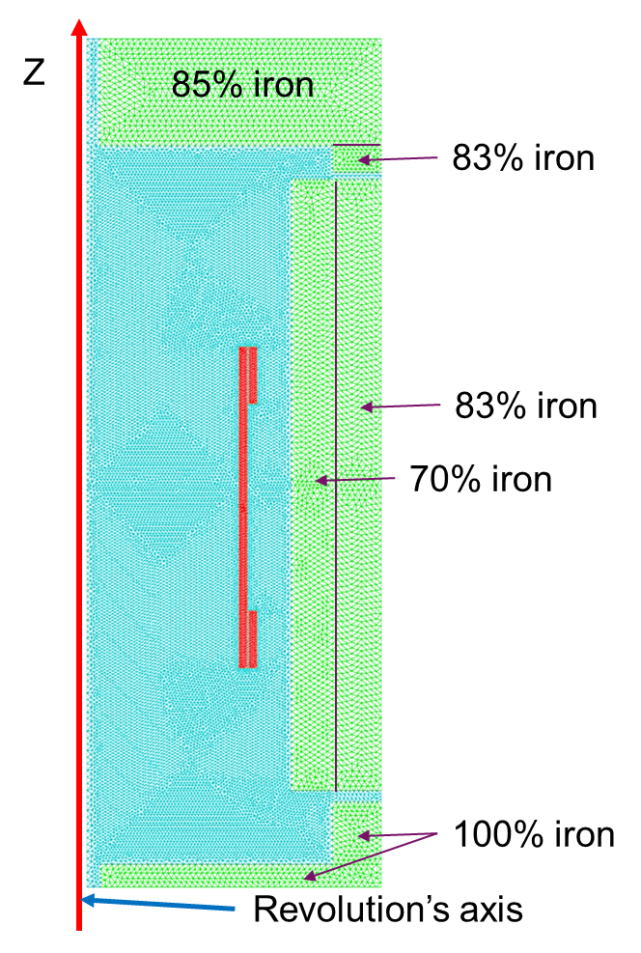
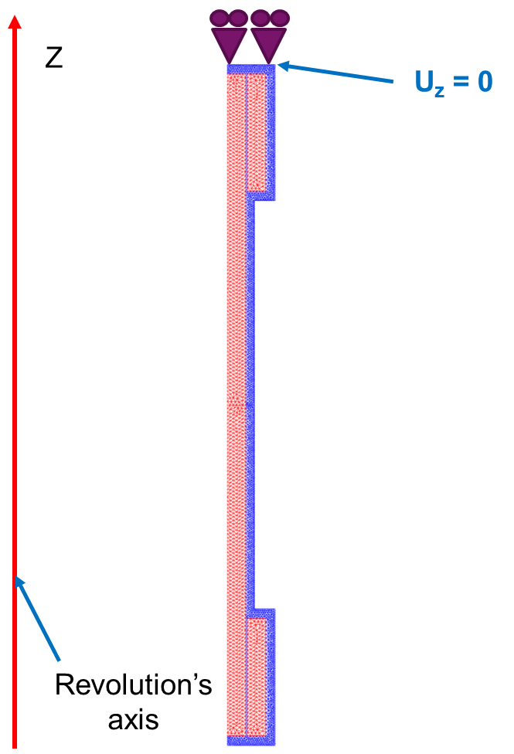
Preliminary MECHANICAL DESIGN
2D axisymmetric mechanical model
In red: coils In blue: support structure
(thickness = 50 mm)
Boundary condition:
Top of the support structure is blocked in z
Contact conditions:
coils/support structure → sliding contact with possible separation
ATHENA Proposal Committee-detector concept&integration sub-group – October, 27 2021

Slide 13
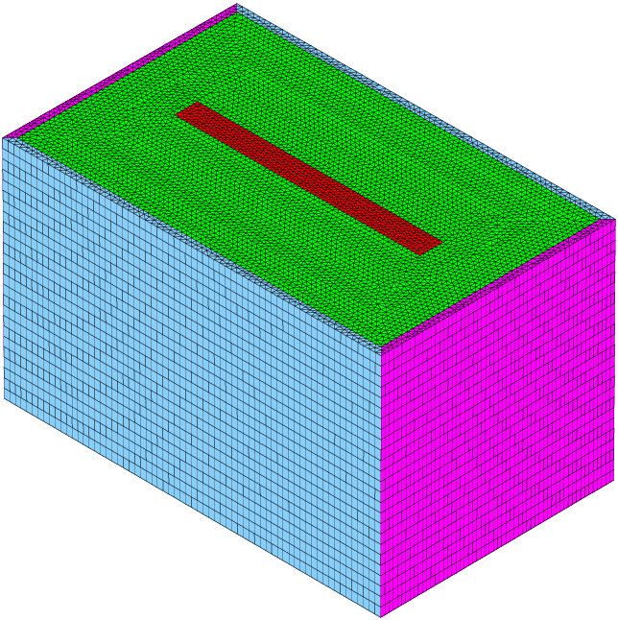
Preliminary MECHANICAL DESIGN
Conductor material properties at 4K
Materials | Young’s modulus (GPa) | Poisson’s ratio n | Integrated thermal shrinkage
Cu/NbTi composite | 128 | 0.35 | 2.65 10⁻³
Al | 78 | 0.34 | 4.15 10⁻³
Glass epoxy (G-10) | 42 (warp) 20 (normal) | 0.25 0.34 | 2.41 10⁻³ 7.06 10⁻³
Cartesian coordinate system
z
y
x
Main material properties at 4K
Materials | Young’s modulus (GPa) | Poisson’s ratio n | Integrated thermal shrinkage from 293 K to 4 K | 2/3 of the Yield stress for security margin (MPa)
Al (conductor stabilizer) | 78 | 0.34 | 4.15 10⁻³ | 70
Reinforced Al (support structure) | 78 | 0.34 | 4.15 10⁻³ | 135
Young’s moduli Ex, Ey, Ez (GPa) | Poisson’s ratios nxy, nxz, nyx, nyz, nzx, nzy | Shear moduli Gxy, Gyz, Gxz (GPa) | Integrated thermal shrinkage
72, 73, 78 | 0.34, 0.33, 0.33, 0.32, 0.35, 0.35 | 18, 26, 25 | 4.11 10⁻³
Cool down + Energization (via magnetic forces at each of the conductor nodes) + orthotropic conductor are taken into account for calculations
ATHENA Proposal Committee-detector concept&integration sub-group – October, 27 2021

Slide 14
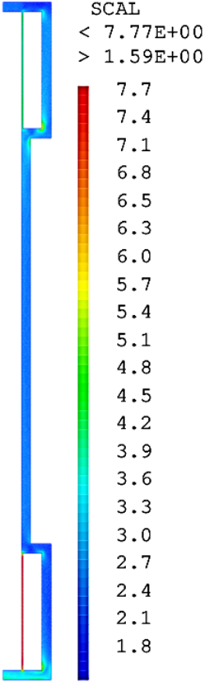
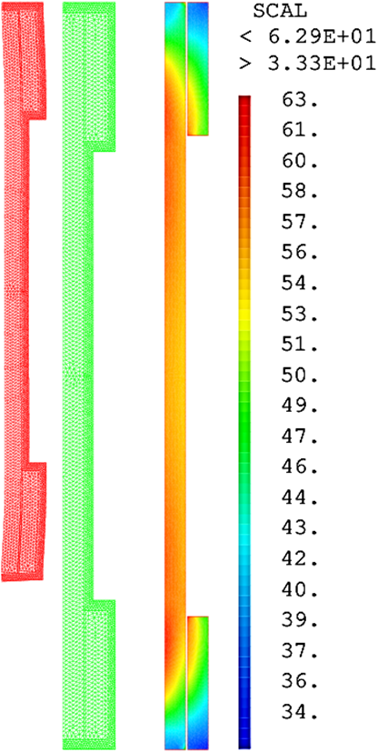
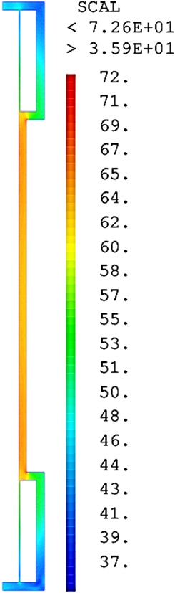
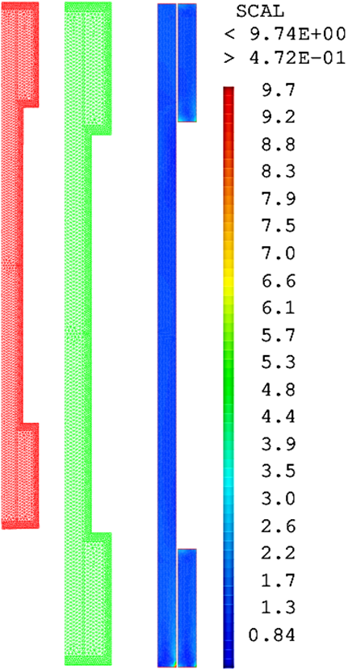
Preliminary MECHANICAL DESIGN
50 mm thick reinforced Al support structure
Cool down
Energization
Peak Von Mises stress at 4K
= 10 MPa in coils
(< spec of 70 MPa)
= 8 MPa in Al support structure
(< spec of 135 MPa)
Peak Von Mises stress at energization
= 63 MPa in coils
(< spec of 70 MPa)
= 73 MPa in Al support structure
(< spec of 135 MPa)
ATHENA Proposal Committee-detector concept&integration sub-group – October, 27 2021

Slide 15
PRELIMINARY CRYOGENICS DESIGN SCHEME
Surfaces
 | 4.5 K Level Static / Dynamics | 45 K – 80 K Level Static / Dynamics
Radiative Losses
Radiation on the cold mass (0.3 W/m²) | 30
Radiation on the reservoir (0.1 W/m²) | 0.7
Radiation on he screens (3 W/m²) |  | 300
Conductive Losses
Cold mass support | 0.4 | 5
Screen support |  | 20
Piping |  | Tbd
Cryogenics valves | 2 | 20
Instrumentation | Tbd
Current leads | Tbd
Electric Losses
Joints | 3
Foucault currents on the mandrel | Tbd
Foucault currents on the screens |  | Tbd
TOT | 36.1 | 345
4000
Reservoir
1000 * 500 * 2000 mm³
S=7 m²
3000
Chimney
R : 50 mm
L : 1100 m
S=0.35 m²
2100
S=98 m²
1680
Magnet + insulation
Rint : 1680 mm
Rext :2100 mm
L : 3720 mm
ATHENA Proposal Committee-detector concept&integration sub-group – October, 27 2021

Slide 16
COLD MASS THERMOSIPHON
2 times 10 pipes over ½ perimeter
Space between pipes : 400 mm
ΔT in the mandrel (Al 5083) (200 mm) : 16 mK
Collector diameter: Φ = 21.3 x 1.6 mm
Inner diameter : 8 mm
Tank riser : 500 mm
Flux in every pipe: ~0,6 g/s
ATHENA Proposal Committee-detector concept&integration sub-group – October, 27 2021

Slide 17
SCREEN CIRCUIT – EXTERNAL PANELS + FLOOR
5 loops spaced by 1.4 m
ΔT inside a 3 mm panel of (Al3003) : ~2.5 K
260 W to extract between 45 et 80 K (15 b)
→ ~1 g/s
insulators
ATHENA Proposal Committee-detector concept&integration sub-group – October, 27 2021

Slide 18
SCREEN CIRCUIT – INTERNAL PANEL
85 W to extract between 45 et 80 K (15 b)
→ 0.35 g/s
Cooling by conduction from the ends
ΔT inside a 5 mm (Al1050) panel : ~2 K
insulators
ATHENA Proposal Committee-detector concept&integration sub-group – October, 27 2021

Slide 19
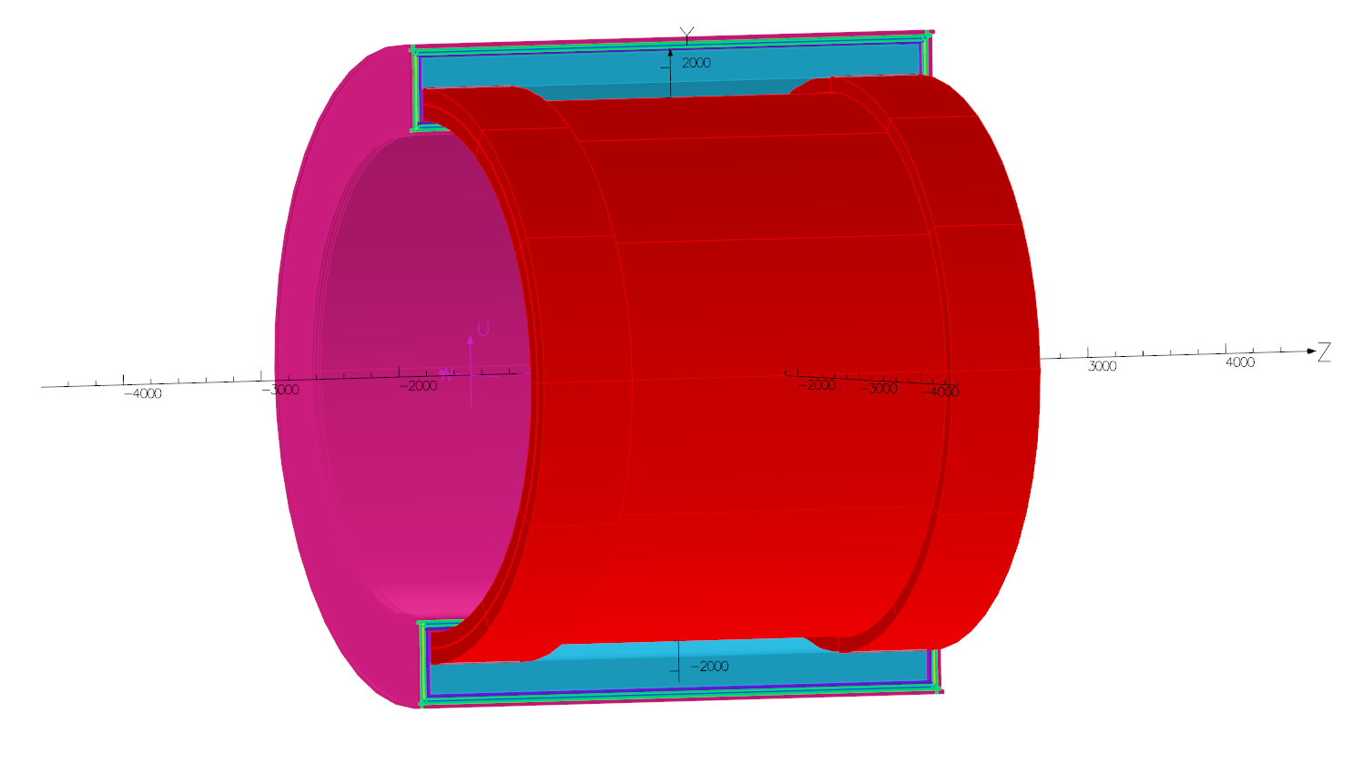
PRELIMINARY MASS BUDGET AND ASSEMBLY
Coil former & mechanical support
Solenoidal Configuration | Volume (m³)
SS* | 3.214
Cu (thermal shield) | 0.970
MLI | 3.183
Al | 2.632
Coil NbTi | 0.2161
Coil Insulation | 0.8719
Conductor Stabilizer (Al) | 7.2621
Cryostat with
MLI
Thermal shields
coils
H Cal
ATHENA Proposal Committee-detector concept&integration sub-group – October, 27 2021

Slide 20
CONCLUSIONS
Preliminary Conceptual Designs are OK
No major issues
Fringe field → understand what are the margins respect to the other equipment / experiments
Time to move towards a detailed design
ATHENA Proposal Committee-detector concept&integration sub-group – October, 27 2021

Slide 21

Commissariat à l’énergie atomique et aux énergies alternatives
Centre de Saclay | 91191 Gif-sur-Yvette Cedex
Etablissement public à caractère industriel et commercial | R.C.S Paris B 775 685 019
Direction de la Recherche Fondamentale
Institut de recherche
sur les lois fondamentales de l’Univers
Notes:
Saisir le champ « Service »

