Slide 1
Schedule Input Important for Costing
E.C. Aschenauer (BNL)
Co-Associate Director for the Experimental Program
October 26, 2021

Slide 2
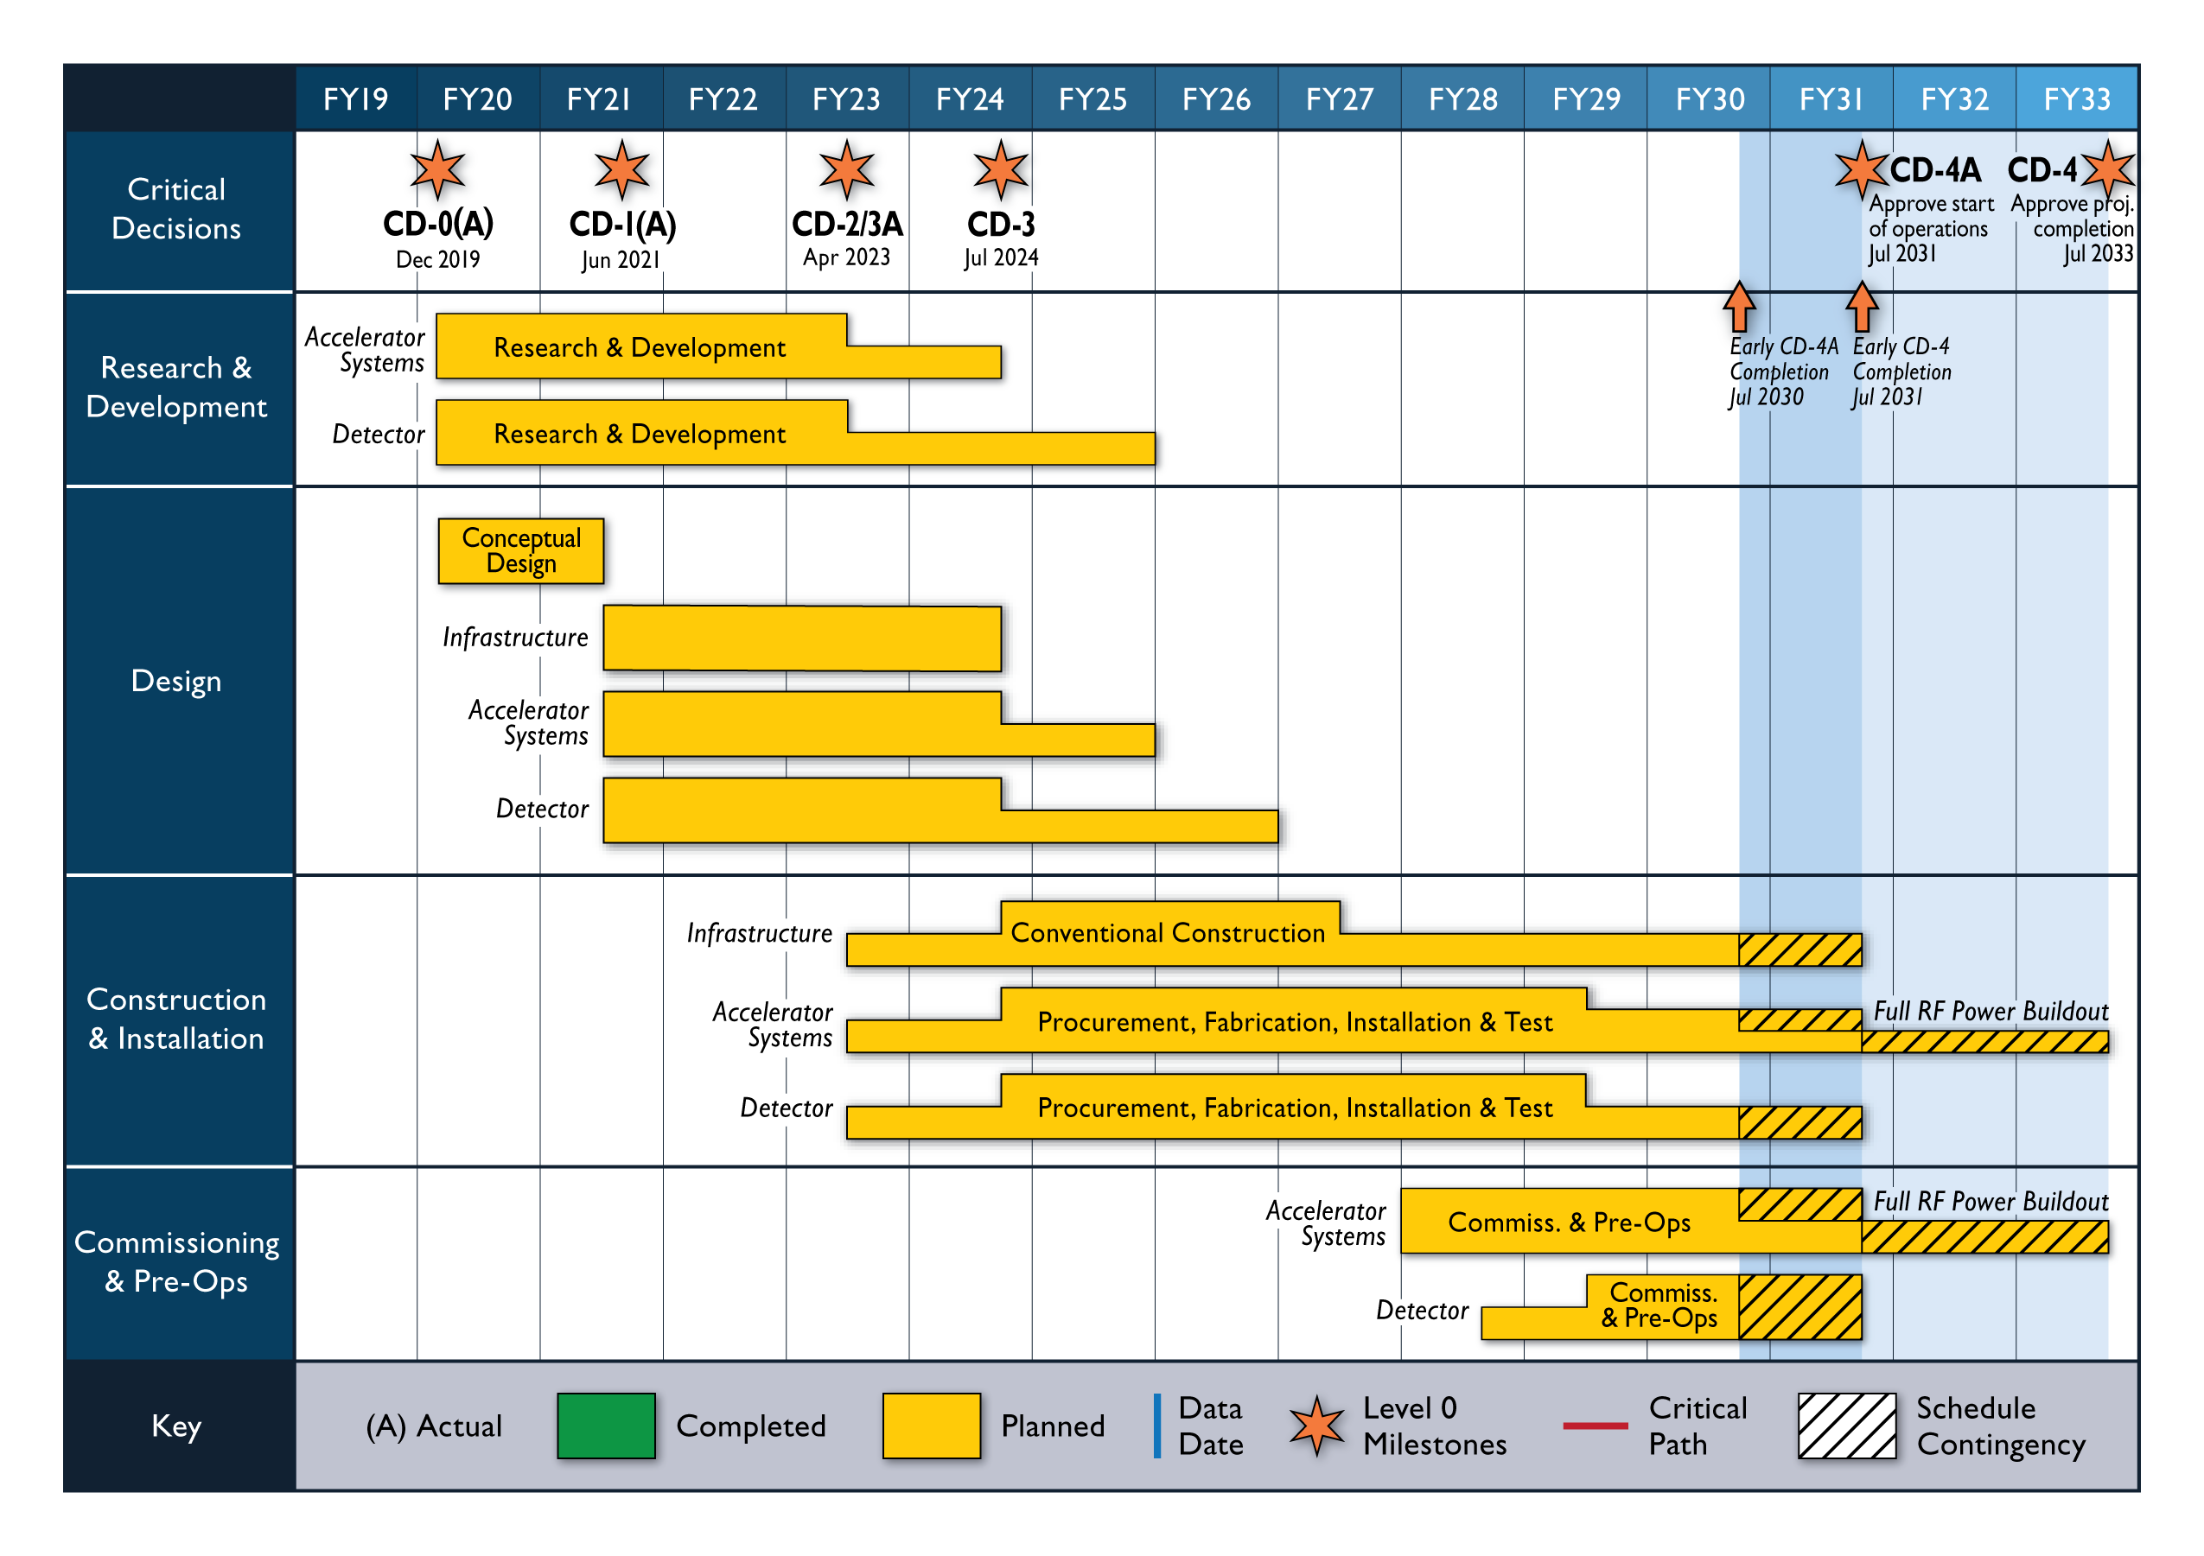
Latest Schedule
KPPs

Slide 3
KPPs for Detector
PreOps activities aligned with achieving KPPs
KPP | Performance Measure | Threshold KPP | Objective KPP | Ultimate PP
DET-4a | Detector | Detector subsystem component testing complete. | Detector subsystems constructed and tested with cosmic rays. | Same as Objective
Detector sits as a whole in the assembly hall and gets tested with cosmic
KPP | Performance Measure | Threshold KPP | Objective KPP | Ultimate PP
DET-4 | Detector | Detector installed and ready for beam operations. | Inelastic scattering events in e-p and e-A collisions measured in Detector. | Inclusive, semi-inclusive, and exclusive events measured as the basis for 3D maps of subatomic quark-gluon structure.
Detector is moved into the collision hall to take first collision data

Slide 4
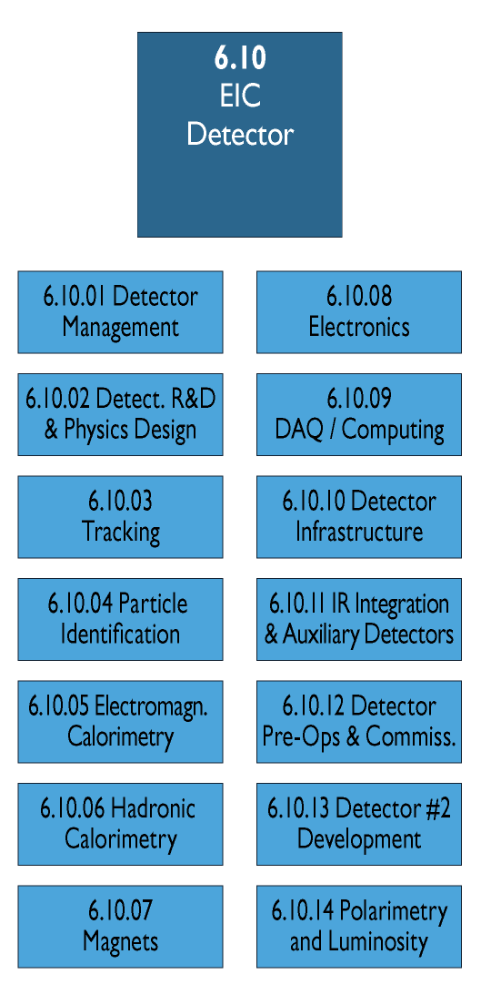
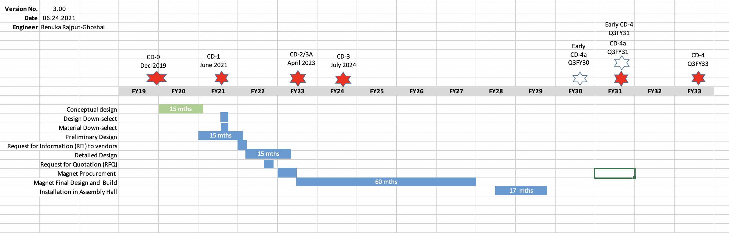
WBS 6.10.12
Scope:
This WBS covers all activities to commissions the detector first with cosmic and then with beam to be ready for data taking.
Big Picture:
Magnet and sub-detector system tests in FY28 and FY29
location assembly hall and wide-angle hall
Full system cosmic test in FY29/FY30, and ramp-up to in-beam tests
location assembly hall
after accelerator has finished first beam commissioning detector is rolled into collision hall
Beam commissioning in FY30/FY31.
Period of Pre-Ops interleafed with installation

Slide 5
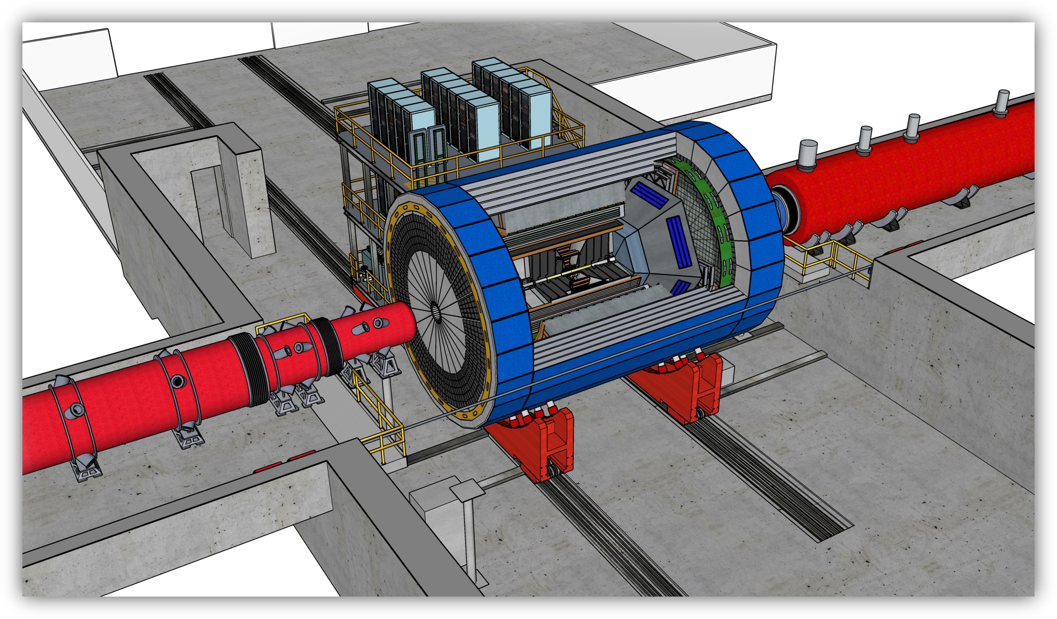
Installation Sequence
Principles for Installation:
Barrel: subdetectors are installed from outside in in the barrel
Endcaps: from the inside out
Installation sequence
the lower half of the barrel HCal
solenoid
upper half of of the barrel HCal
inner barrel ecal
DIRC
barrel tracking
endcap tracking
aRICH + dRICH and GEM tracker behind dRICH
electron endcap ECal
Everything along the beam lines is independent
luminosity detector and polarimeters need to be fully ready by CD-4A
Hadrons
In parallel endcap HCals + hECAL
RCS
Electrons
KPP | Performance Measure | Threshold KPP | Objective KPP | Ultimate PP
POL-4 | Polarization | Hadron beam polarization of > 50% and electron beam polarization of > 40% measured at E_{cm} = 100 GeV. | Hadron beam polarization of > 60% and electron beam polarization of > 50% measured at E_{cm} = 100 GeV. | Hadron and electron beam polarization of ~70% measured at E_{cm} = 100 GeV.
LUM-4 | Luminosity | Luminosity for e-p collisions measured up to 1.0x10³² cm⁻² s⁻¹. | Luminosity for e-p collisions measured up to 1.0x10³³ cm⁻² s⁻¹. | Luminosity for e-p collisions measured up to ~10³³ - 10³⁴ cm⁻² s⁻¹.
CD-4

Slide 6
3T Magnet Schedule

Slide 7
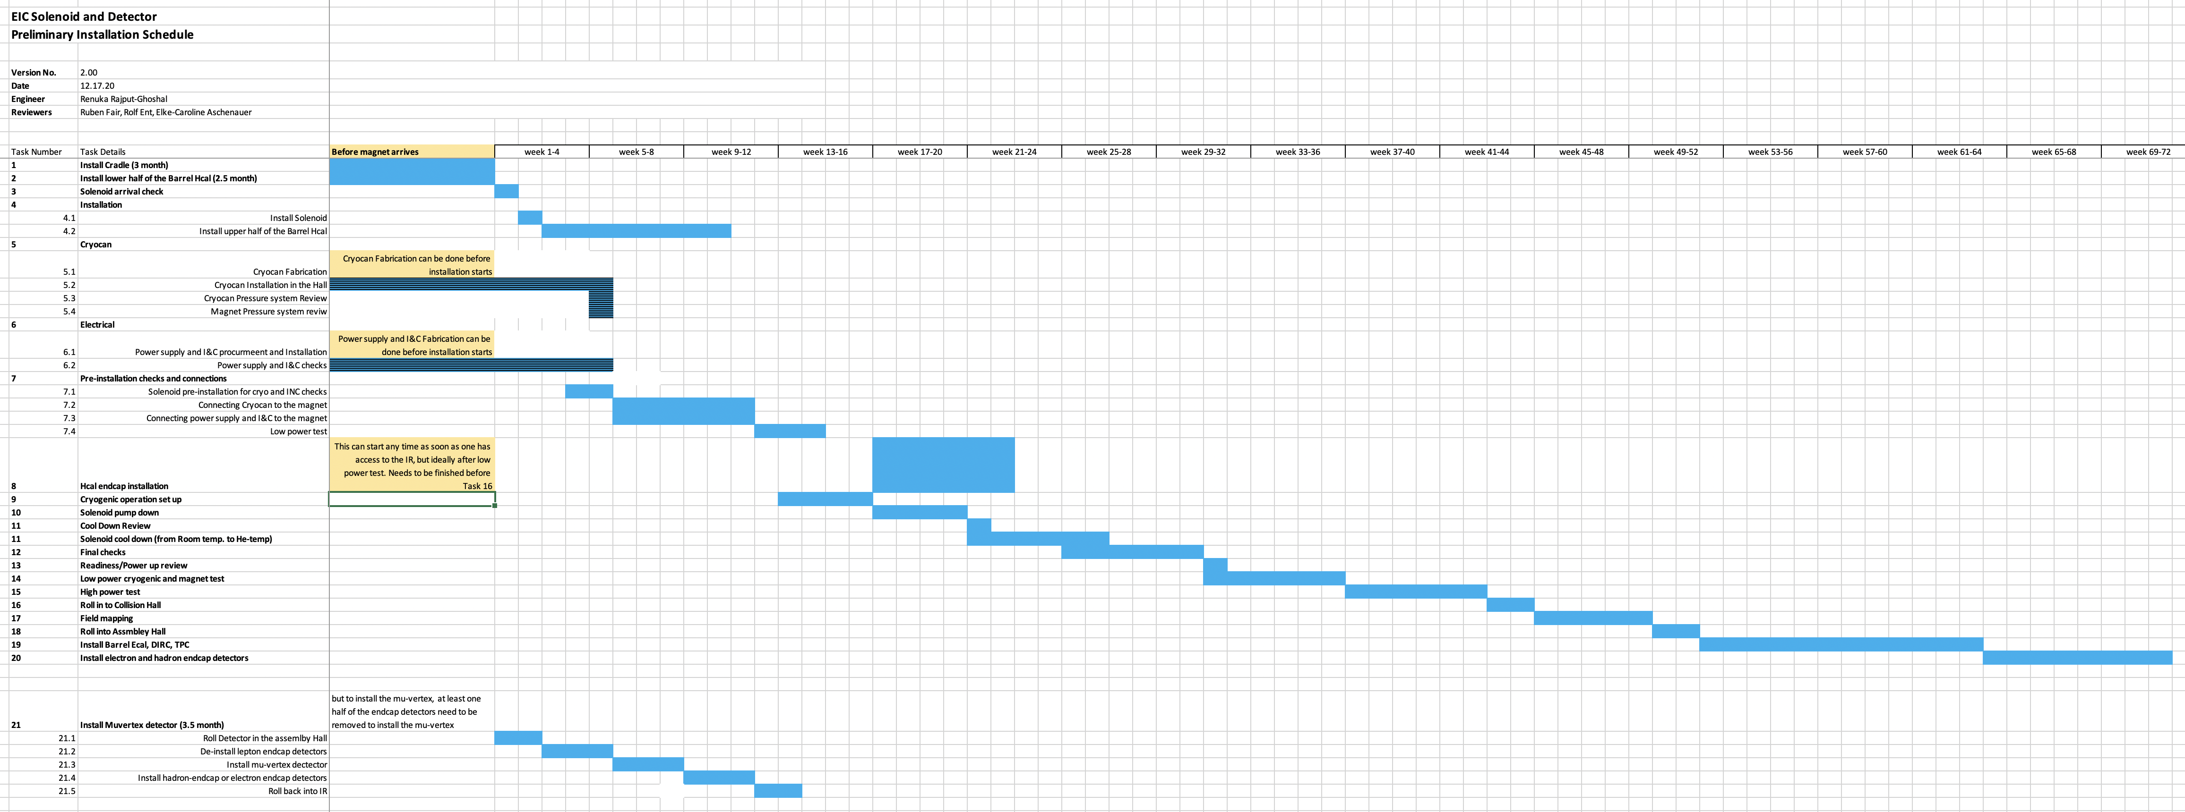
Detailed Installation Planning
*
*
Tracker (MPGD, Si)
It is critical to integrate this installation order and planning into the costing exercise
through the start date and duration of the different activities for the subdetectors.

Slide 8


Slide 9
Schedule – what do the CD milestones mean?
CD-0 – Approve mission need: this documents that a scientific goal or a new capability, requiring material investment exists.
CD-1 – Approve Alternative Selection and Cost Range: serves as a determination that the selected alternative and approach is optimized to meet the mission need defined at CD-0. What is perhaps most relevant is that CD-1 allows for release of Project Engineering and Design (PED) funds, which means the next phases of design of accelerator and detector can begin.
CD-2 – Approve Performance Baseline: CD-2 is an approval of the preliminary design of the project and the baseline scope, cost, and schedule. What is most relevant is that CD-2 means there is now a definitive plan that the project will be measured against in cost, schedule and technical performance.
CD-3 – Approve Start of Construction: CD-3 is an approval of the project’s final design and authorizes release of funds for construction. What is most relevant is that projects can now proceed with construction related procurements and activities. CD-3 is sometimes split in CD-3A in a tailored approach to approve start construction for long-lead procurements.
CD-4 – Approve Start of Operations or Project Completion: CD-4 provides recognition that the project’s objectives have been met. CD-4 is sometimes split in CD-4A that allows, after agreed-upon criteria for technical success have been met, for transition into operations, and CD-4B that provides the formal closeout of the project.

