Slide 1
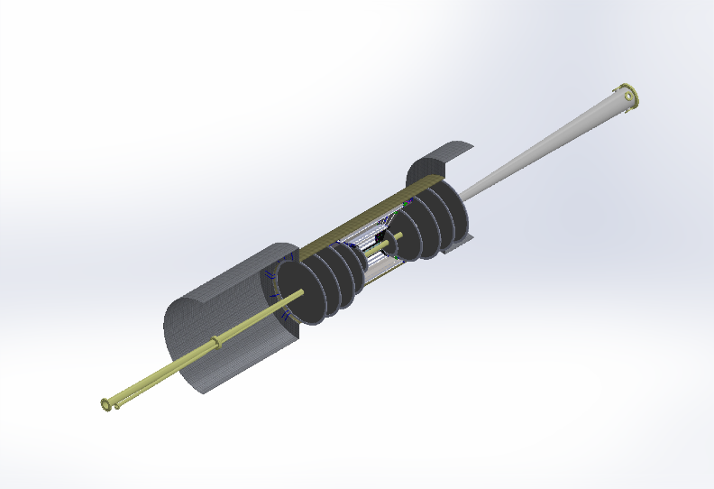
EIC Silicon CAD Update
Jim Fast

Slide 2
Models Built
All silicon tracker from Yellow Report “V0” Release
Only barrel silicon detailed
ATHENA Hybrid tracker (latest geometry)
Barrel and disks detailed
ECCE Hybrid Tracker (working on adjustment to latest quasi-projective geometry)
Need to incorporate detailed disks – can utilize work done for ATHENA version
Need geometry data from CORE to build model specific to them
Ideas for future consideration (CAD concepts posted for those interested)
Integrated barrel-disk or “step” concept (for future consideration)
Vertex + sagitta layers same length and get innermost disk much further in towards IP
Curved staves for sagitta and outer layers
Working model files, STEP, etc. are available at https://userweb.jlab.org/~jfast/EIC/
Plan for release of Version 0 for collaboration-specific hybrid layouts in near future

Slide 3
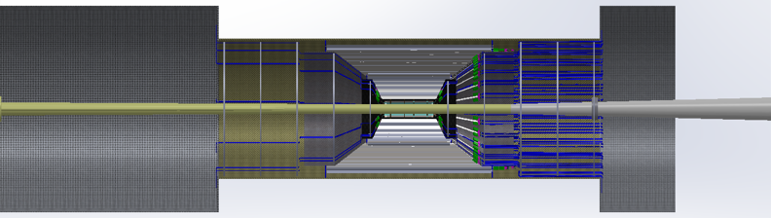
All silicon tracker from Yellow Report “V0” Release
Vertex/barrel layers are fairly detailed
individual silicon dice, signal cable connectors an cabling, DC-DC converters
Cable routing biased toward hadron direction
Disks are representative volumes – no details
Carbon fiber structures
Vertex support, Outer layer supports, Cylinder to enclose tracker

Slide 4
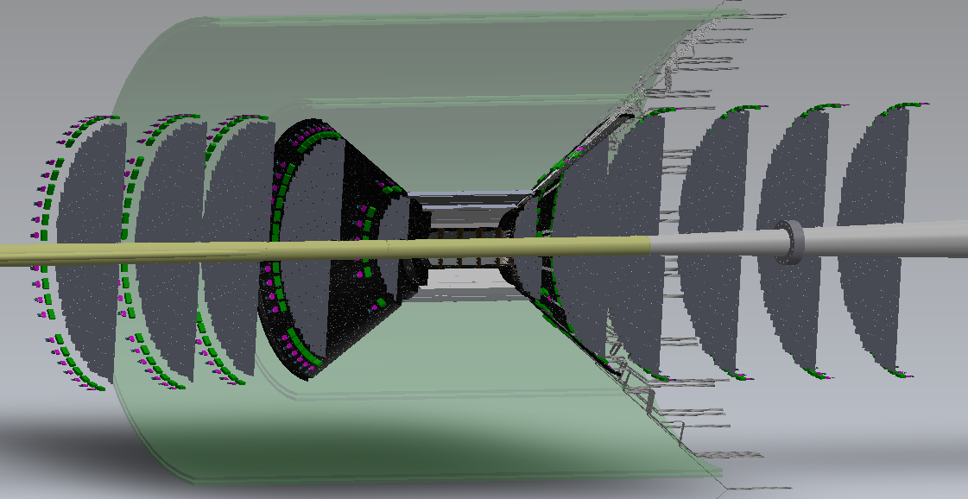
ATHENA Hybrid tracker (latest geometry)
First model with all of the silicon fully detailed out at sensor level
Barrel supports and service routing path sorted out fairly well
Biased towards routing out hadron end
Many details remain undone
Cooling
Power cables (LV and bias voltage) an connectors
Disk mechanical supports
Disk cabling
Realistic layout of end of flex interconnects filter circuits and DC-DC converters
Representative models of MPGD included
Needed to envision services paths
Silicon support needs to couple to support for MPGDs
Projective cone at 36.4 degrees (eta=1.1)

Slide 5
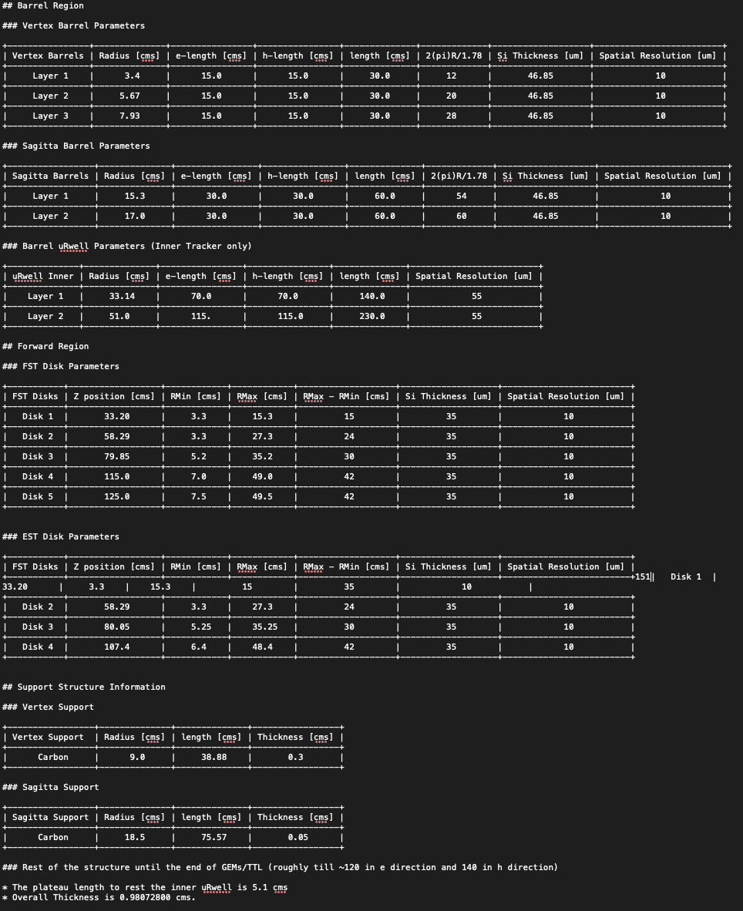
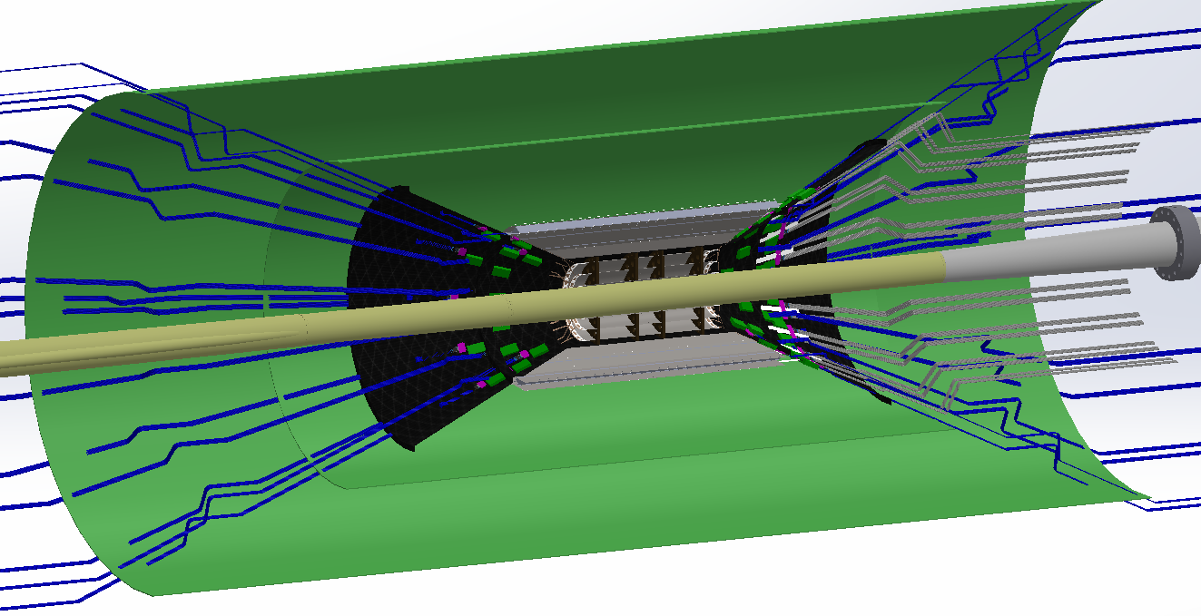
ECCE Hybrid tracker (latest geometry)
Under construction….
Barrel (vertex + sagitta) layers are done
Disks need to be detailed and fit in to structure
Cabling, cooling etc. all needs to be done or updated
Projective cone at 25.5 degrees (eta=1.5)

Slide 6
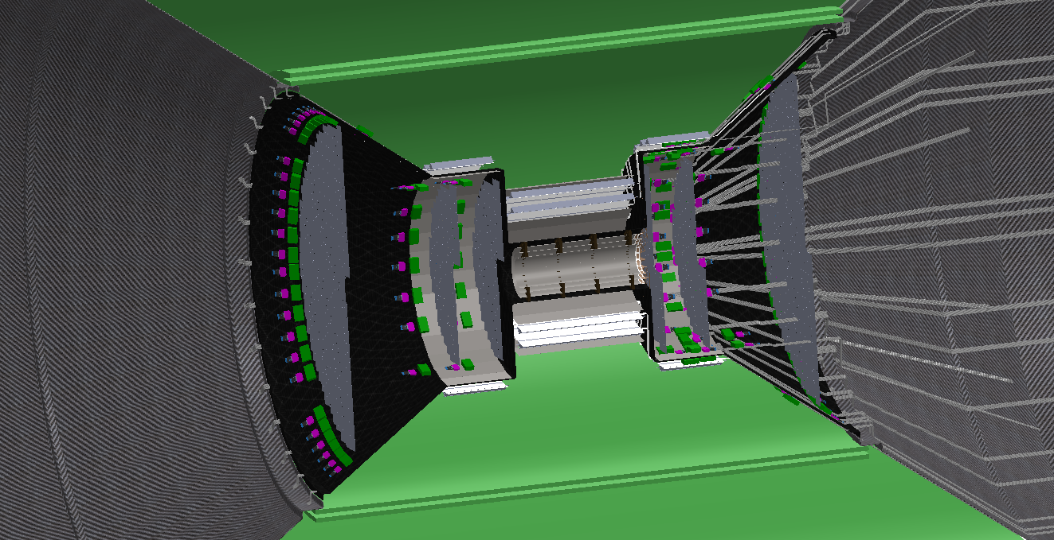
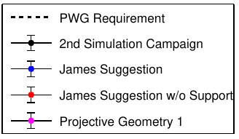
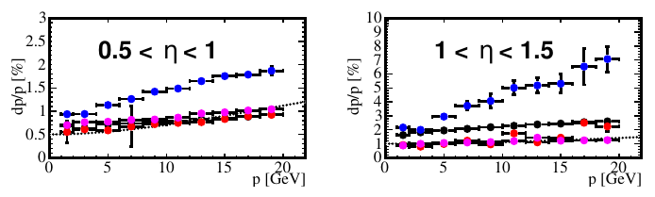
Integrated barrel-disk concept
D0 tracker had series of barrels with disks on ends – interleaved disks and barrels
Needed to cover long interaction region out to high eta
My thought
Simplify barrel to all same length (vertex + sagitta); ease assembly of vertex and inner disks?
One small disk at Z=180 + stave-lets (shown) to fill in eta region sagitta layers covered
Alternative is two closely space “sagitta” disks at small Z (~180-190 mm)
ECCE looked at this quickly
Used quite a lot of material following structure
Significant performance hit for 0.5<eta<1.5
I’ve abandoned this idea for now

Slide 7
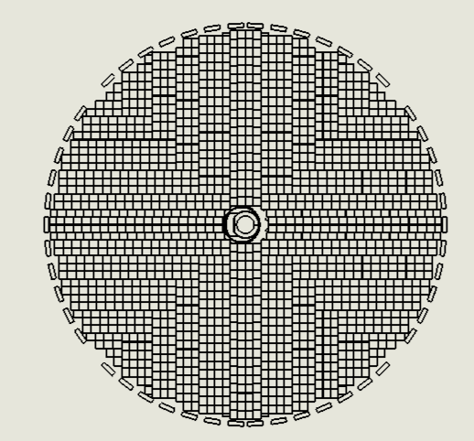
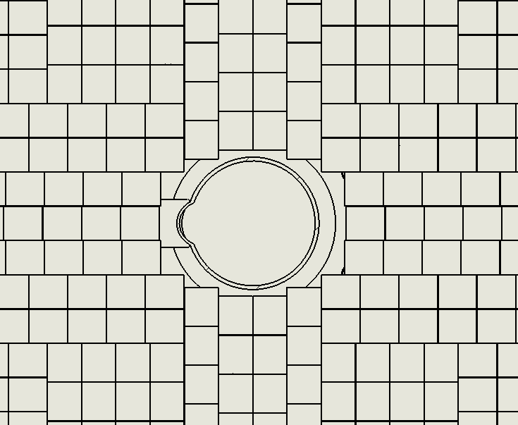
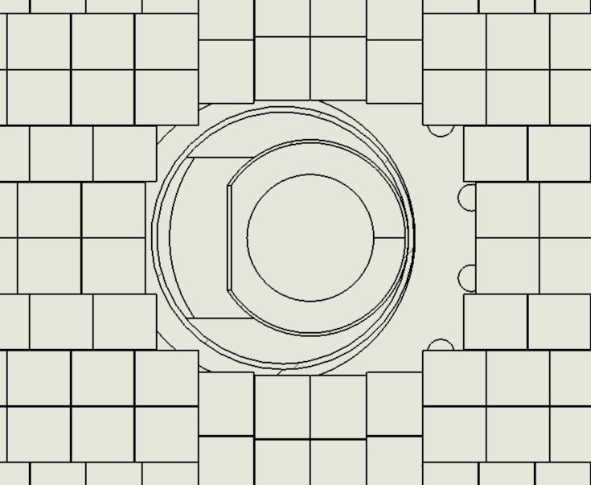
Tiling disks – quite a detailed effort
Tiling disks with unit cell size derived from vertex layer constraints (one unit sensor size)
Start with fitting as tightly as reasonably possible around beam pipe
Work outward in strips in “stitching” direction
Again, determined by barrel layout
Need to run to all the way to the edge to route services along “staves” in the disks
Some very long elements and od shapes in disks
Post-proposals some careful thought needs to go in to the number and size of dice from the silicon wafers and the added complexity for handling/testing jigs and fixtures
Disk 4, h-direction
Fitting around beam pipe
e-direction
h-direction

Slide 8
Summary
Mature CAD models developed to inform simulations and costing
Evolved from YR All Silicon to ECCE and ATHENA hybrid design concepts
Need to create CORE-specific model
Trackers constrained to be built from same unit cell (reticle) size
Assume a single, dedicate EIC reticle and sensor wafer layout will be designed
Paying attention to fitting sensors on wafers and yield implications for larger area devices
Simulations geometries updated to accommodate manufacturing constraints
Good feedback loops between simulators, CAD designs and cost models

