Slide 1
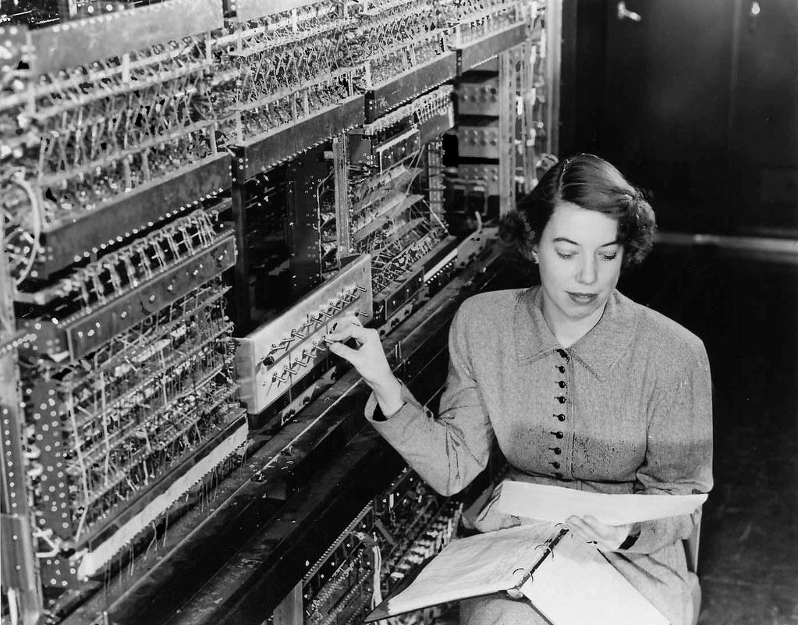
Simulation & Reconstruction Status ATHENA COLLABORATION MEETING Friday 2021-09-17
The Software and Computing WG Conveners: Andrea Bressan (University of Trieste and INFN) , Dmitry Romanov (Jefferson lab) , Sylvester Joosten (Argonne National Laboratory) , Whitney Armstrong (Argonne National Laboratory) , Wouter Deconinck (The University of Manitoba)

Slide 2
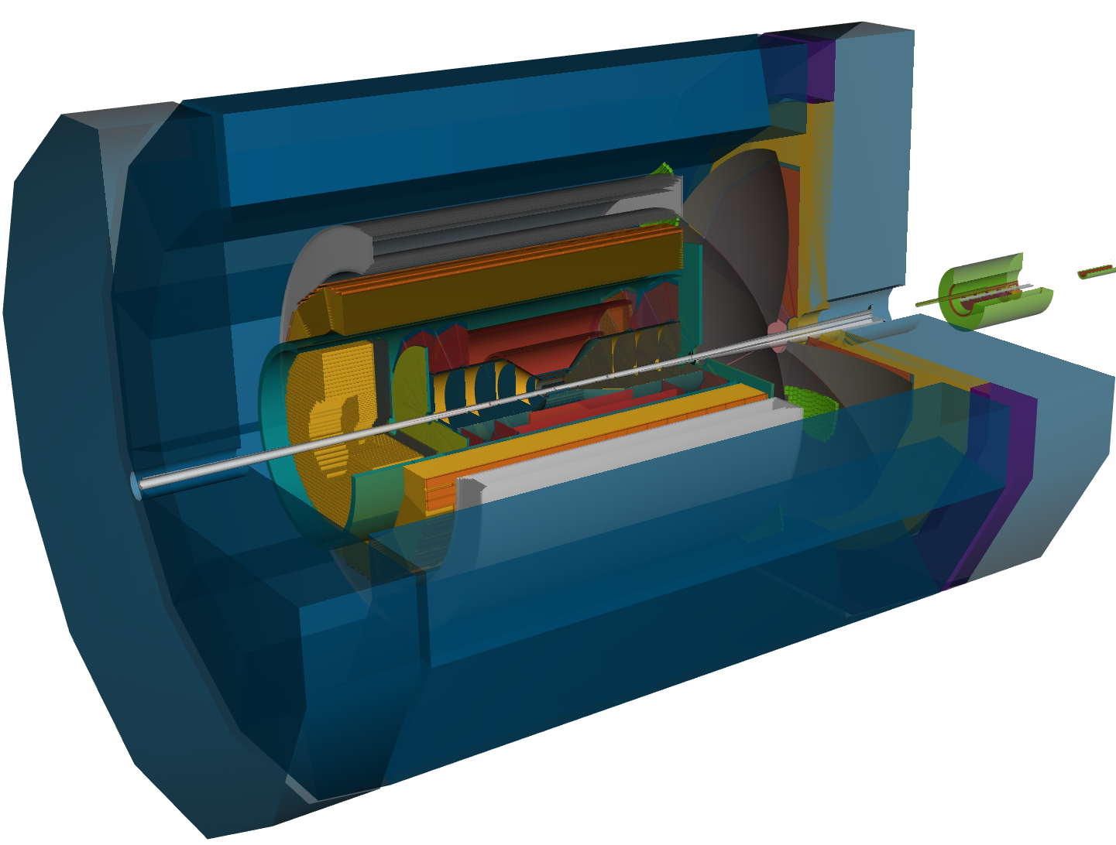
Simulation status
LEGEND:
✅ : done
🚧 : ongoing
❌ : task not allocated to anyone or not fully defined
“Canyonlands” geometry
✅ Central calorimetry ready for proposal
❌ Optimize ECAL/HCAL acceptance? (near beampipe and corner of BHCAL blocking PECAL)
✅ Hybrid tracker version 2.0 fully functional
🚧 Iterative changes to geometry
❌ Integrate first BECAL silicon layer into tracking geometry
✅ Forward/backward RICH fully functional
🚧 2-mirror design for dRICH
🚧 better pfRICH services
✅ 12-sided “Fake-DIRC”
❌ Fix geometric overlaps in DIRC
✅ Realistic central beampipe
❌ Beampipe needs 50cm extension in forward direction.
✅ B0 tracker/preshower ready for proposal
✅ Forward beamline, including RPs and OMDs ready for proposal
🚧 Detect beam energy setup in HepMC file to automatically set FF magnets
🚧 ZDC redesign almost complete

Slide 3
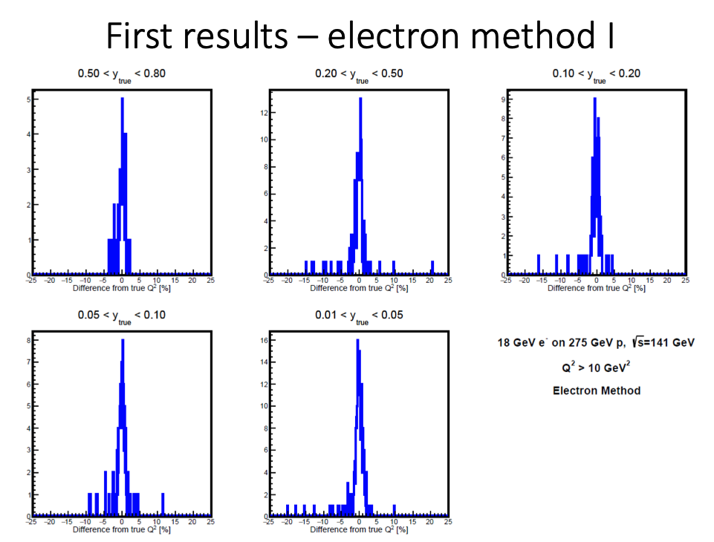
Reconstruction status
LEGEND:
✅ : done
🚧 : ongoing
❌ : task not allocated to anyone or not fully defined
https://eicweb.phy.anl.gov/EIC/eicd/-/blob/master/eic_data.yaml
https://eicweb.phy.anl.gov/EIC/juggler
JUGGLER
GAUDI
Status
✅ ECAL reconstruction ready
🚧 Validate calorimetry digitization for BECAL
✅ Tracking with ACTS working well
🚧 Validation + fine-tuning material effects
❌ Add B0 (after proposal deadline)
🚧 Realistic vertexing
✅ Neutral particle reconstruction
🚧 Realistic PID
✅ Truth PID for all particles
🚧 IRT for dRICH/pfRICH
❌ DIRC reconstruction
❌ e/π separation using calorimetry+PID
✅ Inclusive kinematic reconstruction
🚧 Tune algorithms
🚧 FF reconstruction
✅ Fast FF reconstruction
✅ RP/OMD proton reconstruction
🚧 ZDC reconstruction
Full simulation/reconstruction DIS events with electron method (Jacquet-Blondel and double-angle also available) Implementation and results courtesy of Barak Schmookler

Slide 4
Computing and Support
Large production running right now!
#software-helpdesk office hours every week: Mo-We-Fr at 2:00pm EDT https://zoom.us/j/93744567735.
In case of questions/issues, you can reach us at Slack (#software-helpdesk), or by creating an issue on eicweb.
Getting started: curl -L get.athena-eic.org | bash
Full simulation tutorials
eic-ip6-software-I@lists.bnl.gov #software-helpdesk on Slack

