Slide 1
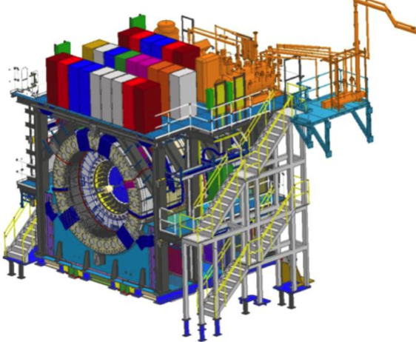
sPHENIX MIE Project
TPC | Project Director | Last CD Achieved | % Complete | CPI | SPI
$27.0M | Edward O’Brien | PD-2/3 | 88.2% BCWP/BAC @ 10/31/2021 | 1.02 | 0.90
Scope
Detector systems produced, tested and ready for installation: Time Projection Chamber w/ electronics, Electromagnetic Calorimeter w/ electronics, Hadronic Calorimeter w/ electronics, DAQ/Trigger, Minimum Bias Detector, Project Management
Not in scope
SC-Magnet, Bldg/Det Infrastructure, Installation and System Commissioning
Schedule
CD-0 received Sept 2016
CD-1/3A received Aug 2018
PD-2/3 received Sept 2019
Early completion based on Sept status end of March 2022
PD-4 Dec 2022
Cost
$27.0M AY TPC 54.2% contingency on an ETC of $3.96M
99.3% Costed & Committed
Commitments = $3.267M
9 months float between MIE Early Completion and PD-4

Slide 2
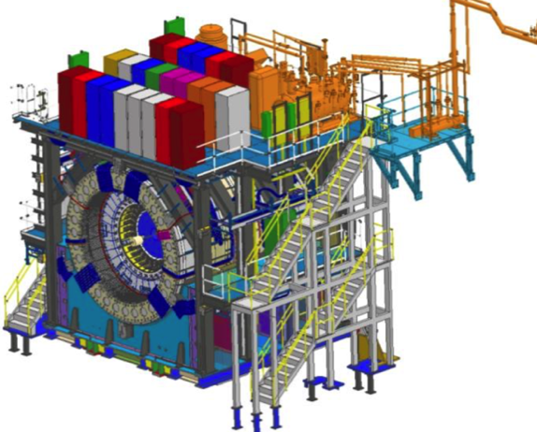
BNL 1008 Infrastructure & Facility Upgrade
TPC | Project Director | % Complete | CPI | SPI
$33.4 M AY | Edward O’Brien | 69.4% BCWP/BAC @ 10/31/2021 | 1.03 | 0.87
Scope
SC-Magnet support including the Flux Return, Cryogenics into Bldg 1008, Detector Carriage/Cradle, other Bldg 1008 Infrastructure improvements
sPHENIX Installation, Integration and Commissioning of each Subsystem is part of the scope
Not in Scope
PreOps prior to RHIC collisions
Schedule
sPHENIX Ready for Operations (Early Completion) 11/22/22
First RHIC run of sPHENIX Feb 1, 2023
2.5 months float in schedule between sPHENIX ORR and
nominal start of RHIC 2023 run.
Cost
$33.4 M AY Total Project Cost with 16.1% contingency on ETC of $10.27M
80.6% Costed and Committed
Commitments = $4.21M
2.5 months of float between I&F Early Completion and RHIC Run-2023

Slide 3
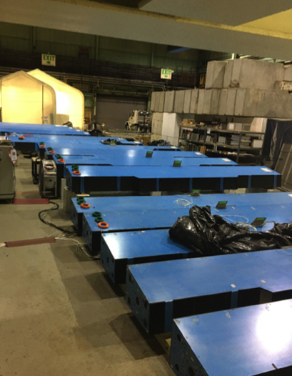
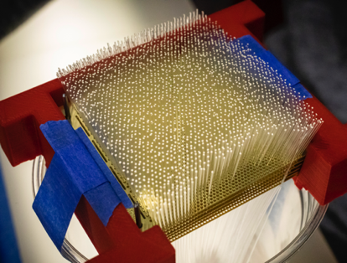
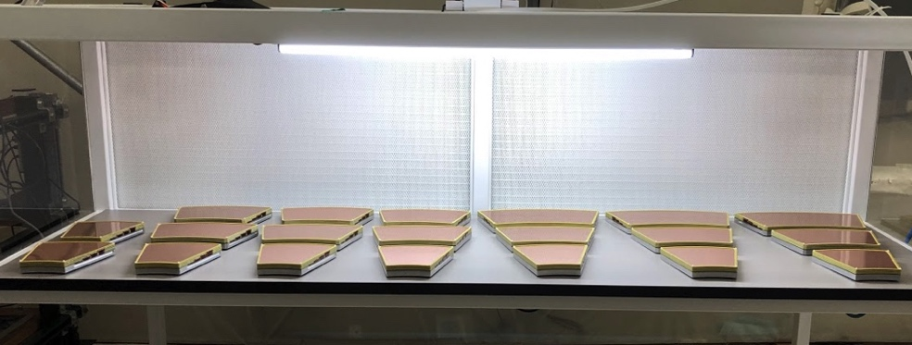
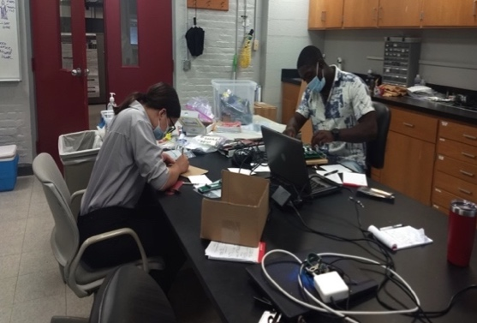
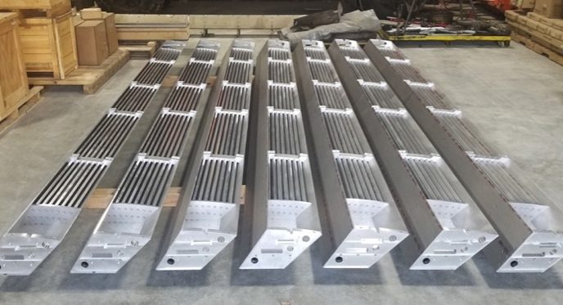
sPHENIX MIE Status
Outer HCal sectors going through final testing/burn-in
sPHENIX Assembly continues in the 1008 Assembly Hall. SC-Magnet installed on detector w/ successful HiPot test (No shorts).
The Outer HCAL Sectors are complete. All sectors burned-in and ready to install.
Inner HCal mechanical sectors 100% complete.
EMCal blocks 95% complete at UIUC. EMCal Sectors 67% complete at BNL.
All TPC ASICs complete, tested and at BNL. Assembly house has begun building 700 TPC Fee boards. First article Fee boards good. All FELIX boards assembled and ready to test.
All EMCal and OHCal on-detector electronics received at BNL. Calorimeter digitizer components continue to arrive at Columbia University (95% received to date)
All GEM framing for TPC at WSU, WIS, Vanderbilt, Temple. Quad-GEM module assembly 70% complete at SBU
Major DAQ/Trigger orders: Large switch, DAQ computers and Buffer Boxes are delivered to BNL.
EMCal block fab @ UIUC
TPC Quad-GEM modules at SBU
All IHCal sectors at BNL
TPC Outer field cage at SBU
Students testing EMCal preamps @ Lehigh Univ

Slide 4
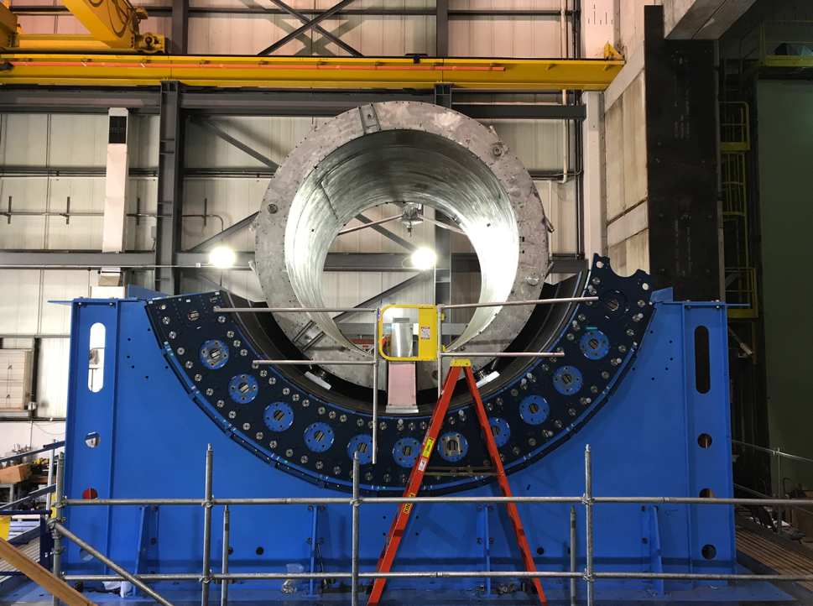
1008 Infrastructure and Facility Upgrade Status
Carriage/Cradle assembled in 1008
XY Carriage tables, Carriage Hydraulics installed
SC- Magnet installed in 1008
EMCal Installation fixture completed at SBU
IR track reinforcement complete.
Large Support Rings fabbed, assembly started at BNL
LHe cryo components part delivered installation begun
LN2 & warm piping part delivered installation begun
Magnet flux return Pole tip/end cap in production
sPHENIX Beam Pipe at vendor for modification.
Rack Platform in production at vendor
90% of IHCal assembly installations fixtures awarded and in fab. Remaining 10% submitted to BNL PPM.
The sPHENIX group was part of the CAD Safety stand down in October. All installation, assembly and contractor work paused for that day to reassess safety approach

Slide 5
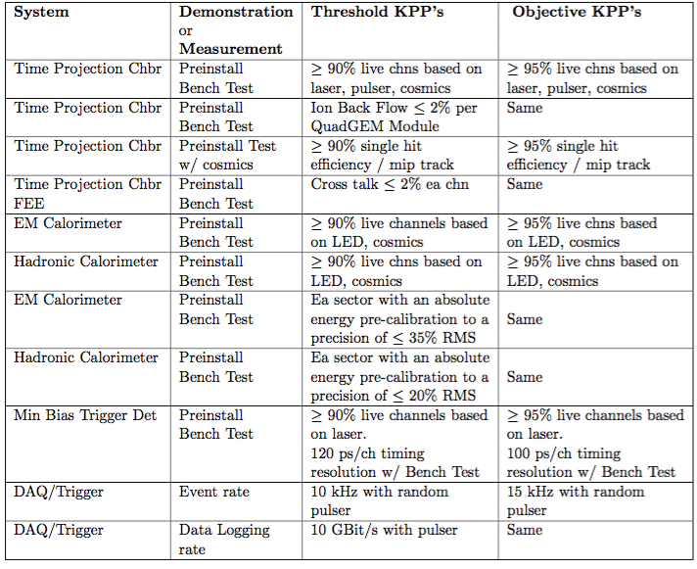
Threshold & Objective KPP’s
KPP’s were approved by DOE & BNL after the PD-2/3 Review May 2019
The individual L2 components of sPHENIX are the MIE deliverables.
Installation is not part of the MIE and not a deliverable.
KPP’s are determined using bench tests, LED/Pulser/laser tests, and cosmics. Beam collisions are not needed to satisfy the KPP’s.

Slide 6
Demonstrating the KPP’s
No beam necessary to demonstrate KPP’s
Everything is done w/ bench tests, laser, pulser, cosmic rays.
% Good Live channels are being/have been measured for each EMCal, HCal sector and TPC quad GEM module as the sectors/GEM modules are being built. Live channel percentage ~ 99%.
TPC single hit efficiency will require the TPC to be assembled with gas, HV and taking cosmic rays.
TPC cross talk will be demonstrated with TPC Fee bench tests.
TPC Ion back flow will be measured with x-ray test of all GEM modules at SBU.
EMCal/HCal absolute energy precalibration is a demonstration using bench test data that each sectors can be tuned using bias adjustments to an energy response w/ an RMS of 35%/20% respectively. This is not an energy normalization which will require beam to perform.
MBD timing resolution has already been demonstrated with bench tests
The DAQ/Trigger event rate (trigger rate with good live time) and DAQ/Trigger data taking rate (bandwidth, data logging) can be demonstrated using our slice test set up in 1008.

Slide 7
Summary
sPHENIX Installation continues to make good progress in sPHENIX Assembly Hall (Bldg 1008)
SC-Magnet successfully installed into sPHENIX in October.
Major 2021 shutdown tasks for sPHENIX successfully completed
The sPHENIX CPI continues to be very good at 1.02. The SPI is 0.90 improving as orders arrive. The MIE is 99.3% Costed and committed. Contingency 54.2%.
The 1008 I&F CPI good at 1.03. The SPI improving at 0.87. I&F is 80.6% Costed and Committed. 16.1% contingency.
Construction is proceeding on sPHENIX final detector components at a wide variety of sites.
Continued great progress in sPHENIX factories: OHCal sectors complete, 95% of EMCal blocks and 67% EMCal sectors complete. Assembly of TPC Fee production boards started. TPC quad-GEM fab started > 70% complete. All MVTX staves complete and half barrel construction begun at LBNL. Electronic, DAQ/Trigger, MBD, INTT, IHCal all making good progress.
Concern remains about maintaining staffing levels, particularly our need for mech and electrical techs at BNL.
Recent availability of techs make us optimistic we will be able to cover our needs.
Concern about delivery dates for electrical and electronic components. Concern about availability of epoxy. Delays may pushback the Early Completion date of MIE but will not affect the PD-4 date.

Slide 8
Back Up

Slide 9
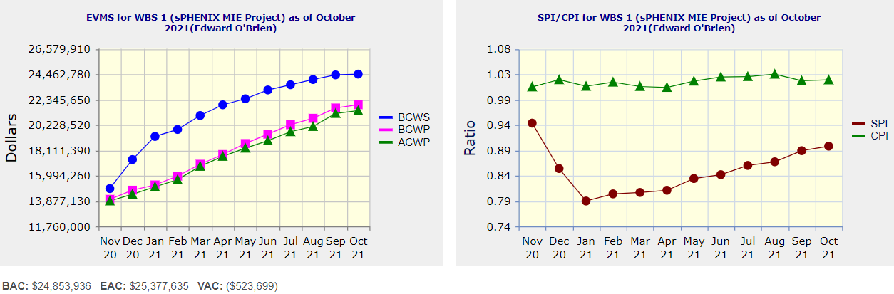
Performance Indices – sPHENIX MIE
Cumulative SPI | Cumulative CPI
0.90 | 1.02
Cumulative BCWS (Scheduled) | $24,470,691
Cumulative BCWP (Performed) | $21,916,150
Cumulative ACWP (Actual) | $21,419,152
DOE SPI or CPI Value Thresholds
0.90 to 1.15
0.85 to 0.89 or 1.16 to 1.25
<0.85 or >1.25

Slide 10
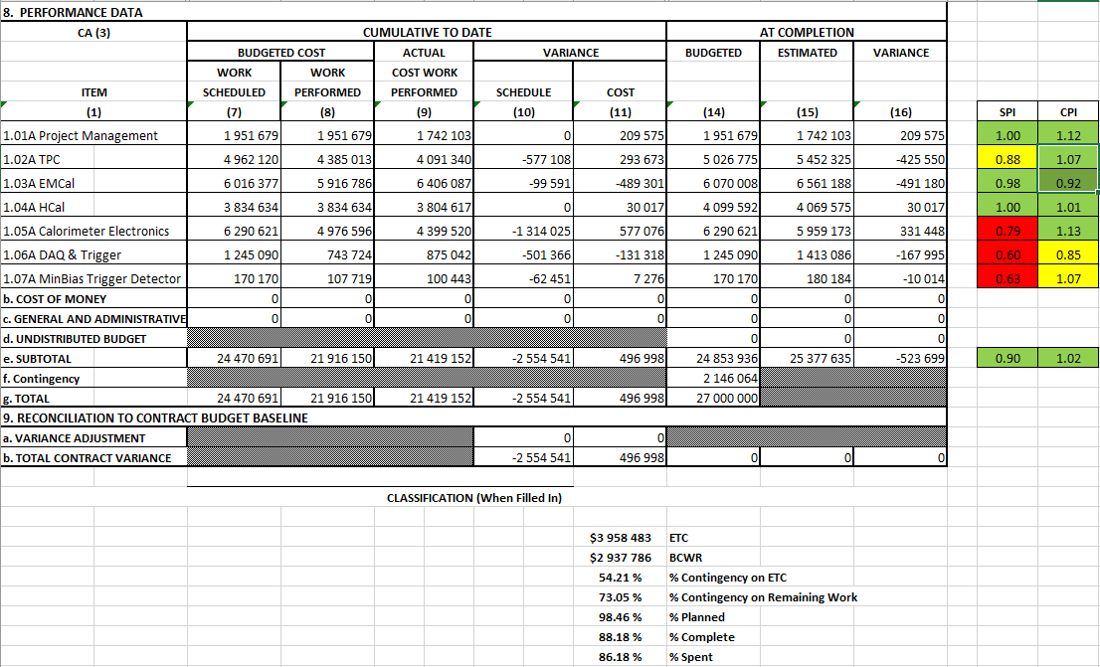
Cost Performance Report (CPR) – sPHENIX MIE
DOE SPI or CPI Value Thresholds
0.90 to 1.15
0.85 to 0.89 or 1.16 to 1.25
<0.85 or >1.25
*Highlights in table above takes variance $ into consideration, not just Indices

Slide 11
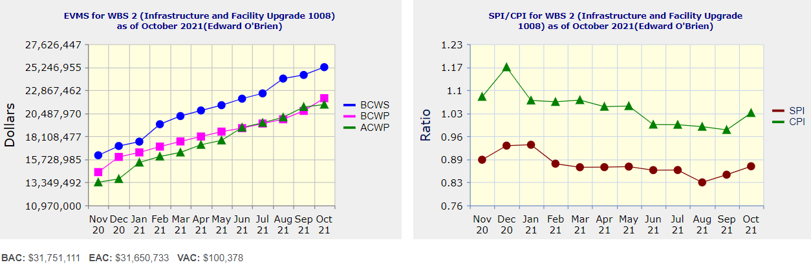
Performance Indices – 1008 Infra and Facility Upgrade
Cumulative SPI | Cumulative CPI
0.87 | 1.03
Cumulative BCWS (Scheduled) | $25,253,149
Cumulative BCWP (Performed) | $22,045,806
Cumulative ACWP (Actual) | $21,383,852
DOE SPI or CPI Value Thresholds
0.90 to 1.15
0.85 to 0.89 or 1.16 to 1.25
<0.85 or >1.25

Slide 12
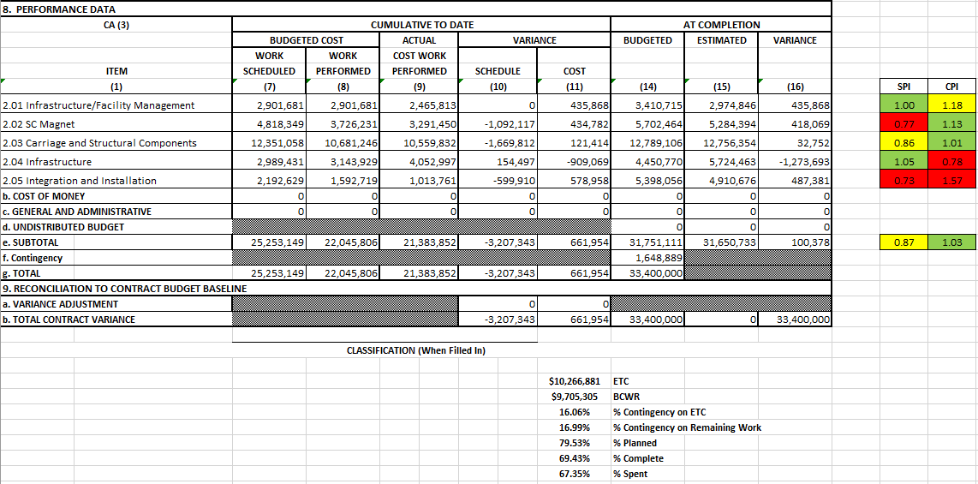
Cost Performance Report (CPR) – 1008 Infra and Facility Upgrade
DOE SPI or CPI Value Thresholds
0.90 to 1.15
0.85 to 0.89 or 1.16 to 1.25
<0.85 or >1.25
*Highlights in table above takes variance $ into consideration, not just Indices

Slide 13
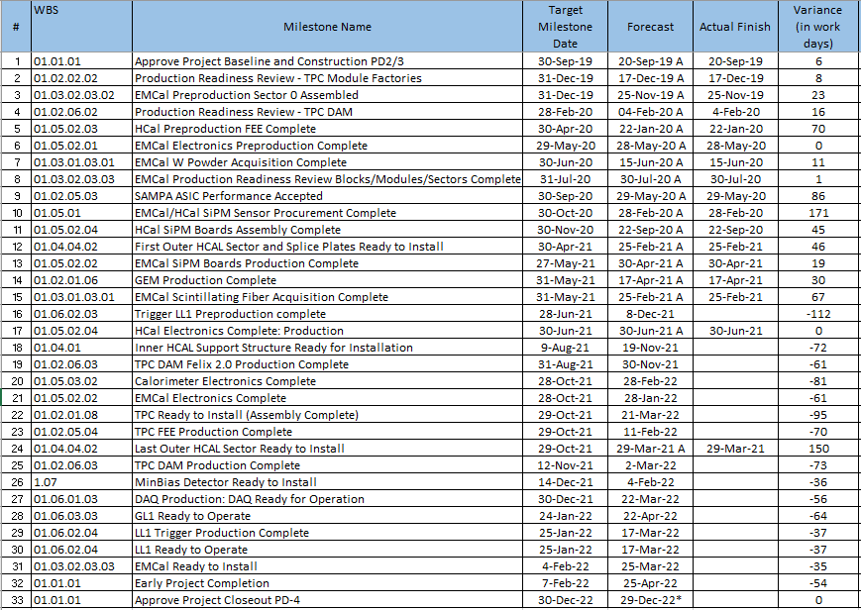
Milestones Status – sPHENIX MIE

Slide 14
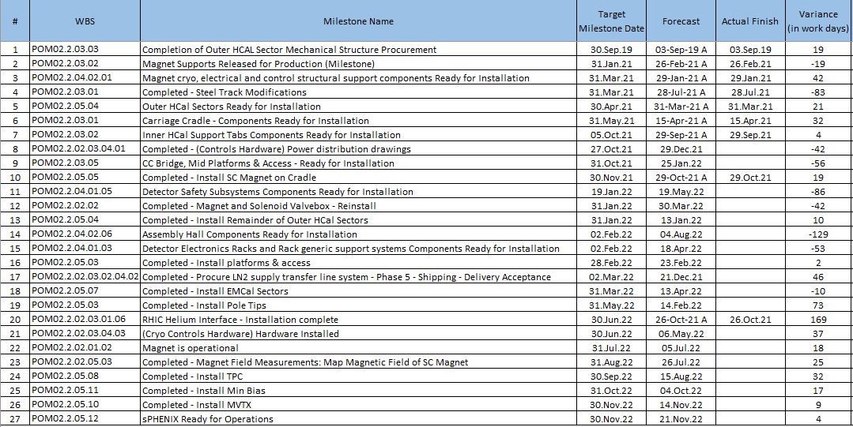
Milestones Status – 1008 Infra and Facility Upgrade

Slide 15
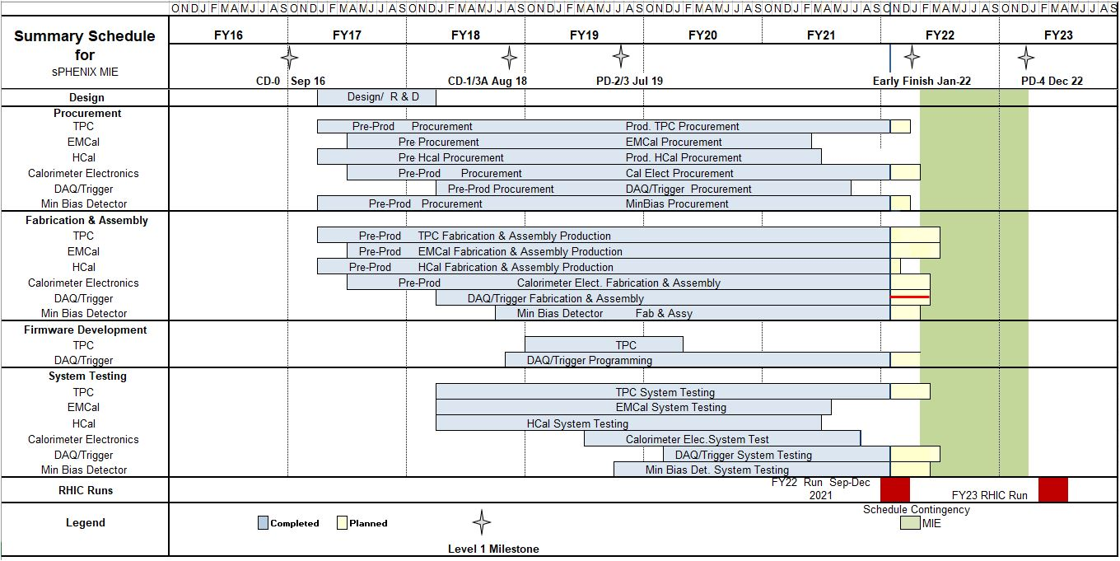
Summary Schedule – sPHENIX MIE

Slide 16
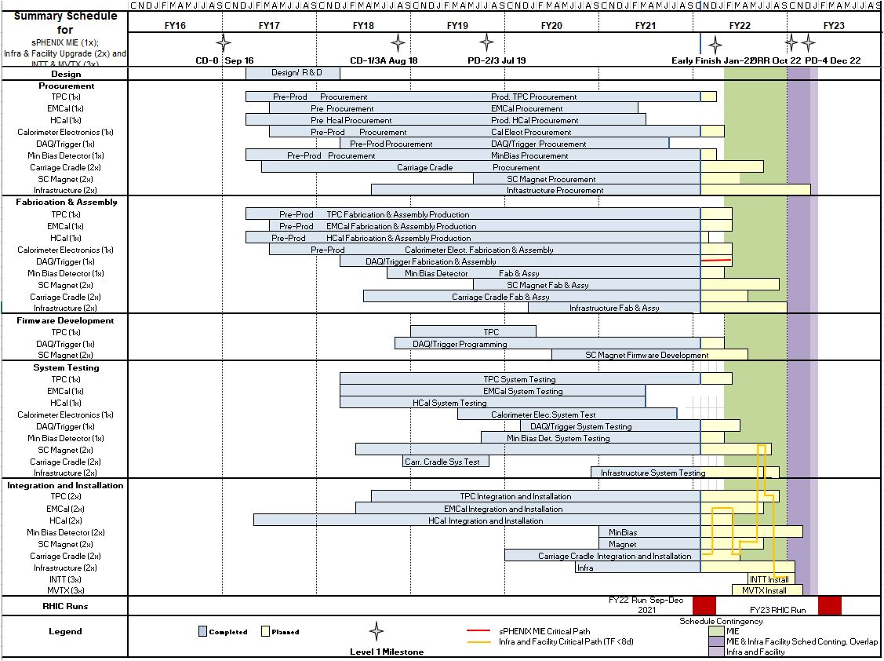
Summary Schedule – sPHENIX MIE and 1008 Infra and Facility Upgrade

Slide 17
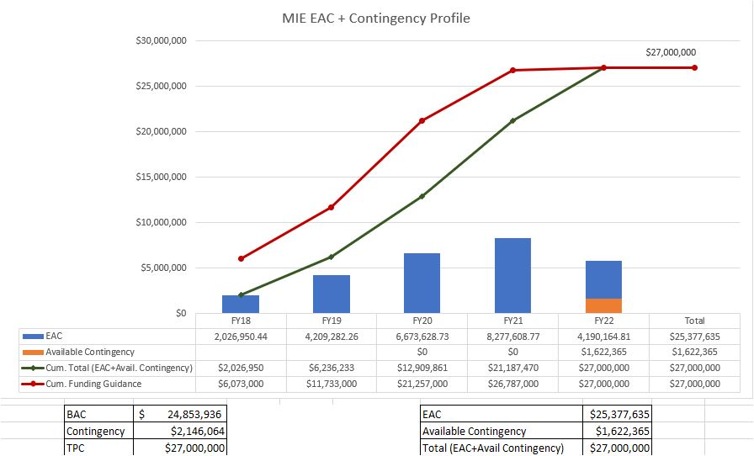
EAC and Contingency Profile – sPHENIX MIE

Slide 18
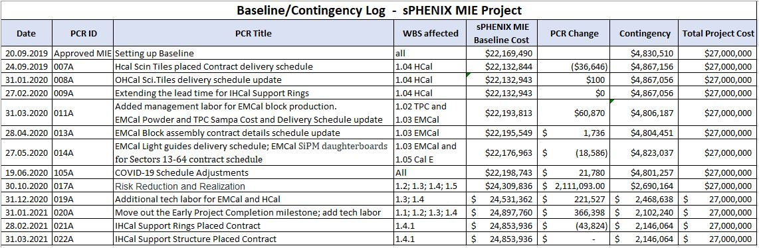
Baseline/Contingency Log and ETC adjustment Log - MIE
ETC Adjustments
Control Account | Aug’21 | Sep’21 | Oct’21
1.02 | $326,377 | $556,377 | $716,238
1.05 | $22,833 | $22,833 | $219,343
1.06 | $79,352 | $79,352 | $26,259
1.07 | $25,705 | $25,705 | $16,041
Total | $454,267 | $684,267 | $977,880

Slide 19
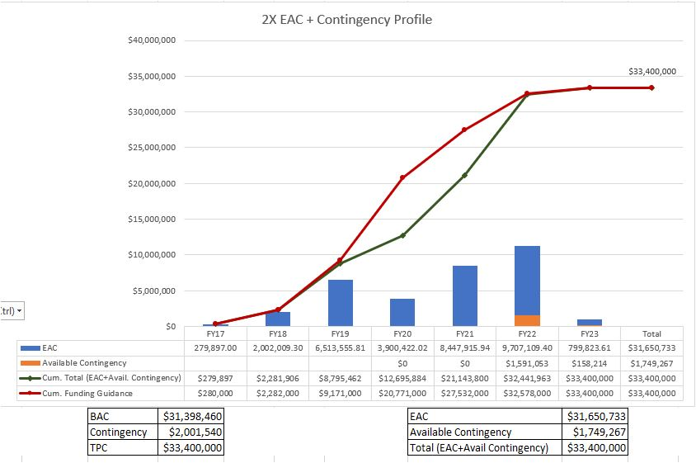
EAC and Contingency Profile – 1008 Infra and Facility Upgrade

Slide 20
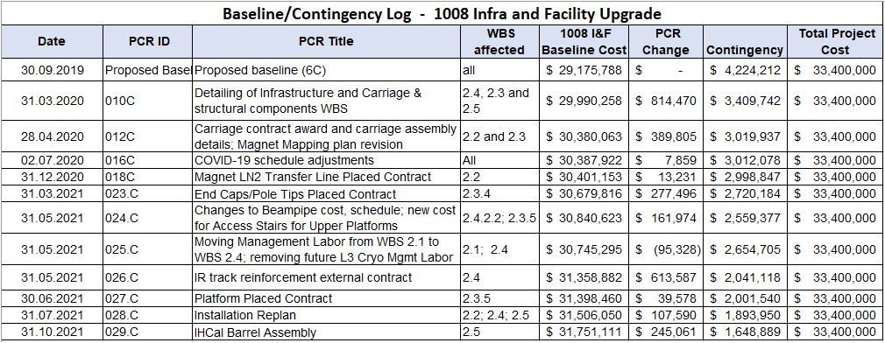
Baseline/Contingency Log and ETC adjustment Log – 2.X
ETC Adjustments
Control Account | Sep’21 | Oct’21
2.3 | $90,775 | $70,349
2.4 | $70,160 | $350,388
2.5 | - | $73,413
Total | $160,935 | $494,150

Slide 21
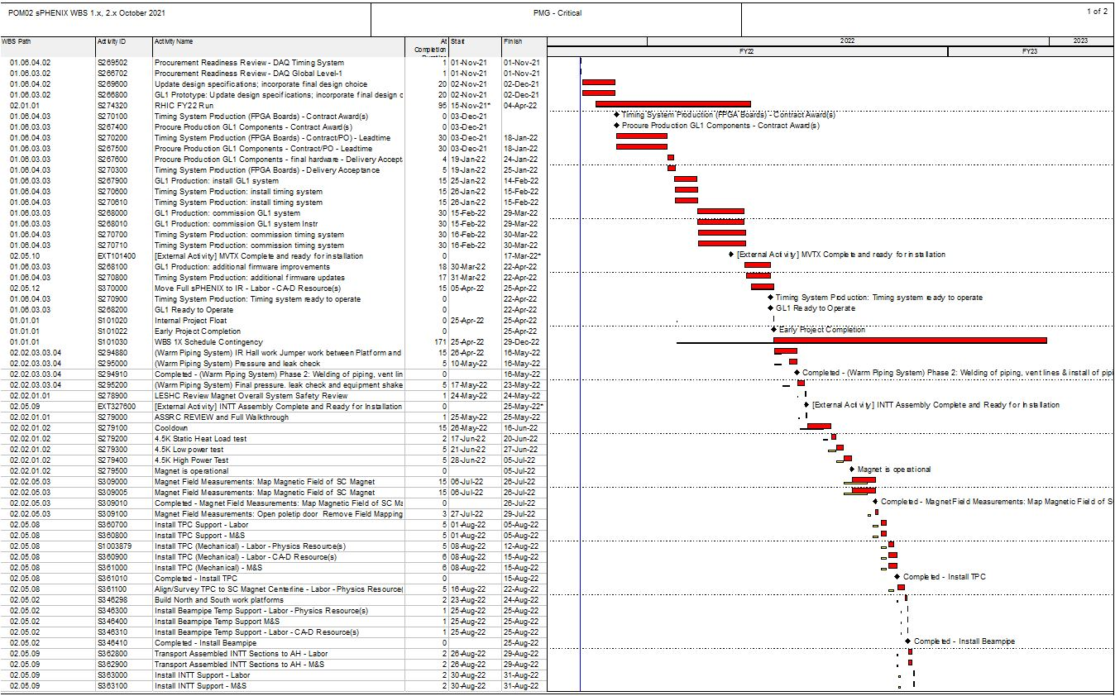
Critical Path (1x, 2x and 3x Combined)

Slide 22
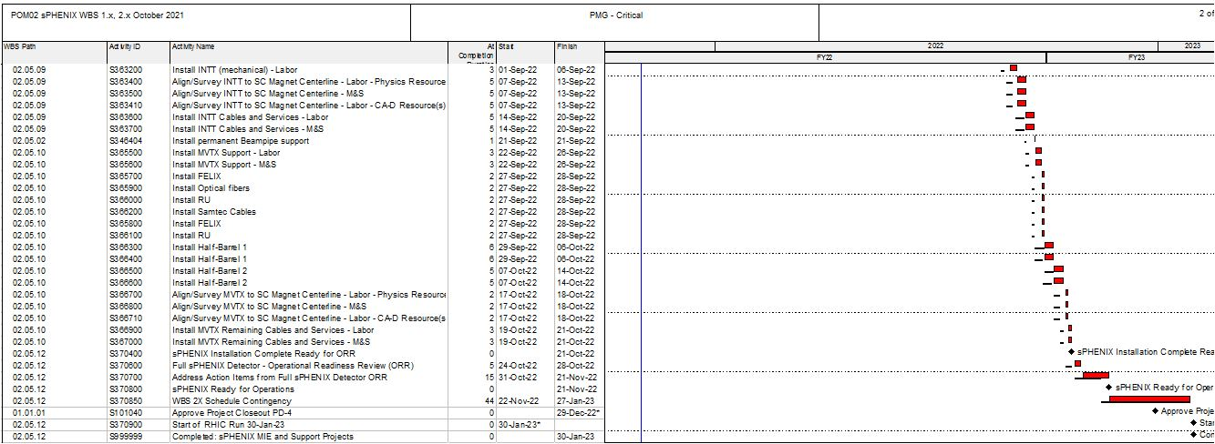
Critical Path (1x, 2x and 3x Combined)

