Slide 1
sPHENIX TPC Module QA
TK Hemmick

Slide 2
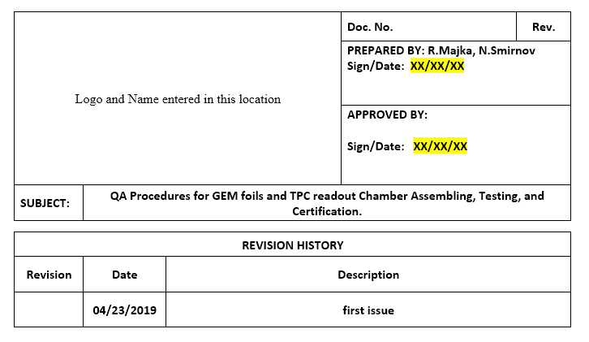
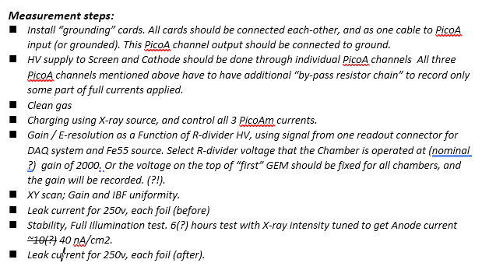
Standard Operating Procedure Document
sPHENIX SOP for Module Assembly draft was written
by Dick Majka and Nikolai Smirnov
  Basically a copy of the ALICE document for the IROC manufacture.
  Adjustments made to radiation load test criterion
Initially Yale was to perform the testing using the ALICE apparatus.
  This agreement fell through.
  SBU built a “philosophical duplicate” of the Yale system.
  Procedures are criterion are basically identical except:
    Different brands of components.
    Different software running the show.
sPHENIX changes to ALICE Procedure:
⁵⁵Fe test is skipped.
  sPHENIX doesn’t use dE/dx.
  Handling of ⁵⁵Fe not worth it.
Stability test scaled to 40 nA/cm²
  See next slide.

Slide 3
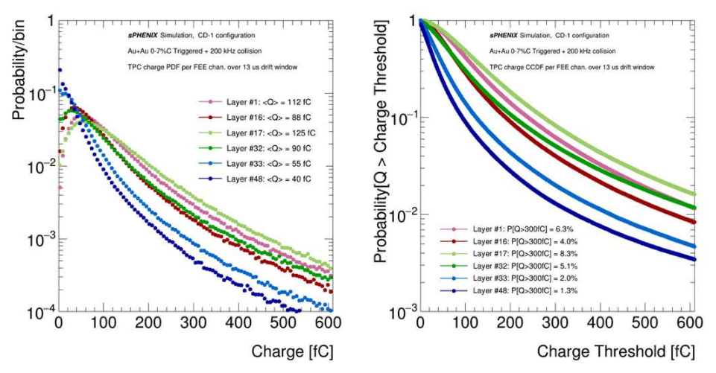
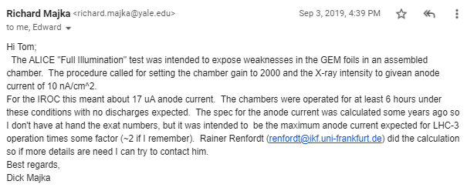

Radiation Load Test
ALICE specification:
  10 nA/cm² for 6 hours
  IROC = 17 μA
Experience:
  Sounds extreme
  Not really troublesome in experience.
sPHENIX specification:
  40 nA/cm² for 6 hours
  R1 = 12 μA; R2 = 21 μA; R3 = 29 μA
Experience:
  Sounds extreme
  Not really troublesome in experience.

Slide 4
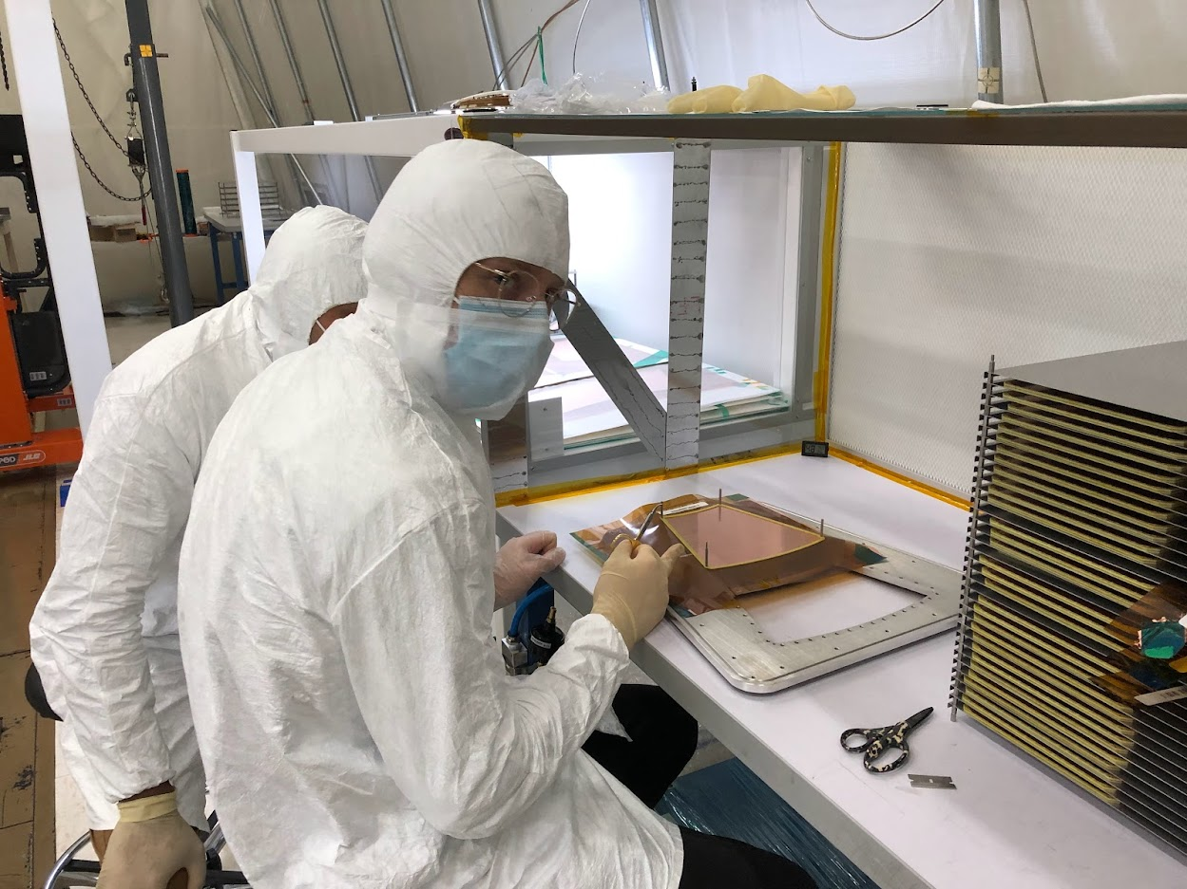
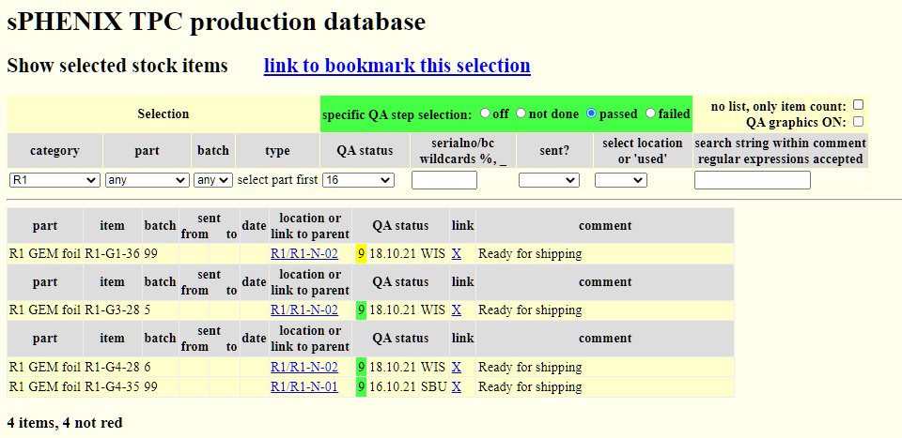
Nitty Gritty Details: GEM Trimming
Bar Code
Database (courtesy Peter Glaesel)
Every GEM is barcoded and has a status from the factories (WSU, WIS, Temple, Vanderbilt) and has a status recorded in the database with regard to all factory tests.
Only Green & Yellow (e.g. visually marred not affecting performance) are trimmed.
NOTE: GEMs only handled on clean TABLE inside clean room (better than best clean room)

Slide 5
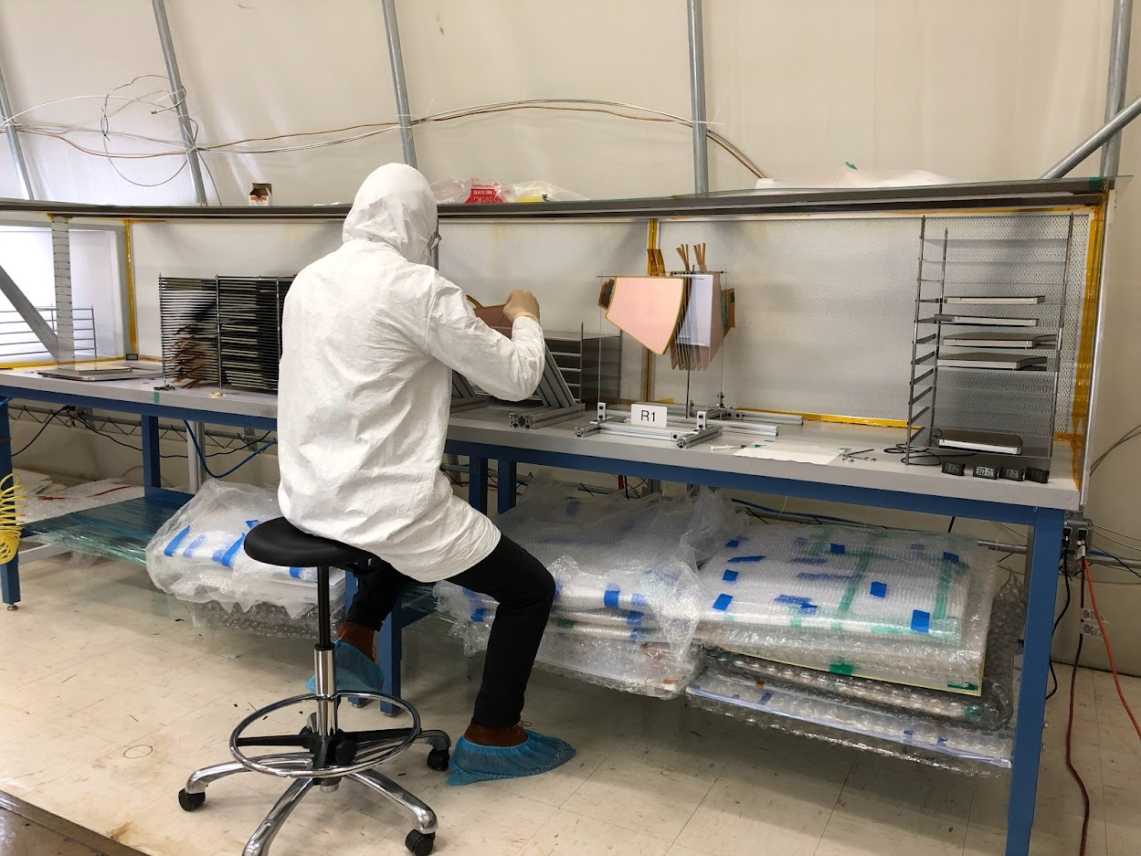
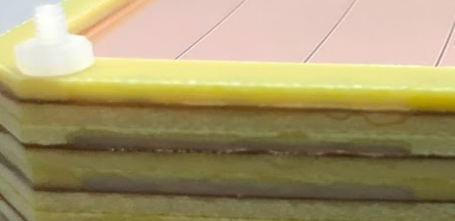
Nitty Gritty Details: Resistor Potting
Cured at 90º
Sealed
Syringe injection at 45º
ALICE experience revealed a weak point: Sharp exposed solder points.
sPHENIX design eliminates those solder points using “tails”
  Distance to next gap retained.
  Only exposed voltage is CERN-mounted inside “frame pocket”
  Fully potted to completely eliminate all exposed voltage.

Slide 6
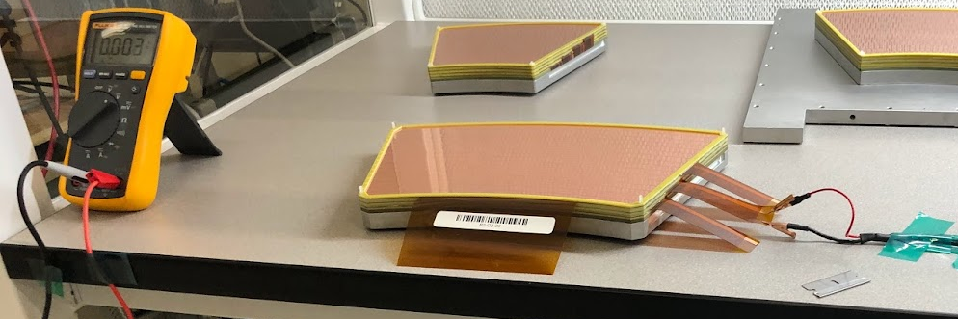
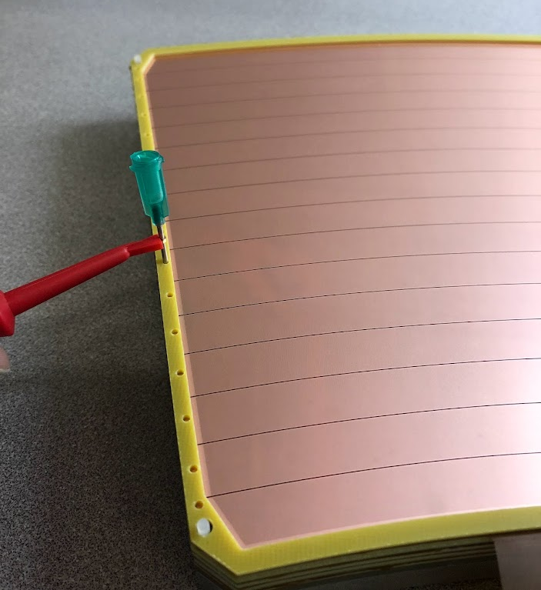
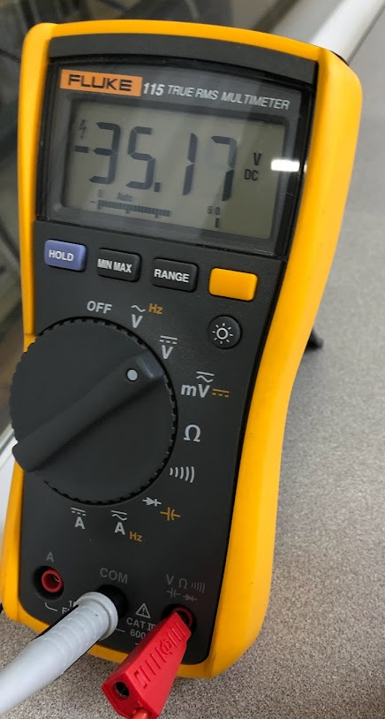
Nitty Gritty Details: Continuity Test
33 Volts
100 Volts
Each GEM is stacked onto the pad plane.
100 Volts is applied to the pad plane:
  Each stripe has 20 MΩ current limiting resistor.
  Voltmeter has 10 MΩ input resistance.
  33 Volts expected on each stripe
    Can reveal disconnect at resistor. (3 GEMs out of 240 failed)
    Can reveal break in HV trace to tail. (zero failures so far)
    Can reveal shorts to neighbor. (zero failures so far).
Test Probe
Access Holes

Slide 7
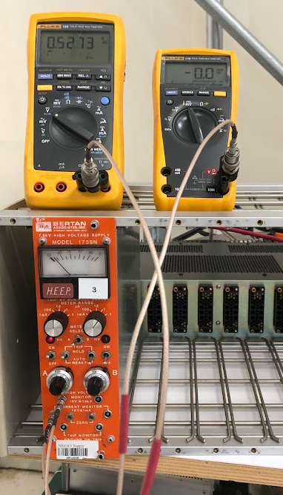
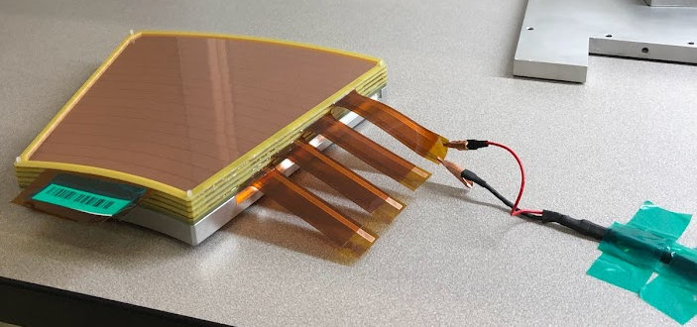
Nitty Gritty Details: Air HV test
Slice away bar code if & only if GEM passes HV
Over-stress each individual GEM
  MAKE it fail now, if it every will.
  Started at 525 Volts in air, upgraded to 535 volts in air.
    NOTE: SBU clean room has lots of fans and is HOT.
    Humidity always 35% even when the rest of the lab is muggy.
  If any activity is seen, send to 555 V, leave it there (try to kill it)

Slide 8
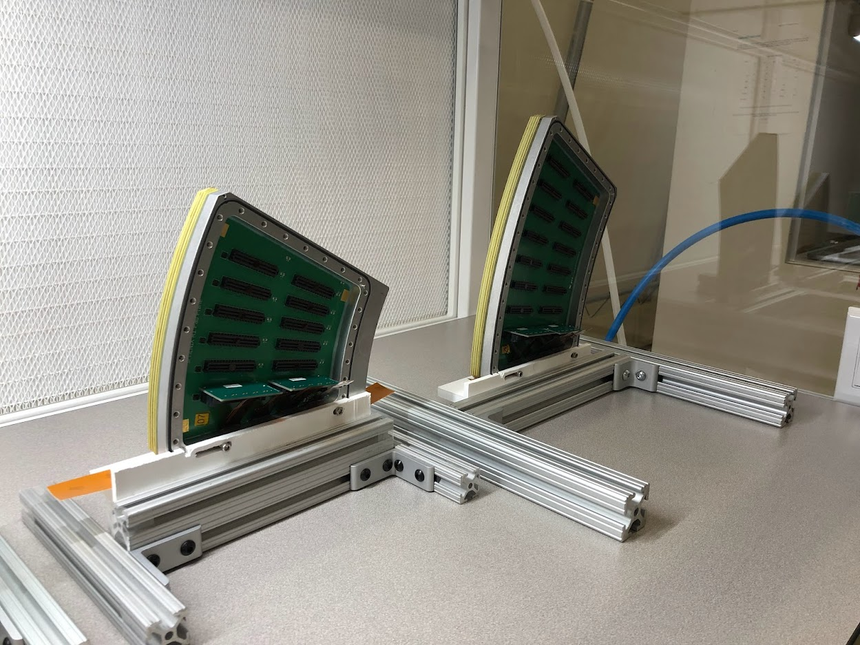
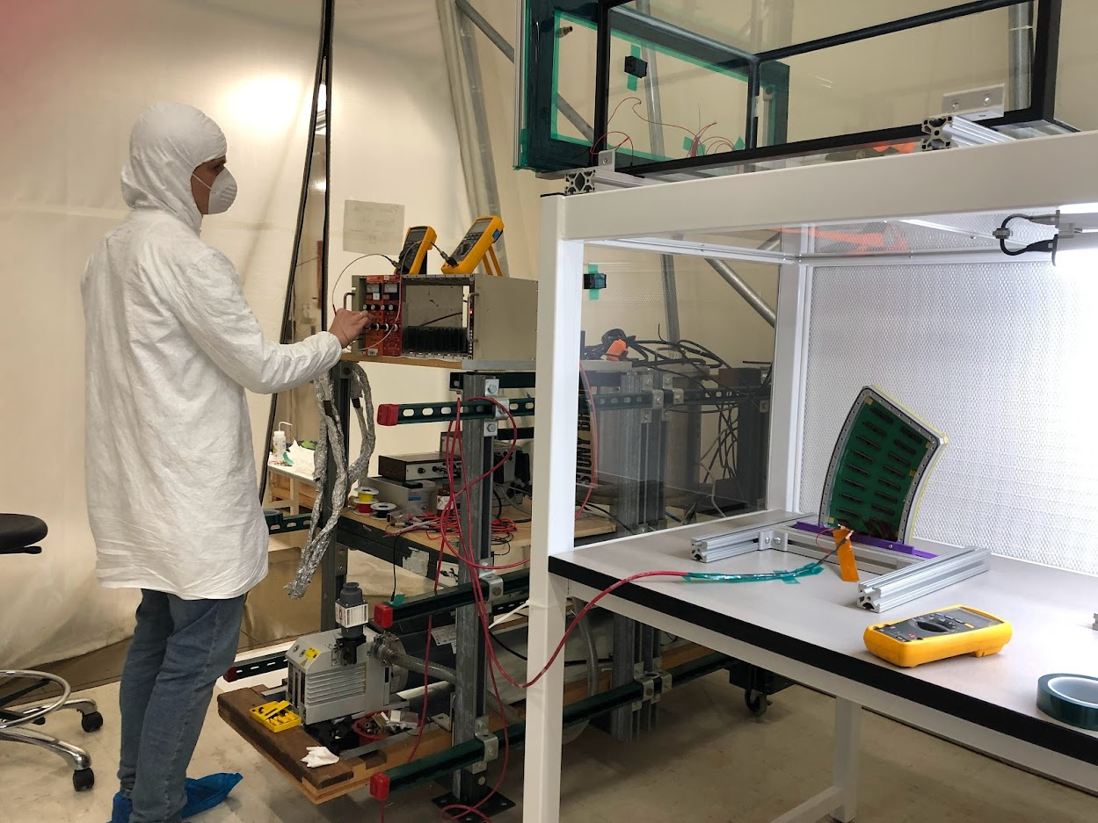
Nitty Gritty Details: Tail Potting
HV tail exist the detector via small slot in the strongback.
Potting for gas seal.
After cure, final test can be performed for GEM-by-GEM
  This test has been replaced during the Xray box testing…

Slide 9
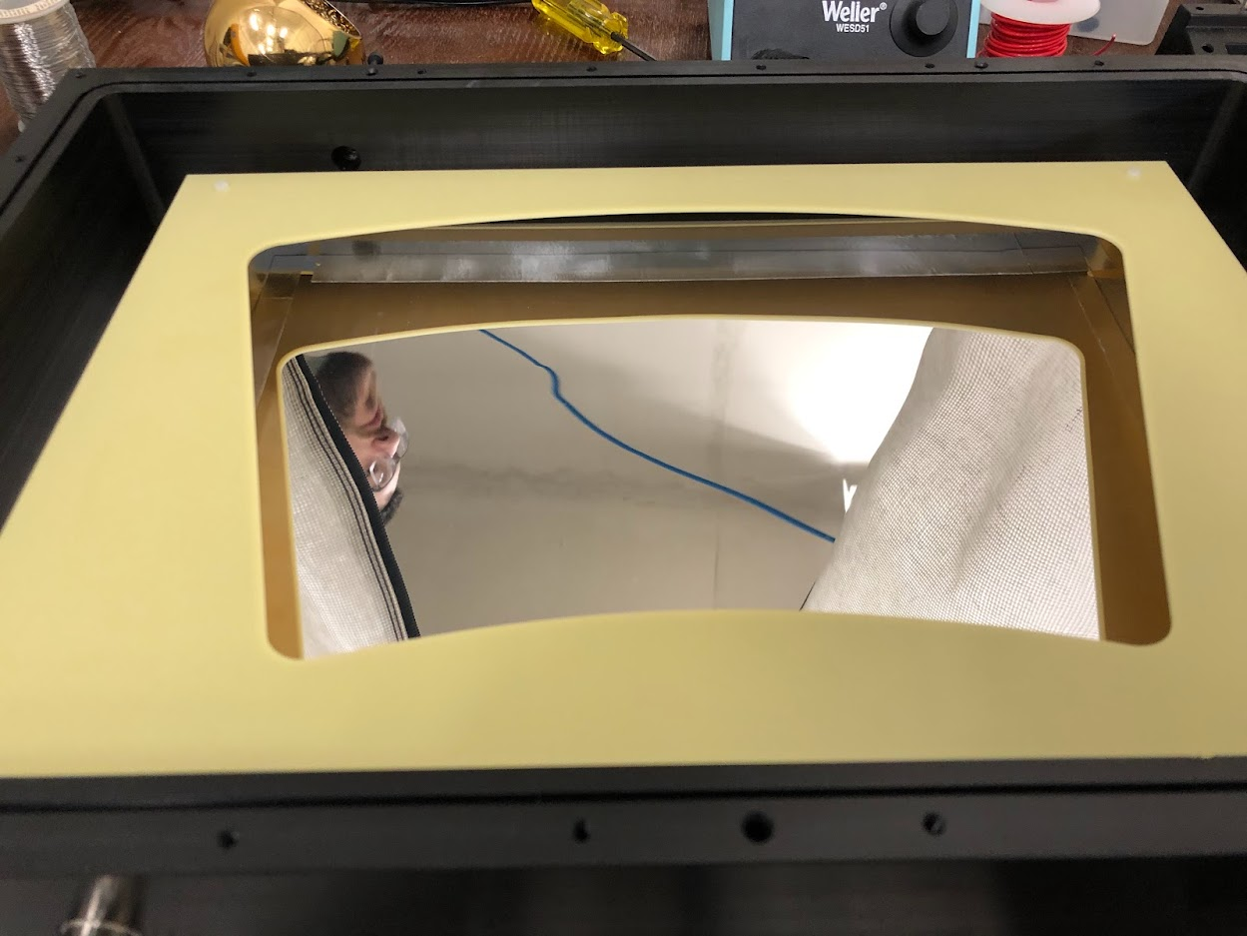
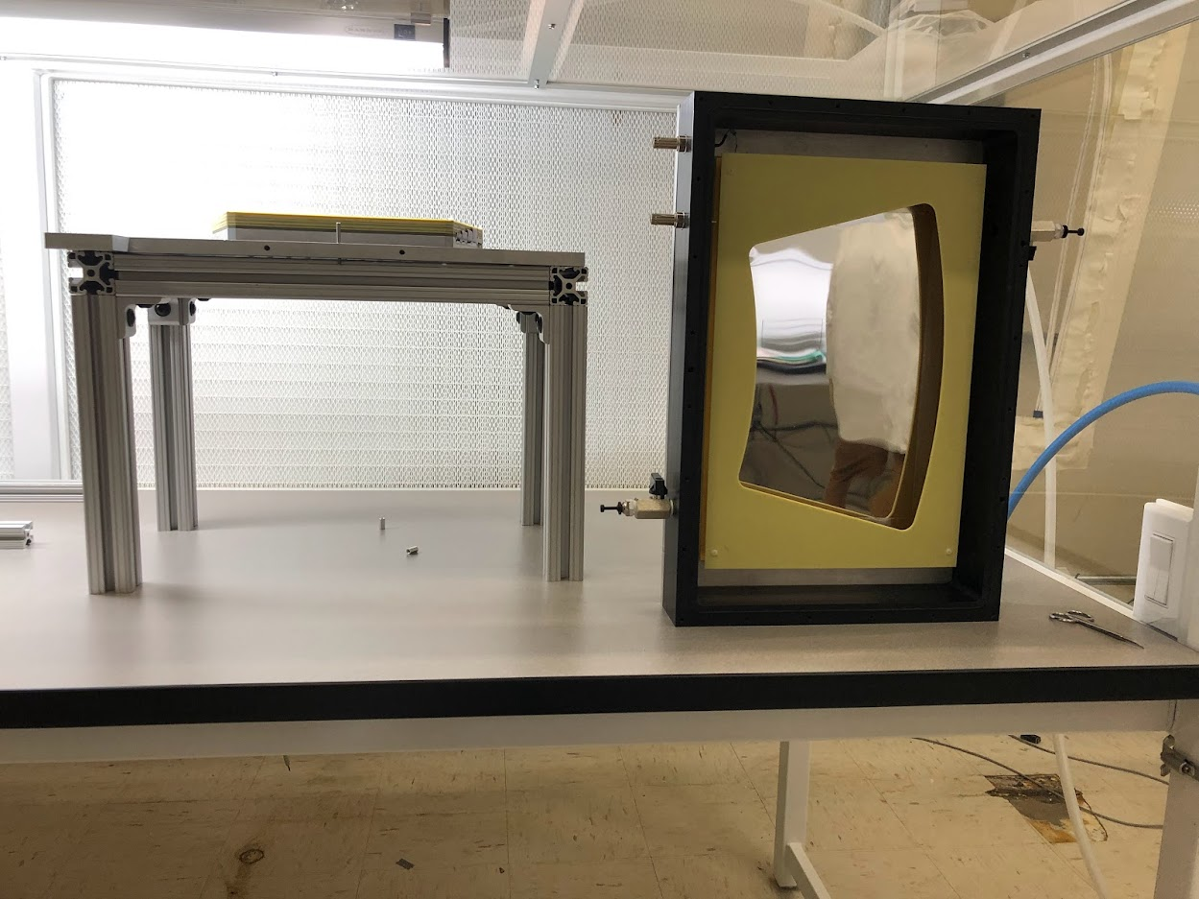
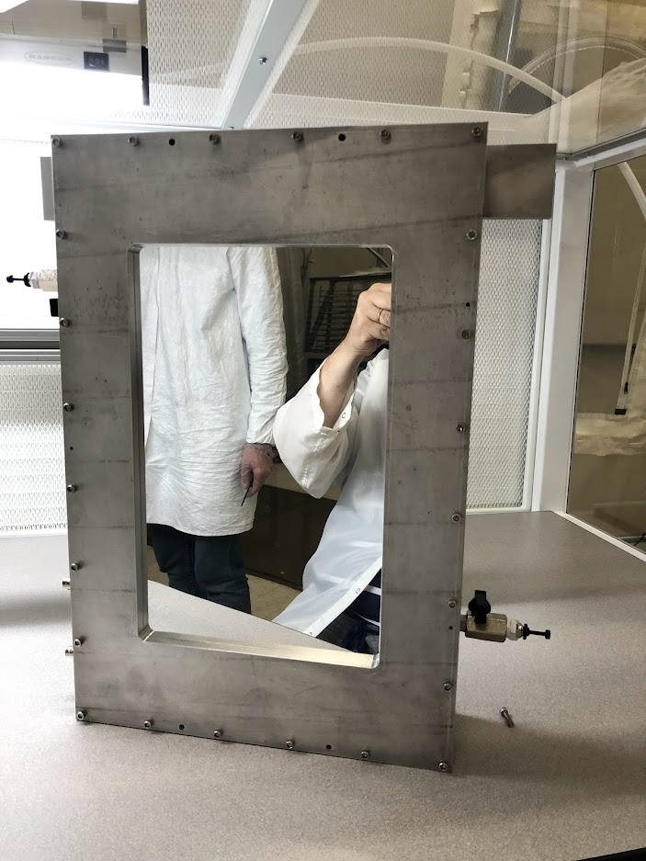
Nitty Gritty Details: Xray Gas Enclosure
IBF Collection
“Mask”
Module “raised” to ease bolt insertion
Box top alignment pins ensure safety
The Xray test box has two potential planes:
  Al-mylar sheet collects positive ions for IBF mapping.
  Open “mask” extends top GEM potential to smooth the field.
Module bolts to back plate and “window assembly” seals.
  Dove-tail O-ring grooves so O-rings never fall.
Sealed box suitable for travel to non-clean environment

Slide 10
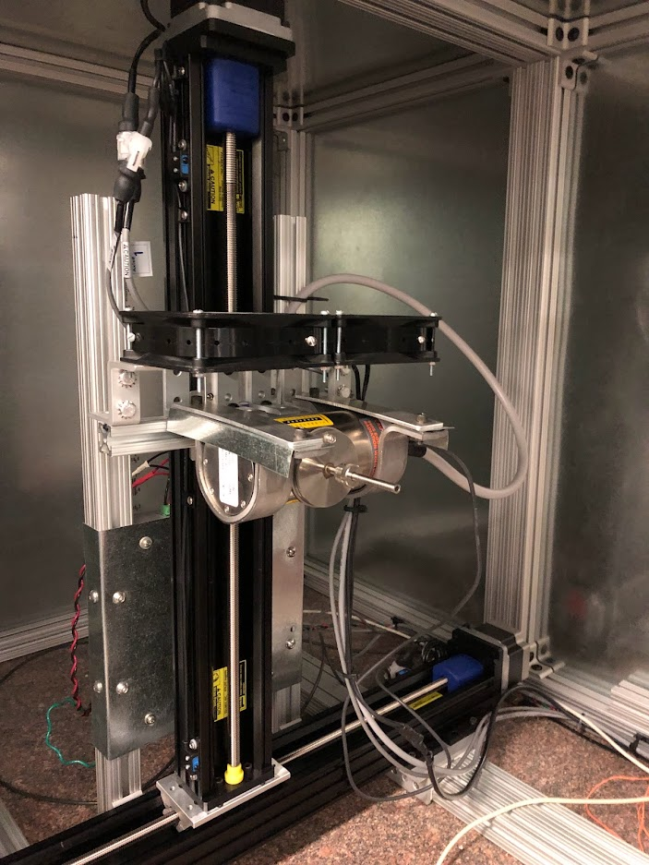
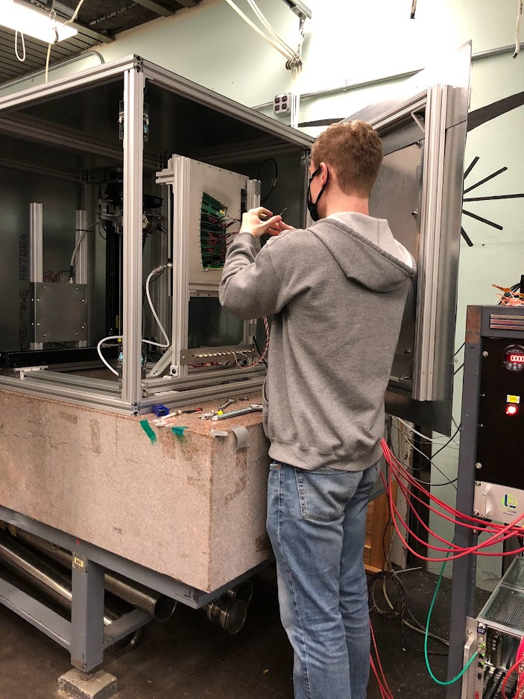
Nitty Gritty Details: Xray Box Installation
Pad Charge Collection
Xray Gun
Module Install
Xray Gun mounted to X-Y translational stage
Module installation:
  Connect Gas.
  Connect HV
  Connect pad-charge collection boards.
μPORE
Door Interlock(s)
High Voltage

Slide 11
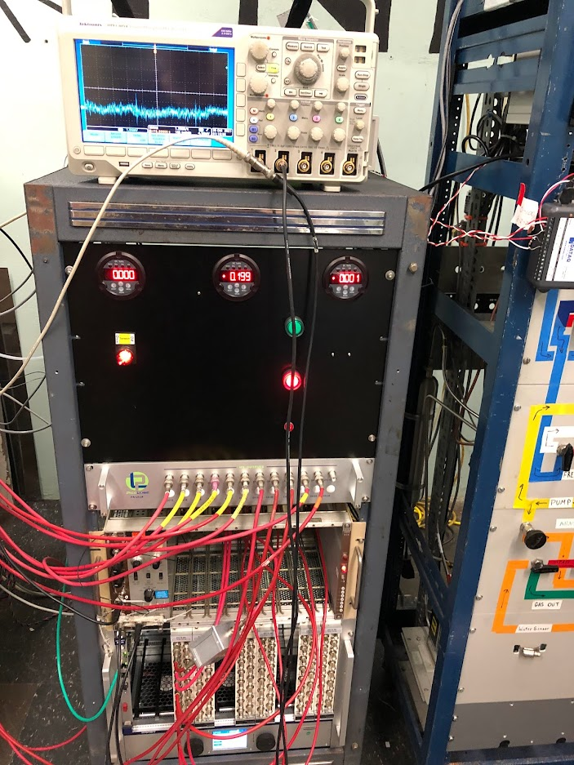
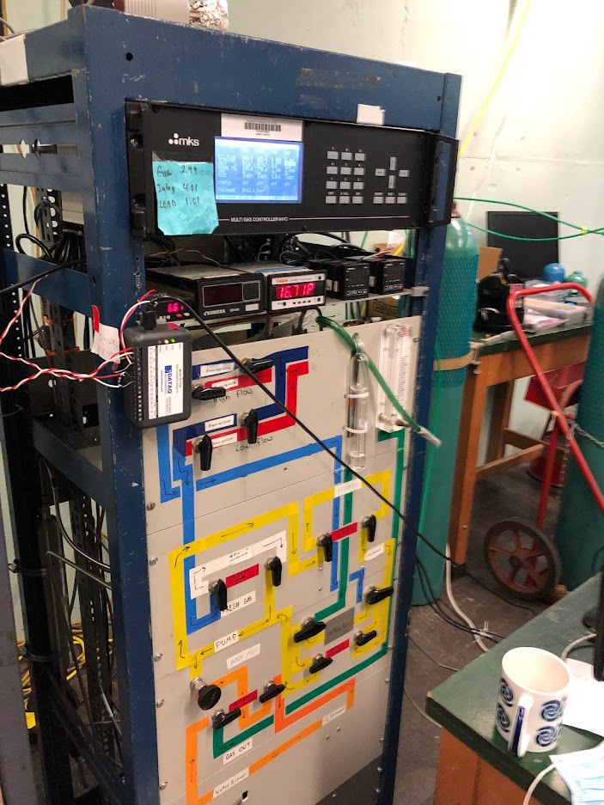
Nitty Gritty Details: Xray Box Installation
Venerable “Klaus’ Gas System”
  Computer control all flows/
  O₂ and H₂O readings
  Pressure Reading
  Temperature Reading
Used as pass-through here.
Used recirculating on TPC.
Xray
pA
NIM
HV
Xray panel has HARDWARE readout of settings (trust but verify)
Xray panel has human-actuated interlock (allow or crash)
Standard “Zagreb” 12-channel pAmmeter

Slide 12
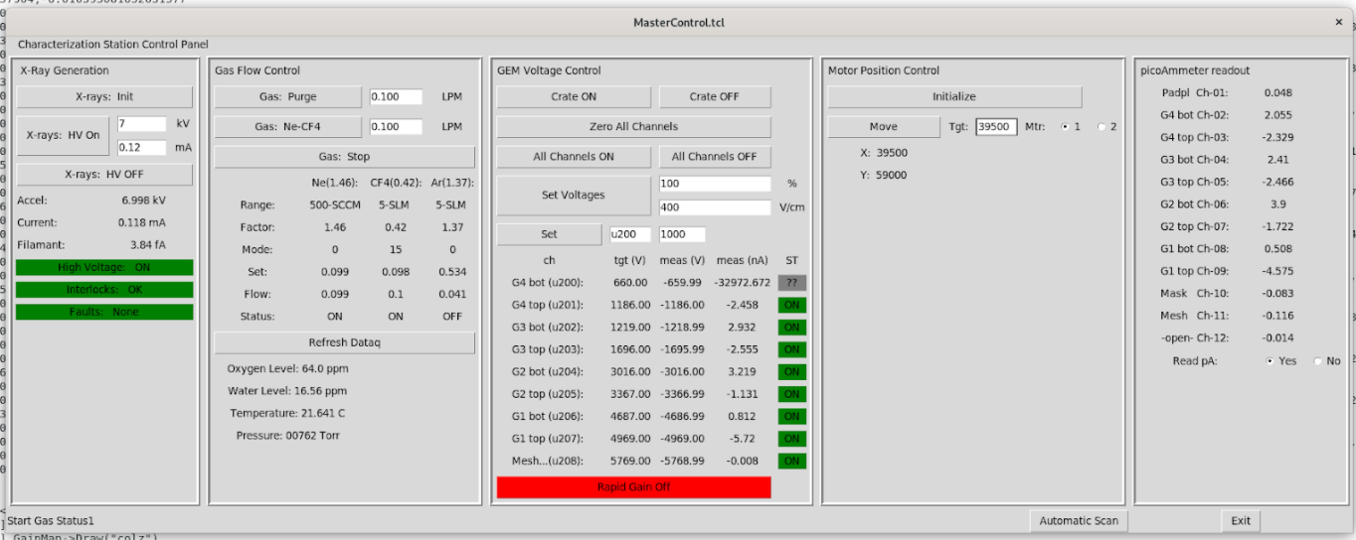
Nitty Gritty Details: Control Software
Purschke Philosophy:
  All actions are prompt level shell commands
  Stateless GUI (Tcl/Tk) submits shell commands (buttons) and
  monitors status (labels)
X-ray controls: Zhenia Shulga
Gas Flow controls: Zhenia Shulga
High Voltage controls: Sara Kurdi
Motor Controls: Luke Legnosky
pAmmeter Controls: Zhenia Shulga
Stateless GUI: TKH

Slide 13
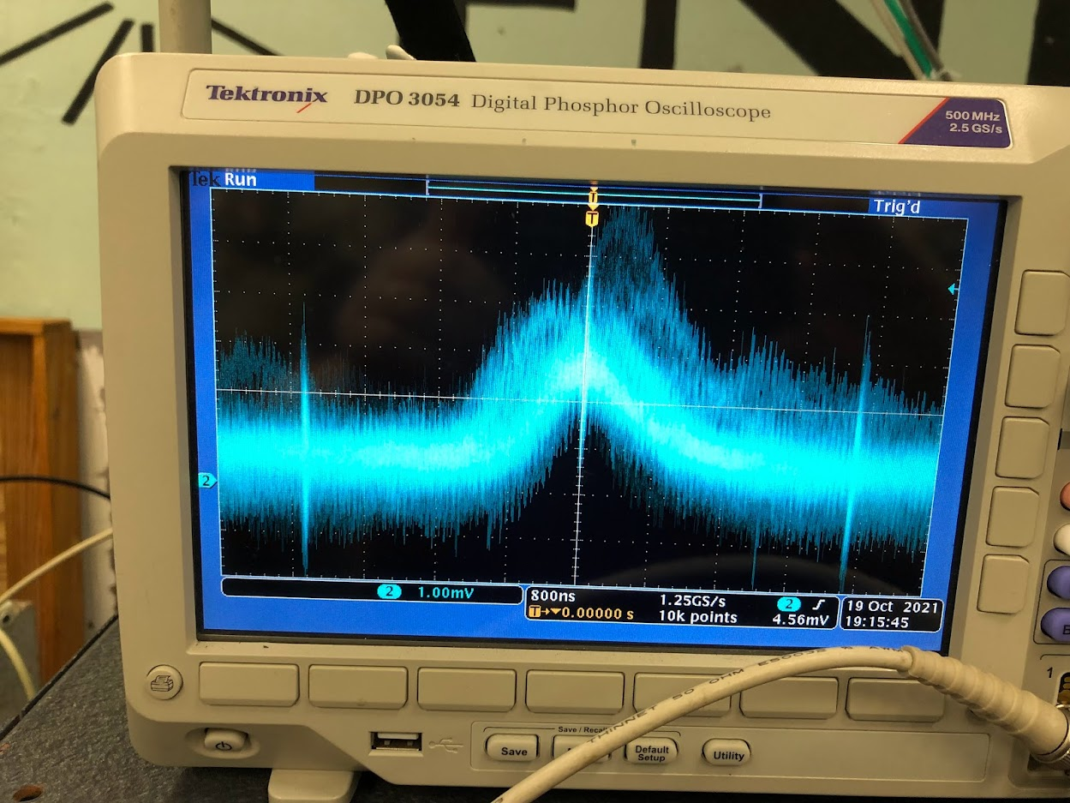
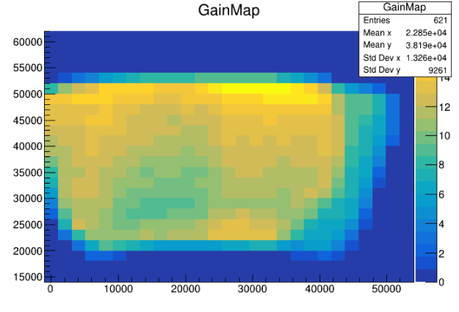
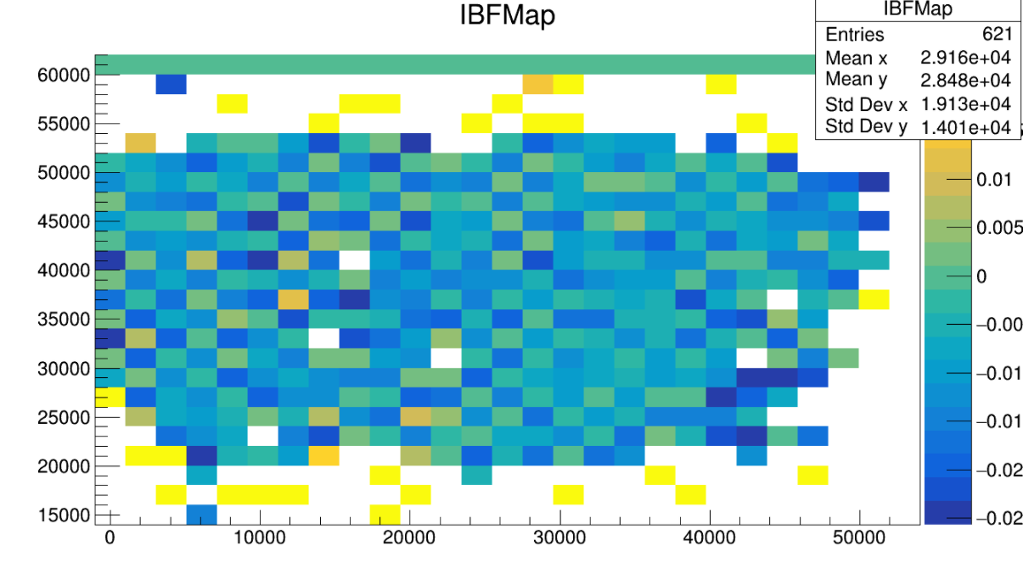
Nitty Gritty Details: In Operation
Xrays from 32-ganged pads
Just coming alive now.
Quick scan (X-ray aperture too big & too far back)
3 hour “bombardment”…no issues.

Slide 14
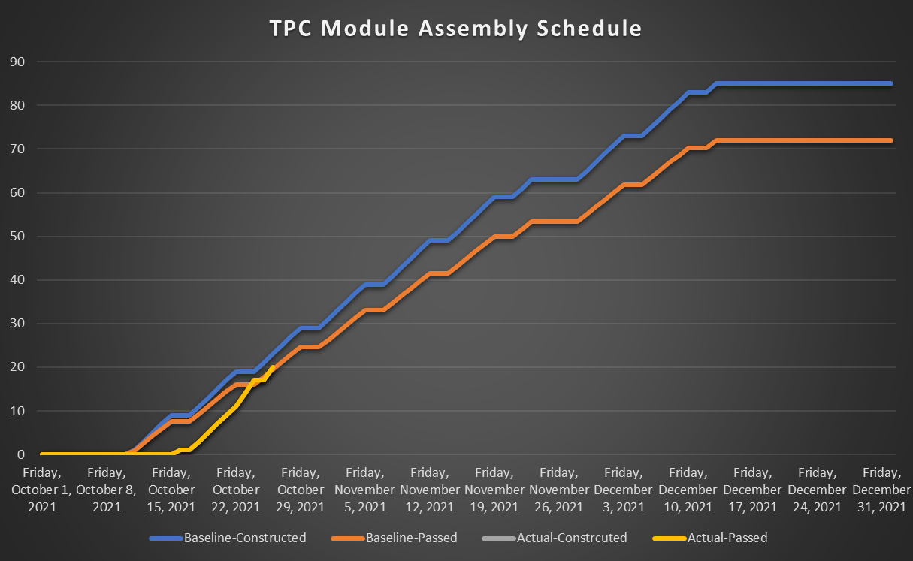
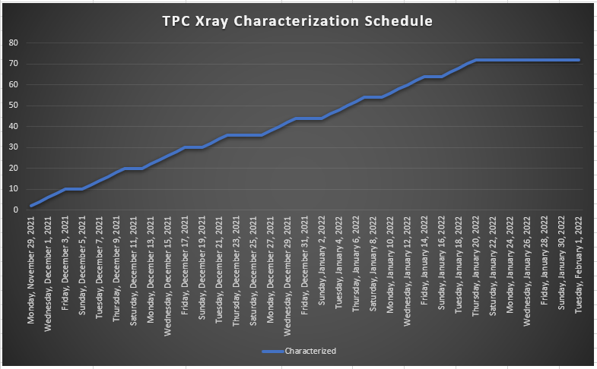
Schedule
Today
Thanksgiving
New Year’s
float
Christmas
float
3 modules/day
2 modules/day
Routine module testing begins after Thanksgiving.
  System working, but still needs code development, database interface, pass/fail analysis code…
Installation of modules into the TPC will proceed in parallel with the Xray characterization of the modules throughout January 2022.
For the Xray testing, we assume 2 modules per day 5 days per week from a fully dedicated crew
(Luke Legnosky, Chris Reynolds, Sara Kurdi)
Schedule lag can be compensated using weekends (working well for Assembly crew)
10 days float for on-time module installation by February 1.

Slide 15
Summary
QA at the factory (complete, largest source of failure is single GEMs):
  High voltage stability of individual GEM foils.
QA at Assembly (3 GEMS out of 240 failed…not used):
  Connectivity, stripe-by-stripe
  Overstressed in air.
QA in Xray box (starting up…refining procedure…)
  GEM-by-GEM and gap-by-gap on working gas.
  Gain map.
  IBF Map.
  Stress test (40 nA/cm²)
QA in the TPC (Spring)
  Recirculation flow.
  Sector-by-sector cosmics (ain’t streaming readout grand!)
  Demonstrate KPP (live channels, efficiency, …)
  Deliver July 2022

