Slide 1
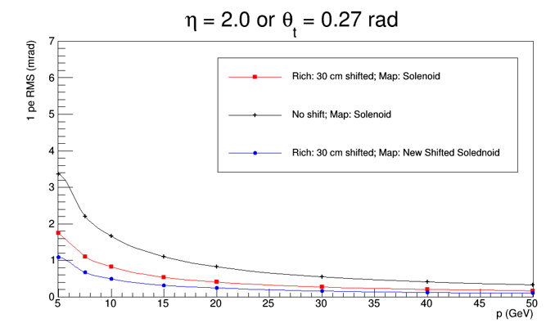
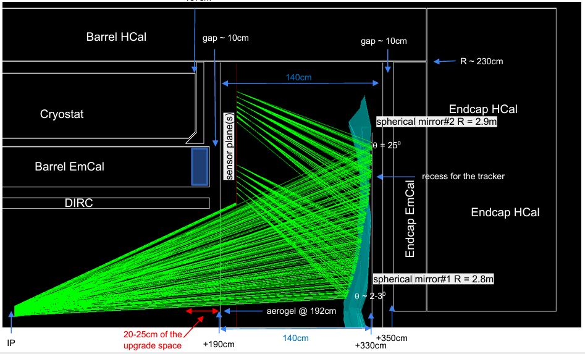
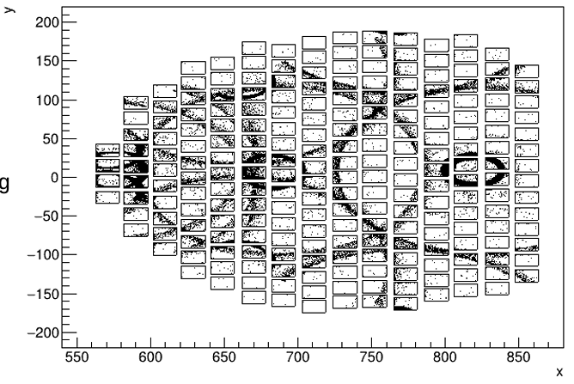
a)
b)
“pretty plot” needs to be updated to a single mirror
Result needs to be updated.
Alexander promises update.
c)
d)

Slide 2
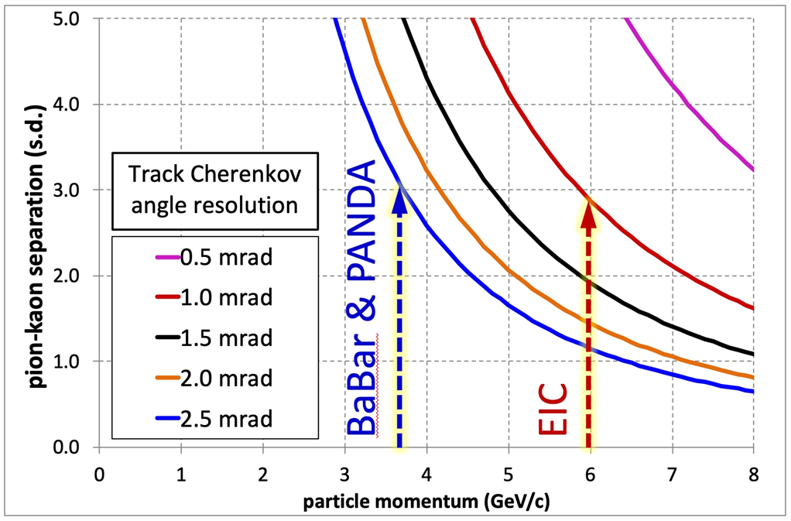
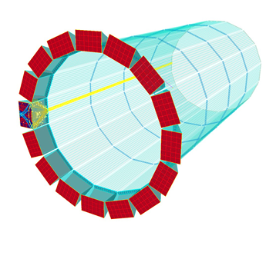
Volunteer from SBU to help with coding technicalities.
Also Sylvester & Wenqing have a separate effort to determine the pointing resolution at all places.
This information can be forwarded from ayk to DIRC folks.
Presently ecal is NOT included in this fit.
Greg promises update of the performance plot (at least from standalone)
Also, a DD4HEP replacement for part a.
Suggestion: Dump b… replace with e-pi
e-pi
b)
a)
pi-K
c)
d)

Slide 3
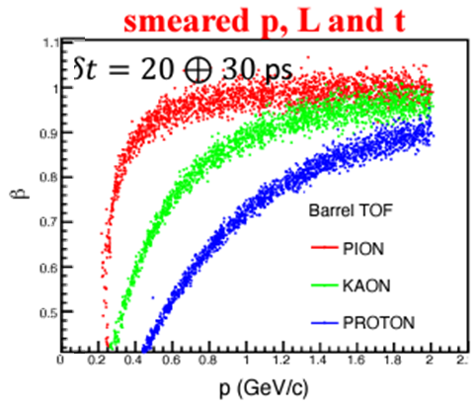
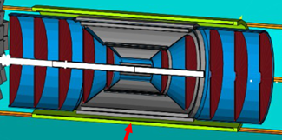
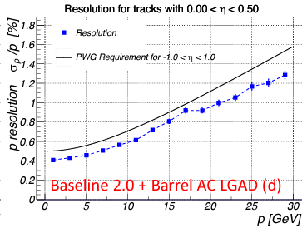
c)
Plot b will be updated with fresh simulations
Pretty plot replaced by the original.
Question:
What is the correct eta acceptance of the barrel TOF?
Radius is 52 cm (outside uMEGAS)
Fix the eta acceptance to +/- 1.1 (matches the service cone).
Physical rates of hadrons
p_{T} plots limited to 15 GeV/c
a)
d)
b)
3σ thresholds

Slide 4
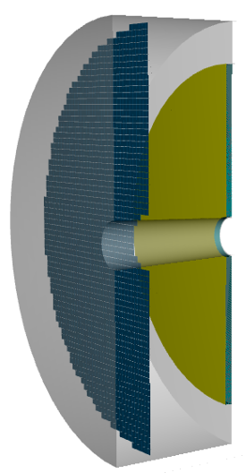
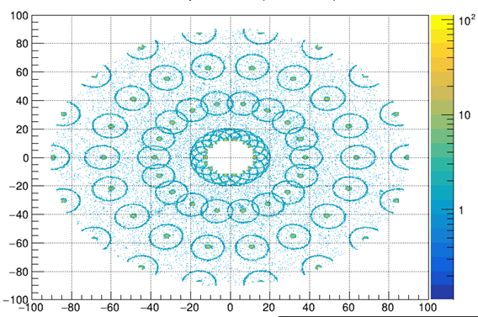
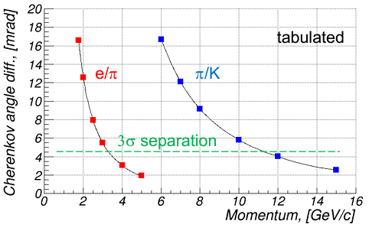
b)
a)
Chandra:
Software installed and working on it
Working on purity & efficiency
Software similar to dRICH
Plans for threshold evaluation?
IRT from ayk is not finding rings:
Hypothesis testing.
May be already included??
c)

