Slide 1
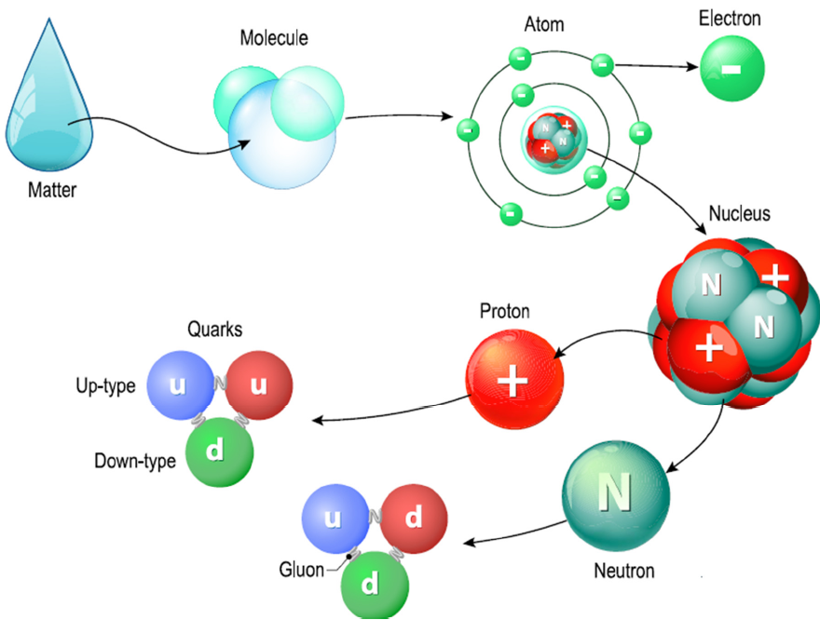
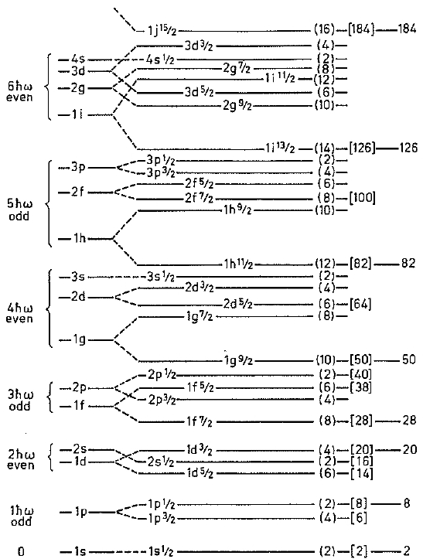
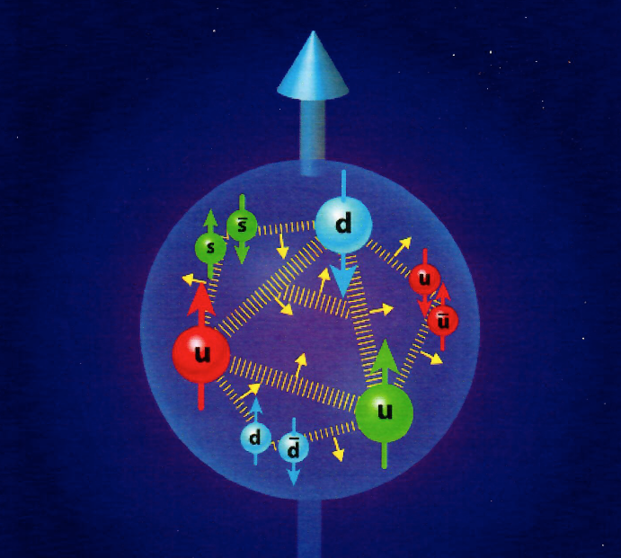
Nuclear Shape Observables and Methods
- 21st Century View of the Nuclear Structure -
(Ab Initio SM Studies: From No-Core to Symplectic Symmetry with Roots in Effective Field Theory)
Low-Energy (QED) Discoveries!
High-Energy (QCD) Challenges?
RBRC
Isobar Science
(01/25-28/2022)
Legacy Shell Model ...
21st Century
Cross Over
... Femto-Science World
²⁰Ne
RHIC & JLab
race to the
EIC
82
50
- QCD - Quantum
Chromo
Dynamics
Two forces – strong color force for hadrons and the electromagnetic force for nuclei are responsible for the structure of hadronic clusters (atomic nuclei) – understanding this ‘how’ and ‘why’ question is a 21st Century Grand Challenge!
28
20
8
2
Where LSM / LE-NP (QED) &
FSW / HE-NP (QCD) “Meet”!
PIs: Jerry P. Draayer, Kristina D. Launey, Tomas Dytrych, Feng Pan
GAs: David S. Kekejian & Grigor Sargsyan
__________________________________________________
U.S. NSF & DOE + LSU & SURA/JLab Sponsored Research
Notes:
1

Slide 2
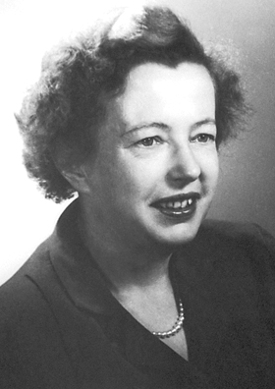
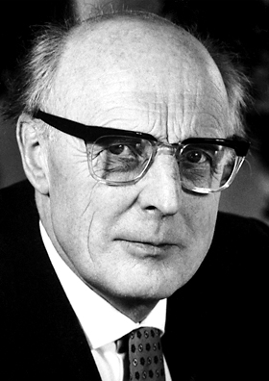
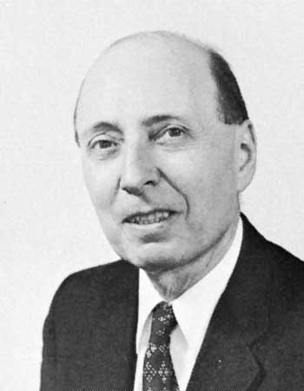
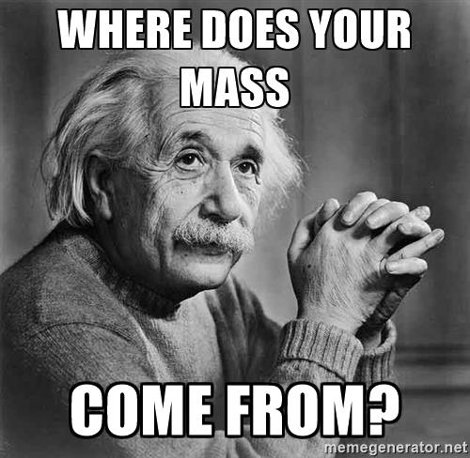
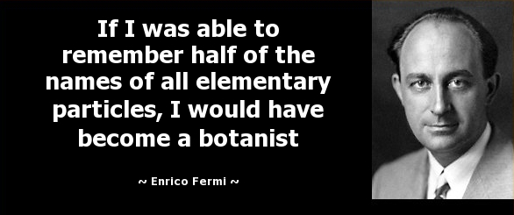


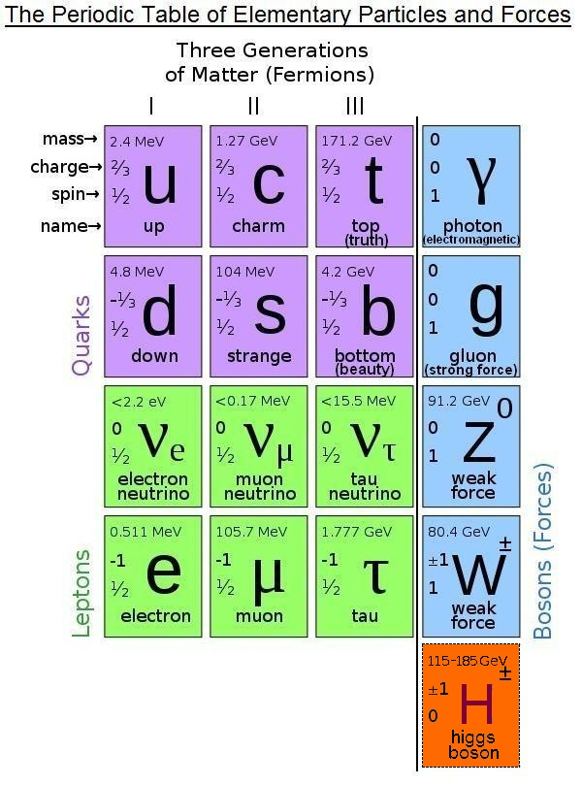

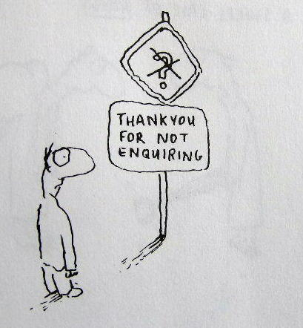

Historical Perspectives / Subatomic Physics
Nuclear (LE-QED) Discoveries!
Particle (HE-QCD) Challenges?
?
...
?
...
Maria Goeppert Mayer & Hans Jansen
Won Nobel Prize (1963) “...for their discoveries (late 1940s) concerning nuclear shell structure”
Eugene Wigner
?
Simplicity within Complexity
?
Standard Model?
Numerous Follow-on Developments:
Single-particle Models
SP plus Pairing Modes
Many-body Approaches
Collective Models (BH)
Geometrical Theories
Quasi-particle Models
Algebraic Approaches
Effective Interactions
- 50 -
Years
Higgs?
Show me Something Mister!
Where’s the Mass, Man?
Numerous Follow-on Developments:
Confinement – Long & Short Range
What is Mass (EHM), or a Quantum?
1990s – HPC – 2000s
Dynamic Mass Generation
Lattice or Continuum (Strong) QCD
1990s – HPC – 2000s
Game
Changer
?
Group
Theory & Therapy
?
No-Core Shell Model (NCSM)
Non-compact Symplectic Model
Symplectic Symmetry & EFT Roots*
EIC
BNL
RBRC
Nuclear Shape Observables and Methods
(21st Century View of the Nuclear Structure)
2 of 18
RBRC Collaboration – Isobar Science
BNL Virtual Meeting / 01/25-28/2022

Slide 3
Subatomic Physics from 10,000 Feet
(Digging Ever Deeper exploiting High Performance Computing)
– 20th Century Highlights –
“Early” School: 1900s -> 1950s -> Bifurcation / Liquid Drop and SP Methods
“Classical” Period: 1950s -> 2000s -> Collective vs Many-Particle Theories
Collective Models – Bohr-Mottelson on Steroids / Mean Field Methods
Algebraic Theories – Elliott SU(3) Model; Arima & Iachello IBM Theory
Realistic Methods – Mean Field and Effective Interaction Developments
– 21st Century Trajectory –
Game Changer (1990s – HPC ERA – 2020s) Expand Reach
“Ab Initio” Era: 2000s -> Full Speed Ahead, Exploit Availability of HPC Facilities
No-Core Shell Model (NCSM) – (2000) P. Navrátil, J.P. Vary and B.R. Barrett
Symmetry Adapted (SA-NCSM) – (2010) LSU Team (JPD, Dytrych, & Launey)
Symplectic Effective Field Theory (Sp-EFT) – (2020) D. Kekejian - LSU Thesis
– What Next? LE/HE Cross-Talk … Your Next Grand Challenge –
Part 1: Bold & Simple Caricature (Modern View) of Nuclear Structure & Dynamics
Part 2: SA-NCSM Examples that Illustrate the Efficacy of such a Characterization
Part 3: How this follows from Sp-EFT and Bridging the LE (QED)/HE (QCD) Divide
EIC
BNL
RBRC
Nuclear Shape Observables and Methods
(21st Century View of the Nuclear Structure)
3 of 18
RBRC Collaboration – Isobar Science
BNL Virtual Meeting / 01/25-28/2022

Slide 4
Simple Caricature of Nuclear Structure & Dynamics
(Within the context of the Sp(3,R) -> U(3) -> SU(3) -> SO(3) Model)
Factorization Lemma
Ψ[A(Z,N)
Ψ[Φ(Fermion Cores) X Θ(Boson Cloud)]
Mapping 3-D Rotor to SU(3)
(β, γ) Bohr-Mottelson
(λ, μ) Elliott (1958)
Antisymmetrization
Requirements from
the Pauli Principal
Horizontal Mixing within and between Low-lying Shells of 3-Dimensional HO
Particle Picture of
Elliott SU(3) Model
Nine (9) Generators Elliott’s SU(3) Group spans Fermion Space
Particle Symmetric
Vertical Excitations X-Pauli Restriction
Excitations on the (Bandhead Cores) of A(Z,N) subsystems in 3-Dimensional HO
Energy Picture of
the Sp(3,R) Model
Six ( ) plus Six ( ), (L=0&2) of Sp(3,R) 21= (9) + (12) Total
β² ~ C₂
(2nd Order SU(3) Invariant)
Elliott
reorg of
complete
shell
model
Mapped
onto the
β and γ
collective
variables
β³cos(3γ) ~ C₃
(3rd Order SU(3) Invariant)
Big Question:
Simplicity within Complexity?
Answer #1: Yes!
γ = 60⁰
β
(0,μ)
(β,γ)
(λ,μ)
- Deformation Dominates –
Driven the by Symplectic S and D boson raising and lowering operators that represent giant monopole (“S”) & quadrupole (“D”) degrees-of-freedom of the system. Must not be confused with the “s” and “d” operators of IBM; the Sp(3,R) theory yields quadrupole moments, B(E2s), and reproduction of rms radii without a need for effective charges.
γ = 0⁰
(λ,0)
EIC
BNL
RBRC
Nuclear Shape Observables and Methods
(21st Century View of the Nuclear Structure)
4 of 18
RBRC Collaboration – Isobar Science
BNL Virtual Meeting / 01/25-28/2022

Slide 5
Symmetry Adapted NCSM (SA-NCSM) Campaign
(Going on 20+ years … 2001 – 2021/22 …)
Overarching Objective: Reproduce & predict properties of light to heavy nuclei, ultimately starting with with QCD/EFT informed and inspired interaction (parameter free, except for oscillator parameter )
hω
- Estimated Timeline (Three 5-year Periods / Tomas Dytrych & Kristina Launey) –
Timeline (years): 5 (2001-05)
+ 5 (2006-2010)
+ 5 (2011-15)
Exploit existing capabilities to assess the probability success and level of effort required to develop a full-blown Symmetry Adapted NCSM
Create a Symmetry Adapted No-Core Shell Model (SA-NCSM)code that capitalizes on exact and approximate (partial) symmetries in nuclei
Study the emergence of collective phenomena, tracking their evolution to and from fundamental (ab initio) features of the interaction
Exploit existing NCSM technology to prove efficacy of method, revealing (or not) any inherent limitations
Explore need (or not) for renormalization, winnowing of the model space to physically relevant and tractable subspaces
Evaluate the extensibility of theory and its various characteristics vis-à-vis current/emerging computational resources
Apply the theory to study of extreme processes known to be important to understanding nuclei and nuclear systems
Develop a user-friendly desktop version of code for simple applications as well as educational and training purposes
Extend theory to include coupling to the continuum, and apply the result to the study of nuclear reactions
EIC
BNL
RBRC
Nuclear Shape Observables and Methods
(21st Century View of the Nuclear Structure)
5 of 18
RBRC Collaboration – Isobar Science
BNL Virtual Meeting / 01/25-28/2022

Slide 6
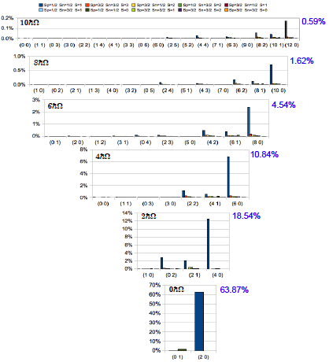
Results for ⁶Li with N_{max} = 10
(Early/First Example - Proof of Principle)
… Proof of Principle …
~ 70-90 % of Physics
in < 1% of the
“reorganized” space
JISP16* bare interaction in N_{max} = 10 space with
ħω = 20 MeV
… Team Work …
Many helps along the way: James Vary (ISU) making the NCSM available that allowed benchmarking of early results, Mark Caprio (ND) spending a part of his sabbatical at LSU, quality input from Anna Hayes (LLNL), and collaborators from Bulgaria, China, Mexico, Czech Republic, etc. Also, we thank the NSF for PetaApps Award, and DOE for an EPSCoR grant, as well as SURA for release time and other support!
?
Simplicity
within
Complexity
?
*Bonn, Argonne, Idaho,
N3LO (optimized), etc.
... yield similar results ...
Typically
70% - 90%
Leading Sp-IR
EIC
BNL
RBRC
Nuclear Shape Observables and Methods
(21st Century View of the Nuclear Structure)
6 of 18
RBRC Collaboration – Isobar Science
BNL Virtual Meeting / 01/25-28/2022

Slide 7
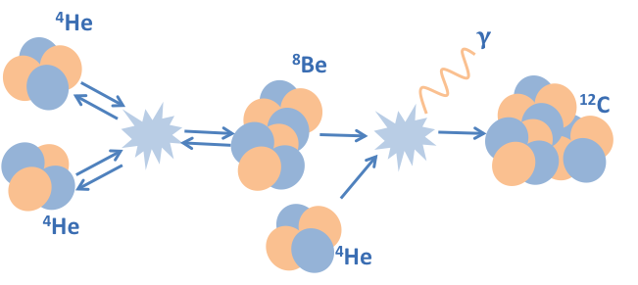
Creation of ¹²C in Hot Stars / Nucleosyntheses
… The Elusive Hoyle State …
EIC
BNL
RBRC
Nuclear Shape Observables and Methods
(21st Century View of the Nuclear Structure)
7 of 18
RBRC Collaboration – Isobar Science
BNL Virtual Meeting / 01/25-28/2022

Slide 8
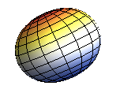
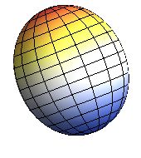
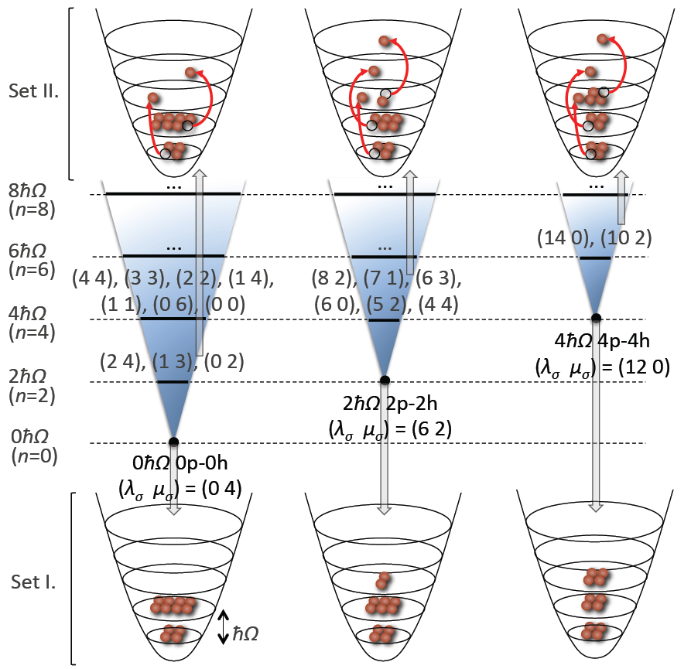
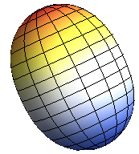
Three Primary “Slices” in NCSpM Description
0p-0h
¹²C
2p-2h
(0 4) Bandhead (Oblate)
(6 2) Bandhead (Prolate)
4p-4h
(12 0) Bandhead (More Prolate)
Intertwining
Shell & Alpha
Cluster Pictures
EIC
BNL
RBRC
Nuclear Shape Observables and Methods
(21st Century View of the Nuclear Structure)
8 of 18
RBRC Collaboration – Isobar Science
BNL Virtual Meeting / 01/25-28/2022

Slide 9
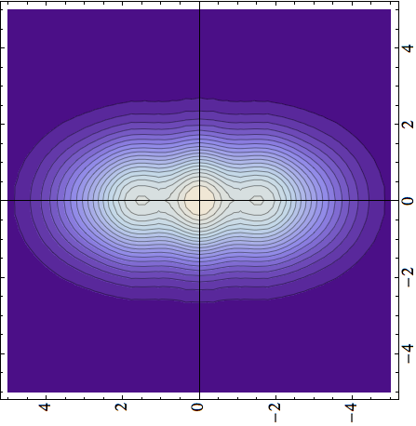
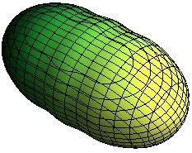
¹²C Systematics as a Function of N_{max}
2hω
(N_{max} = Total Number of Excitations above Ground State)
2⁺
0⁺
4p4h
Hoyle State
0⁺
NCSM
2p2h
2⁺
0p0h
N_{max}
Full
Plus
NCSpM
NCSpM
EIC
BNL
RBRC
Nuclear Shape Observables and Methods
(21st Century View of the Nuclear Structure)
9 of 18
RBRC Collaboration – Isobar Science
BNL Virtual Meeting / 01/25-28/2022

Slide 10
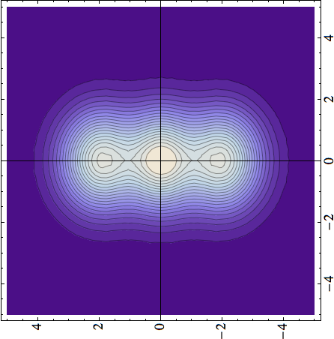

¹²C - Cluster Formations
(Now with spin-orbit mixing added at band-head level!)
Density [fm^{–3}]
z [fm]
x [fm]
x [fm]
x [fm]
Hoyle state
Hoyle state
0⁺
0⁺
4⁺
2⁺
model space (major shells)
Standard ab initio NCSM
(Band-Head Mixing & NCSpSM)
(Hybrid-Theory: Full Space up to N_{nmax↓} & NCSpM extended up to N_{nmax↑})
EIC
BNL
RBRC
Nuclear Shape Observables and Methods
(21st Century View of the Nuclear Structure)
10 of 18
RBRC Collaboration – Isobar Science
BNL Virtual Meeting / 01/25-28/2022

Slide 11
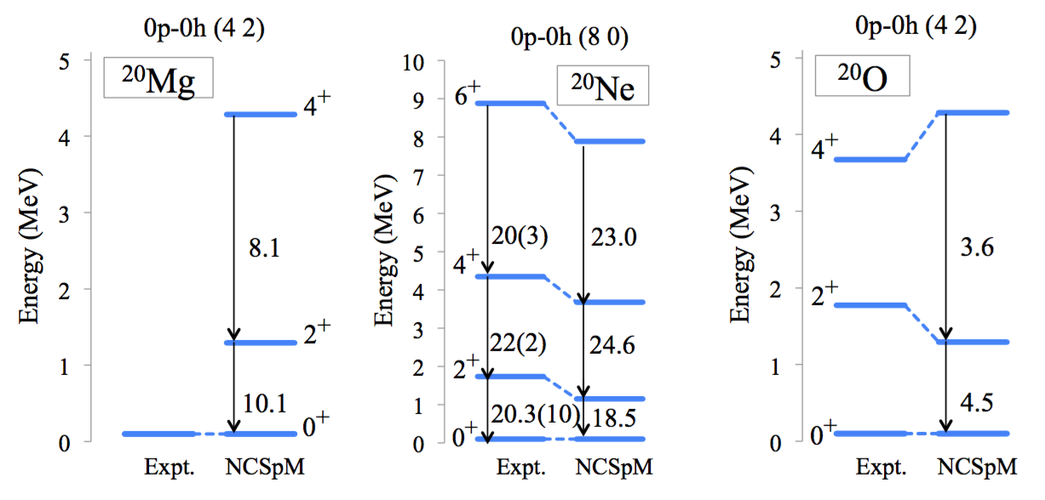
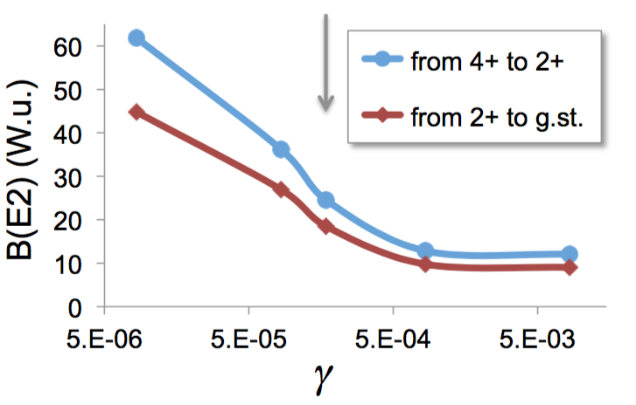
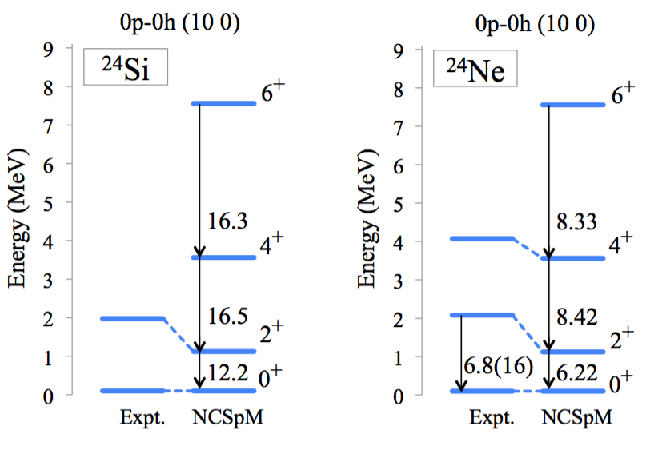
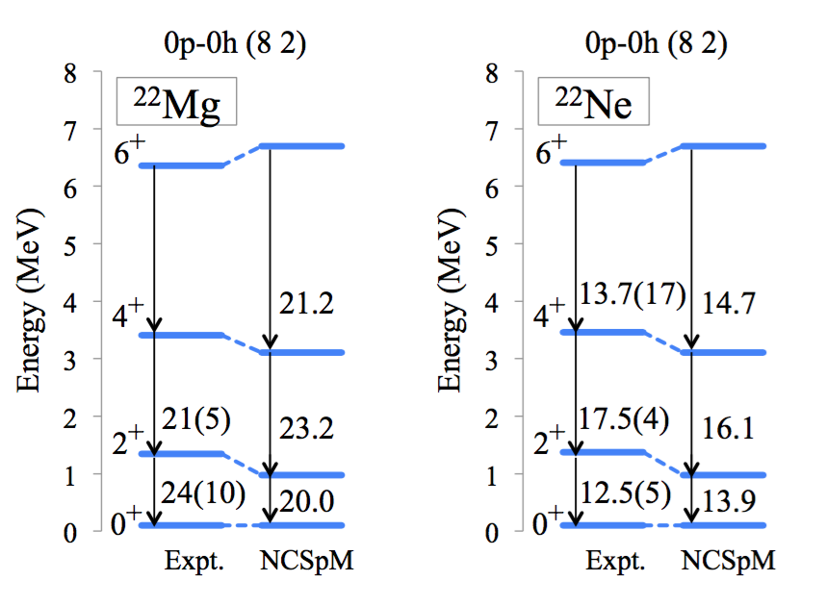
Medium Mass Nuclei (Gegory Tobin / REU Student)
Almost “Laptop” Level Calculations!
Ne-20: grey arrow is gamma used
EIC
BNL
RBRC
Nuclear Shape Observables and Methods
(21st Century View of the Nuclear Structure)
11 of 18
RBRC Collaboration – Isobar Science
BNL Virtual Meeting / 01/25-28/2022

Slide 12
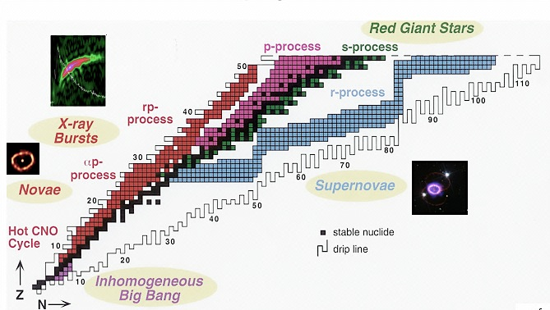
Further sd-shell Results (Robert Baker - GS)
²⁴Si
Selected (pre-thesis) Examples
(Now onto Beta Decay)
²²Mg
³²Ne
²⁰Ne
… nuclei… elements… stars…
¹⁹Ne
²⁴Ne
Ab initio description (converged selected spaces) (NNLO_{opt}, ħΩ=15 MeV, 13 HO shells)
EIC
BNL
RBRC
Nuclear Shape Observables and Methods
(21st Century View of the Nuclear Structure)
12 of 18
RBRC Collaboration – Isobar Science
BNL Virtual Meeting / 01/25-28/2022

Slide 13
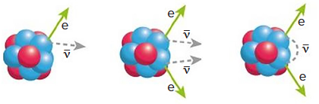
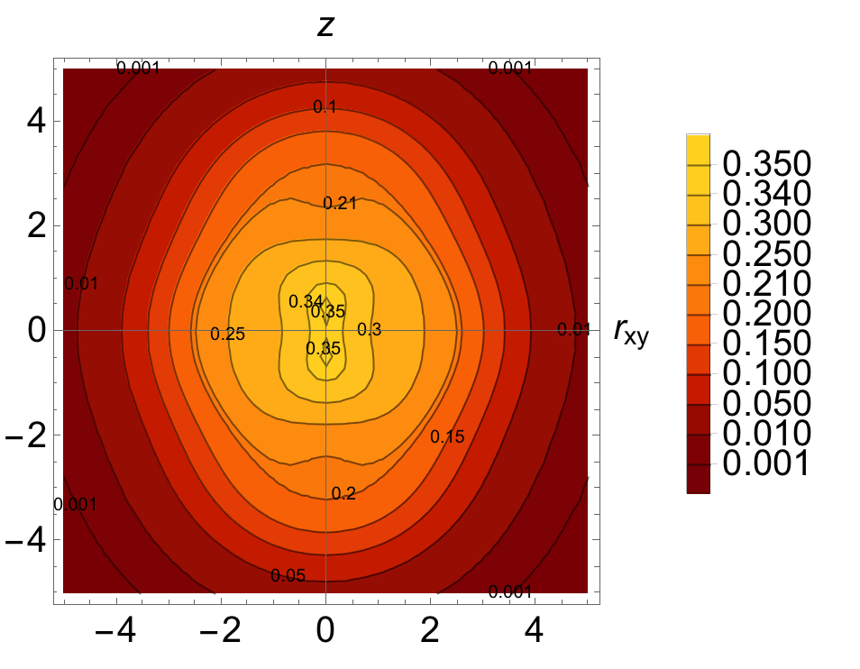
Plus fp-shell Results (Grigor Sargsyan - GS)
⁴⁸Ca
⁴⁸Sc
⁴⁸Ti
⁴⁸Ca
⁴⁸Ti
Neutrinoless ββ decay
8 shells, N2LOopt
0⁺
SA-NCSM (selected): ........................ 966,152
Complete model space: ....... 3,162,511,819 2⁺
SA-NCSM (selected): ................... 3,055,554
Complete model space: ..... 14,522,234,982
8 shells, N2LOopt
0⁺
SA-NCSM (selected): ......................... 602,493
Complete model space: ..... 24,694,678,414
2⁺
SA-NCSM (selected): ..................... 1,178,834
Complete model space: .... 113,920,316,658
⁴⁸Ti, Q(2⁺) [e²fm²]
--------------------------
Experiment ..................... -17.7
8 shells ............................ -19.3
(no effective charges)
EIC
BNL
RBRC
Nuclear Shape Observables and Methods
(21st Century View of the Nuclear Structure)
13 of 18
RBRC Collaboration – Isobar Science
BNL Virtual Meeting / 01/25-28/2022

Slide 14
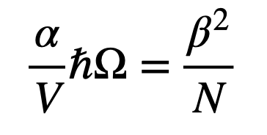
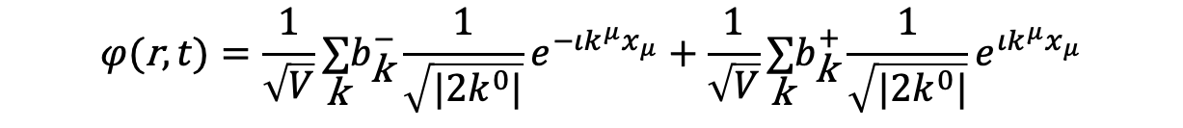

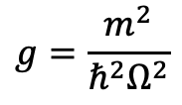
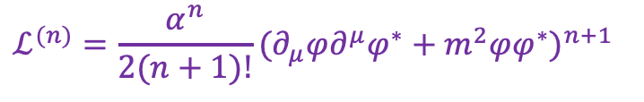
Constructing an Effective Field Theory (David Kekejian - GS)
Generic (Scalar) Field Theory
Quantum (Scalar) Field Theory
canonical
quantization
$ℒ=\frac{1}{2}(∂_{μ}φ)(∂^{μ}φ)+\frac{1}{2}m^{2}φ^{2}$ $H=\underset{\text{k}}{∑}E_{\text{k}} (b_{\text{k}}^{+}b_{\text{k}}^{−}+\frac{1}{2})$
$$φ(\text{r},t)=\frac{1}{\sqrt{V}}\underset{\text{k}}{∑}b_{\text{k}}^{−}\frac{1}{\sqrt{|2k^{0}|}}e^{−ιk^{μ}x_{μ}}+\frac{1}{\sqrt{V}}\underset{\text{k}}{∑}b_{\text{k}}^{+}\frac{1}{\sqrt{|2k^{0}|}}e^{ιk^{μ}x_{μ}}$$
$$ℒ^{(n)}=\frac{α^{n}}{2(n+1)!}(∂_{μ}φ∂^{μ}φ^{∗}+m^{2}φφ^{∗})^{n+1}$$
$$ℋ^{(n)}=\frac{α^{n}}{2(n+1)!}(\overset{·}{φ}{\overset{·}{φ}}^{∗}−φ^{′}⋅φ^{′∗}+m^{2}φφ^{∗})^{n}((2n+1)\overset{·}{φ}{\overset{·}{φ}}^{∗}+φ^{′}⋅φ^{′∗}−m^{2}φφ^{∗})$$
$$H^{(n)}∼(\frac{α}{V}ℏΩ)^{n}×(g^{2}Q⋅Q)^{n},(K⋅K)^{n},(gQ⋅K)^{n},(K⋅gQ)^{n}$$
Parameter #1
(Sets Scale)
$$g=\frac{m^{2}}{ℏ^{2}Ω^{2}}$$
Parameter #2
(Q Strength)
Symplectic symmetry emerges naturally from a quantum effective field theory!
EIC
BNL
RBRC
Nuclear Shape Observables and Methods
(21st Century View of the Nuclear Structure)
14 of 18
RBRC Collaboration – Isobar Science
BNL Virtual Meeting / 01/25-28/2022

Slide 15
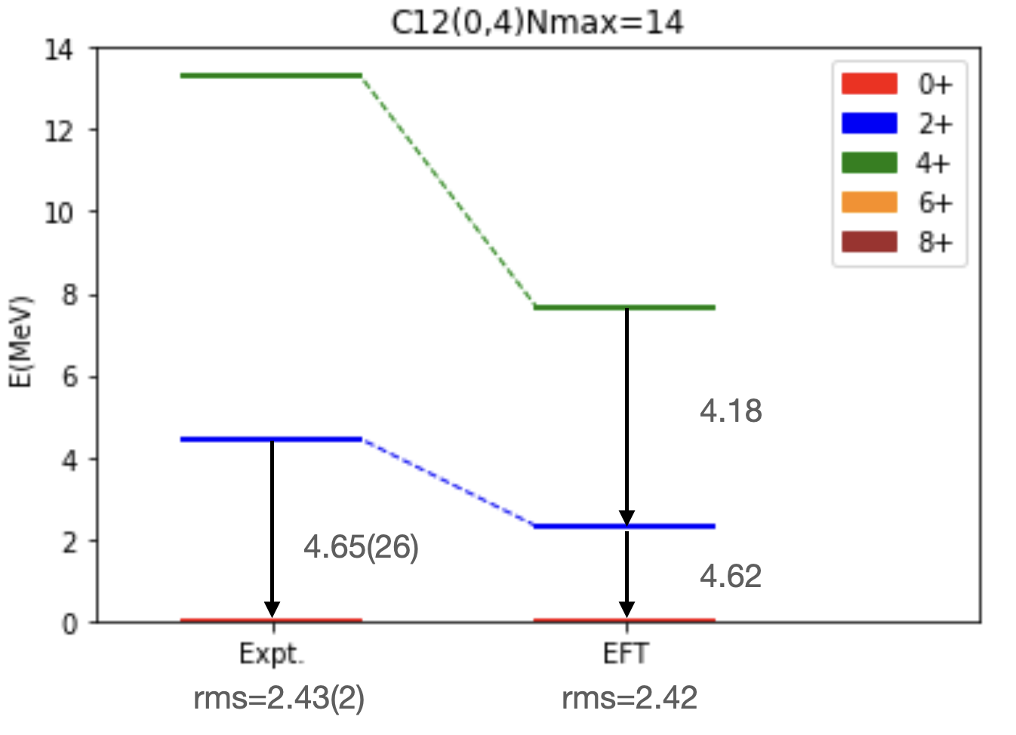
Results for ¹²C using Sp-EFT
¹²C (04) N_{max} = 14 (Up to 2nd Order)
EIC
BNL
RBRC
Nuclear Shape Observables and Methods
(21st Century View of the Nuclear Structure)
15 of 18
RBRC Collaboration – Isobar Science
BNL Virtual Meeting / 01/25-28/2022

Slide 16
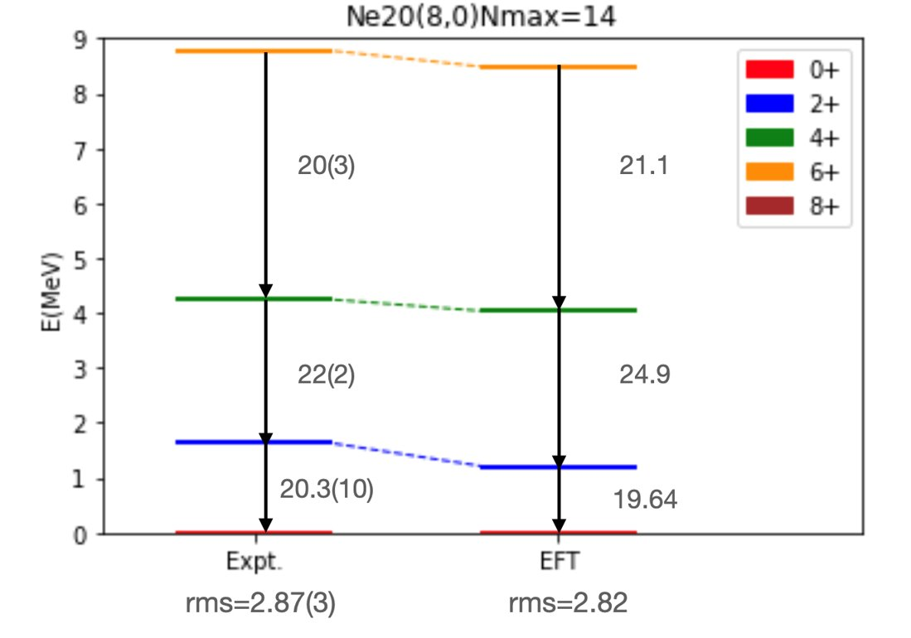
Results for ²⁰Ne using Sp-EFT
²⁰Ne (80) N_{max} = 14 (Up to 2nd Order)
EIC
BNL
RBRC
Nuclear Shape Observables and Methods
(21st Century View of the Nuclear Structure)
16 of 18
RBRC Collaboration – Isobar Science
BNL Virtual Meeting / 01/25-28/2022

Slide 17
… Here’s the Deal …
Nuclear (LE-QED) Discoveries!
Particle (HE-QCD) Challenges?
20th Century Subatomic Physics
-----------------------------
Great Minds and Creative Models
Numerous Prestigious Awards Won
Major New Facilities Commissioned
Simplicity within Complexity Thrives
Analytic Solutions Highly Regarded
------
Physics Changed Technology
1990s – HPC/ERA – 2010s
Technology Changed Physics
------
21st Century Subatomic Physics
-----------------------------
Bigger Computers! -> Better Results?
Eugene Wigner
?
Simplicity within Complexity
?
- 100 -
Years
- 100 -
Years
<-- NCSM & SA-NCSM Lattice QCD -->
<-- NCSpM & Sp-EFT Continuum QCD -->
Simpler Picture! -> Clearer Results?
Deformation
&
Dynamics
Partial Symmetries Expose Coherent Features
Collaboration Essential: Lunch (5 years back) at JLab: “Are the nucleons deformed (round)?”
EIC
BNL
RBRC
Nuclear Shape Observables and Methods
(21st Century View of the Nuclear Structure)
17 of 18
RBRC Collaboration – Isobar Science
BNL Virtual Meeting / 01/25-28/2022

Slide 18
Subatomic Physics from 10,000 Feet
(Digging Ever Deeper exploiting High Performance Computing)
– Historical Highlights - 1940s / 2020s –
– Deformation Dominance / Symplectic Symmetry –
– Symmetry Adapted No-Core Shell Model / SA-NCSM –
– Some First - Early Confirming Results / ⁶Li & ¹²C + –
– New: Symplectic Effective Field Theory / Sp-EFT –
– Fundamental cross-cutting Foundational –
EIC
BNL
RBRC
Nuclear Shape Observables and Methods
(21st Century View of the Nuclear Structure)
18 of 18
RBRC Collaboration – Isobar Science
BNL Virtual Meeting / 01/25-28/2022

Slide 19
EIC
BNL
RBRC
Nuclear Shape Observables and Methods
(21st Century View of the Nuclear Structure)
19 of 18
RBRC Collaboration – Isobar Science
BNL Virtual Meeting / 01/25-28/2022

Slide 20
Mentors (Community) Matter
Fermion-Based Algebraic Models – 1st Generation Leadership
J.P. (Phil) Elliott – Great Britain & Akito Arima – Japan
K.T. (Ted) Hecht – USA & L. (Larry) C. Bidenharn – USA
Marcos Moshinsky – MEX & M. (Malcolm) Harvey – CAN
J.B. (Bruce) French – USA & K. Wildermuth - Germany
David Rowe – UT/CAN & George Rosensteel - TU/USA
V. G. Neudachin & Y. (Yuri) F. Smirnov – MSU - Russia
G. F. Filippov – Ukraine & Peter Raychev – Bulgaria
V. V. Vanagas & S. Alishauskas – Lithuanaia
… 2nd Generation … 3rd Generation … 4th Generation …
Enabling Technologies Essential
1990s – HPC – 2000s
Algebraic Modeling requires Coupling & Recoupling Coefficients
SU(2): Eugene Wigner & Giulio Racah
SU(3): Elliott (1958) & Gell-Mann and Ne’eman (1961)
John D. Vergados (analytic) / Yoshimi Akiyama & Jerry P. Draayer (numeric)
Wigner and Racah Coefficients for SU(3); J. Math. Phys. 14 (1973) 19041912
Fortran Library for Calculating Coupling Coefficients of SU(3); C. Phys. Com. 5 (1973) 405415
- Out with the Old (50 Year Life) -
- In with the New (CPC Archives) -
Computer Physics Communications
SU3lib: A C++ Library for Accurate Computation of Wigner and Racah Coefficients of SU(3)
Corresponding Author: Tomas Dytrych
EIC
BNL
RBRC
Nuclear Shape Observables and Methods
(21st Century View of the Nuclear Structure)
20 of 18
RBRC Collaboration – Isobar Science
BNL Virtual Meeting / 01/25-28/2022

Slide 21
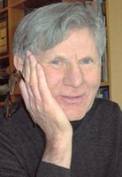
No-Core (Regular & Symplectic) Shell Models
*
*
No-Core Shell Model (NCSM)
(Vary, Navratil, & Barrett, ~2000 to present)
Symplectic Shell Model (Sp-NCSM)
Rowe & Rosensteel, ~1980s to present)
**
Reorganize
Basis States
by
- SHAPES -
Coherent Clusters (Natural Subspaces)
-------------
...
“No Big Deal” or “Major Driver”?
Typical Vertical Symplectic Excitation (Multiple 1p-1h / )
–
+2hω
Lie
Algebra
Symmetry
Adapted Basis
------------
- Special Features -
Canonical & Unitary
Algebraic Framework
Organized by Shapes
Band-heads ➔ np-nh
Quadratic in x’s & p’s
Spurious Free Cones
Captures Coherence
No Effective Charges
Exposes DD Postulate&
Sp(3,R)
6 “A” Raising
(L = 0 & 2)
1p-1h
–
+2hω
–
+2hω
SU(3)
–
2p-2h
0hω
–
+2hω
Sp(3,R)
6 “B” Lowering
(L = 0 & 2)
...
np-nh
–
EFT Known & Natural
–
+nhω
-2hω
*Realistic interactions (local or not; NN, NNN, …)
In principle, exact solutions, up to N_{max} cutoff
Successful descriptions to date through ¹⁶O
**
*Simple logical algebraic underpinning
Elliott SU(3) if no symplectic modes
Sp(3,R) adds monopole & quadrupole
1936
2020
MAY8
EFT: Symplectic Symmetry is the Dynamical Extension of the Harmonic Oscillator!
EIC
BNL
RBRC
Nuclear Shape Observables and Methods
(21st Century View of the Nuclear Structure)
21 of 18
RBRC Collaboration – Isobar Science
BNL Virtual Meeting / 01/25-28/2022

Slide 22





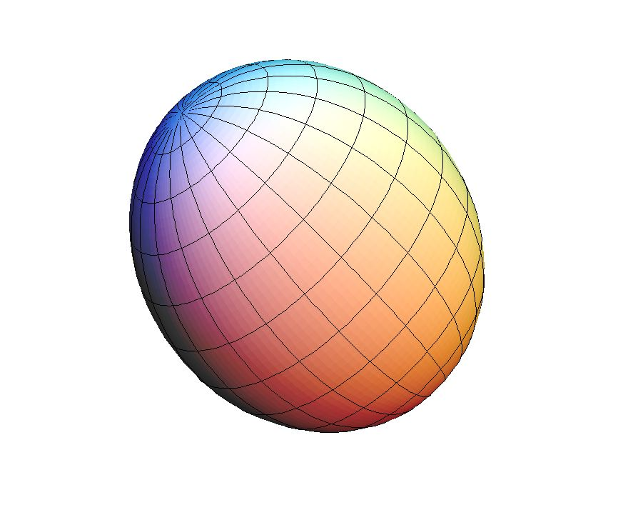
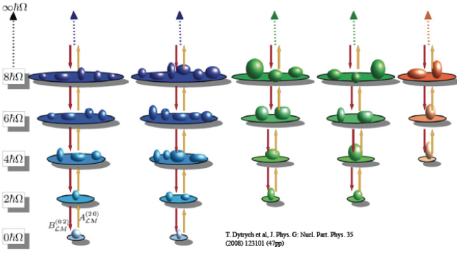
Symplectic Symmetry / Spectrum Generating Algebra
As realized by the 21 generators of the Sp(3,R) symplectic group
- all distinct quadratic forms in the coordinates (q_{i} ) and momenta (p_{i} ) -
Orbital Angular
Momentum Operator (3)
Moment of Inertia & More
“Circulation / Vorticity” (6)
Quadrupole (Shape)
“Tensor” (6)
Kinetic Energy
“Tensor” (6)
Internal Dynamics
“Circulation / Vorticity” (6)
Deformation Flow
“Circulation / Vorticity” (6)
Every symplectic configuration (cone) is labeled by the SU(3) quantum numbers (λ,μ) of the Elliott (1958) Model which in turn specifies the band-head shape of each symplectic configuration.
Spherical Oblate Prolate Tri-Axial
(0,0) (0,μ) (λ,0) (λ,μ)
Mapping 3-D Rotor to SU(3)
(β, γ) Bohr-Mottelson
(λ, μ) Elliott (1958)
γ = 60⁰
Lattice QED
β
β² ~ C₂
(2nd Order SU(3) Invariant)
(0,μ)
(β,γ)
β³cos(3γ) ~ C₃
(3rd Order SU(3) Invariant)
(λ,μ)
γ = 0⁰
T. Dytrych et al, J. Physics G: Nuclear & Particle Physics 35 (2008) 123101 (47pp)
(λ,0)
Symplectic Symmetry is the Dynamical Symmetry Group of the Harmonic Oscillator… !
EIC
BNL
RBRC
Nuclear Shape Observables and Methods
(21st Century View of the Nuclear Structure)
22 of 18
RBRC Collaboration – Isobar Science
BNL Virtual Meeting / 01/25-28/2022

