Slide 1
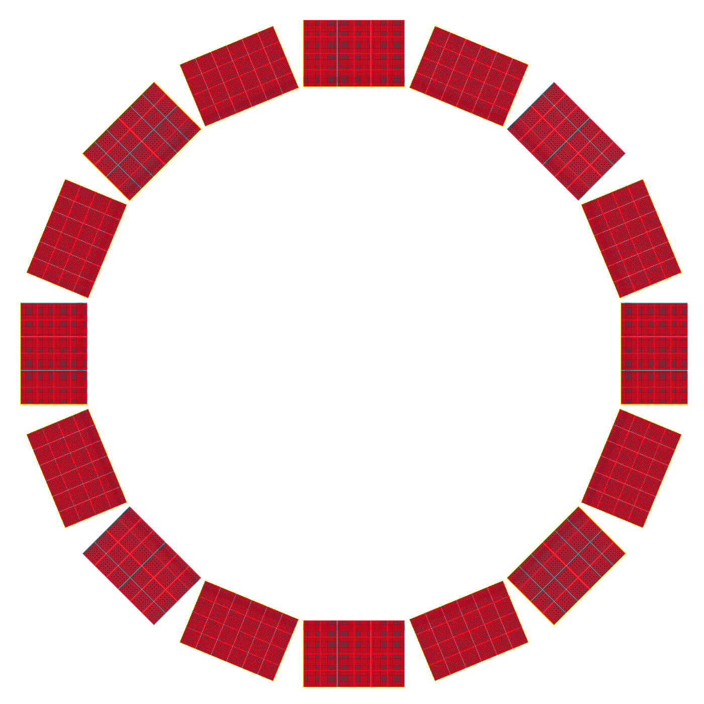
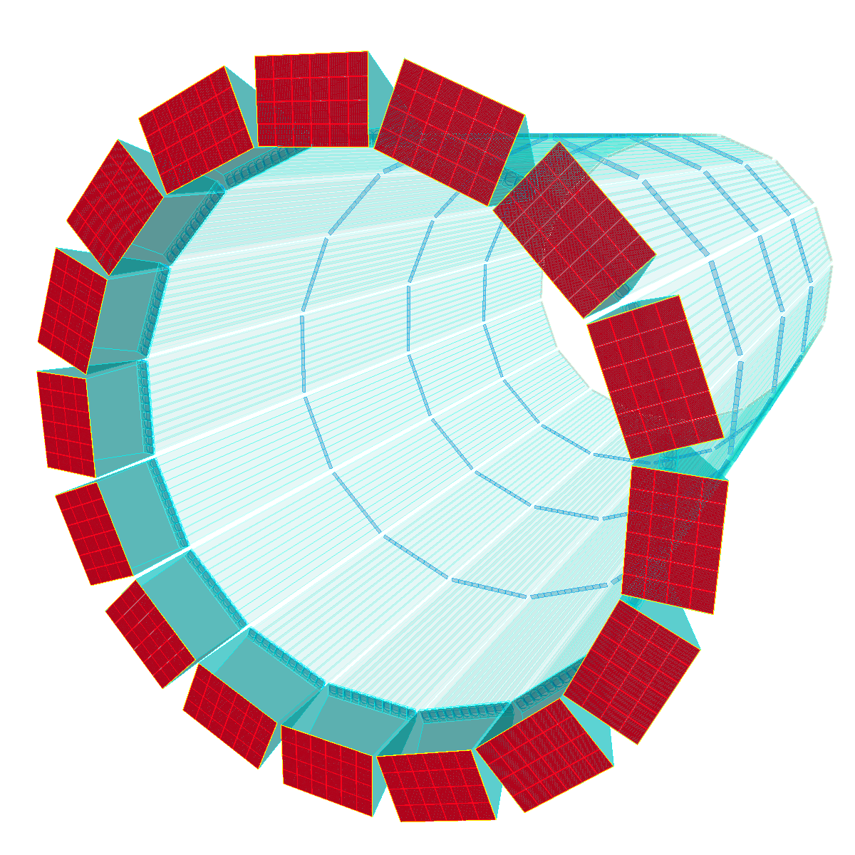
hpDIRC: ATHENA Geometry
Geometry from standalone Geant4
to be replaced by DD4Hep figure

Slide 2
hpDIRC: ATHENA Performance
Geometry:
barrel radius: 964.5 mm (middle of the barbox at 90 degree)
number of bar boxes: 16
bar box width: 350
bar length: 4200
number of bars in bar box: 10
PMT layout: 6x4
z_IP = -600
Simulation parameters:
10k pions and 10k kaons @ 6 GeV/c; same for pi/e @ 1.2 GeV/c;
Azimuthal track angle = 0
0.5 mrad tracking resolution @ 6 GeV/c, 2.2 mrad @ 1.2 GeV/c.
100 ps time resolution

Slide 3
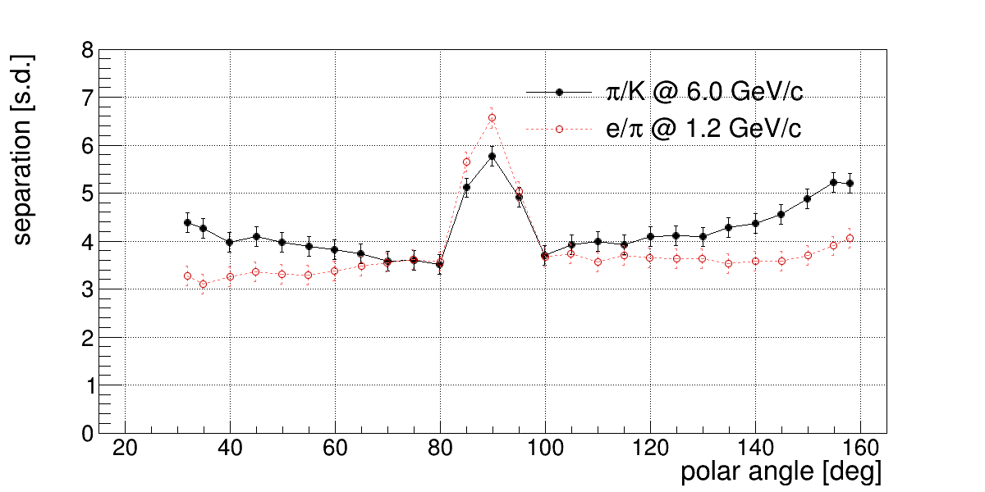
hpDIRC: ATHENA Performance
Performance from standalone Geant4

