Slide 1
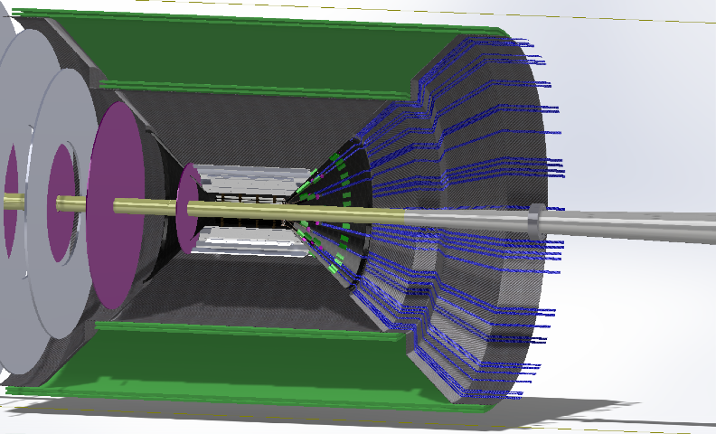
Integration of BTOF into ATHENA
AC-LGAD Barrel TOF
Z=[-0.673m, 0.673m], R=0.525m, Area=4.9 m², Eta=[-1.11, 1.11]
Services (~1 kW)
Cables for HV/LV, I/O signals
Liquid cooling
service
BTOF service
BTOF

Slide 2
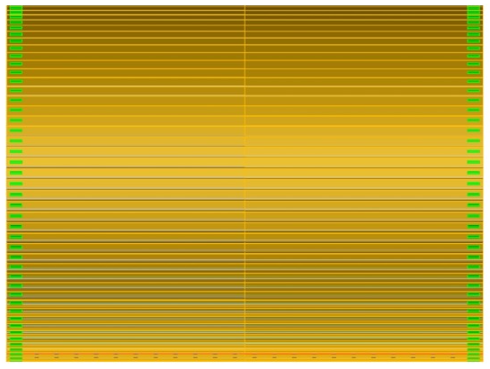



ATHENA Barrel TOF Detector Layout
$$η= 1.11$$
r = 0.525 m
$108(φ)×2(z)$ modules
L = 1.3460 m

Slide 3
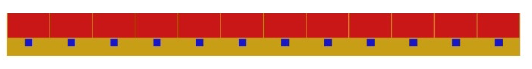
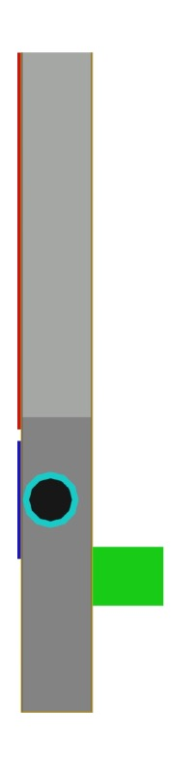

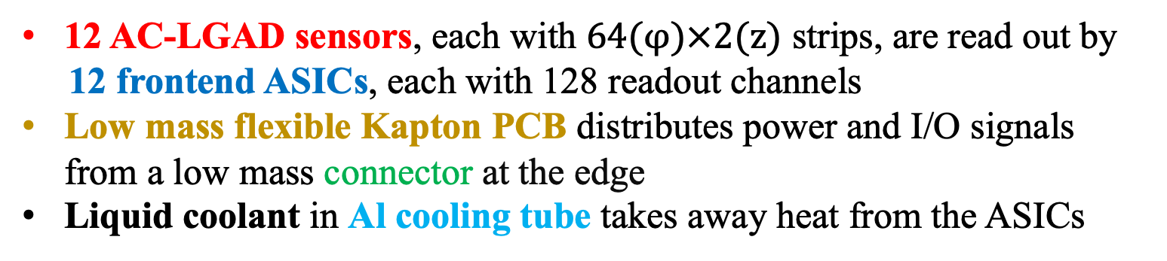
ATHENA Barrel TOF Module
98 % coverage in Z
h=0.642 cm
5.5 cm
3.2 cm
l =½ L = 0.673 m
w = 5.6 cm
12 AC-LGAD sensors, each with $64(φ)×2(z)$ strips, are read out by
12 frontend ASICs, each with 128 readout channels
Low mass flexible Kapton PCB distributes power and I/O signals from a low mass connector at the edge
Liquid coolant in Al cooling tube takes away heat from the ASICs
H=1.242 cm

Slide 4
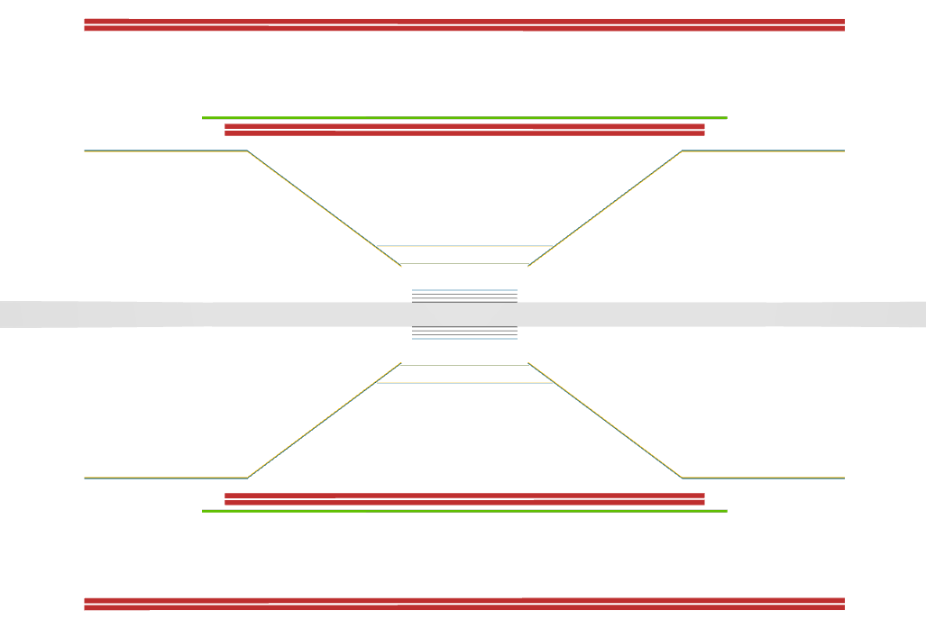
ATHENA Barrel TOF in DD4HEP

Slide 5

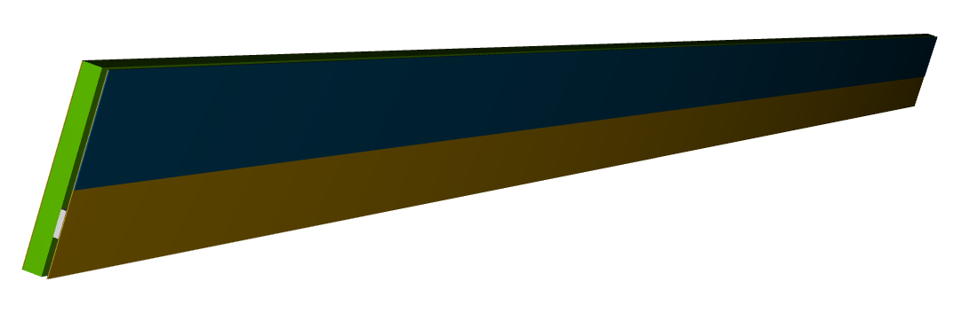
ATHENA Barrel TOF in DD4HEP

Slide 7
a)
c)
a)
b)
d)

