Slide 1
Hadron PID Considerations in ePHENIX concepts
For seeding the discussion on eRD14 integration options
Jin Huang
Brookhaven National Lab

Slide 2
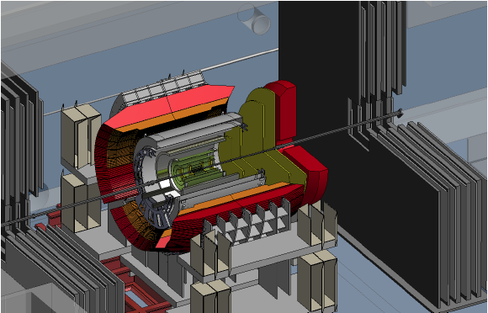
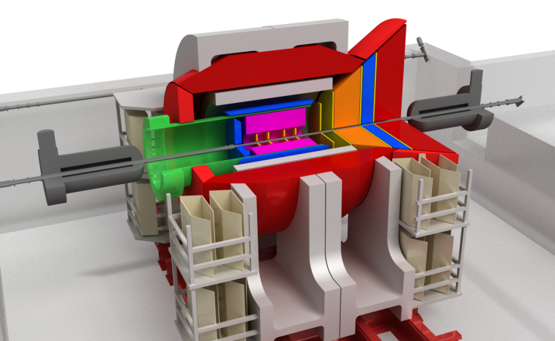
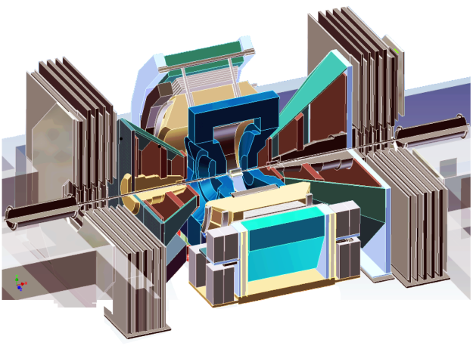
Evolution of the PHENIX experiment
Documented: http://www.phenix.bnl.gov/plans.html
Current PHENIX
sPHENIX (+fsPHENIX)
An EIC detector
14y+ operation
100+M$ investment
Broad spectrum of physics (QGP, Hadron Physics, DM)
140+ published papers to date
Last run in this form 2016
Comprehensive central upgrade base on BaBar magnet
Rich jet and beauty quarkonia physics program
→ nature of QGP
fsPHENIX : forward tracking, Hcal and muon ID → Spin, CNM
Path of PHENIX upgrade leads to a capable EIC detector
Large coverage of tracking, calorimetry and PID
Open for new collaboration/new ideas
arXiv:1501.06197 [nucl-ex]
arXiv:1402.1209 [nucl-ex]
~2000
2017→2020
~2025
Time
RHIC: A+A, spin-polarized p+p, spin-polarized p+A
EIC: e+p, e+A

Slide 3
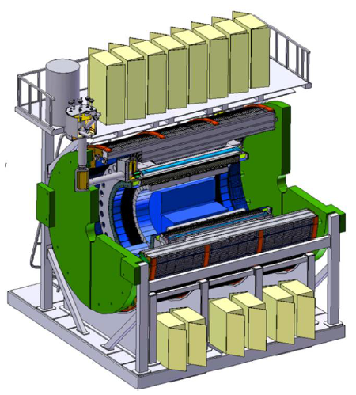
sPHENIX
– quick summary and look “forward”
sPHENIX: major upgrade to the PHENIX experiment aim for data @ 2020
Physics Goals: detailed study QGP using jets and heavy quarks at RHIC energy region
Baseline consists of new large acceptance EMCal+HCal built around recently acquired BaBar magnet. Additional tracking also planned
Detailed performance simulation. Simulation/analysis software open access:
https://github.com/sPHENIX-Collaboration/coresoftware
Very positive DOE scientific review Apr 2015.
Forming new scientific collaboration:
https://www.bnl.gov/lajudr2015/
Nov 2015: Cost schedule review
Dec 2015: first collaboration meeting
as new scientific collaboration
A good foundation
for future detector upgrade
Baseline detectors for sPHENIX
sPHENIX MIE, arXiv:1501.06197 [nucl-ex]

Slide 4
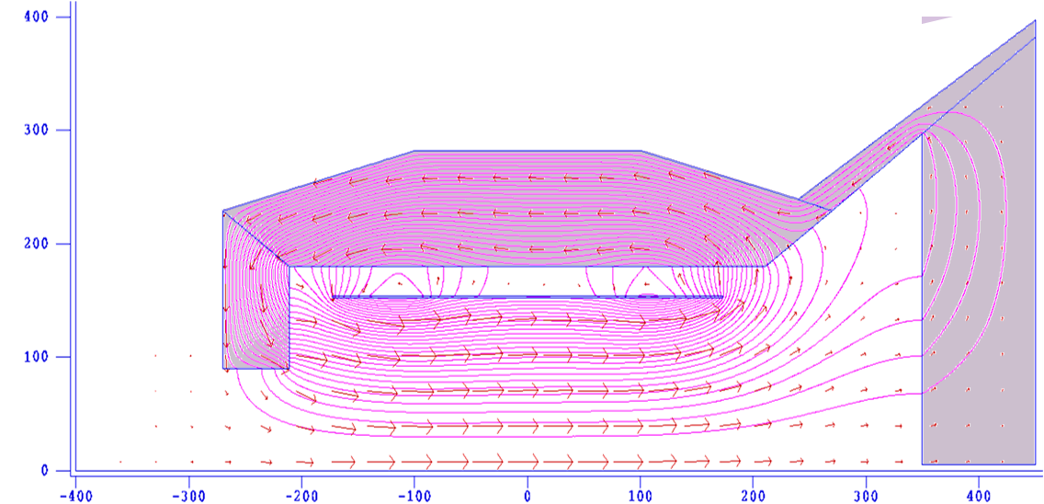
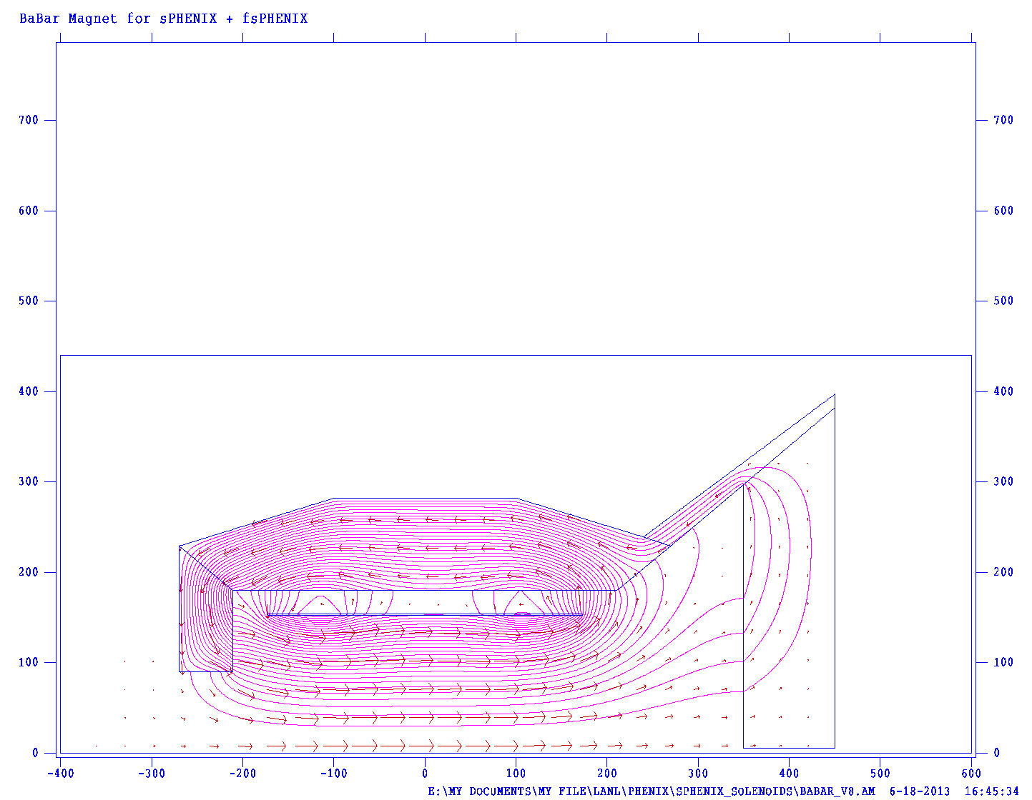
In EIC era: concept for an EIC Detector
-1<η<+1 (barrel) : sPHENIX + Compact-TPC + DIRC
-4<η<-1 (e-going) :
High resolution calorimeter + GEM trackers
+1<η<+4 (h-going) :
  1<η<4 : GEM tracker + Gas RICH
  1<η<2 : Aerogel RICH
  1<η<5 : EM Calorimeter + Hadron Calorimeter
Along outgoing hadron beam: ZDC and roman pots
Working title: “ePHENIX”
LOI: arXiv:1402.1209
Review: “good day-one detector”
“solid foundation for future upgrades”
η=+1
R (cm)
R (cm)
η=-1
HCal
HCal
Aerogel
EMCal
-1.2
z ≤ 4.5m
DIRC
EMCal & Preshower
RICH
Outgoing
hadron
beam
TPC
EMCal
η= 4
p/A
e⁻
BBC
GEMs
GEMs
Station1
GEM
Station2
GEM
Station3
GEM
Station4
z (cm)
ZDC
z≈12 m
Roman Pots
z≫10 m

Slide 5
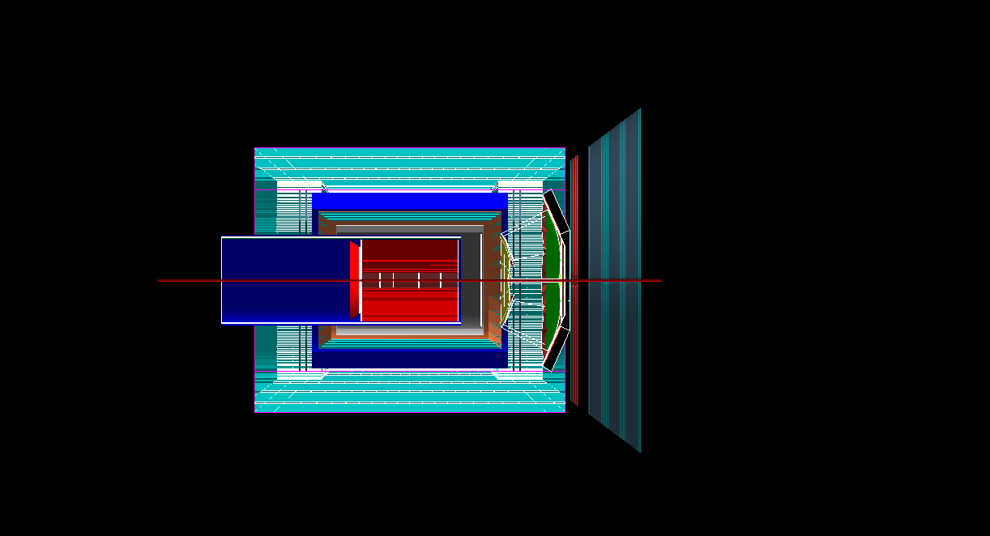
Recent evolving of ePHENIX with sPHENIX
Field map/balance in COMSOL
(N. Feege, SBU)
Available under GitHub/EIC-Detector:
coresoftware-eic/macros/Fun4All_G4_ePHENIX.C
Aerogel
1.2<η<2
DIRC & e-EMC
Gas RICH
1.4<η<4
New SPACAL
New HCal
Support Ring
GEM (η<1.22)
Forward Cal (η<1.1)

Slide 6
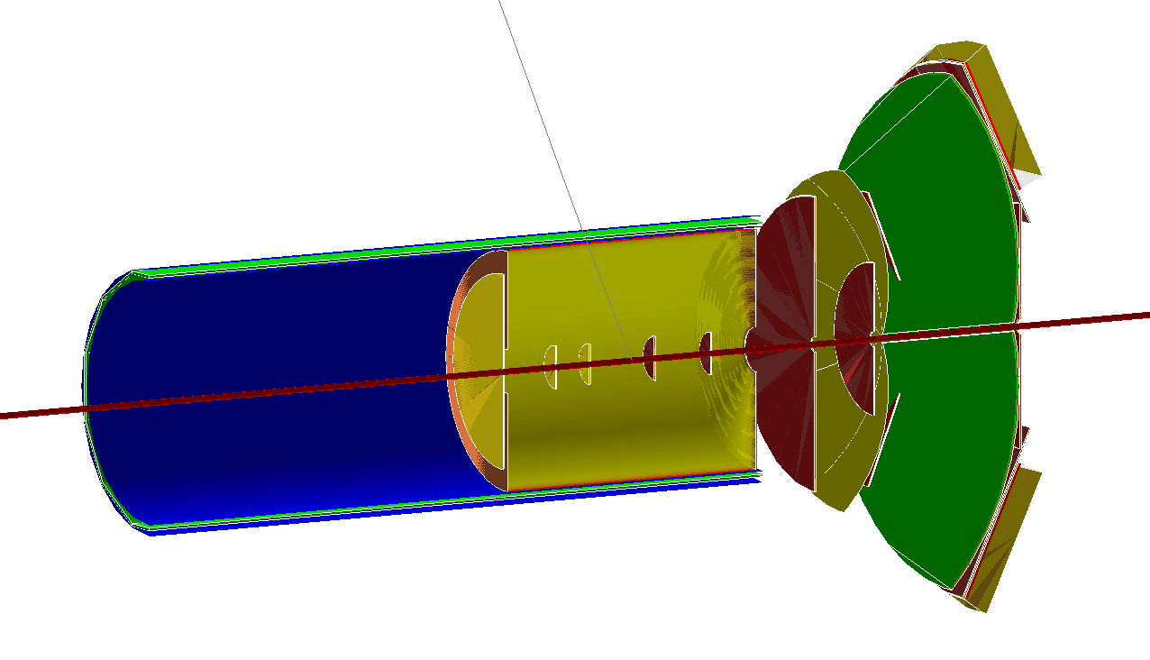
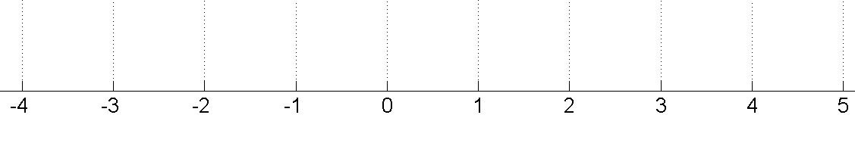
Tracking and PID detectors
e-going GEMs
-4.0<η<-1
TPC
-1<η<+1
DIRC
-1<η<+1
h-going GEMs
1<η<2
gas RICH
1<η<4
Aerogel RICH
1<η<2
Geant4 model of detectors
inside field region
TPC
GEMs
e⁻
p/A
eGEM
IP
RICH
Space for Aerogel RICH
-3<η<-1
Fringe field
1.5 T main field
Fringe field
Tracking
Calorimeters (H-Cal cover η > -1)
AeroGel&Gas RICHs
AeroGel RICH?
TPC+DIRC
p/A
TOF?
e⁻
η

Slide 7
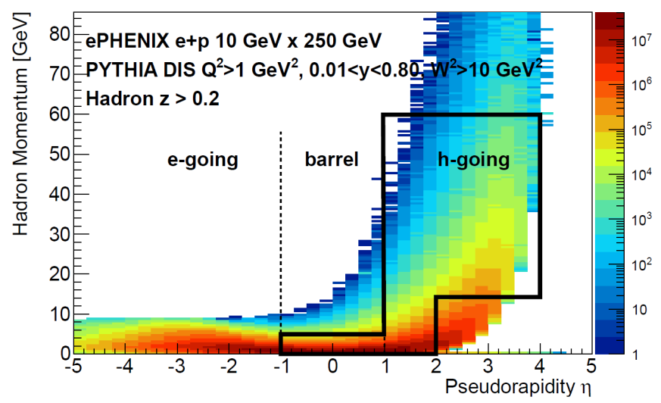
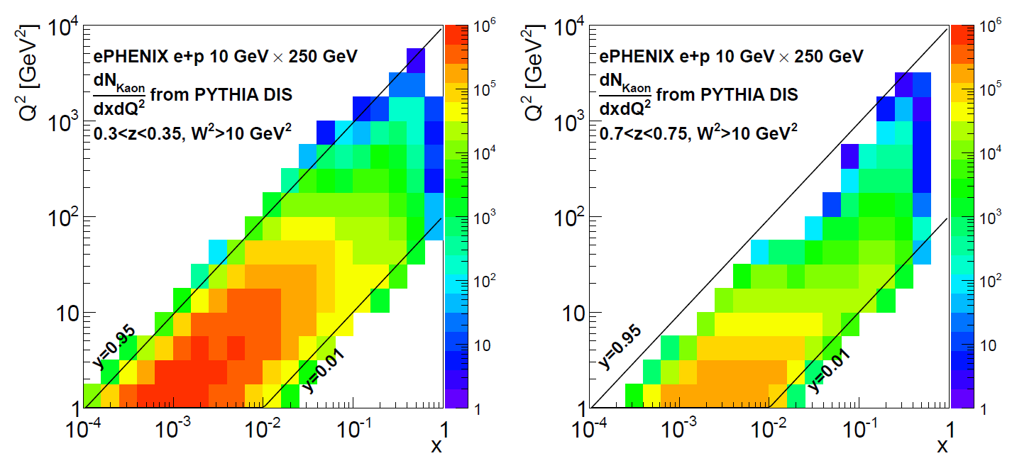
Hadron PID Overview
Aerogel RICH
1<η<2
One configuration for hadron PID
10 x 250 GeV beam
DIRC
-1.2<η<+1
Gas RICH
1<η<4
TPC
GEMs
e⁻
p
eGEM
IP
RICH
Mirror
Hadron PID Coverage
SIDIS x-Q² coverage with hadron PID in two z-bins
DIRC
  Based on BaBar DIRC design plus compact readout
  Collaborate with TPC dE/dx for hadron ID in central barrel
Aerogel RICH
  eRD11 modular design should work well
  Collaborate with gas RICH to cover 1<η<2
  PID in e-going direction for higher e-beam
Gas RICH: eRD6 single gas radiator
TOF solution: next few slides

Slide 8
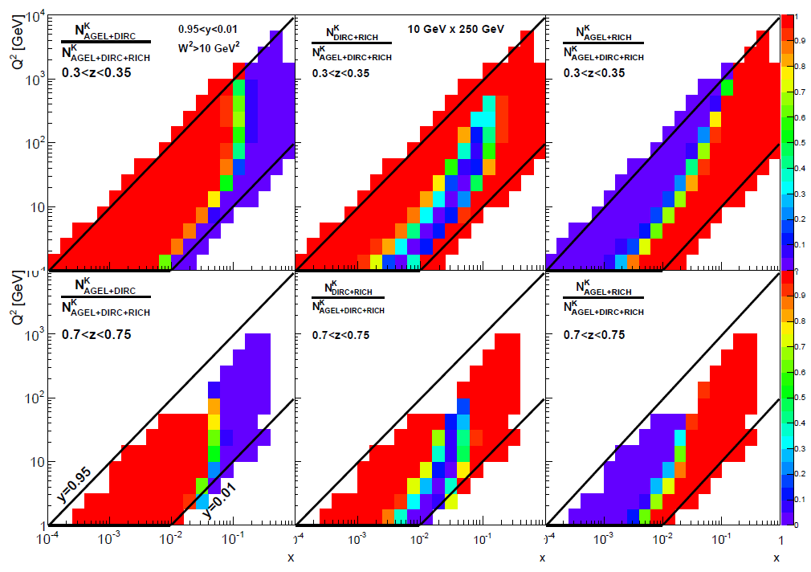
Coverage of each subsystem quantized in SIDIS kinematic space coverage (x, Q2, z)
DIRC
-1.2<η<+1
Gas RICH
1<η<4
Aerogel RICH
1<η<2
Evaluated for one possible configuration
TPC
GEMs
e⁻
p
eGEM
IP
RICH
Mirror
Missing PID coverage, IF any single subsystem is removed

Slide 9
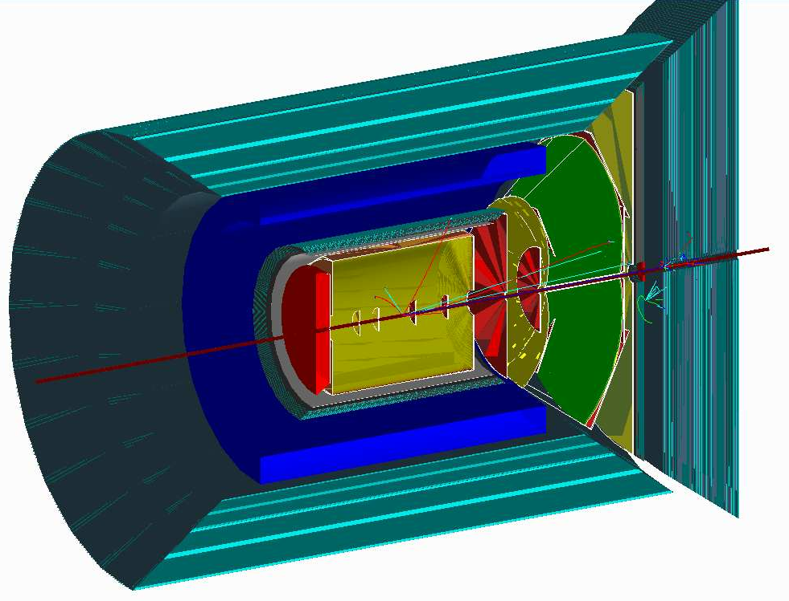
Another PID detector configuration
Full detector TOF solution, eRD10
H-going TOF
Replacing/compliment AeroGel
1<η
Barrel TOF
Replacing/compliment DIRC
-1<η<1
e⁻
p
e-Going TOF
η<-1
Full detector ToF system to cover
low-mid momentum range PID

Slide 10
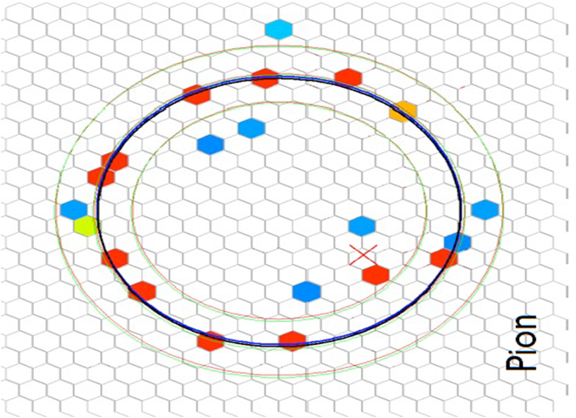
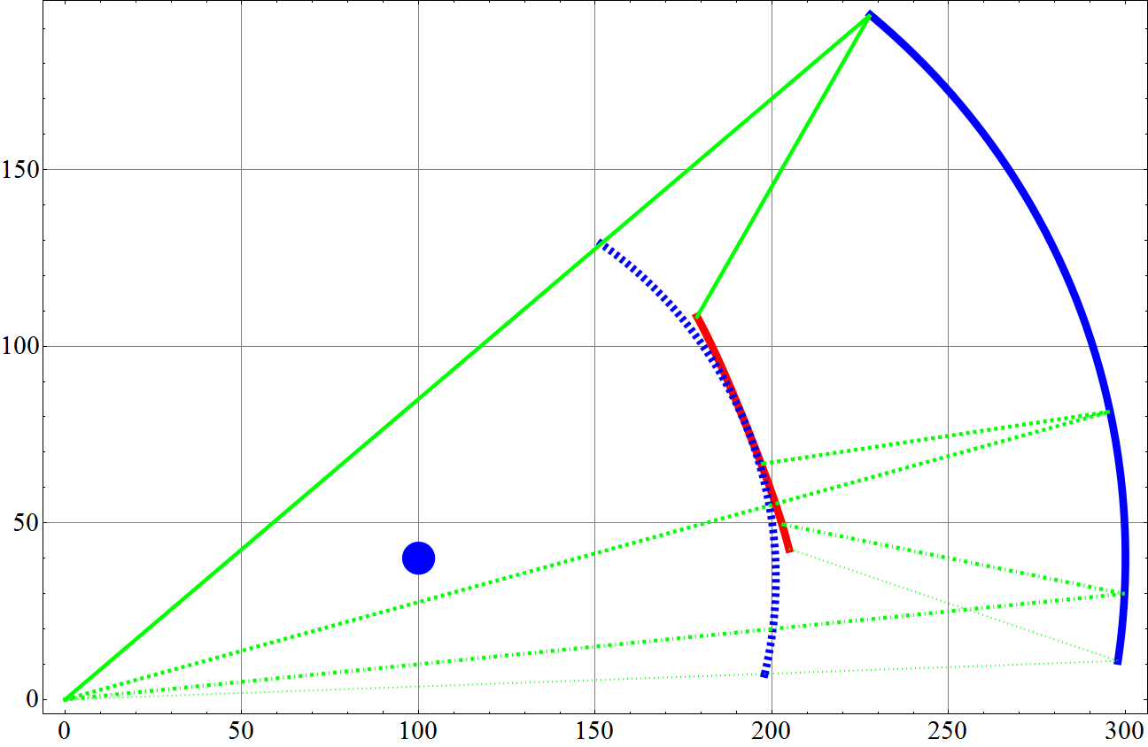
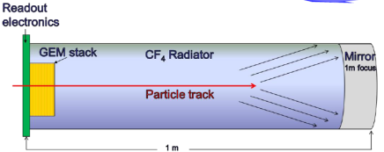
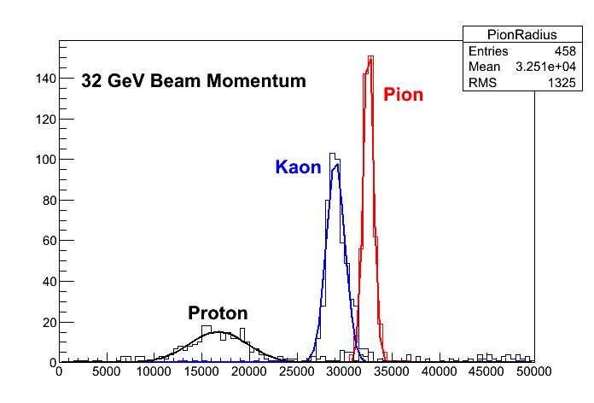
Gas RICH
- The Design
Beam test data
StonyBrook group
R (cm)
η=1
RICH Mirror
RICH Gas
Volume (CF₄)
Hadron ID for p>10GeV/c require gas Cherenkov
  CF₄ gas used, similar to LHC_{b} RICH
Beautiful optics using spherical mirrors
Photon detection using CsI−coated GEM in hadron blind mode
- thin and magnetic field resistant
Active R&D:
  Generic EIC R&D program
  recent beam tests by the stony brook group
Focal plane
HBD detector
η=2
spherical
mirror
center
η=3
Entrance
Window
η=4
IP
Z (cm)
Courtesy : EIC RD6 TRACKING & PID CONSORTIUM
Fermilab T-1037 data
Ring size (A.U.)

Slide 11
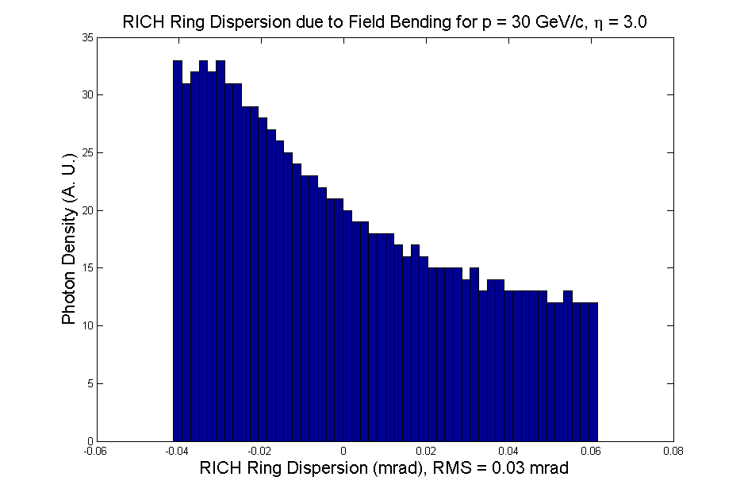
Field effect - distortion for RICH
A RICH Ring:
Photon distribution due to tracking bending only
Field calculated numerically with field return
Field lines mostly parallel to tracks in the RICH volume with the yoke
We can estimate the effect through field simulations
R
R < 52 mrad for C₄F₁₀
Dispersion
ΔR <2.5 mrad
η~1
Aerogel
EMCal
track
RICH
η~4

Slide 12
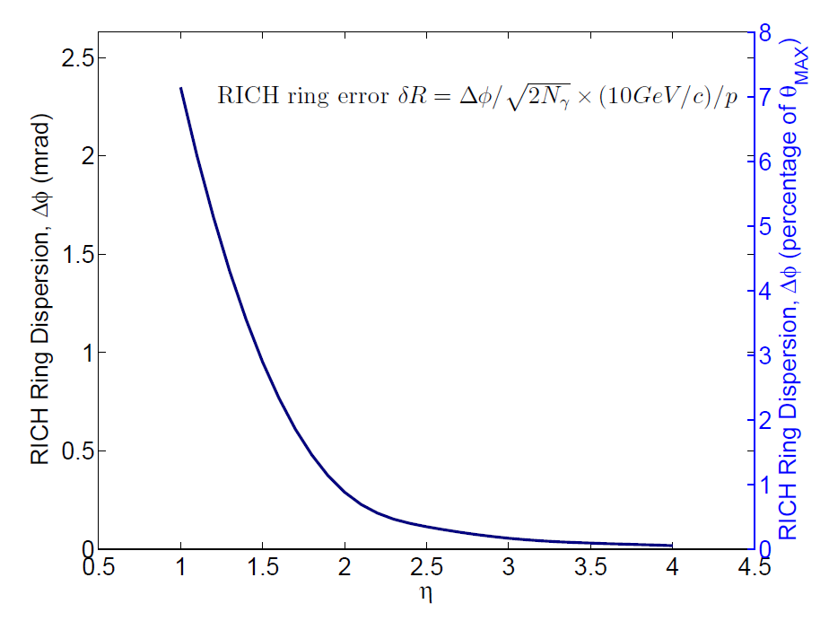
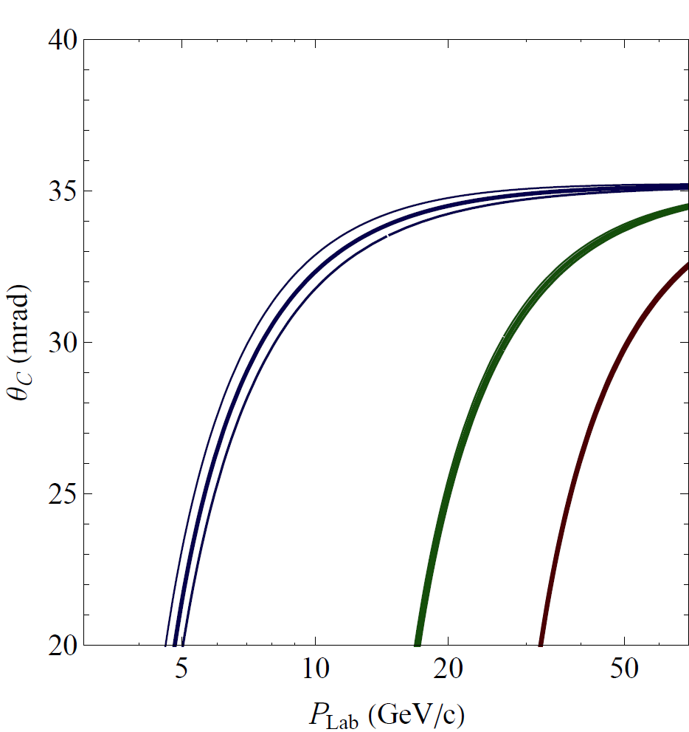
Field effect –
Radius uncertianty of RICH Ring
Ring radius ± 1σ field effect (for worst η=1)
Field effect has very little
impact for PID
π
K
p
Quantify ring radius error
In the respect of PID: minor effect

Slide 13
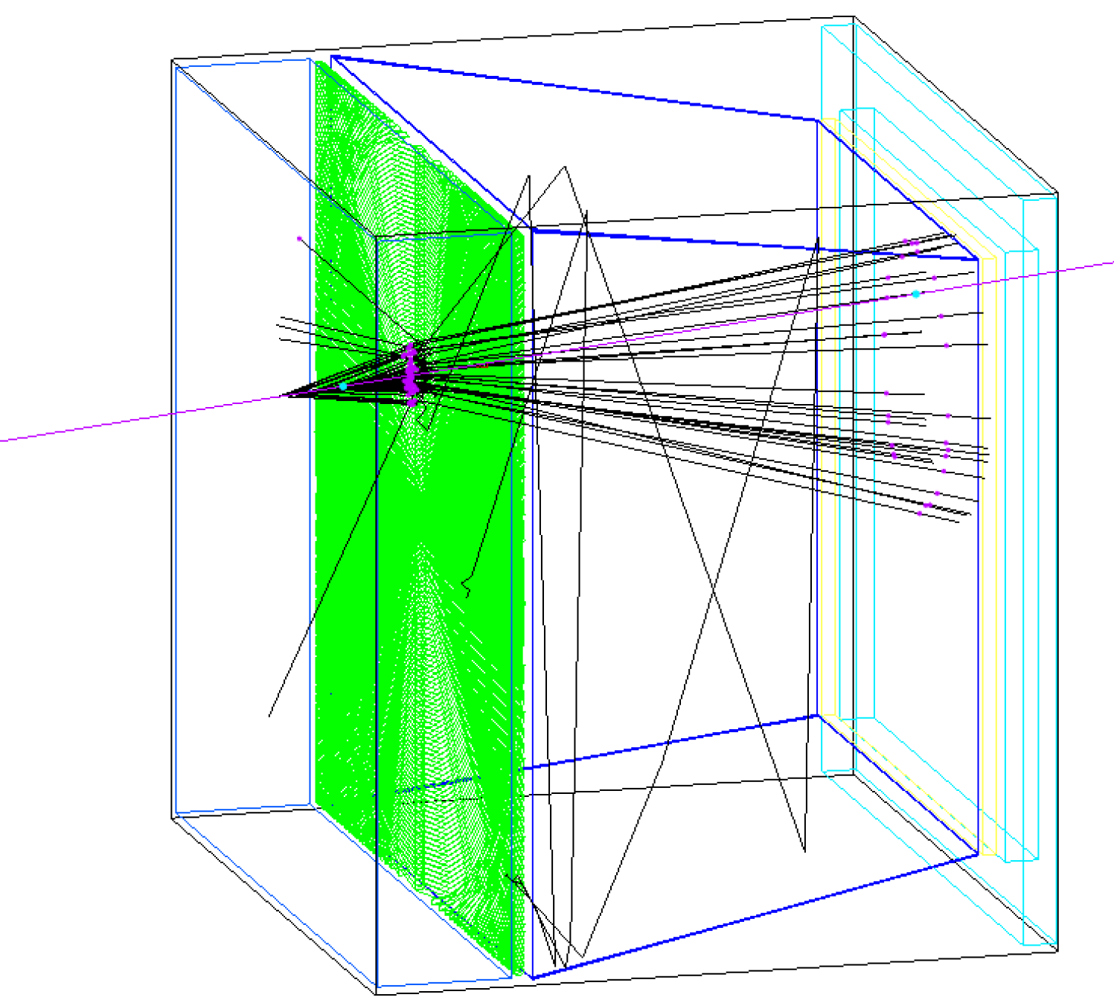
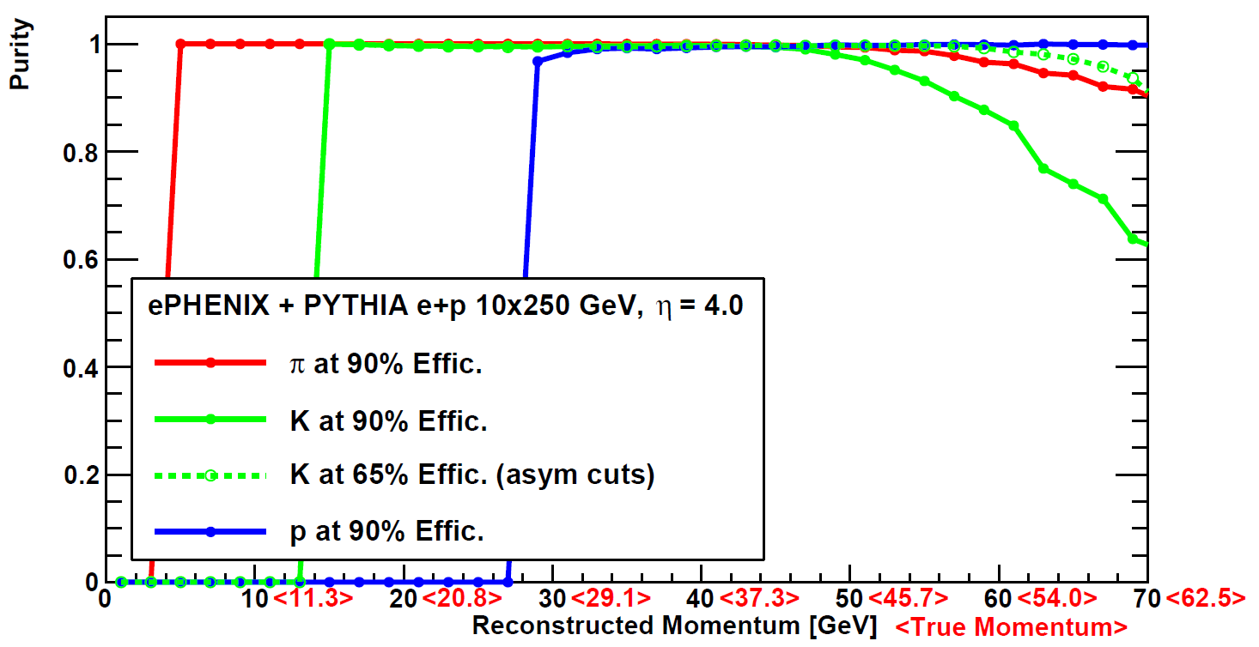
H-going side - performance
AeroGel RICH PID eff.
η~1
Aerogel
EMCal
track
RICH
Gas RICH PID purity at η=4 (most challenging region w/ δp)
η~4
Purity

Slide 14
Summary
“ePHENIX” concept based on sPHENIX upgrade
Evolving concepts of full detector hadron PID
  H-going: AeroGel RICH (medium momentum range) + Gas RICH (high-p range)
  Barrel : TPC (low momentum range) + DIRC (medium momentum range)
  E-going: AeroGel RICH
  Full detector TOF solution also considered
Fringe field
1.5 T main field
Fringe field
Tracking
Calorimeters (H-Cal cover η > -1)
AeroGel&Gas RICHs
AeroGel RICH?
TPC+DIRC
p/A
TOF?
e⁻

Slide 15
Extra Information

Slide 16
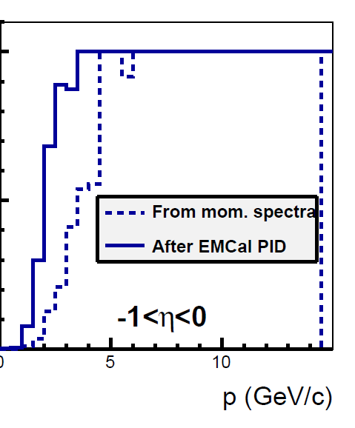
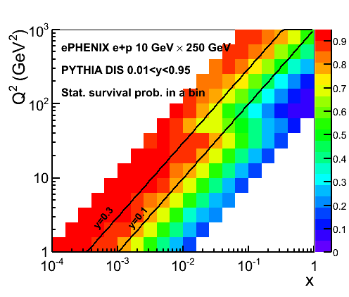
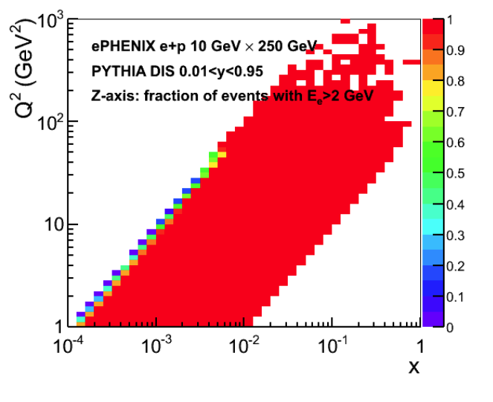
Use of calorimeter for EIC physics
Electron identification (e-EMC, barrel EMC)
Electron kinematics measurement (e-EMC, barrel EMC)
DIS kinematics using hadron final states (barrel EMC/HCal, h-EMC/HCal)
Photon ID for DVCS (All EMC)
Diffractive ID (h-HCal)
High momentum track energy measurement (h-HCal)
From Sasha and Karen using parameterized performance
Electron purity
after EMCal PID
Fraction of DIS event
with good electron ID
DIS kinematics survivability
Electron kinematic method
1
Purity
0

