Slide 1
RHIC Performance Update
Michiko Minty
Accelerator Division Head
December 7, 2021

Slide 2
Contents
Overview of RHIC Runs (Run-21 through Run-25)
RHIC Performance in Run-21
Completed multi-year Beam Energy Scan program
Achieved main Run-21 goal early: Au+Au at 3.85 GeV with bunched beam electron cooling
Early completion enabled execution of all desired experiments in STAR Beam Use Request
Status and Plans for RHIC Run-22
Planned Operating Modes
Upgrades and Improvements
Planning through end of RHIC operations / start of EIC installations (in 2025)
Run-23 – Run-25 with sPHENIX and STAR
25+ year Technical Infrastructure Upgrade Plan
Responses to recommendations from C-AD MAC 2020
2

Slide 3
Overview of RHIC Runs (Run-21 through Run-25)
3

Slide 4
Overview of RHIC Run Plans
From 2020 C-AD MAC (W. Fischer)

Slide 5
RHIC Performance in Run-21
5

Slide 6
Beam Energy Scan (BES)-II
From 2020 C-AD MAC (W. Fischer)
BES-I in 2010/11/14
BES-II: 10x increase in the number of events
From 2015 NSAC Long Range Plan for Nuclear Science
6
Notes:
Picture from 2015 NSAC long-range plan

Slide 7
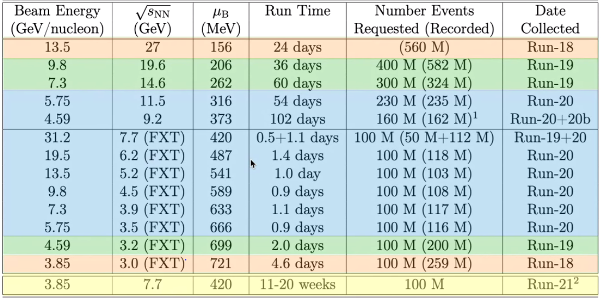
Beam Energy Scan II: Run-18 through Run-20
From 2020 C-AD MAC (W. Fischer)
still to be done
All BES-II goals achieved or exceeded except: Au+Au colliding at 3.85 GeV/nucleon beam energy (=> next Run)
7

Slide 8
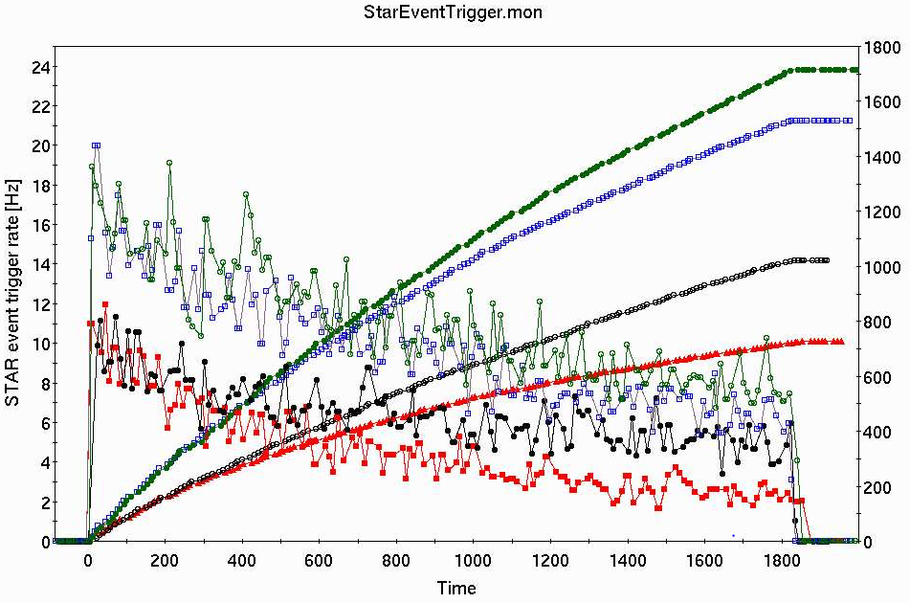
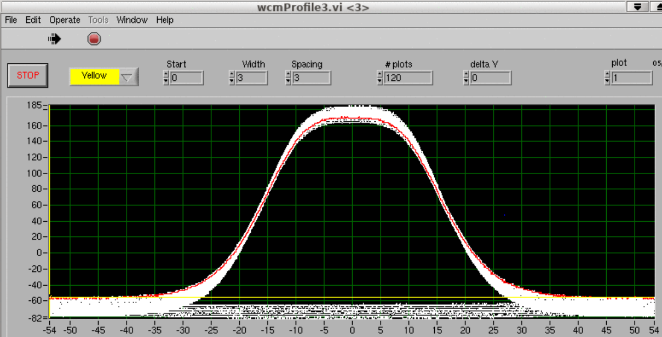
Run-20 Accelerator R&D with Electron Cooling
Au + Au at √s_{NN} = 7.7 GeV
2-9 Sept 2020
final
cooling + 3rd harmonic rf + beta squeeze
cooling + 3rd harmonic rf
cooling
initial
longitudinal ion bunch profile with higher harmonic cavities
2x gain from no cooling to all cooling + 3rd harmonic + beta-squeeze
8

Slide 9
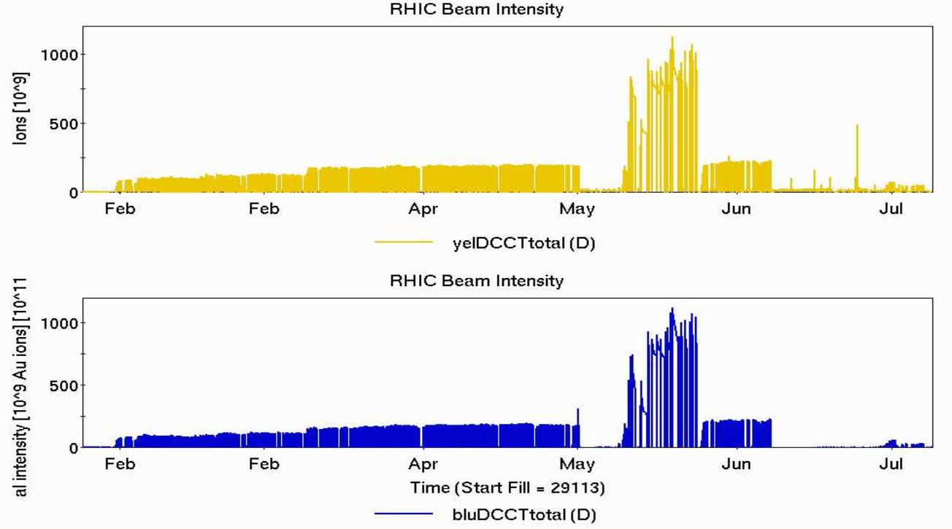
Run Coordinator
Chuyu Liu
Run-21 Overview
priority #1
Au+Au at √s_{NN} = 7.7 GeV
priority #2
Au+Au (FXT) at 4 energies (√s_{NN} = 3.0, 9.2, 11.5, 13.7 GeV)
O+O at √s_{NN} = 200 GeV
Au+Au at √s_{NN} = 17.3 GeV
priority #3
Au+Au (FXT*) at √s_{NN} = 3.0 GeV
RHIC Beam Intensity
d+Au at √s_{NN} = 200 GeV
added
priority
(NPP PAC,
6/22-23/21)
Ions [10⁹]
Ions [10⁹]
Time
8 different modes
+ interspersed operations for CeC PoP at 26.5 GeV/nucleon particle energy
+ FXT* with parasitic CeC operation
+ interspersed accelerator physics experiments (APEX)
9

Slide 10
Beam Energy Scan II: Run-21
8.65
17.3
1.7 B
100 200 d+Au 100 M 4
100 M (central)
Highest priority (Au + Au at √s_{NN} = 7.7 GeV) completed in 13 weeks
All Run-21 Run priorities and event goals + additional d+Au run achieved
10

Slide 11
Principle Investigator
Alexei Fedotov
Low Energy RHIC electron Cooling (LEReC)
704 MHz Cu Deflector Cavity
704 MHz SRF
Booster Cavity
Cathode
loading system
RF Diagnostic Beamline
Transport
Beamline
Technologies
Merger
Beamline
Injection beam dump
2.1 GHz Cu Cavity
DC gun
high QE cathodes
high-power fiber laser
5 RF systems, including one SRF
machine protection
many magnets
instrumentation
100 meters of beamlines
704 MHz Cu Cavity
9 MHz Cu Cavity
COOLING
in Yellow RHIC ring
e⁻
e⁻
e⁻
RHIC TRIPLET
RHIC DX
DC e⁻ Gun
COOLING
in Blue RHIC ring
LF solenoid
HF solenoid
Transport solenoid
Quad corrector
Trim corrector
Corrector 3.8 ID
Corrector 6.0 ID
BPM 2.4 ID
BPM 4.8 ID
Bellows
Ion pump
180°
Bending
Magnet
Extraction beam line
High-Power Beam Dump
* NOT to scale
A. Fedotov et al, Experimental Demonstration of Hadron Beam Cooling Using Radio-Frequency Accelerated Electron Bunches, Physical Review Letters 124, 084801 (Feb 2020).
First operational electron cooling in a collider (Run-20)
Critical for lowest-energy RHIC program in Run-21
11

Slide 12
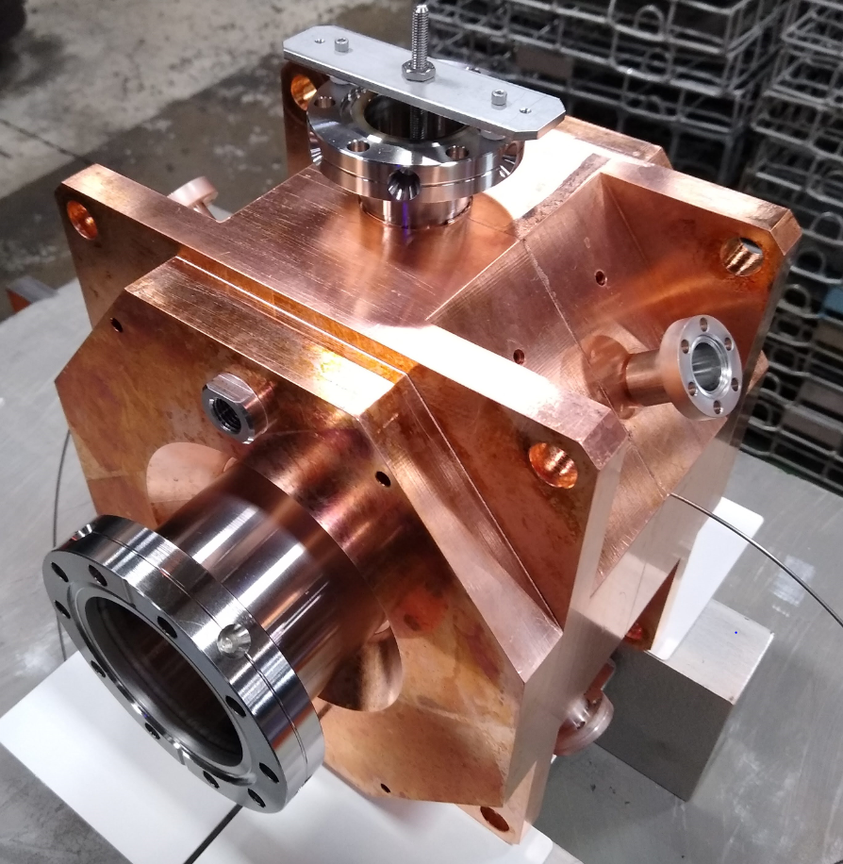
Run Coordinator
Chuyu Liu
Highlights from Run-21 BES-II program with LEReC
All performance goals attained. Additional operational improvements implemented:
New LEReC 1.4 GHz cavity and new RHIC bunch-by-bunch dampers
Feedback-based beam control for electron orbits in cooling sections, electron beam energy, electron beam intensity and laser position feedback.
Utilization of existing 3rd harmonic (28 MHz) cavity in RHIC to reduce ion beam peak current
Optimization of electron beam currents based on operational experience
15-20 mA (for Au ions at 4.6 GeV/n in 2020)
8-20 mA (for Au ions at 3.85 GeV/n in 2021)
Select demonstrated additional technological advances:
Robust photocathodes with high initial Quantum Efficiency
Photocathode lifetimes of 6-10 days
Stable and reliable operation of high-power fiber laser
for photoelectron gun
1.4 GHz cavity
Quantum efficiency
Efficiently and reliably operated LEReC with high-current electron beams and stable cooling at lowest-ever RHIC beam operating energy (3.85 GeV/n) in Run-21
12
Notes:
1.4 GHz cavity, amplifier and circulator installed November, 2020. Designed to increase the electron bunch length from 0.4 to 0.6 ns while preserving the slice energy spread. Intent to reduce the “heating” effect from the electrons on the ions.
Bunch-by-bunch damper: used repurposed stripline kickers and existing BPMs. Long-desired general purpose device to combat instabilities. Reduces tune spread to allow for smaller chromaticity.

Slide 13
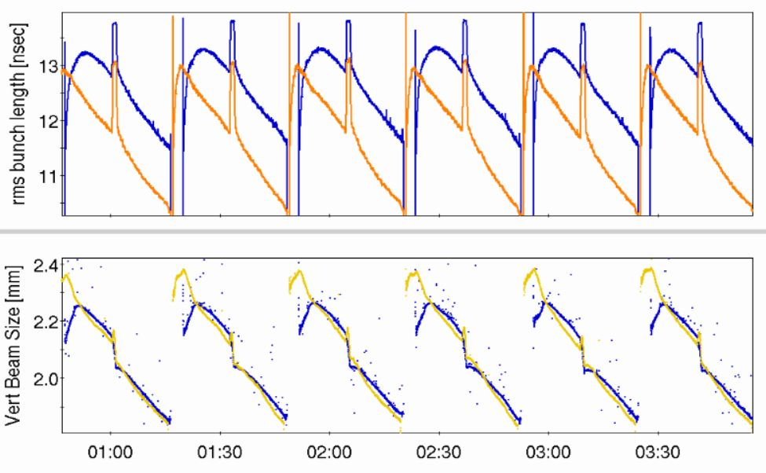
Typical cooling performance in Run-21 at 3.85 GeV/n
4/28/21
rms bunch
length (ns)
vertical beam size (mm)
Time
Stable and efficient operation of LEReC, with simultaneous cooling of ions for BES-II at √s_{NN} = 9.2 GeV
13

Slide 14
RHIC Operational Efficiency – 2002 to 2021
availability reported to DOE
Availability = beam time / scheduled beam time (denominator excludes scheduled maintenance)
Availability goal: 85% (raised in Run-20, from 82.5%)
Achieved 90.6% availability in Run-21 Met availability goal for past 10 consecutive years
14

Slide 15
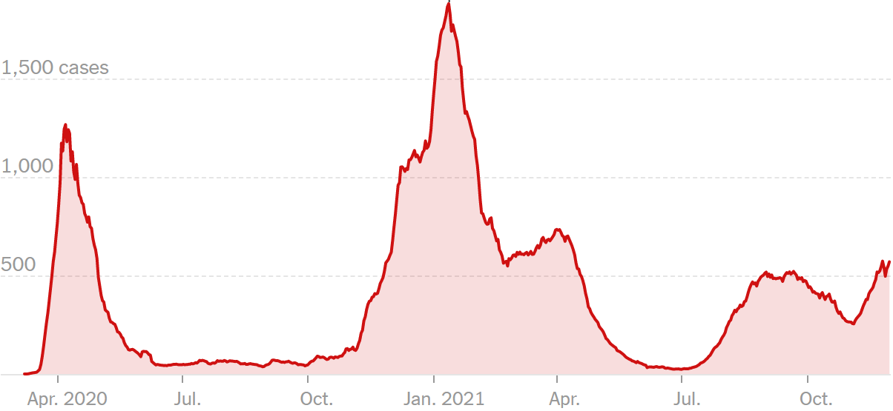
RHIC Operation during the COVID Pandemic
New reported cases by day in New York (from New York Times, 1 Dec 2021)
Challenges (Run-21)
Reduced workforce due to illness and quarantines
Supply chain delays
New methods of communications with MCR
Occasional delayed response time to operational issues
Possible employee “burn-out” – 18+ months of “state of emergency” response
1/29/2021 – Run-21 RHIC Run start
3/20/2020 – end of Run-20A
start of operations stand-down
1/4 – NSRL and BLIP start
7/7/21 – Run-21 RHIC Run end
C-AD MAC (12/1-4/20)
11/29/21 – Run-22 RHIC Start
12/3 – 12/19
NSRL run
6/18 – Run-20B start
10/23 BLIP start
7/11 – NSRL and BLIP end
11/1 NSRL start
9/14 – Run-20 end
Successes
Call-ins: no differences from pre-COVID levels
Remote operations: adapted well
Maintained high accelerator availability
min-safe operations
~ 40 on-site FTEs
130 – 150 on-site FTEs
expansion of limited operations
~ 200 on-site FTEs
~ 225 on-site FTEs
6/4
7/6
limited operations
(~ 70 on-site FTEs)
Despite challenges, RHIC operations, LEReC and STAR all operated well thus completing the multiyear BES program
15

Slide 16
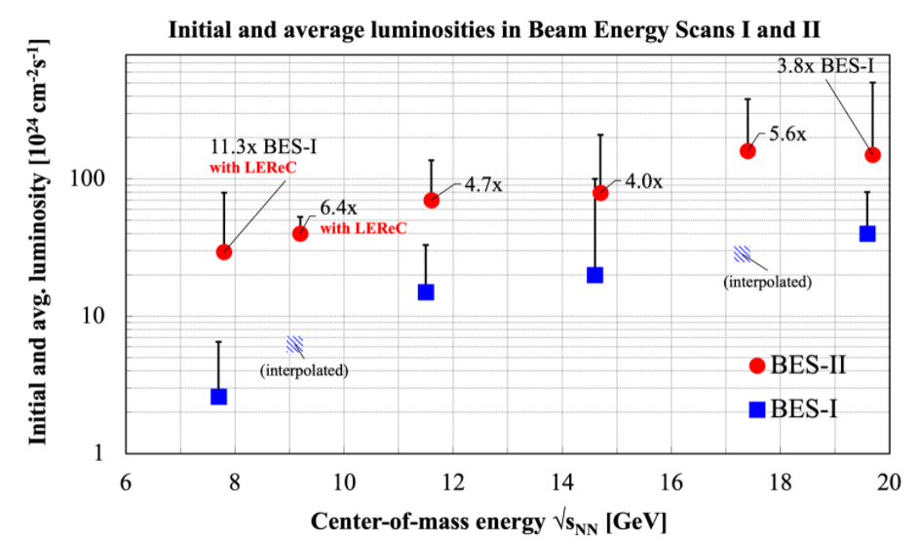
BES-I vs BES-II luminosity
Run Coordinators:
T. Satogata (Run-7, Run-8)
K. Brown, A. Drees,
G. Marr, T. Satogata (Run-10)
G. Marr (Run-11)
C. Montag (Run-12)
G. Robert-Demolaize (Run-14)
C. Liu (Run-19, Run-20, Run21)
Goal:
L_{avg} (BES-II) / L_{avg} (BES-I) = 4
Met all luminosity goals and demonstrated luminosity ratios of
3.8
4.0
4.7
6.4 (with LEReC)
5.6
11.3 (with LEReC)
Run-19
Run-20
Run-21
Run-21 with √s_{NN} = 7.7 GeV: L_{avg} (BES-II) = 11.3 x L_{avg} (BES-I)
16

Slide 17
Status and Plans for RHIC Run-22

Slide 18
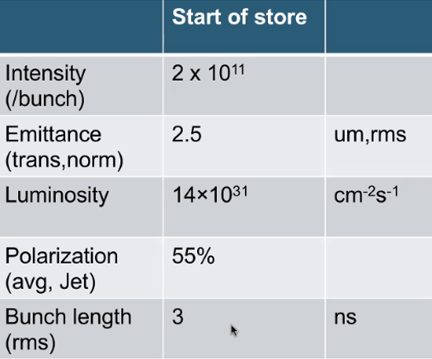
Preparation for RHIC Run-22
Run Coordinator: Vincent Schoefer
Planned Operating Modes
p↑ + p↑ at 255 GeV/n – Physics requirements same as Run-17 Run
Au at 26.5 GeV/n for CeC-X (16 days)
Accelerator Physics Experiments (APEX) for EIC
Au at 3.85 GeV/n for LEReC-based cooling experiments
³He at 100 GeV/n for polarimetry development
Changes for Run-22 RHIC Run (slides to follow)
Ion source upgrades
H- jet polarimeter upgrade
RHIC Machine Protection System (MPS) upgrade
Operational improvement plans
18
Notes:
Budget briefing: 18 cryo-weeks (scenario 1), 20 cryo-weeks (scenario 2)
STAR BUS: 20 cryo-weeks consisting of 16 week run time for SAMPLED luminosity of 400 / pb. + 1 week cooldown + 2 week setup time = 19 weeks total. Per Lijuan, STAR has forward upgrades including 4 subsystems. We assume that we might need 1 additional week for the commissioning. Per BUS, 18 cryo-week run would result in more than ~15% of sampled luminosity.

Slide 19
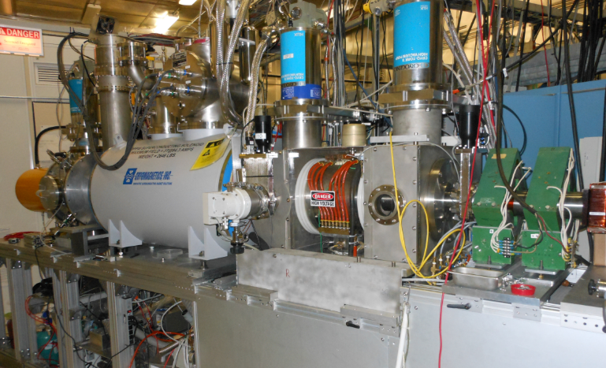
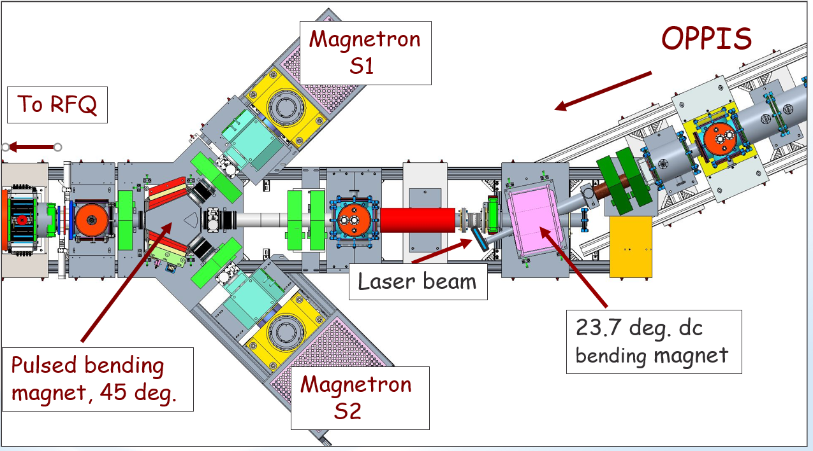
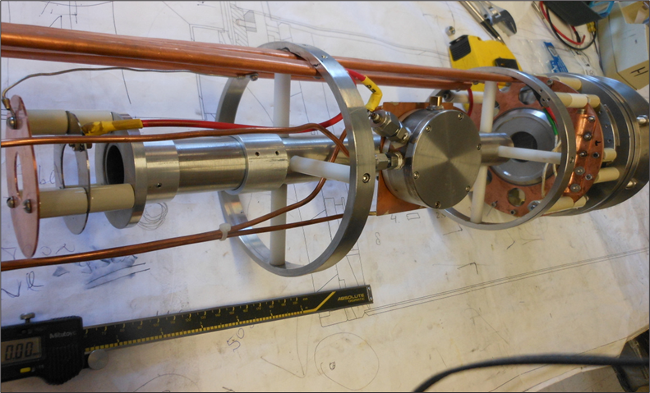
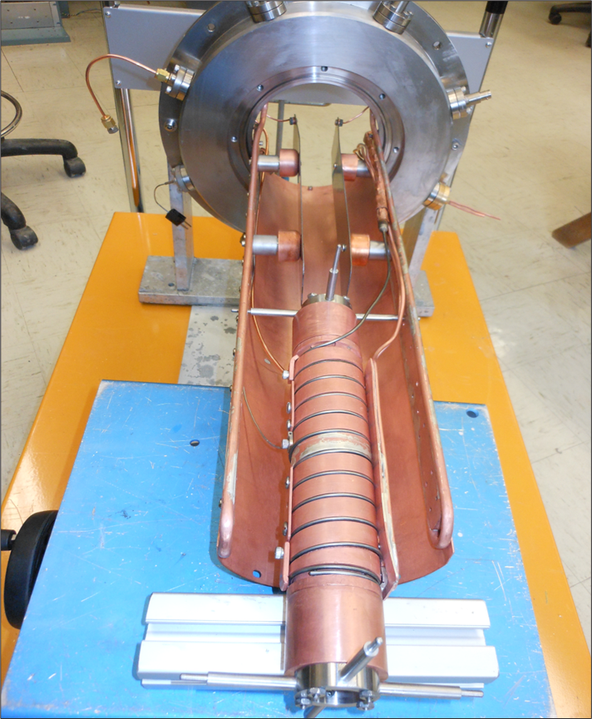
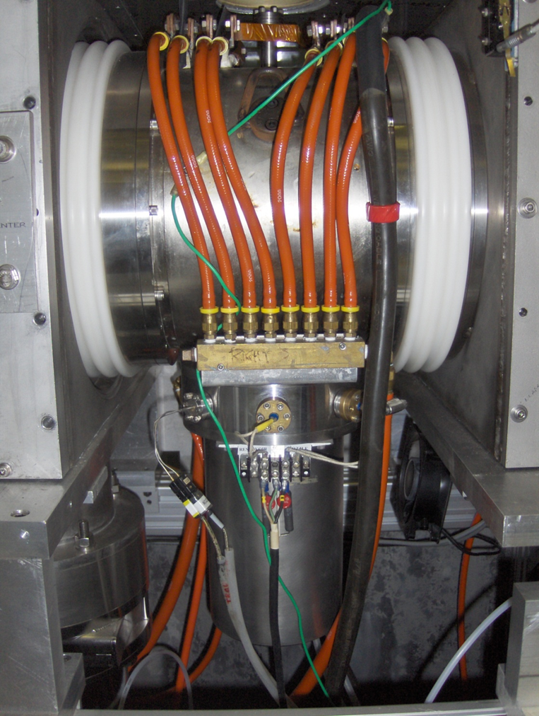
Changes for RHIC Run-22 (1 of 4) - Ion Source upgrades
Optically Pumped Polarized Ion Source (OPPIS)
OPPIS last run in June 2017
January - May 2021: OPPIS Source refurbished and operated for AGS
For Run-22: OPPIS upgrades to H-ionizer cell, optically pumped Rb-vapor cell, and Na-jet ionizer cell completed
Recently demonstrated 80% polarization at 200 MeV
LEBT upgrade - added second high-intensity source in Run-21
He-ionizer cell
Rb-cell
Na-jet ionizer cell
Achieved 225 mA proton beam current (>10% improvement)
19
Notes:
OPPIS source upgrade: new He-ionizer cell, Rb-cell and Na-jet ionizer all part of OPPIS. OPPIS off June 2017 to Nov 2020.
Polarized protons in AGS used for booster AC dipole and AGS flattop bunch merge test.
Not mentioned: 2017 – 2020: studies of optical pumping in high magnetic field. Put He-ionizer cell inside SC solenoid. He-3 ionized by electron current, double-charged. For EIC.

Slide 20
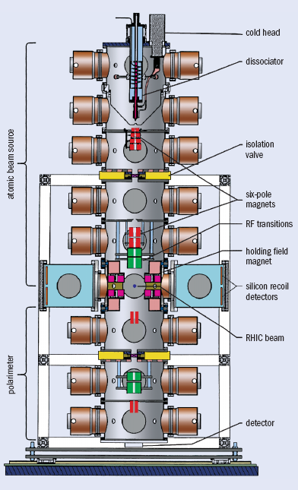
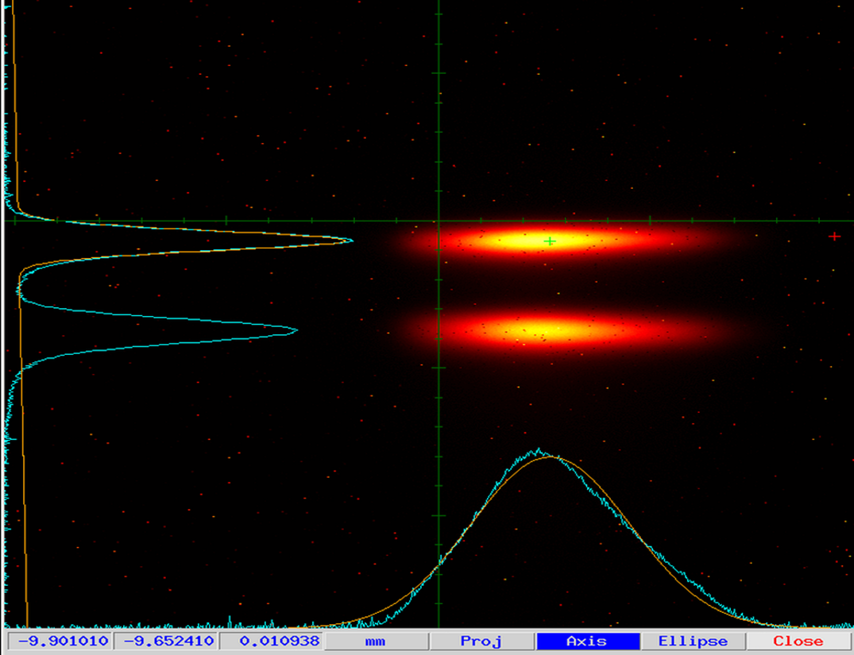
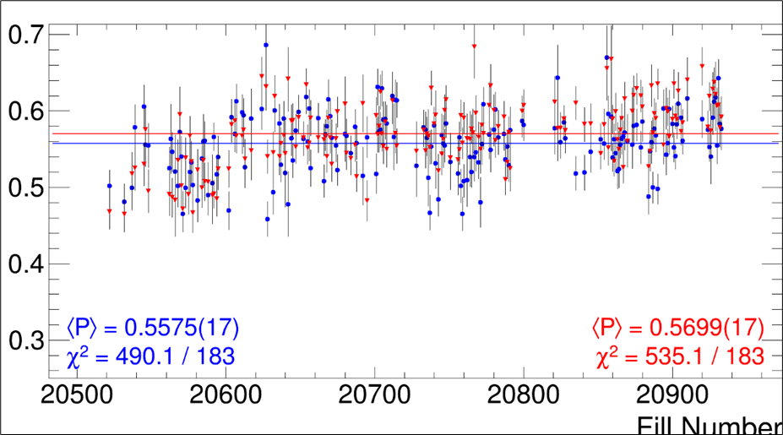
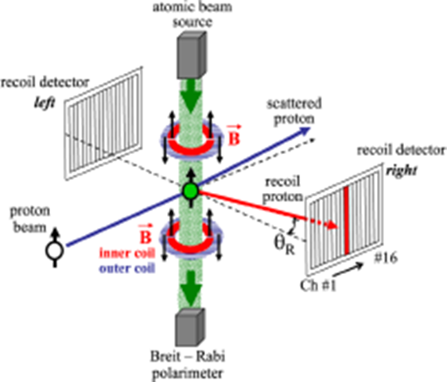
Changes for RHIC Run-22 (2 of 4) - H- jet polarimeter
High accuracy absolute polarization measurements
A.A. Poblaguev, A. Zelenski et al, Nucl. Instr. and Meth.,
In Phys. Res., A 976 (2020) 164261
High time-resolution beam profile monitor for LEReC
From Run-17
‹ P › = (~ 56 ± 2.0 stat ± 0.3syst) % (typical store)
Run-22 Upgrades
turbo-molecular pumps power supplies
detectors and pre-amplifiers
control and interlocks
20

Slide 21
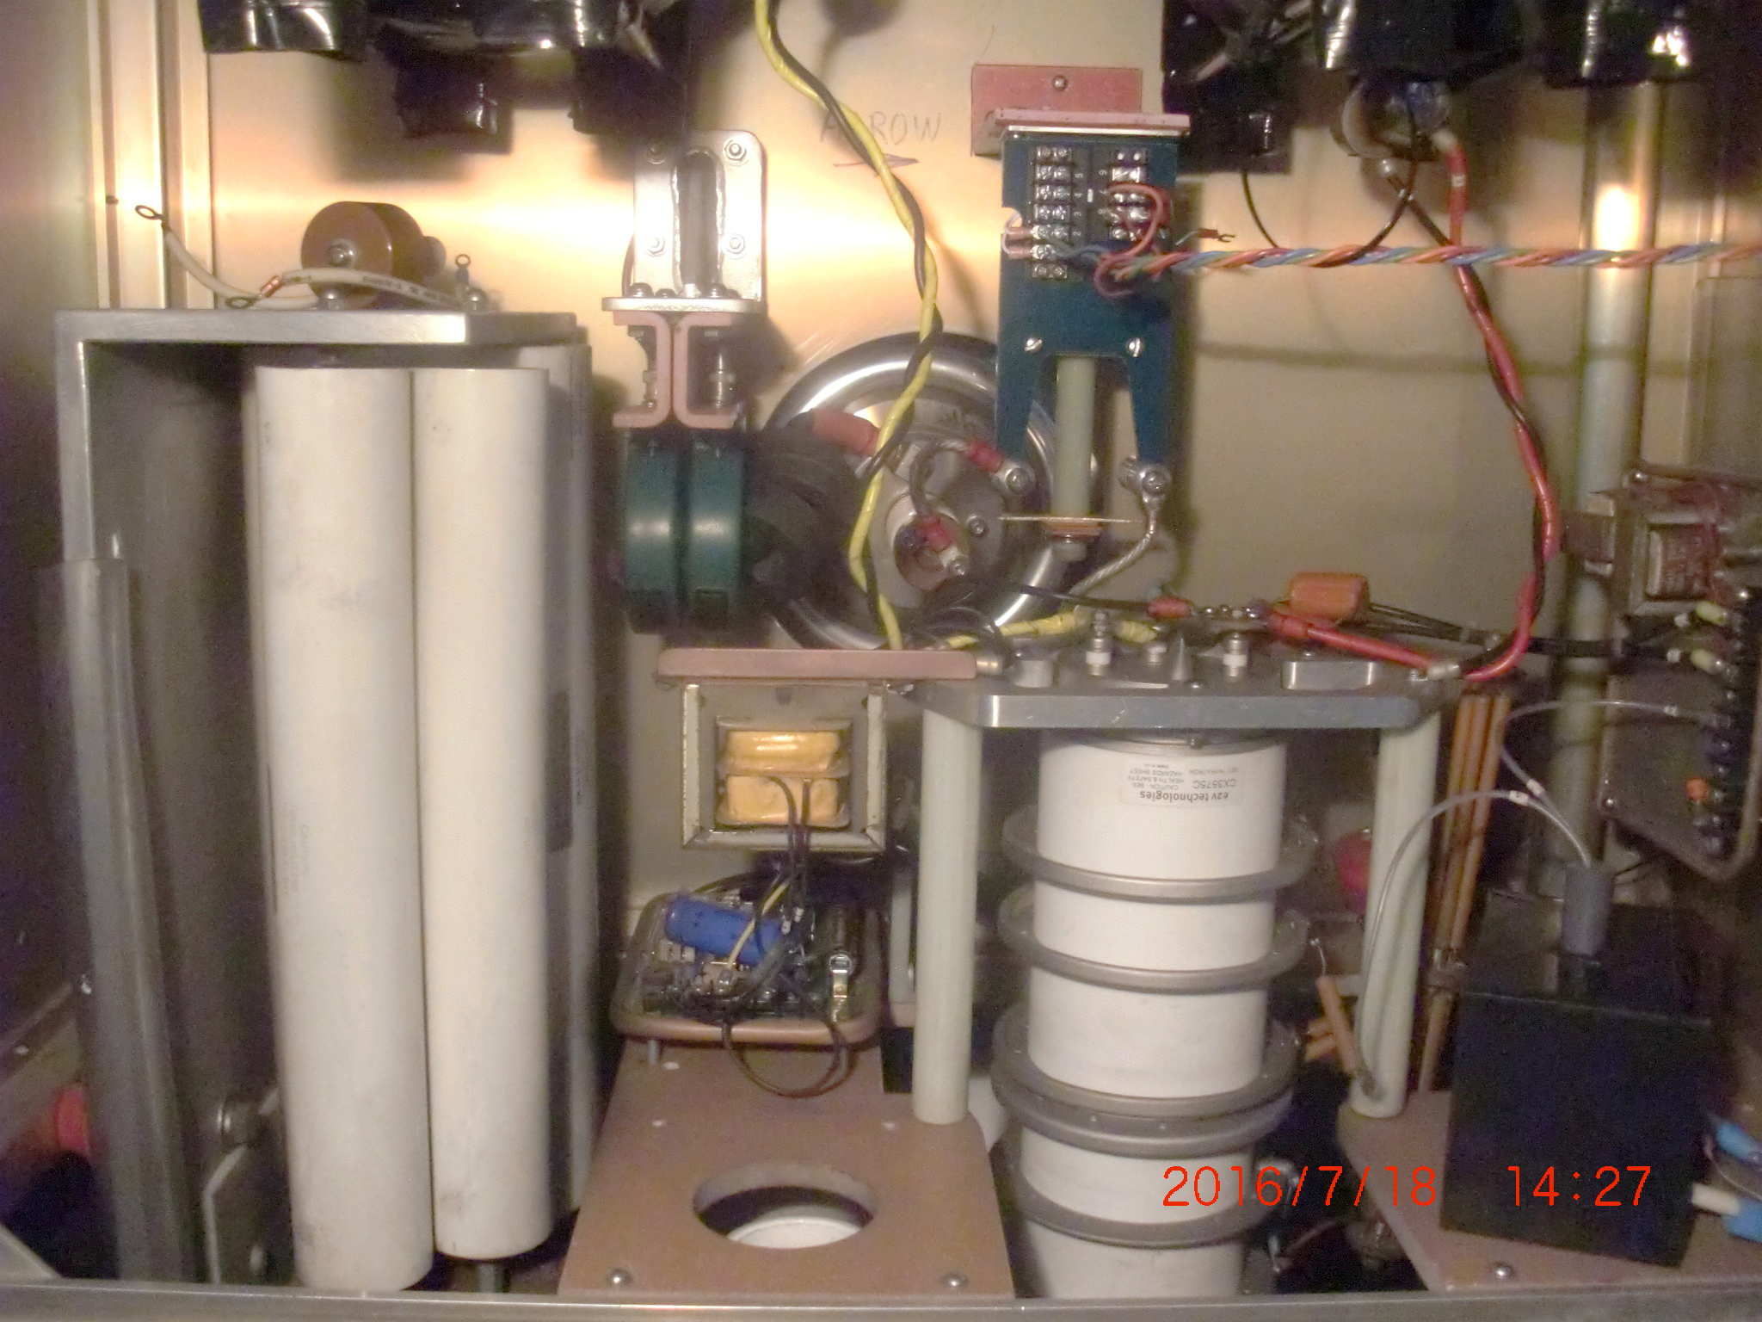
Changes for RHIC Run-22 (3 of 4) RHIC Machine Protection System (MPS)
Motivation: protect sPHENIX and RHIC SC magnets
Issue: RHIC abort system thyratrons occasionally fire spontaneously and asynchronously causing ~10 bunches to miss the RHIC beam dump
Solution: add mechanical relays in series (installed in 2020) and
compensate for the added time delay of 6ms (=460 turns)
include additional inputs to the existing MPS (BLMs, BPMs, RF, corrector PS)
PHENIX MPC start of run
after Yellow pre-fire 05/11/15
after Yellow pre-fire 06/01/15
M. Purschke
thyratron tube
redundant mechanical relays (added)
PFN
abort kicker
More details in Mattheiu Valette’s presentation ‘Operation with sPHENIX’
21

Slide 22
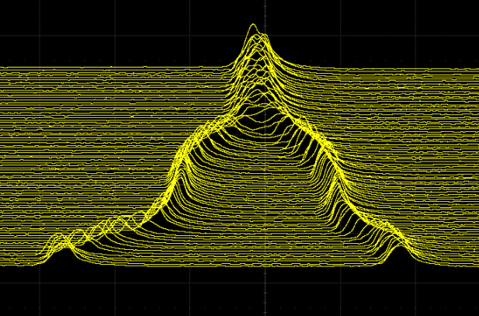
Changes for RHIC Run-22 (4 of 4) – Improvement Plans
New bunch split and merge scheme in the injector to reduce peak current (and hence emittance) at AGS injection
Present scheme: Single bunch from source to RHIC, dual harmonic RF at Booster and AGS injection
RF gymnastics tested in Jan 2021
Booster split
AGS Merge
Booster
AGS
Extract to RHIC
Extract to AGS
h=3
h=6
Dual harmonic RF (h=1,2,adiabatic capture)
Dual harmonic RF (h=6,12)
Time
h=2
h=12
Proposed scheme: Add a longitudinal split in Booster and merge in AGS at 25.5 GeV
Booster
AGS
Extract to RHIC
h=1
h=6
Extract to AGS
500 ns
200 ns
Bunch Merge
h=12->6
Dual harmonic RF
Bunch Split
Dual harmonic RF
12/2/21
Potential improvements:
~ 20% reduction in transverse emittance
~10% increase in relative polarization
200 ns
22

Slide 23
Run-22 RHIC Startup [1]
Unusual events
AGS partial snake magnet, short to ground (Sept)
Booster vacuum bakeout (Sept)
AGS cable tray collapse (Oct)
AGS dipole coils replacement (Nov)
RHIC Yellow Ring vacuum leak (Nov)
RHIC cryo controls upgrade (Nov) → 2 week delay in RHIC setup
Increase in safety-related reportable events (details in backup slides)
Status
Cool-down of RHIC started Nov 15, as planned.
In parallel, work to minimize impact on Run-22 programs
Development of new bunch split-and-merge schemes in the injectors
Electron beam commissioning for CeC (a primary Run-22 program)
Next-in-priority LEReC setup for EIC-related accelerator physics studies
Final RHIC cool-down to 4K started Nov 29
Injector (LINAC, Booster, and AGS) setup completed
RHIC beam setup underway
23

Slide 24
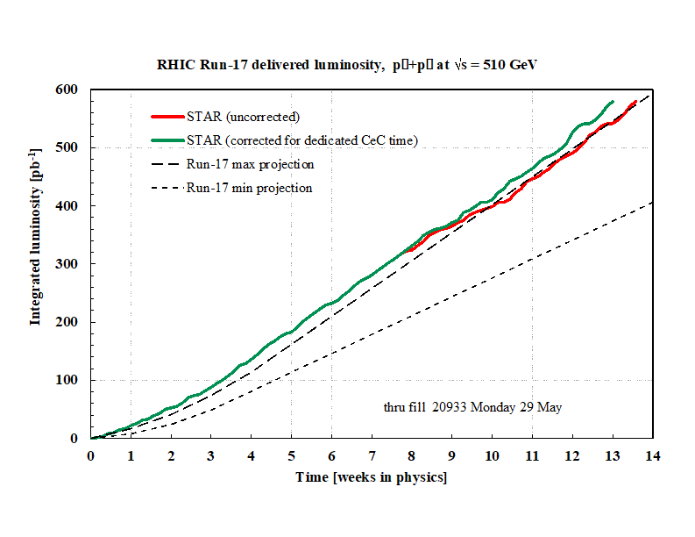
Run-22 RHIC Startup [2]
Objectives
p↑ + p↑ at 255 GeV/n for STAR
400 pb⁻¹ sampled luminosity (~16 weeks estimated in STAR beam use proposal)
Figure of merit, LP² = 120 pb⁻¹ with <P> = 55%
CeC-X
16 days
Accelerator Physics Experiments
~ 5 days (tbd)
RHIC Run-17 delivered luminosity p↑ + p↑ at 255 GeV/n
Challenges
last high energy polarized proton operation in Run-17
delayed start (2 weeks)
tight shutdown schedule (before Run-23)
Integrated luminosity [pb⁻¹]
Mitigation plans
quickly restore good operating conditions from Run-17
leverage performance improvements for increased polarization
Time [weeks in physics]
Run-22 end date fixed for now with contingency planning underway
24

Slide 25
Planning through end of RHIC operations / start of EIC installations (in 2025)

Slide 26
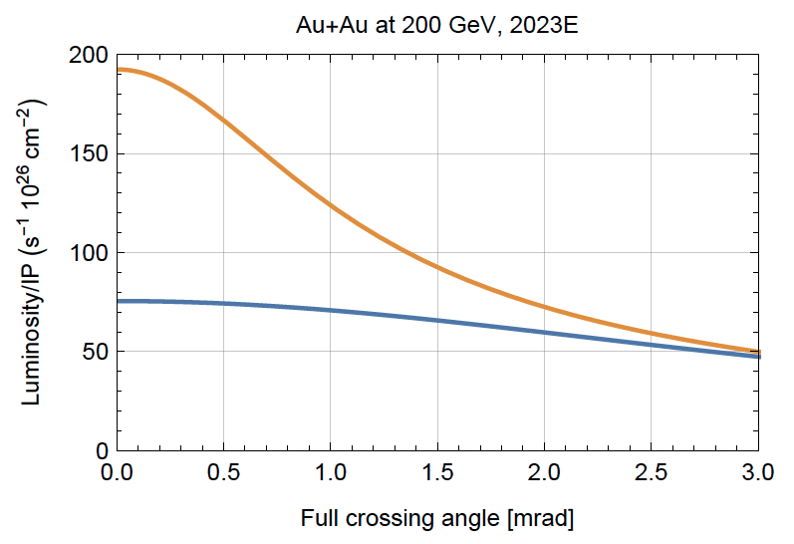
Run-23 through Run-25 with sPHENIX and STAR
Planned Operating Modes – all with 100 GeV/n beams
Run-23 RHIC Run: Au + Au
Run-24 RHIC Run: p↑ + p↑, p↑ + Au
Run-25 RHIC Run: Au + Au
Maximizing useful luminosity with sPHENIX
Run-23 Au+Au
Use of 56 MHz SRF cavity (for increased longitudinal focusing)
Small vertex (+/- 10 cm) via 2 mrad crossing angle
Use of upgraded machine/experimental protection system (abort kicker relays+ faster detection of anomalies)
New power supplies in IR8 for larger operating margin / smaller β*)
L(±10 cm) ~ L(total) with 2 mrad
Total luminosity
Total luminosity in +/- 10 cm
26

Slide 27
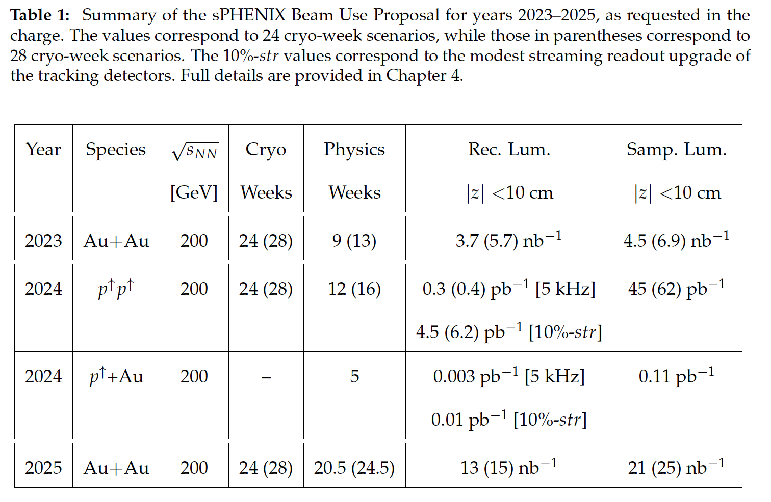
Run-23 to Run-25 with sPHENIX and STAR
From 2020 C-AD MAC (W. Fischer)
<= sPHENIX request
will have to move DX magnets during Run-24 (~1 week)
STAR request =>
27

Slide 28
25+ year technical infrastructure upgrade plan
Manager: Rob Michnoff
Developed in 2018 for RHIC, the injector complex and possible EIC
Assessed annually based on need for
performance upgrades
upgrades of obsolete systems
Assumes no further large performance upgrades of RHIC until end of RHIC operations
Upgrade Plan Goals
Maintain technical infrastructure
Ensure hadron injector complex ready for EIC commissioning while also running for external users (e.g. NSRL and BLIP), possibly HEET
Ensure that system upgrades satisfy both short-term injector and RHIC needs as well as longer-term EIC requirements
Develop a 4-year upgrade plan to allow new systems to be tested prior to the end of RHIC beam operations (mid-2025)
28

Slide 29
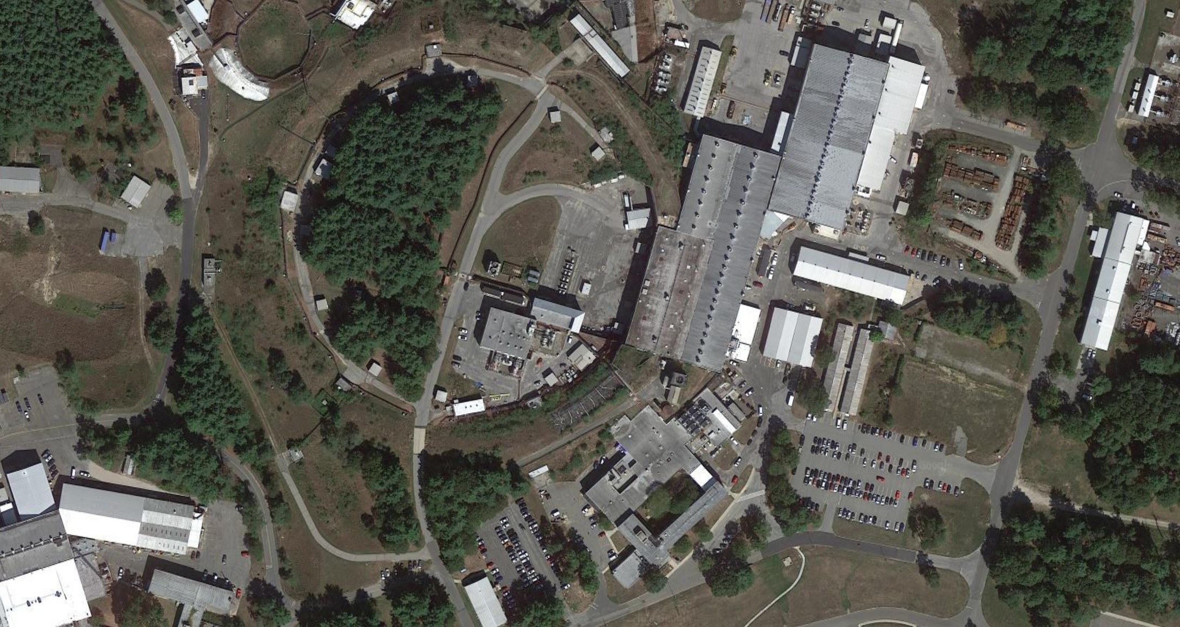
Technical infrastructure Upgrades that will support the EIC
Bldg. 912 Existing SRF Infrastructure
(clean rooms, HPR, VTFs, RF test area)
Existing Laser development area
Cryo Upgrade in progress
Bldg. 924 Instrumentation
Upgrade complete
Bldg. 905 Vacuum
Upgrade in progress
Bldg. 911 Power Supplies
Upgrade in progress
Work support by off-EIC-project funding, by BNL Modernization Project Office, and the BNL Facilities and Operations Directorate (F&O)
29

Slide 30
Responses to recommendations from C-AD MAC 2020

Slide 31
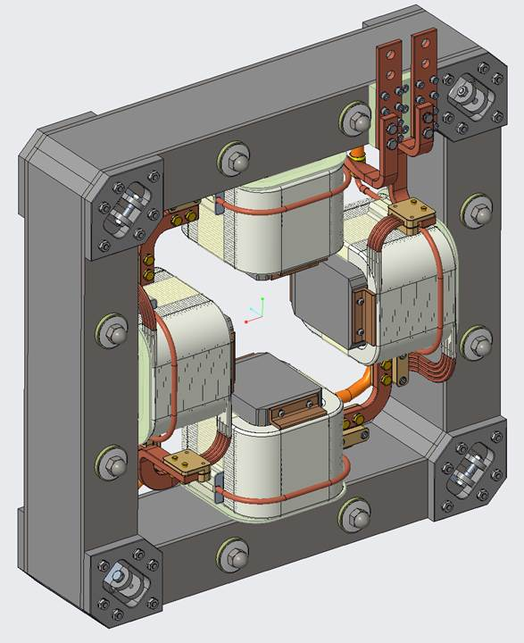
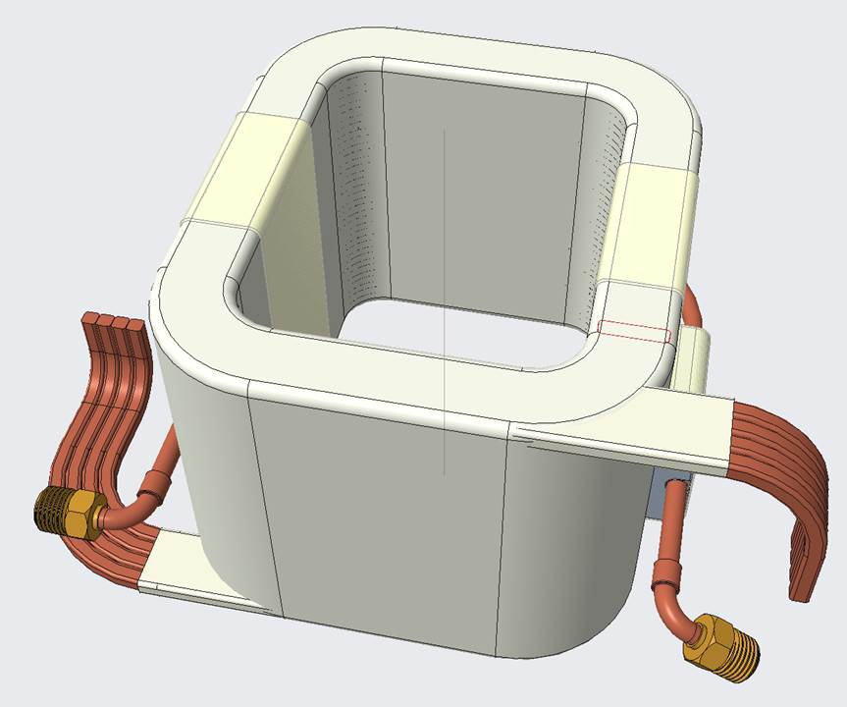
Responses to recommendations from C-AD MAC 2020
R1: Continue optimization of the skew quad scheme, aiming for reduction of power.
Dec. 2020
Pulsed system parameters |  | Unit
Int. gradient (max) | 0.45 | T
Current (max) | 500 | A
Voltage (max) | 400 | V
Power (peak, 15 magnets) | 2-3 | MW
July, 2021
Pulsed system parameters |  | Unit
Int. gradient (max) | 0.2 | T
Current (max) | 275 | A
Voltage (max) | 450 | V
Power (peak, 15 magnets) | 1.8 | MW
Status
Finished power supply and magnet design
Power supply procurement underway (July, 2021)
Magnet procurement starting
Plan for commissioning in Run-23
R2: Carry on planned tests of the split/merge scheme.
In progress (slide 22)
31

Slide 32
Summary: Accelerator Operations

Slide 33
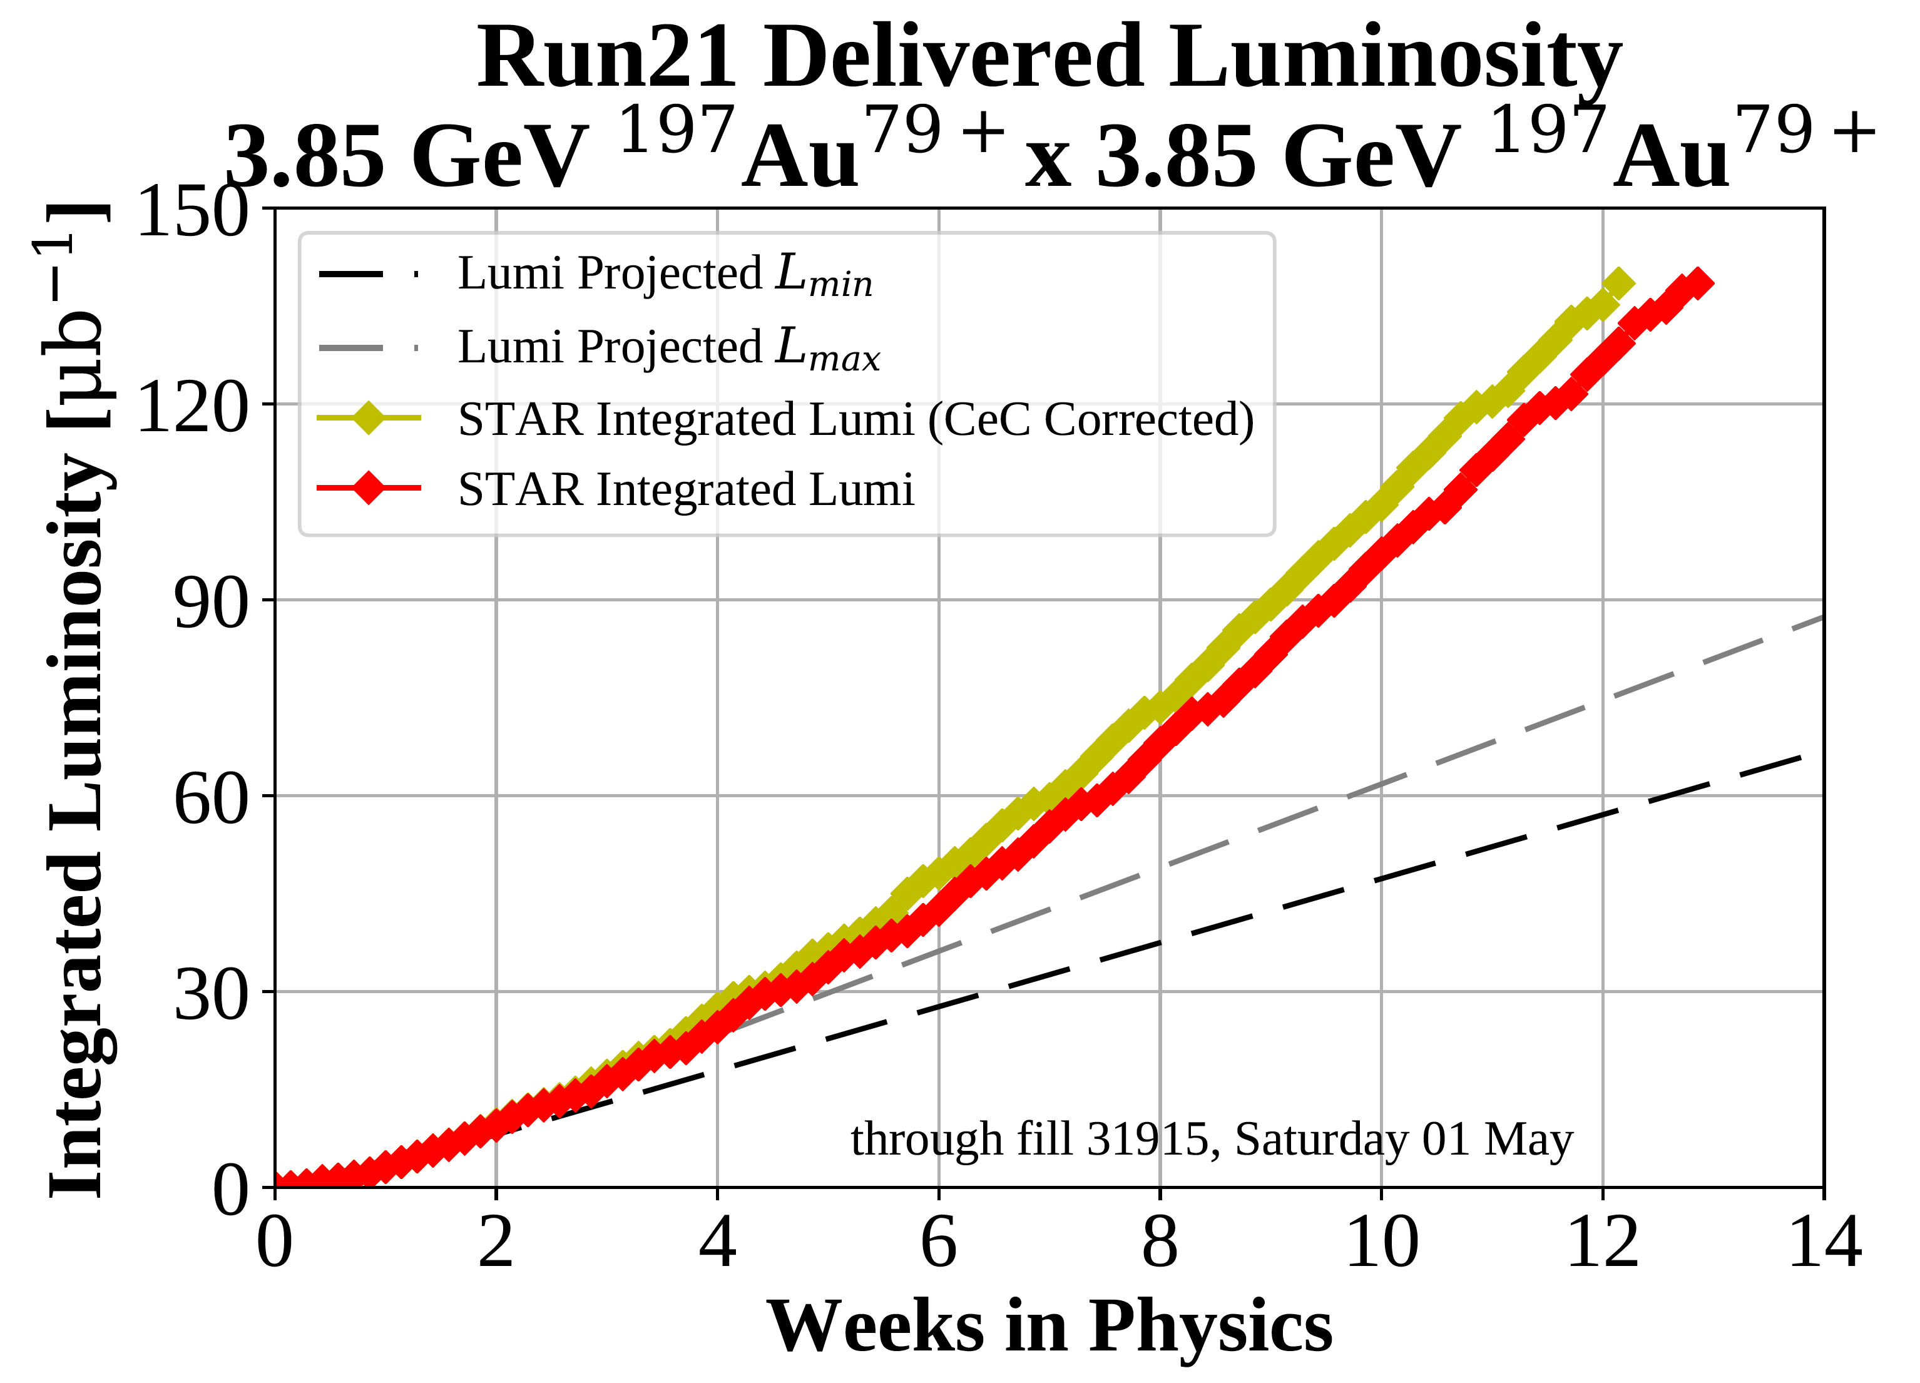
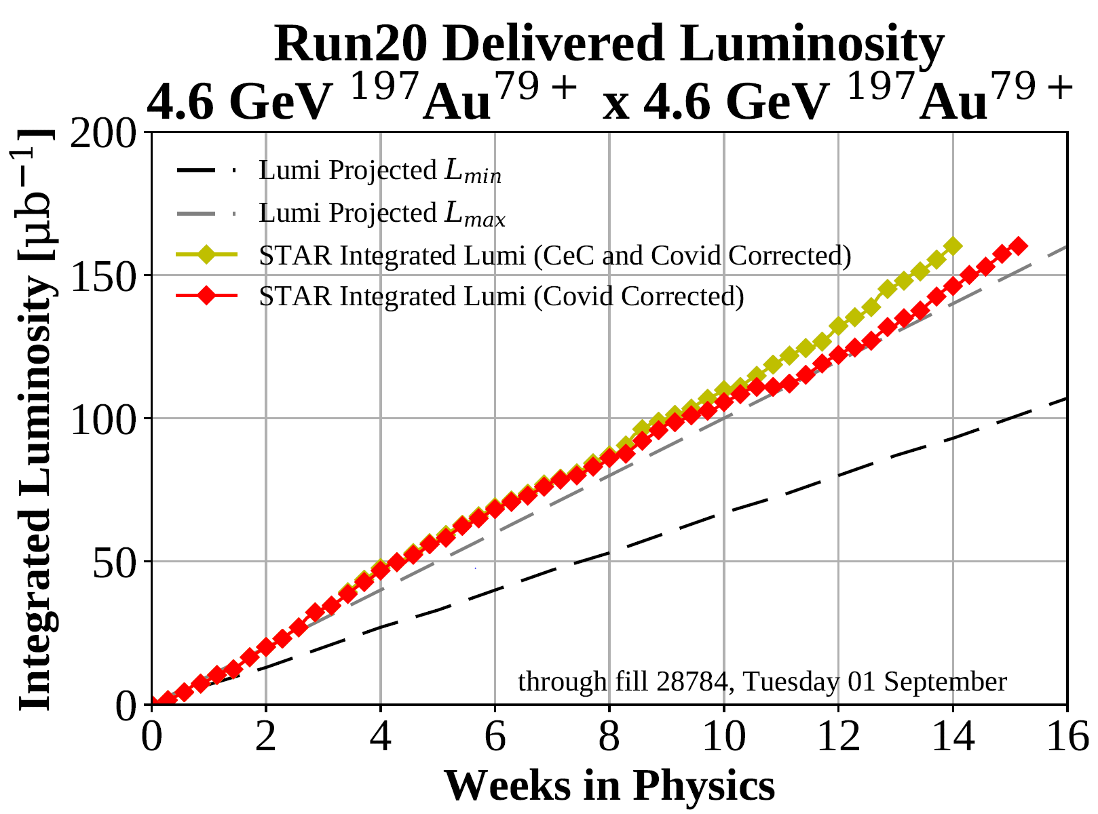
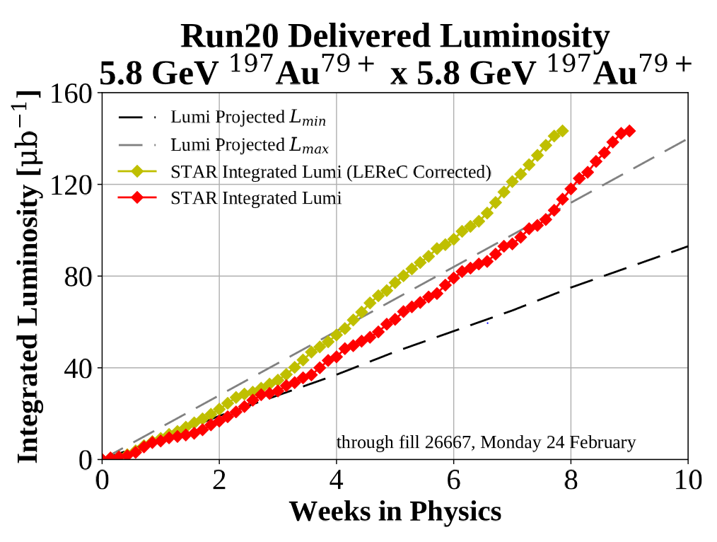
Summary – RHIC Performance Update
Run-21 Run – extraordinarily successful
Completed the multi-year BES scan program.
Highest priority Run-21 goal for BES-II achieved with LEReC in 13 weeks.
Met all next-priority STAR goals including an additional d+Au run (8 modes + beam delivery for CeC).
Achieved 90.6% accelerator availability.
Missions achieved with limited on-site staff and full off-site coverage during the COVID pandemic.
Run-22 RHIC Run – very challenging
Resuming polarized proton operation at full energy (last operated in Run-17).
Since Run-17 accelerator availability goal raised to 85%.
Multi-faceted RHIC MPS upgrade to be fully implemented.
Operational improvements targeted on increased polarization in the injectors underway.
Planning for Run-23 through Run-25 with both sPHENIX and STAR underway
25+ year technical infrastructure upgrade plan
Many technical infrastructure upgrades completed and/or underway.
Goal is to have hadron injector complex ready for EIC commissioning while maintaining
operation for external user facilities (for NASA, Isotope production, maybe HEET).
33

Slide 34
Reference Slides

Slide 35
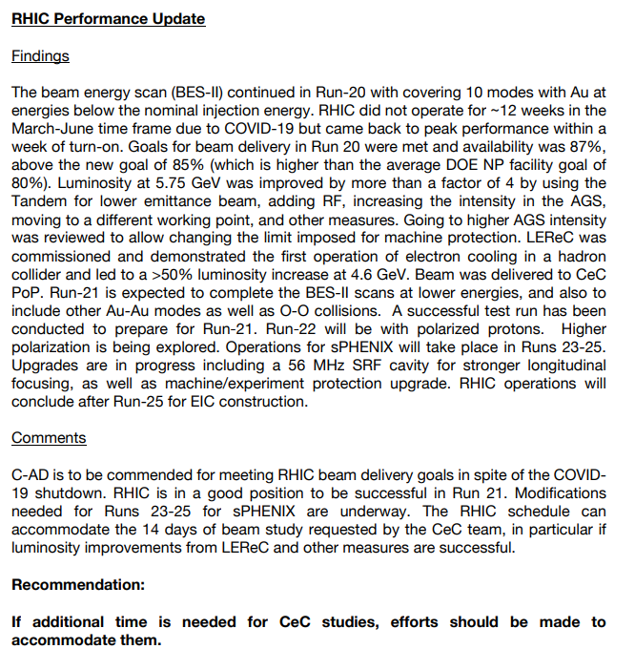
Excerpts from C-AD MAC 17 Report (Dec, 2020)

Slide 36
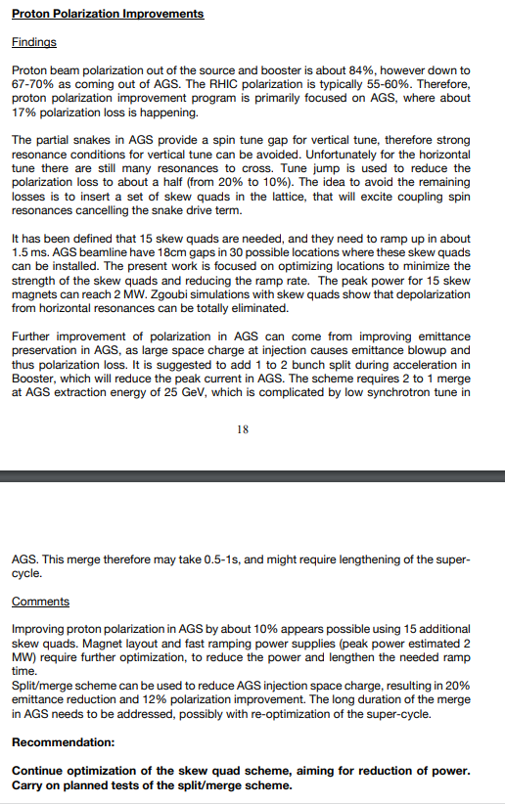

Slide 37
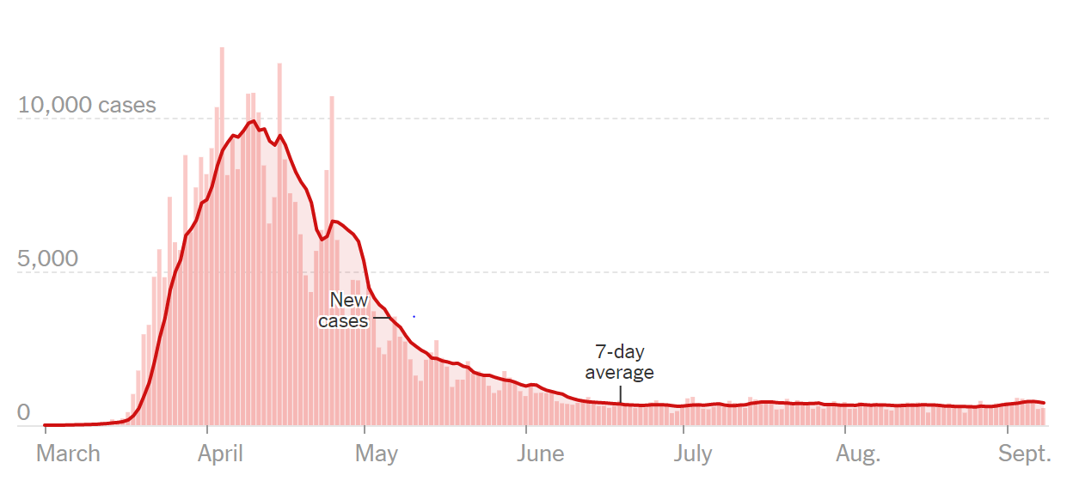
RHIC operation during COVID pandemic in Run-20
New reported cases by day in New York (from New York Times, 9 Sept 2020)
Major challenges
Critical system maintenance during stand-down
Startup of accelerators during min-safe
Personnel management (including adapting to change)
Work Planning, Enhanced Work Planning
Coordination of new ways of doing work (to minimize time and/or staff required for a particular task, sequential scheduling of work, etc.)
Tracking of staff and maintaining compliance
Remote checkout, turn-on, and operation
Procurement and management of personal protective equipment
3/20 – end of Run-20A; start of operations stand-down
5/19 – NSRL program start (with EBIS, Booster)
6/15 – RHIC operations start
6/18 – Run-20B start
9/1 – Run-20B end
9/14 – Run-20
end
min-safe operations
(~ 40 on-site FTEs)
limited operations
(130 – 150 on-site FTEs)
6/4
7/7
Despite challenges, RHIC operations, LEReC and STAR resumed Run-20B at Run-20A peak performance levels within 3 days of beam operation.
limited operations
(~ 70 on-site FTEs)

Slide 38
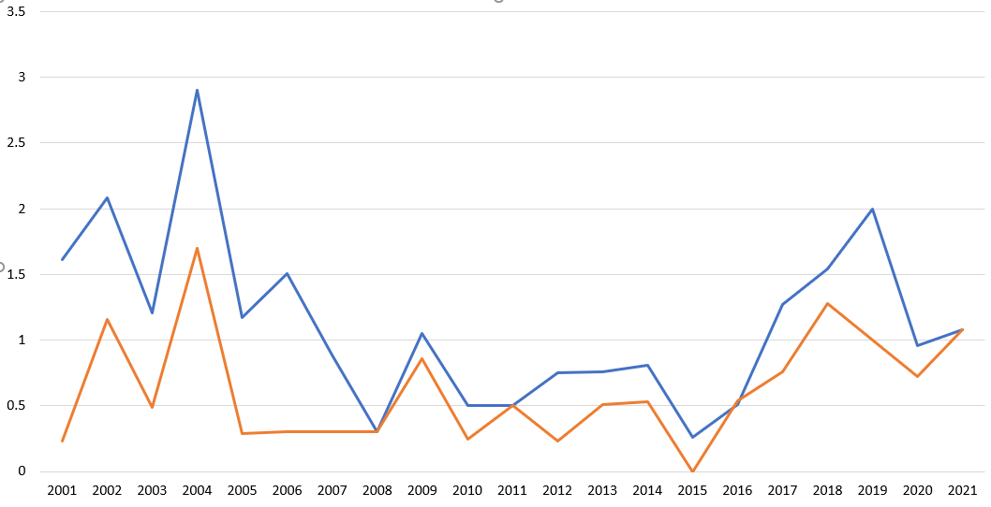
Safety Statistics at C-AD FY01-FY21
Injury rate was overall low and sustained over many years
Notable uptick starting in 2017
Downturn in 2020 (attributable partially to reduced hours on site during the pandemic)
TRC (Total Recordable Incident Rate )
DART (Days Away Restricted Transfer)
Injury rate per 100 FTEs
Continued vigilance necessary to achieve target of 0 TRC and 0 DART cases.
High visibility events not captured by these metrics (next slide)

Slide 39
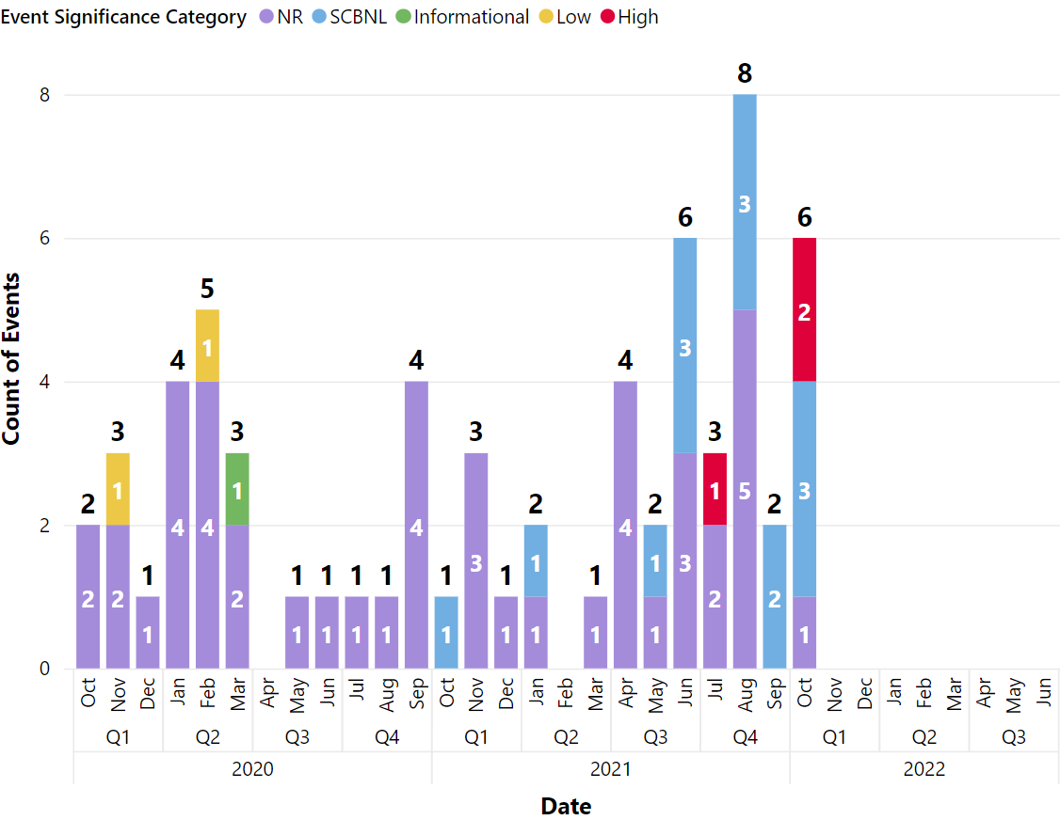
Recent High Significance Events at C-AD
Increased number of events since May, 2021 including 3 high significance ORPS events
07/15/21 – two employees incur minor electrical shock when touching equipment
investigation (7/15/21 - 9/21/21)
independent safety culture review (9/20/21 – 9/24/21)
10/06/21 – employee receives electric shock from exposed wires
investigation (10/6/21, ongoing)
10/21/21 – employees receive electrical shock during Dewar transfer
investigation (10/21/21, ongoing)
all-day safety standdown, 10/22/21
emphasis: safety as highest priority (over schedule)
timely reporting and categorization

Slide 40
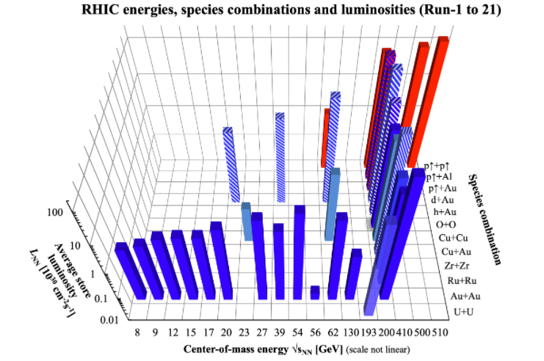
RHIC – all colliding running modes to date 2001 to 2021
2019-21 BES-II with LEReC
nominal injection energy

Slide 41
Operational efficiency – setup time
Setup time: - for 1st species in run: from both rings cold to 1st physics store - for following species: from beginning of setup to 1st physics store
Run-20
5 days Au+Au √s_{NN} = 11.5 GeV
TRANSPARENT: low energy
BLUE: heavy ion runs
8 days for Au+Au √s_{NN} = 9.2 GeV
INTRANSPARENT: high energy
RED: polarized proton runs
(includes LEReC setup)
HATCHED: light-on-heavy ion runs

Slide 42
Reported events since October 1, 2020
Event Date and Time | Event Title | Event Significance Category | DART
10/3/2020 9:00 | Building 911 Chilled Water Spill | SCBNL | No
11/2/2020 16:00 | Employee felt left rib pain | NR | Yes
11/8/2020 9:30 | Minor Steam Leak in Vacuum Lab | NR | No
11/24/2020 11:30 | Laboratory Cooling Tower Exceeded NYS Regulated Level of Legionella Bacteria | NR | No
12/31/2020 11:00 | Government vehicle impacks a yellow bollard | NR | No
1/23/2021 11:00 | Operation outside RHIC ASE requirement (ASE Violation) | SCBNL | No
1/28/2021 15:00 | Employee feels pain in elbow and hand while pulling wires | NR | No
3/4/2021 9:00 | BNL Exceeded NYS Regulated Level of Legionella Bacteria | NR | No
4/5/2021 9:00 | A Chemical Dosing Pump was Started Without Proper Authorization | NR | No
4/11/2021 8:00 | Employees Contract Illness While Working Onsite | NR | Yes
4/22/2021 0:01 | Driver Backs Lab Vehicle into Jersey Barrier | NR | No
4/23/2021 8:30 | Employee feels pain in hand and wrist while lifting | NR | No
5/5/2021 9:41 | Violation of ASE Requirement at the Tandem Van de Graaff | SCBNL | No
5/17/2021 9:39 | Employee feels lower back pain while bending | NR | No
6/1/2021 10:00 | Water Infiltration into Building 801 D-Tank Room | SCBNL | No
6/10/2021 14:00 | Water Leak Behind Ventilation Control Panel Leads to Corroded Contacts at Tandem Van de Graaff Facility | SCBNL | No
6/17/2021 14:56 | Accelerator Safety Envelope (ASE) Violation at the RHIC | SCBNL | No

Slide 43
Reported events since October 1, 2020 (cont’d)
Event Date and Time | Event Title | Event Significance Category | DART
6/18/2021 13:54 | Odor from Lighting Ballast Leads to Fire/Rescue Response at Building 801 | NR | No
6/22/2021 14:00 | Water Intrusion into D Tank Room | NR | No
6/29/2021 11:00 | Irradiation Target Failure at BLIP Facility | NR | No
7/8/2021 14:35 | Employee injures hand while pulling down on bookshelf | NR | No
7/8/2021 20:11 | Government Vehicle Damaged | NR | No
7/15/2021 11:00 | Two Employees incur minor electrical shock when touching equipment | High | No
8/5/2021 14:15 | Employee feels pop in bicep while rotating pipe | NR | Yes
8/9/2021 8:00 | Water Intrusion into C-AD MIRP Lab | SCBNL | No
8/13/2021 14:30 | UPDATE: Two smoke purge fans failed | SCBNL | No
8/16/2021 14:00 | Broken bags of vermiculite in Building 901A | NR | No
8/19/2021 9:30 | Employee Injures Shoulder | NR | Yes
8/20/2021 12:30 | Improperly applied LOTO at Tandem Van de Graaff | SCBNL | No
8/25/2021 10:15 | Government Vehicle Damage | NR | No
8/25/2021 15:00 | Employee hits head on electrical box | NR | Yes
9/16/2021 14:00 | Cable pullers observe electrical spark | SCBNL | No
9/17/2021 10:30 | C-AD Access Control Certification Tests out of compliance with C-AD & SBMS Requirements | SCBNL | No
10/6/2021 14:00 | Employee Receives Electric Shock from Exposed Wires | High | No
10/12/2021 13:55 | Employee falls and injures finger | SCBNL
10/14/2021 14:14 | Smoke Odor Detected From Building 928 | SCBNL | No
10/14/2021 16:00 | Improper Lock Found on Gate | SCBNL | No

