Slide 1
Outstanding RHIC Experiments for EIC
Vadim Ptitsyn,
C-AD Machine Advisory Committee
December 7, 2021

Slide 2
Outline
EIC and EIC Hadron Storage Ring Overview
Hadron Beam Parameters: EIC vs RHIC
Experiments in RHIC for EIC
Some experimental results and plans
Conclusions

Slide 3
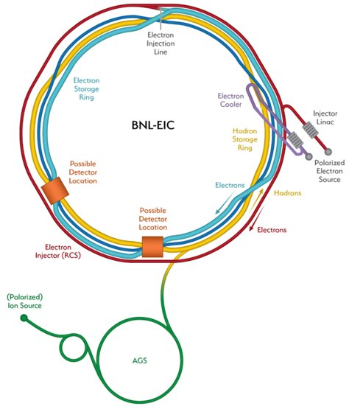
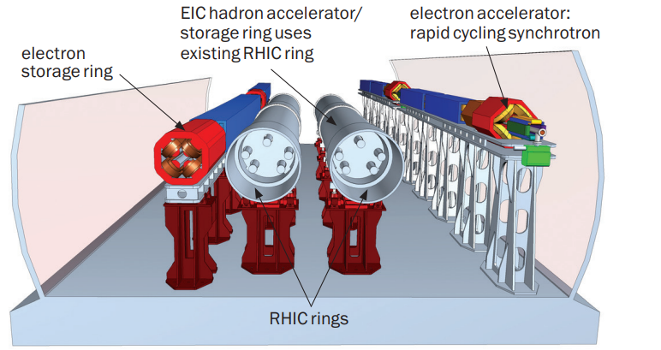
EIC Overview
Design based on existing RHIC Complex
RHIC is well-maintained, operating at its peak
Hadron storage ring 40-275 GeV
based on existing RHIC
  1160 bunches, 1A beam current (3 x RHIC
  Bright vertical beam emittance 1.5 nm
  Strong hadron cooling (coherent electron cooling)
Electron storage ring 2.5–18 GeV new ring in RHIC tunnel
  1160 bunches
  Large beam current, 2.5 A ➔ 9 MW S.R. power
  SRF cavities
Electron rapid cycling synchrotron 0.4- 18 GeV new ring in RHIC tunnel
  2 x 28 nC bunches, 1 Hz cycle time
  Use spin transparency for high polarization
High luminosity interaction region(s) new
  L = 10³⁴ cm⁻²s⁻¹, Superconducting magnets
  25 mrad crossing angle with crab cavities
  Spin rotators (longitudinal electron spin)
  Forward hadron instrumentation for tagging
3

Slide 4
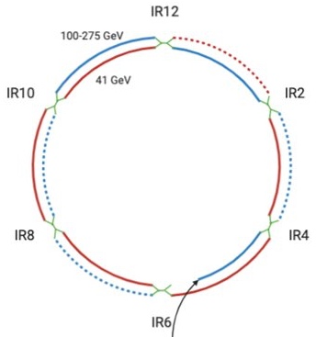
EIC Hadron Ring
Existing RHIC ion accelerator complex will be re-used for EIC.
In 100-275 GeV energy range the EIC HSR consists of four Yellow and 2 Blue sextants of RHIC ring.
For operation at 41 GeV the HSR ring will use Yellow (inner) 10-12 o’clock arc instead of a Blue one.
4-6 o’clock Blue arc RHICvwill be used as injection beamline to deliver the hadron beam into injection kicker area at 4 o’clock.
On-going upgrade of ion source EBIS will provide capability of polarized ³He.
Present injector chain will be entirely re-used. (EBIS, Linac, Booster, AGS)

Slide 5
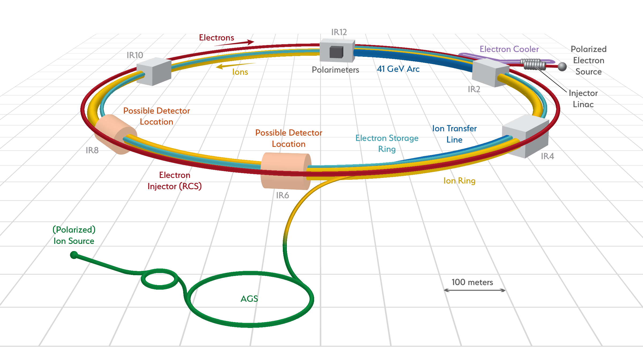
Key Updates of the RHIC Hadron Rings Towards EIC
Injection
System
Upgrade
Beam Instrumentation Upgrade
Path Length
Variation, Energy Upgrade
Vacuum Chamber Update
EIC
Interaction Regions
Strong Hadron Cooling
Additional Snakes
Hadron Ring RF Systems
Notes:
We identify 8 key updates

Slide 6
EIC hadron beam parameters are advanced compared with RHIC
Parameter | Proton |  | Au ion
 | EIC design | RHIC demonstrated | EIC design | RHIC demonstrated
Energy [GeV/nucleon] | 275 | 255 | 110 | 100
Particle per bunch [10¹⁰] | 20 | 22.5 | 0.08 | 0.22
Number of bunches | 290,1160 | 111 | 290,1160 | 111
Beam Current [A] | 1 | 0.34 | 0.85 | 0.22
RMS nor. Emit. h/v [μm] | 3.3/0.3 | 3.1/3.1 | 5.0/0.4 | 2.0/2.0
BB parameter, h/v [10⁻³] | 12/12 | -18/-18* | 3/2 | -4/-4
RMS bunch length [cm] | 6 | 55 | 7 | 35
Polarization [%] | 70 | 60 | - | -
Notes:
Here this table displays the beam parameters demonstrated in RHIC and those for which EI has been designed. Indeed RHIC is a great start for the EIC. Highlighted you see the parameters that significantly change. For example, energy increase , BB and dp/p being monitored by Yun Luo, shorter bunches and deliver higher polarization according to plan explained by Vaim Ptitsyn.
Energy upgrade: magnet strength, power supplies, RF cavities
BB: receiving especial attention, as EIC will use crab cavities and impact of their RF frequency, RF noise (beam-beam studies by Task Force led by Yun Luo).
Shorter bunch length: heating, HOM power, ecloud
Larger momentum spread (dp/p): (dynamic aperture studies by Task Force led by Yun Luo).
Polarization: maximum polarization at center of beam (actually zero emittance beam would have highest polarization; the lower the emittance, the better the average polarization), almost the same as in source except if matching issues during injection through accelerators. The values quoted for polarization correspond to polarization measured during Run-17 Mode 1A averaged over storage time and transverse profile (thus conservative) for the two rings.
POC for beam-beam and dynamic aperture studies is Yun Luo.

Slide 7
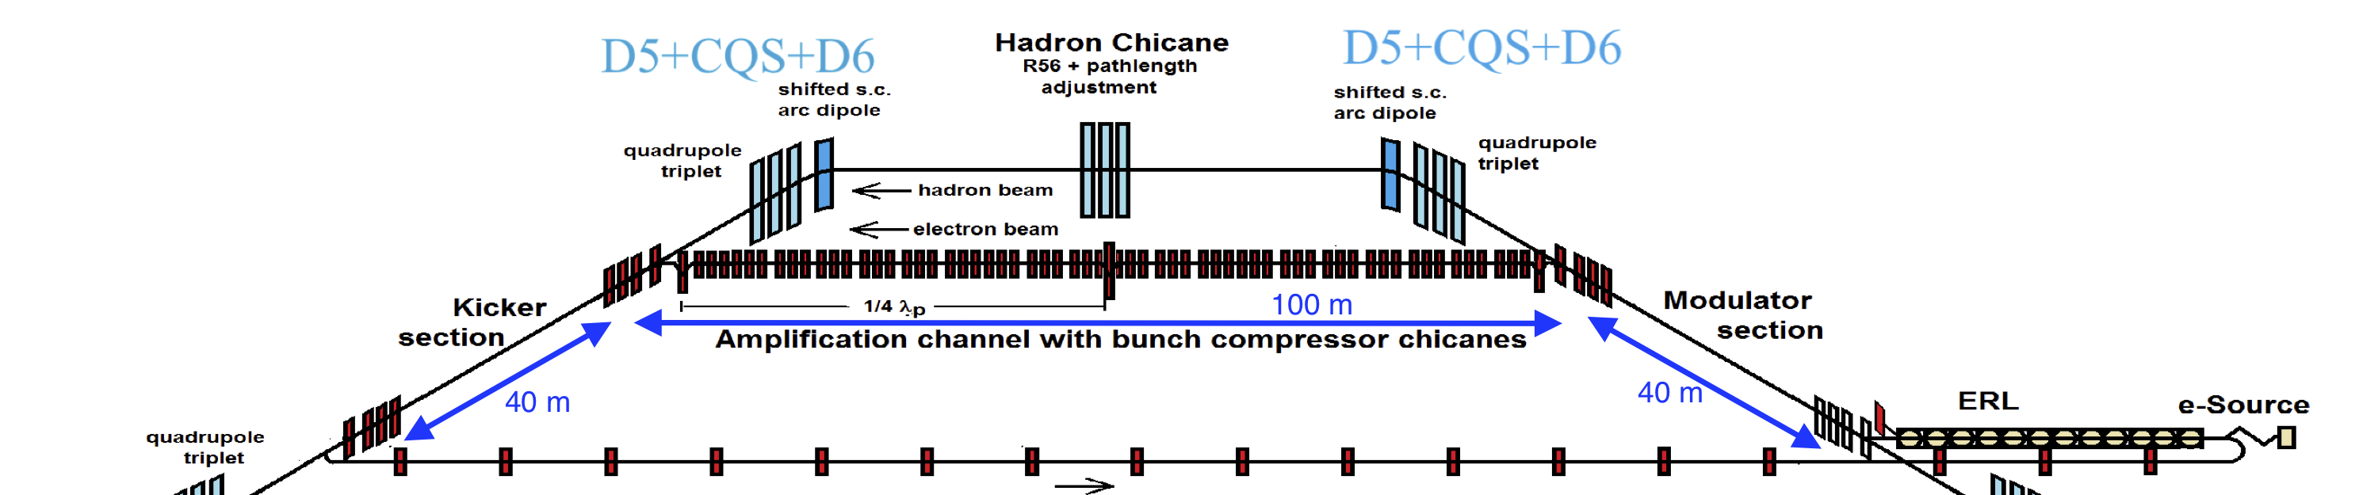
Strong Hadron Cooling
Present design of the hadron cooler is based on Coherent Electron Cooling with Micro-bunched amplification
150 MeV electron accelerator utilizing 100 mA injector, Energy Recovery Linac and beam transport lines
  ERL consists of eight 591 MHz and three 1773 MHz SRF cavities
  Scope includes 2K cryogenics system for ERL
Two-stage amplification section uses three chicanes and two λ_{p}/4 drifts
Hadron delay chicane
Modulator and kicker section common for both hadron and electron beams

Slide 8
Beam Experiments for EIC
Several APEX studies are underway (or planned) to explore various areas related with achieving EIC design conditions or with getting data for EIC design studies:
  Radial shift studies
  Decoupling and flat beam demonstration
  Impedance measurements
  Spin transparency mode study
  Collimator studies
  RF reverse phasing studies
You will see more on these studies in the rest of my talk.
The CeC-X experiment and the LEReC cooler studies would provide valuable results to be used in designing the EIC cooler.
See details of these experiments in V.Litvinenko’s and
S.Seletskiy’s talks.

Slide 9
Radial Shift for 100-275 GeV Operation
In order to synchronize hadron and electron
revolution frequencies in hadron energy range
100-275 GeV considerable radial shift is applied
in hadron arcs.
Maximum shifts corresponds to dp/p =+-0.01
On-center orbit in the straight section is made by
using dipole correctors on each end of
each arc.
(Courtesy S.Peggs and G.Robert-Demolaize)

Slide 10
Radial Shift studies in Run-21
Team led by G. Robert-Demolaize
Fully demonstrated the concept of radial shift as intended for EIC at 100 GeV/u - with two different straight section configurations.
Successfully used tune/coupling feedback during each attempt, which helped keeping the beam loss rate to very low levels; however, there were issues with chromaticity control for δB = -1.0%, putting extra strain on tune feedback and generating beam losses.
To address this, the response matrix for chromaticity control in RHIC (i.e. for on-axis operations) was tested with the orbit fully shifted, and the measured changes were on par with what was requested. On the other hand, redesigning the shifted lattices with offline models did not improve the chromaticities as much as anticipated => current assumption is that there is an issue with some magnet parameters, most notably the multipole components of the field, not modeled appropriately.
A ramp with the -1.0% configuration using only an “up” sequence was also used, which quadrupoles go to their intended strengths but cap the dipoles to the shifted field setting. Similar chromaticity errors were seen.
Further analysis is still needed to fully understand the difference in behavior between the -1% and +1% setups, the latter being pretty much spot on compared to the lattice design from offline models for both Short and Long configurations.
Run22: more APEX time will be requested, notably to study the potential effects of Radial Shift on polarization. This could help determine which configuration is best between Short and Long.

Slide 11
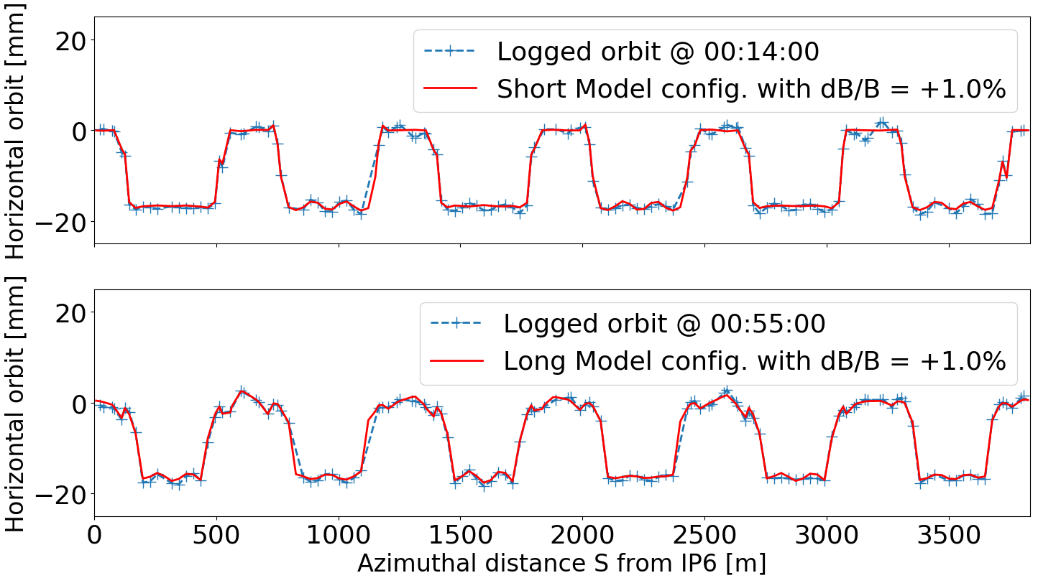
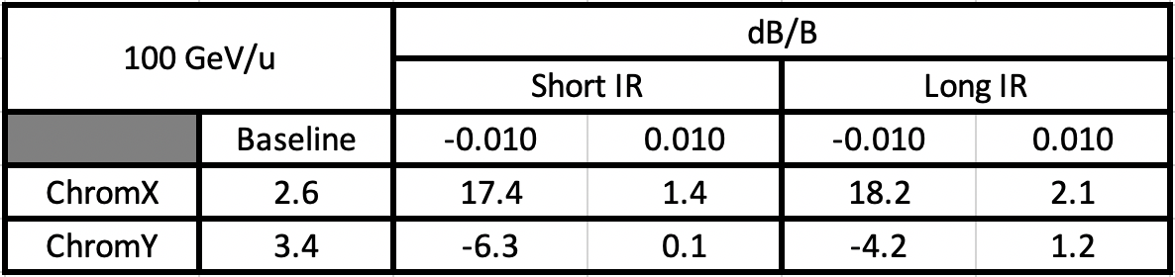
Radial Shift Data from Run-21
Gold beam @ 100.0 GeV/u, δB = +1.0%

Slide 12
Radial Shift Experiment
The range of radial shift defines the range of operational energies of hadrons.
It also defines ESR and HSR revolution frequency and the circumference of electron ring.
This year experiments would allow us to finalize the choice of these important design parameters.

Slide 13
Flat beam and Decoupling
Team led by Y. Luo
EIC HSR design proton H/V emittances are ~10 /1 nm at 275GeV.
This reduction of vertical emittance will be provided by the cooling. The cooling also will be used to prevent emittance growth in the store.
Goals of this experiment:
  verify RHIC decoupling tools efficiency for EIC requirements
  demonstrate as large as possible the emittance ratio in RHIC

Slide 14
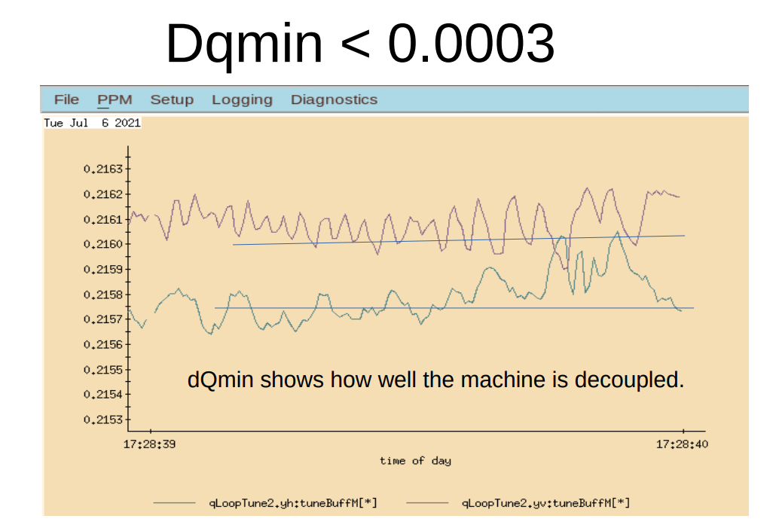
Decoupling studies in Run-21
Present design tunes (defined from beam-beam simulations and polarization considerations) of EIC HSR: (0.228, 0.210). That is 0.018 tune split.
From analytical calculation and numerical simulations dQmin < 0.0018 is needed to maintain 1nm vertical emittance within 5% tolerance.
Best ever dQmin in RHIC was demonstrated in
the Decoupling experiment in Run-21

Slide 15
Flat beam studies
Possible ways to create large emittance ratio in RHIC : 1) stochastic cooling to reduce vertical emittance, 2) scrape vertical plane to reduce vertical emittance, 3) offset injection to increase horizontal emittance, 4) IPM/Artus to blow up horizontal emittance, any other ways
Previous study and operational data demonstrated H/V emittance ratio up to 2:1
In next 100 GeV Au ion run the experiment will use stochastic cooling to create beam with larger emittance ratio.

Slide 16
Impedance Measurements
Team led by M.Blaskiewicz
Measurements done so far shows the longitudinal and transverse impedances
of RHIC are significantly larger than the design values and the values in the two rings
are quite different.
Done with Au ions at 100 GeV/u using Longitudinal Schottky signals at different intensities
Blue: 1.5+- 0.2 Ohm
Yellow: 5.4+- 1 Ohm
M. Blaskiewicz, J.M. Brennan, K. Mernick, IPAC2015, p746 (2015)
Done at injection using Beam Transfer Function data at different intensities
Blue: 14 MOhm/m
Yellow: 3 MOhm/m
N. Biancacci et. al. IPAC2014, p1730 (2014).

Slide 17
Broadband Impedance Measurements
All previous measurements have constrained the impedance at low frequency, yielding a single number.
The measurements are planned with 100 GeV/u Au ions using stochastic cooling pickups.
Measure open loop beam transfer functions with the least upstream filtering possible.
These measurements would allow more complete data on impedance over frequency range (~GHz scale range).

Slide 18
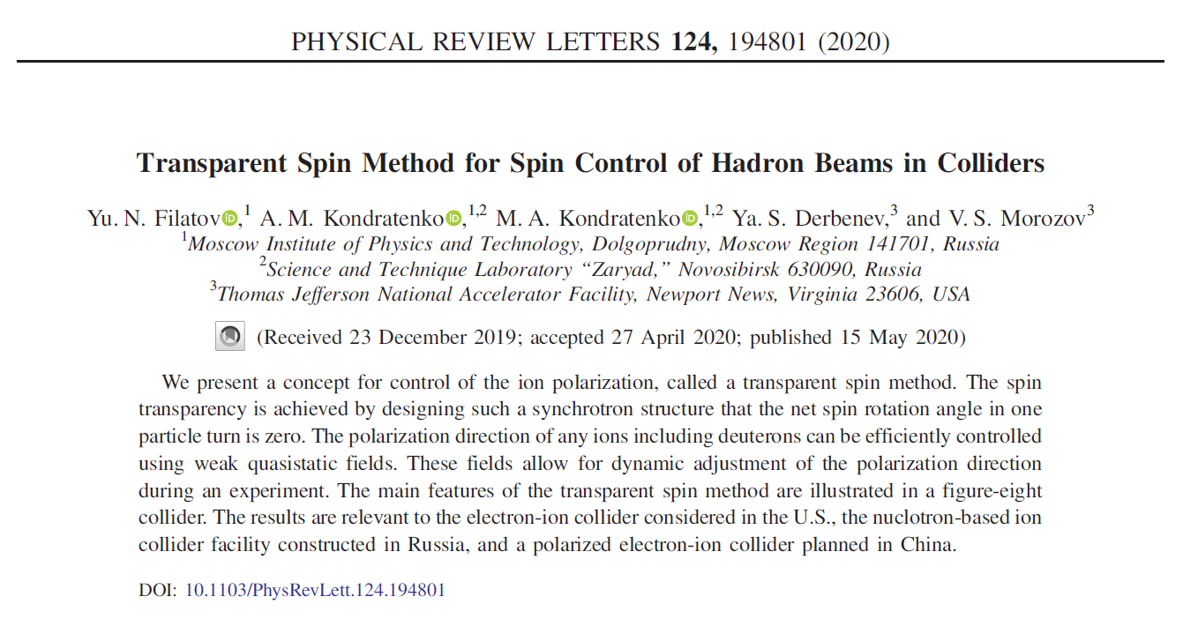
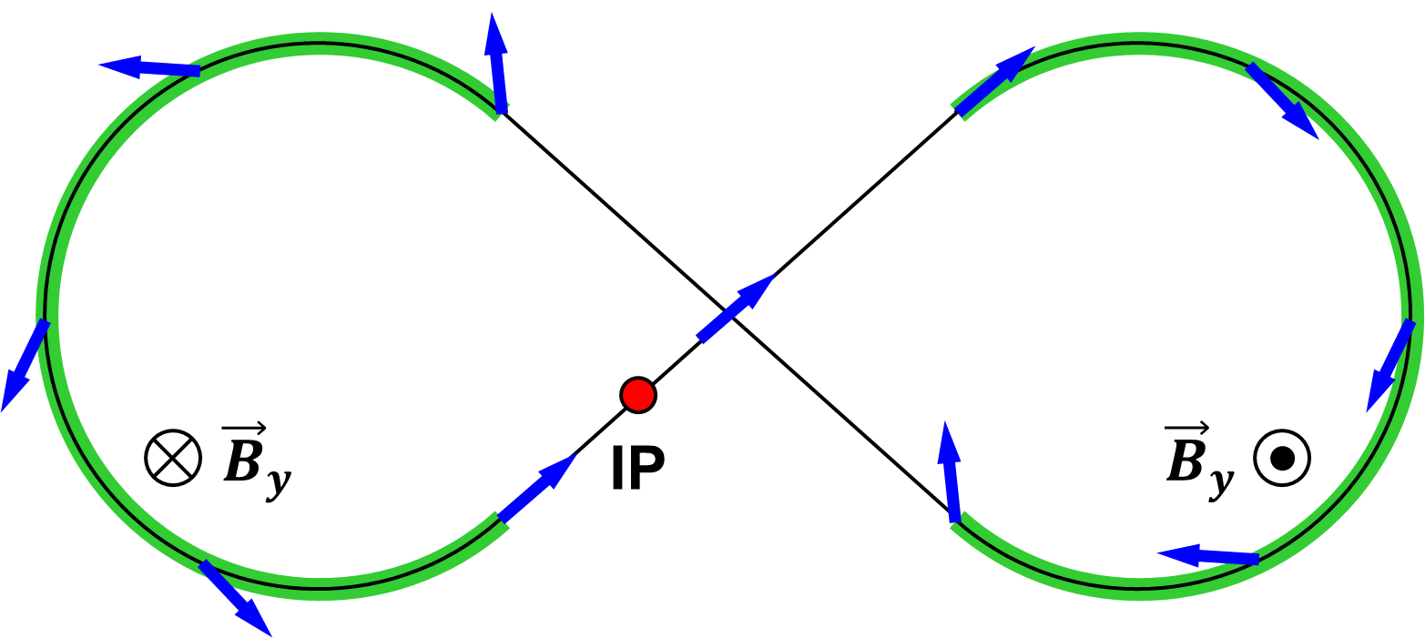
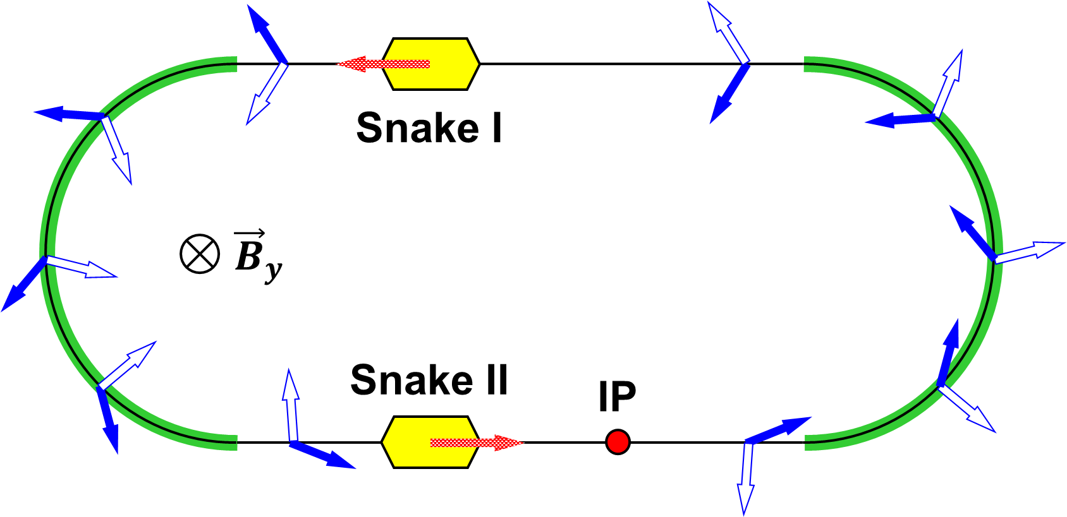
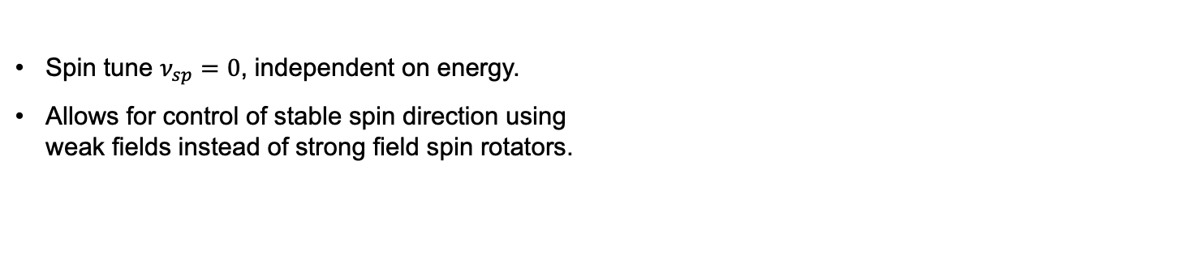
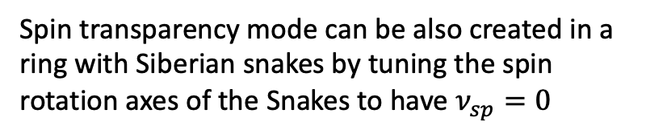
Spin Transparency Concept
Team led by V. Morozov (ORNL)
Spin tune $ν_{sp}=0$, independent on energy.
Allows for control of stable spin direction using
weak fields instead of strong field spin rotators.
Spin transparency mode is natural
for the Figure-8 ring configuration
Spin transparency mode can be also created in a ring with Siberian snakes by tuning the spin rotation axes of the Snakes to have $ν_{sp}=0$

Slide 19
Potential Benefits of Spin Transparency Mode to EIC
EIC HSR configured in the spin transparency mode using two identical Siberian snakes
  Eliminate the need for spin rotators at certain energies
  Longitudinally polarized deuterons at certain energies
EIC ESR configured in the spin transparency mode using electron spin rotators and additional snake
  Same lifetimes of the two spin states
  Simplified spin matching
The experiment planned in Run-22 will:
  Demonstrate the capability of stable spin direction control using weak fields in the spin transparency mode.
  Demonstrate the acceleration of polarized protons without polarization loss in the spin transparency mode.

Slide 20
Conclusions

Slide 21
Thank you
for your attention!

Slide 22
Back-Up Slides

