Slide 1
Operation with sPHENIX
M. Valette, A. Drees, G. Robert-Demolaize, H. Lovelace,
S. Peggs, R. Hulsart, J. Lastner, P. Dyer, T. Gage,
D. Bruno, C. Schultheiss, T. Shrey, and many more …
December 7th 2021
CAD MAC 18 (dry run)

Slide 2
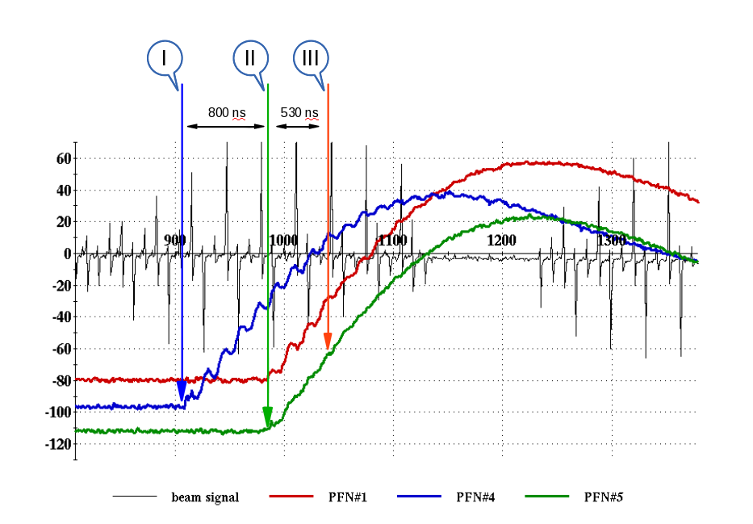
Introduction : Pre-fires
Reminder :
Asynchronous discharge of one of the AK modules
10-13 bunches partially kicked causing quenches and damage to experiments
Caused by high voltage and radiation on thyratrons
First mitigated by protection bump
Fill #18066, run 14

Slide 3
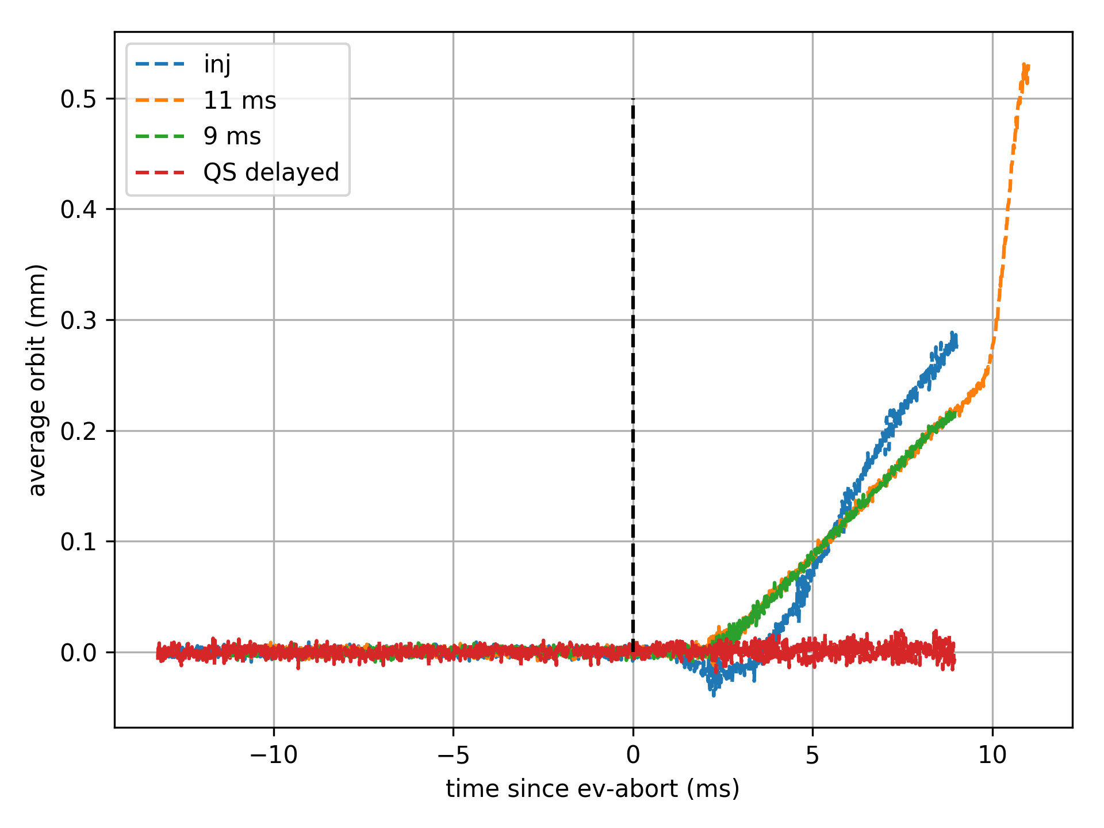
Delayed Abort
Thyratron
Magnet
PFN
Relay
(w/ redundancy)
Successfully tested in 2018
To protect sPHENIX and SC-magnets:
mechanical relays added in series with thyratrons
induces 6 ms delay to dump
no other facility has to deal with such constraints (6 ms ~ 460 turns)
emergent issues like switch monitoring and timing jitter are being followed up and automatic alarms are put in place
Since Run18:
268 delayed aborts,
250 with physics beams

Slide 4
Failure Cases
The long delay to dump requires he early detection of failures with ~ millisecond rise-time :
All aborts are reviewed systematically, with follow up actions leading to configuration changes to close all openings in the MPS.
Failure | RF & QLI | PS-BPS | BPM | BLM
Interlocked devices | ✔️ | ✔️ |  | ✔️
Quench | ✔️ | ✔️ |  | ✔️
Powering failures |  | ✔️ | ✔️ | ✔️
Instabilities |  |  | (✔️) | ✔️
Others ? |  |  | (✔️) | ✔️

Slide 5
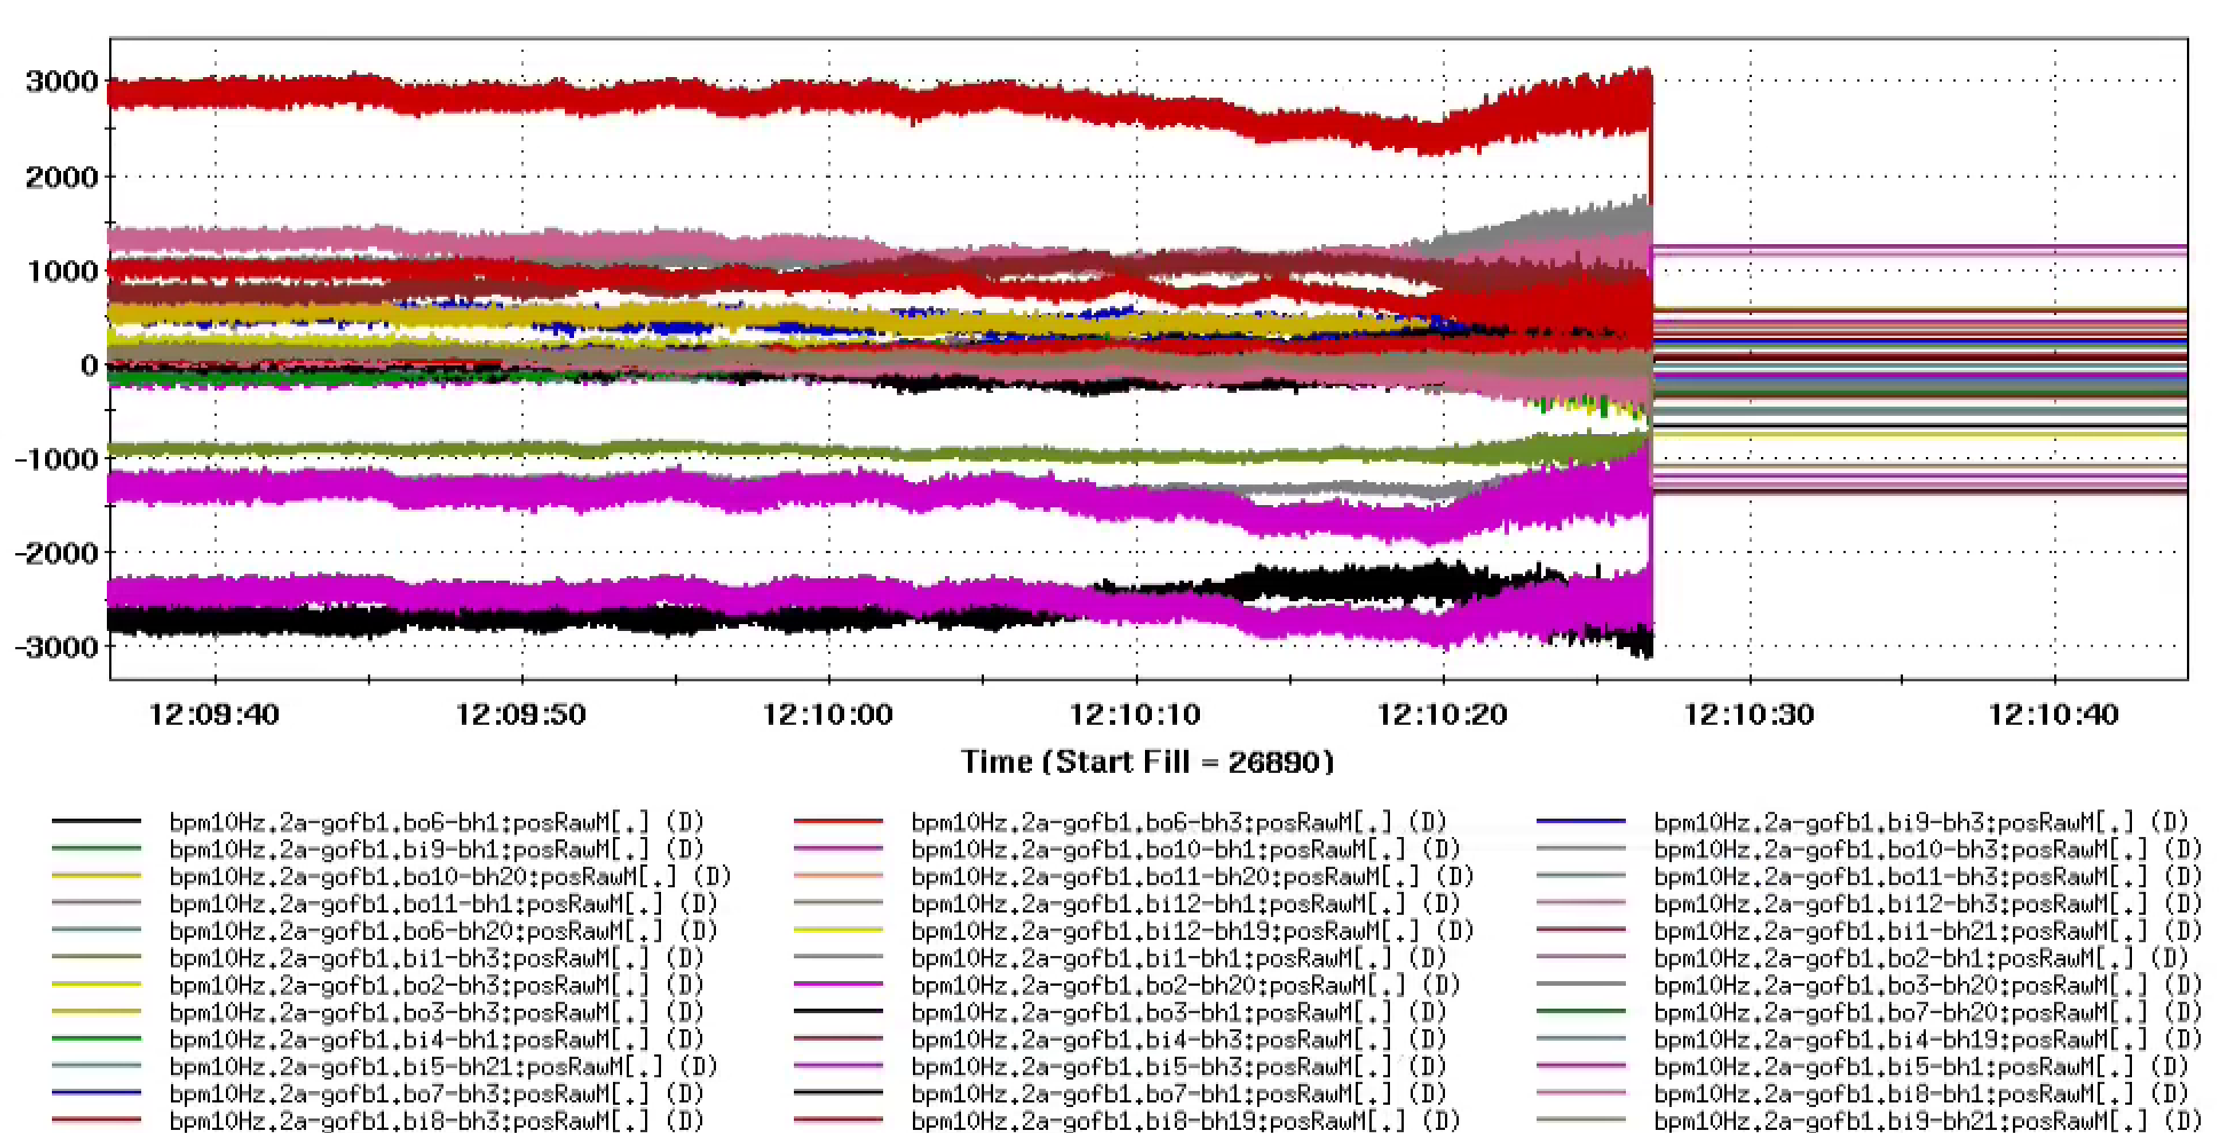
New permit inputs : BPMs
BPM-MPS :
36 horizontal and 8 vertical per beam, monitoring absolute position, difference (drift speed) and coherence.
Cover most failure cases causing changes to the orbit.
Abort the beam milliseconds (and sometimes seconds) before losses are even detected.
New in 2022 : Handling of bad signals from too many monitors.
Do not protect against failures that do not affect the orbit, BLMs remain the last line of defense.
Trip on coherence signal, 8 s before losses and and abort
Steep learning curve :
From 20 unwanted trips/day in 2020, …
To being part of the commissioning procedure and protection during APEX(s)

Slide 6
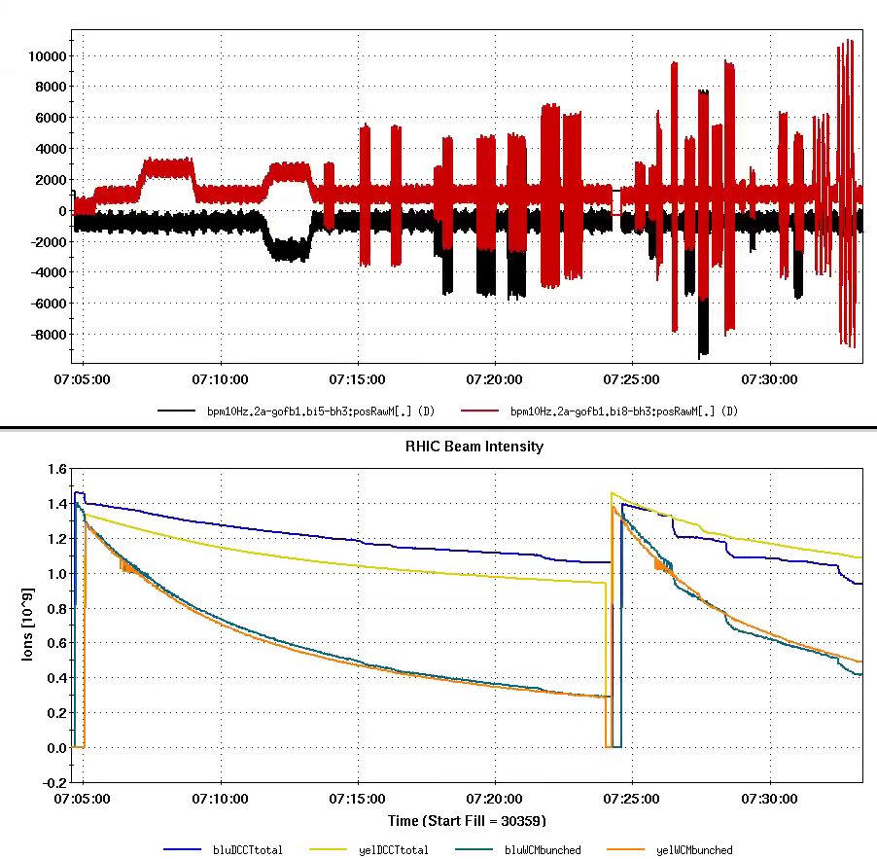
New permit inputs : power supplies
Failures of Nested Quadrupole PS and Corrector PS in alcoves have caused quenches and loss of the entire beam less than 6 ms after the onset of losses.
CPS-BPS : covering Correctors was unmasked in 2021, this system is very sensitive and caught power dips early allowing to abort before losses.
New System in 2022 : QPS-BPS monitoring most of the Quad PS in all IRs, Run22 is a good learning opportunity before the sPHENIX run.
Dipole PS failures are covered by the BPMs as tested in Run21.
NB : Historic veto channel from experiments in the MPS inputs
B12
B10
B10
B12
B10
B12
B10
B12
6

Slide 7
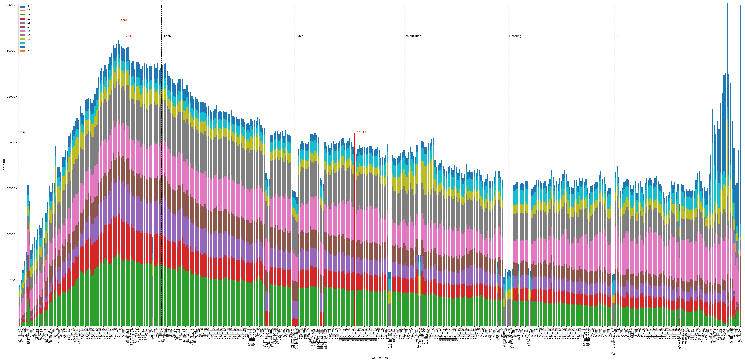
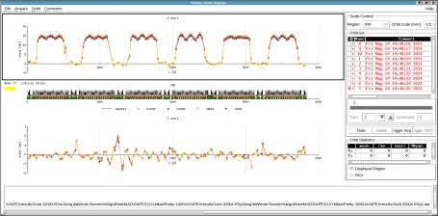
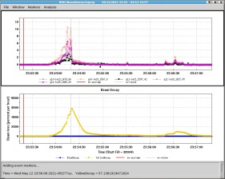
Failures, Losses & Backgrounds
Losses and backgrounds have been lowered over the years.
Mean Time Between Failures (MTBF) has also been trending down for most systems.
The collimators underwent and extensive repair and update following a bearing failure due to radiation.
Radial Shift APEX for EIC circumference control allowed exploring the Yellow aperture to +/- 20 mm. No obstructions were found.

Slide 8
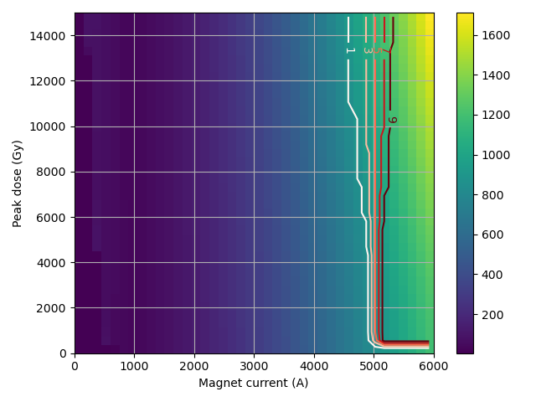
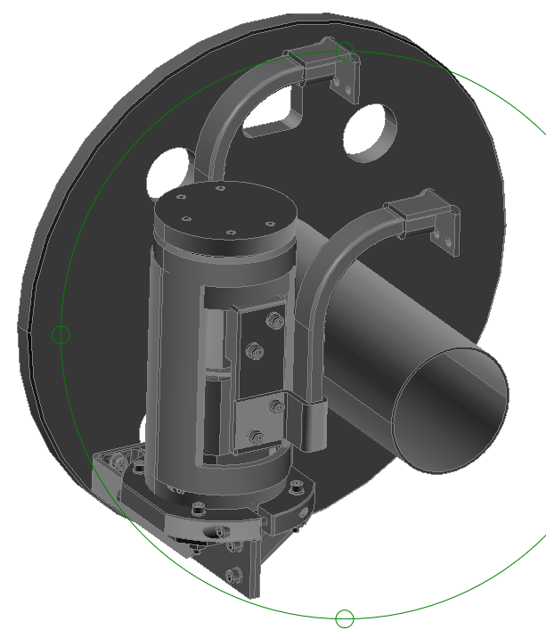
Ongoing issues
Hotspot temperature (K)
SC magnets’ bypass diodes failures remain a risk for operations. Ongoing studies include :
Simulations to understand and predict mechanisms of damage.
- Measurements (C/W) of all diodes to identify ‘sitting ducks’ and monitor evolution.
B10D19
Y7D6

Slide 9
Conclusion
Mechanical relays have been added to the abort system to prevent pre-fires. They induce a significant delay to the beam abort.
Upgrades to the Machine Protection system have been performed to increase the number of inputs and cover fast failure cases.
Aborts are systematically analyzed; new failure modes are monitored.
The system can not protect against failures with rise-times shorter than 6 milliseconds or instabilities that would blow up the beam without affecting the orbit except with Beam Loss Monitors.
We rely on our knowledge of beam physics and a careful but reasonable beam intensity ramp up during commissioning and after breaking vacuum or major configuration changes.

Slide 10
Thank you for your attention !
Any questions ?

