Slide 1
LEReC performance summary and plans
Alexei Fedotov
C-AD MAC
December 7-10, 2021

Slide 2
Outline
Response to LEReC recommendations from 2020
LEReC performance summary
Run-22 plans and beyond
2

Slide 3
Response to recommendations from MAC 2020
R1: Explore options to further increase the luminosity with cooling during the
upcoming run.
Luminosity optimization was done during operation, including electron current scans and different working points. Details in this presentation.
R2: Support dedicated experimental studies of cooling R&D in LEReC. The proposed
studies will not only contribute to the development of general cooling theory, but
can discover some of the effects relevant for EIC coolers using electron beams.
Several dedicated Accelerator Physics Experiments (APEX) on cooling were approved and performed. Details in Sergei Seletskiy presentation.
R3. Prepare a realistic, resource-loaded planning for the proposed electron
accelerator R&D tasks.
This recommendation was interpreted with regard to a possible upgrade of LEReC electron accelerator to the ERL (“Phase II”), which was briefly mentioned at last MAC. Since such an upgrade will not be pursued, no resource-loaded planning was developed.
Current plan is to use LEReC for further cooling experiments and high-current electron source R&D. Details in this presentation.

Slide 4
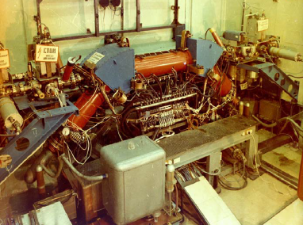
Electron Cooling
The method of electron cooling was first presented by G.I. Budker
(Novosibirsk) at Symposium
in Saclay, 1966.
First experimental
electron cooling demonstration at NAP-M storage ring (Novosibirsk, Russia, 1974).
High Voltage DC coolers (1974-): all DC electrostatic accelerators; all use magnetic field to confine electron beam (magnetized cooling). FNAL Recycler cooler: Pelletron electrostatic generator (4MeV electrons), transport of electron beam without continuous magnetic field.
RF-based coolers (High Energy approach) (2019-): BNL LEReC cooler:
First RF-linac based electron cooler. LEReC does not use any magnetization of electrons. The same electron beam is used twice to cool Au ions in both collider rings. LEReC was successfully used for RHIC operations in 2020-21 to cool ion bunches directly at collision energy.
4

Slide 5
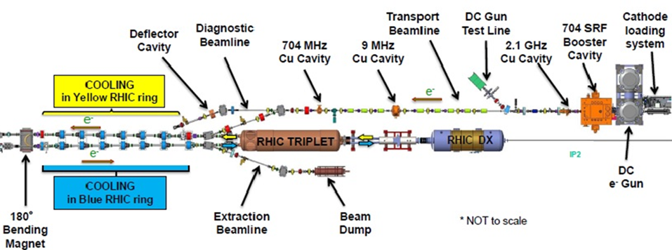
Distinctive features of LEReC
LEReC is fully operational electron cooler which:
utilizes RF-accelerated electron bunches
uses non-magnetized electron beam (there is no magnetization at the cathode and there is no continuous solenoidal field in the cooling section)
LEReC approach is directly scalable to high energies (10’s MeV)
LEReC offers unique capability for experimental studies of various cooling topics which are relevant to high-energy coolers
5

Slide 6
LEReC roadmap to electron cooling of colliding ion bunches in RHIC
Production of 3-D high-brightness electron beams ✓
RF acceleration and transport of electron bunches maintaining “cold” beam ✓
Control of various contributions to electron angles in the cooling section to a very low level (<150urad) required for cooling ✓
Velocity matching (<1e-4) of electron and ion beams ✓
First electron cooling demonstration in longitudinal plane (April 2019)✓
Establishing cooling in 6-D✓
Matching electron and ion velocities in both Yellow and Blue RHIC rings✓
Achieving cooling in both Yellow and Blue Rings simultaneously using the same electron beam✓
Demonstrating longitudinal and transverse cooling of several ion bunches (high-current 9MHz CW e-beam operation) simultaneously ✓
Cooling ion bunches in collisions, in both Yellow and Blue RHIC rings using CW electron beam ✓
Successful operation for RHIC Physics program during 2020-21 ✓
6

Slide 7
LEReC operational experience
Stable 24/7 running of high-current electron accelerator 2019-2021.
Stable cooling was provided over many weeks of collider operation in 2020 and 2021.
Reliable operation was ensured by implementation of laser position feedbacks, intensity feedback, energy feedback, automatic cooling section orbit correction and feedback.
Operational electron current based on optimization between cooling and other effects, including ion beam lifetime effects, was: 15-20 mA (for Au ions at 4.6 GeV/n in 2020) and 8-20 mA (for Au ions at 3.85 GeV/n in 2021).
Robust photocathodes (K₂CsSb) with initial Quantum Efficiency: 8-9%
Typical cathode exchange: once every two weeks

Slide 8
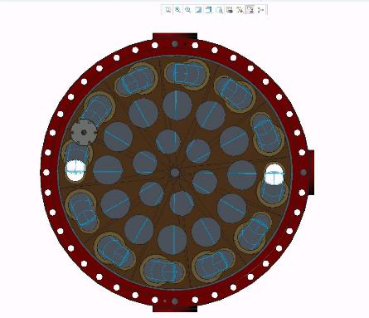
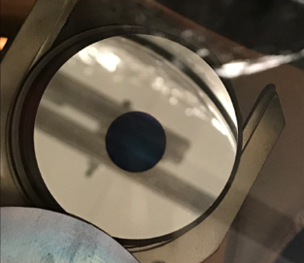
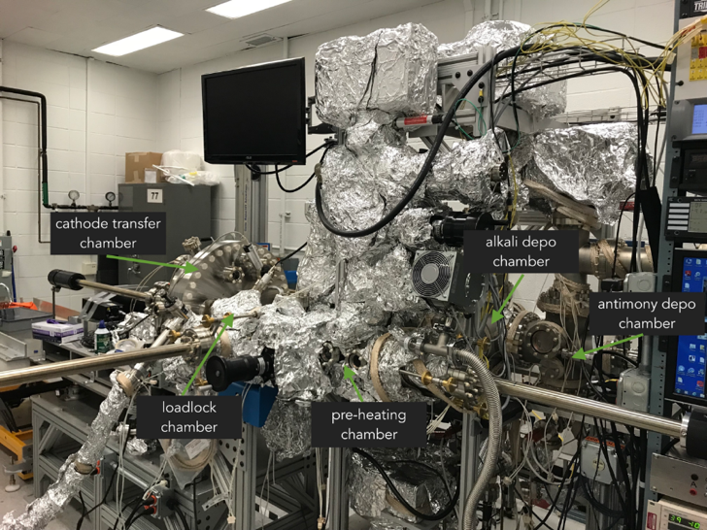
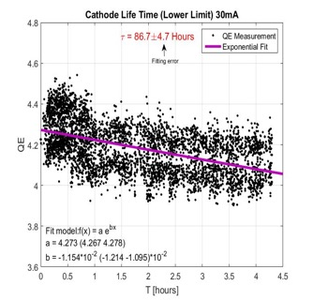
Photocathodes production
To support 24/7 operations, cathode production and exchange systems were developed which include two cathode deposition systems, three multi-cathode (up to 12 cathodes) vacuum suites and a mechanism allowing for cathode exchange in RHIC tunnel in about 1 hour.
High QE cathodes allowed for reliable beam operation during 2019 – 2021
On center large (12mm) active area used during 2017-18
Off center by 6 mm
small active area (6mm),
used in 2018 and
2019-2021
Cathode transfer camera can hold up to 12 cathodes pucks
30 mA beam current,

Slide 9
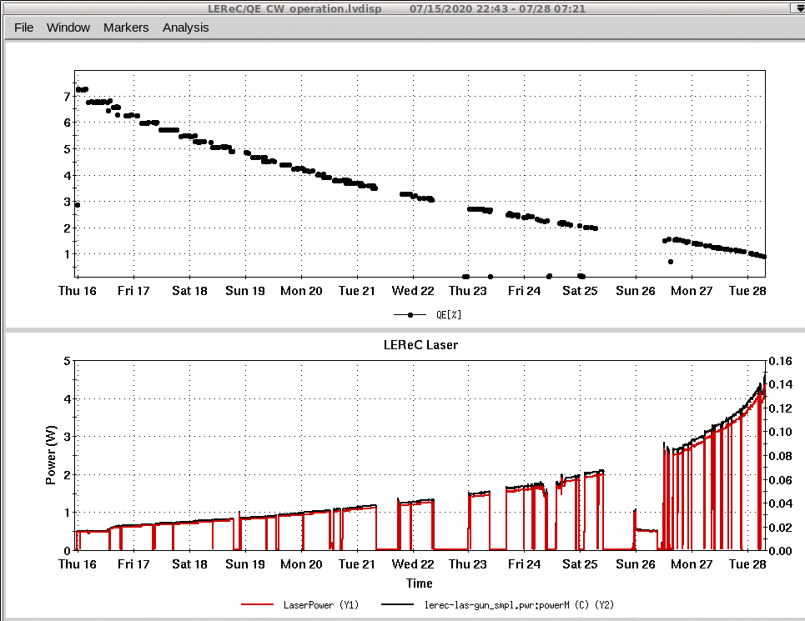
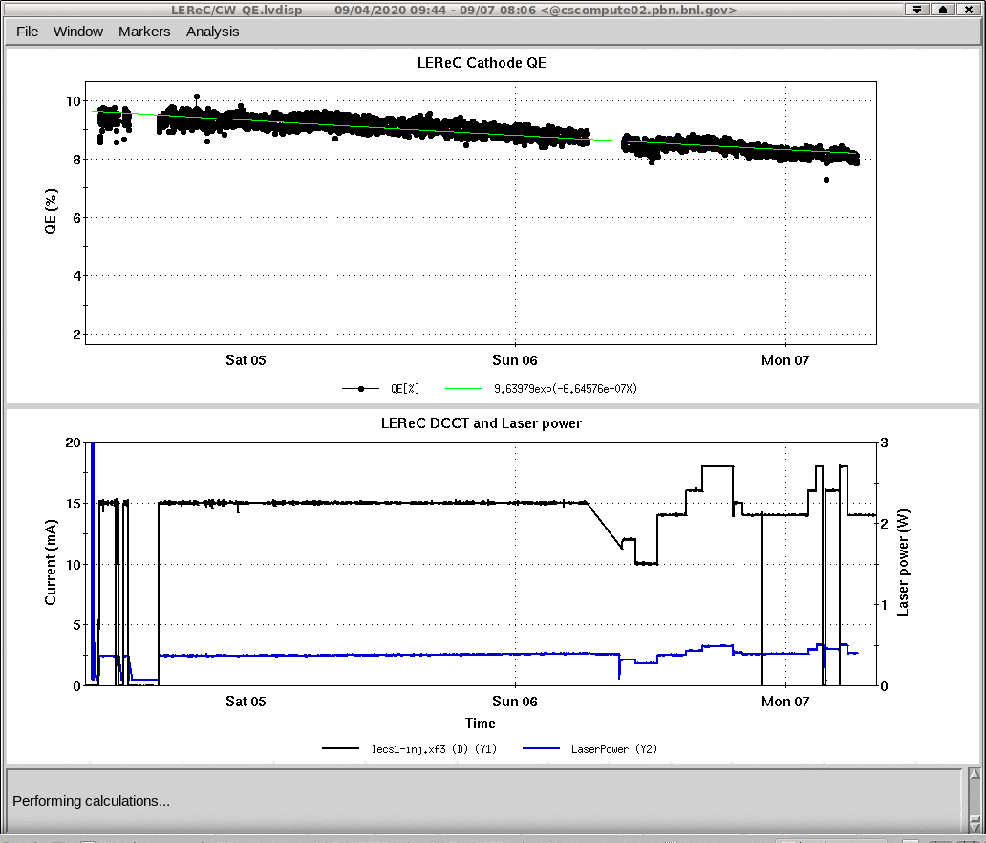
Cathode lifetime during LEReC operation (2020-21)
Cathode QE from 7% to 1%
Cathode QE: from 9.5% to 8%
12 days
3 days
Laser power 0.5W-4W
Laser power ~0.5W
At low laser power the main suspect of the QE drop is vacuum pressure in the gun
LEReC operation with current scan 10-18 mA
Typical cathode exchange: once every 2 weeks

Slide 10
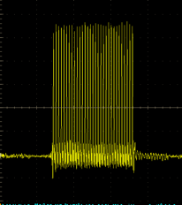
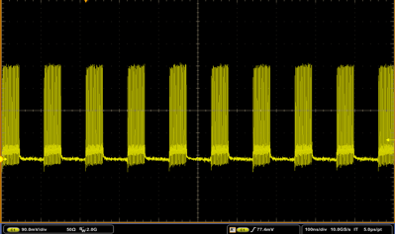
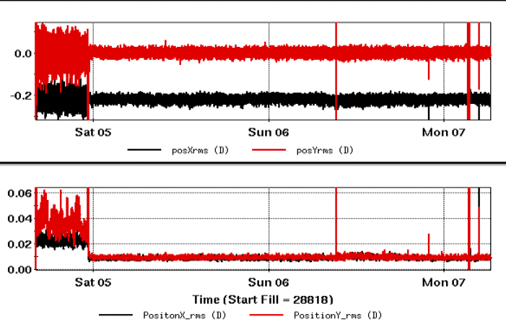
LEReC Laser: 24/7 operation
8.5W
Laser parameters for 130 pC electron bunch charge and 1% cathode QE
wavelength 520 nm
repetition rate 704 MHz
pulse length 2.1 ps from laser and 40 ps on the cathode
pulse energy 93 nJ from laser and 31 nJ on the cathode
peak power 44 kW
average power 25.5 W from laser and 8.5 W on the cathode
Laser profile 4mm aperture
Operation modes:
1 Hz several MBs: electron beam diagnostics
76 kHz several MBs: ion cooling optimization
9 MHz bunches (CW mode): to cool all ion bunches
9 MHz CW
30 pulses per MB
Required point stability of 10um rms was achieved with fast feedback assisted by slow feedback to compensate environment-driven drifts
Laser operated 24/7 for many months providing stable beam on the cathode
mm
Long term stable Laser spot position
mm
rms fluctuation <10um
Fast feedback is turned on

Slide 11
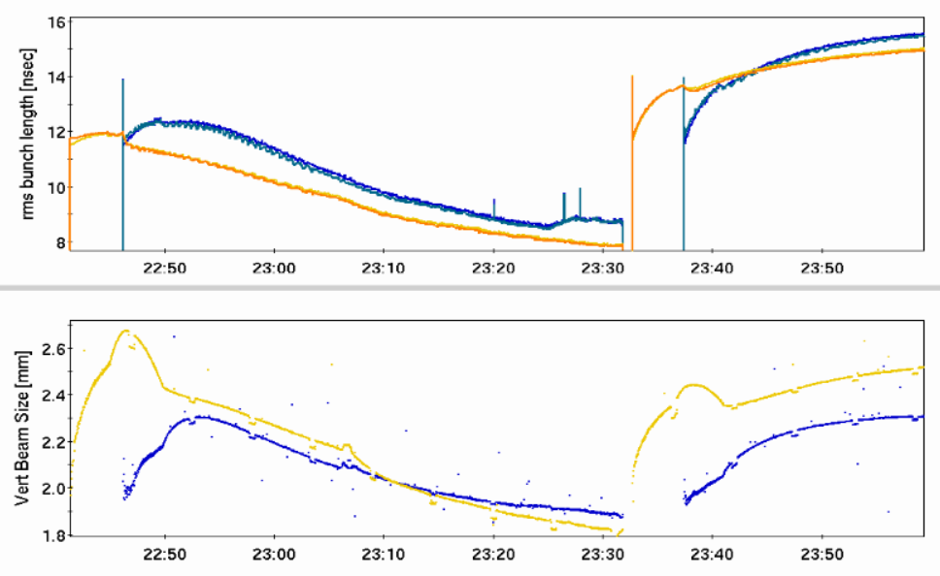
Physics stores (111x111 ion bunches at 4.6 GeV/n) with and without cooling (2 MeV electrons) of ions in Yellow and Blue RHIC rings - rms bunch length (top) and rms beam size (bottom)
Cooling ON
Cooling OFF
Time

Slide 12
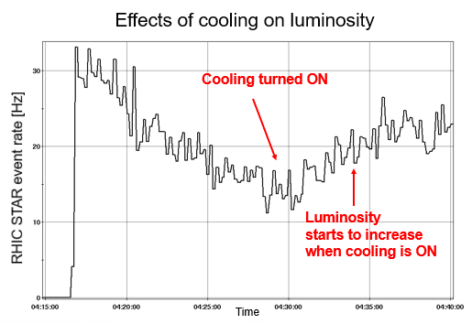
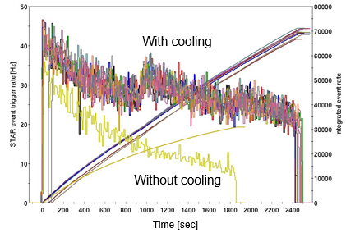
Cooling optimization for luminosity
Luminosity optimization with cooling included:
Finding optimum angular spread of electrons in cooling sections to provide sufficient transverse cooling.
Optimization of electron and ion beam sizes in the cooling sections.
Finding optimum working point in tune space for colliding beam in the presence of electron beam.
Finding optimum electron current to reduce effects on ion beam from electrons and at the same time still provide sufficient cooling.
Longer stores with cooling.
With cooling counteracting longitudinal IBS and preventing debunching from the RF bucket, the ion’s RF voltage was reduced resulting in smaller momentum spread of ions and improving ion lifetime.
Once the transverse beam sizes were cooled to small values, the dynamic squeeze of ion beta-function at the collision point was established.

Slide 13
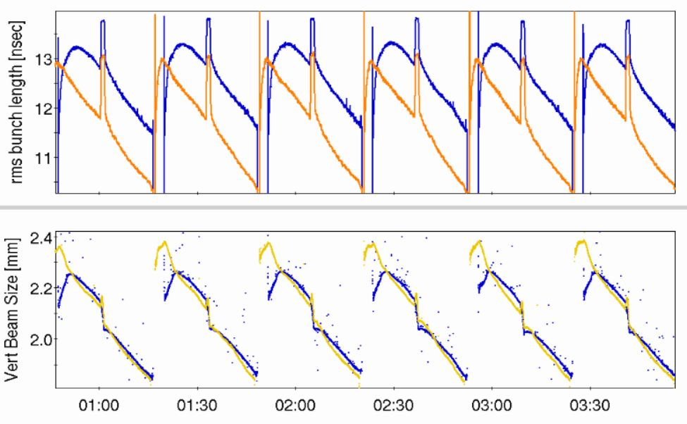
2021 operation for physics (several physics stores), 1.6 MeV electrons, 111x111 Au ion bunches at 3.85 GeV/n, rms bunch length (top) and rms beam size (bottom)
Spikes in bunch length are due to ion-beam RF manipulation
to alleviate space-charge effects during the beta-squeeze.
Time
24/7 stable and robust cooling over many weeks

Slide 14
LEReC cooling studies
LEReC operations for RHIC physics program (Beam Energy Scan II) concluded in 2021.
Starting June 2021 LEReC is being used for dedicated experimental studies of various cooling topics.

Slide 15
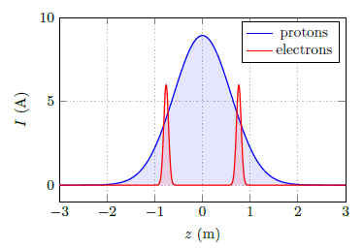
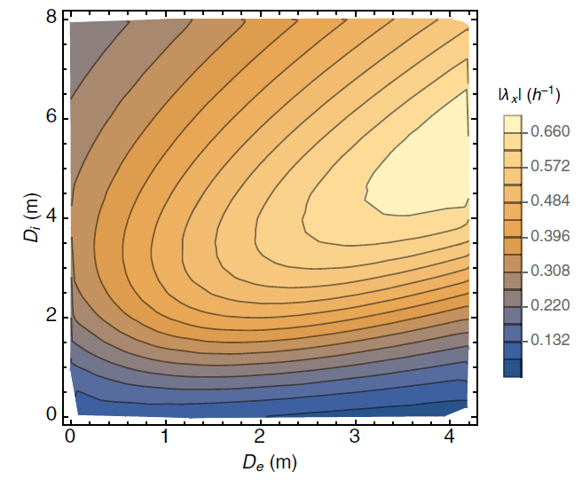
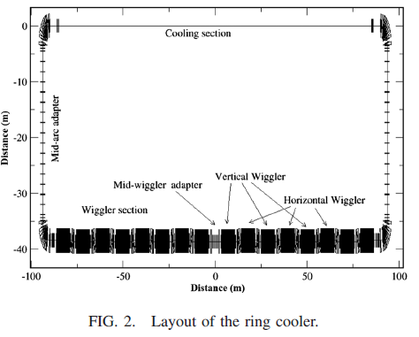
High-energy cooling studies, including for EIC
Electron cooling using bunched electron beams (LEReC-type cooler) is proposed for:
Pre-cooling of protons at 24GeV for EIC (13 MeV electron cooler)
Cooling protons directly at collision energy of 41GeV in EIC (22 MeV electron cooler)
A. Fedotov, S. Benson et al., “Low energy cooling for EIC”, BNL-220686-2020-TECH (2020)
Cooling of protons at the highest energy of 275GeV using storage ring electron cooler (150 MeV)
H. Zhao, J. Kewisch, et al., “Ring-based electron cooler for high energy beam cooling”, Phys. Rev. Acc. Beams 24, 043501 (2021)
Dispersive cooling (275GeV, EIC):
Horizontal cooling rate
150 MeV Storage Ring
electron cooler

Slide 16
Cooling experiments using LEReC
Emittance growth of ion beam (“heating”) due to interaction with bunched electron beam
Coherent excitations of ions and circular attractors
Recombination of ions without continuous magnetic field in cooling section
Cooling of ion bunch with electron bunches overlapping only small portion of ion bunch
Dispersive cooling (redistribution of cooling decrements), to provide stronger transverse cooling
Effects of the presence of the electron beam on the ion beam lifetime
Understanding of these effects is of critical importance for future high-energy coolers, including those proposed for the EIC.
Studies above started under Accelerator Physics Experiments (APEX) program.
Details in Sergei Seletskiy presentation.

Slide 17
LEReC electron source and accelerator R&D
High-current electron sources is important area of research. They are also required for various cooler designs of the EIC. For example, proposed electron coolers for pre-cooling at low energy in EIC (at 24 GeV and 41 GeV) require stable operation at around 100 mA current. Also, the Strong Hadron Cooler (SHC) for EIC requires 100mA source of electrons.
High-current source R&D:
LEReC Gun is designed to operate at high current. Many R&D items critical to high-current source operations could be explored and are planned.
Other accelerator studies:
LEReC accelerator could be used for other R&D studies.
Electron beam dynamics: Micro-bunching, effects of mergers, CSR, beam halo, ion trapping and clearing, as well as effects relevant to space-charge dominated beam transport.
Testing high-current high-power electron beam diagnostics: Various high-power instrumentation devices could be tested in LEReC. Examples of previously considered diagnostics include Beam Induced Fluorescence monitor, BNNT screen and wire scanner.

Slide 18
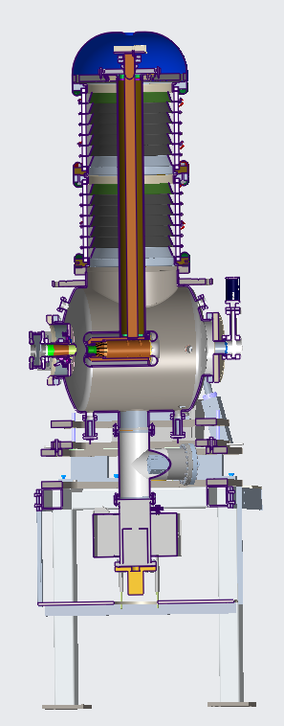
LEReC high-current R&D
Explore Gun operation with high currents: 50-100mA. Determine limitation of the Gun and HVPS.
Explore Gun voltage limitations: can one have stable long-term high-current operation at 400kV, 425kV, 450kV?
Explore operation with active cathode on center vs cathode off center.
Explore large cathode area vs small active area. Explore various laser spot sizes on the cathode.
Explore cathode QE at various laser powers with and without cathode stalk cooling.
Test multi-alkali photocathodes using different growth methods.
High-charge high-peak current: beam halo and beam loss studies

Slide 19
LEReC Run-22 plans and beyond
2022 (RHIC physics run: December’21-April’22):
Cooling experiments (require Au ions at low RHIC energy):
Continue cooling studies under Accelerator Physics Experiments program (available time for cooling studies may be limited in Run-22: very short physics run with polarized protons).
High-current R&D (without ions):
Start of Gun tests at high current (30-50 mA and above)
2023 (RHIC run with Au ions, could be more suitable for cooling experiments which require Au ions):
High-current R&D and remaining cooling studies
Details in Sergei Seletskiy presentation.

Slide 20
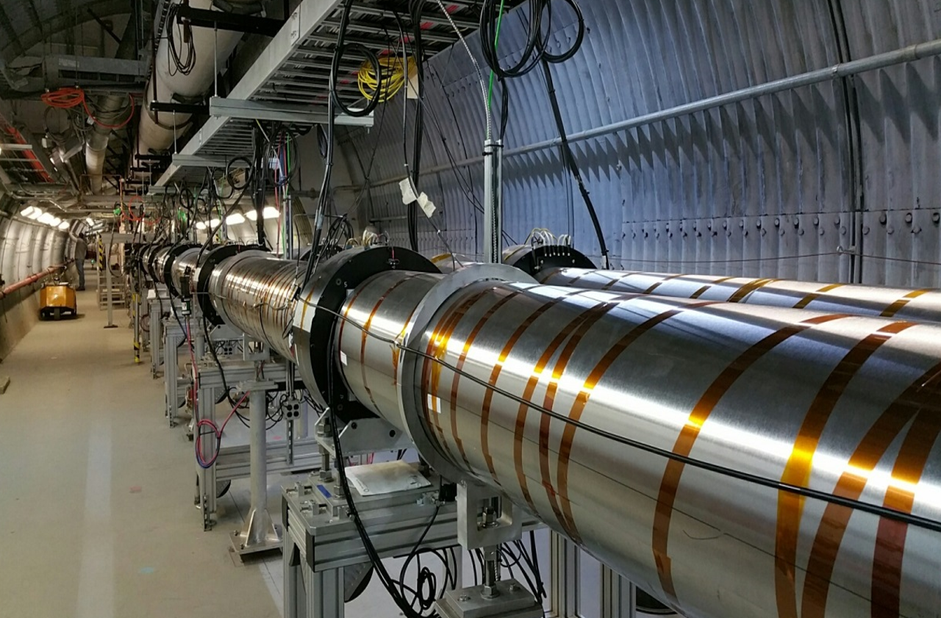
Summary
LEReC successfully operated for RHIC physics program in 2020 and 2021, making it the world’s first operational electron cooler to cool ions directly at collision energy.
LEReC offers unique opportunity to study various aspects of electron cooling using short electron bunches, as well as effects relevant to the ion beam dynamics under cooling.
Several dedicated cooling experiments were already performed in 2021, with more cooling studies planned.
Planned electron cooling and high-current studies are directly relevant for EIC coolers, both for regular and coherent electron cooling.

