Slide 1

LEReC experiments, past and future
Sergei Seletskiy
C-AD Machine Advisory Committee Meeting (MAC-18)
December 7-10, 2021

Slide 2
Outline
LEReC – prototype of EIC precooler and testing ground for EIC high energy coolers
Completed studies
  1. Coherent excitations in cooled ion bunches
  2. Recombination in non-magnetized coolers
  3. Test of machine learning algorithm for cooling optimization
Ongoing studies
  4. Mechanism of electron-ion heating
  5. Redistribution of cooling decrements
  6. Cooling with electron bunches overlapping a small fraction of an ion bunch
Planned studies
  7. Mechanism of elevated ion loss in coolers
  8. High current studies
Studies plan
Summary

Slide 3
Unique features of LEReC approach
LEReC is the first:
  RF-based electron cooler
  cooler using neither e-beam magnetization nor continuous solenoidal field in the cooling section
  electron cooler which is applied directly to the ions in the collider at top energy
  electron cooler that utilizes the same electron beam for cooling ions in two consecutive cooling sections in two rings of the collider
LEReC approach (RF acceleration and no beam magnetizations) can be easily scaled for high energy applications
LEReC beam dynamics differs significantly from dynamics in previous electron coolers
  The velocity distribution in LEReC e-bunches is close to be spherically symmetric, while in DC beams the velocity distribution is “flat”
  In the absence of beam magnetization an e-beam emittance, an ion-electron focusing, an ion-electron trajectory kick, and specific measures to keep the cooling section free from magnetic field become very important.

Slide 4
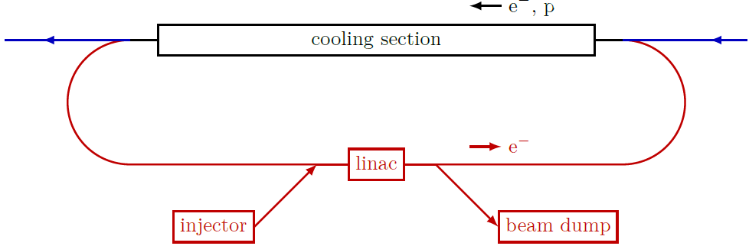
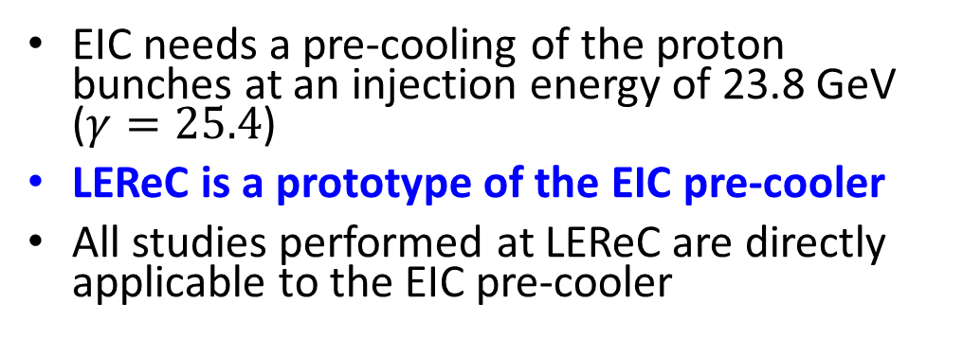

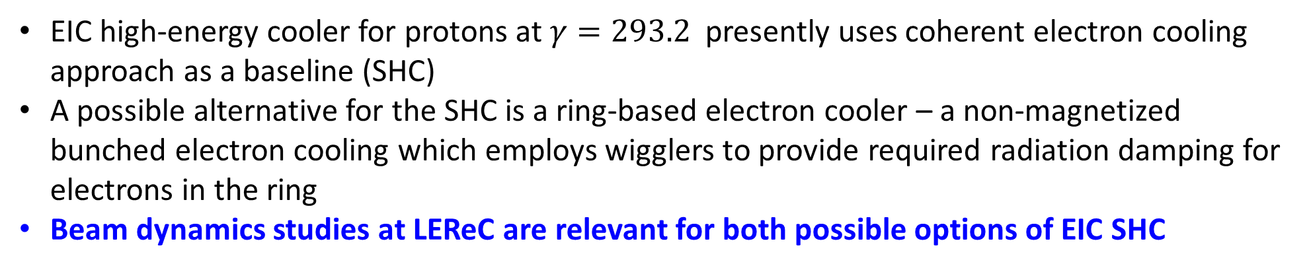
LEReC and EIC coolers
EIC needs a pre-cooling of the proton bunches at an injection energy of 23.8 GeV ($γ=25.4$)
LEReC is a prototype of the EIC pre-cooler
All studies performed at LEReC are directly applicable to the EIC pre-cooler
LEReC-type cooling section
LEReC-type injector
EIC high-energy cooler for protons at $γ=293.2$ presently uses coherent electron cooling approach as a baseline (SHC)
A possible alternative for the SHC is a ring-based electron cooler – a non-magnetized bunched electron cooling which employs wigglers to provide required radiation damping for electrons in the ring
Beam dynamics studies at LEReC are relevant for both possible options of EIC SHC
All EIC coolers require an injector with average current of $≈100$ mA
LEReC Gun is designed to operate at high current (up to 100 mA)
R&D critical to operation of high-current sources will be performed at LEReC

Slide 5
Studies completed during Run 2021

Slide 6
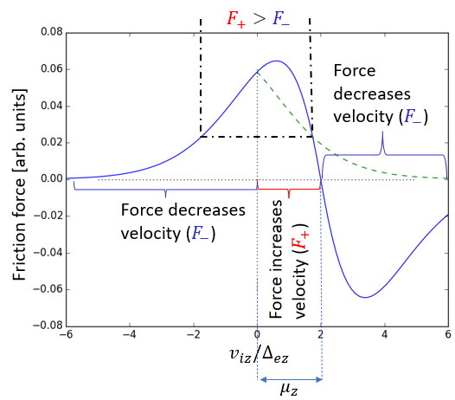
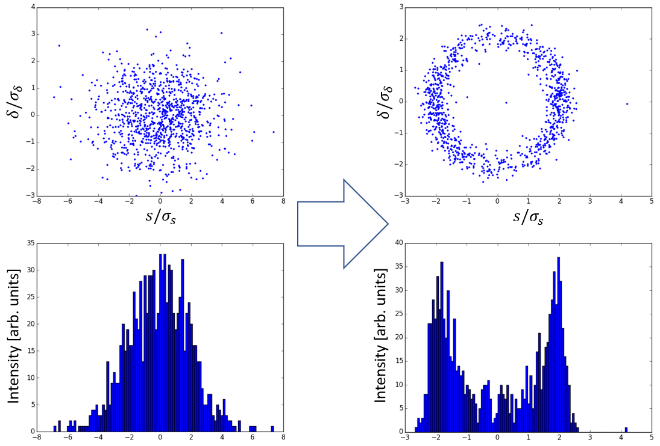
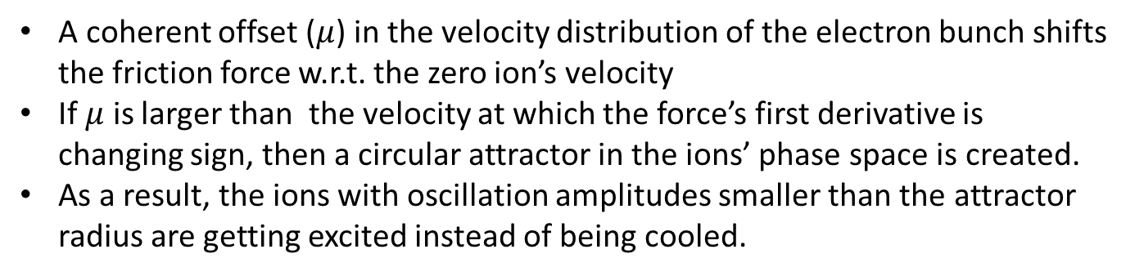
1. Coherent excitations (I)
The ion-electron interaction in E-cooling can be described by a friction force acting on ions
A coherent offset ($μ$) in the velocity distribution of the electron bunch shifts the friction force w.r.t. the zero ion’s velocity
If $μ$ is larger than the velocity at which the force’s first derivative is changing sign, then a circular attractor in the ions’ phase space is created.
As a result, the ions with oscillation amplitudes smaller than the attractor radius are getting excited instead of being cooled.
Initial and final distributions (simulations)
LEReC is the first RF-based e-cooler and this effect had never been studied in bunched coolers until now
Very similar effect is expected in CeC-based cooling
Coherent excitations in both longitudinal and transverse directions must be avoided, which sets strict requirements to the design of both the EIC CeC-based SHC and the e-ring-based SHC, as well as to the design of the EIC pre-cooler.
LEReC studies of coherent excitations are important for all EIC coolers

Slide 7
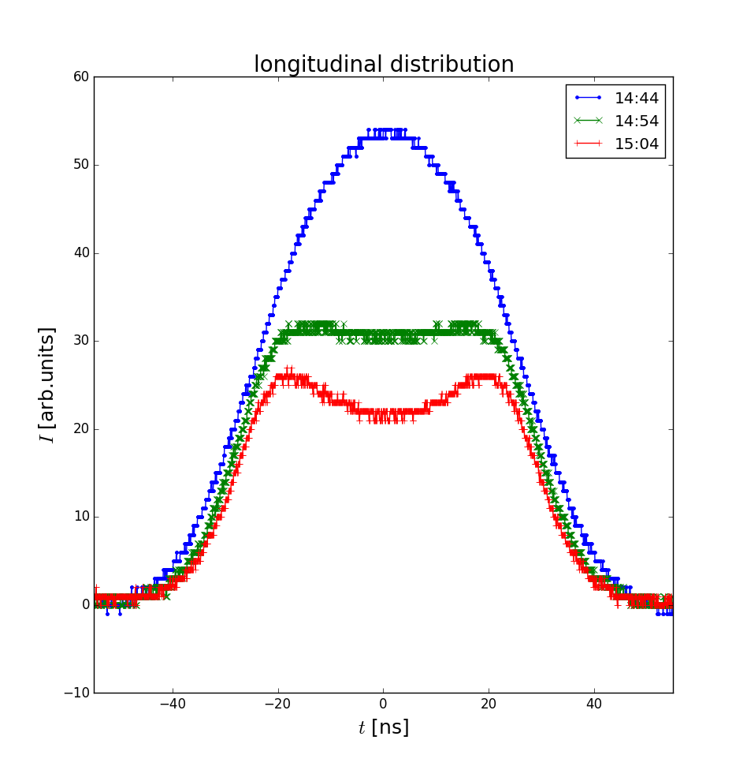
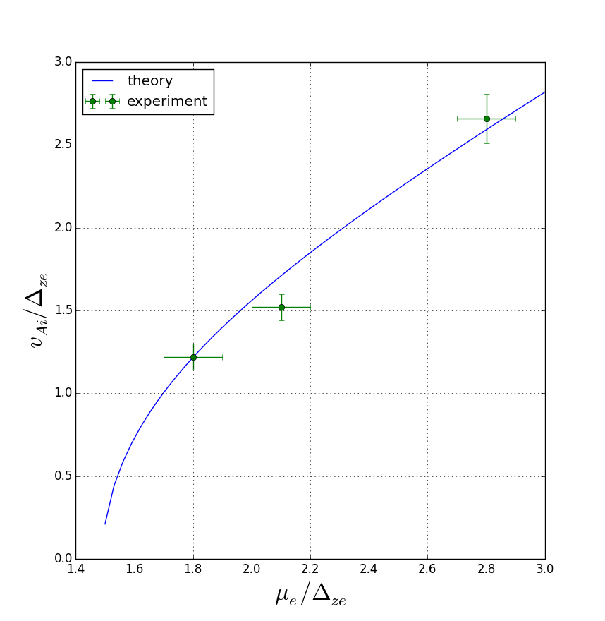
1. Coherent excitations (II)
With a special setup we were able to observe the effect of circular attractor on longitudinal distribution of the ion bunch
We were able to measure the radii of circular attractors created by various coherent offsets in e-beam’s average velocity.
Ion bunch evolution in presence of a circular attractor (experiment)
The obtained results are in good agreement with theoretical predictions
Studies were presented at COOL21. We are preparing a respective paper
We are confident that we can set proper requirements to parameters of each EIC cooler to avoid coherent excitations
Radius of attractor vs
coherent offset

Slide 8
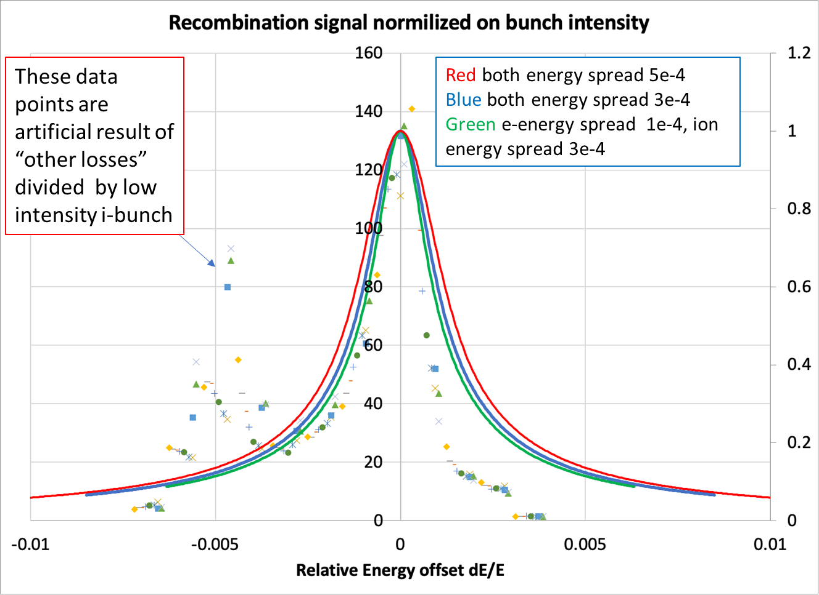
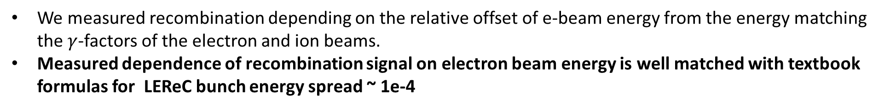
2. Recombination
Radiative recombination of ions is one of the sources of ions’ lifetime reduction in coolers (it is present in both regular electron coolers and in CeC scheme)
The effect was extensively studied in magnetized electron coolers where recombination is enhanced by the presence of continuous solenoidal field in the CS.
LEReC is the first non-magnetized e-cooler. Hence, the importance of checking the recombination rate at LEReC, especially, since there was a suspicion that we too might have the recombination enhancement.
We measured recombination depending on the relative offset of e-beam energy from the energy matching the $γ$-factors of the electron and ion beams.
Measured dependence of recombination signal on electron beam energy is well matched with textbook formulas for LEReC bunch energy spread ~ 1e-4

Slide 9
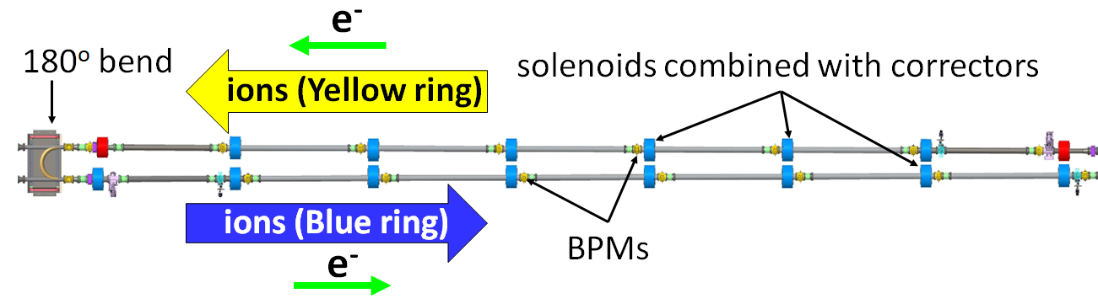
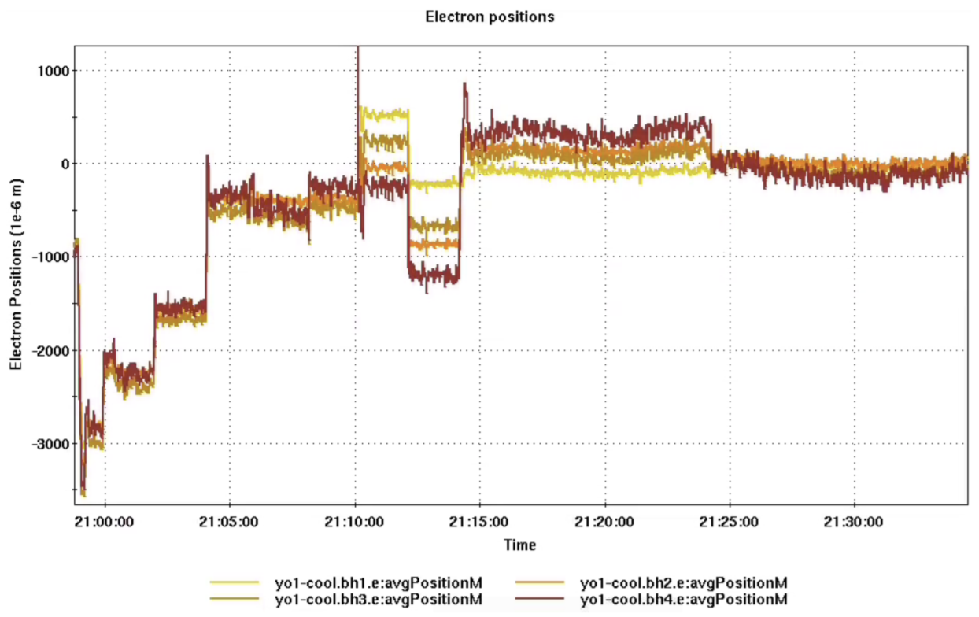
3. Machine learning at LEReC
LEReC was used as a testing ground for machine learning (ML) algorithms, which in the future may become useful for optimizing performance of the coolers.
The objective of the test was to optimize the cooling rate by improving the e-beam trajectory (as measured by 8 BPMs in the cooling section)
The algorithm based on Bayesian Optimization method worked successfully and returned the proper e-beam trajectory (BPMs read zeros)
A paper based on these studies will be published soon in Phys. Rev. Accel. Beams

Slide 10
Ongoing Studies

Slide 11
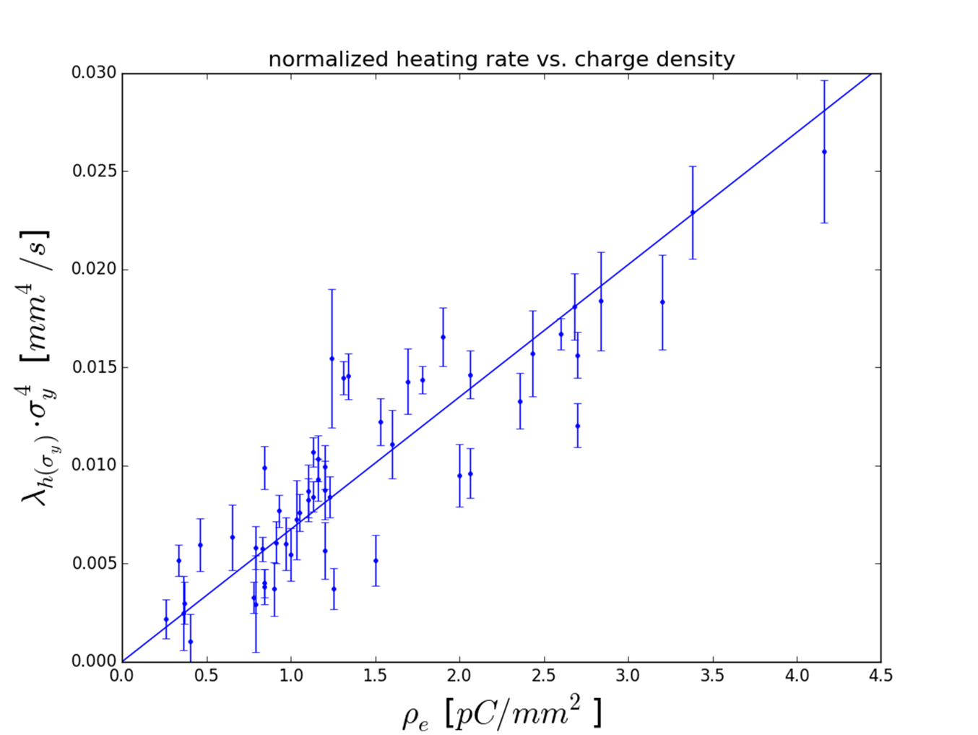
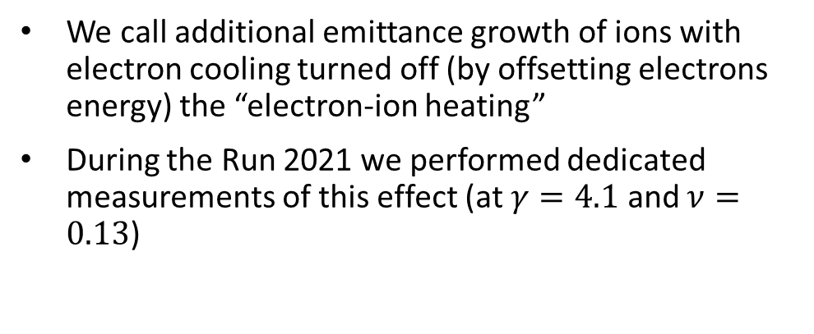
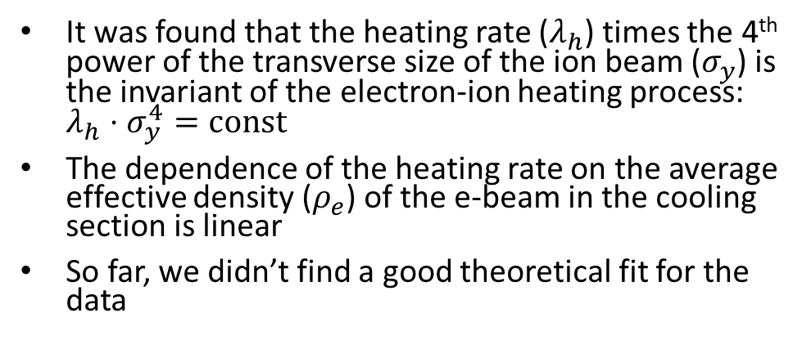
4. Electron-ion heating (I)
We call additional emittance growth of ions with electron cooling turned off (by offsetting electrons energy) the “electron-ion heating”
During the Run 2021 we performed dedicated measurements of this effect (at $γ=4.1$ and $ν=0.13$)
It was found that the heating rate ($λ_{h}$) times the 4th power of the transverse size of the ion beam ($σ_{y}$) is the invariant of the electron-ion heating process: $λ_{h}⋅σ_{y}^{4}=const$
The dependence of the heating rate on the average effective density ($ρ_{e}$) of the e-beam in the cooling section is linear
So far, we didn’t find a good theoretical fit for the data
The optimized electron cooling overcomes both the heating and the IBS. The e-i heating was not a limiting factor for RHIC operations with the cooler, which doesn’t mean that this effect won’t be a limiting factor for high energy coolers of any type
Further experimental studies of the electron-ion heating are planned

Slide 12
4. Electron-ion heating (II)
We are planning to explore:
The higher electron bunch densities
A possible connection between transverse heating and coherent excitations
The heating dependence on the working point (tunes around 0.1 vs tunes around 0.23)
Heating at a higher energy (𝛾=4.9). This requires LEReC setup for 2MeV and must be postponed for Run-23
We continue our search of a theoretical model properly explaining this effect
The current results were reported at HB2021
Our group is continuously discussing the obtained observations and possible theoretical explanations with experts both at BNL and at other laboratories
Understanding this effect is important both for coolers in general and for high energy coolers in particular.

Slide 13
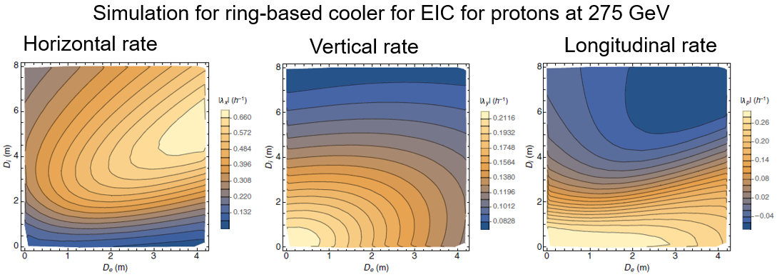
5. Redistribution of cooling decrements (I)
It is possible to enhance the transverse cooling at the expense of the longitudinal cooling
Such a redistribution of cooling decrements requires ion dispersion in the cooling section and the transverse gradient of the longitudinal friction force
The possibilities to create the transverse gradient of longitudinal friction force include:
  Creating electron dispersion in the cooling section
  Utilizing a non-uniformity of transverse density distribution of the electron bunch
  Offsetting electron beam transversely with respect to the ion beam
The transverse cooling in CeC-based cooler for EIC simply does not exist without redistribution
While transverse cooling is present in e-ring-based EIC cooler, its enhancement through decrements’ redistribution is an integral part of the design
LEReC is well suited for the studies of redistribution of cooling decrements

Slide 14
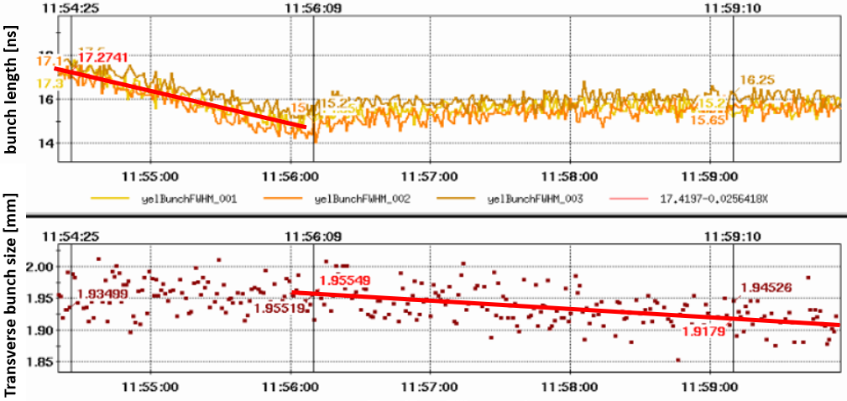
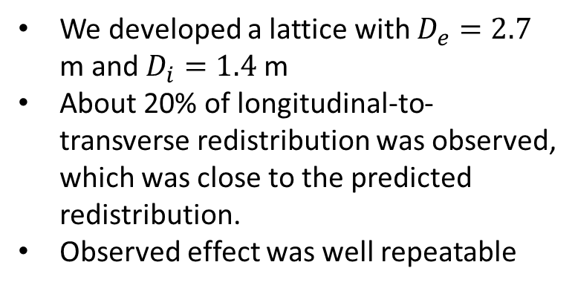
5. Redistribution of cooling decrements (II)
We developed a lattice with $D_{e}=2.7$ m and $D_{i}=1.4$ m
About 20% of longitudinal-to-transverse redistribution was observed, which was close to the predicted redistribution.
Observed effect was well repeatable
Change in redistribution coefficient due to change in e-bunch energy chirp
Future plans:
Establish new setup and parameters using 28MHz RHIC RF (9MHz was used in 2021)
Implement high-current setups with electron beam dispersion larger than 2.7 meters (used in 2021).
Establish stronger dispersive cooling with larger electrons dispersion (if possible, implement ions lattice with larger dispersion 2-3 meters ).
Systematic study of dispersive cooling for various settings and parameters
Exploring cooling with offset of electron beam
Cooling redistribution studies are critical for creating a realistic design of the EIC SHC

Slide 15
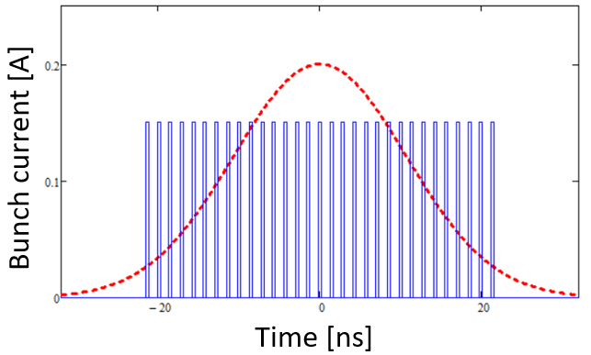
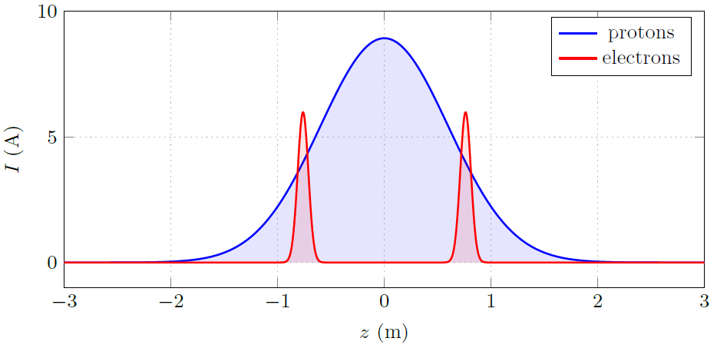
6. Cooling with short electron bunches (I)
In high energy bunched electron coolers, the electron bunches are typically much shorter than the hadron bunches.
In order to redistribute cooling more equally, several electron bunches per one hadron bunch are used
e-p timing scheme at EIC precooler
Electron-ion timing scheme at LEReC
Due to ion-electron space charge focusing the angular spread and transverse density in each electron bunch depends on the bunch’s longitudinal position along the ion bunch
Therefore, both the effective cooling and a possible electron-ion heating from each electron bunch depends on its longitudinal placement with respect to the ion bunch’s center
It is important to learn how to optimize the cooling of high-intensity hadron bunches by finding the proper balance between cooling/heating/lifetime

Slide 16
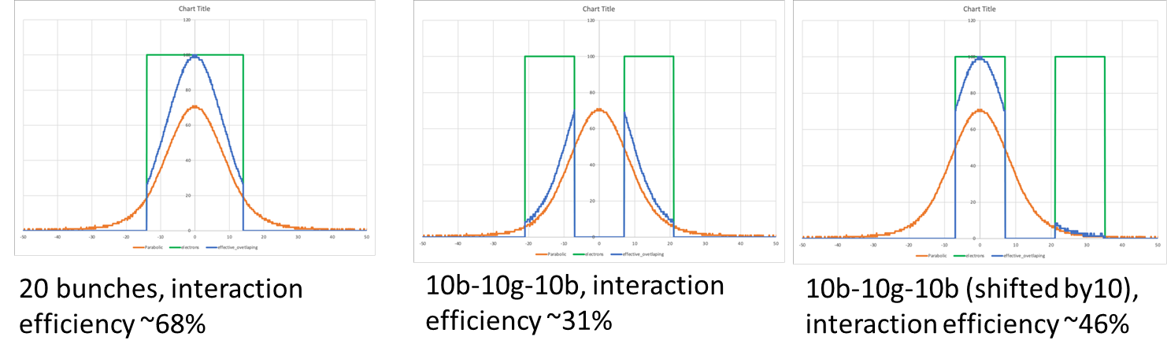
6. Cooling with short bunches (II)
Three setups were experimentally explored
Overall cooling rate was well correlated with the effective overlapping charge
Transverse cooling was more efficient for centered pattern (long or short electron macro-bunches)
Longitudinal cooling was more efficient for hollow electron macro-bunches
Plans:
Measurements with shorter electron macro-bunches require significant modification of the laser pulse picking system
We prefer performing such a modification after other LEReC experiments are finished

Slide 17
Planned Studies

Slide 18
7. Elevated ion losses in coolers
Operational electron cooling at LEReC was associated with elevated ions losses.
Such an effect on ion beam lifetime was observed in several electron coolers and is not fully understood.
Part of the elevated losses is caused by recombination, but also there are additional, not recombination-related losses.
During the commissioning in 2019 we had set-ups for which the lifetime of a cooled ion bunch was comparable or even larger than the lifetime of ion bunch not interacting with the electron beam.
Studies of the elevated ion losses in the presence of the electron beam are critical for creating a feasible design of the EIC coolers (of any type).
We plan to:
Reestablish a setup with a positive effect on ion beam lifetime, similar to what was observed during commissioning in 2019 and explore such a setup.
Explore the dependence of ion losses on:
  Electron beam average size, current, density
  RHIC tunes (working point around 0.1 and working point around 0.23)

Slide 19
8. High current studies
High-current electron sources is important area of research. High current sources are required for various cooler designs of the EIC:
  The EIC pre-cooler requires stable operation at around 100mA current
  The Strong Hadron Cooler for EIC requires 100mA source of electrons.
LEReC Gun is designed to operate at high current of up to 100mA. Many R&D items critical to high-current source operations could be explored.
High-current source R&D (from Alexei Fedotov’s presentation):
  Explore Gun operation with high-current: 50, 75, 100mA. Determine limitation of the Gun and HVPS.
  Explore Gun and HVPS long-term stability at high currents.
  Explore Gun voltage limitations
  Explore operation with active cathode on center vs cathode off center.
  Explore large cathode area vs small active area. Explore various laser spot sizes on the cathode.
  Explore cathode QE at various laser powers with and without cathode stalk cooling.
  Test multi-alkali photocathodes using different growth methods.
  Explore possible upgrade of laser system to allow ramping of high-current for fixed electron bunch charge.

Slide 20
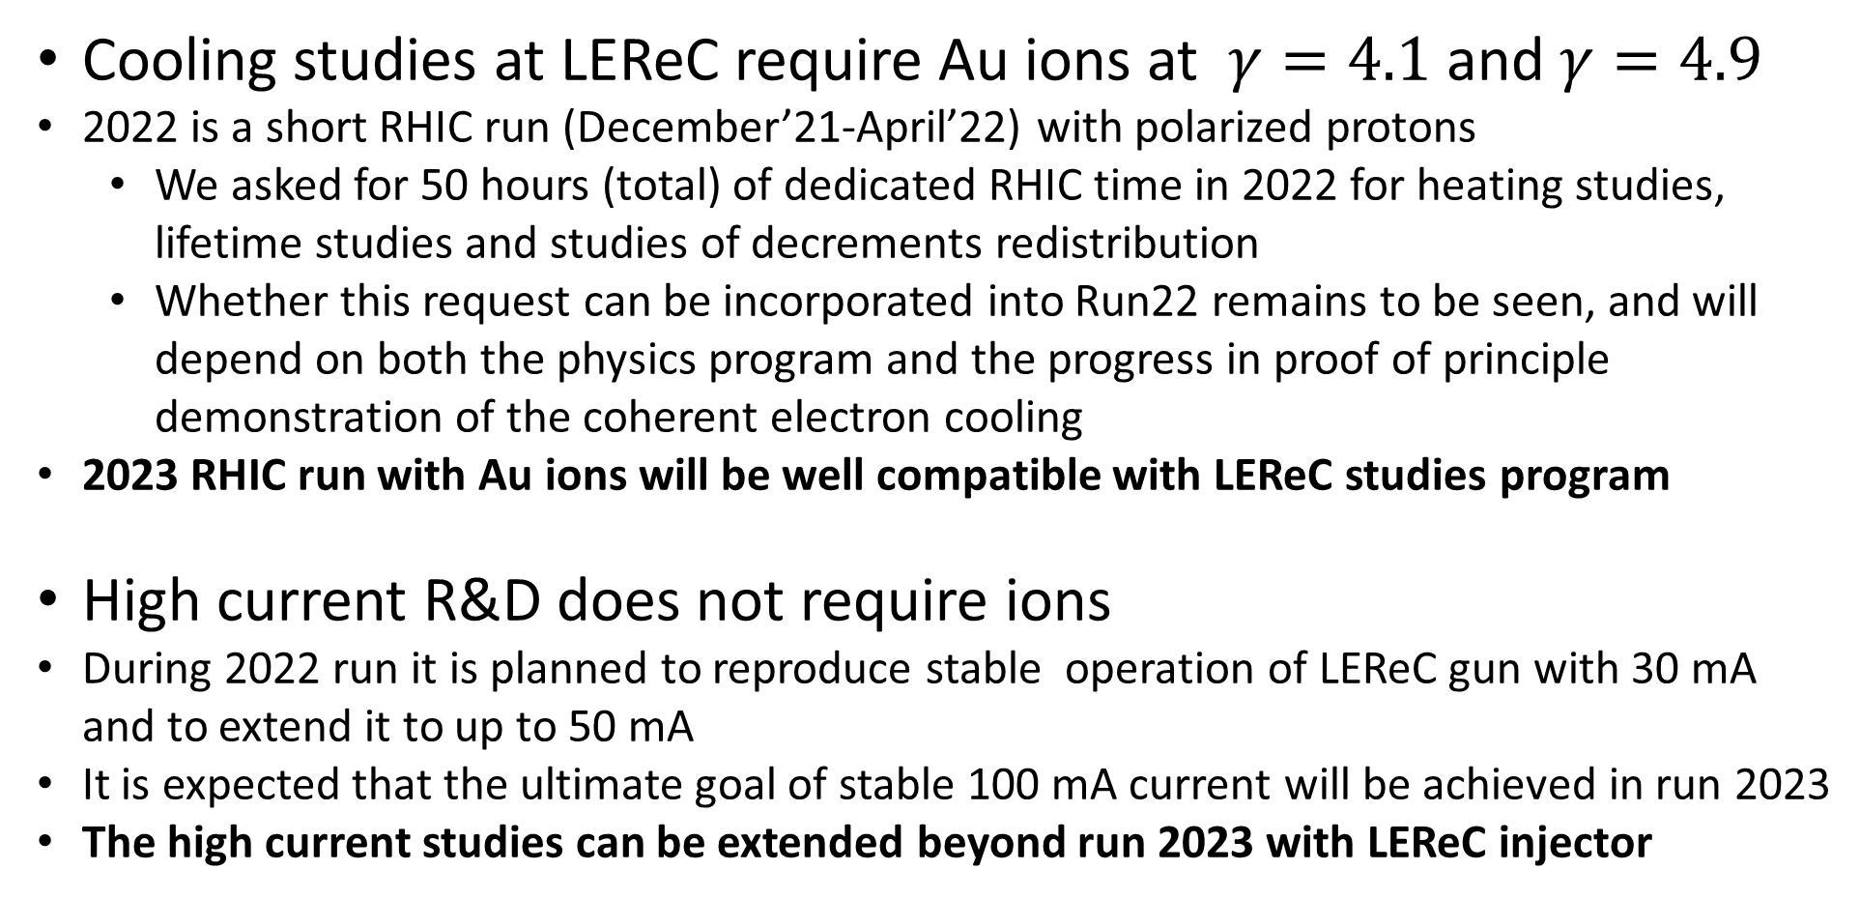
Future experiments
Cooling studies at LEReC require Au ions at $γ=4.1$ and $γ=4.9$
2022 is a short RHIC run (December’21-April’22) with polarized protons
  We asked for 50 hours (total) of dedicated RHIC time in 2022 for heating studies, lifetime studies and studies of decrements redistribution
  Whether this request can be incorporated into Run22 remains to be seen, and will depend on both the physics program and the progress in proof of principle demonstration of the coherent electron cooling
2023 RHIC run with Au ions will be well compatible with LEReC studies program
High current R&D does not require ions
During 2022 run it is planned to reproduce stable operation of LEReC gun with 30 mA and to extend it to up to 50 mA
It is expected that the ultimate goal of stable 100 mA current will be achieved in run 2023
The high current studies can be extended beyond run 2023 with LEReC injector

Slide 21
Summary
Cooling studies at LEReC are critical for realistic design of EIC coolers of any type
LEReC is a unique testing ground for development of cooling technology and for the R&D of high current electron sources
Several LEReC cooling studies were successfully completed in Run 2021
Intensive program of the cooling studies and high-current R&D is proposed for upcoming RHIC runs
Other studies important for EIC coolers are being discussed

Slide 22
Backup slides

