Slide 1
EBIS Development BNL For Polarized 3He2+
E. Beebe, G. Atoian, B. Coe¹, S. Ikeda¹, S. Kondrashev¹, M. Musgrave², M. Okamura¹, D. Raparia¹, T. Rodowicz¹, J. Ritter¹, B. Schoepfer¹, A. Zelenski¹
¹Brookhaven National Laboratory, Upton, NY 11973, USA
²MIT, Cambridge, MA, USA
*Project funded by US Department of Energy and the National Aeronautics and Space Administration
Dry Run MAC21
Nov 30, 2021

Slide 2
Motivation for a New “Extended EBIS” at Brookhaven National Laboratory (BNL):
Provide increased intensities of Au³²⁺ and other species for the Relativistic Heavy Ion Collider (RHIC)
Provide Polarized ³He²⁺ for a future electron-ion collider (EIC) with near term feasibility studies at RHIC
Maintain Rapid switching of Ion Beams for quasi-simultaneous beam delivery to RHIC and the NASA Space Research Laboratory (NSRL) at BNL
Provide H+ from the EBIS, reducing or eliminating the need to use the TANDEM and 200Mev LINAC facilities to provide protons to NSRL

Slide 3
Production of Polarized ³He²⁺ in an EBIS
Polarized 3He ions offer a “polarized neutron beam for RHIC and a future EIC
EBIS capable of producing high ratio of ³He²⁺ / ³He⁺
EBIS can maintain high polarization throughout the ionization and confinement process
³He²⁺ can be transported without depolarization
Identified as high priority R&D for EIC by EICAC review in 2009, Office of Nuclear Physics Community Review in 2017, and the 2018 assessment of the US National Academy of Sciences.

Slide 4
Design and Construction of ExtendedEBIS
To meet the specific set of challenges and our approach has been to test and develop some new EBIS concepts on various test benches and then integrate them into the ExtendedEBIS in our TestEBIS laboratory.
We expect to experimentally demonstrate the concept by June2022 and install the ExtendedEBIS in place of the operational RHIC EBIS during the Summer of 2022. System integration and beam testing would take place during Autumn 2022 with Operations to RHIC in Winter 2023.

Slide 5
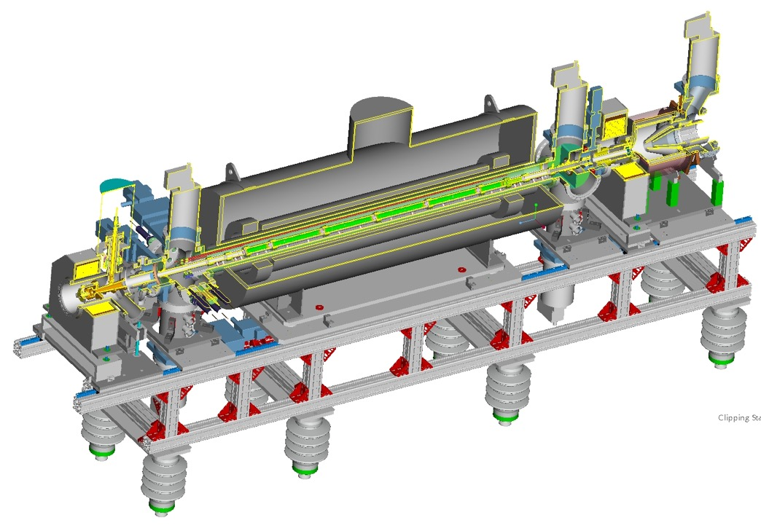
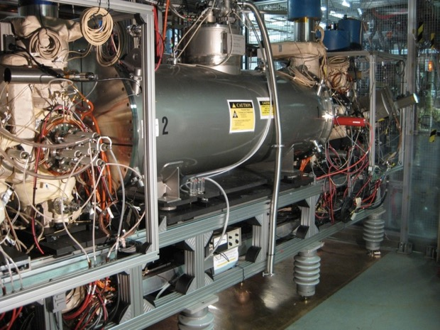
EBIS Source Assembly
Superconducting Solenoid (5 T)
Electron Collector
Drift Tube Structure (P=10⁻¹⁰ Torr)
E-Gun
(10 A)
Parameter | RHIC EBIS
Max. electron current I_{el}= | 10 A
Electron energy E_{el}= | 20 keV
Electron density in trap j_{el}= | 575 A/cm²
Length of ion trap L_{trap}= | 1.5 m
Ion trap capacity Q_{el}= | 1.1x10¹²
Ion yield (charges) Q_{ion}= | 5.5x10¹¹ (10 A)
Yield of ions Au³²⁺ N_{Au}³²⁺= | 3.1x10⁹ [1.9x10⁹]
N =κ∗ I_{e}*L_{trap}* E_{e}^{-0.5}

Slide 6
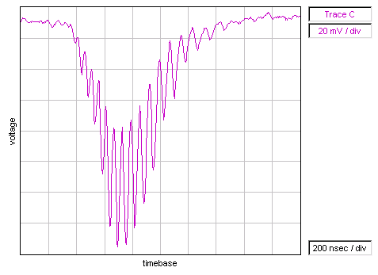
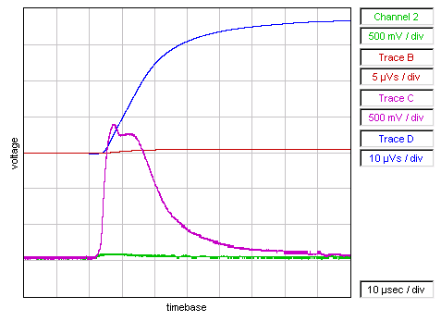
EBIS is an Accumulator and Charge State Multiplier with a widely programmable output pulse width and is capable of working with Internal gas Injection.
Typically operation is with ion injection from external sources:
Fast injection: Laser Ion Source (LION) , ~100’s uA – 1mA , 10-200 us
Slow injection: HCIS, 1-10’s uA, 10-40 ms
Widely variable extraction pulse width 5uS to greater than 50ms
Booster/AGS/Rhic injection typically 5-40 us (High Intensity)
Pure Beams (low contamination by unwanted ion species)
High utilization of relatively low charge capacity
Lower space charge beam transport to RFQ
Note very low background contamination characteristic of EBIS
Above: Au Time-of-Flight Spectrum
(Reflex mode – channeltron EM)
Max peak is Au32+
Au pulse (all charge states)
With external Au1+ ion injection:
ChC Magenta3.5mA, 1 mA/div, 10 µs/div
ChD Blue: 70nC , 20uVs/div
Without external ion injection
Ch2 Green: 0.2mA, 1 mA/div, 10 µs/div
ChB Red: 1nC , 10uVs/div

Slide 7
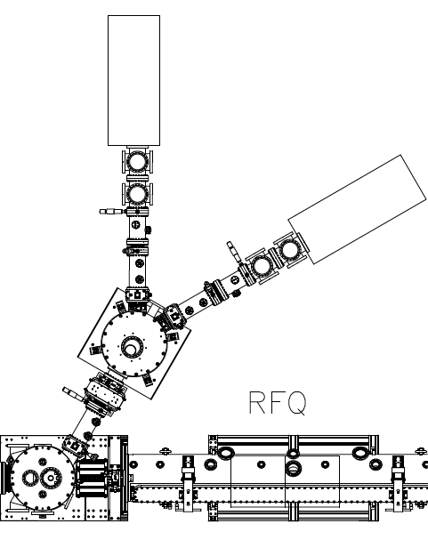
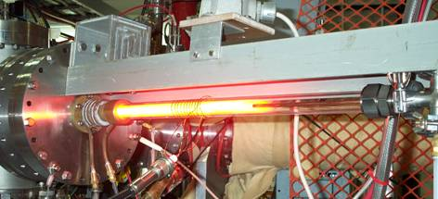
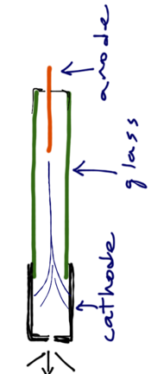
External 1+ ion production to feed the EBIS trap
Slow injection (accumulation mode)
HCIS
Cu source
Hollow cathode ion source
U source, then Au
EBIS is a “charge breeder” of the injected 1+ ions
1+ Ions
into EBIS

Slide 8
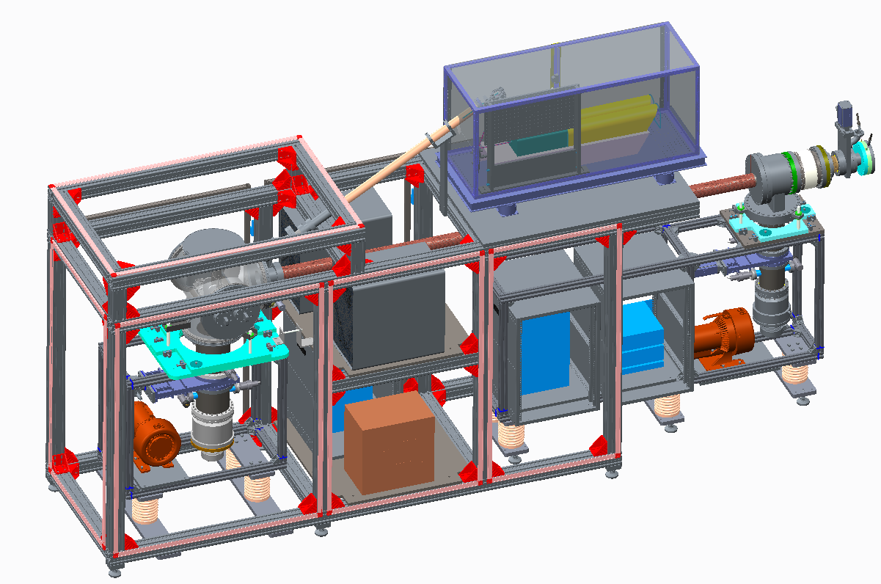
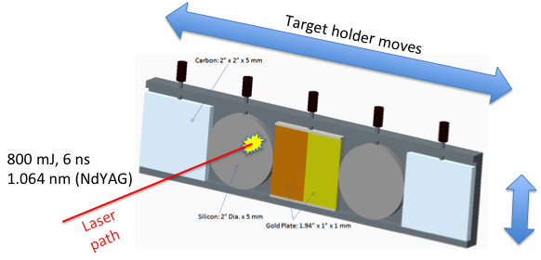
Versatile 1+ ion injection into EBIS by Laser Ion Source (LION)
3rd injection line added for LION
improved flexibility (multiple species)
low gas load
Fast injection into EBIS
See Tues. P34 (Okamura et. al.) for details

Slide 9
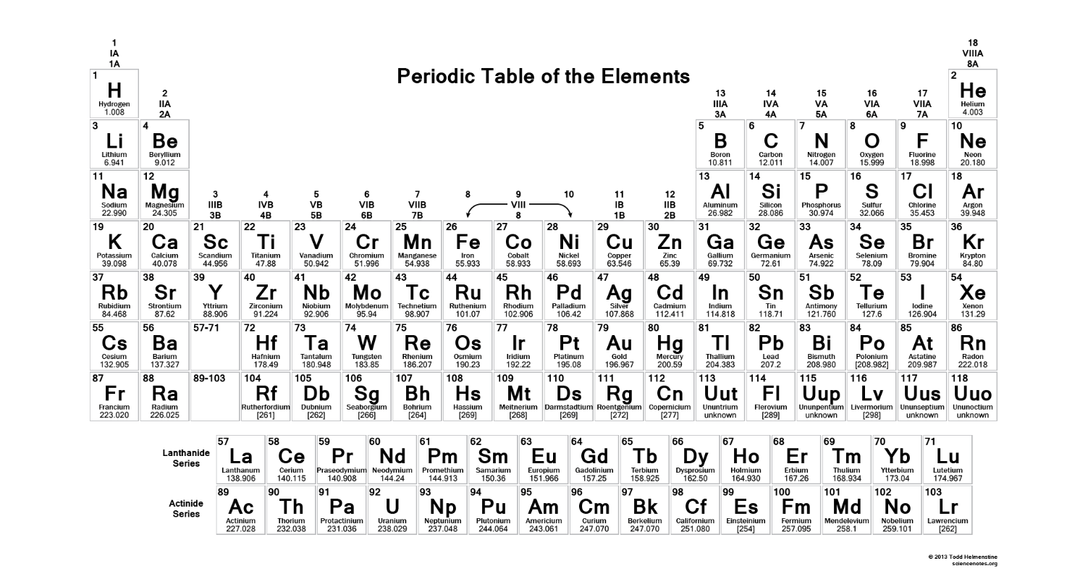
EBIS beams run to date on RHIC EBIS
D, ³He²⁺, ⁴He^{1+,2+}, Li³⁺, C^{5+,6+}, O⁷⁺, Ne⁵⁺, Al⁵⁺, Si^{11+,12+}, Ar¹¹⁺, Ca¹⁴⁺, Ti¹⁸⁺, Fe^{20+,24+}, Cu¹¹⁺, Kr¹⁸⁺, ⁹⁰Zr¹⁵⁺, ⁹⁶Zr¹⁶⁺, Nb¹⁶⁺, Xe²⁷⁺, Ta³⁸⁺, ¹⁸⁴W³¹⁺, Au³²⁺, Pb³⁴⁺, ²³²Th³⁹⁺, U³⁹⁺
1 second switching between species (2, or more), alternating
<30 second switching among almost any 10, if loaded into external sources

Slide 10
Challenges and Key Development for the Extended EBIS
Early work with injection of 3He into EBIS showed that it would be difficult to polarize the 3He gas external to the EBIS and then transport the gas into the EBIS for ionization to 3He2+, while maintaining both high intensity and maintaining polarization.
The concept of an in-bore gas / high field polarization cell has been developed. This necessitates the development of a highly efficient gas injection system and led to the development of a hybrid vacuum system using both conventional internal drift tubes and a new modular “external” drift tube system to accommodate placement of the gas reservoir and polarization equipment.
Pumping Ultra-High Vacuum Regions
  Custom heated linear high capacity NEG
  (see Wed. M04 – Kondrashev, et. al.)
Alignment of Magnetic systems
  (see Mon. P24 – Ikeda, et. al.)
3He Polarization for EBIS
  Gas Purification, and pulsed valve developments
  (see Thurs. I02. – Zelenski, et. al.)
* While polarization tests after ExtendedEBIS installation are not expected to occur until Summer2021, It is extremely important that the gas injection system is complete and operational for the Summer2020 installation at the RhicEBIS location.

Slide 11
3He²⁺ Polarized Ion Production in EBIS – (concept)
By introducing a separate “gas injection solenoid” one could effectively introduce a high pressure gas injection region (~ several mB) while still maintaining a very low pressure (~ 10⁻¹⁰ mB) trap region in which ionization to high charge state 3He2+ would occur with high efficiency.

Slide 12
Two Solenoidal System Concept:
In-bore ³He gas polarization and injection system plus vacuum separation requires separate solenoids.
Heavy ion intensity upgrade
Need spare solenoids for operations in case of failure.
Use two identical Superconducting solenoids:
Upstream solenoid occupied by the gas handling and polarization system.
Single spare solenoid required, can be used for TestStand puposes
Electron optical system of launch and collection similar to the existing RhicEBIS.
A two solenoid system for an EBIS heavy ion intensity upgrade, while maintaining the same electron beam power, was proposed earlier. (HIAT2012, Pikin, et.al.)
Intensity Estimates for EBIS upgrade (at Extended EBIS exit)
He²⁺ ~ 2.5 - 5 x 10¹¹ ions/pulse
H⁺ ~5 – 10 x 10¹¹ ions/ pulse
Au³²⁺ ~2.6x10⁹ ions/pulse (an increase of 1.4-1.5 over RhicEBIS)
The gas injection cell may also increase the intensity of light ions that can be injected as neutral gas.

Slide 13
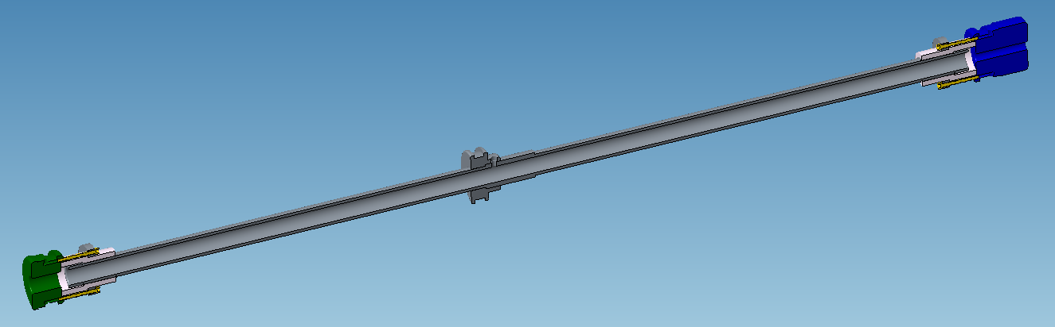
A Gas Injection Cell with end caps was used for Electron Beam Tests at the BNL TestEBIS (most extreme case: small dia., very long)
The gas cell assembly consists of a 46 cm long, 10 mm diameter gas cell with an electrically isolated 3 cm long, 10 mm diameter upstream barrier electrode (green) and a 3 cm long, 5 mm diameter downstream barrier electrode (blue).
The electrodes are inserted into the existing TestEBIS 31mm diameter drift tubes. Electrical contact to three axially adjacent TestEBIS ion trap region drift tubes is made using RF springs around the circumference of each electrode insert.

Slide 14
Gas Cell Drift Tube Assembly Electron Beam Test Results
Electron beams up to 6 A were successfully propagated through the assembly consisting of a 46 cm, 10mm gas cell with a 3 cm long, 10 mm upstream barrier electrode and a 3 cm long, 5 mm diameter downstream barrier electrode.
Ion extraction from residual gas ions was made from both the 46 cm long, 10mm diameter “gas cell” and the remaining ionization region trap consisting of the 17 cm long, 31 mm diameter TestEBIS drift tube electrode. Ion transfer between the two adjacent trap regions with different diameters has also been tested.
No gas feed for gas injection was provided during these experiments, since this would require a substantial rework of the TestEBIS which was designed for external ion injection.

Slide 15
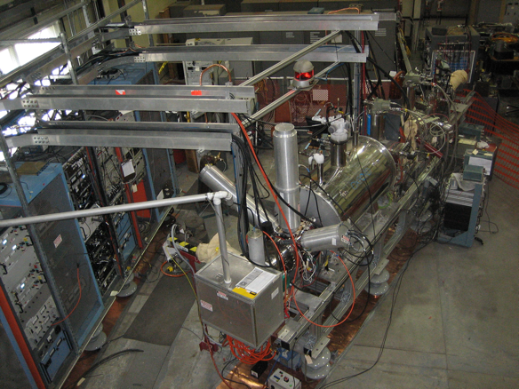
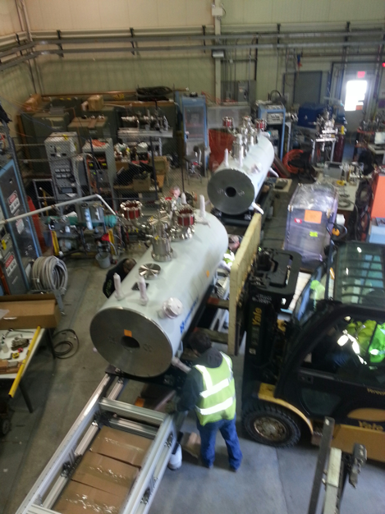
TestEBIS Laboratory upgrade for ExtendedEBIS development
The TestEBIS setup has been moved away.
The single 1.3 meter superconducting solenoid cryostat is visible in the photo at left.
The two Extended EBIS superconducting solenoids, each with cryostat length 2.3 meters, have been installed on newly constructed stands in the TestEBIS laboratory.
On site Quench and Acceptance testing completed during June 2018.

Slide 16
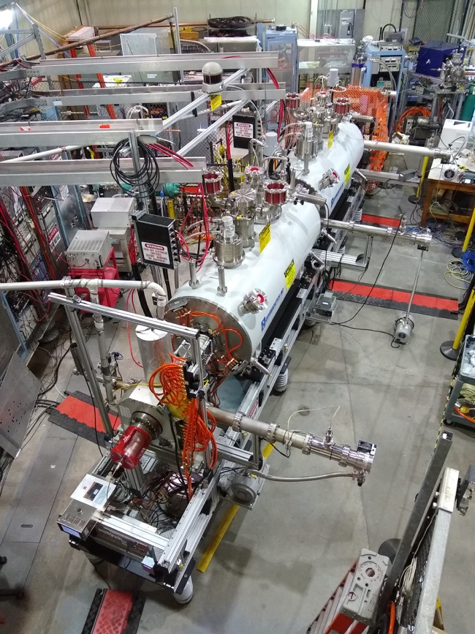
ProgressiveTest Configurations
Top: 5.5A electron beam to Simple FC between solenoids
Middle: 5.5A electron beam to Simple FC after 2nd Solenoid (each 5T)
[ 20cm (1T min) and 45cm (0.5T min) inter cryostat gaps ]
Bottom: 3.6A ebeam to high current collector for both the TestEBIS and RHIC EBIS internal electrode geometries.

Slide 17
Electron Beam Alignment Setup Assembly
A simplified modular vacuum system has been used to during initial electron beam testing
and to allow quick changes for testing new concepts and configurations:
NOW: “External” drift tubes (all drift tube diameters are ~2cm during first electron beam tests)
COMING SOON: Gas injection cell
Pulsed gas valve
High Capacity and Linear NEG pump Installation with custom electrical regeneration

Slide 18
Electron Beam Alignment Setup Details
Modular ”Gas Injection” Drift Tube Region:
2 cm dia. Drift tubes in Standard Conflat 2.75” 30kV Ceramic Breaks
Voltages applied externally. Tested to 20kV between Adjacent Tubes.
Diagnostic Chamber:
Insertable 4 Quadrant apertures
8 independent electrodes
(Front and Back)
Insertable FC/plate

Slide 19
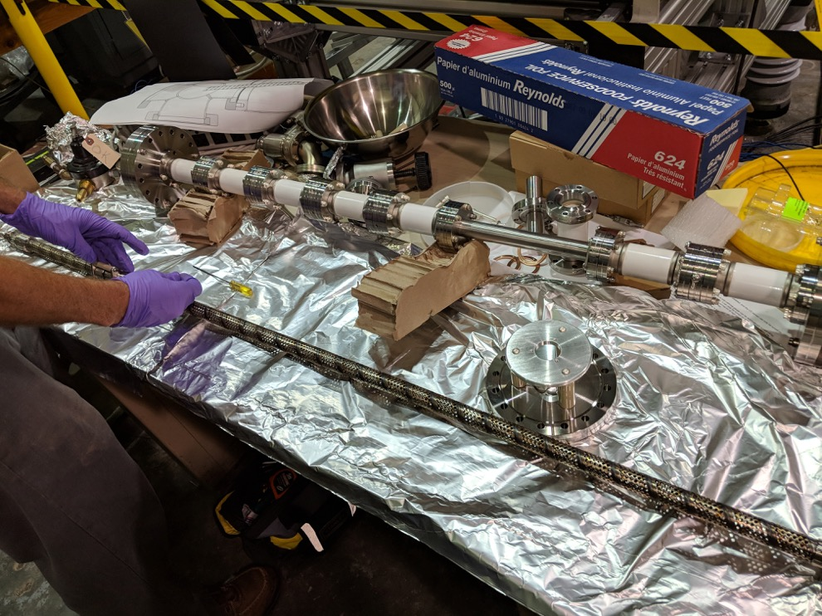
“External” and perforated 2cm diameter internal Drift Tube assemblies for the upstream solenoid

Slide 20
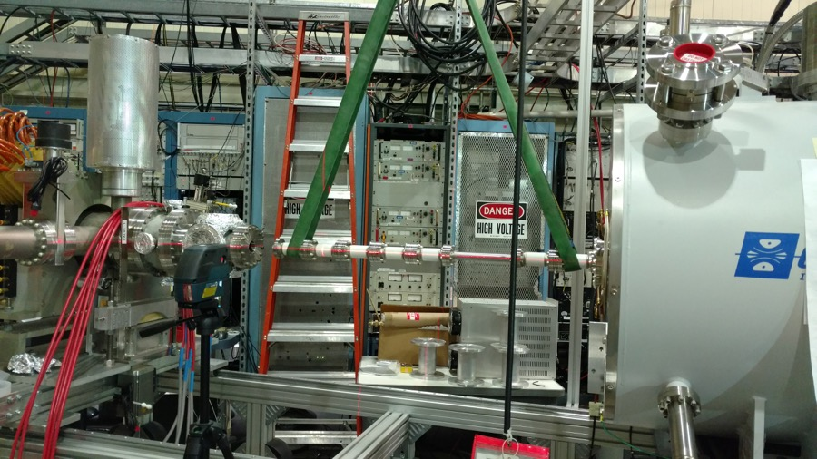
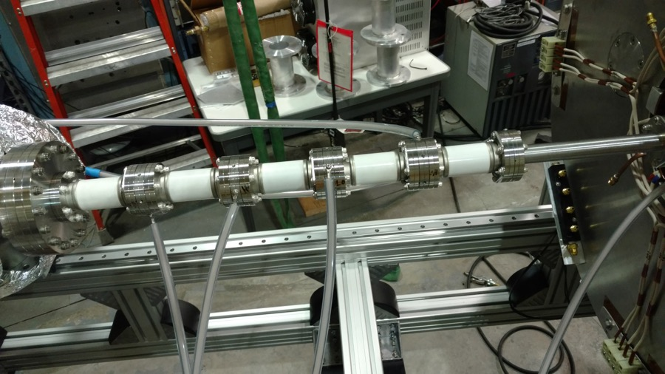
Upstream Drift Tubes

Slide 21
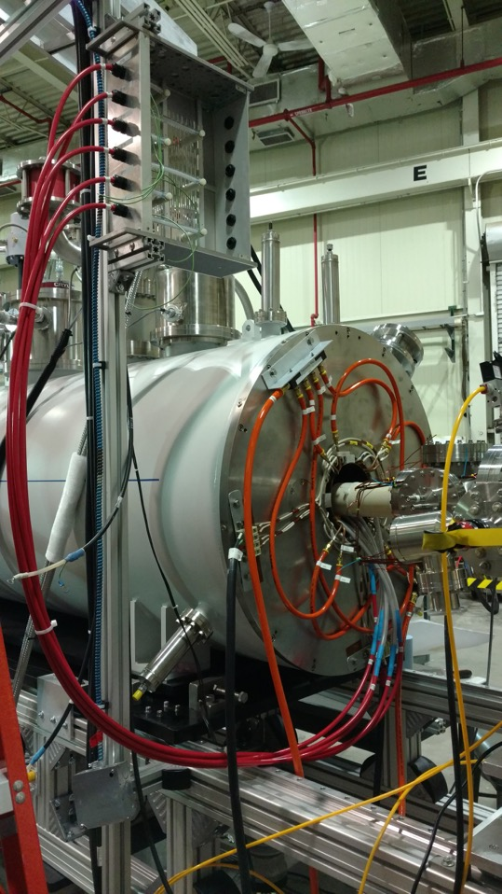
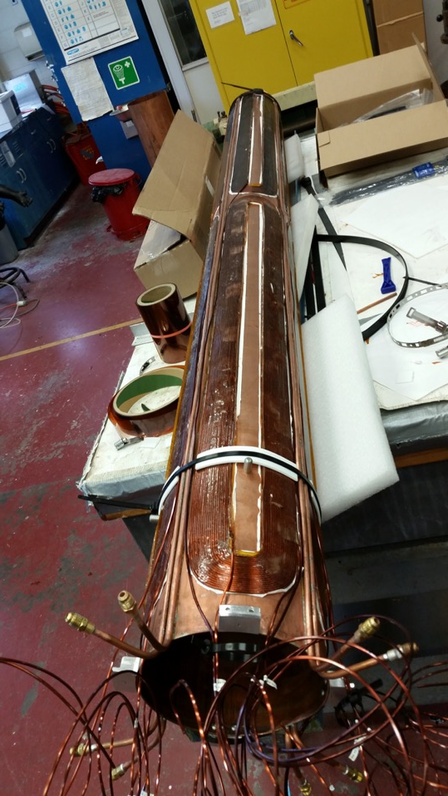
Transverse Coils and High Voltage Connections

Slide 22
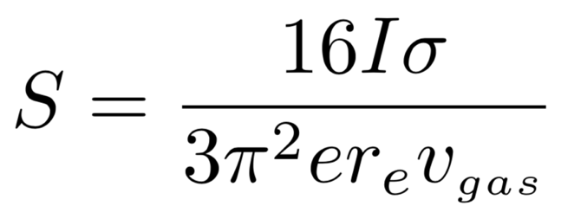
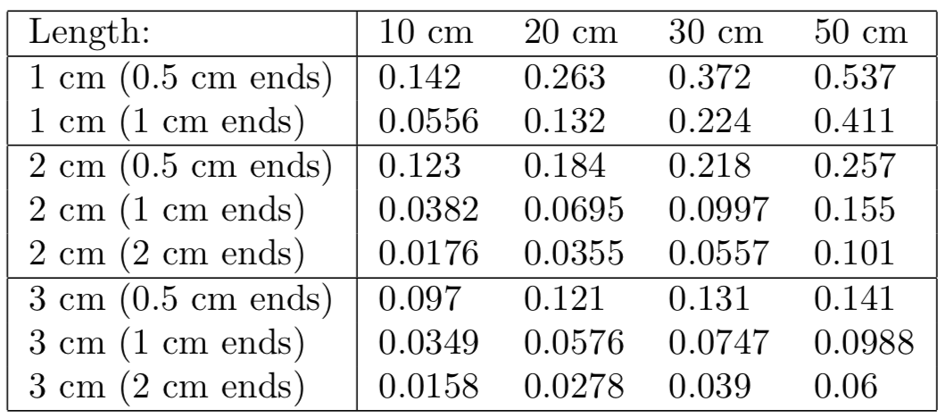
Electron Beam Ionization of ³He
Proportion of ³He ionized after 20 ms
For an e-beam of 25 keV there is a ≈0.5% probability that ³He is ionized during traverse of the e-beam.
Therefore, treat the e-beam as an ideal pump with 99.5% transparency.
Notes:
The electron beam in the EBIS acts as an ion pump on the injected gas. When 3He is ionized it is removed from the gas system and quickly moves downstream into the trap region. The probability of 3He capture during a traverse of the e-beam is determined from the electron impact ionization cross section of 3He, the velocity of 3He, the electron beam current, and the radius of the electron beam. The ionization cross section depends on the electron energy, but the electron energy cancels out elsewhere in determining the probability of 3He capture.

Slide 23
Gas Diffusion and Pumping in Ionization Cell
6.18 x 10¹¹ ³He atoms injected
10 A, 25 keV e-beam
Ionization Cell
  30 cm long
  2 cm diameter
  1 cm constrictions
Notes:
The purpose of this simulation was to measure how fast the 3He gas could be pumped out of the gas injection/ionization system. According to Ed the maximum rate the EBIS delivers pulses to the booster ring is once every 200 ms, so we want to be able to achieve ultra-high vacuum in the ionization cell and definitely in the down stream drift tubes 200 ms after gas is injected. This is important for switching between ion species and for achieving high charge states. This is not very important for 3He. This simulation should be redone with injection of heavier gas.

Slide 24
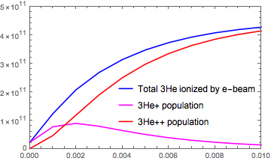
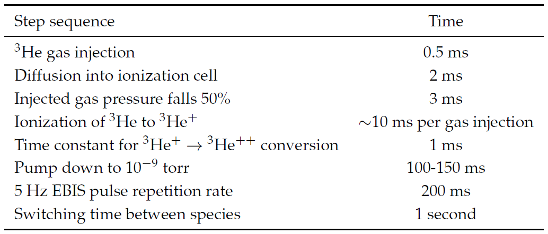
Electron Beam Ionization of ³He

Slide 25
Schedule / Milestones (Need to update/Add)
Completed acceptance tests of solenoids. June 2018.
Electron beam through upstream solenoid to FC - test collector. Dec-Feb 2019 (5.5A)
Electron beam propagated through both solenoids to FC - test collector. Also varied separation between solenoids, 20cm and 45cm. April - May 2019 (4.25A)
Electron beam to high power (RHIC EBIS) collector. 8A achieved
Linear NEG 3-module (activation, pumping speed tests);separate stand and Installed and tested
Gas Cell prototype installation and testing in upstream solenoid. Sept – Oct 2019
Further buildout and testing. (Vacuum separations, NEG Installation) Nov. 2019 – June 2020
Complete Extended EBIS with all improvements ready for testing (Ions beams). January 2022
RhicEBIS decommissioning (Summer shutdown 2020)
Extended EBIS Installation. July - Sept 2022
Extended EBIS System Testing and Commissioning. Oct – Dec 2022
Extended EBIS Operations January 2023 (gas injection possible…..polarization Summer 2025)

Slide 26
Polarized ³He⁺⁺ R&D: The Ion Source
Upgrade the RHIC EBIS by installing a second 5 T superconducting solenoid
Install ³He polarization and injection systems into the upstream solenoid
³He is polarized at high-field via meta-stability exchange optical pumping (MEOP)
³He gas is injected into the EBIS electron beam with a high speed pulsed valve
³He is ionized by the electron beam while differential pumping maintains UHV conditions
³He cell being polarized via MEOP at BNL

Slide 27
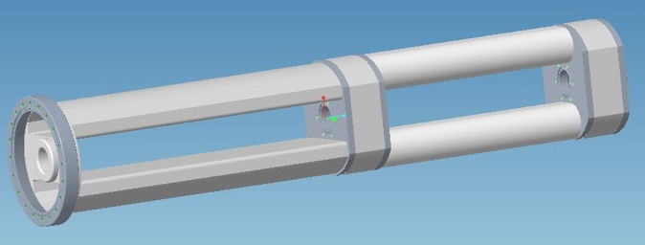
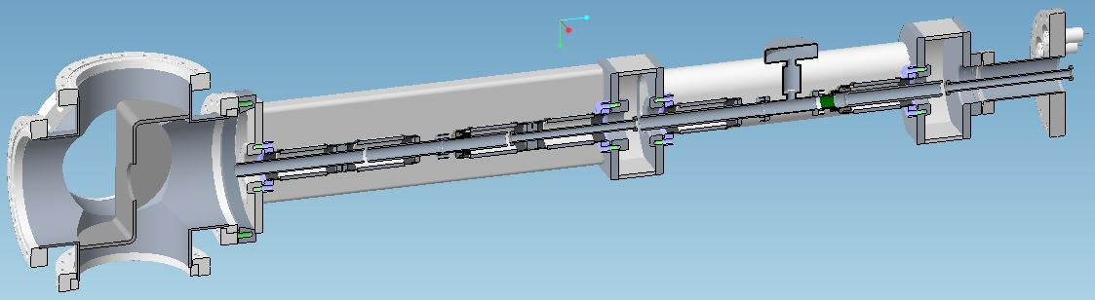
Gas cell configuration and pumping detail
High conductance gas cell pump out manifold without “external” Drift Tube electrodes installed. Right side is the gas cell pump out manifold. Left side is the electron gun entrance drift tube bypass manifold.
High conductance gas cell pump out manifold with “external” drift tube electrodes installed. The gas cell is towards the right side. Turbomolecular pumps for the differential pumped high vacuum drift tube sections and the gas cell are added to the cross on the left side. A low conductance “external drift tube joins the gas cell with a more conventional internal drift tube volume (not shown) at the right side.

Slide 28
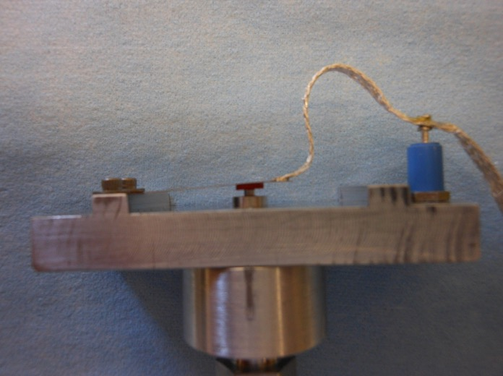
Pulsed Valve Development and Testing
Pulsed valve must be open quickly and close completely between pulses.
Such a valve has been used by A. Zelenski (BNL) for the Polarized H- ion source OPPIS. Tests are underway to make sure it meet the requirements for EBIS
The valve opens due by overcoming its own spring force due to ExB forces generated when a valve pulsed current interacts with the EBIS (static) high magnetic field.
A reverse current can be applied to increase the closing force, if necessary.
Two gas cells reservoirs and two pulsed valves are planned in the bore of the upstream Extended EBIS module to allow quasi-simultaneous polarized ³He and other gas injection capability. The second cell would serve as an spare in case of a cell or valve failure).

Slide 29
Summary
Electron beams >8A were propagated through the most Extreme Gas Cell geometry and ion beam manipulations were made to verify EBIS operation using long, small diameter drift tubes.(done on TestEBIS, just prior to decommissioning)
Electron beam was propagated through the double superconducting system with minimal mechanical alignment adjustment showing that the transverse coils could provide adequate corrections.
Axial Gap was varied separation between solenoid cryostats from 20cm to 45cm during electron beam testing. This indicated that we may be able to exceed the minimum desired spacing if necessary.
The high power (RHIC EBIS) collector has recently been installed. High power, extended pulse width electron beam tests have begun with electron beams up to 3.6A propagated.
Gas cell installation is expected to begin in August 2019 with electron beam are expected during Sep. –Oct. 2019

