Slide 1
Center for Linac Isotope Production (CLIP) proposal p-accelerator
D. Raparia
December 09, 2021

Slide 2
Outlines
Introduction
Options
Proton upgrade
Summary

Slide 3
Acknowledgement
CLIP team

Slide 4
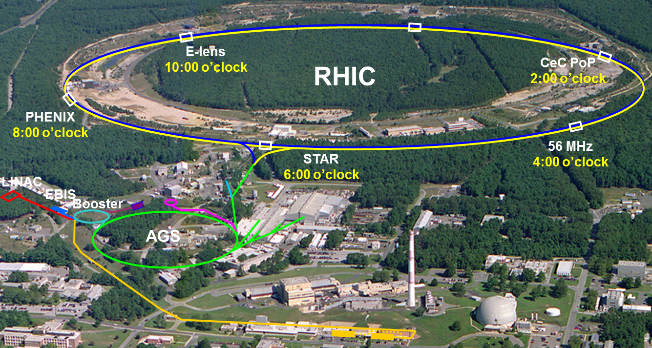
Overview of the BNL Hadron Complex
H- jet
12:00 o’clock
NSRL
BLIP
Tandem Van de Graaff
Hadron-based user and research facilities:
Linac Isotope Production (BLIP) / Medical Isotope Research and Production Program (MIRP)
NASA Space Radiation Laboratory (NSRL)
Tandem van de Graaff accelerators
Relativistic Heavy Ion Collider (RHIC)

Slide 5
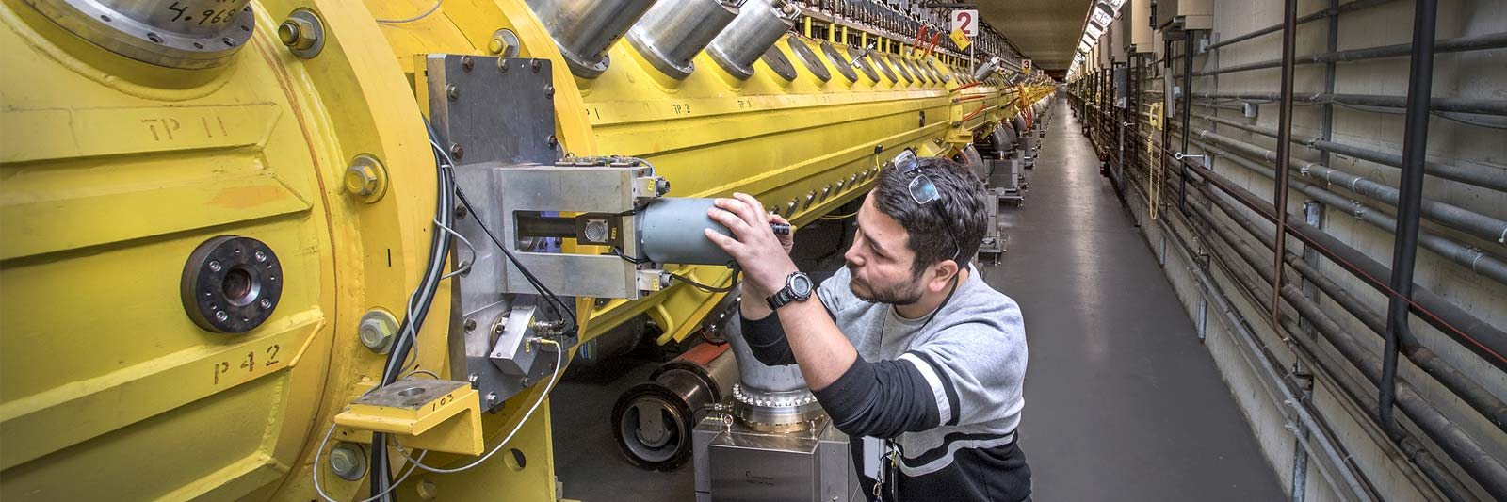
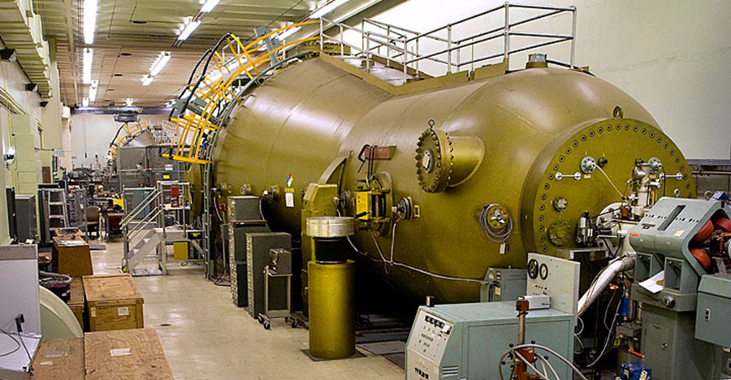
Hadron Preinjector at BNL
Linac (1970) EBIS injector (2010) Tandem (1970)
Ion: H-, H-^ H-U H-U
E: 10 -200 MeV 2 MeV/u 14 MV(1+q)
I_{ave} : 200uA, ~150 nA ~10 uA
RR: 10 Hz 5 Hz dc/pulsed
User: BLIP, NSRL, NSRL, RHIC SEU, NSRL
RHIC RHIC,
Can serve all the users simultaneously

Slide 6
Motivation
  Increase proton energies to 600 MeV or higher
    BLIP can irradiate up to 5 100-gram Th targets producing approximately 10 Ci of Ac-225
    increase in beam energy allowing more targets to be irradiated.
    Increase in beam energy could result in even higher Ac-225 production from Th as well as Ra-225 for generator production of Ac-225 free of Ac-227
    Allow for more spallation target irradiations
    Neutron source for isotope production
  Utilize fast neutrons for isotope production
  Higher energy allow more fast neutrons for radiation damage studies.

Slide 7
Motivation
Light Ion linac energies up to 60 MeV/u
  To reach the energies and current of light ions which are not available elsewhere for a variety of applications
  Nuclear reaction cross section measurements
  Allow for alpha emitter production unique capability (Rn-211,At-211, Pt-193m, Pt-195m, Sn-117m)

Slide 8
Requirements
Proton:
Energy 600 MeV
Av. Beam Current 200 𝛍A
Beam Power 120 kW
Ion:
m/q <2.3
Energy 60 MeV/u
Av. Beam Current 200 𝛍A
Beam Power 84 kW

Slide 9
Protons

Slide 10
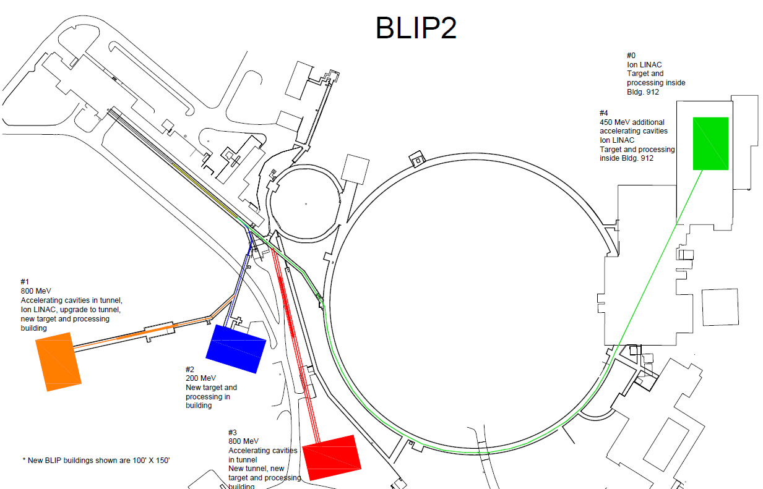
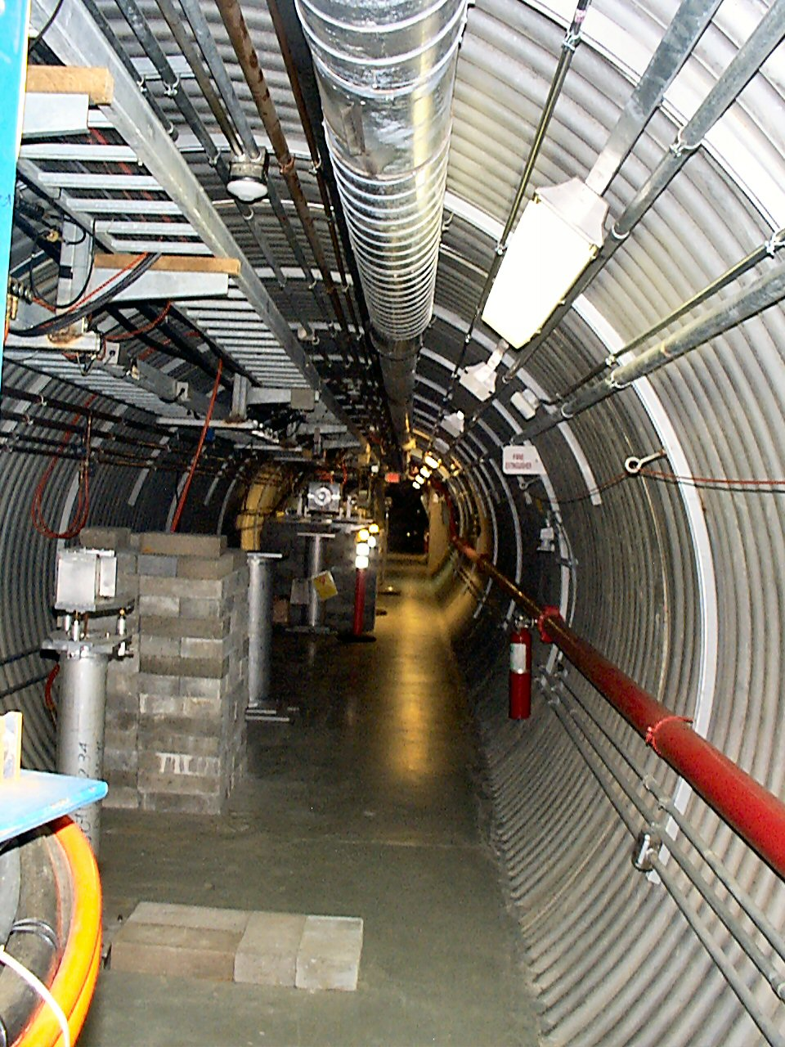
Options for Proton and Ions

Slide 11
Options
Option 0:
  Beam Current 320 uA, 200 MeV
  Ion Linac in building 912 new target station and hot cells
Option 1:
  Go up to 650 to 800 MeV proton energy and a new multiparticle Ion Linac
  Will use REF (Radiation Effects Facility) and NBTF (Neutral Beam Time of Flight ) tunnel and buildings
  New building for RF gallery will be needed
  Ion Linac tunnel will at side of NBTF tunnel
  New target building (100’ X 150’) or possibly use existing building

Slide 12
Options (Cont…)
Option 2: (previously called BLIP 2)
  New building and energy 37 up to 200 MeV separate from BLIP
  New target building (100’ x 150’)
  New target station and hot cells
  Ion Linac in building 912
Option 3:
  Proton energy up to 800 MeV
  New tunnel and building for RF gallery will be needed
  Minimum coupling with other programs, space for future expansion
  New target building (100’ x 150’ )
  Ion Linac can be accommodated in the same tunnel

Slide 13
Option (Cont…)
Option 4:
  Energy up to 450 MeV, transport line along AGS in the AGS tunnel
  Target station in building 912, (100’ x150’)
  Might need new RF building
  Some inter-program dependency
  Ion Linac can be accommodated in building 912
  Proton energy
  Up 60 MeV Ion Linc
  66-200 Present linac
  200 -600 New Target station

Slide 14
Comparison of the alternatives
Parameters | Option 0 | Option 1 | Option 2 | Option 3 | Option 4
Proton Energy | 200 MeV | 800 MeV | 200 MeV | 800 MeV | 450 MeV
New Building | No | Yes | Yes | Yes | No
Ion Linac | Yes* | Yes | Yes* | Yes | Yes*
New Hot Cells | Yes | Possible | Yes | Yes | Yes
Decoupled | yes | yes | yes | Yes | No
* Ion Linac in the Building #912

Slide 15
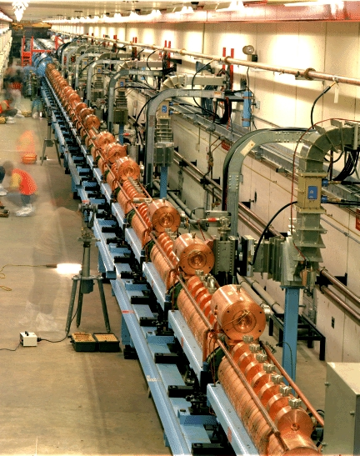
Options for Protons (Cont. )
Green field 600 MeV SC cw/pulse Linac: Too costly
Addon 400 MeV SC linac: Will not fit in the existing tunnels (currently idle), need new tunnel
Replace 5 or 4 tanks of DTL: Interrupt many programs
A 400 MeV CCL in existing tunnel to add on 200 MeV Linac leaving room for expansion
FNAL CCL
REF Tunnel

Slide 16
REF and NBTF tunnel

Slide 17
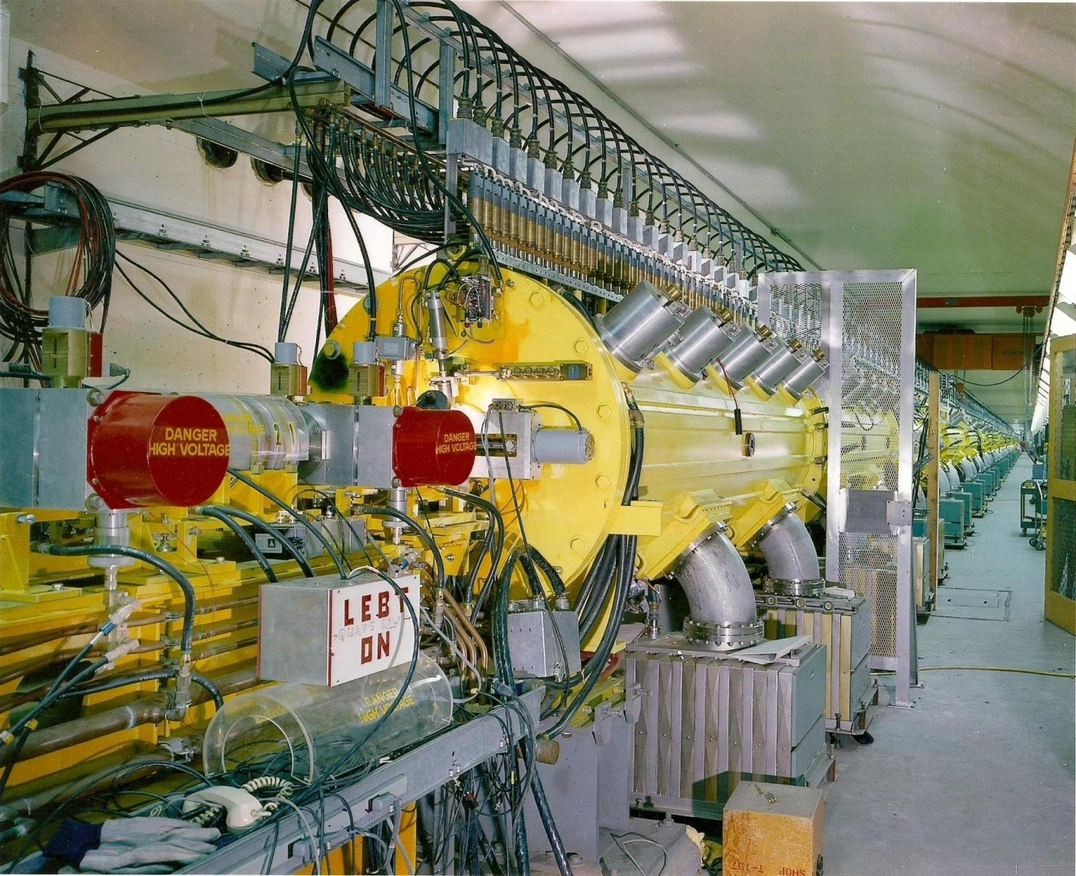
BNL 200 MeV LINAC Beam Parameters
Ion H⁻
Frequency 201.25 MHz
Injection Energy 0.750 MeV
Final Energy* 10-200 MeV
Peak Current 60 mA/ ~ 1.5 mA P^ (~85%)
Pulse Length 575 μs
Repetition Rate 6.67-10 Hz
Number of Tank 9
Length 144.8 m
Total Peak RF Power 22 MW
*Energy can be changed pulse to pulse
Build in 1970
Q: if 50-year-old linac good for an injector
In 1970

Slide 18
Yearly Ave. Current and Beam Power, Availability and Residual Radiation
Max Ave. Current 215 uA in 2021
𝜇A

Slide 19
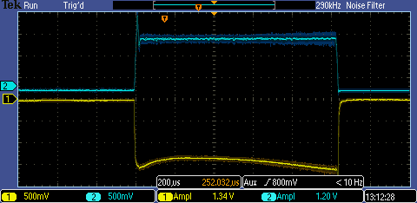
Two High Intensity Sources
OPPIS
Peak current 1.5 mA
Pulse Length 500 𝜇s
Polarization. ~85%
Magnetron Source 1
Polarized source OPPIS
RFQ
H- pulse at 200 MeV
Magnetron Source 2
Magnetron H- Source
Peak current 135 mA
Pulse Length 1.1 ms
Extraction 35 kV

Slide 20
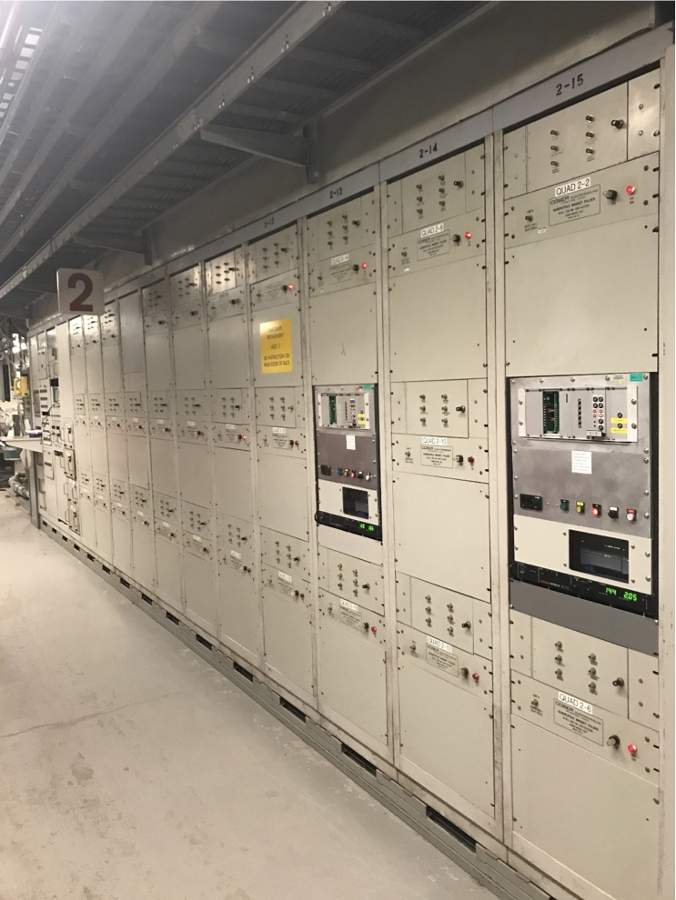
Linac Intensity Upgrade Phase II
Upgrade all hardware and controls to allow operation with
2x pulse length (increase from 450 to 900 μs); peak current and repetition rate unchanged
Project goal: increase average current to I_{avg} = 250 μA
(with potential for larger increase)
Upgrades to
1. RF system
2. Controls
3. Instrumentation
4. Pulsed quadrupoles PS
Two prototypes' PS tested
5. Tanks #5 and #7 were
tested with 1.1 ms RF
55 mA
beam current
0
450 ms
900 ms
6.67-10 Hz repetition rate
time
Shovel Ready

Slide 21
Proposed CCL
200 MeV: β=0.5662, γ=1.213, βγ=0.687
600 MeV: β=0.7944, γ=1.6395, βγ=1.2992
E_{max} = 0.8 Kilpatrick (E_{max}= 1.4 Kilpatrick*)
8 CCL Module (12 MW each)
4-8 section per module ( 3-7 Bridge couplers ; 3/2 βλ)
16 cells per section
Total number of cell 48*16=768
Two 16 cell buncher (200kW each)
Total Length with Transition 120 meters
90 meter of tunnel length for future upgrade
* Fermilab CCL, Nose not water cooled

Slide 22
CCL Comparison
 | BNL | LAMPF | FERMI | SNS | BNLII
Structure | DTL | CCL | CCL | CCL | CCL
Freq. | 201.25 | 805 | 805 | 805 | 805
E in (MeV) | 0.75 | 100 | 116 | 86.8 | 200.4
E out (MeV) | 200.4 | 800 | 400 | 185.6 | 608
E₀T (MV/m) | 1.4-1.0 | 1.4-1.3 | 6.8-6.1 | 2.1-2.0 | 4.4*
Length (m) | 145 | 731 | 64 | 55.1 | ~121
Pulse Len (µs) | 500 | 1000 | 60 | 1000 | 1000
Spark Rate |  |  | <0.1%
ΔE (RS) (MeV/m) | 1.37 | 0.96 | 4.4 | 1.8 | 3.4
* 0.8 Kilpatrick

Slide 23
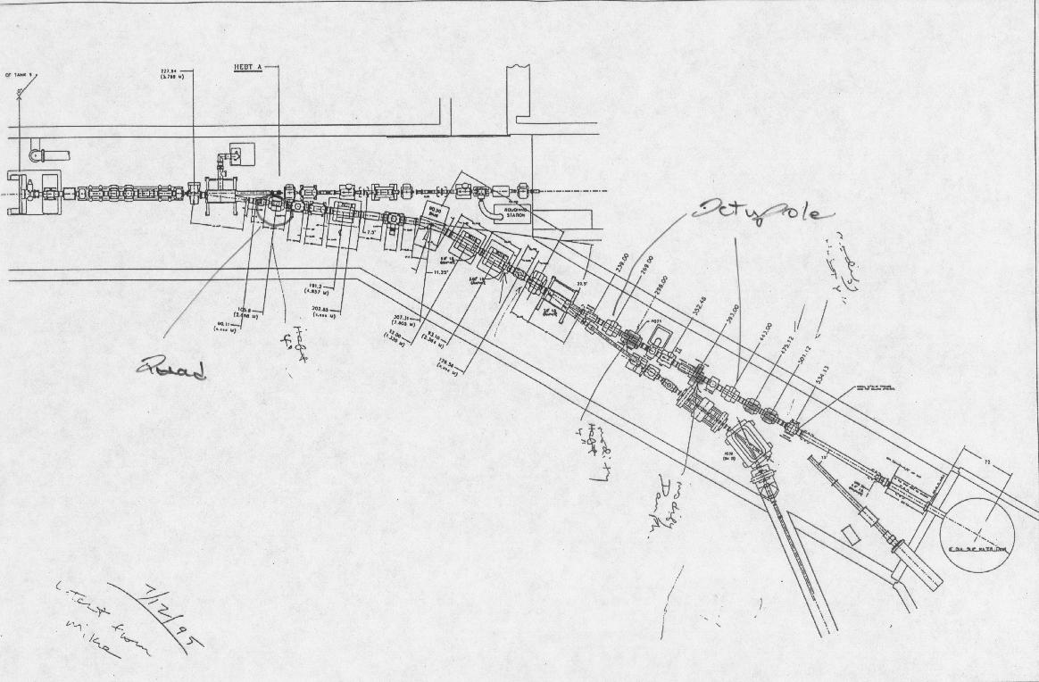
Tank 9 to RFF, TRACE3D
Tank 9
TRACE3D SIMULATIONS
BLIP
REF

Slide 24
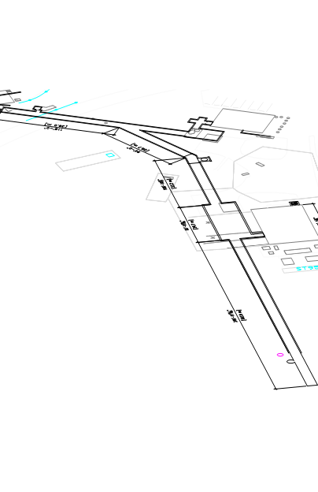
REF To BNTF Tunnel
Length between wo 30-degress bend 29 m
Six 90-degrees FODO cells, canceling dispersion
Maximum beam size 15 mm. aperture 30 mm
In dipole Lorenz stripping looses < 1e-10
10 accelerating section in two module
REF
NBTF

Slide 25
TRACE3D simulation 200 to 600 MeV
Accelerated to 600 MeV
200 MeV beam drifting through CCL

Slide 26
CCLDYN simulations , 10k particle, no losses , less than 10% emittance growth
𝛥 E (MeV)
𝛥𝚽 (deg)
X (cm)

Slide 27
Beam Transfer Line to End of NBTF Tunnel
12 six meters long FODO Cell
Last 12 meter for final focus, rasterand diagnostics

Slide 28
Summary
Protons 200 to 600 MeV, max beam power 120 kW
Will use existing linac as injector,
Based on Fermilab CCL design at lower Kilpatrick
Use existing tunnel, new RF gallery
A 90 m tunnel available for future upgrades
Since linac can change user 100 ms , will satisfy existing user ( RHIC, NSTL, BLIP)

Slide 29
Extra slides

Slide 30
SUPERFISH Calculations
Field normalization (NORM = 0): EZERO. = 1.00000 MV/m
Frequency = 805.00003 MHz
Particle rest mass energy = 938.272029 MeV
Beta = 0.5660383; Kinetic energy = 199.884 MeV
Normalization factor for E0 = 1.000 MV/m = 6342.262
Transit-time factor = 0.8461504
Stored energy = 0.0040052 Joules
Using standard room-temperature copper.
Surface resistance = 7.40217 milliOhm
Normal-conductor resistivity = 1.72410 microOhm-cm
Operating temperature = 20.0000 C
Power dissipation = 787.9716 W
Q = 25709.0 Shunt impedance = 66.881 MOhm/m
Rs*Q = 190.303 Ohm Z*T*T = 47.885 MOhm/m
r/Q = 98.157 Ohm Wake loss parameter = 0.12412 V/pC
Average magnetic field on the outer wall = 1417.9 A/m, 0.744081 W/cm^2
Maximum H (at Z,R = 4.1698,2.79391) = 2129.57 A/m, 1.67846 W/cm^2
Maximum E (at Z,R = 2.57648,1.69151) = 4.20443 MV/m, 0.161358 Kilp.
Ratio of peak fields Bmax/Emax = 0.6365 mT/(MV/m)
Peak-to-average ratio Emax/E0 = 4.2044

Slide 31
General parameter of the CCL.
Initial Kinetic Energy (β=0.454) | 200.4 | MeV
Final Kinetic Energy (β=0.714) | 593 | MeV
Beam Current, Design | 50 | mA
Repetition Rate | 10 | Hz
Beam Pulse Length, Design | 1.0 | ms
Length, with REF-NBTF bend | ~125 | m
Frequency | 805.0 | MHz
Number Buncher Cavities | 2, (16 cells)
Number of Modules | 8
Number of Section/Module | 6
Number of Cell/Section | 16
Total number of cell (8x6x16) | 1728
Bridge Coupler Length | 3β λ/2
Length between Modules | 3β λ/2
Cavity Bore Radius | 1.5 | cm
Accelerating Phase | -23.0 | deg
Average Axial Field (E0) | 4.4 | MV/m
Kilpatrick | < 1.0
Maximum Surface Filed | 27.3 | MV/m
rf Power per Module | < 12 | MW
Copper Losses | 26.6 | MW
Beam Power (@ 50 mA) | 20.0 | MW
Control and Reserve | 2.8 | MW
Transverse Focusing | FODO
Average Phase Advance (Transverse) | 79 | deg
Quadrupole Length (Magnetic) | 8.0 | cm
Quadrupole Bore Radius | 2.0 | cm
Quadrupole Pole Tip Field | 5.2 | kG

Slide 32
Summary of module’s parameters.
Module | E_In (MeV) | E_Out (MeV) | # Section | Length (m) | Power, Cu (MW) | Power, Beam (MW ) | Power Total (MW)
B-1 | 200 | 200 | 1 | 1.6978 | 0.6 | 0.0 | 0.6
B-2 | 200 | 200 | 1 | 1.6978 | 0.6 | 0.0 | 0.6
1 | 200 | 253 | 8 | 16.811 | 4.178 | 2.820 | 7.000
2 | 253 | 298 | 6 | 13.533 | 3.202 | 2.271 | 5.473
3 | 298 | 346 | 6 | 14.233 | 3.231 | 2.388 | 5.619
4 | 346 | 379 | 4 | 9.839 | 2.21 | 1.651 | 3.861
5 | 379 | 430 | 6 | 15.234 | 3.376 | 2.557 | 5.933
6 | 430 | 483 | 6 | 15.750 | 3.446 | 2.643 | 6.089
7 | 483 | 528 | 6 | 16.210 | 3.473 | 2.721 | 6.194
8 | 528 | 593 | 6 | 16.022 | 3.443 | 2.790 | 6.233
Total |  |  | 50 | 118.232 | 26.559 | 19.841 | 47.600

