Slide 1
Center for Linac Isotope Production (CLIP) proposal light ion accelerator
D. Raparia
December 09, 2021

Slide 2
Outlines
Motivation
Considerations
Light Ion Linac
Summary

Slide 3
Acknowledgements
CLIP team

Slide 4
Motivation
  Increase proton energies to 600 MeV or higher
    BLIP can irradiate up to 5 100-gram Th targets producing approximately 10 Ci of Ac-225
    increase in beam energy allowing more targets to be irradiated.
    Increase in beam energy could result in even higher Ac-225 production from Th as well as Ra-225 for generator production of Ac-225 free of Ac-227
    Allow for more spallation target irradiations
    Neutron source for isotope production
  Utilize fast neutrons for isotope production
  Higher energy allow more fast neutrons for radiation damage studies.

Slide 5
Motivation
Light Ion linac energies up to 60 MeV/u
  To reach the energies and current of light ions which are not available elsewhere for a variety of applications
  Nuclear reaction cross section measurements
  Allow for alpha emitter production unique capability (Rn-211,At-211, Pt-193m, Pt-195m, Sn-117m)

Slide 6
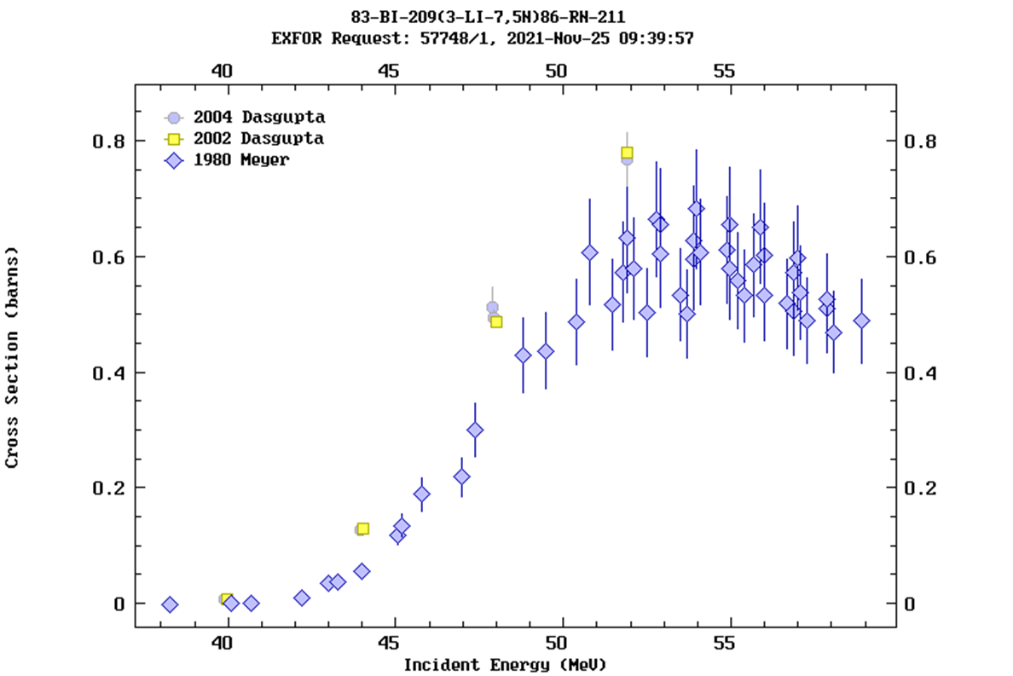
Li-7 beam application for isotope production
Production of radiotherapeutic alpha emitter At-211 (T_{1/2}=7.21 h)
  Pseudo generator approach via ²¹¹Rn route
    ²⁰⁹Bi(⁷Li, 5n)²¹¹Rn(T_{1/2}=14.6 h) →²¹¹At
    The excitation function approaches 650 mb at 53 MeV (7.6 MeV/u). The thick target saturation yield was 5.5 μCi/nA.
Another route (more popular )
²⁰⁹Bi(⁴He,2n)²¹¹At

Slide 7
Requirements
Ion:
m/q <2.3
Energy 60 MeV/u
Av. Beam Current 200 𝛍A
Beam Power 84 kW

Slide 8
Light Ion Linac

Slide 9
Light Ion Linac
Options
Room temperature , Superconducting , or combinations
- Wide range of experience with RT RFQ and IH up to several MeV/u
- Higher energy, superconducting linac
- Transition energy RT to SC (depends on peak current, Space charge)
Pulse or CW
- Limited experience with RT CW operation
Higher current ion source for light ions (Laser, EBIS, ECR)
What is riskier, high peak current IS (Li) or CW RFQ (RT) ?

Slide 10
Considerations
This facility will an isotope production facility
Ion energies range 5 MeV to 60 MeV/u
Reliability is priority within the irradiation time
Maintainability

Slide 11
Proposed Design for Light Ion Linac
ECR (Li)
162.5 MHz β_{G} 0.25
45∘
Switcher
RFQ (162.5 MHz)
IH (162.5 MHz)
HWR
HWR
HWR
HWR
^{22.5∘}
ECR (He)
-45∘
1000 keV/u, 2.83m
11 MeV/u, 8. m
60 MeV/u
20 keV/u
ECR (H,D)
Peak beam current 2 mA
Beam pulse length 3 ms
Repetition rate 100 Hz

Slide 12
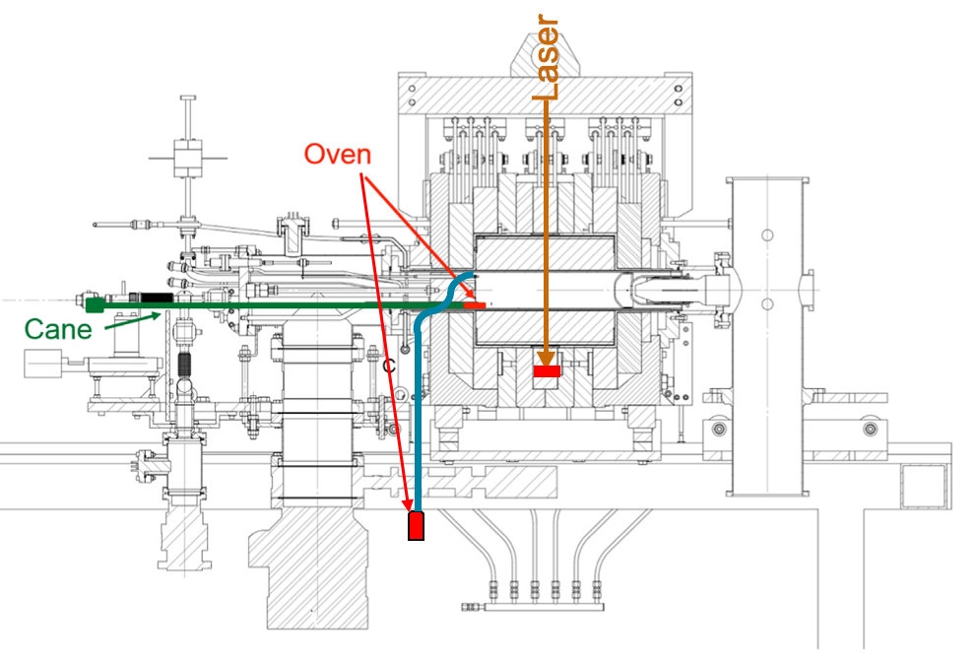
Ion Sources and LEBT (20 keV/u)
ECR sources could be used for the light ions
IONS | source | Frequency | current | Emittance
H, D | ECR | 2.5 GHz | 2 mA | <1 pi mm mr
He, Li | ECR | 14-18 GHz | 2 mA | <1 pi mm mr
Li oven and ECRIS

Slide 13
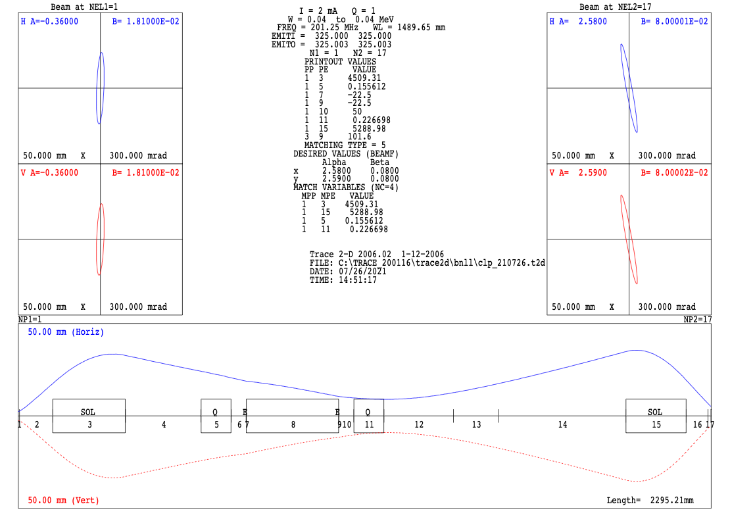
Low Energy Beam Transport (LEBT)
LEBT
-Magnetic switchyard to inject the beam from either source into the RFQ.
-To provide mass to charge separation big angles (-45⁰, +22.5⁰, and +45⁰) to RFQ
- Adjustable water-cooled slits all three lines expected total power several hundred Watts
TRACE2D showing one branch at 45 deg

Slide 14
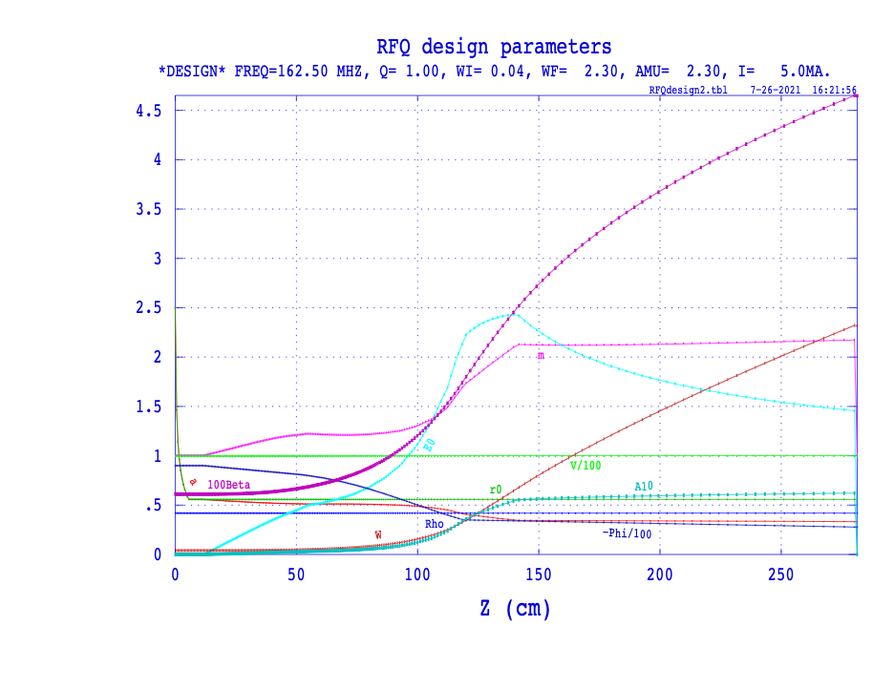
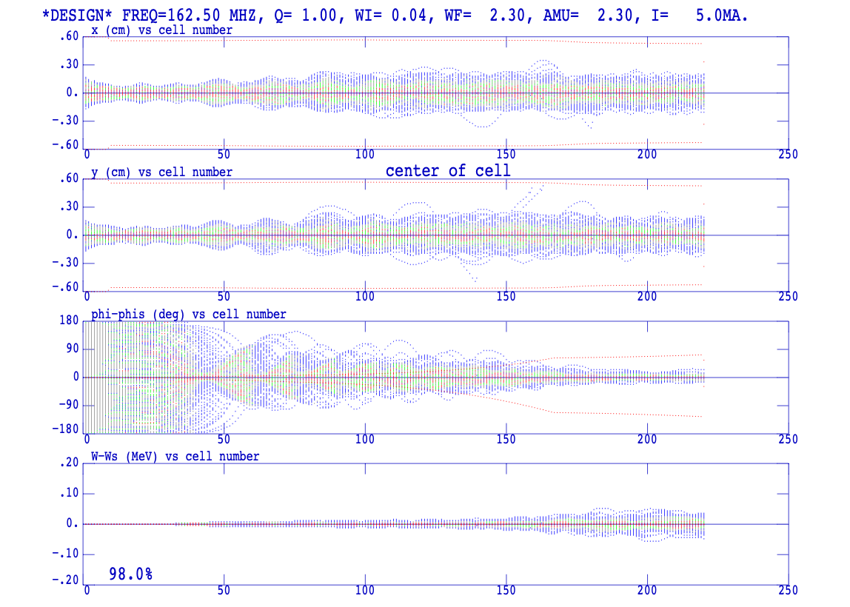
RFQ: 1 MeV/u
RFQ parameters
Parameters
ions | <2.3 | M/Q
Frequency | 162.5 | MHz
Ein | 20 | keV/u
Eout | 1000 | keV/u
Length | 2.82 | m
Ave. Radius | 5.6 | mm
Vane Voltage | 90 | kV
power | ~ 180 | kW
Transmission | 98 | %
current | 5 | mA
emittance | 0.7 | 𝚷 mm mr
PARMTEQM simulation for Li⁺⁺⁺

Slide 15
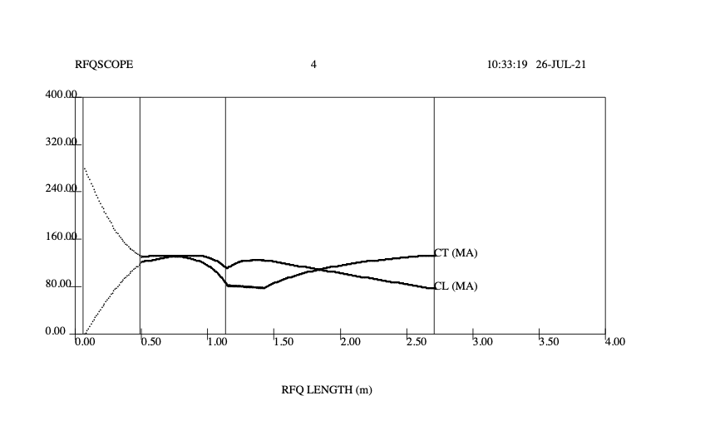
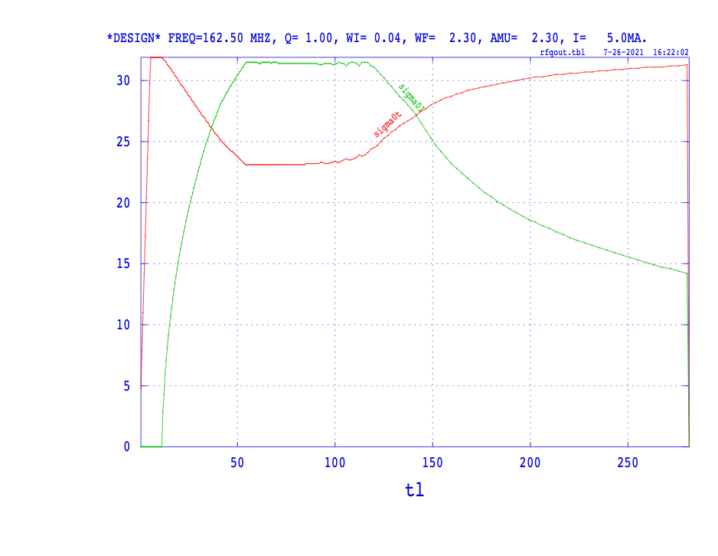
Current limits and phase advances
Transverse and longitudinal
phase advance along the RFQ.
Transvers and longitudinal
Current limits through the RFQ

Slide 16
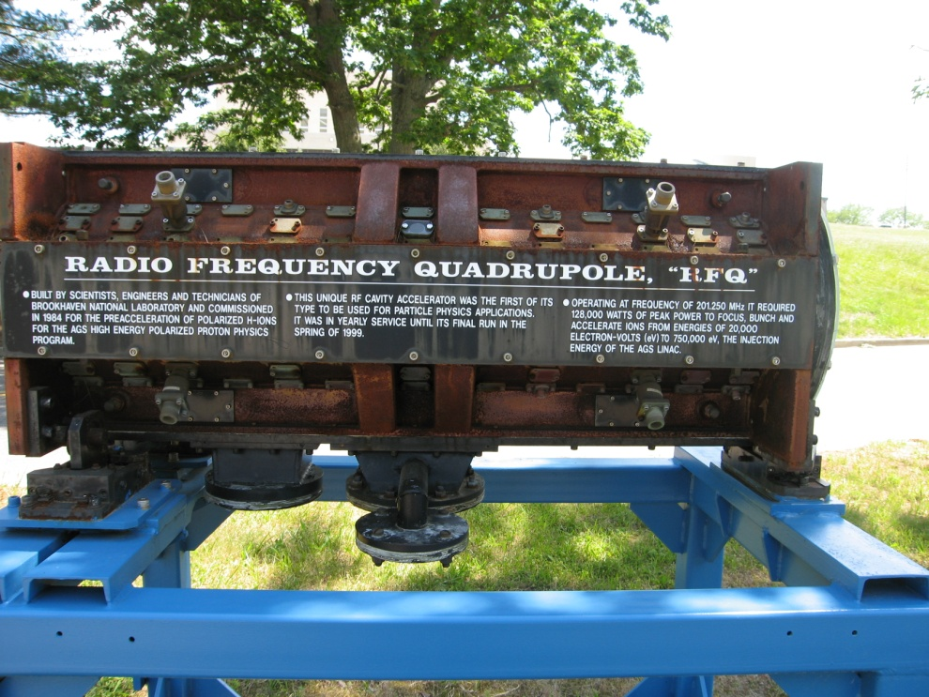
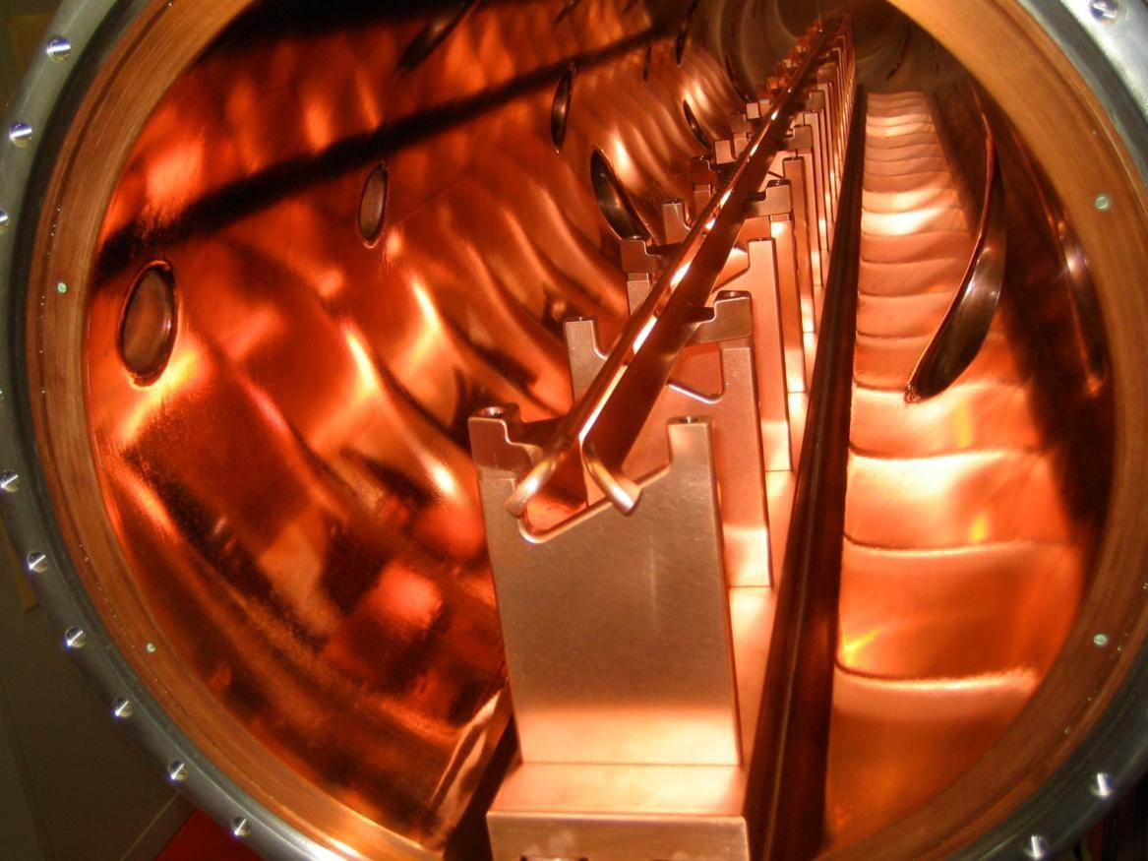
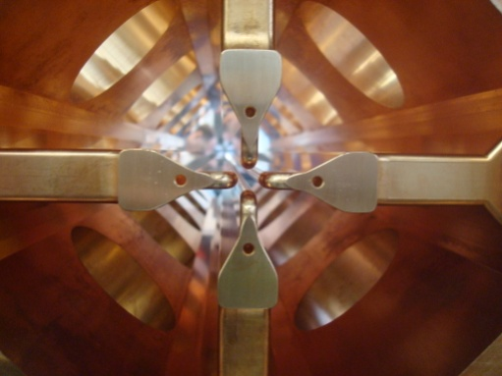
RFQs
BNL Polarized RFQ 200 MHz
750 keV
BNL EBIS RFQ 100 MHz, 300 keV/u, M/Q ~ 6
BNL high intensity RFQ 200 MHz
750 keV
PIP IT RFQ 162.5 MHz, 2.1 MeV

Slide 17
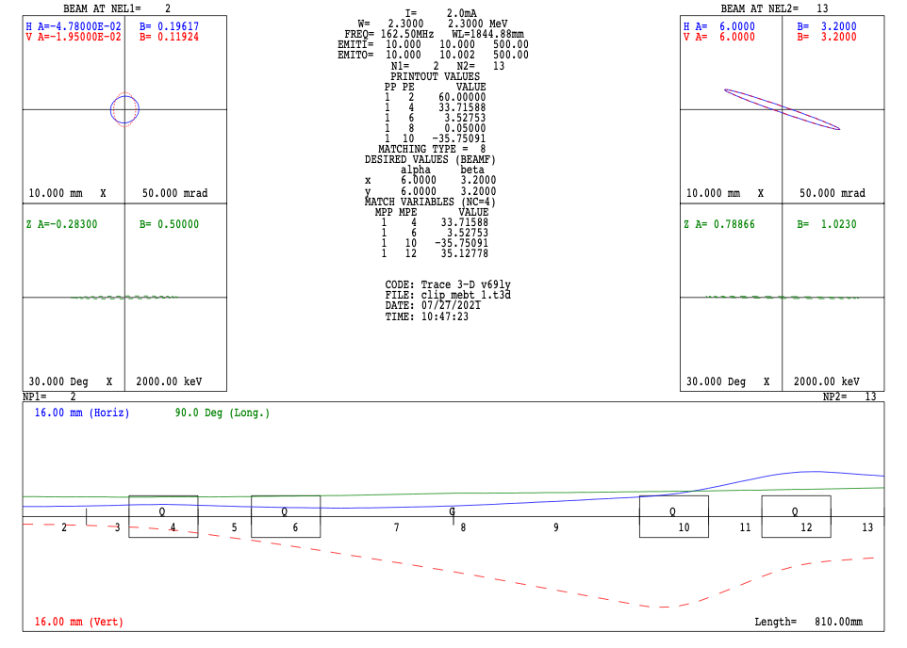
Medium Energy Beam Transport (MEBT)
90 cm long,
RFQ will have Crandall Cell
Five controllable knobs and buncher position
TRACE3D calculations for the MEBT

Slide 18
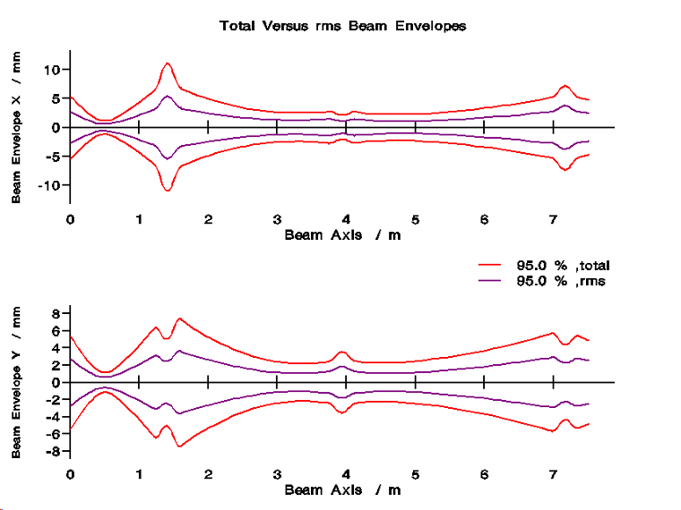
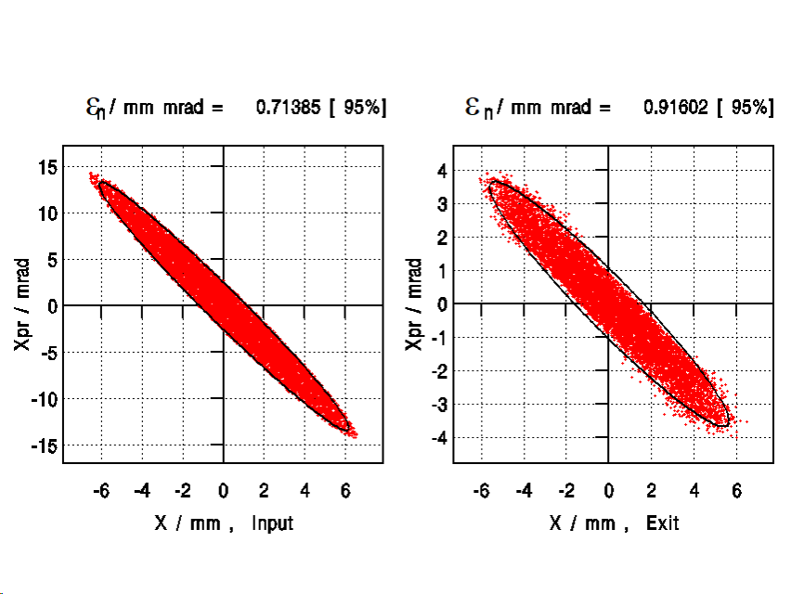
IH Linac: 11 MeV/u
Proven technology BNL, CERN, GSI
Paramweter | Values | Units
Ions | <2.3 | M/Q
Ein | 1 | MeV/u
Eout | 10.8 | MeV/u
Freq | 162.5 | MHz
Section | 2
# of Gap | 63
Length | 7.8 | m
Power | ~1.5 | MW
Transmission | 100 | %
Emittance | 0.9 | 𝚷 mm mr

Slide 19
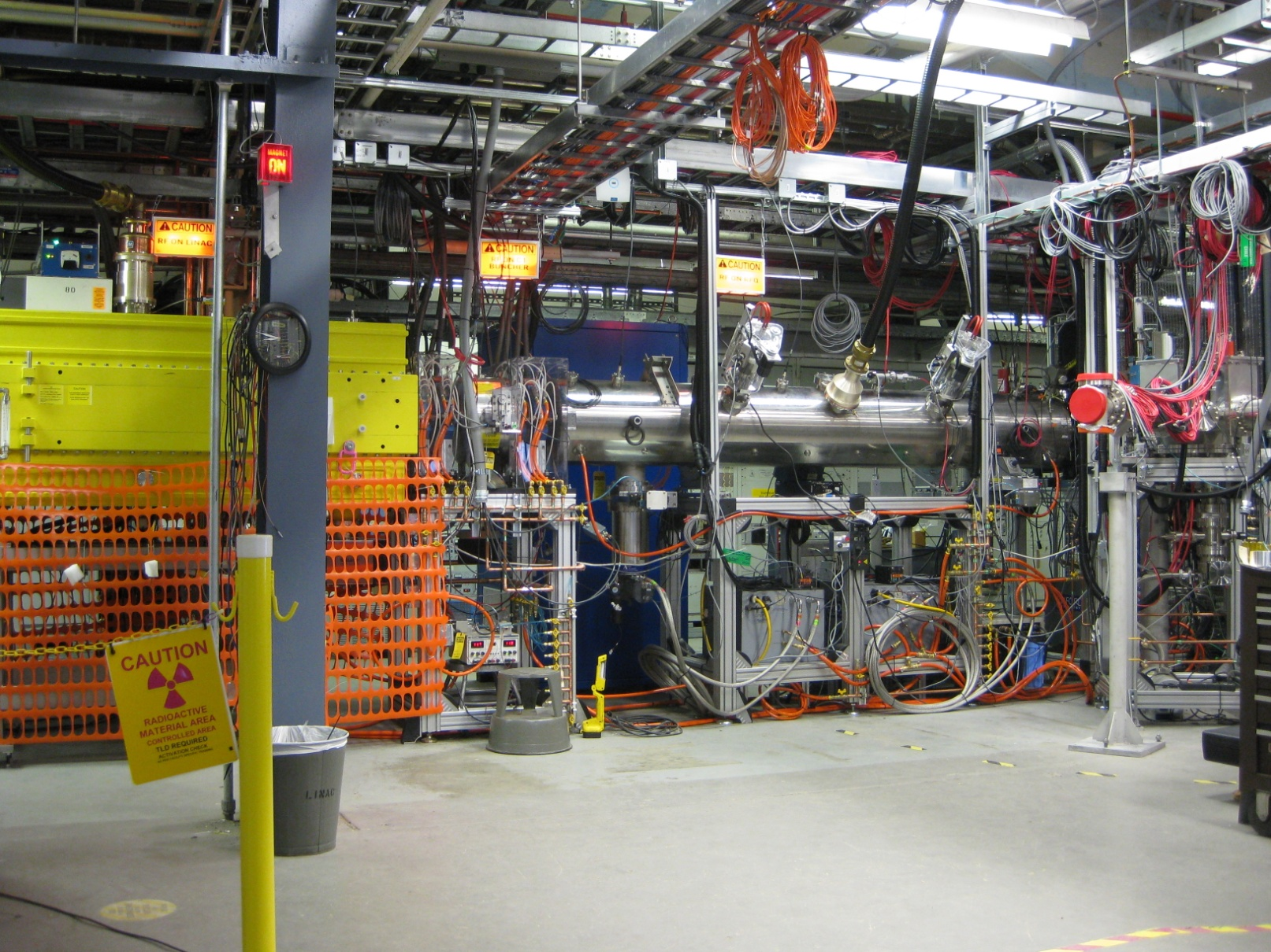
IH Linac at BNL
IH Linac
RFQ
BNL EBIS IH Linac
BNL EBIS Preinjector
Ion | D-U
Q/M | .16-0.5
Energy | 2 MeV/u
Current | 1.5 emA
Pulse Length Rep. Rate | 10 μs 5 Hz
Emittance | 0.7 π mm rad (nor, 90%)
Energy Spread | 1.8 keV/amu

Slide 20
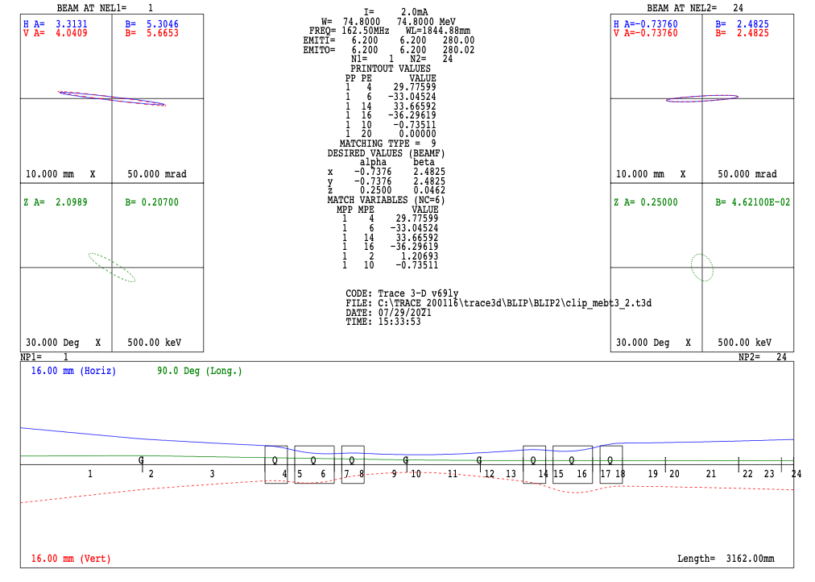
Medium Energy Beam Transport-2 (MEBT2)
3 meter long (space for transition )
Six degree of freedom
TRACE3D calculations for the MEBT 2

Slide 21
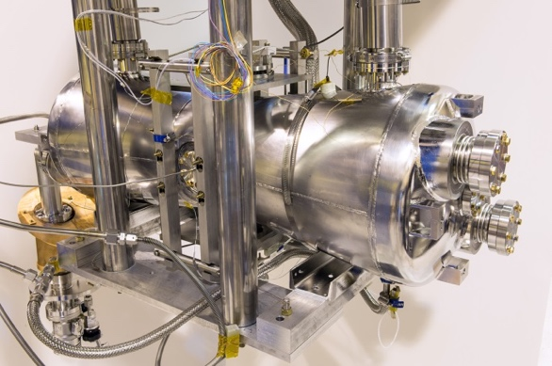
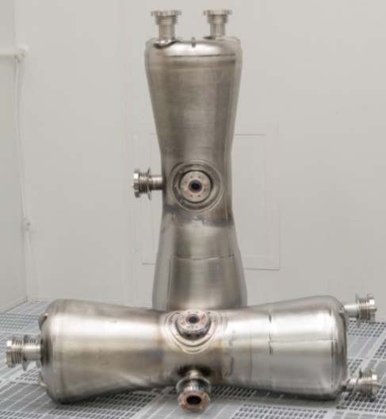
SC Sections
Parameters | Value
E in | 10.8 MeV/u
E Out | 60 MeV/u
Freq | 162.5 MHz
RR | cw
Cryomodule | 4
Cavity /(CM) | 6
Solenoid/(CM) | 3
Cavity type | HWR
𝛃_{G} | 0.25
Eacc | 10.5MV/m
Length | 25 m
PIP II 162.5 MHz HWR

Slide 22
Transit Time Factor
The transit time factor and energy gain for the two-cell cavity is given by
Transit time verse normalized particle
velocity.
Design b VS # of cavity to reach 60 MeV/u

Slide 23
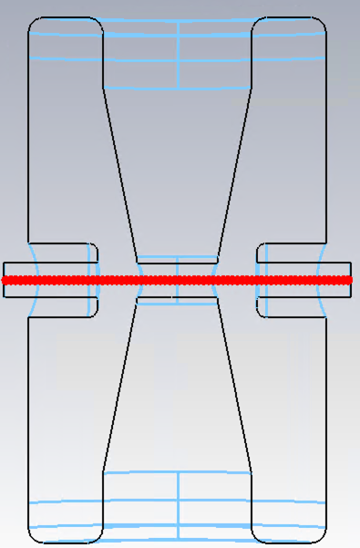
HWR Cavity
O. Masahiro
HWR Design
Parameter | HWR | UNITS
Frequency | 162.5 | MHz
b_{G} | 0.25
Length bl | 0.46155 | m
E_{acc} | 14.8 | MV/m
Phase | -20 | deg
E_{Peak} | 68 | MV/m
B_{Peak} | 72.5 | mT
E_{peak}/E_{acc} | 4.9
B_{peak}/E_{acc} | 6.9
R/Q | 256 | Ohm
 |  | Ohm
# of cavities | 24
162.5 MHz HWR cavities ,
(E_{Peak} =68 MV/m, B_{PEAK} =72 mT ,

Slide 24
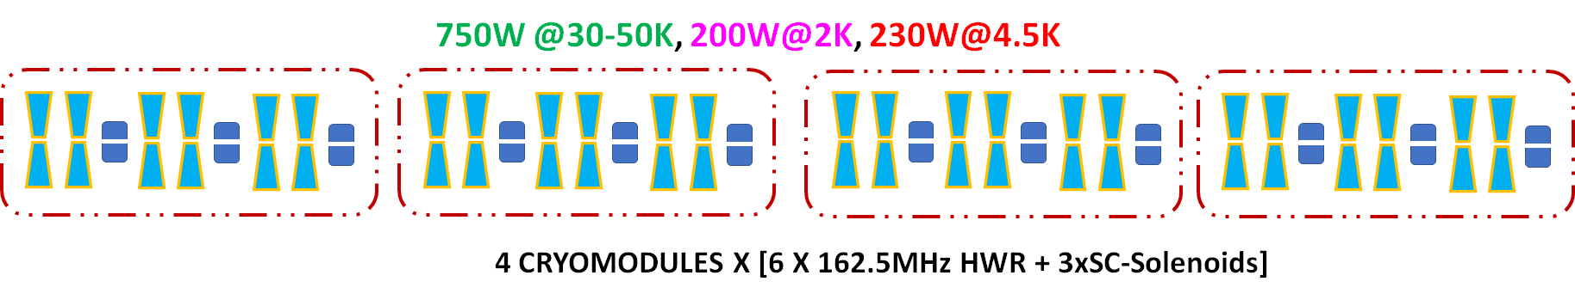
Cryomodule
4.3.8.XII.
Cryogenic Load Requirements
 | 2K | 4.5K | 30-50K | LN2 Shield
 | W | W | W | W
SRF modules | 200 | 230 | 750
Cryo-Distribution |  | 50 | 50 | 1000
Total | 200 | 280 | 800 | 1000

Slide 25
SC Sections
TraceWin Simulation
Input Phase Spaces
Output Phase Spaces
Accelerating field
X, Y profiles
𝚫E and 𝚽 Profiles

Slide 26
Space for future upgrade 100 MeV/u
Two cryomodule / 6 cavity (beta=0.4)
External quadrupole
Transverse and Longitudinal
Profiles
Output phase space
Input phase space

Slide 27
Final Focus and Switch Yard
17 meters space for switch yard , final focus and raster
Switching magnet
10 meter
+/-30 deg switching dipole
Final focus triplet
8 meters space for raster
Beam size 8 mm

Slide 28
Summary
Light ions
Light ions 60 MeV/u (m/q ~ 2.3), max beam power 28 kW
Use existing technologies
Considerations for high reliability and maintainability
New tunnel and RF gallery
Three target stations

