Slide 1
Lithium ECRIS for CLIP
Dec 2021
M. Okamura

Slide 2
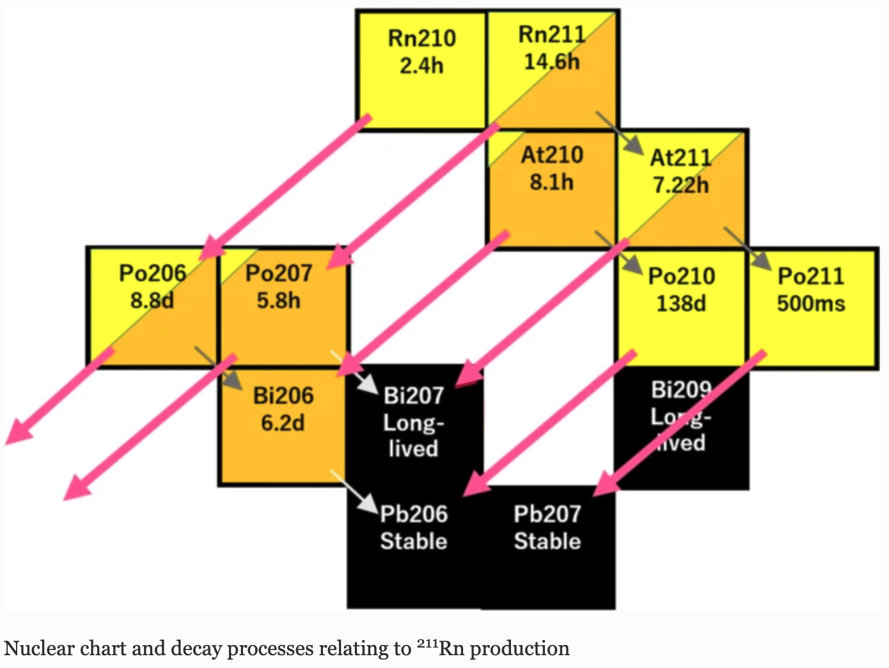
High performance ECRIS for He²⁺ and Li³⁺ beam.
²⁰⁹Bi(⁷Li, 5n)²¹¹Rn
Li³⁺ beam
He²⁺ beam
²⁰⁹Bi(⁴He, 2n)²¹¹At
High current Li3+ and He2+ beams are required.
Do we have enough technologies for the ion source?
Journal of Radioanalytical and Nuclear Chemistry (2020) 323:921–926

Slide 3
Why ECRIS??
At CAD, we have world class ion sources. However,,
 | Li³⁺ capability | He²⁺ capability | High current | CW like operation
EBIS | ✔️ | ✔️
LIS | ✔️ |  | ✔️
OPPIS
H⁻ magnetron |  |  | ✔️ | ✔️
ECRIS | ✔️ | ✔️ | ✔️ | ✔️
Without ECRIS, a new isotope facility cannot be realized in BNL.
Why is the R&D required??
No great Li ECRIS in the world.
Lithium is a chemically active material.
Prototype test is indispensable.

Slide 4
Target species:
 | Mass | Charge | Total Energy (keV) | Column Voltage (kV) | Peak Current (mA)
H⁺ | 1 | 1 | 20 | 20 | 2
D⁺ | 2 | 1 | 40 | 40 | 2
He²⁺ | 4 | 2 | 80 | 40 | 2
Li³⁺ | 7 | 3 | 140 | 46. 7 | 2
RFQ input energy : 20 keV/u
Duty factor : 10 %
Emittance : 0.2 pi mm mrad nor. rms

Slide 5
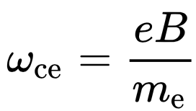
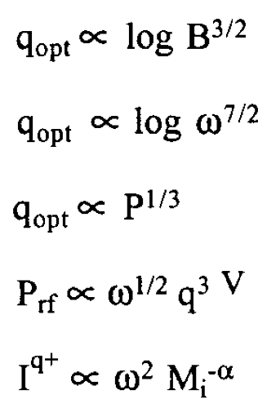
Frequency Choice
Species / charge state | Ionization energy
H⁺, D⁺ | 13.6 eV
Li³⁺ | 122.4 eV
He²⁺ | 54.4 eV
C⁴⁺ | 64 eV
C⁵+ | 392 eV
O⁵⁺ | 113 eV
Ar⁷⁺ | 124 eV
ECR condition
Microwave Frequency | Magnetic field
2.45 GHz | 875 Gauss
10 GHz | 3.6 KGauss
14 GHz | 5.0 KGauss
18 GHz | 6.4 KGauss
28 GHz | 1.0 T
For Proton
Plasma temperature
Better emittance
For He & Li
Geller’s scaling laws
Beam emittance is proportional to the magnetic field strength at the extraction.
High field -> Large emittance
He²⁺ can be provided from a higher frequency ECRIS

Slide 7
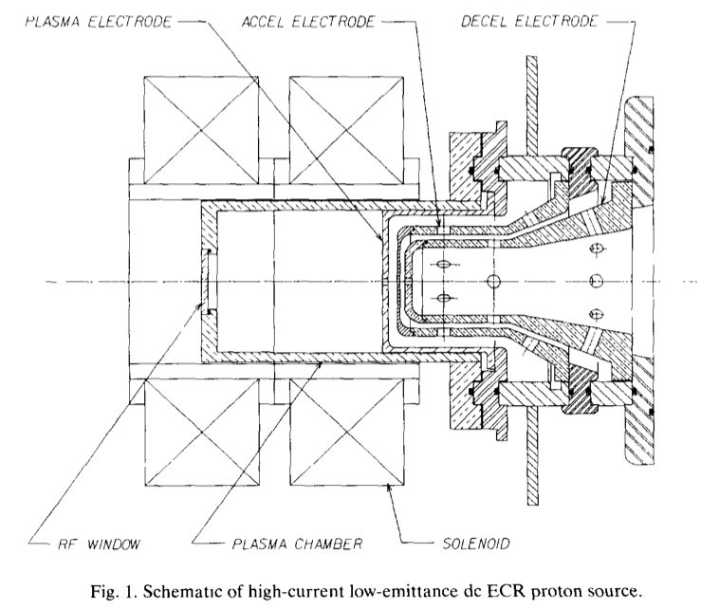
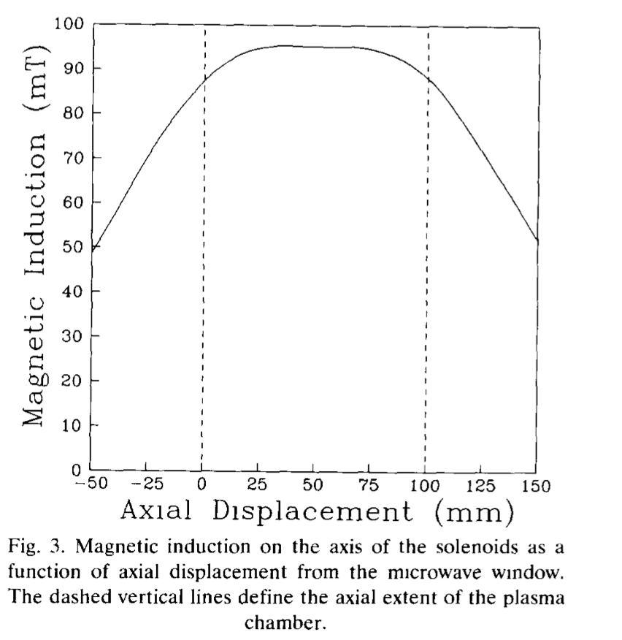
For H+ and D+, Taylor type ECR works good.
2.45 GHz (same frequency to a kitchen microwave)
Two axial solenoid magnets
No transverse confinement magnet
2 kW provides more than 10 mA
Proton fraction more than 90%
NIMA 309 (1991) 37-42

Slide 8
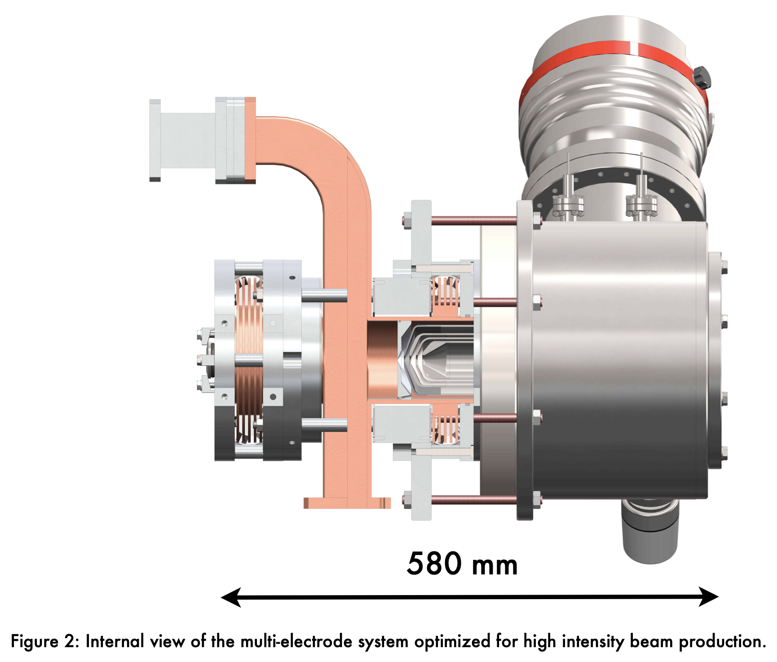
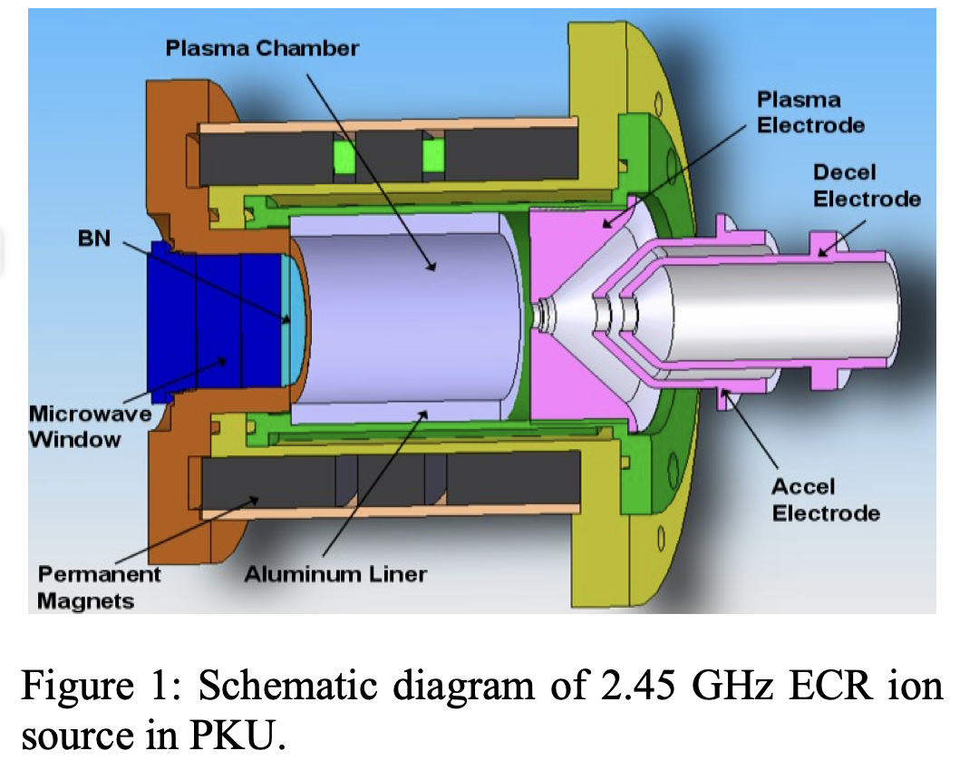
Permanent magnet 2.45 GHz ECR is getting popular now.
TUCOCK02 Proceedings of ECRIS2010, Grenoble, France
Commercial solution is available
Pantenik Monogan M-1000
Proton ECRIS can be fabricated in house or purchased.

Slide 9
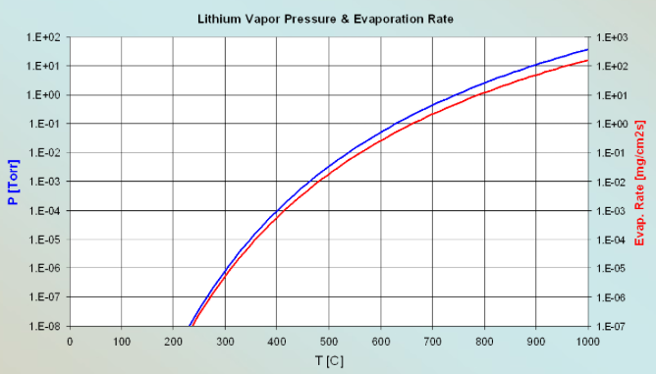
There have been no mA class Electron Cyclotron Resonance Ion Source for Li³⁺ beam.
Lithium is classified as an alkali metal on the Periodic Table.
At 300°C, lithium has a significantly high enough vapor pressure to cause ppm level contamination in a vacuum system.
How to control lithium vapor pressure?
How to manage lithium contamination?
ECR requirement range from E-8 to E-6.
Temperature range from 230 C to 310 C.
Temp. (°C) for Given Vap. Press. (Torr) | 10⁻⁸: 227 10⁻⁶: 307 10⁻⁴: 407

Slide 10
Comparison with other alkali metals
Natural abundance of ⁷Li is 93 %. 7 % is ⁶Li which is not our interest.
Name | Lithium | Sodium | Potassium | Rubidium | Caesium
Atomic number | 3 | 11 | 19 | 37 | 55
Standard atomic weight (u) | 6.94 | 22.98 | 39.09 | 85.46 | 132.9
Electron configuration | [He] 2s¹ | [Ne] 3s¹ | [Ar] 4s¹ | [Kr] 5s¹ | [Xe] 6s¹
Melting point (°C) | 180.54 | 97.72 | 63.38 | 39.31 | 28.44
Boiling point (°C) | 1342 | 883 | 759 | 688 | 671
Density (g·cm⁻³) | 0.534 | 0.968 | 0.89 | 1.532 | 1.93

Slide 11
Notable chemical property of Li
Li does not readily react with water-free 0₂ below 373 K, but reacts above 373 K to form an oxide (Li₂O).
The reaction between metal Li and N₂ is slow in the case of N₂ without moisture, but when even a small amount of moisture is present, the exothermic reaction proceeds rapidly even at room temperature to produce nitride (Li₃N).
This is highly corrosive to iron and steel (the melting point of Li₃N itself is almost 1118 K).
Li and C react at high temperatures to form carbides (Li₂C₂). The reaction with H₂ produces a stable solid compound (LiH: melting point 960 K, decomposition temperature ~1245 K), which is the most stable among alkali metal hydrides.
Li at room temperature easily loses its luster and turns black when it comes in contact with air containing moisture, and becomes a white powder if left for a long time, but this is thought to be due to the formation of compounds such as Li₃N, LiOH, and LiOH-H₂O first, and finally Li₂CO₃ powder.
From the standpoint of corrosion resistance, it is desirable to make the device out of Mo, Nb, Ta, Zr, Ti and W. Fe is also relatively safe, and SUS316 is used in fusion reactors as a non-magnetic material.
Li feed line is kept between 200 C and 300 C.
Interior of the ion source should be made of Mo, Nb, Ta, or SUS316.

Slide 12
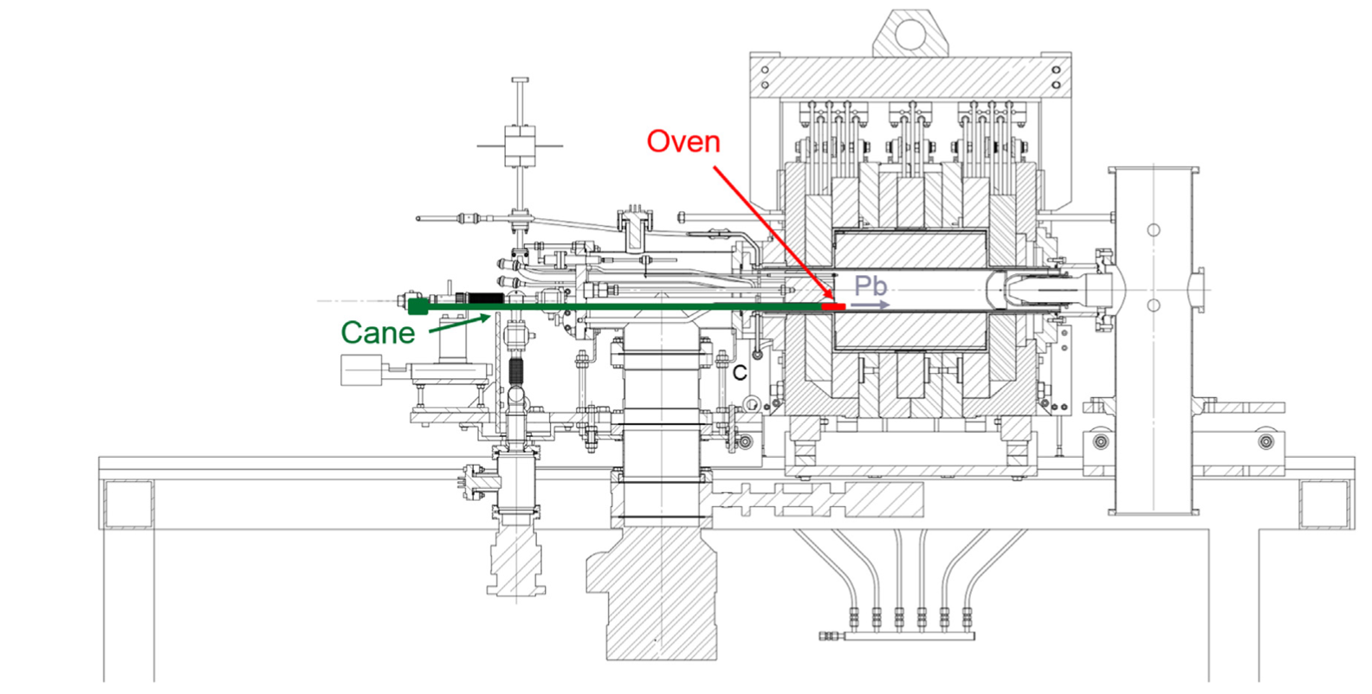
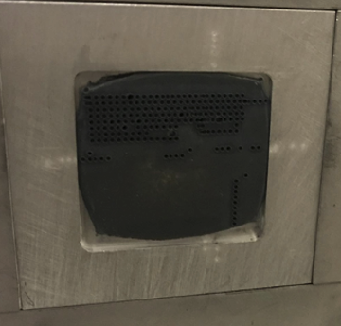
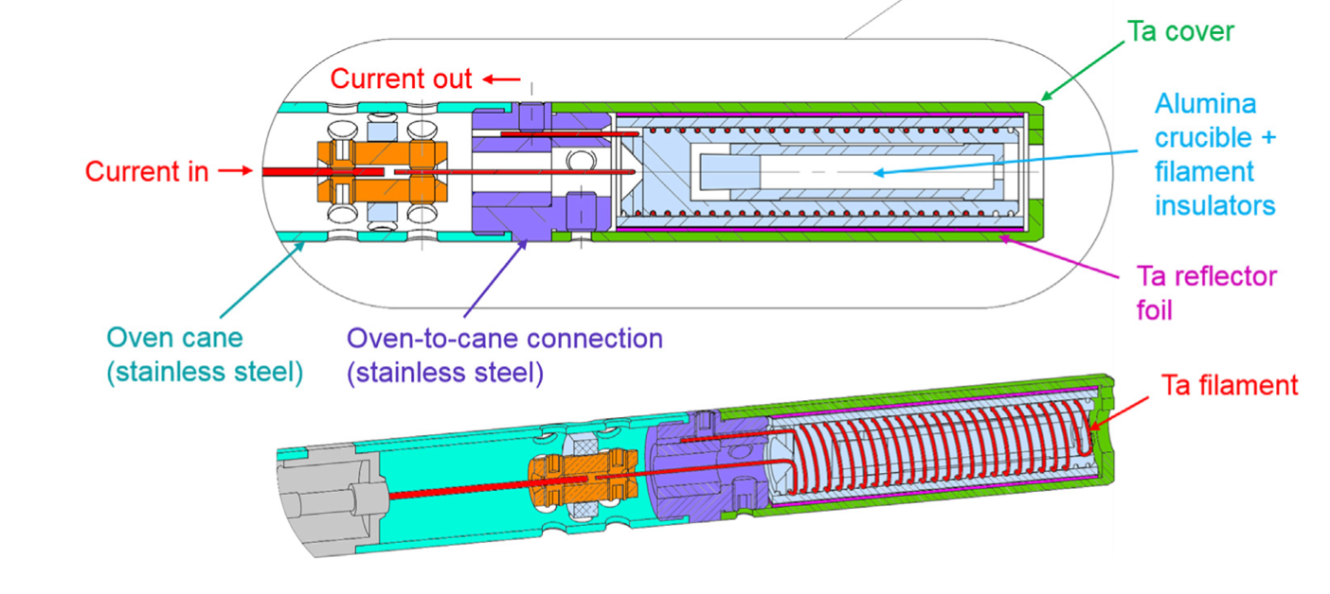
Develop Li feeding system
Laser
Laser ablation type
Oven type: Internal or external
Lithium laser target at LIS

Slide 13
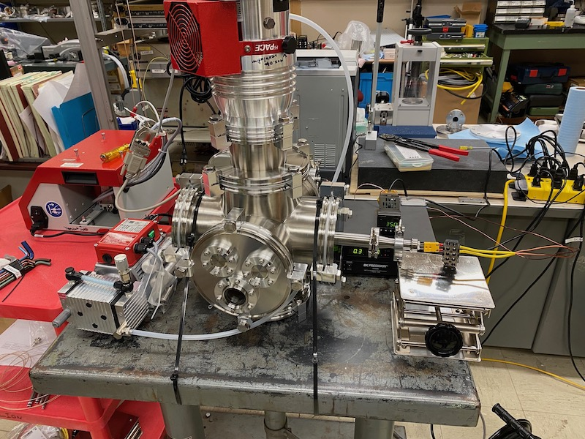
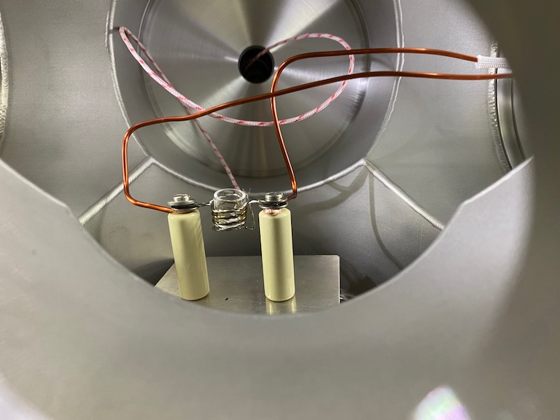
Li evaporation test is in preparation

Slide 14
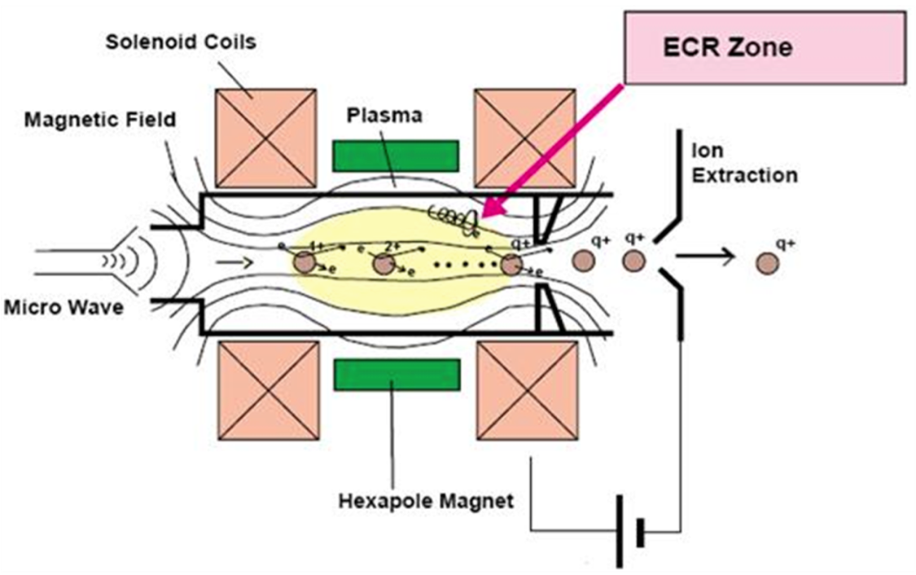
Based on the evaporation experiment, we will design temperature distribution in the ECRIS.
Heat insulator to protect PM
Hexapole is usually made of Nd magnet.
To avoid Li condensation, all the surface will be kept above 200 C.

Slide 15
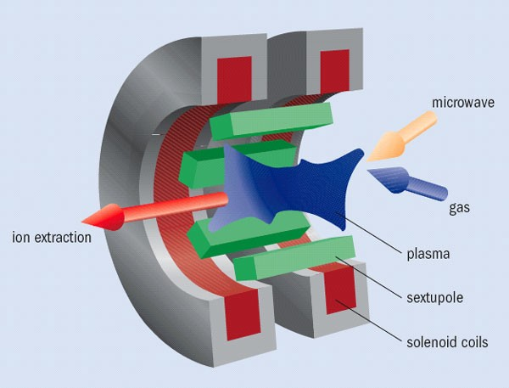
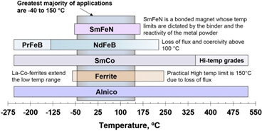
18 GHz microwave needs 6.4 kG.
Nd₂Fe₁₄B is commonly used to form hexapole field for transverse confinement.
However, it is strongly recommended below 100 C to avoid irreversible demagnetization.
Choice of a different PM material.
Electrical magnet without core. (Core cannot be used because it will reduce the axial field of the solenoids.)
Good design to prevent thermal penetration to the hexapole magnet.
Solenoid mirror and cusp field

Slide 16
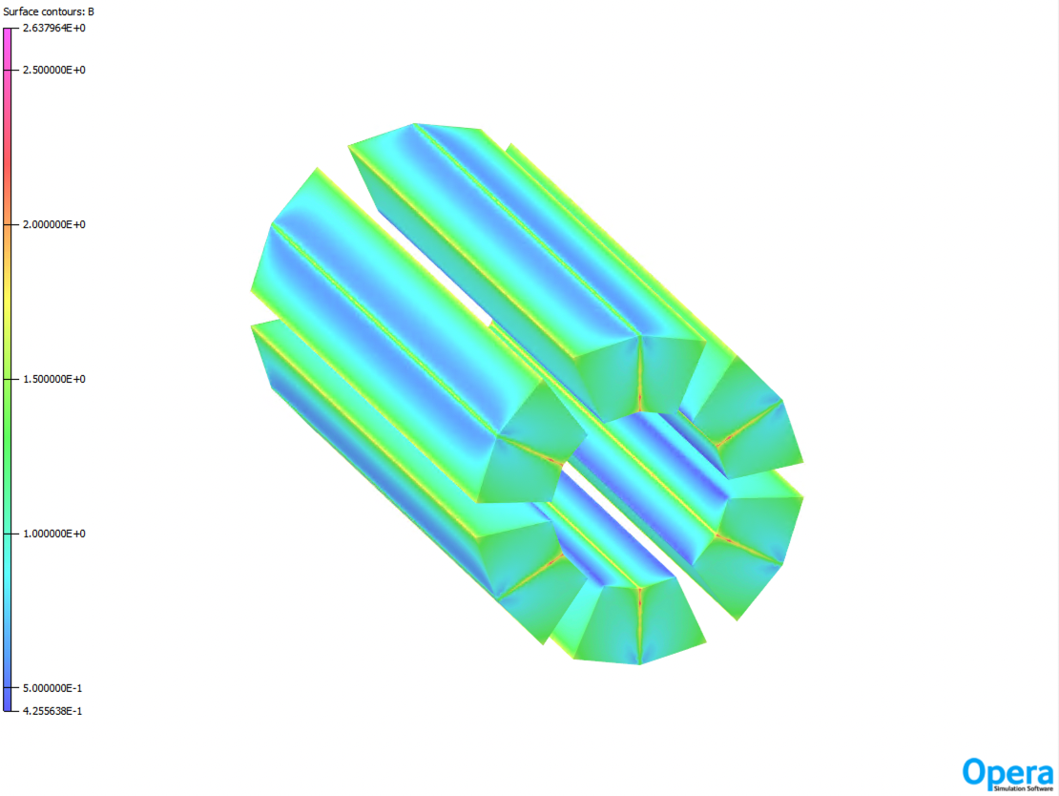
300 mm
84 mm
Permanent magnet hexapole

Slide 17
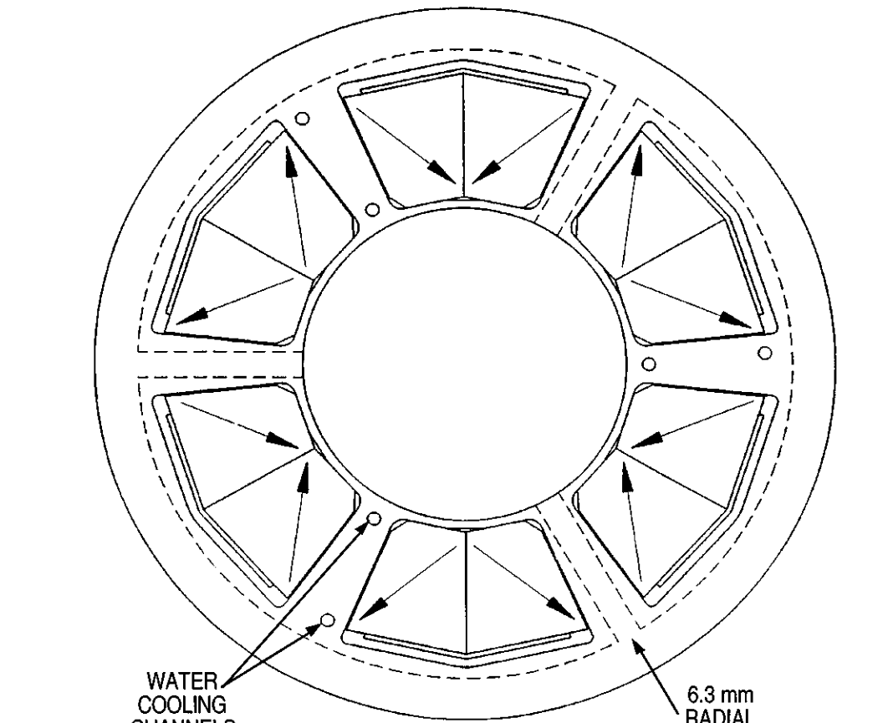
The simulation was conducted based on ANL's ECR design.
31.7
34.7
52 deg
2
24 deg
150
156
86
ID 80 mm
78.7 deg
60 deg

Slide 18
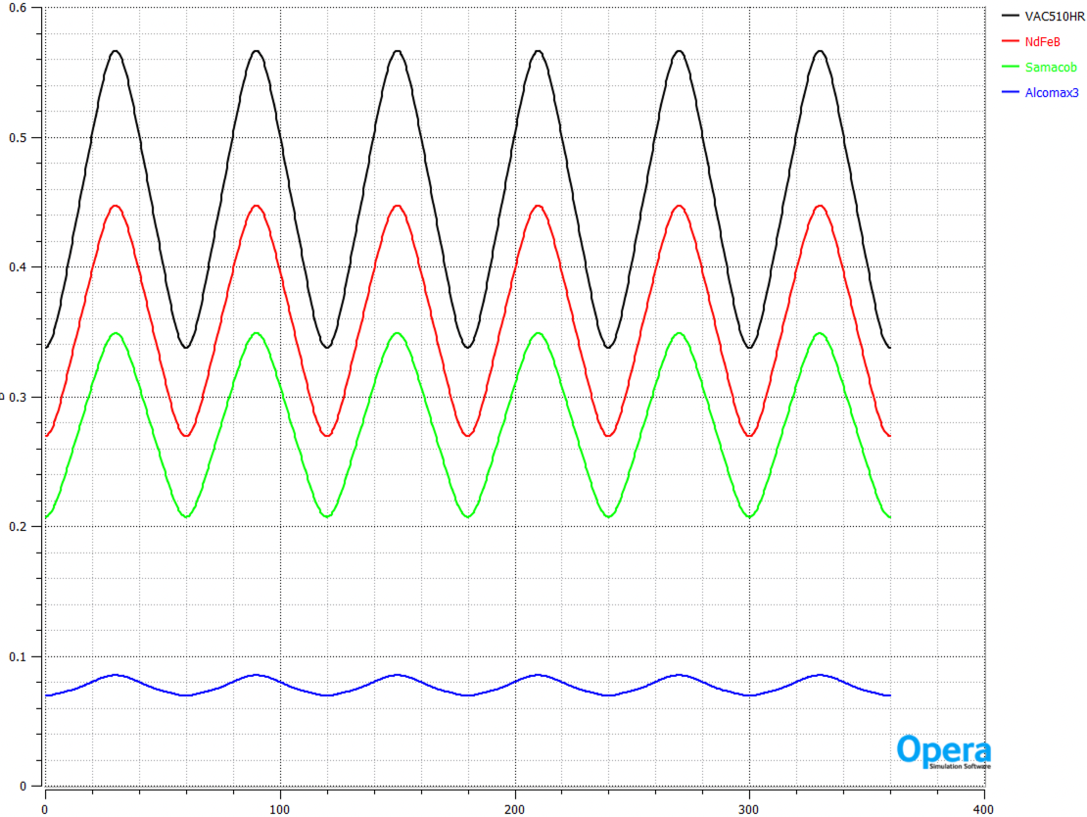
Nd Magnet
Samarium-cobalt magnet
Alnico magnet

Slide 19
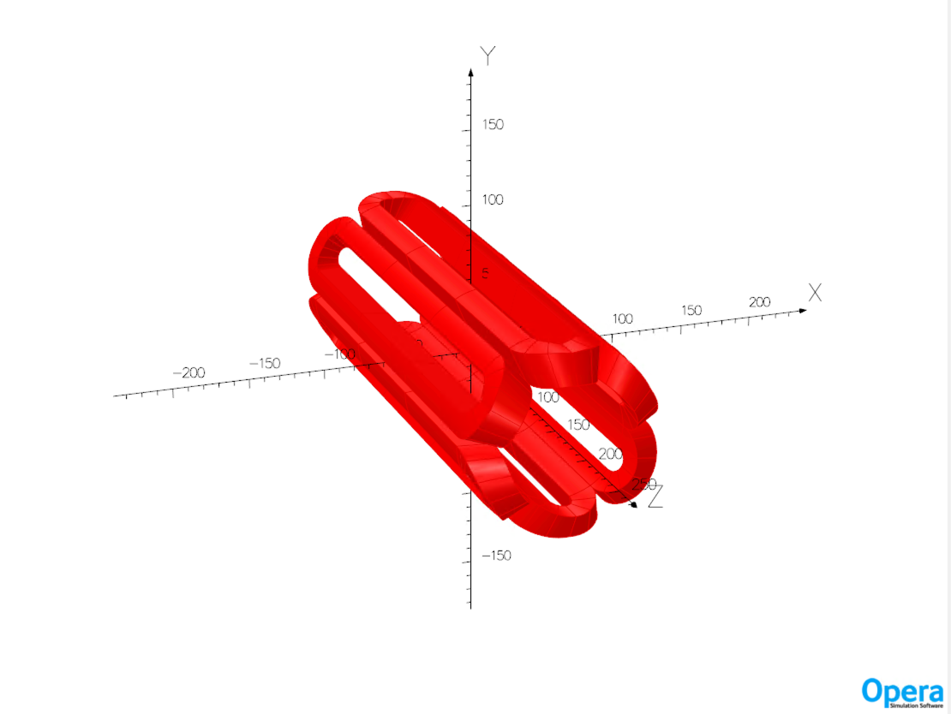
Electromagnet can be used??
Same dimension as the PM model

Slide 20
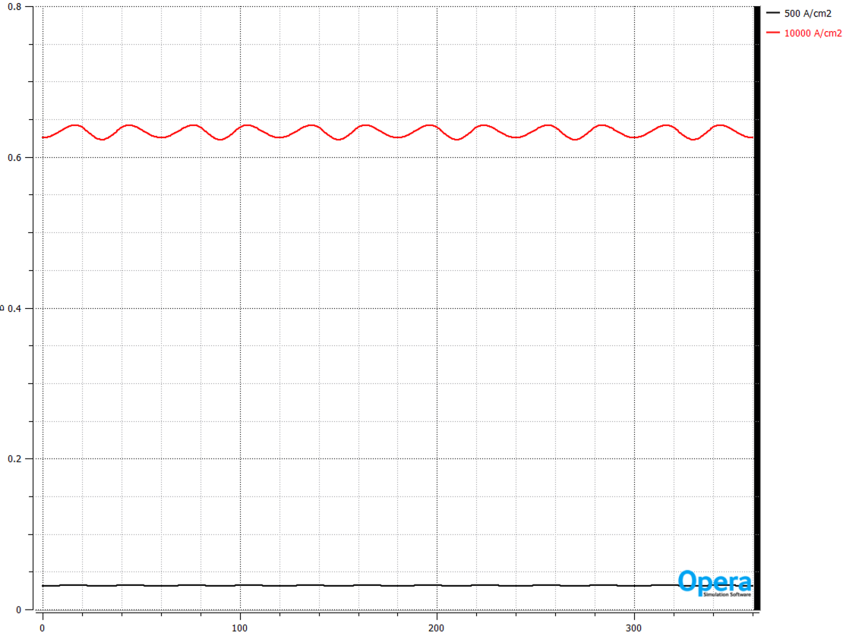
20X 10 % duty factor and 5 times of temperature rise.
Probably too extreme!
Typical water cool condition.

Slide 21
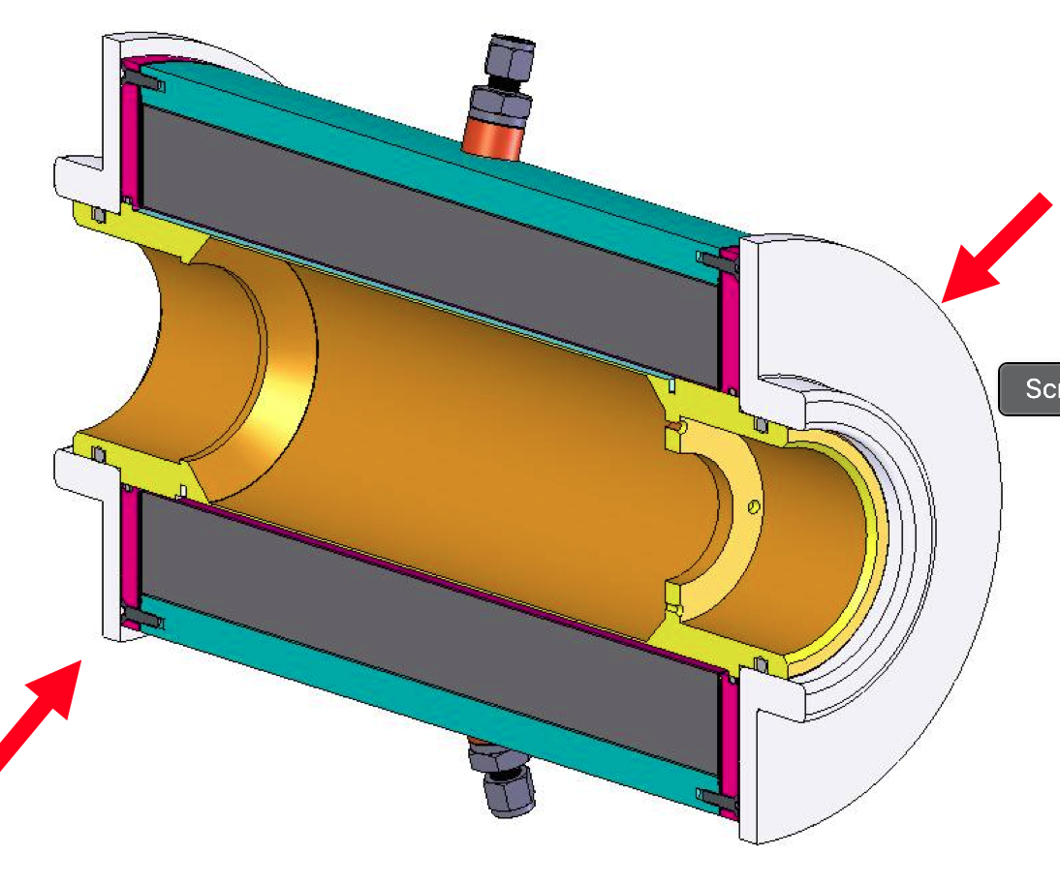
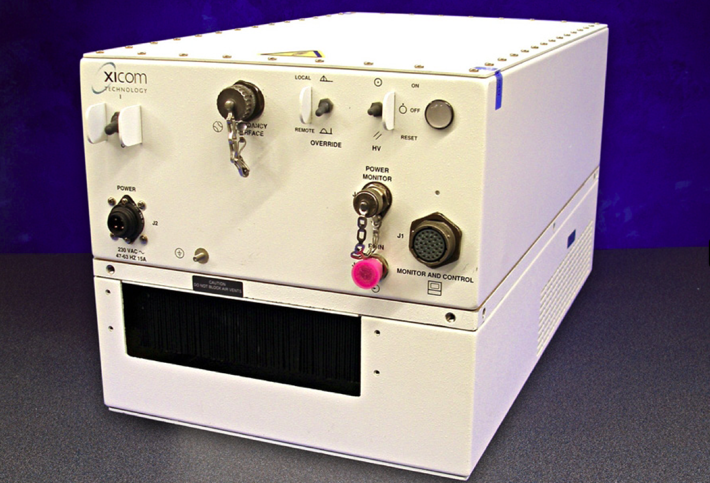
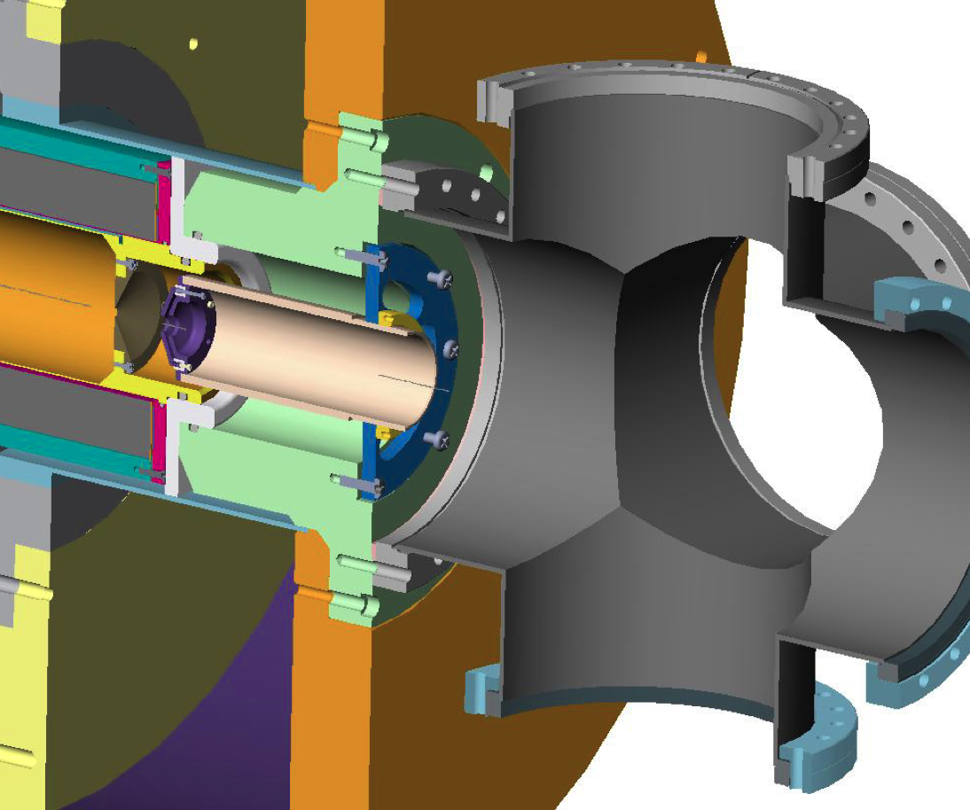
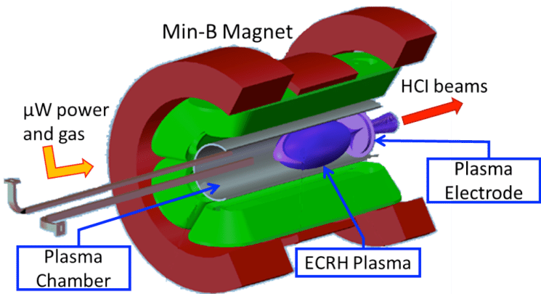
TEST ECRIS is proposed
for investigating the feasibility and beam current.
Design of plasma chamber
Design of microwave feed line
Heat insulation
to permanent magnets
Volume less than 0.5L
Design of beam extractor
Avoid condensation
of lithium
Effect of a support gas will be also tested.

Slide 22
1.68 T at extraction aperture
Li3+: 2mA
Li2+: 2mA
Li1+: 2mA
Extraction aperture R=3mm
30 kV- -3kV - 0
Z=400 means 100 mm
(Mesh uniti is 0.25 mm)
R=40 means 10 mm
(Mesh uniti is 0.25 mm)
r-r' |  |  |  |  | x-x' and y-y'
 | Erms | Erms_norm | E_tot_norm |  |  | Erms | Erms_norm | E_tot_norm
 | p mm mrad | p mm mrad | p mm mrad |  |  | p mm mrad | p mm mrad | p mm mrad
Li3+ | 6.795 | 0.021 | 0.103 |  | Li3+ | 3.398 | 0.010 | 0.052
Li2+ | 7.174 | 0.022 | 0.109 |  | Li2+ | 3.587 | 0.011 | 0.054
Li1+ | 3.805 | 0.012 | 0.058 |  | Li1+ | 1.903 | 0.006 | 0.029

Slide 23
1.68 T at extraction aperture
ZEND=400 (100 mm)
R-rms ~5.6 mm

Slide 24
1 T at extraction aperture
r-r' |  |  |  |  | x-x' and y-y' | x-x'
 | Erms | Erms_norm | E_tot_norm |  |  | Erms | Erms_norm | E_tot_norm
 | p mm mrad | p mm mrad | p mm mrad |  |  | p mm mrad | p mm mrad | p mm mrad
Li3+ | 3.649 | 0.011 | 0.055 |  | Li3+ | 1.825 | 0.006 | 0.028
Li3+ | 2.048 | 0.006 | 0.031 |  | Li2+ | 1.024 | 0.003 | 0.016
Li3+ | 3.262 | 0.010 | 0.049 |  | Li1+ | 1.631 | 0.005 | 0.025

Slide 25
1 T at extraction aperture
ZEND=400 (100 mm)
R-rms ~5.6 mm

Slide 26
Summary
Proton and deuteron ECRIS can be built or purchased.
mA class LI3+ ECRIS is a challenging task.
Li is chemically highly reactive. Needs to establish maintenance procedure.
Li vapor supply systems will be studied. External oven, internal oven or laser.
Hexapole magnet design must be experimentally confirmed.
Based on test ECRIS study, we will scall every design parameters.
He2+ can be delivered from the Li ECRIS.
Establish high current ECRIS for He²⁺ and Li³⁺ beams.

