Slide 1
Proposed BNL High Energy Effects Testing Facility
Kevin A. Brown, C-AD
December 9, 2021

Slide 2
Outline
Community and National Needs
Alignment with BNL Strategic Initiatives and Capabilities
AGS HEET Layout and Capabilities
Operations and Construction
Program Developments & Meetings
Summary

Slide 4
HEET

Slide 5
The AGS is capable of going as high as > 10 GeV/n.
No users envision going this high, so current stakeholders specify that 2500 MeV/n is sufficient. However, future upgrades would only require modifying part of the external beamline and adding a second one.
Note:
FRIB/MSU < 200 MeV/n
HEET: 40 - 2500 MeV/n
https://nscl.msu.edu/users/beams.html

Slide 6
Alignment with BNL Strategic Initiatives and Capabilities
BNL Capabilities
  NSRL* can provide from 40 MeV/n up to 1500 MeV/n ions
  NSRL cannot provide a high number of hours
    Not a 24/7 operation (need more people)
    staging and storage facilities are saturated (need more space)
    NASA Program (i.e., biology) has priority
  TVDG can provide up to 30 MeV/n ions
    Have experience supporting SEE experiments
  Costs – NSRL costs more than TVDG, doing low energy at NSRL is not competitive with other low energy facilities
Strategic Initiatives
A dedicated high energy facility will support both classified and unclassified research on the radiation effects in materials, electronics, and other systems of interest and as approved by the facility program advisory oversight and management. These experiments fit in with the laboratory strategic initiatives in national security, strategic partnerships, and applied science.
*NSRL = NASA Space Radiation Laboratory

Slide 7
AGS HEET Layout and Capabilities

Slide 8
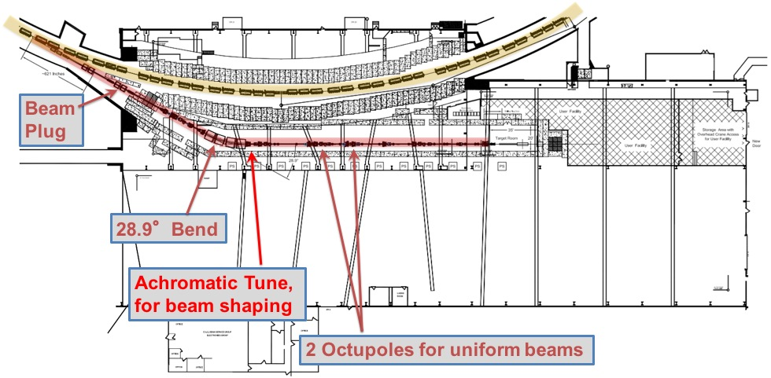

Slide 9
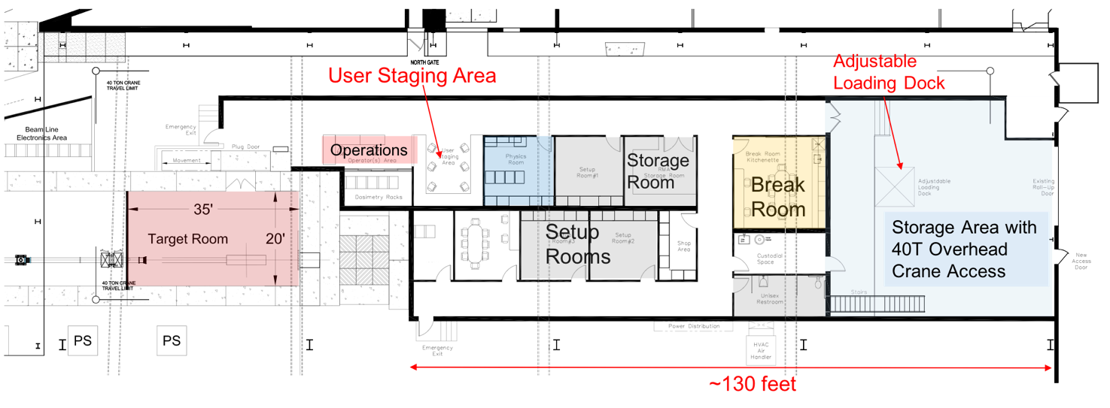
Side View

Slide 10
13.5’
Top View
Side View

Slide 11
Capabilities
Large range of beam energies (e.g., 40 - 2000 MeV/n Fe²¹⁺ ions)
Large number of available ion species (e.g., H to U [Z = 1 to 92] and more)
Fast energy change (minutes)
Fast switching of ions (minutes) [note: Simulation of Galactic Cosmic Rays]
Support for both unclassified and classified experiments
3D Uniform Beams
Square uniform beam sizes from 1 cm² to 400 cm², and larger
Small beams on the scale of 1 cm rms (and smaller are possible)
Beam spills from 0.1 - 5.0 seconds (longer and shorter are possible)
Fast beam cutoff with insignificant overshoot (e.g., 0.1%)
Same level of support and service as NSRL
Notes:
I want to note that for this design we intend for all beam intensity control to be done in the beamline, using two collimators. This simplifies the ability to control the beam intensity over a large range - from 100 particles to full intensity. There should be no need to reach upstream, to the source or something else, to go to low intensities.

Slide 13
AGS HEET Layout and Capabilities

Slide 14
Operations Models

Slide 15
Operations
The total number of weeks available in a year is 44 (we shut down for about 8 weeks every summer for maintenance, typically)
  ~5000 (up to 6000) hours of availability per year
  Every two weeks, typically on a Wednesday, there will be an 8-hour maintenance period when beam is not available
We assume 24/7 operations during the 44 weeks of the yearly operation period
We use an 80% facility availability during operations. The remaining 20% of the time accounts for down time due to failures and for use of the accelerator for injecting beam into RHIC and EIC in the future
We assume the present situation of concurrent operation with RHIC, NSRL, and BLIP (Medical Isotope Production) and, in the future, concurrent operation with EIC, NSRL, and BLIP. During the period of EIC construction (2025 – 2030) operations only concurrent with NSRL and BLIP
NSRL & HEET would run concurrently and can be taking different ions

Slide 16
Construction and Operations
We assume the following
Construction funded by DoD, to be finished in 3 to 4 years
  Critical path for construction timeline is production of magnets and power supplies for the magnets
Commissioning costs are part of construction funding
First year of operations supported by grant from DoD
Futures funds will be collected based on proposal review process and collecting funds in advance of operations
  User database is being developed
  Letters of Interest and support are being sought
  Funding could come from Government grants, STTR/SBIR grants, commercial users, and international users
  International agreements may be beneficial, but need to be developed and coordinated with government agencies

Slide 17
Two BNL PD Funds supported work
(2020) First PD fund supported a preliminary cost estimate to develop and understand the impact on existing programs and the cost to build the facility
(2021) A second PD fund supported development of KPPs, engagement with stakeholders, development of a beamline optics solution, development of a brochure, and development of an operations plan

Slide 18
Meetings, Workshops, Conferences
May 1, 2020: Presentation to MDA on Preliminary Design
Dec. 2020 – current: Monthly Meetings with MDA
April 13, 2021: 2021 Domestic High-Energy Single-Event Effects (SEE) Testing Users Meeting
August 31, 2021: SEE/MAPLD Workshop
September 1, 2021: RADECS

Slide 19
Summary
This proposal addresses a national need for electronics test time as well as reaching higher energies to simulate the radiation environment in space, which can only be done at NSRL today
The proposal has been developed with input from stakeholders
  Developed the requirements (KPPs)
  Formulated a preliminary cost estimate for construction
  Formulated a preliminary construction schedule
  Formulated a preliminary operations model with cost breakdown and FTEs
Planned operating model involves
  first year of operations supported by grant from DoD
  Futures funds will be collected based on proposal review process and collecting funds in advance of operations
There will be no Impact on EIC operations (nor NSRL)
Synergies with EIC program include cost sharing for EBIS/Booster/AGS
  Presently NASA pays 40% of EBIS, 20% of Booster and participates in common upgrades
  Keeping the AGS running in prior years to EIC commissioning will benefit EIC
  Having the AGS running behind EIC will keep systems in good operational shape

