Slide 1
DAQ WG Meeting Agenda – 11/18/21
Progress / Outstanding issues (Jeff)
Simulation status (Alexandre)
AOB

Slide 2
Progress / Outstanding Issues
“Final” versions of the costing spreadsheets and text are in. Costing text in general is still being edited… Not by WGs though, the costing meetings continue though...
Text comments to come today – Pietro will help get the details regarding the RICH noise correct.
Yesterday at integration meeting extensive discussion of table of channels/rates… Discussion will continue, but the summary is:

Slide 3
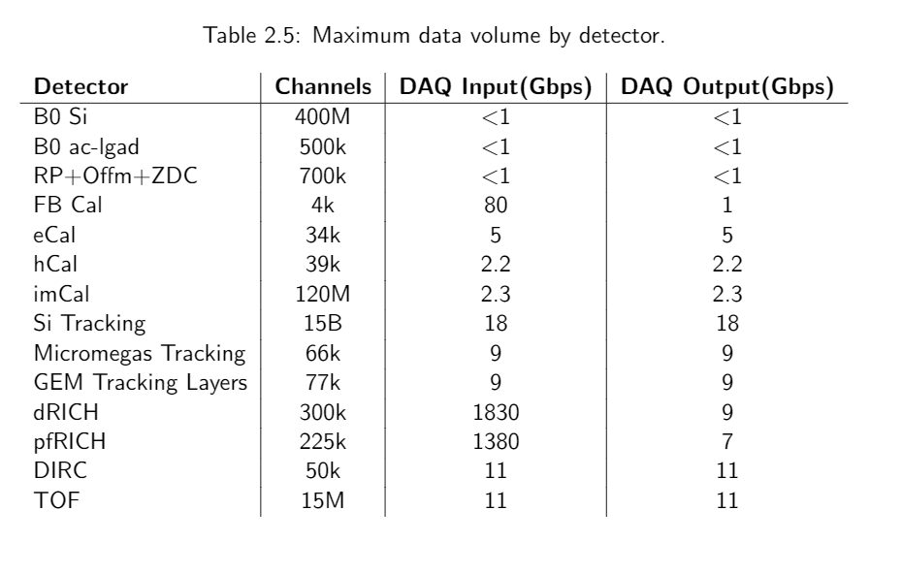
Progress / Outstanding Issues → Rate table discussions
Comments and Todo on this table:
Several updates already incorporated from previous:
eCal/hCal (1 iteration with Oleg Tsai so far… expect more)
Update Silicon tracker channels. (15B is 6 m^2 * 20um pixel pitch. “Still too small” from LEO, but no suggestion how to parametrize)
Update dRICH/pfRICH from Pietro
Same values for Input / Output “look bad”. I agree
Thus far: These numbers are estimated physics rates with error bars larger than expected noise (except for RICH/FB where there are other circumstances)
Each of these detectors (other than RICH/FB) have large input overhead capability. They are all link limited.

Slide 4
Progress / Outstanding Issues → Rate table discussions
We should have a strategy for the optics here though, which (I think) means increasing the DAQ input rates appropriately.
The first thing to do is to compile reasonable specific values for the noise of each technology. We have the info already, although requires super arbitrary decisions (e.g. I have quotes between 10^-5 and 10^-9 for MAPS false hits). This noise should be added to the DAQ input rates.
Also, note for small reductions there are simple but detail dependent solutions:
Aggregating headers (stream is time, location, adc. The time will be significant. Assuming extremely sparse data as will be the case for noise the location overhead will also be significant, but dependent on detector). Highly detector specific, but will certainly be done as part of detailed design once electronics / data formats are specified.
Cluster finding where appropriate
Compression
Noise reduction as per RICH discussions (event selection, feature selection via pattern recognition and/or AI/ML)

Slide 5
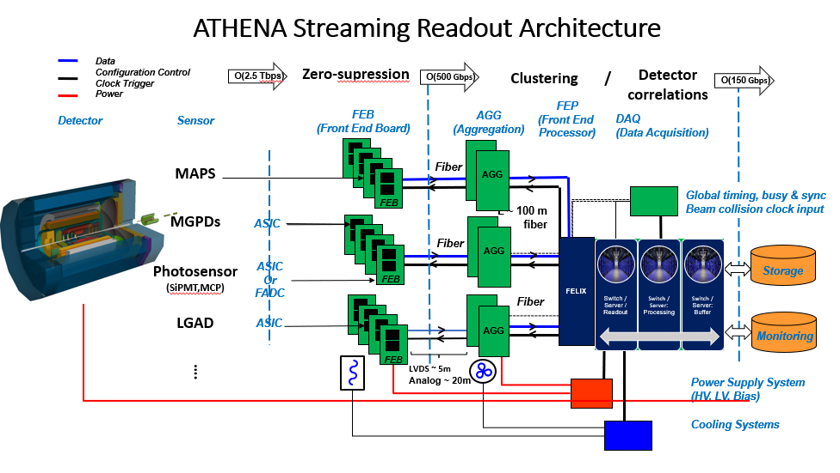
Progress / Outstanding Issues
System Diagram Updates
To do:
Fonts
Final numbers

