Slide 1
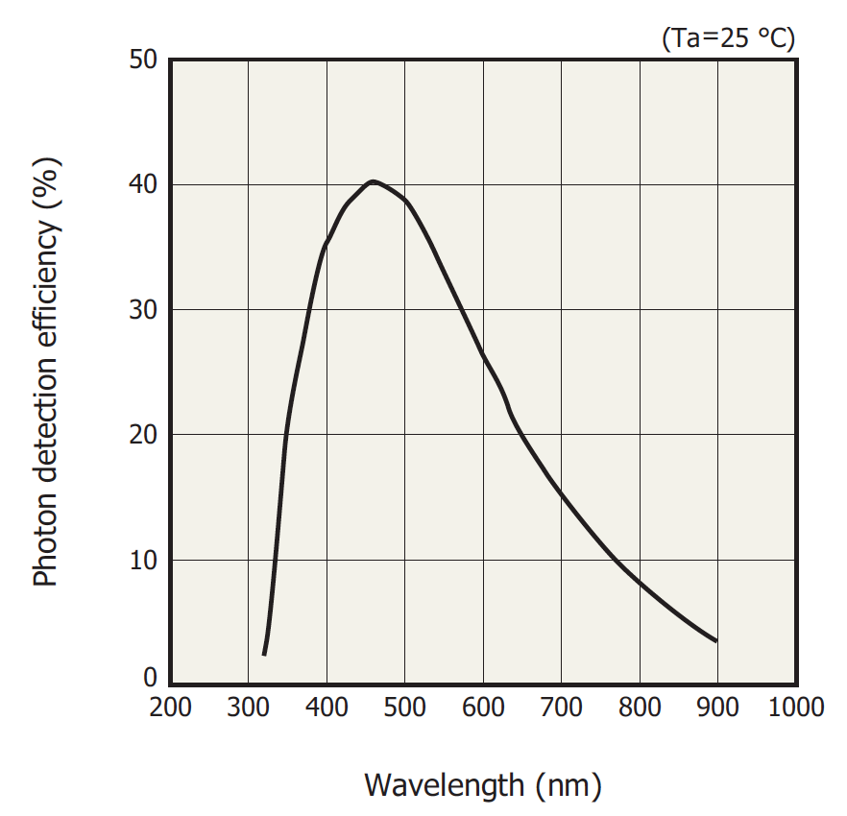
Technical details on pfRICH
Geometry: proximity focusing, no mirrors
Aerogel: parameterizations based on CLAS12 data
3cm thick @ density 110mg/cm³ (effective <n> came out ~ 1.019)
Rayleigh scattering
Absorption length
Thin acrylic layer
~40cm long (air) expansion volume
SiPMs (S13361-3050AE-08 8x8 panels)
3.4 mm pitch
QE as given by Hamamatsu
85% geometric fill factor & 70% “safety factor” on top of it
ATHENA simulation environment
npsim, juggler IRT plugin, analysis scripts

Slide 2
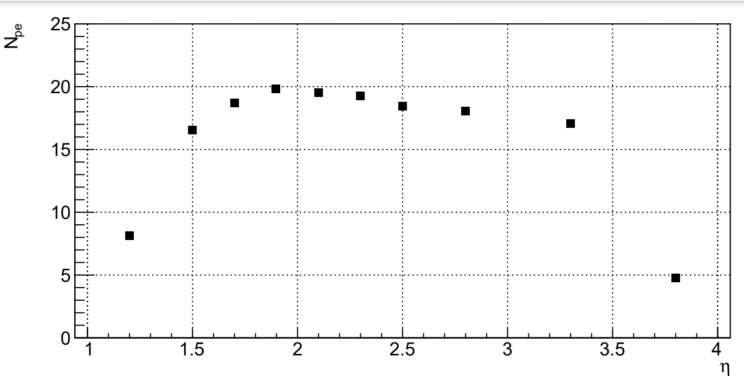
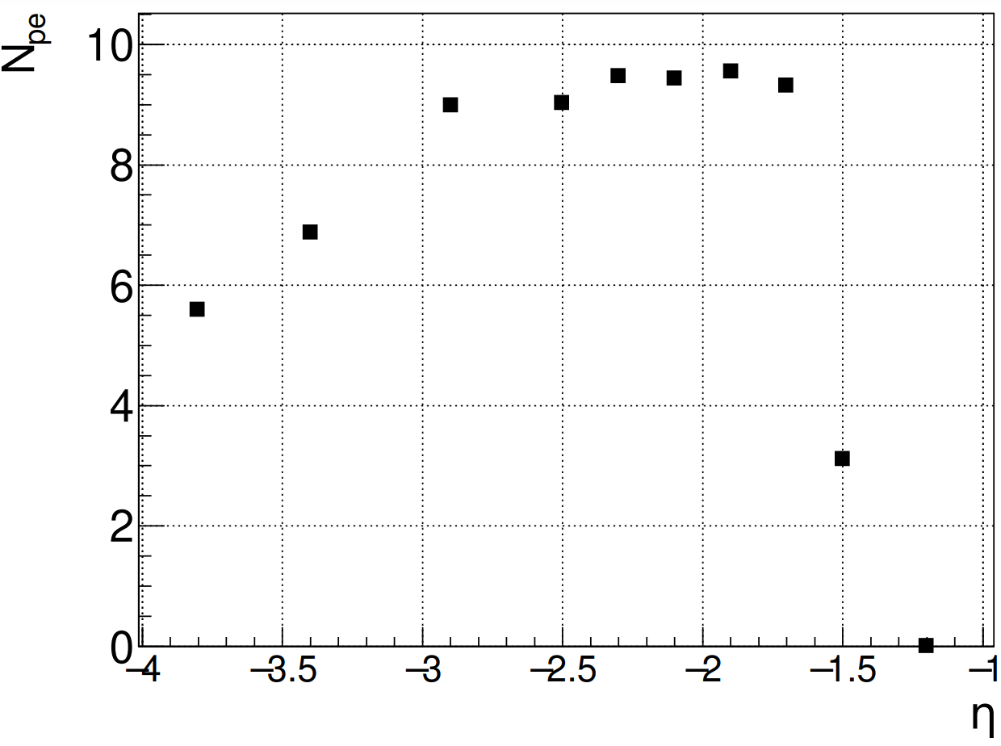
Acceptance
C2F6 dRICH 12 GeV pions
pfRICH 8 GeV pions
“Fast parameterizations for Deplhes provided”

Slide 3
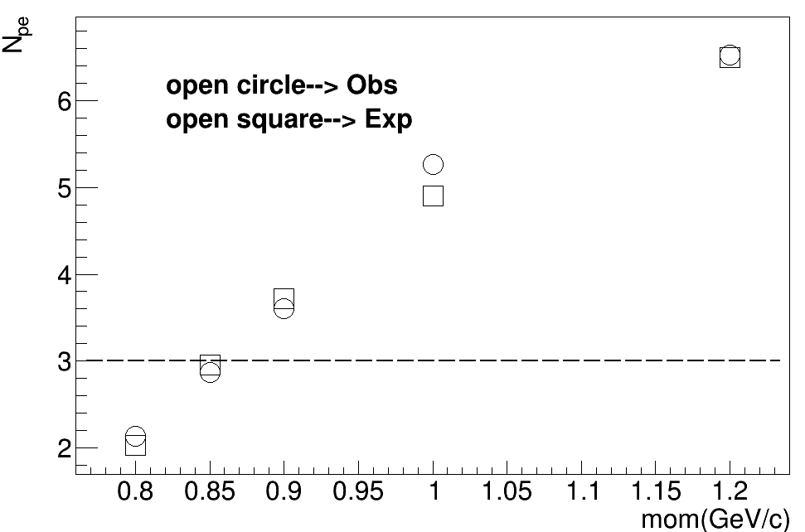
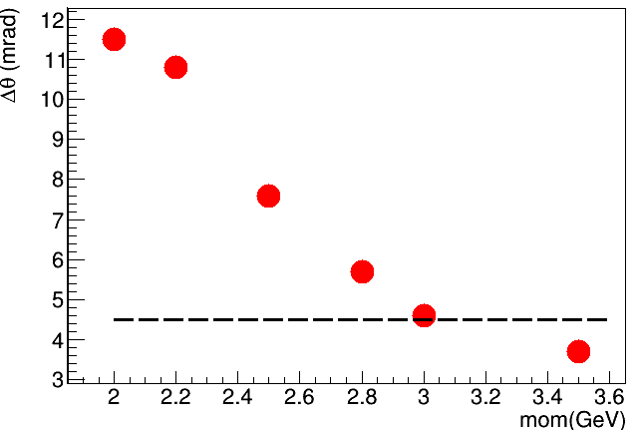
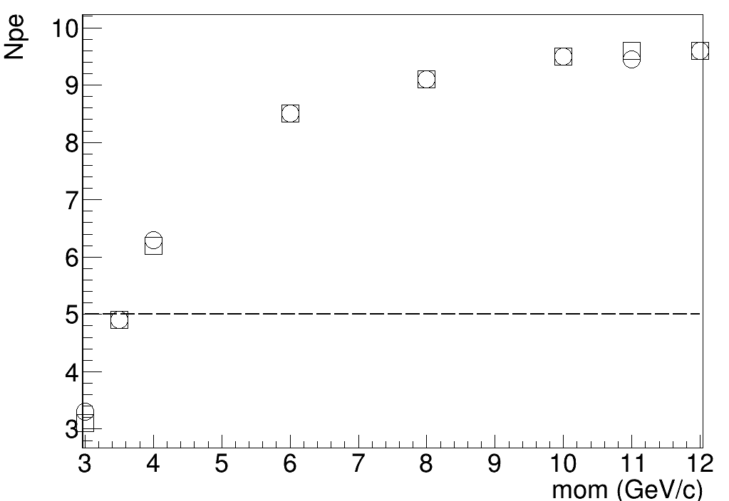
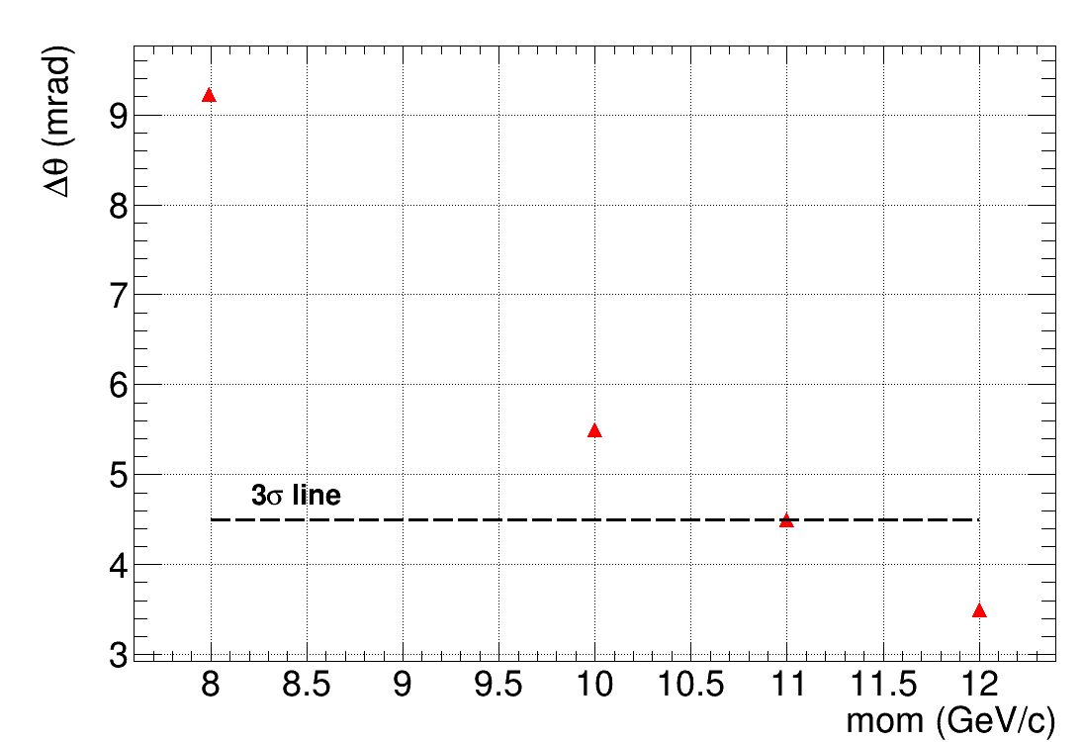
Eta -2.0 to -2.4
PID momentum limits pfRICH

Slide 4
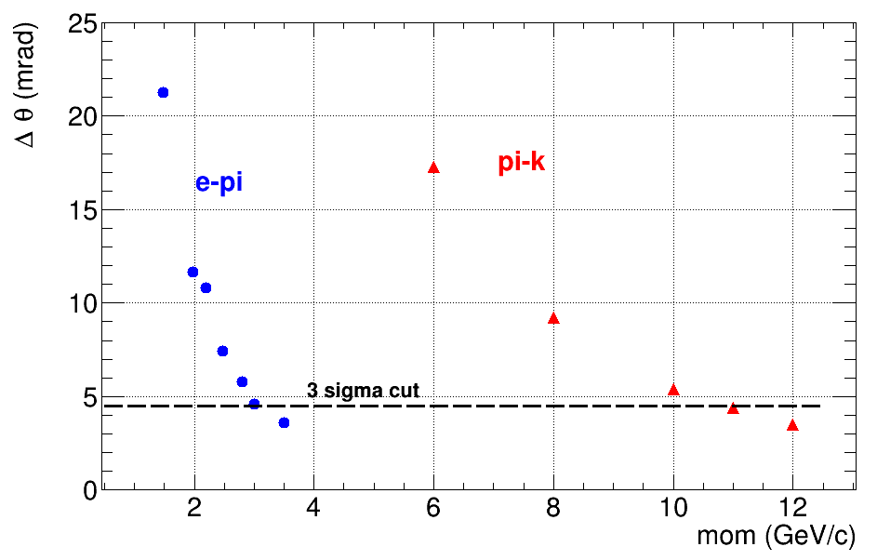
Separation pi-k e-pi for pfRICH as a function of momentum for eta -2.0 to -2.2

Slide 5
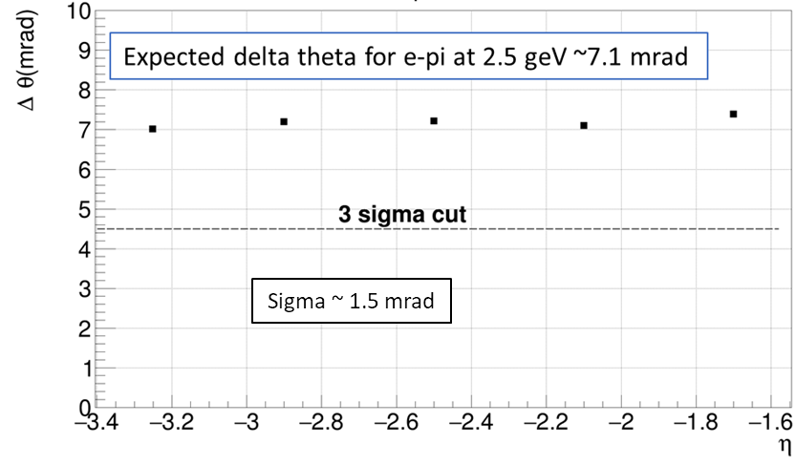
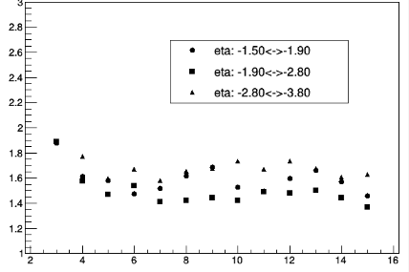
Theta difference and evolution of sigma theta
Sigma_theta (mrad)
Pi hypothesis
Mom (GeV)

Slide 6
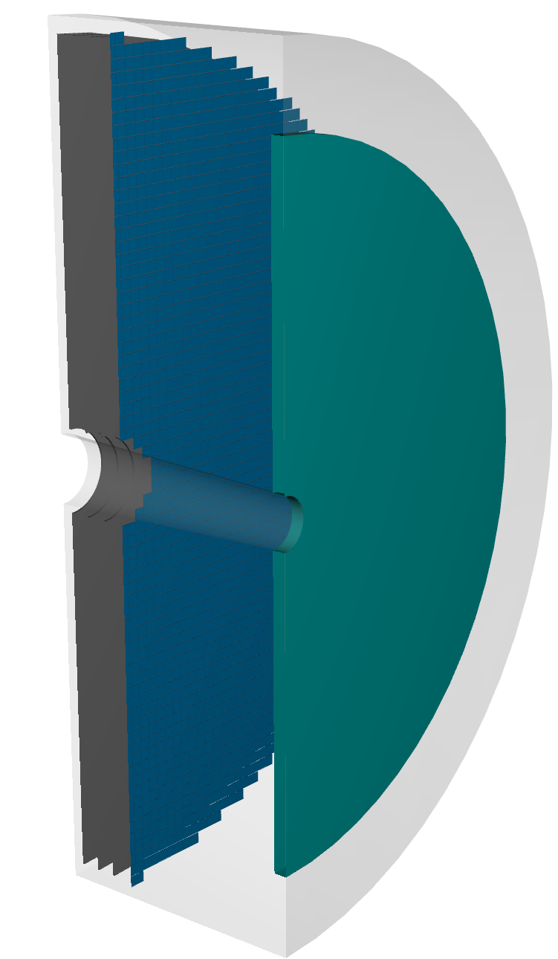
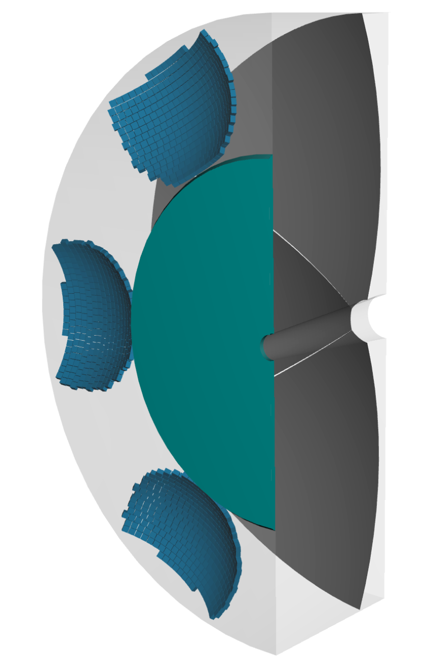
Geometry→ Chris circulated

Slide 7
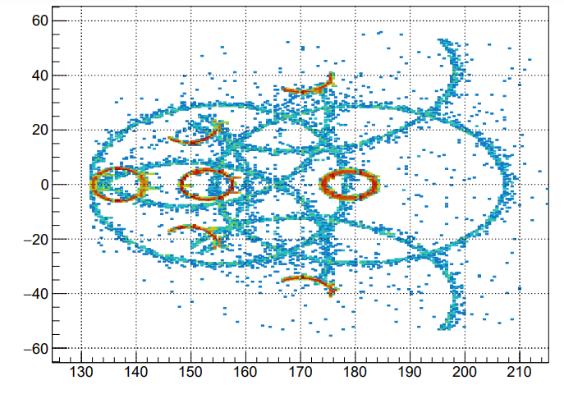
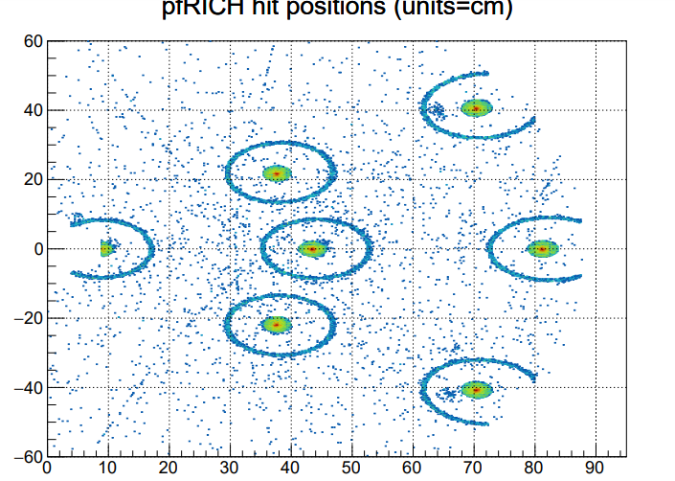
Magnetic field is OFF... 3 positions in eta are used, with ranges given below; 3 positions in phi are also used: {-30,0,+30} degrees, so we see some half rings along dRICH sector boundaries. In the highest eta bin, only phi=0 is used. 100 particles are aimed at each position, to obtain enough stats to see clear rings. for pfRICH: etaMin_ = 1.6 etaMax_ = 3.8 20 GeV electrons for dRICH: etaMin_ = 1.5 etaMax_ = 3.4 20 GeV pions

Slide 8
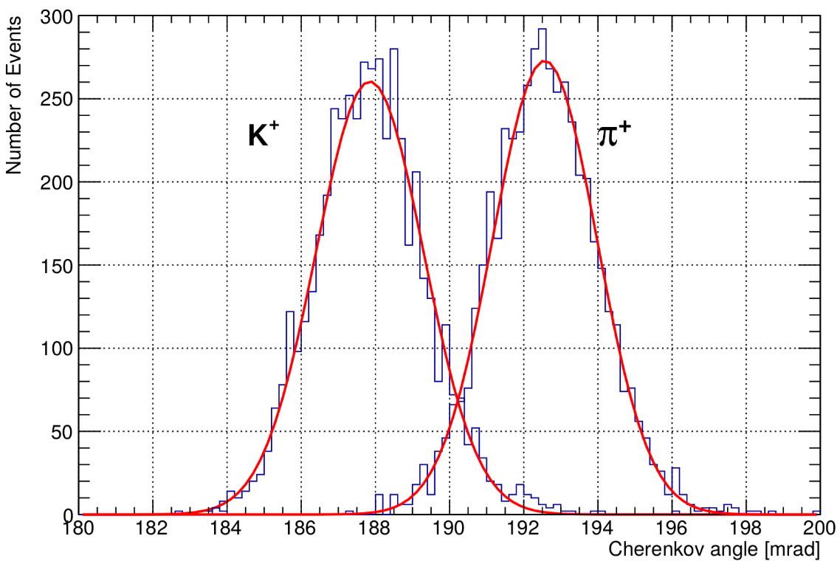
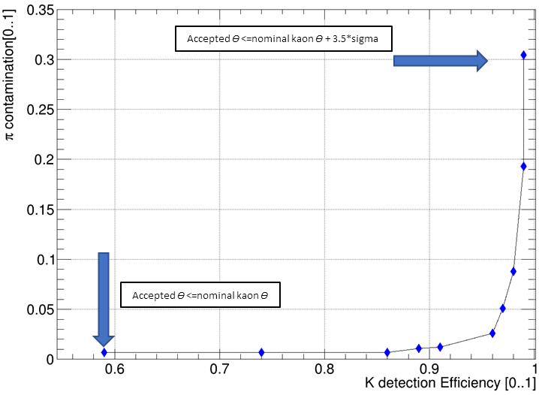
Identified pion /(identified pion +identified kaon)
Pion kaon PID performance study

Slide 9
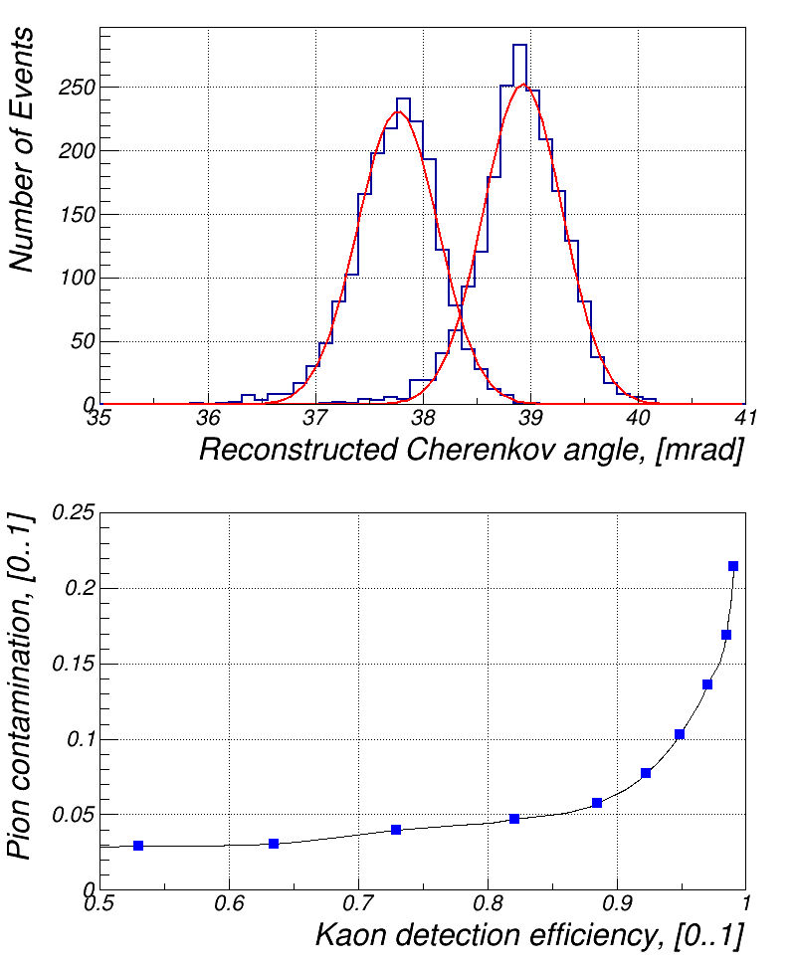
K⁺
π⁺
σ ~ 0.4 mrad
η = 3.0, p = 50 GeV/c
θ (accepted) < 38.7 mrad
θ (accepted) < 37.8 mrad

