Slide 1
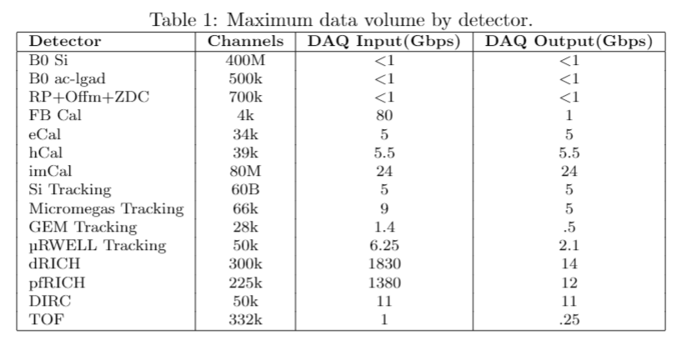
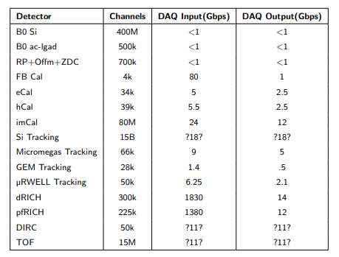
Notes:
Total data volume in line with original yellow report ~85Gbps vs 100Gbps
Link to supplemental material where broken down by source. Thus far only have collisions + hadron beam gas. Working on converting to hits
Conversion from hits to data volume:
eCal, hCal, imCal : about half due to hadron beam gas. Reduction here would be possible by identifying it.
dRICH /pfRICH, the reason the DAQ input and DAQ output do not scale by 200 is that the hit data would not be reduced. There is an assumption of 5gbps hit data.
DIRC still don’t know the source. for scale: It is roughly 17 tracks * 20 photons/track * 64 bits per hit * 500khz.
TOF Number of channels drastically reduced due miscommunication. This will have a significant change to the costing as well (~700k reduction) if verified…
Det | Bits/incident track
MAPS, calorimeters | 64 bits
RP, Offm, ZDC, gem, urwell, micromegas | 64 bits * 5 channels
dRICH, pfRICH, DIRC | 64 bits * 20 photons
TOF | 120 bits * 5 channels

