Slide 1
The Snowmass Energy Frontier Activities
BNL Snowmass Retreat Day
December 17, 2021
Alessandro Tricoli (BNL)
BNL Snowmass retreat day, December 17, 2021

Slide 2
Our vision for the future of the Energy Frontier
We are in an exciting and pivotal time for the future of HEP
LHC Run 2 is providing a wealth of new measurements.
We have entered the era of precision Higgs physics.
The HL-LHC is becoming a reality.
We have updated scenario of proposed future colliders.
Exciting results from other frontiers: rare processes, cosmology, …
...and we have no preferred way beyond the SM:
⇒ Great time to propose new ideas, new perspectives, new tools.
BNL Snowmass retreat day, December 17, 2021

Slide 3
Our vision for the future of the Energy Frontier
The Energy Frontier (EF) group at Snowmass will explore the TeV energy scale and beyond, under different future accelerator scenarios, including lepton-lepton, hadron-hadron, and lepton-hadron colliders.
Sharp physics questions will bring focus to issues pertaining to EF future directions
Re-evaluate existing ideas and emphasize how existing work can lead to new ideas
HL-LHC results will shape future colliders
Identify new ideas
Highlight “scientific merit” of various collider options and connections with other Frontiers
2020 EF Workshops and Meetings:
Energy Frontier Kick-off Meeting on May 21, 2020, see agenda
Big Picture questions were discussed in the Panel: “The importance of the Energy Frontier in the US HEP future planning” at the “Energy Frontier Workshop - Open Questions and New Ideas”, July 20-22, 2020 (Zoom recording of Panel Discussion)
Community Planning Meeting, Oct. 5-8, 2020, see agenda
Several Topical Meetings and Workshops, see indico pages
BNL Snowmass retreat day, December 17, 2021

Slide 4
Energy Frontier Restart in 2021
Snowmass reports delayed to 2022 due to ongoing COVID-19 pandemic (announcement)
EF slowed down its activities from Jan 2021 until end of June 2021
Community continued to work collaboratively
Monte Carlo production activities continued to support the needs of EF
Occasional and informal Topical Group ‘conversations’ to assure scientific continuity and support of ongoing activities
Restart of Activity - EF Community Workshop, Aug.30-Sept.3 2021, agenda:
Regroup after the few months of slowdown/pause of Snowmass activities
Assess progress made so far
Share new studies that started in the meantime
Identify gaps in our strategies
Update the community with schedule, goals and plans for the upcoming months towards the final reports in summer 2022
➔ A week of interesting plenary and parallel sessions, with open discussions on various topics
Snowmass Day, Sept. 24, 2021: agenda
Early Career (EC) as EF speakers: they provided their own perspective and highlight EC studies
Topical group meetings have restarted, on biweekly/monthly basis
BNL Snowmass retreat day, December 17, 2021

Slide 5
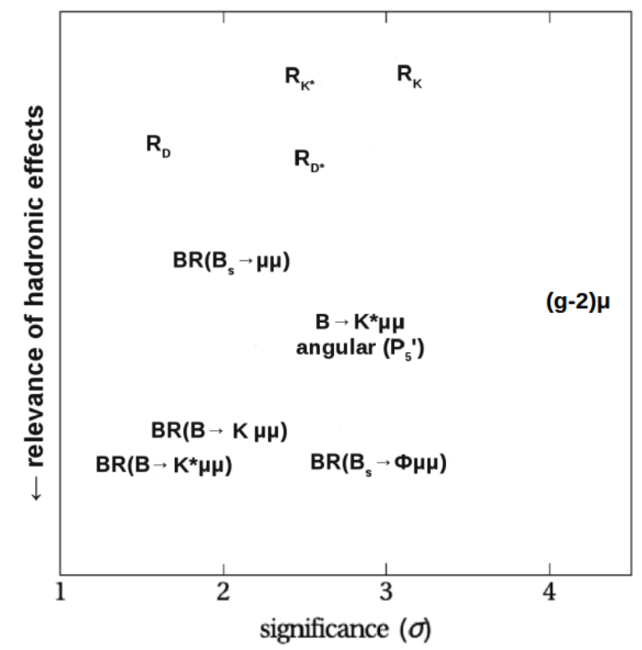
A fast changing landscape
by Wolfgang Altmannshofer
Physics landscape has been changing since we started Snowmass (a year ago)
Do we have evidence of the breaking of the SM paradigm in the lepton flavor sector?
How can we probe (directly or indirectly) the underlying flavor structure of the SM ?
BNL Snowmass retreat day, December 17, 2021

Slide 6
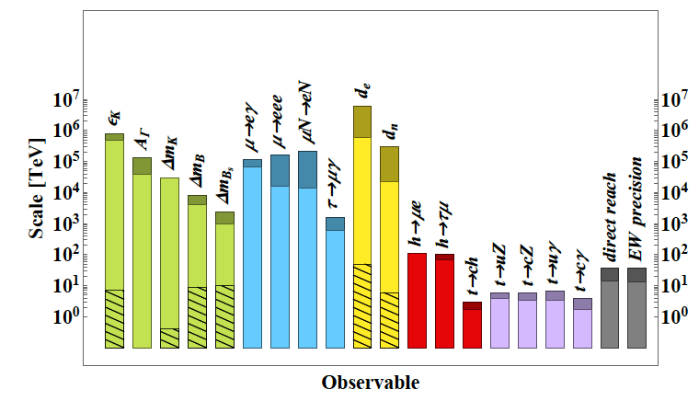
Probing the energy scale for new physics
Probing the energy scale for new physics
Patrick Meade
Reach in new physics scale from generic dim. 6 operators
Unique complementarity between electroweak precision fits and flavor observables.
Collider reach much broader: colliders needed to test models across the spectrum of all collider observables
BNL Snowmass retreat day, December 17, 2021

Slide 7
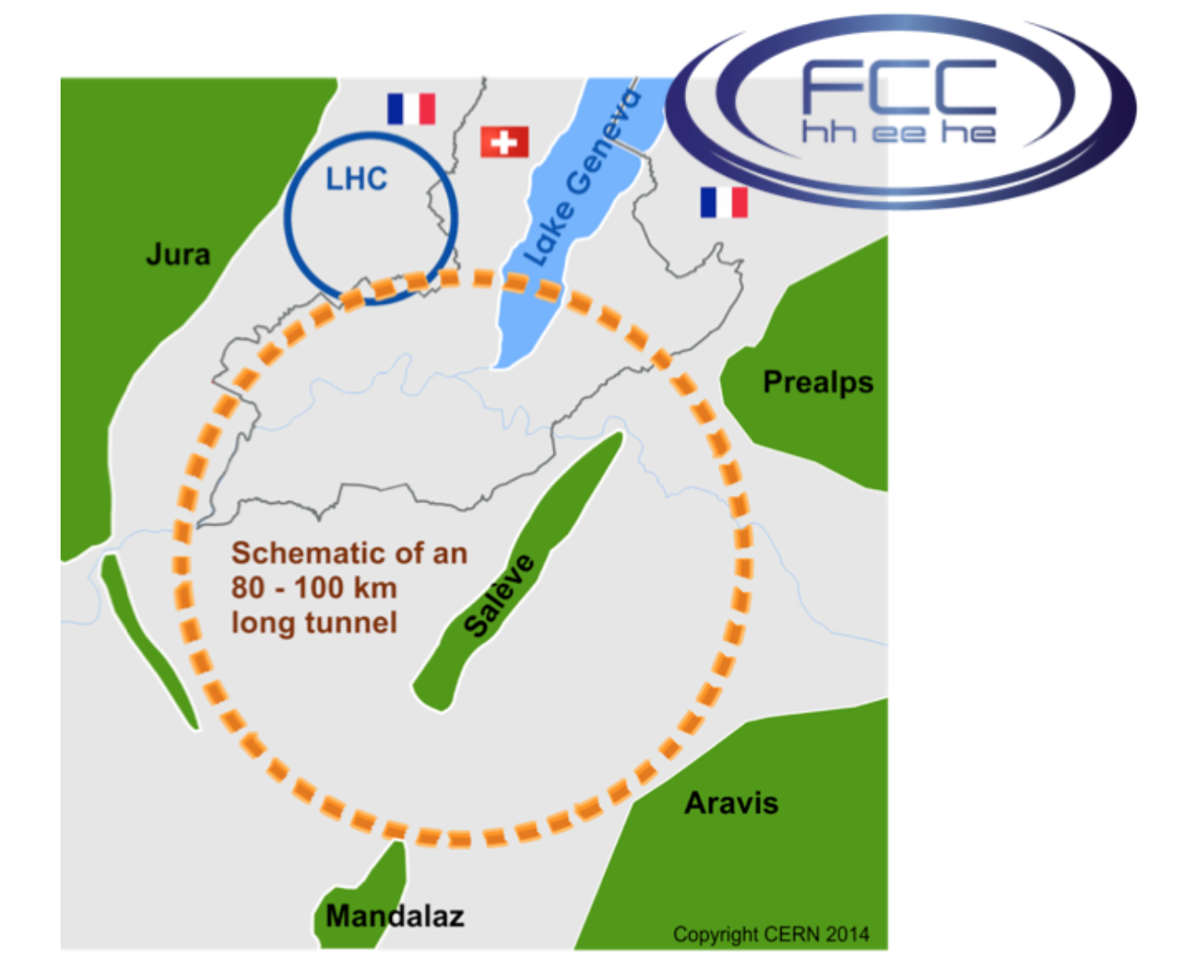
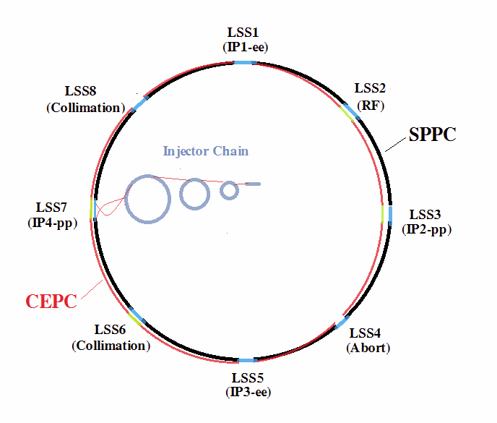
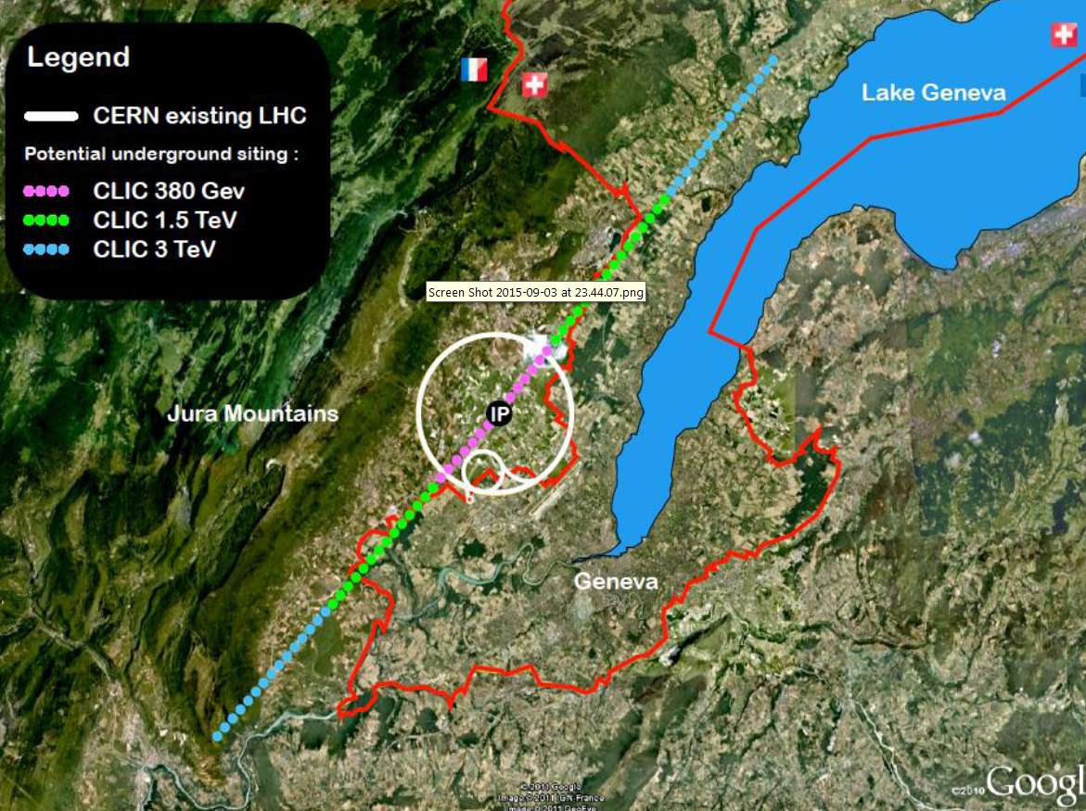
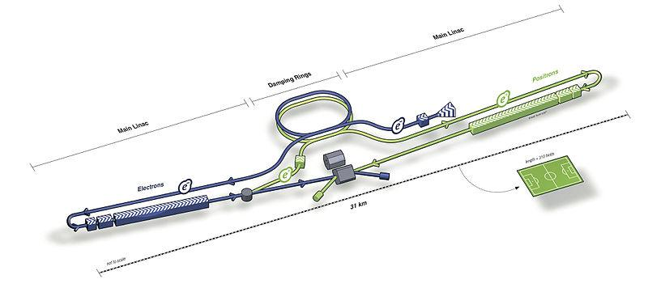
Which machines?
Muon Collider
- e⁺e⁻
- hadron-hadron
- hadron-electron
FCC
CEPC SppC
ILC
CLIC
LHeC
gamma-gamma colliders?
BNL Snowmass retreat day, December 17, 2021

Slide 8
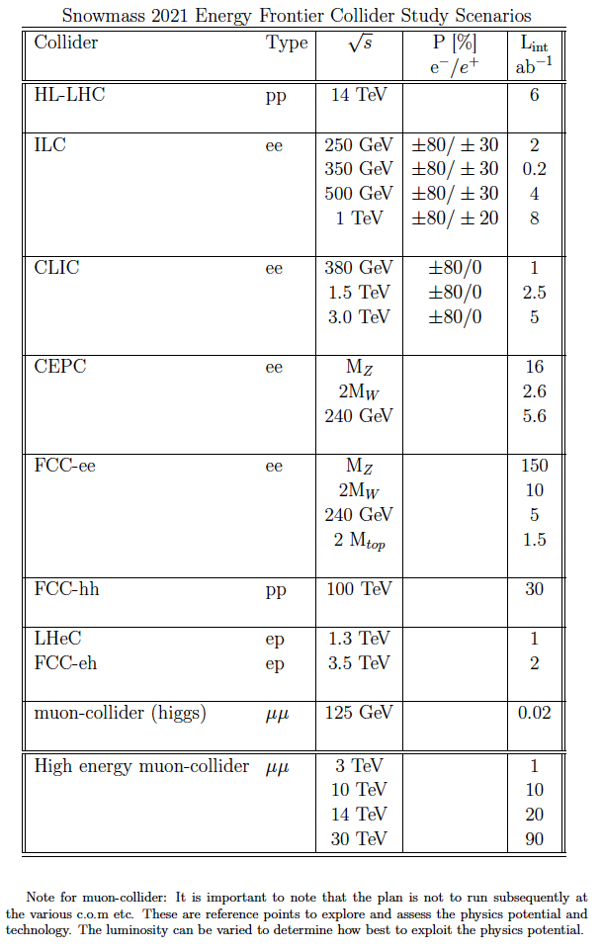
Accelerator Benchmark Parameters
Other options to explore:
Very high energy e+e- collider
Other emerging ideas:,
e.g. γ−γ collider, and the C³
e⁺e⁻ collider [C³=Cool Copper Collider]
Snowmass Agora on Future Colliders: series of events to enable discussions on physics and feasibility of future collider options (physics potential, technology challenges and R&D, synergies, time frame and costs)
One event per month - Dec. 2021-April 2022
Linear e+e- colliders, Dec 15 (https://indico.fnal.gov/event/52161/)
Circular e+e- colliders
Muon colliders
Circular pp and ep Advanced colliders
New
BNL Snowmass retreat day, December 17, 2021

Slide 9
The Energy Frontier Group (I)
EF Convenors: Laura Reina (FSU), Meenakshi Narain (Brown U.), Alessandro Tricoli (BNL)
Ten Topical Groups (TGs):
BNL Leadership
Topical Group | Co-Conveners
EF01: EW Physics: Higgs Boson properties and couplings | Sally Dawson (BNL), Andrey Korytov (U Florida), Caterina Vernieri (SLAC)
EF02: EW Physics: Higgs Boson as a portal to new physics | Patrick Meade (Stony Brook), Isobel Ojalvo (Princeton)
EF03: EW Physics: Heavy flavor and top quark physics | Reinhard Schwienhorst (MSU), Doreen Wackeroth (Buffalo)
EF04: EW Physics: EW Precision Physics and constraining new physics | Alberto Belloni (Maryland), Ayres Freitas (Pittsburgh), Junping Tian (Tokyo)
EF05: QCD and strong interactions: Precision QCD | Michael Begel (BNL), Stefan Hoeche (FNAL), Michael Schmitt (Northwestern)
EF06: QCD and strong interactions: Hadronic structure and forward QCD | Huey-Wen Lin (MSU), Pavel Nadolsky (SMU), Christophe Royon (Kansas)
EF07: QCD and strong interactions: Heavy Ions | Yen-Jie Lee (MIT), Swagato Mukherjee (BNL)
EF08: BSM: Model specific explorations | Jim Hirschauer (FNAL), Elliot Lipeles (UPenn), Nausheen Shah (Wayne State)
EF09: BSM: More general explorations | Tulika Bose (U Wisconsin), Zhen Liu (Maryland), Simone Pagan-Griso (LBL)
EF10: BSM: Dark Matter at colliders | Caterina Doglioni (Lund), LianTao Wang (Chicago), Antonio Boveia (Ohio State)
Monte Carlo Task Force and Production Team: coordinated by John Stupak (U. Oklahoma)
1) Assess the MC needs ⇒ “Task force” (work completed)
2) Produce MC samples ⇒ “Production Team” (ongoing)
BNL Snowmass retreat day, December 17, 2021

Slide 10
Topical Group Activities
EW Topical Groups
EF01, EF02, EF03, EF04
QCD & Strong Interact.
Topical Groups
EF05, EF06, EF07
General Energy Frontier Wiki
Electroweak TGs
EF01, EF02, EF03, EF04
QCD and Strong Interaction TGs
EF05, EF06, EF07
BSM TGs
EF08, EF09, EF10
BSM Topical Groups
EF08, EF09, EF10
Other
Frontiers
Other
Frontiers
Other
Frontiers
Multiple Ongoing Activities
See Topical Group Wiki pages and indico meeting agendas for details of ongoing activities
EF calendar and communications
BNL Snowmass retreat day, December 17, 2021

Slide 11
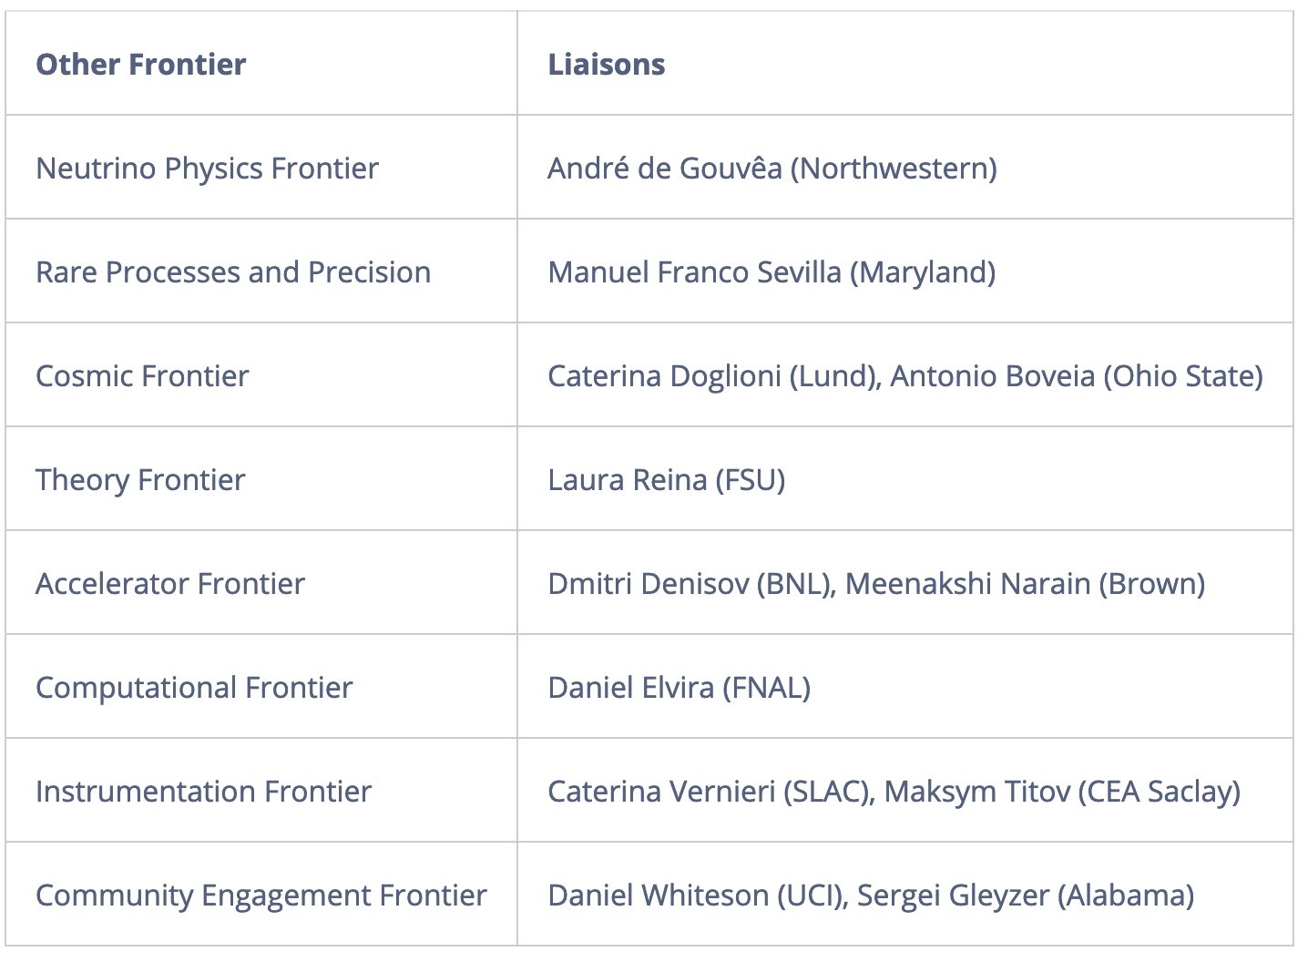
The Energy Frontier Group (II)
BNL Leadership
Liaisons: high-level and bi-directional communication b/w Frontiers
Renew interest in Snowmass community for Muon Collider:
Muon Collider Forum established with Accelerator and Theory Frontiers → Wiki (new)
Muon Collider Forum Coordinators
EF: Kevin Black (U. Wisconsin-Madison), Sergo Jindariani (Fermilab)
AF: Derun Li (LBNL), Diktys Stratakis (Fermilab)
TF: Patrick Meade (Stony Brook U.), Fabio Maltoni (Louvain U., Bologna)
BNL Snowmass retreat day, December 17, 2021

Slide 12
The Energy Frontier Group (III)
Snowmass thrives on the participation of Early Career (EC) physicists and offers an ideal environment for young people to get involved and promote their own initiatives
Early Career Representatives
Grace Cummings (U. Virginia) - gec8mf@virginia.edu
Matt LeBlanc (U. Arizona) - matt.leblanc@cern.ch
EC leadership is for a 3-month term (staggered): Grace and Matt are current EF representatives
Get in touch especially if you want to get involved in EF activities, but need guidance how to do it effectively: Grace and Matt will help build bridges between projects and new collaborators
Additional Snowmass resources for Early Careers:
#snowmass-young and #welcome-to-snowmass as points of entry for newcomers
The Snowmass Early Career twiki, which includes a description of our structure, current leadership, and the SEC calendar of all events.
BNL Snowmass retreat day, December 17, 2021

Slide 13
LOIs and Contributed Papers
Broad effort of LOI solicitation through dedicated Topical Group meetings
- 376 received - see list here
- 268 have EF as primary
- Cross-frontier LOIs: TF (21), AF (20), IF(17), RF (16), CF (14), NF (11), CompF (9)
LOIs have contributed to shaping Topical Group activities
- see breakout sessions of the Community Planning Meeting (CPM), Oct 5-8, 2020
List of Expected Contributed Papers (work-in-progress):
https://docs.google.com/spreadsheets/d/e/2PACX-1vSoMhW5FiyD_0DVN1zau9ttAI4LDdT3NFqDZppltO_5u-ULXWLRcMULYcPCbVFbQ5lHapLpz5T5dGcS/pubhtml?gid=1225382680&single=true
New
If you haven’t submitted a LOI, or you are not in the above list of planned papers, you can still contribute! just get in touch with your ideas and plans
BNL Snowmass retreat day, December 17, 2021

Slide 14
Timeline and Activities
1/21-6/21 Activity Slowdown | 30/6/21 Restart of Activities | 12/7/21 DPF Meeting + Snowmass Townhall | 30/8/21 EF restart Workshop | 24/9/21 Snowmass day | 15/3/22 Deadline Contributed Paper Submission | 31/5/22 Prelim. TG Reports | 30/6/22 Prelim. Frontier Reports | 17-26/7/22 Community Summer Study (UW-Seattle) | 30/9/22 Final Reports | 31/10/22 Snowmass Book & ArXiv docs
Future EF Events:
Regular EF Topical Group meetings, on a bi-weekly/monthly basis
Snowmass Agora on Future Colliders, once a month
Winter 2021-2022: few one-day virtual EF workshops by topic (SM, Higgs, BSM, Colliders,…)
Check progress towards March deadline for contributed papers, discuss overlap with other frontiers
28 March – 1 April 2022 at Brown Univ: EF workshop to review contributed papers
Focus on main themes and messages by contributed papers, towards May deadline for TG reports.
April-July 2022: drafting and circulations of prelim. TG and EF reports, then public readings
17-26 July 2022 in UW-Seattle: Community Summer Study, see web page
Hybrid meeting with 700 expected in-person participants, 10 days, similar format as in Snowmass 2013
Goals: Build community consensus, Cross-group collaborations, Report final preparation, Preparing the main messages for the P5 hand off
BNL Snowmass retreat day, December 17, 2021

Slide 15
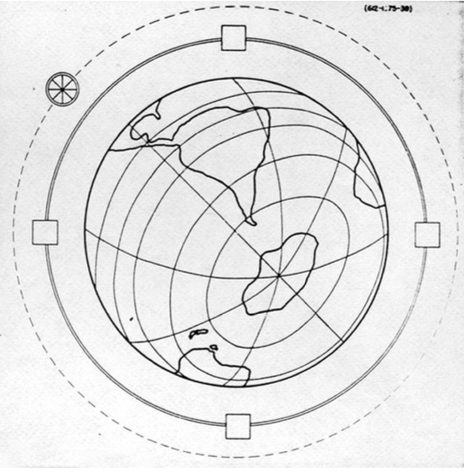
Summary
The Future of the Energy Frontier is in our hands ➔ let’s build a coherent vision for the future
Ambitious Energy Frontier plans to pave the way towards addressing big questions
Cross-fertilization across fields (Theory, Cosmics, Accelerators, Instrumentation etc.)
Energy Frontier activities have taken off in 2020, and restarted in Summer at full steam
The 2020 EF organization carries on, Strategic plans have been laid out, Connection with other frontiers is established, Early Career representation is active, Monte Carlo sample production has started, Studies are on-going
Plenty of time to join activities, propose new studies and address the many open questions
E. Fermi (1954, APS)
The Globatron: 5000 TeV collider,
Cost: 170B USD,
to be built by 1994
Let’s collectively DREAM BIG!
BNL Snowmass retreat day, December 17, 2021

Slide 16
Backup
BNL Snowmass retreat day, December 17, 2021

Slide 17
The Snowmass Process
Recurring long-term planning exercise for the US particle-physics community
“Develop community long-term physics aspirations.”
“Communicate opportunities for discovery in particle-physics to broader community and to the (US) government.” (Young-Kee Kim, former DPF Chair, Town-Hall Meeting, 2020 April APS meeting)
Physics-driven effort
Covers all areas of particle physics and facilitates cross-cutting.
Develop overarching physics studies.
Global effort
An opportunity for the entire HEP community to define the most important questions for our field and identify promising directions to address these questions in a global context
Input from non-US community is essential
Input from recent international studies, e.g. HL-LHC, European strategy (see report, July 2020), future colliders communities etc.
BNL Snowmass retreat day, December 17, 2021

Slide 18
Big Picture Questions
Why is physics at the energy frontier important?
How should the US be involved in near future and far future energy-frontier machines after HL-LHC?
What could be the energy-frontier machines that follow the HL-LHC?
How can the US continue to play a leadership role in energy-frontier experiments?
How can the Snowmass process help develop a plan for the energy-frontier research and convince the community about our priorities?
Should we start entertaining the idea of a future collider in the US again? If so, what are our goals, the benefits for the US and the international community, and how can we get there?
etc...
Energy Frontier Kick-off Meeting on May 21, 2020, see agenda
These questions were discussed in the Panel: “The importance of the Energy Frontier in the US HEP future planning” at the “Energy Frontier Workshop - Open Questions and New Ideas”, July 20-22, 2020
By Jorgen D'Hondt, Nima Arkani-Hamed, Sarah Eno, Vladimir Shiltsev, Xinchou Lou, Young-Kee Kim
See Zoom recording of Panel Discussion
BNL Snowmass retreat day, December 17, 2021

Slide 19
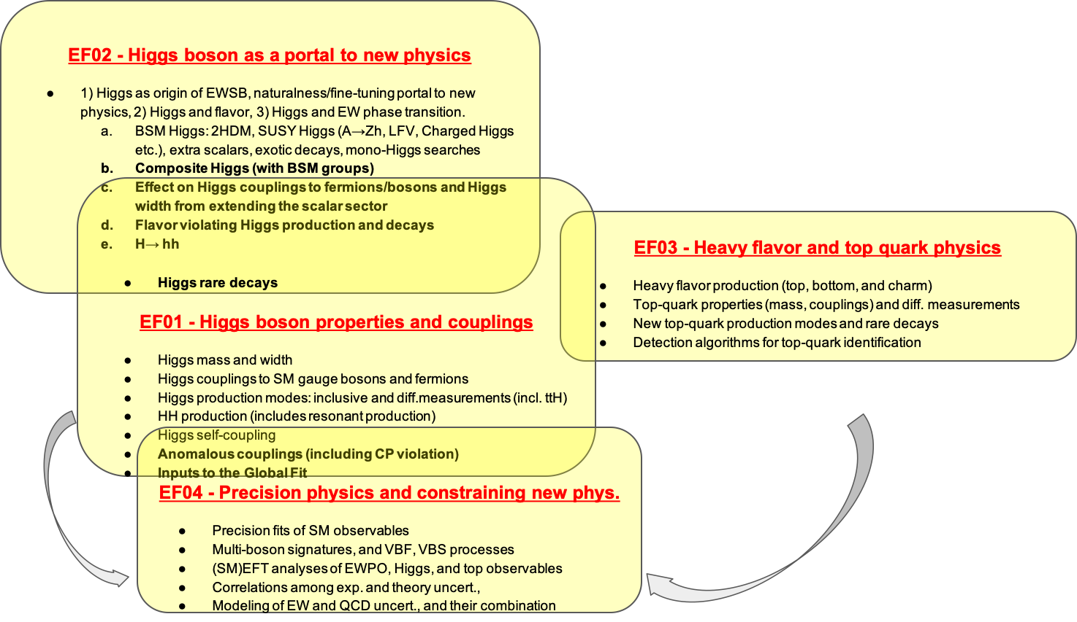
Topical Group Activities
EW Topical Groups
BNL Snowmass retreat day, December 17, 2021

Slide 20
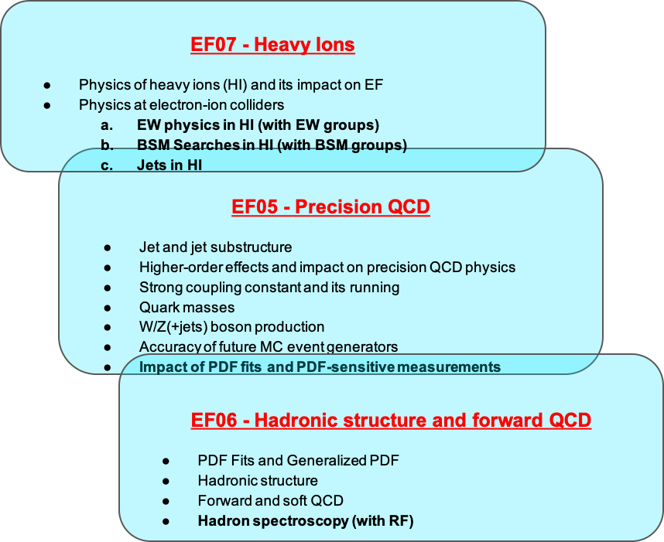
Topical Group Activities
QCD Topical Groups
BNL Snowmass retreat day, December 17, 2021

Slide 21
Topical Group Activities
BSM Topical Groups
BNL Snowmass retreat day, December 17, 2021

