Slide 1
Modular RICH Simulation -- Aerogel thickness & Refractive Index
Cheuk-Ping Wong
Georgia State University
11-19-2015

Slide 2
Update Aerogel Properties
We update aerogel properties: 1.) Thickness and 2.) Refractive Index base on Marco Contalbrigo’s report¹.
In the report
Aerogel thickness = 3cm
Aerogel refractive index is in range 1.0477 to 1.0523
https://clasweb.jlab.org/wiki/index.php/2015_October_13_RICH_Project_Mid-term_Review

Slide 3
In This Update
We change modular Rich detector dimension (see next slide) for flexible aerogel thickness
Compare simulation results between
3cm and 2cm thick aerogel
Different refractive indices
refractive index ≈1.02 (a function of photon energy given by Hubert) which is what we usually use
refractive index =1.0477
refractive index =1.0523

Slide 4
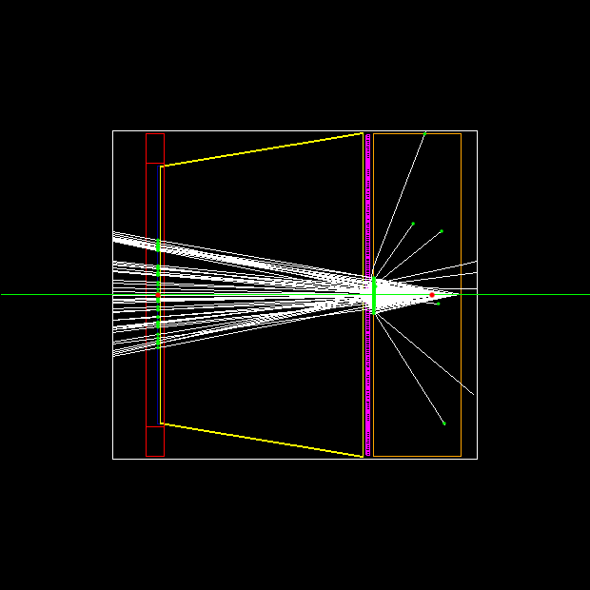
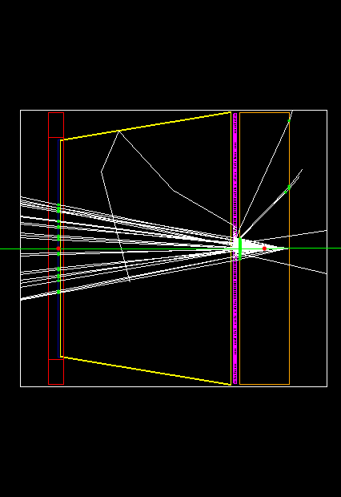
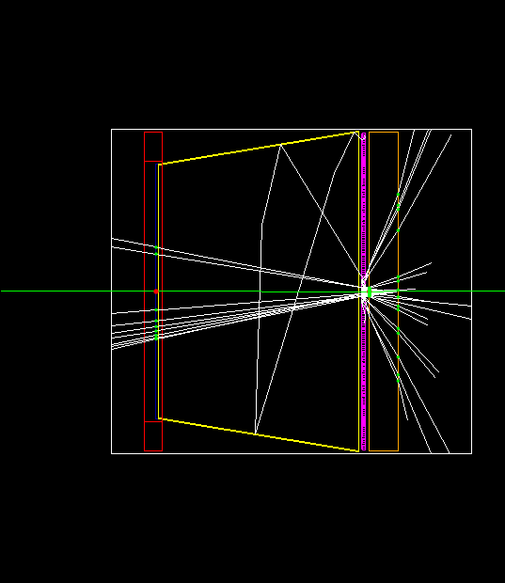
Updated Dimension of Modular RICH Detector in GEMC Framework
3cm Aerogel
2cm Aerogel
1cm Aerogel
Enlarged but fixed dimension of detector holder box

Slide 5
Updated Dimension of Modular RICH Detector in GEMC Framework
Updated Dimension of Modular RICH Detector in GEMC Framework
Shift Fresnel lens, mirrors, photonsensor and readout to the left
z-position of these components is fixed (independent on the thickness of aerogel)

Slide 6
Updated Dimension of Modular RICH Detector in GEMC Framework
================== 3 cm thick Aerogel ==================
Printing detector positions and sizes …
hold box position: ( 0.0, 0.0, 112.5 mm), half size in XYZ: ( 56.25 mm, 56.25 mm, 62.5 mm )
aerogel position: ( 0.0, 0.0, 69 mm), half size in XYZ: ( 55.25 mm, 55.25 mm, 15 mm )
fresnel lens position: ( 0.0, 0.0, 85.5 mm), half size in XY: ( 55.25 mm, 55.25 mm )
photon detector position: ( 0.0, 0.0, 158.5 mm), half size in XYZ: (44.2 mm, 44.2 mm, 1 mm )
readout position: ( 0.0, 0.0, 157.5 mm, and 163.5 mm )
=====================================================================

Slide 7
Simulation Setup
Momentum range 0-15 GeV/c
1000 events
Pion-
Kaon-
Magnetic field off
Agel thickness
3 cm
2cm
Agel refractive index
refractive index ≈1.02 (a function of photon energy given by Hubert) which is what we usually used
refractive index =1.0477
refractive index =1.0523
Thus, we have 2x2x3=12 sets of data

Slide 8
Compare Simulation Results
with Different Refractive Indices

Slide 9

Ring Radius vs Momentum
 | 2 cm thick Aerogel | 3 cm thick Aerogel
Pion
Kaon
-- 1.0523
-- 1.0477
-- 1.02
$$\cos{θ}=\frac{c}{nv}$$
Larger the refractive index, larger the Chenerenkov ring radius

Slide 10
Num. of Photon Hits per Event vs Momentum
 | 2 cm thick Aerogel | 3 cm thick Aerogel
Pion
Kaon
Number of photon hits per event increases with refractive index
-- 1.0523
-- 1.0477
-- 1.02

Slide 11
Compare Simulation Results
with Different Aerogel Thicnkesses

Slide 12
Ring Radius vs Momentum
 | Refractive index~1.02 | Refractive index=1.0477 | Refractive index=1.0523
Pion
Kaon
Ring Radius shifts up a bit when thickness of agel is increased
-- 2cm thick agel
-- 3cm thick agel

Slide 13
Num. of Hits per Event vs Momentum
 | Refractive index~1.02 | Refractive index=1.0477 | Refractive index=1.0523
Pion
Kaon
Num. of Hits per Event increases with agel thickness
-- 2cm thick agel
-- 3cm thick agel

Slide 14
Compare Simulation Results
with Different Incident Particles

Slide 15
Ring Radius vs Momentum
 | Refractive index~1.02 | Refractive index=1.0477 | Refractive index=1.0523
2cm
3cm
-- Pion-
-- Kaon-

Slide 16
Num. of Hits per Event vs Momentum
 | Refractive index~1.02 | Refractive index=1.0477 | Refractive index=1.0523
2cm
3cm
It is hard to identify pion and kaon in high momentum region (roughly higher than 6 GeV/c) by looking at the plots on slide 14 and 15. However, it is hard to make conclusion at this point, and a sophisticated analysis using Likelihood Analysis is needed.
-- Pion-
-- Kaon-

Slide 17
Summary
In order to make the simulation result more reliable, we changed aerogel properties in simulation to fit the actual aerogel sample shown by Marco
Both ring radius and num. of hits per events increase with refractive index
Both ring radius and num. of hits per events increase with aerogel thickness
Maximum Likelihood analysis is needed to analysis the effect of refractive index and aerogel thickness on PID

Slide 18
Next
Study Likelihood analysis
Set agel thickness=3cm, refractive index=(1.0477+1.0523)/2=1.05
then compare analysis results with Liang’s works
Delta ray electrons energy distribution

