Slide 1
SDCC Website Content Editing
Jason Smith
Louis Pelosi
12-8-2021

Slide 2
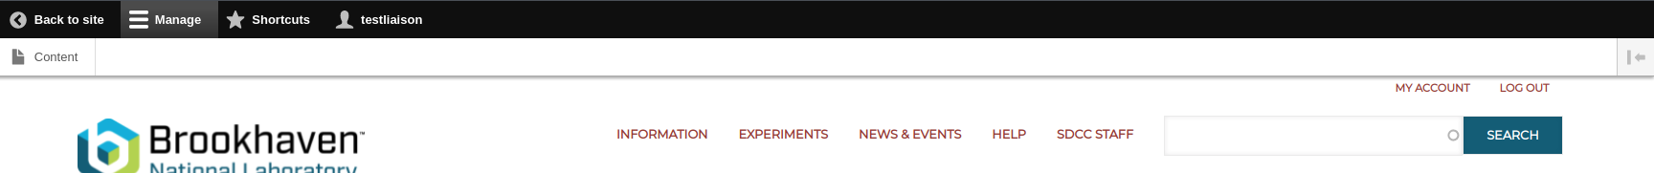
Initial steps
All liaisons will need to log into sdcc.bnl.gov first and request their account be elevated to the liaison role via the Www RT queue
RT-RACF-Www@bnl.gov
Once the user has the liaison role attached to their account they will see a new toolbar on the site with access to a section called “content”
<number>

Slide 3
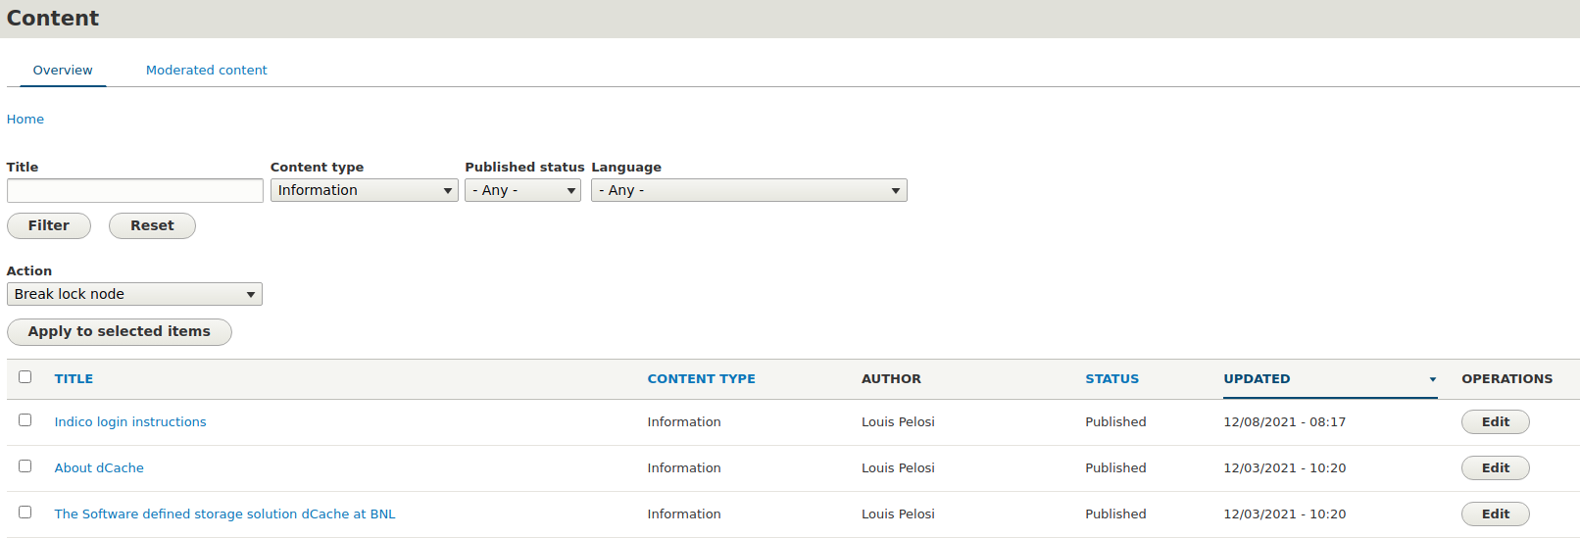
How to edit
Clicking through ‘content’ from the toolbar will bring you to a new section listing all available content that can be edited
Select which page you are going to edit
<number>

Slide 4
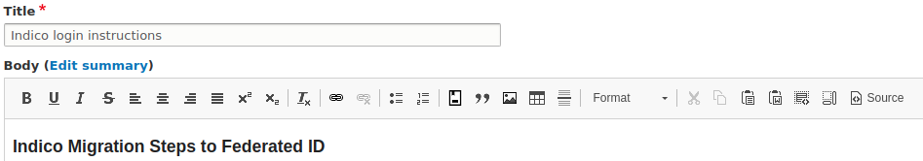
Editing
Once you edit the content it will be considered “locked” from other users preventing parallel editing
You can make your changes/updates using the editor, you will also be able to edit using html if you choose by selecting the ‘source’ button on the right of the body section toolbar
<number>

Slide 5
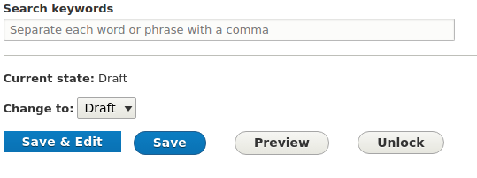
Saving
When you are finished making your changes you should select the “Save” button “Save & Edit” will save your work the same but keep the lock on if you need to take a break and come back
The lock is automatically removed after 4 hours of inactivity
A member of the SDCC staff will be able to approve the changes you will need to open a ticket in the Www RT queue
RT-RACF-Www@bnl.gov
Be sure to include a link to the page you are editing so that staff can be sure they are referring to the correct page
<number>

Slide 6
Questions?
<number>

