Slide 1
To Lens or not to lens: ref:https://arxiv.org/abs/1802.05273 and https://arxiv.org/abs/2105.06384
BNL LSST Journal Club
15 December 2021
Mike Sivertz

Slide 2
Lensing effects on Gravitational Waves
Magnification, μ
Increases the apparent amplitude (strain) of the GW
Wrong amplitude used to derive wrong redshift
Cosmologically stretched wave train, λ_{Observed} = λ_{GW} (1+z)
Decreases the apparent distance to the BH merger event making the BBH appear closer than it really is.
Wrong orbital frequency, appears to be lower than in rest frame
Wrong BH mass, appears to be higher than in rest frame

Slide 3
Lensing? What are the important factors?
What is the black hole mass distribution?
Is it the same as the binary black hole (BBH) mass distribution?
What was the mass distribution at the time of formation of the BBH when the Star Formation Rate (SFR) was much higher than it is now?
What is the probability of a random lensing event?
What is the probability as a function of magnification?
What other signatures would lensing produce? Are they seen?

Slide 4
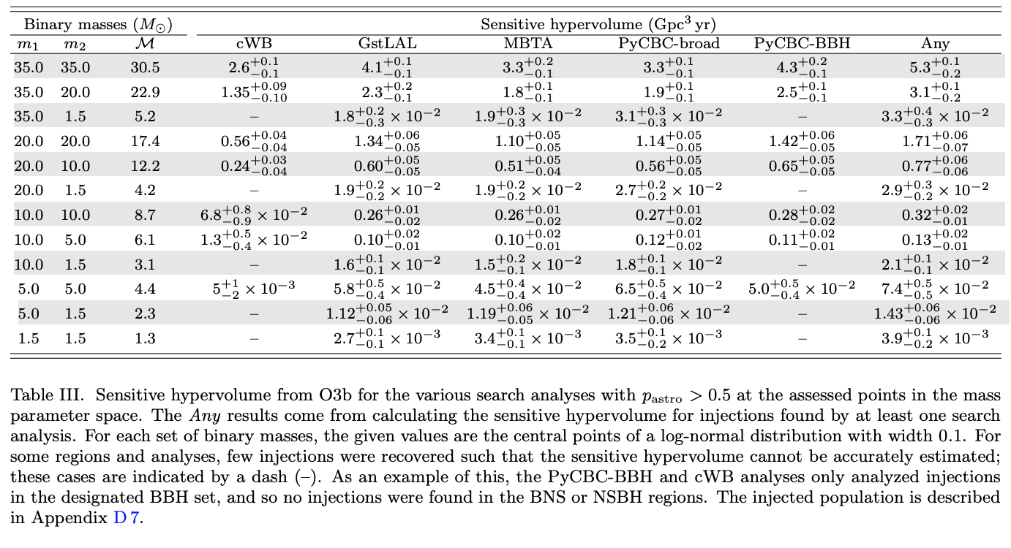
LIGO GW events
BH masses of 20 – 35 M⦿

Slide 5
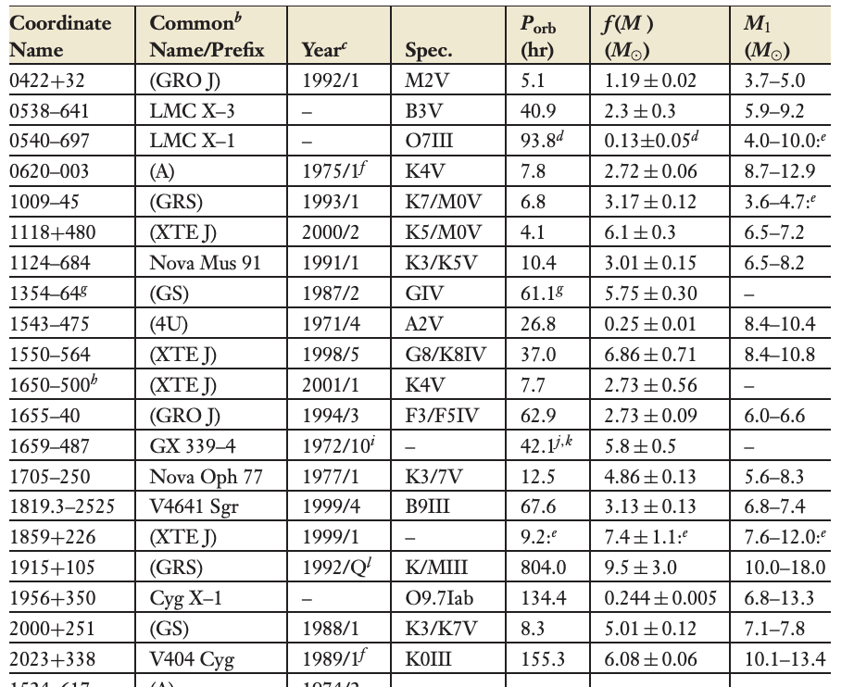
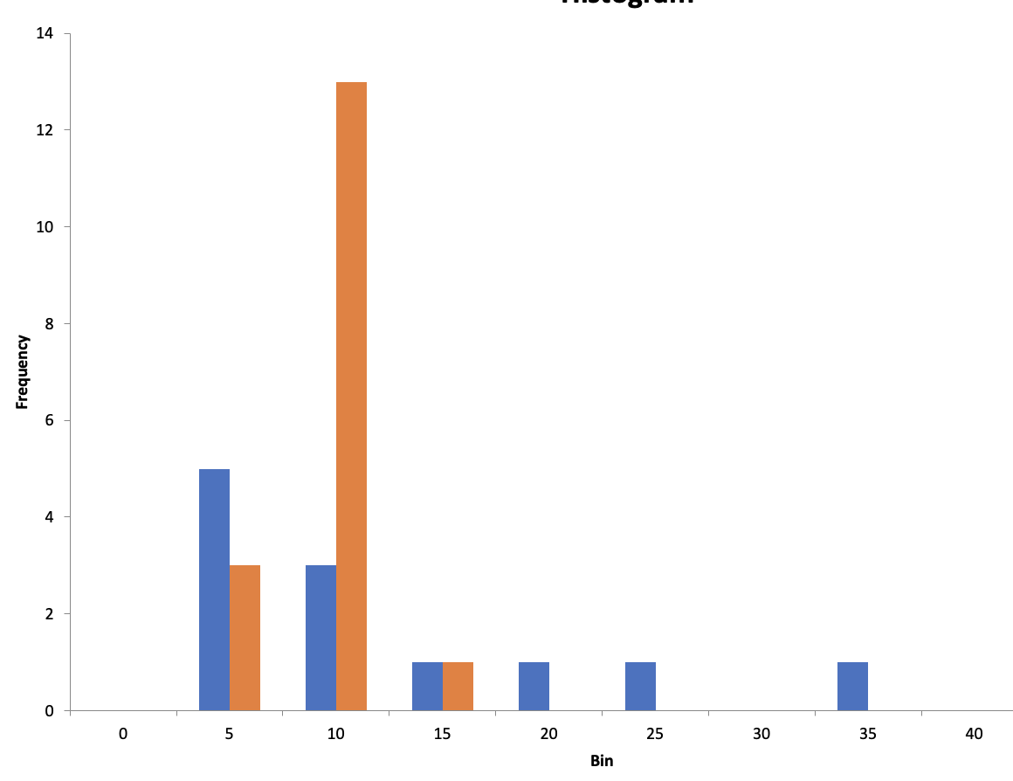
BH Binaries in the Milky Way - 2006 (from https://www.annualreviews.org/doi/pdf/10.1146/annurev.astro.44.051905.092532)
This is a list of the known
Binary black holes in the
Milky Way, giving the mass
Range of the chirp mass
It is used as the prior for the
Mass distribution of BBH in
The LIGO-Virgo study.

Slide 6
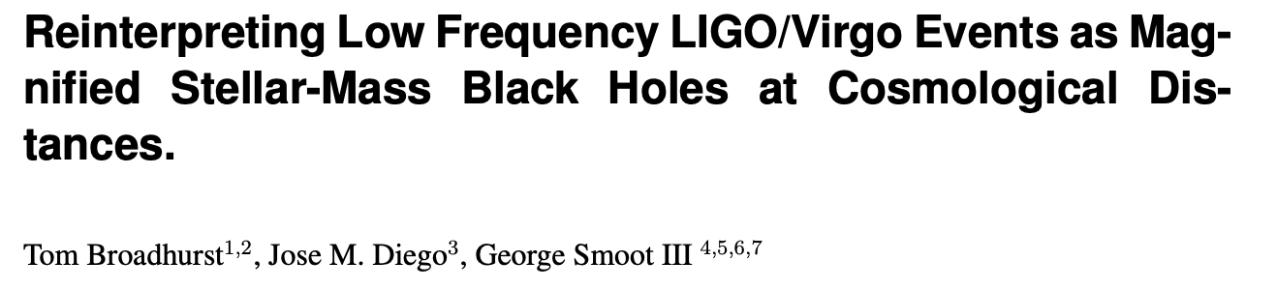
Non-lensing paper: https://arxiv.org/abs/1802.05273
Claims evidence for lensing

Slide 7
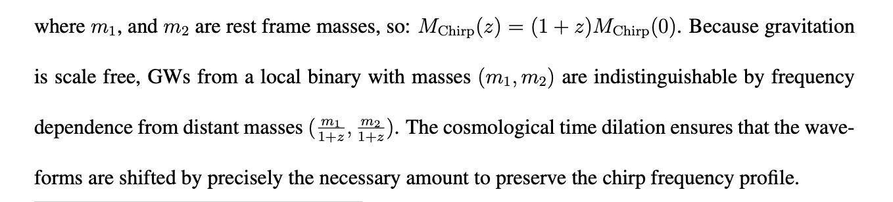
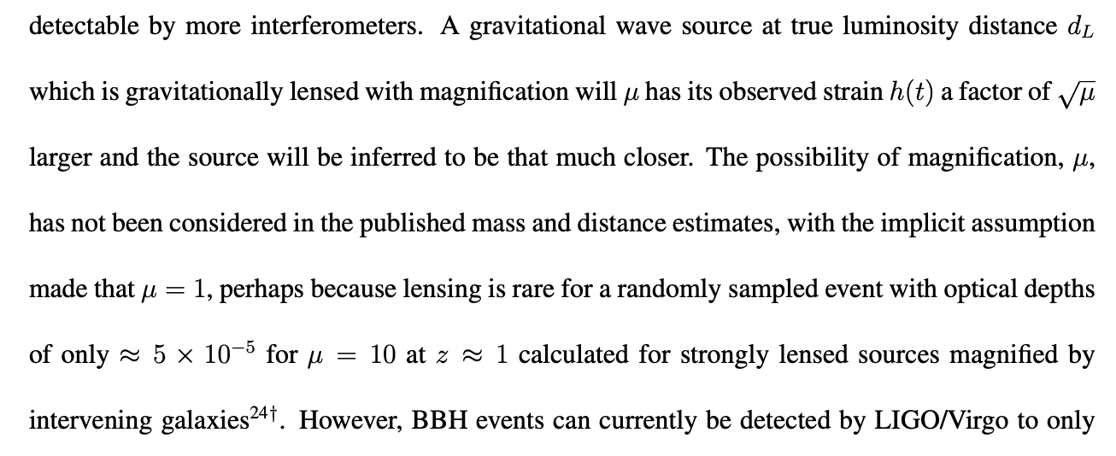
Lensing: Redshifting BBH

Slide 8
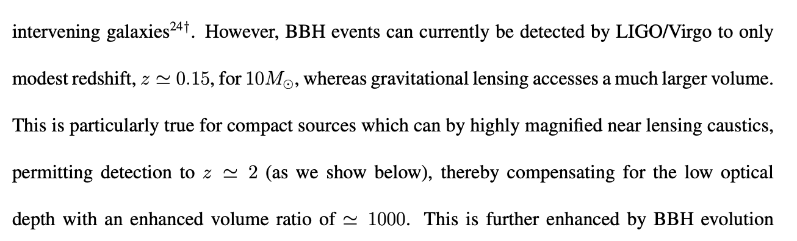
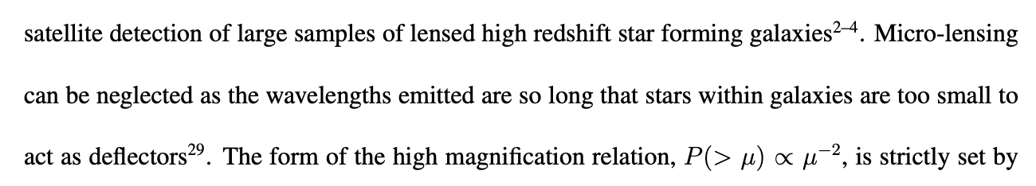
Lensing: Magnifying BH mergers

Slide 9
LIGO Paper: https://arxiv.org/abs/2105.06384
Search for lensing signatures in the gravitational-wave observations from the first half of LIGO-Virgo’s third observing run
The LIGO Scientific Collaboration and the Virgo Collaboration
Claims no evidence for lensing

Slide 10
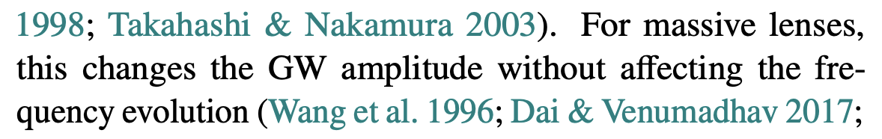
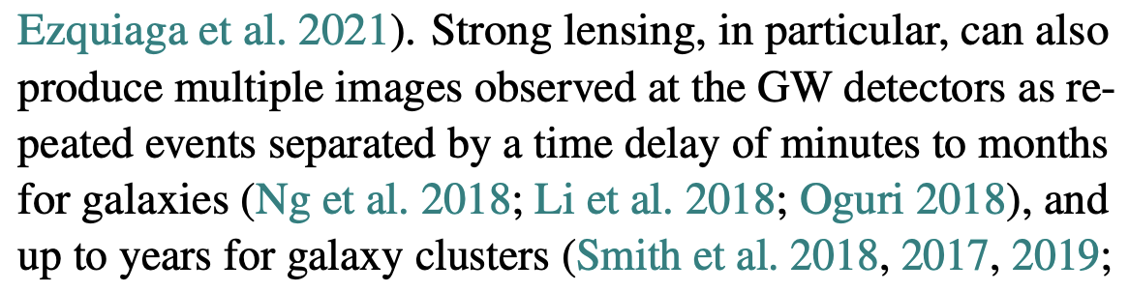
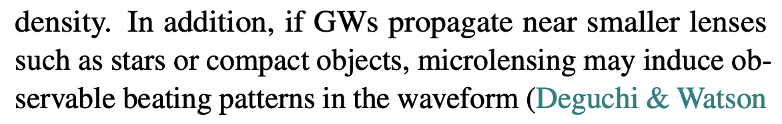
LIGO paper
Singly lensed images
Are predicted to occur
~2 times the rate of doubly
Lensed images.
Wavelength too long
For microlensing

Slide 11
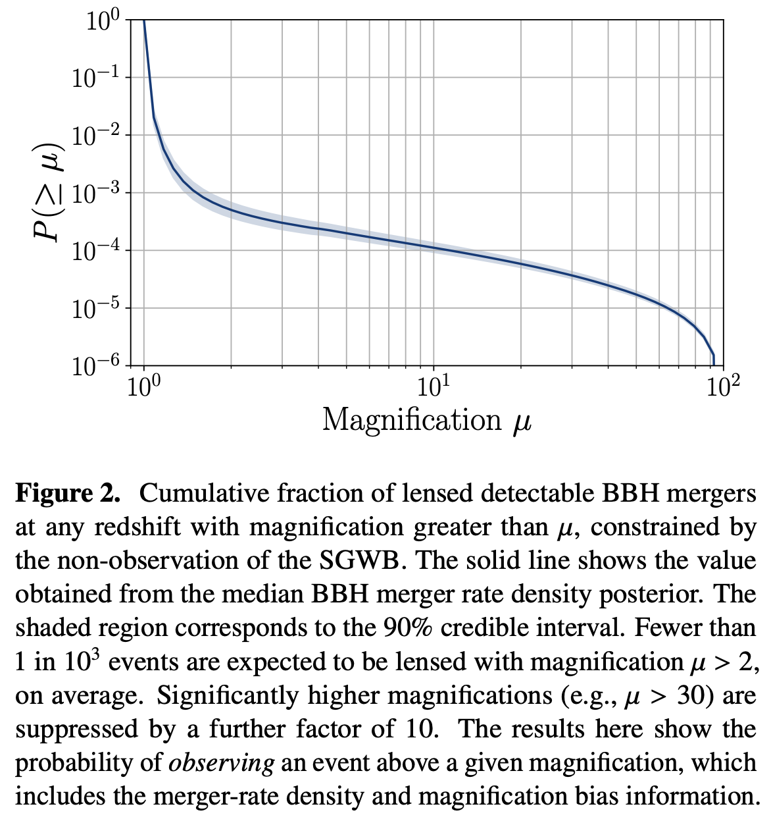
Magnification Rate
Showing the cumulative
fraction of BBH mergers
as a function of the
magnification, μ
Red lines at
μ=2, P = 4.9x10⁻⁴
and
μ=30, P = 3.5x10⁻⁵

Slide 12
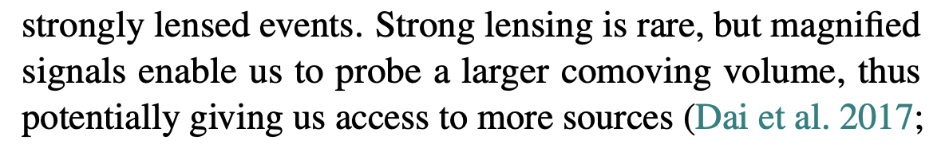
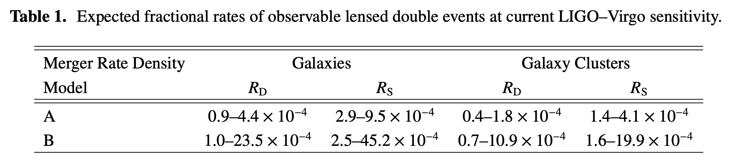
LIGO/Virgo sensitive to unlensed BBH mergers to z=0.15.
Lensed BBH mergers to z=2.
Ratio of volumes = (r₂/r_{0.15})³ = 578 enhancement in rate

Slide 13
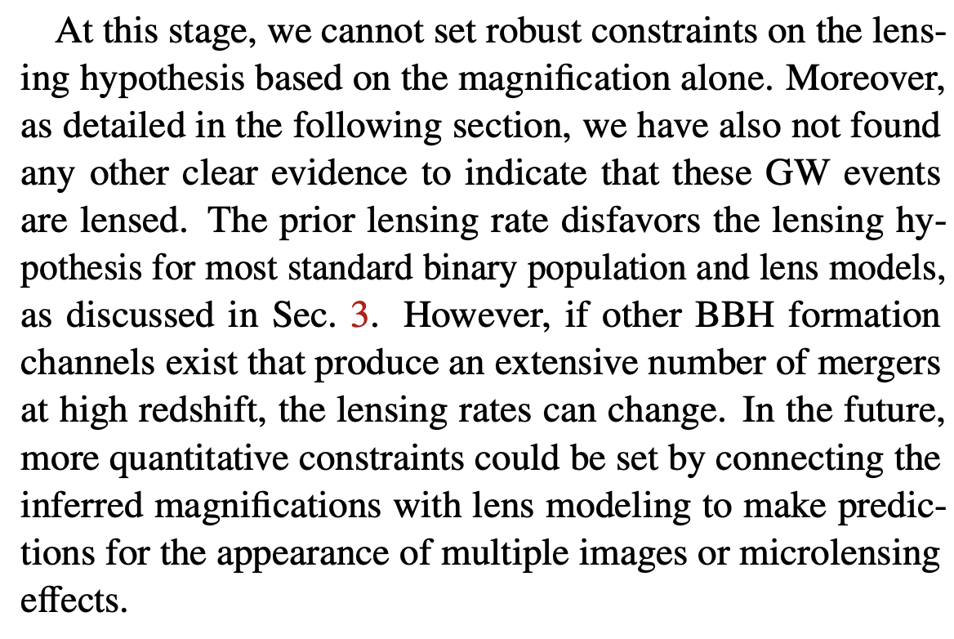
LIGO Summary on magnification

Slide 14
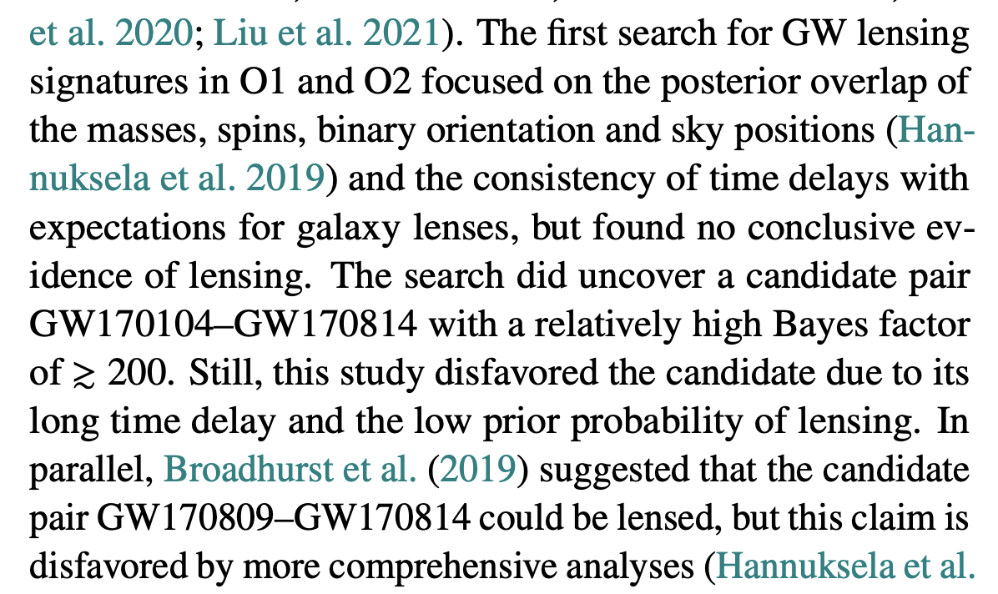
LIGO Summary on double imaging
My opinion:
Evidence for new physics requires
A high bar be passed. The question is:
Which hypothesis constitutes new physics?
- high mass BBH or
- lensed low mass BBH
I am agnostic on this…

Slide 15
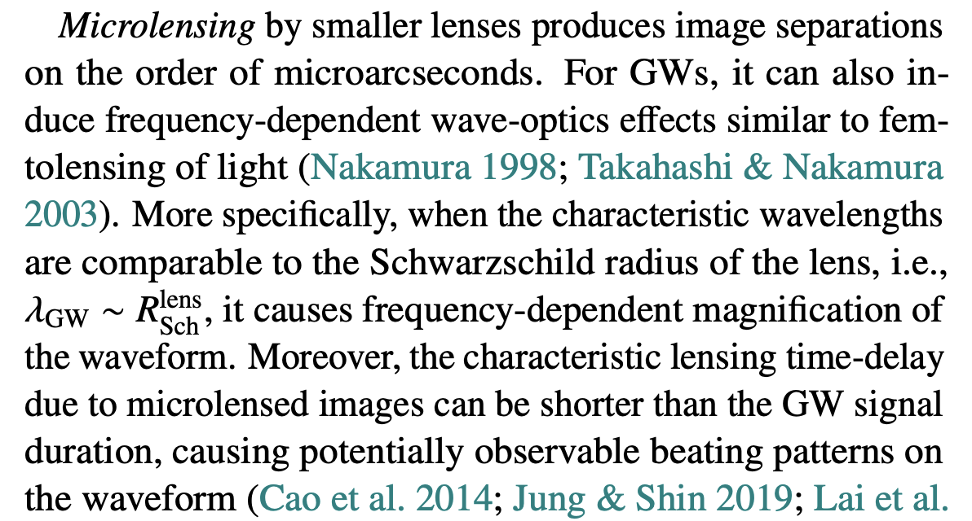

LIGO: Microlensing

Slide 16
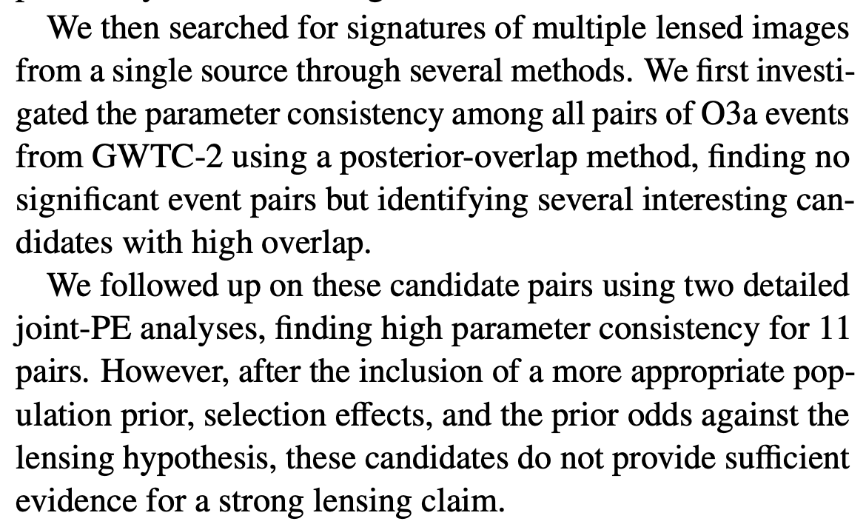
LIGO: Conclusions

Slide 17
My conclusions:
Still agnostic.

