Slide 1
sPHENIX
Edward O’Brien
PMG
December 16, 2021

Slide 2
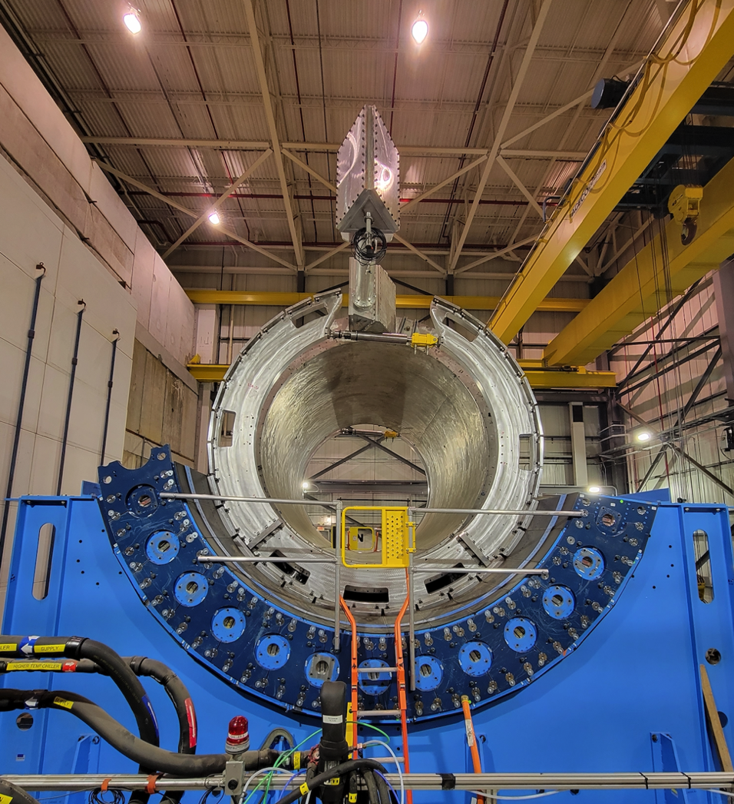
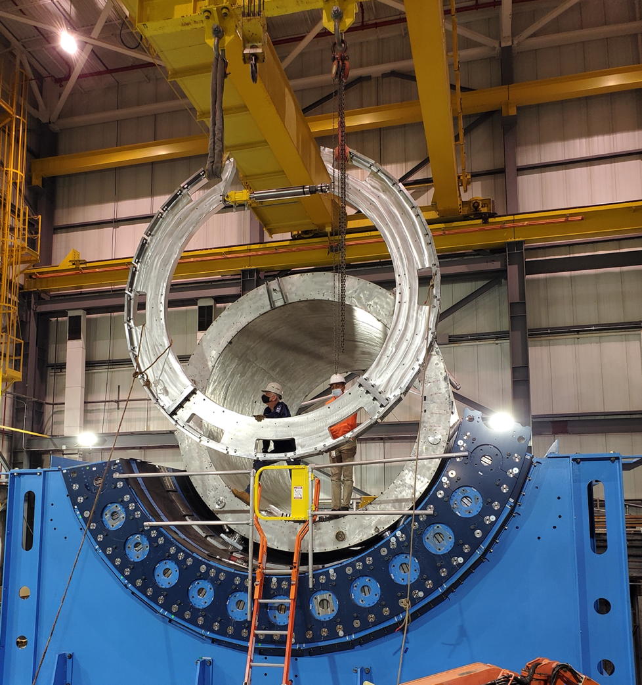
Large Support Rings N&S Installed in 1008
Large Support Ring - South
Large Support Ring - North

Slide 3
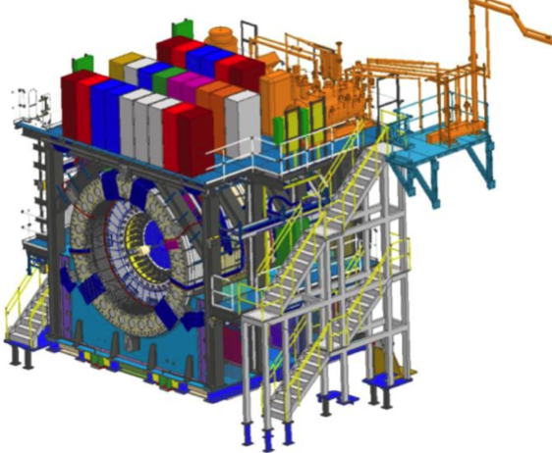
sPHENIX MIE Project
TPC | Project Director | Last CD Achieved | % Complete | CPI | SPI
$27.0M | Edward O’Brien | PD-2/3 | 88.2% BCWP/BAC @ 10/31/2021 | 1.03 | 0.90
Scope
  Detector systems produced, tested and ready for installation: Time Projection Chamber w/ electronics, Electromagnetic Calorimeter w/ electronics, Hadronic Calorimeter w/ electronics, DAQ/Trigger, Minimum Bias Detector, Project Management
Not in scope
  SC-Magnet, Bldg/Det Infrastructure, Installation and System Commissioning
Schedule
  CD-0 received Sept 2016
  CD-1/3A received Aug 2018
  PD-2/3 received Sept 2019
  Early completion end of March 2022
  PD-4 end of Dec 2022
Cost
  $27.0M AY TPC 54.2% contingency on an ETC of $3.96M
99.3% Costed & Committed
Commitments = $3.267M
9 months float between MIE Early Completion and PD-4

Slide 4
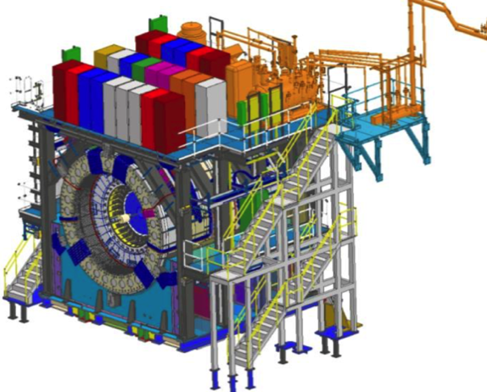
BNL 1008 Infrastructure & Facility Upgrade
TPC | Project Director | % Complete | CPI | SPI
$33.4 M AY | Edward O’Brien | 69.4% BCWP/BAC @ 10/31/2021 | 1.01 | 0.87
Scope
  SC-Magnet support including the Flux Return, Cryogenics into Bldg 1008, Detector Carriage/Cradle, other Bldg 1008 Infrastructure improvements
  sPHENIX Installation, Integration and Commissioning of each Subsystem is part of the scope
Not in Scope
  PreOps prior to RHIC collisions
Schedule
  sPHENIX Ready for Operations (Early Completion) 11/22/22
  First RHIC run of sPHENIX Feb 1, 2023
  2.5 months float in schedule between sPHENIX ORR and
  nominal start of RHIC 2023 run.
Cost
  $33.4 M AY Total Project Cost with 16.1% contingency on ETC of $10.27M
80.6% Costed and Committed
Commitments = $4.21M
2.5 months of float between I&F Early Completion and RHIC Run-2023

Slide 5
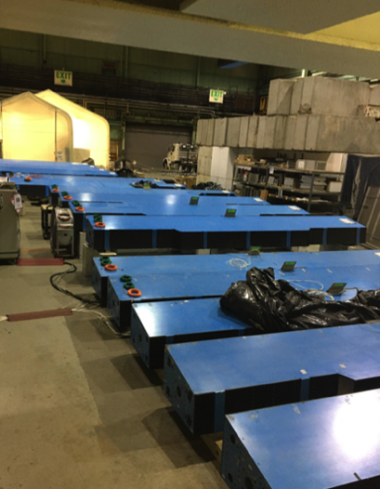
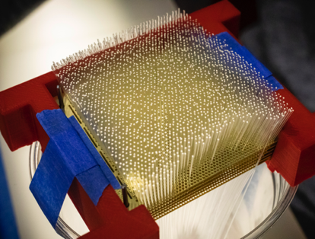
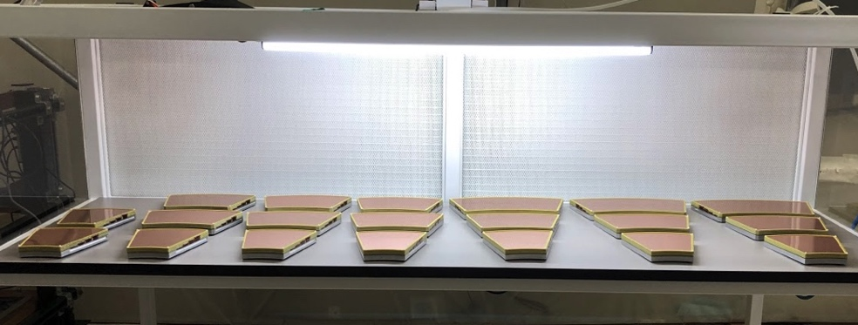
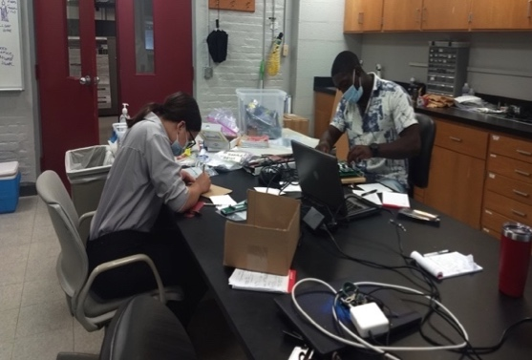
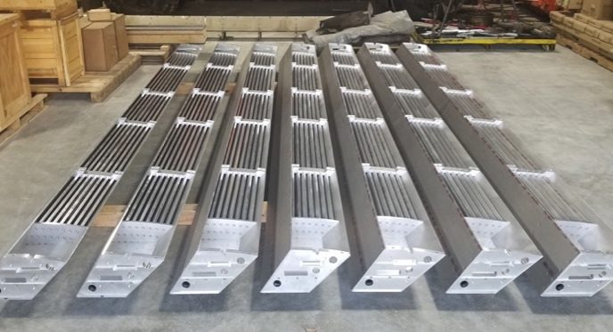
sPHENIX MIE Status
Outer HCal sectors going through final testing/burn-in
sPHENIX Assembly continues in the 1008 Assembly Hall. OHCal installation restarts today.
The Outer HCAL Sectors are complete. All sectors burned-in and ready to install.
Inner HCal mechanical sectors are complete. IHCal sector instrumentation 88% complete. 50% tested and burned in.
EMCal blocks 98% complete at UIUC. Final delivery of epoxy has arrived. EMCal Sectors 72% complete at BNL. Schedule projects mid-late March for Sector completion
TPC Fee boards 92% assembled and ready to test.. All FELIX boards 100% assembled and ready to test.
All EMCal and OHCal on-detector electronics received at BNL. Calorimeter digitizer components continue to arrive at Columbia University (95% received to date)
All GEM framing for TPC at WSU, WIS, Vanderbilt, Temple. Quad-GEM module assembly 100% complete at SBU
Major DAQ/Trigger orders: Large switch, DAQ computers and Buffer Boxes are delivered to BNL.
EMCal block fab @ UIUC
TPC Quad-GEM modules at SBU
All IHCal sectors at BNL
TPC Outer field cage at SBU
Students testing EMCal preamps @ Lehigh Univ

Slide 6
Key Remaining Order MIE
DAQ/Trigger: GL1/GTM boards (parts orders begun) Danny Padrazo
EMCal: UIUC labor. (with PPM) EO’B
TPC: Laser servomotors and mechanics Tom Hemmick
TPC: optical fibers Jin Huang
TPC: Fiber sort-out box Jin Huang
TPC: JACK board Takao Sakaguchi
Need all of these items to complete the MIE deliverables

Slide 7
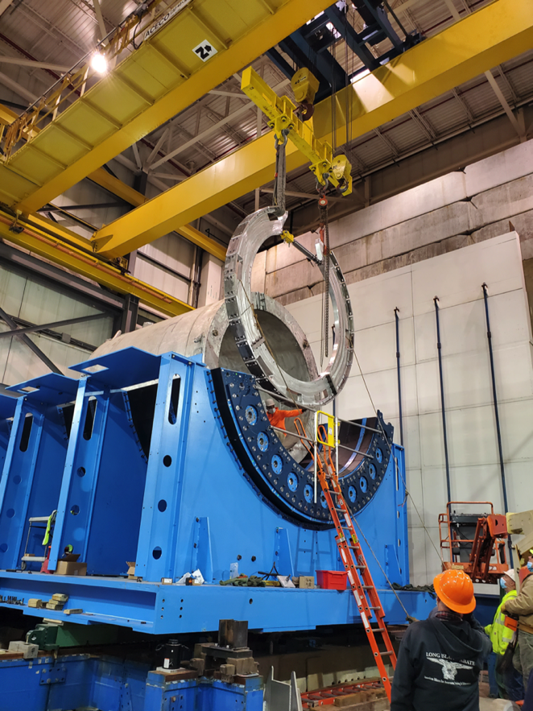
1008 Infrastructure and Facility Upgrade Status
Carriage/Cradle assembled in 1008
XY Carriage tables, Carriage Hydraulics installed
SC- Magnet installed in 1008
EMCal Installation fixture complete
IR track reinforcement complete.
Large Support Rings installed
LHe cryo components part delivered, installation begun
LN2 & warm piping part delivered, installation begun
IHCal assembly, installations fixtures awarded or in production
Magnet flux return Pole tip/end cap in production
sPHENIX Beam Pipe at vendor for modification.
Rack Platform in production at vendor
The sPHENIX group was part of the CAD Safety stand down in October and December during which time we evaluated how to improve our safety practices.

Slide 8
Key Remaining Orders I&F
TPC installation fixtures and bracketry Jim Mills /Connor Miraval
Beam pipe, MBD, sEPD supports, N&S platforms Russ Feder /Brian Bretton
Magnet Mapping (In negotiation w/ CERN) EO’B
Fiber Optics trunk cables John Haggerty
HVAC Improvements Dave Chan
INTT brackets and installation fixtures Dan Cacace
Seismic restraints Jon Hock
Need all of these items to be ready for Run-2023

Slide 9
sPHENIX construction parallel work streams to the end of Run-2022
 | Where | Who | Dec 21’ | Jan 22’ | Feb 22’ | Mar 22’ | Apr 22’ | May 22’
Large Support Rings and oHCAL Installation | 1008 | Techs Rigging Survey
iHCAL Factory and iHCAL Barrel Assembly | 912 | Techs
iHCAL Insertion Structures and iHCAL installation | 1008 | Techs Rigging Survey
EMCAL Factory | 510 | Techs
Carriage, Pole Tip Doors, Platforms, Magnet Valve Box and West Racks | 1008 | Techs Rigging Survey
Infrastructure: Rack and Control Rooms | 1008 | Techs
Infrastructure: XXXX | 1008 | Techs
All Parts Ready
Barrel assembly rig parts arrive mid-December
`
Deploy EMCAL techs to other sPHENIX work = When ??
This is work that could be done by CA-D techs, riggers
`
`

Slide 10
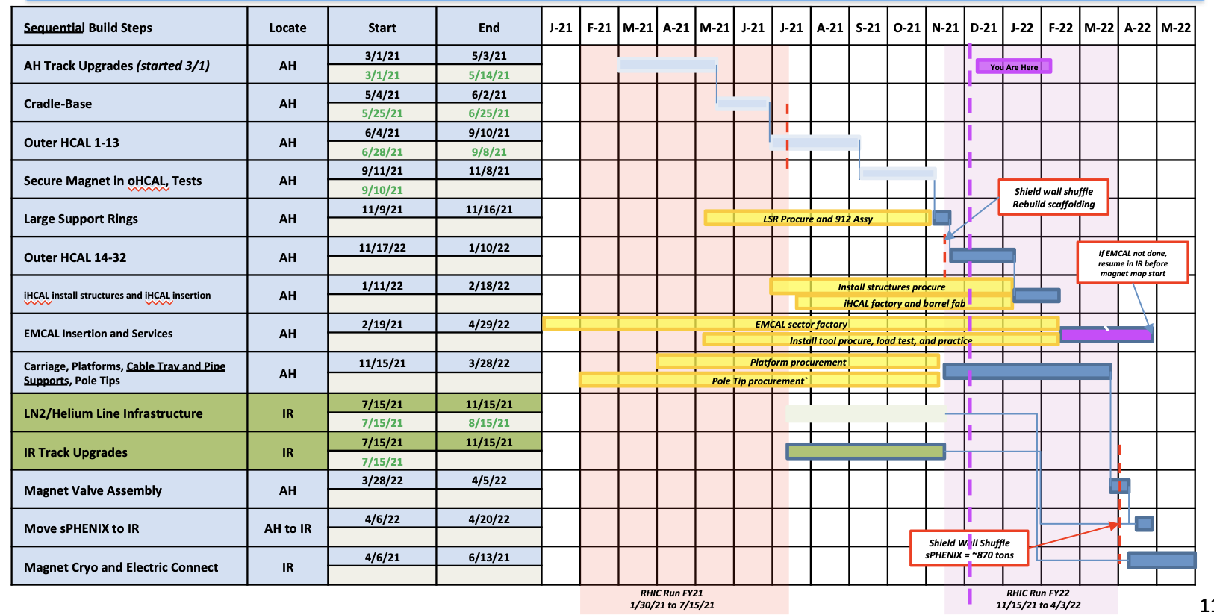
sPHENIX Installation Schedule

Slide 11
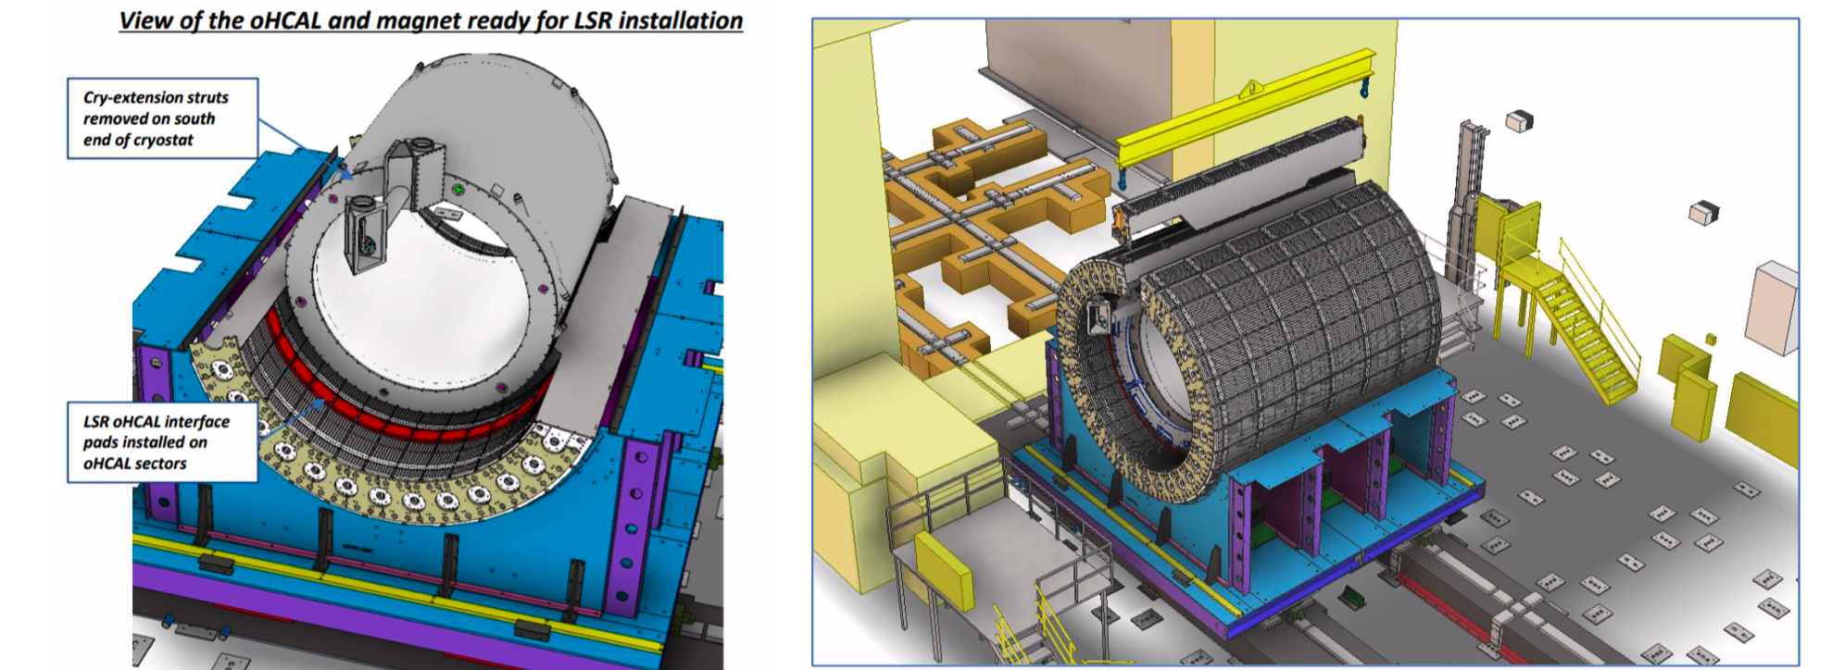
Next Installation Steps
Survey LSR’s on Carriage and tweet position if necessary. Square-up the carriage wrt the reinforced tracks
Install the OHCal sectors 14-32 into the OHCal Barrel. This work will take us until mid-January.

Slide 12
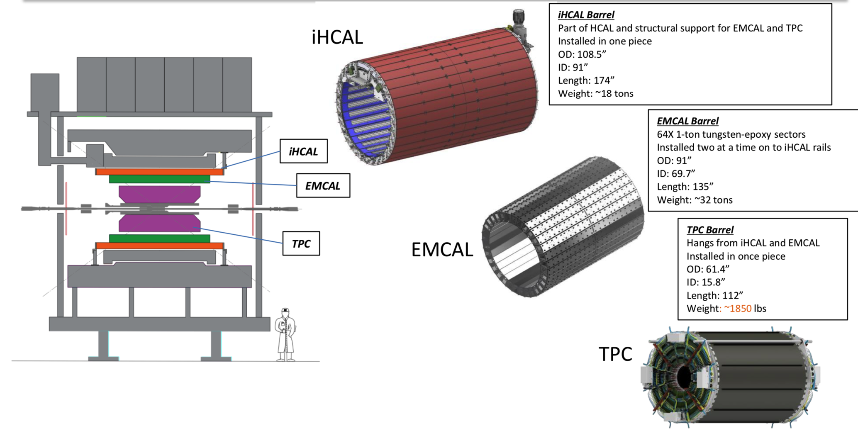
IHCal, EMCal, TPC Installation

Slide 13
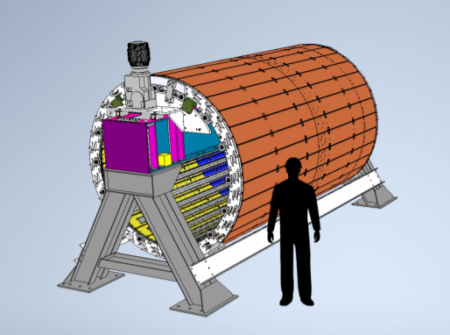
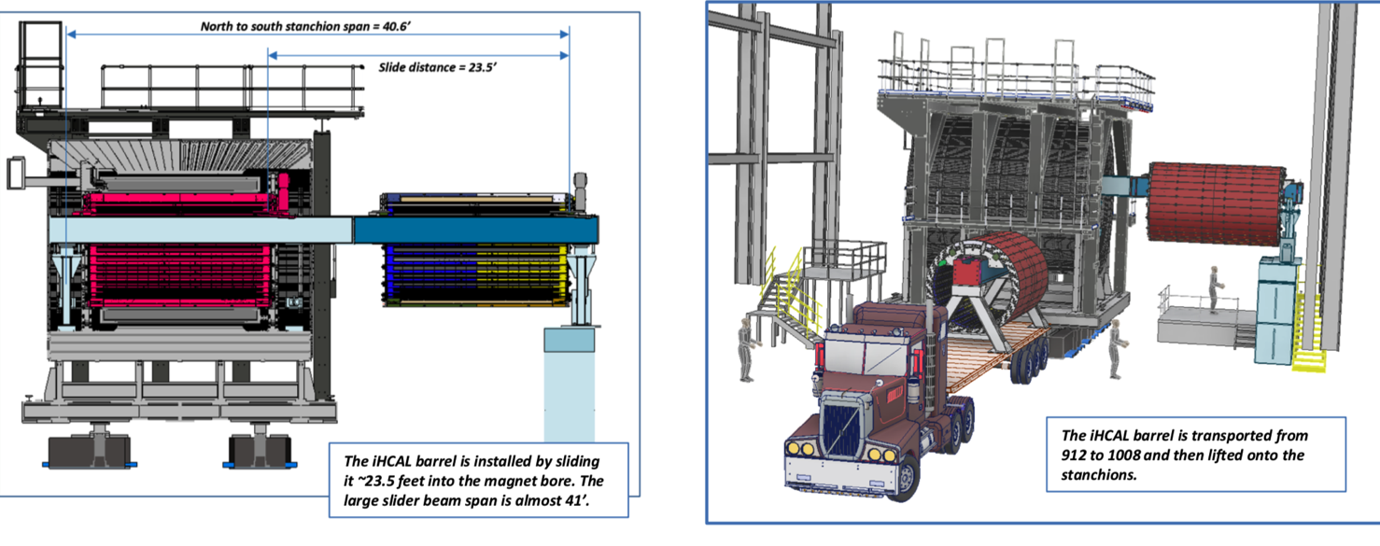
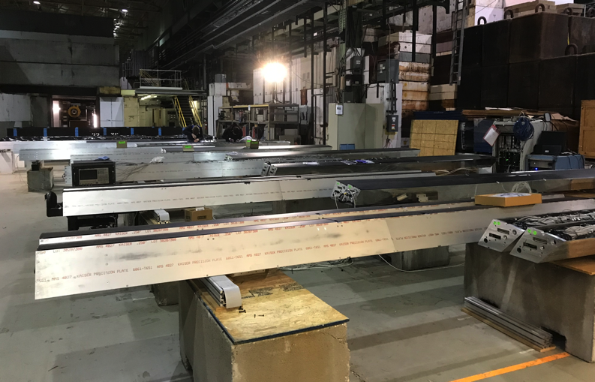
Inner HCal Barrel Fab and Installation
IHCal Sectors Built into Barrel
IHCal Sector Assembly B912

Slide 14
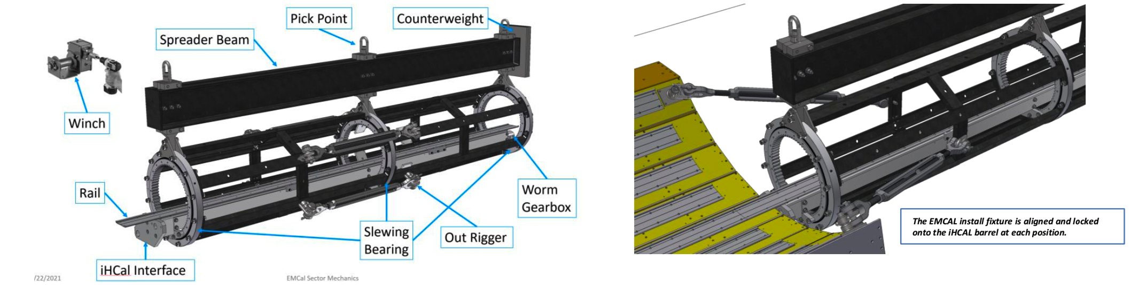
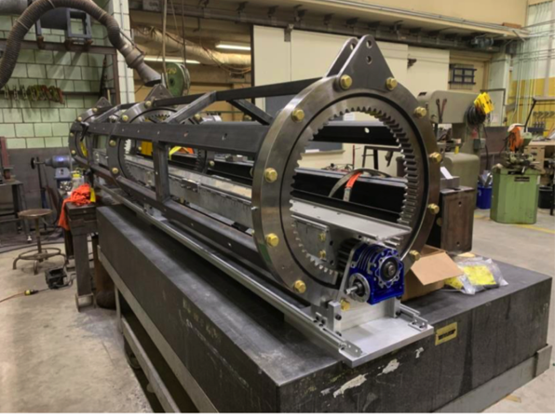
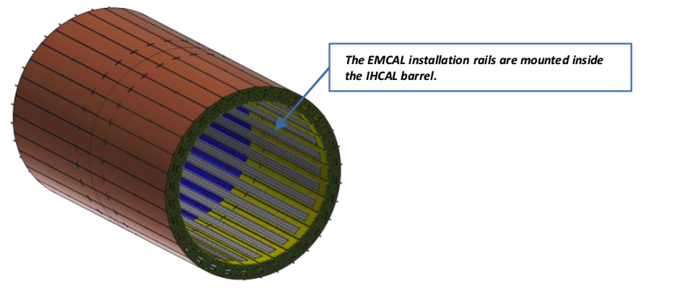
EMCal Installation in sPHENIX
EMCal Installation fixture in SBU shops

Slide 15
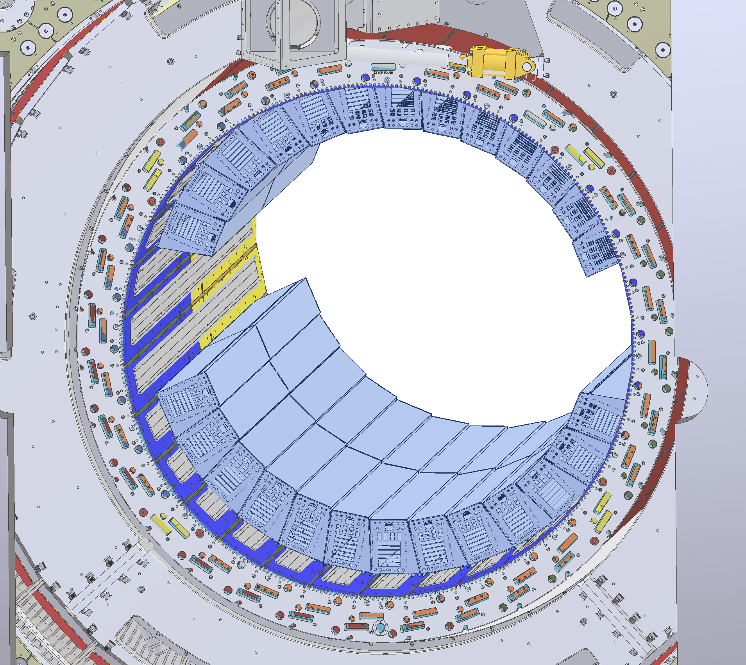
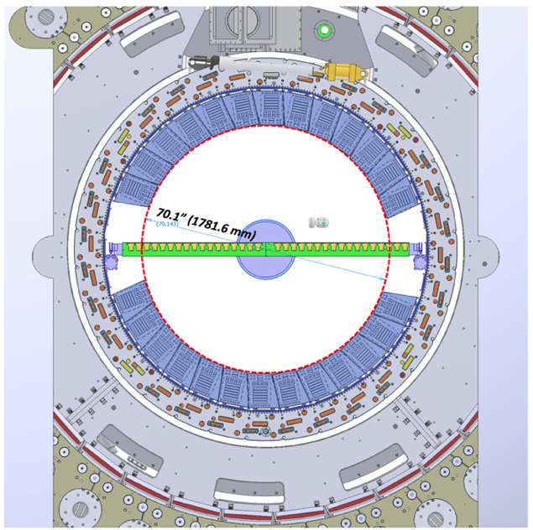
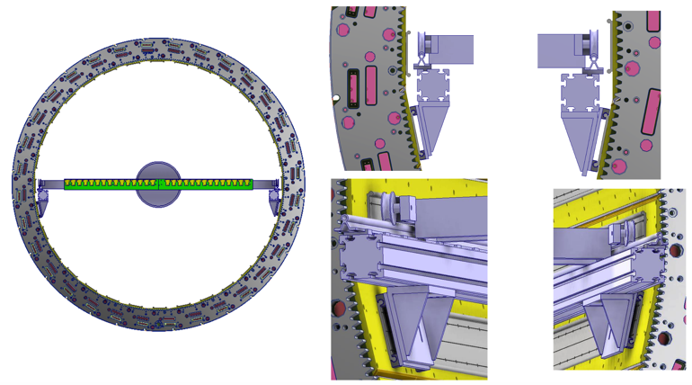
sPHENIX Configuration for Magnet Mapping
Three sector slots (+/-Z) left open at 3:00 and 9:00 in phi, be used for mechanical support of magnet mapping apparatus
The sPHENIX project team has started monthly meeting with CERN Magnet mapping group in order to coordinate planned mapping activities scheduled for June-July 2022

Slide 16
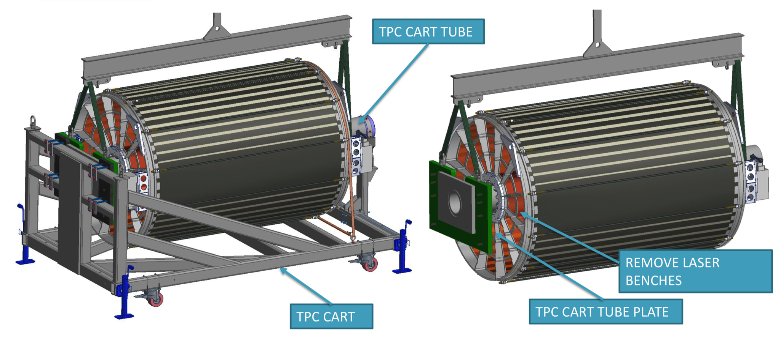
TPC Installation

Slide 17
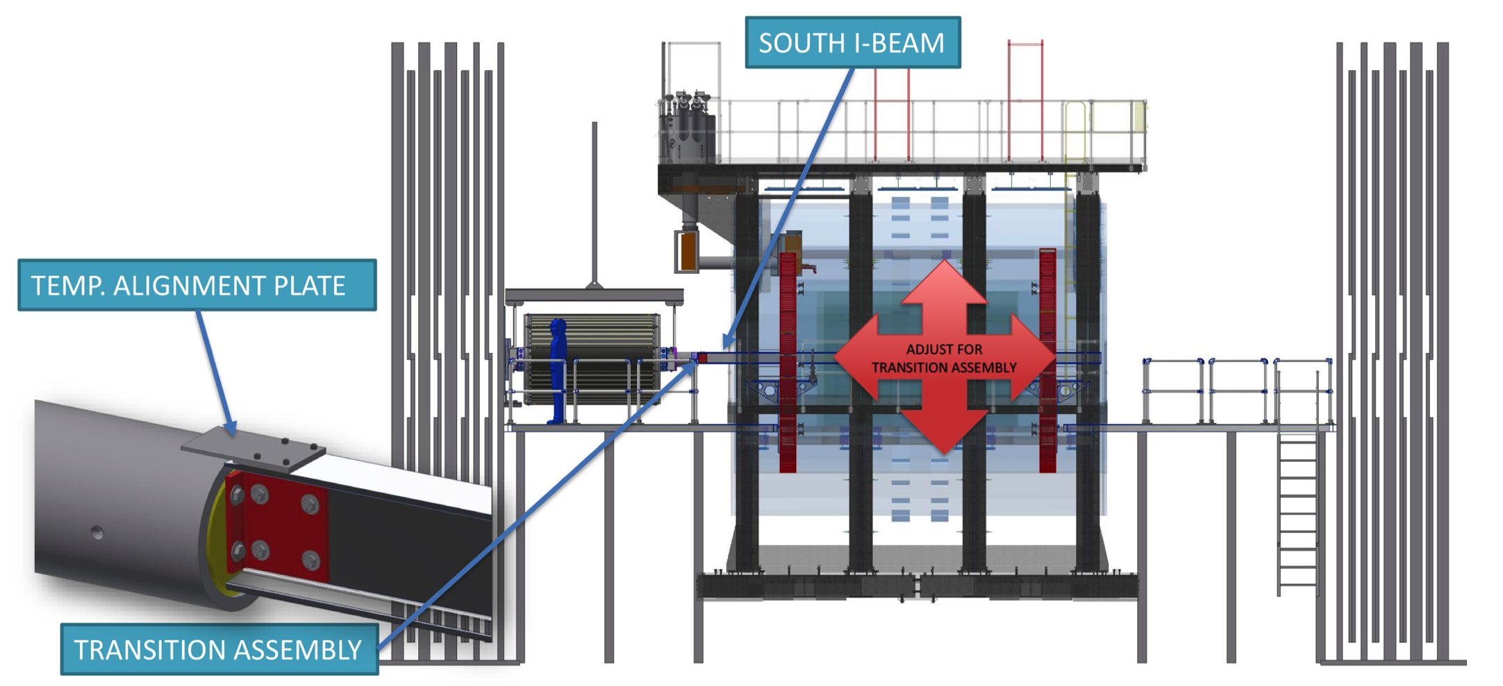
TPC Installation

Slide 18
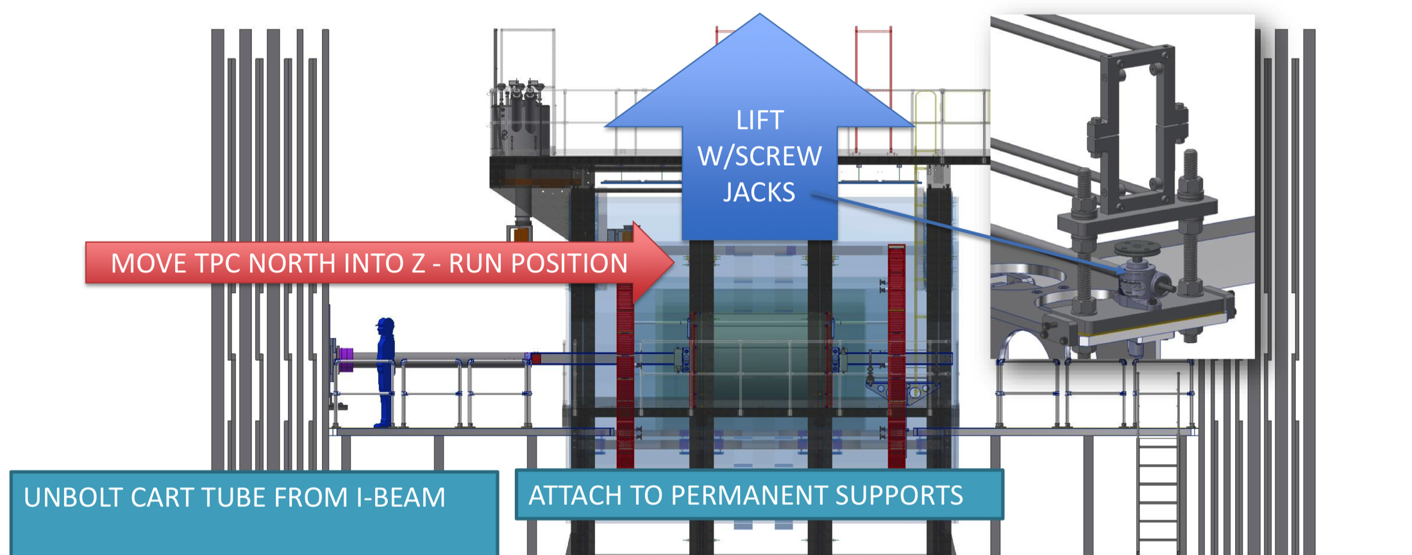
TPC Installation

Slide 19
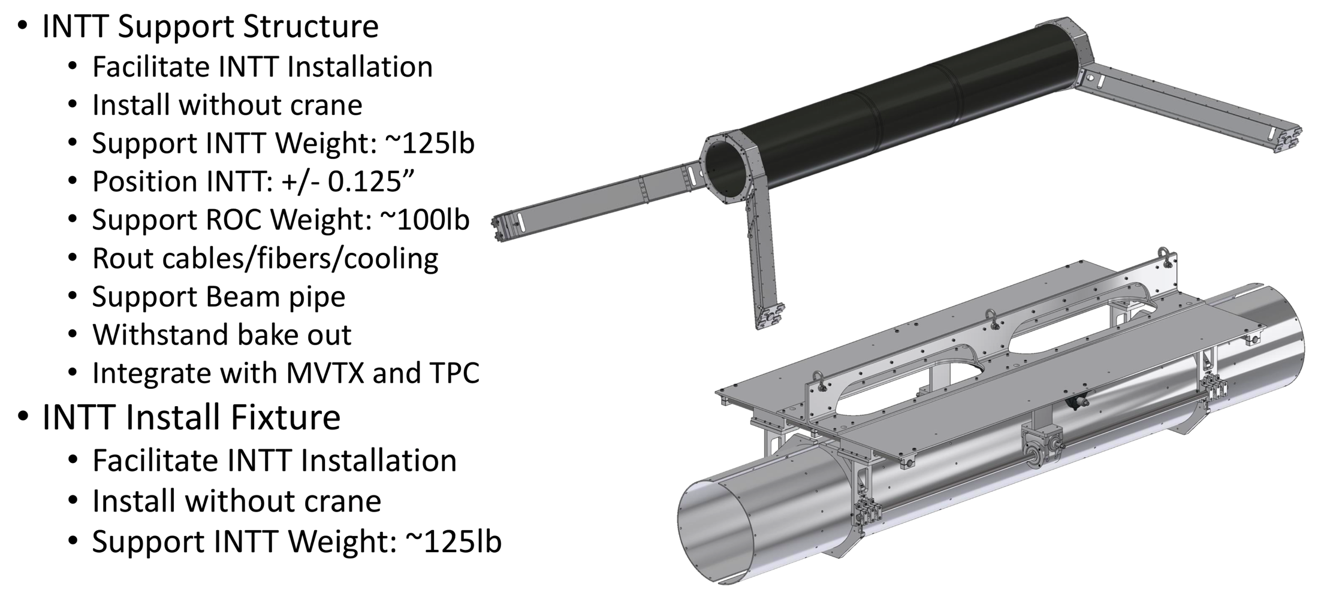
INTT Support Structure and Installation Fixture

Slide 20
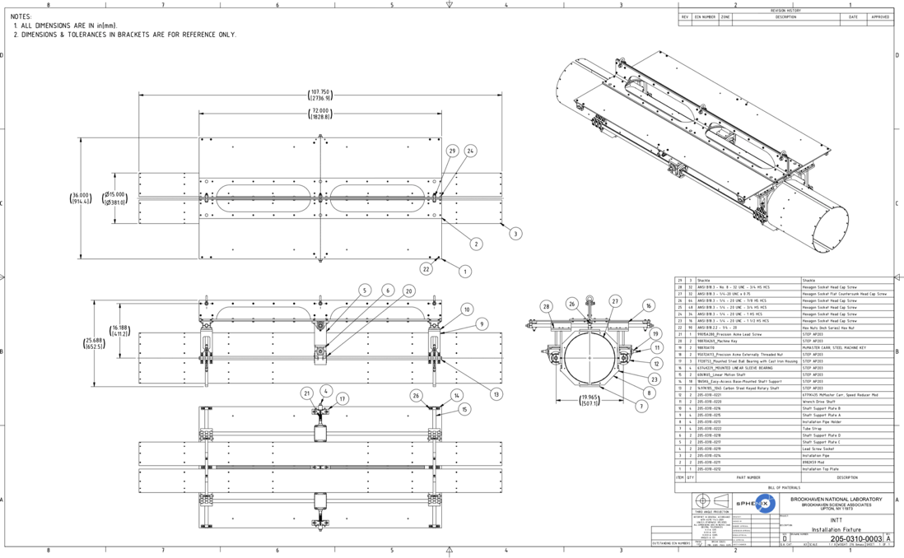
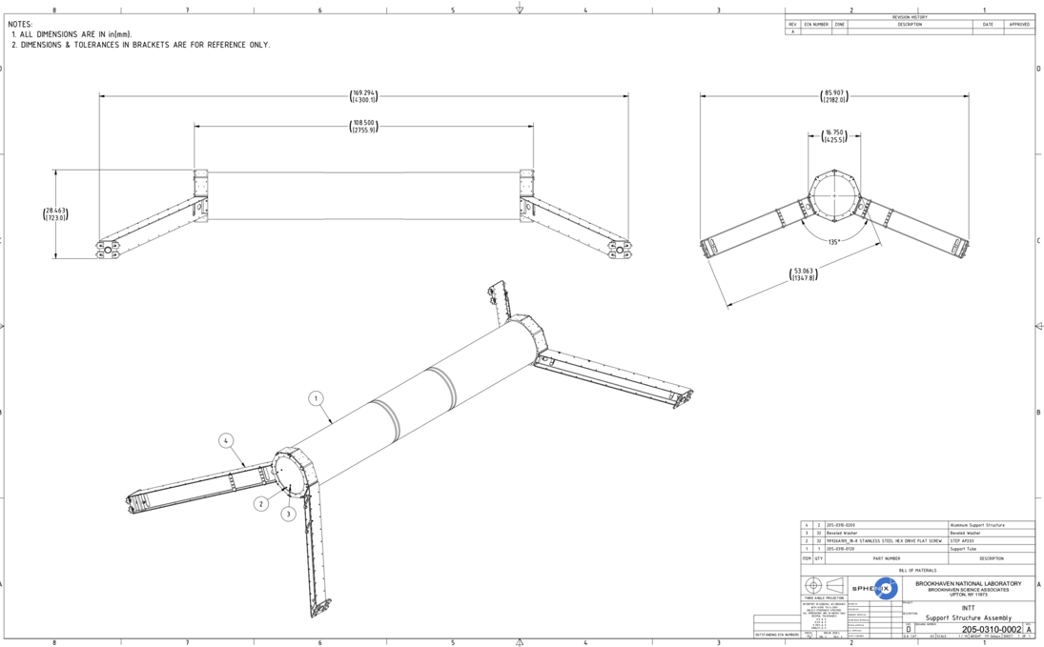
INTT Installation & Support Fixtures
Drawings for INTT installation and support components in final stages of preparation

Slide 21
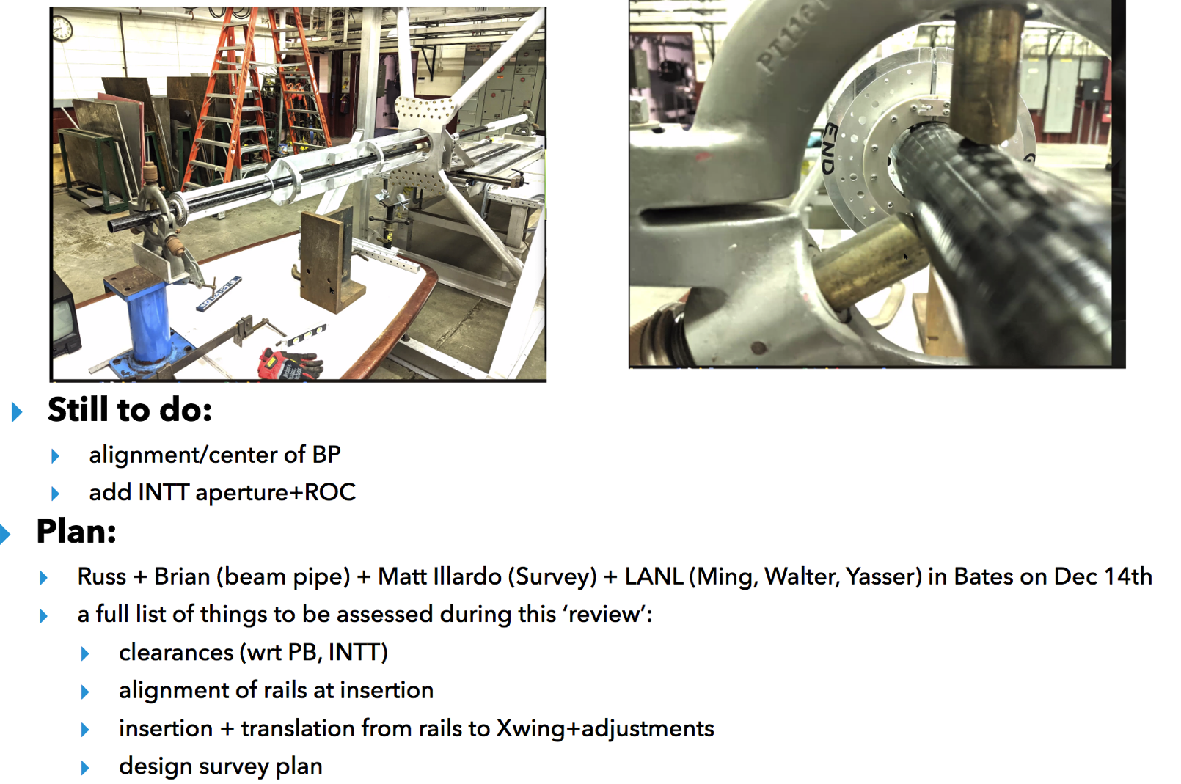
MVTX Installation
MVTX Insertion Mock-up @ MIT/Bates
BNL, MIT, LANL meeting at MIT/Bates, 12/14 for MVTX installation & integration planning. Everything remains on schedule

Slide 22
Risks and Challenges
Maintaining labor force for the next 14 months. Especially important are:
  Technicians for fab and assembly and installation
  Visiting students, postdocs and scientists for QA, testing and commissioning.
  We have been successful in borrowing techs from elsewhere in PO, CAD and ATRO, as well as engineers from CAD, ATRO, and NSLSII. Though pulls from other activities at BNL have put pressure on these resources.
  MoU with ATRO for FY22 labor is in the process of being signed.
Global economic issues may affect the cost and schedule of the project going forward
  Long lead time on certain electronics components may impact the schedule on the outstanding MIE orders. Lead times associated with certain chemicals, like epoxy, may also impact the schedule of detector fabrication.
  Significant cost increases have been seen on certain raw material and machine shop work potentially impacting the 1008 I&F remaining costs.
12/10/21
PMG

Slide 23
Summary
sPHENIX installation is proceeding well.
  The 13 OHCal sectors, the SC-Magnet, Large Support Rings installed on the detector carriage. The installation of the remaining OHCal sectors restarts today.
MIE detector systems nearing completion.
  OHCal complete, IHCal sector mechanics complete, EMCal blocks 98% complete, On detector calorimeter electronics complete. Most major DAQ/Trigger components available. TPC Fee 92% assembled, TPC FELIX 100% assembled.
Major 1008 I&F parts are complete or on order.
  This includes the barrel and end cap flux return steel, LHe and LN2 components, cryo controls and power, carriage/cradle, the beam pipe modification, XY carriage tables, carriage hydraulics, carriage platform, Large Support Rings, various installation fixtures.
Remaining engineering design continues at a fast pace with a large team of engineers and designers.
We have 45 FTEs approved to work on BNL including visiting scientists and students.
  We typically have 35 people working on BNL site for sPHENIX in an average working day.
Challenges are maintaining technician and engineering staff for the next 12-14 months. Enabling a large number of sPHENIX scientists and students to work on BNL site. Securing some long lead time parts.

