Slide 1
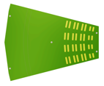
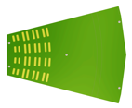
INTT Material Production Status
* Quantity in ½ ladder unit
 | Batch-1 | Batch-2 | Batch-3 | Batch-4 | Total | Status
Silicon | 150* (2019) | 120* (2020) |  |  | 135 (270*) | completed
HDI | 180* (2020) | 90* (2020) | 83* (2021) |  | 176.5 (353*) | completed
Stave | 75 (2020) | 75 (2021) | 27 (2021) | 27 (2021) | 204 | completed
Bus Extender | 20 (2021-22) | 40 (2022) | 70 (2022) |  | 120 | ongoing
Conversion Cable |  |  |  |  |  | Prototyping
Beam Clock Distribution Board |  |  |  |  |  | Prototyping
モンスターストライク
モンスターストライク
Data
Silicon module
Silicon module
Data
CC
BEX
HDI
SSS
SSS
SSS
SSS
HDI
BEX
CC
production
ROC
ROC
completed
prototype
The production for the ladder components had been completed by the end of 2021.
The readout cables are in production and under prototyping.

Slide 2
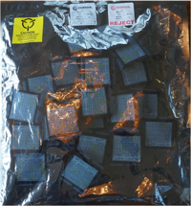
FPHX Production Statistics
*Only good chips
Year | 2016 | 2018 | Total
Quantity* | 5,829 | 7,560 | 12,885
Total FPHX Needed for 56 Ladders |  |  | 2,912
Total Number of Spare FPHX |  |  | 9,973
We produced >12k good FPHX Chips.
This amount is equivalent for 247 ladders. (52 Chips/Ladder)
Sufficient enough spares.

Slide 3
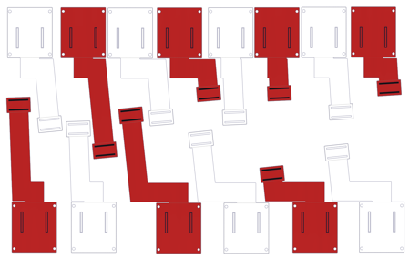
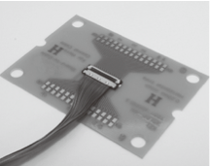
Conversion Cable
Design work by Dan Cacace (2021/July)
FVTX FPC Bus Extenders
INTT FPC Conversion Cable
(prototype-I)
14~20 different FPC designs needed for INTT if we follow the FVTX way ➜ Not affordable.
Started prototyping using the μ-coax technology. Requires only 1 design thanks to its flexibility in transverse direction.
Expected similar signal transmission performance with the FPC solution.
Prototype-II test is ongoing.
Preproduction and Production in 2022.
INTTμCoax Conversion Cable
(prototype-II)
μ-coax Cable : AWG44-UL11130 (Hitachi)
Connector : XSL series (KEL)

Slide 4
Beam Clock Distribution Board (BCDB)
FVTX
FVTX
B
FEM
IR
FEM
Twisted pair
6 feet (1.8m)
FEM-IB
START
BCDB
FVTX
ROC
ROC
ROC
BCO
ROC
FVTX lost packet during data taking issue has been unresolved.
Long twisted pair cable is considered as the biggest suspect.
INTT
BCDB
FEM
FEM
IR
FEM-IB
BCFO
BCDB
<1 feet
START
BCDB
INTT
BCO
BCDB
ROC
FVTX Packet Drop
ROC
BCDB
ROC
ROC
Beam clock fan-out
10Base-t
INTT Solution : get rid of the long twisted pair cable.
Prototyping new BCDB is now underway

Slide 5
Voltage Drop for FPHX Power in Cable Chain
ΔV
INTT Half Ladder
Bus extender
Conversion cable
FVTX Bus Extender
FVTX Ladder
 | @ROC | HDI | Bus Ext. | Conv. Cable | Volt. Drop | @FPHX
 | V [V] | Resistance (1 way) [mΩ] |  |  | ΔV [V] | V [V]
INTT | 2.5 | 135 ~ 185 | 145 | 185 | 0.20 ~ 0.25 | 2.30 ~ 2.25
FVTX |  | 70 | 70 | N/A | ~ 0.1 | 2.4
V@FPHX
ROC Regulator
ΔV@FPHX
HDI
Bus Ext.
Conv. Cable
2.5 V

Slide 6
ΔV for FPHX Power Solution
FPHX regulators
(total 32/ROC)
 |  | V@ROC [V] | ΔV [V] /way | ΔV @FPHX [V]
INTT | Digital | 3.0 V | 0.20 ~ 0.25 | 2.50 ~ 2.60
 | Analogue | 2.8 V | 0.1 | 2.6
FVTX |  | 2.5 V | ~0.1 | 2.3~2.4
16 ROCs were upgraded from 2.5V regulators to 3.0V and 2.8V ones.
Full ROC boards tests are to be carried out this winter in RIKEN. (2 boards have been tested so far)

Slide 7
backup

