Slide 1
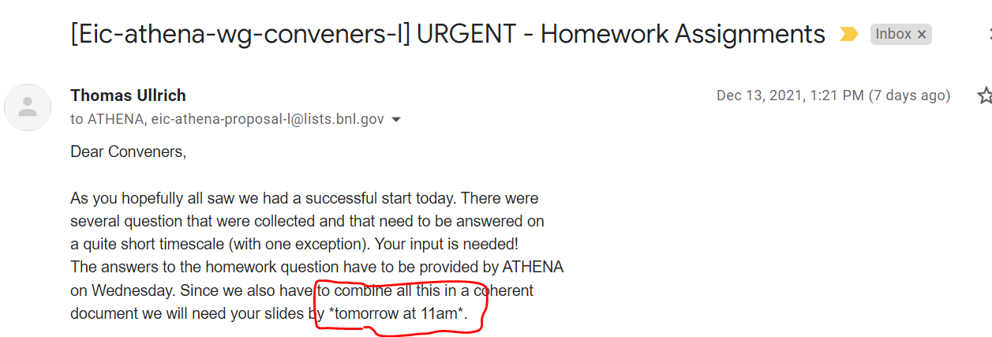
PID Rapid Response Team
Roberto, Tom, Frank, Henry Klest
contacted: Monday 1:12pm due: “tomorrow at 11am”
First Result 10:32pm

Slide 3
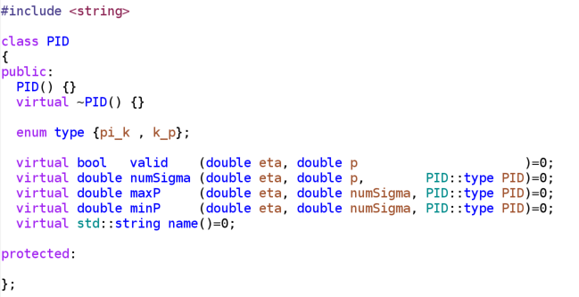
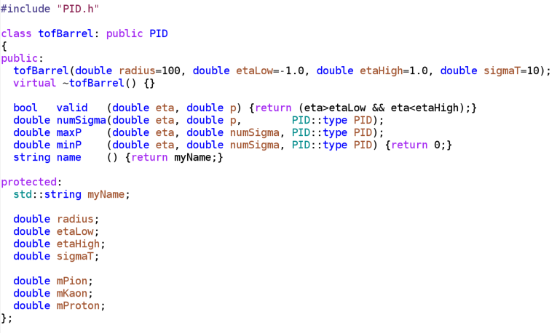
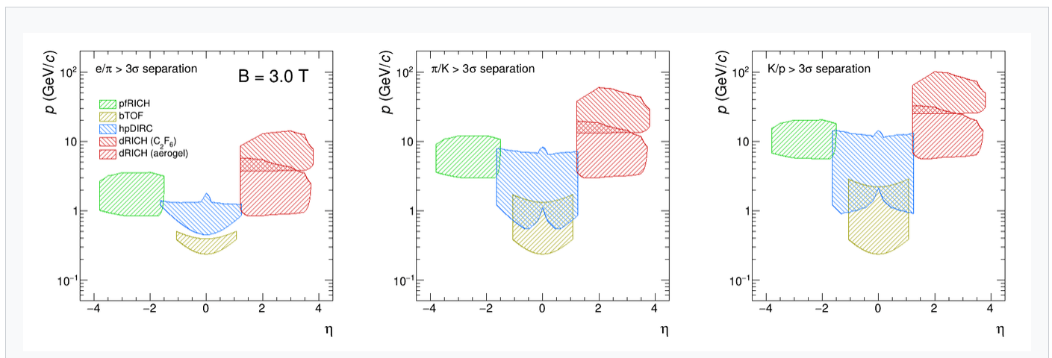
Back in the days of the Yellow Report: PID class
Simple way to make comparative overlays of PID performance.
Hemmick though it long dead.
Roberto dramatically upgraded this approach:
Coded in detailed pfRICH, dRICH, DIRC, TOF response
Used to make the famous PID plot:

Slide 4
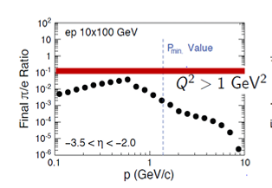
Methodology
Function returns # sigma separation
Electron efficiency:
Integral of Gaussian(0) from –inf to x
x can be chosen for 90%, 95%, 98%
Pion efficiency:
Integral Gaussian(sep power) from –inf to x
Modify original points by:
new = original * (pion-eff/electron-eff)
Original points retrieved by Data Thief
Note:
PID classes reject particles that don’t reach the detector

Slide 5
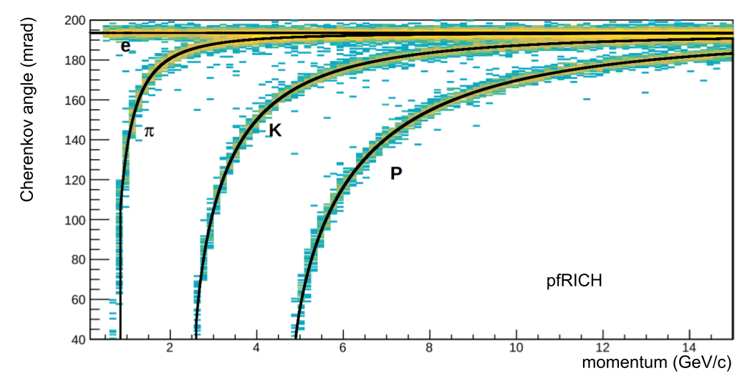
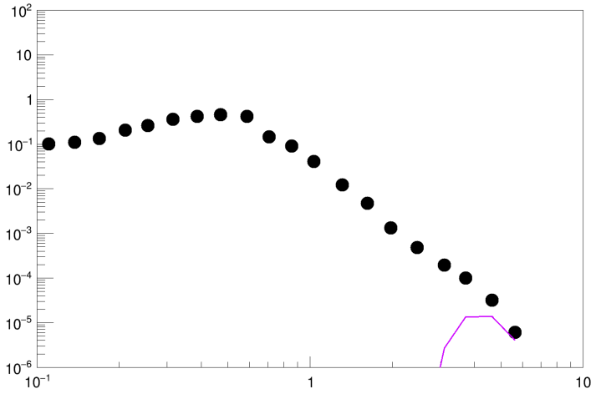
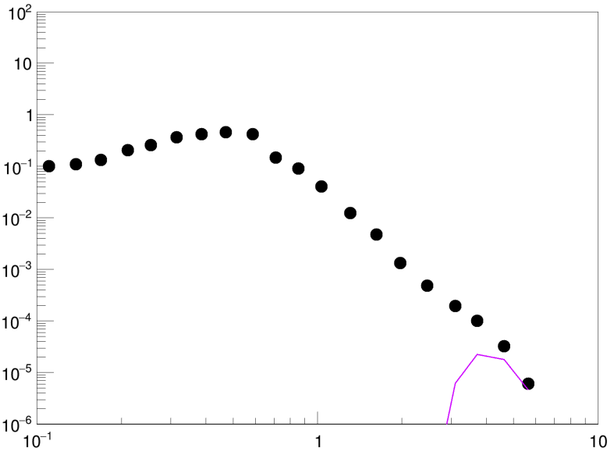
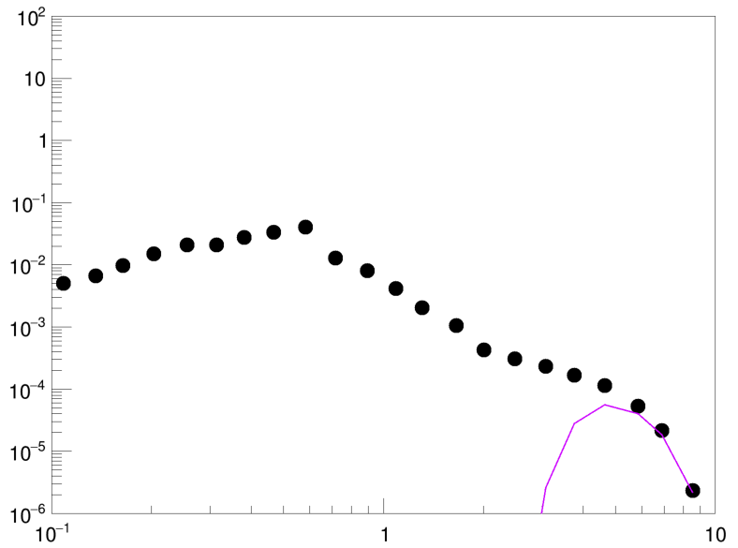
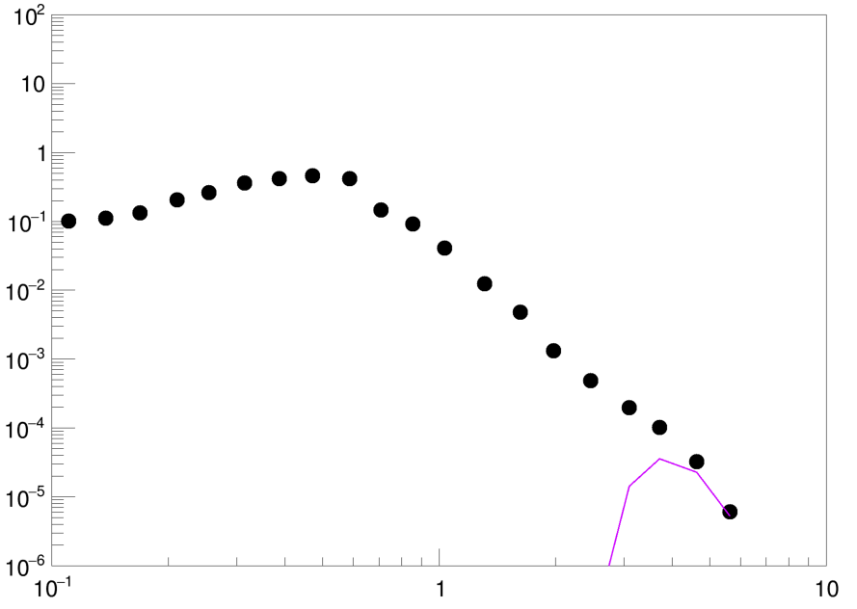
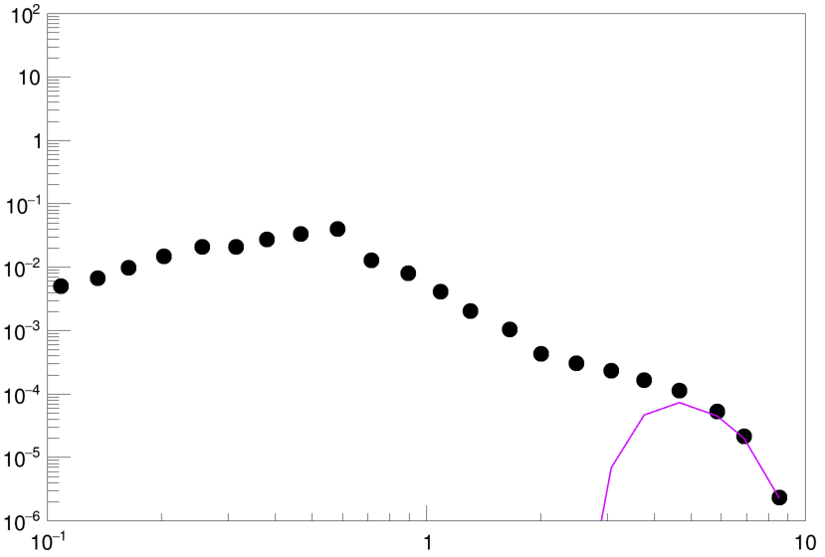
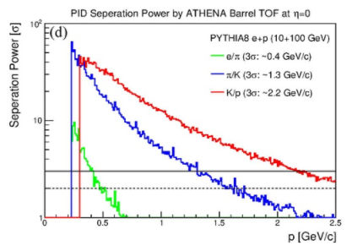
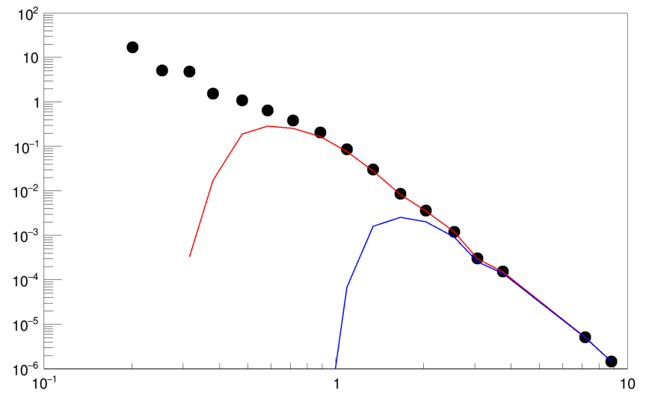
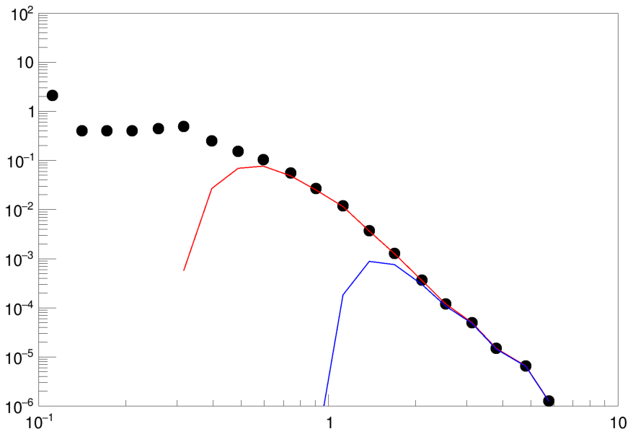
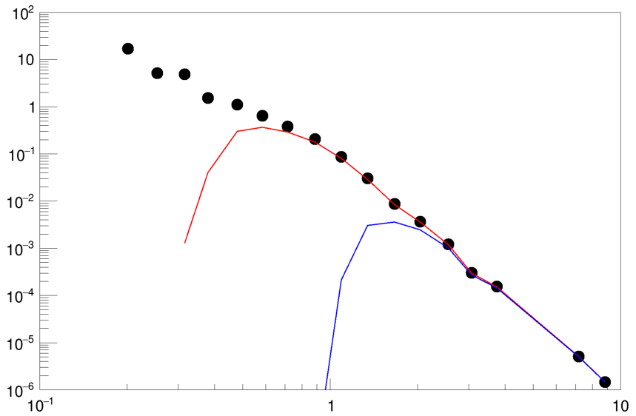
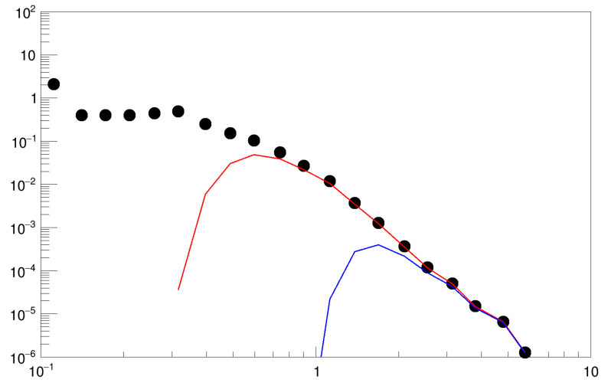
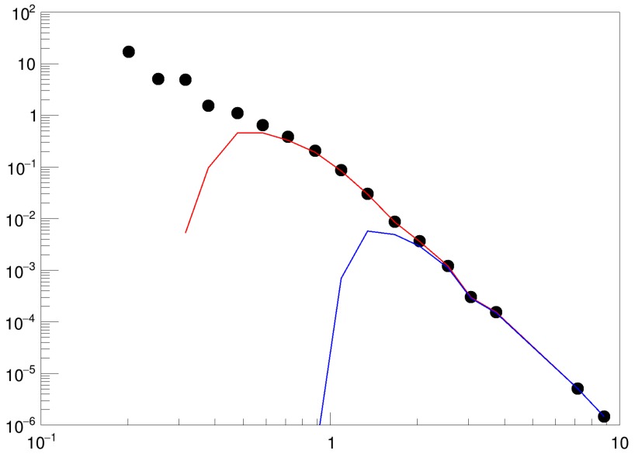
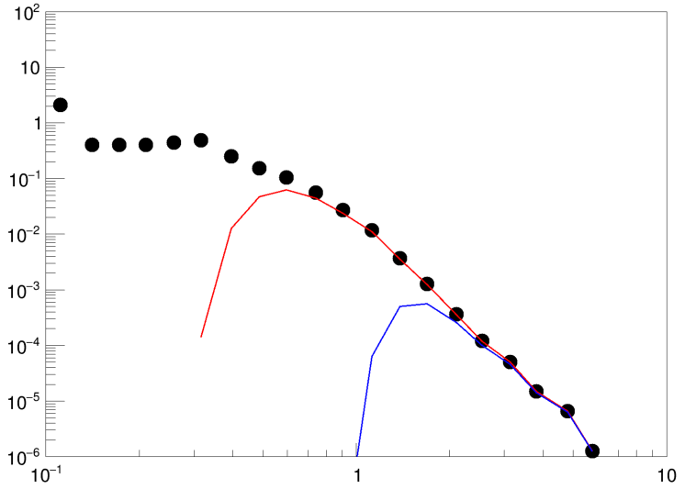
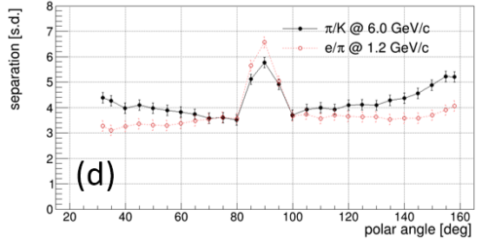
-3.5<η<-2.0
pfRICH
n=1.02
π_{threshold}=0.69 GeV/c
Cuts set at 90%, 95%, 98% electron efficiency
Background hits not included.
TOF
$σ_{T}=30ps⊕20ps$
$σ_{T}=36 ps$
Analytical Response
DIRC
n=1.473
π_{threshold}=0.13 GeV/c
Tabulated from FullSim
0.0<η<1.0
FastSim results below 10⁻⁶ indicated by downward arrows

