Slide 1
DPAP Preamble question
xlsx file prepared and uploaded in the dropbox where the material to answer question is being collected:
Dropbox:
https://www.dropbox.com/sh/482kxfv2og3nqmd/AABNV9T917tY5GYIodvZiH8Oa?dl=0
Dropbox/ATHENA-Proposal/Integration/Review
Also reachable via :
https://www.dropbox.com/sh/7myjjr7ck60es0i/AADe9giiQihj2o6ejgjx4S8oa?dl=0
Dropbox/ATHENA-Proposal, then selecting Integration, Review
File name:

Slide 2
DPAP Preamble question
In file
Introductory text:

Slide 3
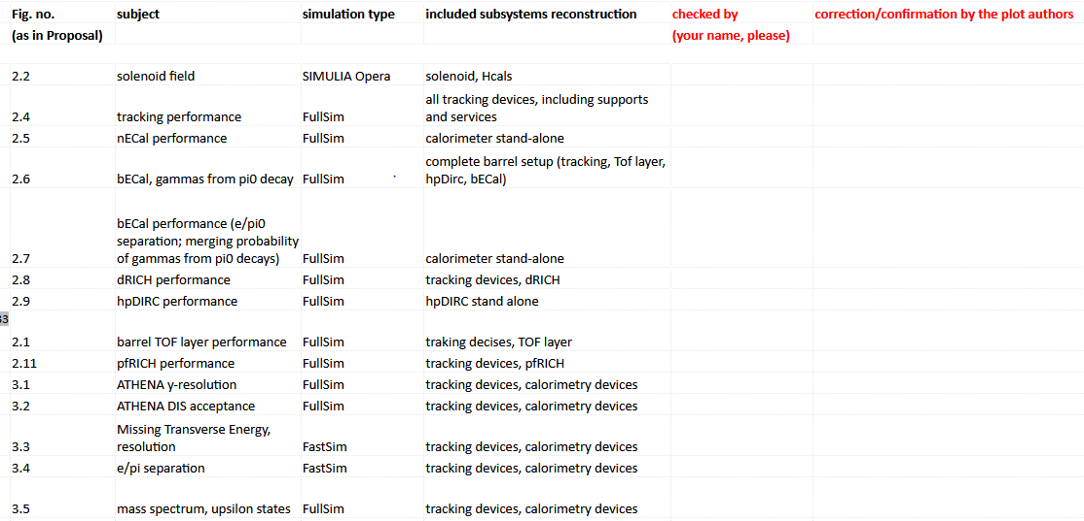
DPAP Preamble question
In file
Table to be cross-checked/corrected by the authors of the plots in the Proposal
…
PLEASE, check and confirm/correct according to needs!
THANK YOU !

Slide 4
Status of the answers to the DAC questions
From DAC (received on 12/22,2021): https://tuprd-my.sharepoint.com/:x:/g/personal/tue59914_temple_edu/Ed_TrOoKjSZGn4b4j5NnMMsBr2wn8oxsEMaXtXqBskvzzA
Timelines
DAC
DAC dead-line: 1/9
internal dead-line: 1/5

Slide 5
Status of the answers to the DAC questions
REMINDER: PID1 and AX1 (about cost comparison with YR) cancelled
TR1 (Si tracking) – final? Do we have any comparative information (from previous exercises) about the material impact on p resolution and vertex resolution ?
TR2 (Si tracking) – final? It includes some plots about radioactivity at ATHENA which are (i) too small, (ii) non really linked with the text in the slide
TR3 (μRWell) – not updated after discussion on Monday
TR4 (fluorocarbons vs pressurized Ar for RICHes) – ideas for the vessel mechanics missing
CA1 (bECal) – material showed by Maria on Monday not transferred in slides using template and added in the common Dropbox directory
CA2 (bECal) – material showed by Maria on Monday not transferred in slides using template and added in the common Dropbox directory

Slide 6
Status of the answers to the DAC questions
EL1-6 (electronics) – in preparation (Alexandre, Jeff, Elke, Sylvester, Andrea, Silvia) – second dedicated meeting on Friday
MA1 (magnet cost) – not yet available
CR1- (decision about ATHENA design upgrades, timelines and costs) – final

