Slide 1
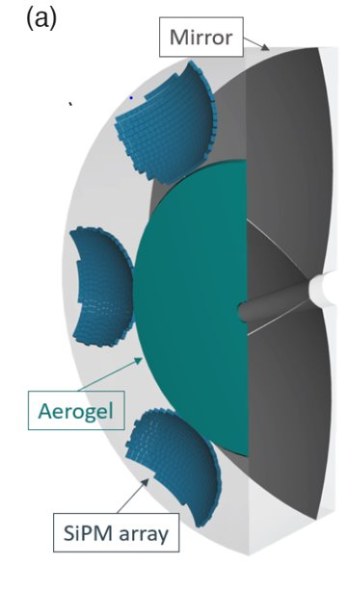
PID Calibration, Cherenkov imaging devices​
The dRICH case is discussed (analogous for pfRICH and hpDIRC)​
Assumptions:
tracking and momentum measurement already calibrated
aerogel support and mirror support (anchorage of the mirror center) are known (with ~1mm resolution, fully adequate).
the relative position of the photosensors within each array is known with resolution better than 100 μm (fully adequate)
Aerogel refractive index known (measured)
C₂F₆
Cutaway rendering of the dRICH detector

Slide 2
PID Calibration, Cherenkov imaging devices​
Each of the six dRICH sectors is independent calibrated
parameters to be determined
Mirror angular orientation (2 parameters);
position in space and angular orientation of the sensor array (5 parameters);
radiator gas refractive index n (1 parameter); not known a priory (depends on P, T and impurities)
→ 8 parameters in total: 7 for alignment + n
1 of the 6 sectors
C₂F₆
Cutaway rendering of the dRICH detector

Slide 3
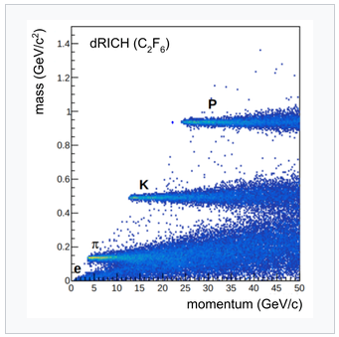
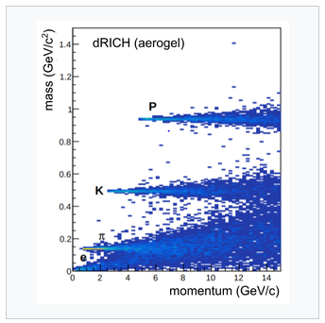
PID Calibration, Cherenkov imaging devices​
Mass plot are produced
The known particle masses used as constrains
Best fit procedure using aerogel data and gas data together to extract the 8 calibration parameters
Cross-check: by comparing the n-values for the 6 dRICH sectors
Monitoring n-value (that continuously evolves with P, T and impurities):
same procedure fixing the 7 alignment parameters (smaller statistics required making continuos monitoring practical)

