Slide 1
The Muon Collider Option
2nd BNL Snowmass Retreat
Mark Palmer
Brookhaven National Laboratory
Acknowledgements:
US Muon Accelerator Program (MAP)
International Design Study for a Neutrino Factory (IDS-NF)
International Muon Ionization Cooling Experiment (MICE)
International Muon Collider Collaboration
European Laboratory Directors Group – Accelerator R&D Roadmap

Slide 2
MC Overview

Slide 3
Can Muon Accelerators Address HEP Community Needs?

Slide 4
Why Muons?
Physics
Frontiers
Intense and cold muon beams a unique physics reach
Precision sources of neutrinos
Colliders
Opportunities
Collider Synergies
High intensity beams required for a long-baseline Neutrino Factory are
readily provided in conjunction with a Muon Collider Front End
Tests of Lepton Flavor Violation
Anomalous Magnetic Moment (g-2)
Next generation lepton collider
s-channel production of scalar objects
Strong coupling to particles like the Higgs
Reduced synchrotron radiation a multi-pass acceleration feasible
Beams can be produced with small energy spread
BUT the accelerator complex and detector must be able to handle the impacts of μ decays
Beamstrahlung effects suppressed at the collider IP
Such overlaps offer unique staging strategies to guarantee physics output
while developing a muon accelerator complex capable of supporting
collider operations

Slide 5
Collider Luminosity
Detector and Physics Performance at a Muon Collider
N. Bartosik et al 2020 JINST 15 P05001
For a muon collider, we can write the luminosity as:
For the 1.5 TeV muon collider design, we have
  N = 2×10¹² particles/bunch
  σ_{x,y} ~ 5.9 μm, β* = 10 mm, ε_{x,y}(norm) = 25 μm-rad
  N_{turns}>1000
  f_{bunch}=15 Hz (rate at which new bunches are injected)

Slide 6
MC Parameters as Developed by MAP
RAST, Vol 10, No. 01, pp. 189-214 (2019)

Slide 7
Parameter Sets for the International MC Collaboration
Performance Aims:
  Achieve the target
  integrated luminosity
  in ~5 years of running
Energy Efficiency

Slide 8
A 10-TeV Class Muon Collider
The muon injector chain provides cooled muons with
roughly 100 GeV/c for acceleration to the TeV-scale
IP 1
μ⁻
Muon Collider
>10TeV CoM
~10km circumference
Accelerator
Ring
μ Injector
μ⁺
IP 2
4 GeV
Proton
Source
Target, π Decay
& μ Bunching
Channel
μ Cooling
Channel
Low Energy
μ Acceleration

Slide 9
Feasibility Status
Critical concepts now demonstrated (at the TRL 1-3 level)
  Muon 6D Cooling
    MICE Demonstration of Emittance Cooling
    High gradient demonstration of RF operating in Tesla-class magnetic fields
    Cooling channel concepts and detailed simulation consistent with operational targets
  Muon Final Cooling
    Advances in HTS conductor/cable/magnet technology
    High Field User Magnet program operationally demonstrating magnet parameters that are rapidly approaching the MC requirements
  Muon Acceleration
    Significant recent advancement in HTS-based fast-ramping magnets
    Focused effort on studying the integrated magnet/power supply efficiency issues for TeV-scale acceleration
  Collider and Detector
    Detailed studies of backgrounds that may impact physics
    Detector performance studies now demonstrate the ability to successfully measure key processes
    Concepts in development to manage off-site neutrino radiation issues
See dedicated JINST Volume for key references:
Muon Accelerators for Particle Physics (MUON)

Slide 10
MC Next Steps

Slide 11

European
Accelerator R&D Roadmap Released
MC R&D Program Included

Slide 12
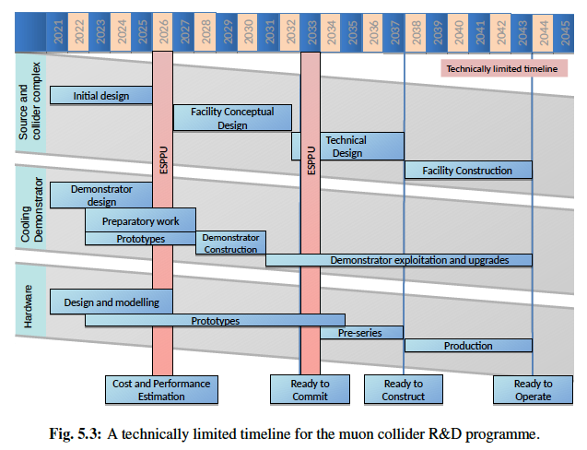
Timeline to a
Multi-TeV Collider

Slide 13
Implications for the US Planning Process
US Timeline – Goals Under Discussion
FY24 (post-P5): US accelerator physicists funded to engage directly with the International Muon Collider Collaboration
  Engage in R&D, simulation, and planning to deliver a Reference Design
  Lay the groundwork for deploying the necessary demonstration facilities in the last half of the decade
~2028 Timeframe: Deliver MC Reference Design Report for next US Planning Process
  Provides the basis for subsequent site-specific efforts – e.g., HF & site-filler options at Fermilab
  Enables a serious discussion of the ultimate limits that may be reached with this technology
Early 2030s: Deliver a full Conceptual Design Report
  Supported by:
    Detailed end-to-end design
    Significant component prototyping
    First results from Demonstrator Facility operations
  Sets the stage fully informed decisions by the community on this technology

Slide 14
Conclusion
The International Muon Collider Collaboration now continues the effort previously pursued by the US MAP program
  Goal is to deliver a Conceptual Design Report that is timely for final decisions on the next multi-TeV machine to construct
  Efforts are consistent with delivering an end-to-end Reference Design Report in time for the next round of the US
Current Snowmass-driven efforts are exploring the performance and physics reach of detectors operating at a multi-TeV MC
The potential for such a machine is significant
  Collider Physics
  Synergistic efforts
    High brightness source of muons for efforts from materials science to rare process physics
    Precision high-intensity source of neutrinos

Slide 15
Thank you for your attention!

Slide 16
Current Activities and Engagement
US Snowmass Process
  Muon Collider Forum
    Slack channel: “muon-collider-forum”
    Mailing list: SNOWMASS-MUON-COLLIDER-FORUM@FNAL.GOV
  Accelerator Frontier Topical Group 4 (AF4) – Multi-TeV Colliders
    multitev-snowmass21@listserv.fnal.gov
International Muon Collider Collaboration
  http://muoncollider.web.cern.ch
  Working groups and contacts:
    Accelerator design – daniel.schulte@cern.ch
    Physics & Detectors – nadia.pastrone@cern.ch
    Physics potential – andrea.wulzer@cern.ch
    Detector simulations – donatella.llucchesi@pd.infn.it
    Muon Cooling – chris.rogers@stfc.ac.uk, klaus.hanke@cern.ch
Detector Performance Baseline Efforts
  DELPHES card (methodology utilized for FCC-hh and CLIC evaluations)
  https//muoncollider.web.cern.ch/node/14
Detector Impacts of Beam Induced Backgrounds
  Studies led by Donatella Lucchesi (Padova) and Sergo Jindariani (FNAL)

Slide 17
Some Useful References
Boscolo, Delahaye, Palmer, RAST, Vol 10, No. 01, pp. 189-214 (2019)
The JINST dedicated volume on Muon Collider Research and Technology:
Muon Accelerators for Particle Physics
https://iopscience.iop.org/journal/1748-0221/page/extraproc46
Demonstration of cooling by the Muon Ionization Cooling Experiment,
Nature 578, 53-59(2020).
Long, K.R., Lucchesi, D., Palmer, M.A. et al., ”Muon colliders to expand frontiers of particle physics,” Nat. Phys. (2021), https://doi.org/10.1038/s41567-020-01130-x

Slide 18
Backup Slides

Slide 19
Key R&D Challenges
Issues
Status
Target
Multi-MW Targets
High Field, Large Bore Capture Solenoid
Ongoing >1 MW target development
Challenging engineering for capture solenoid
Front End
Energy Deposition in FE Components
RF in Magnetic Fields (see Cooling)
Current designs handle energy deposition
Cooling
RF in Magnetic Field
High and Very High Field SC Magnets
Overall Ionization Cooling Performance
MAP designs use 20 MV/m → 50 MV/m demo
>30 T solenoid demonstrated for Final Cooling
Cooling design that achieves most goals
Acceleration
Acceptance
Ramping System
Self-Consistent Design
Designs in place for accel to 125 GeV CoM
Magnet system development needed for TeV-scale
Self-consistent design needed for TeV-scale
Collider Ring
Magnet Strengths, Apertures, and Shielding
High Energy Neutrino Radiation
Self-consistent lattices with magnet conceptual design up to 3 TeV
> ~5 TeV – ν radiation solution required
MDI/Detector
Backgrounds from μ Decays
IR Shielding
Further design work required for multi-TeV
Initial physics studies at 1.5 TeV promising

Slide 20
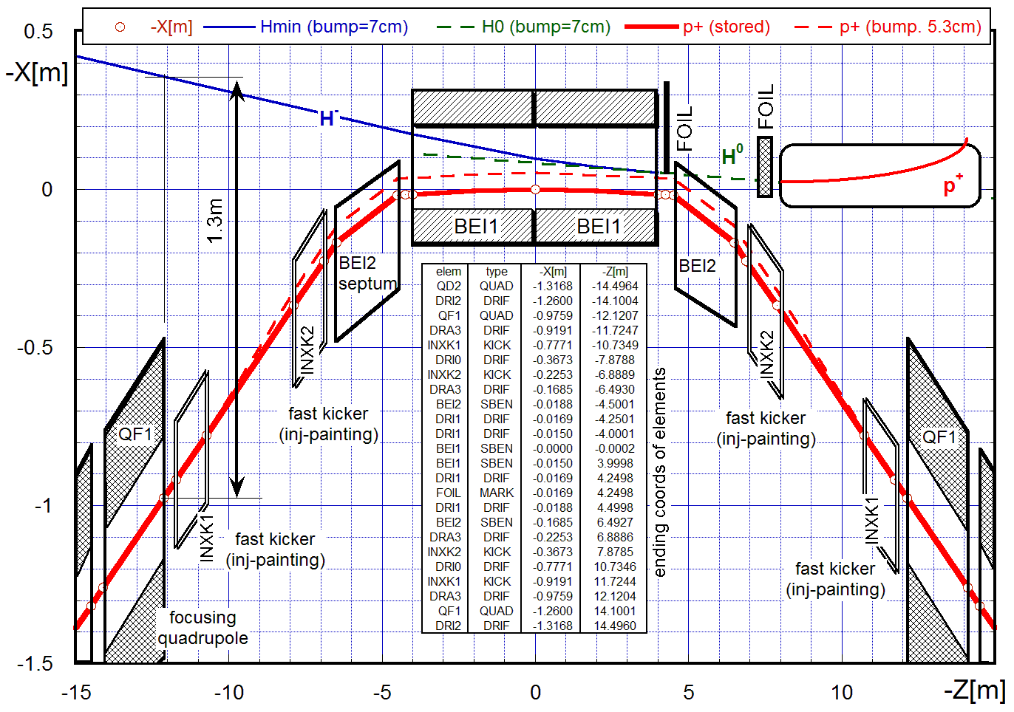
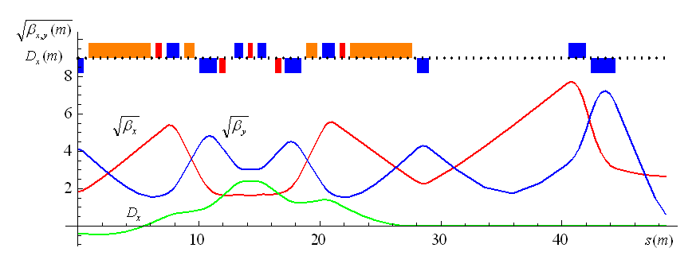
Proton Driver
Based on 6-8 GeV Linac Source
Accumulator & Buncher Ring Designs in hand
H- stripping requirements same as those originally established for Fermilab’s Project X
H⁻ beam
Accumulator Ring
Layout & Injection Orbits
(Alexahin, Kapin)
Buncher Ring
Layout & Optics
(Alexahin)
3.87 MHz RF V=11 kV
kicker for vertical extraction
Optics:
½ staight +
1 arc cell

Slide 21
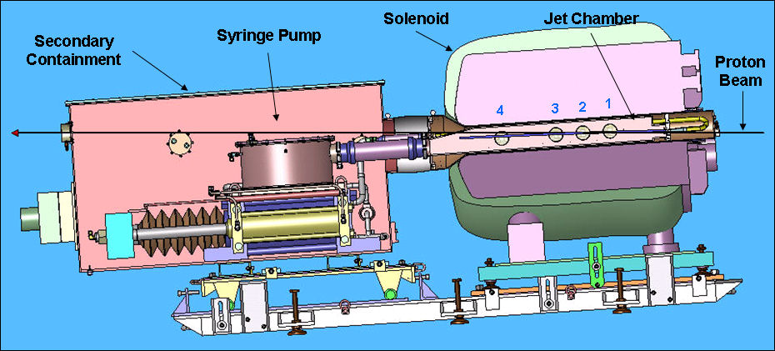
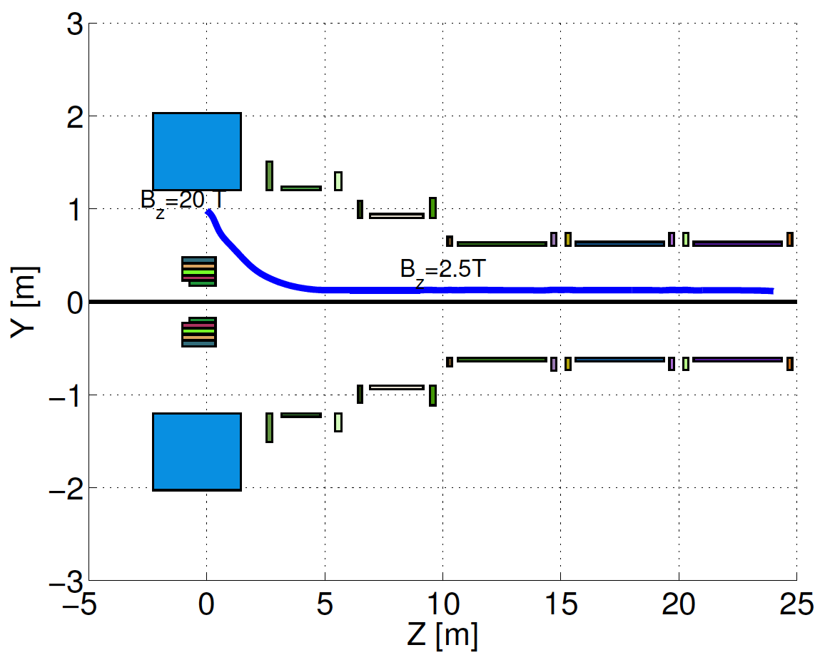

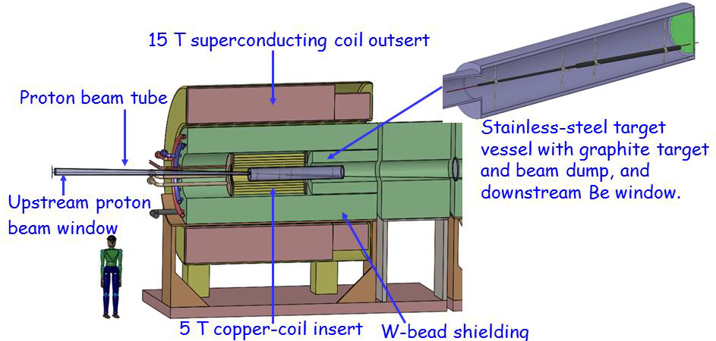
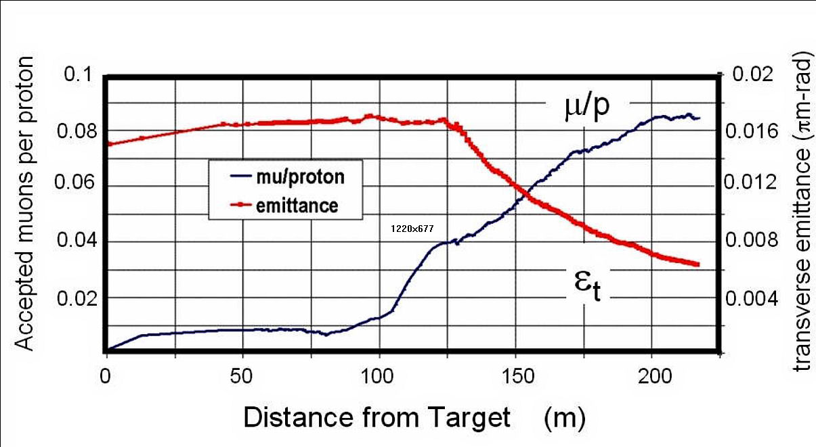
Target & Capture System
Compact
Taper Design
1 cm
C Target
Option

Slide 22
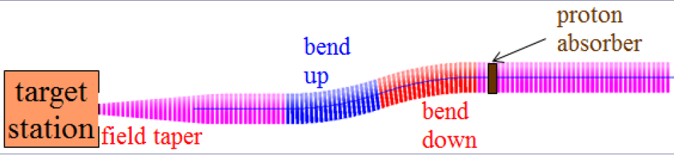
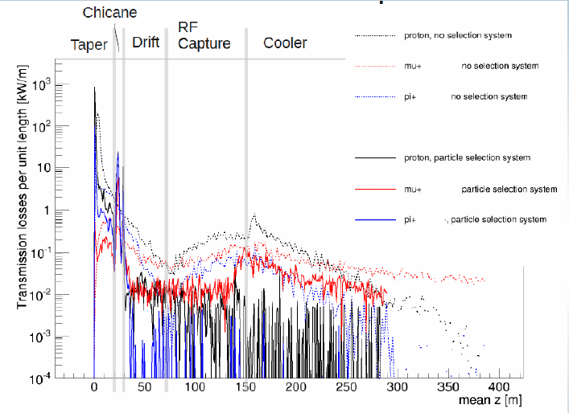
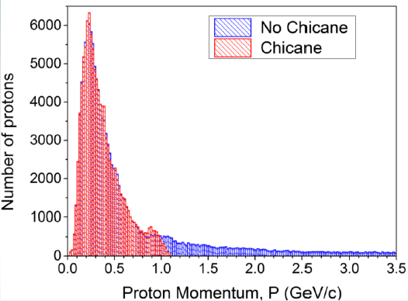
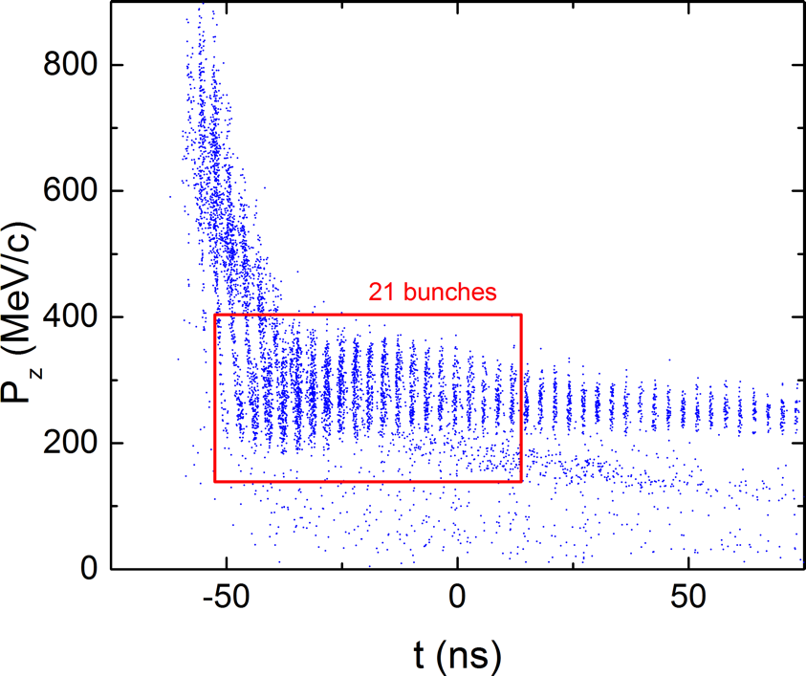
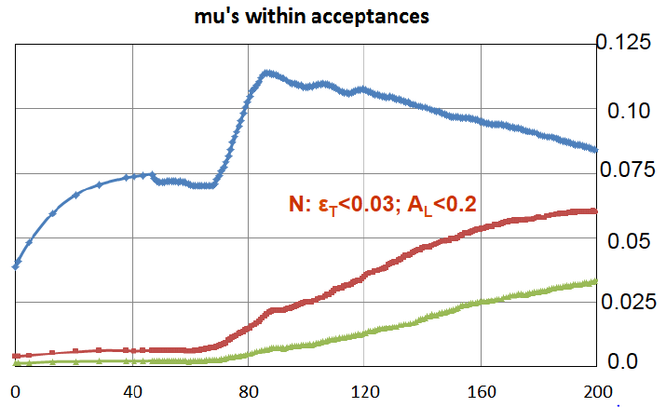
Front End and Energy Deposition
Control of FE Energy Deposition
FE Energy
Deposition
Buncher and Phase
Rotator Matched to a
325 MHz Initial Cooling
Channel
Validation of FE
performance
with gas-filled
cavities
22

Slide 23
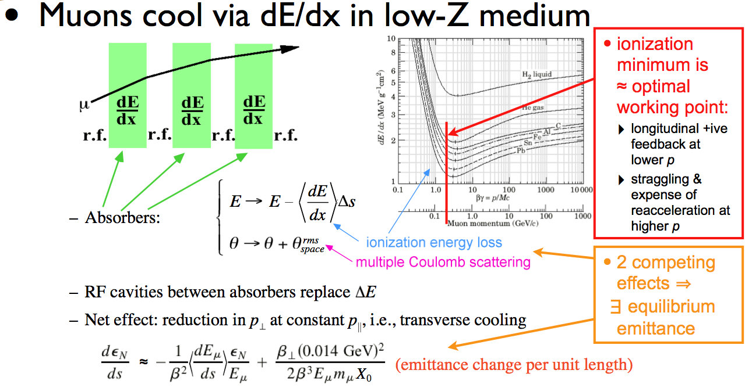
Cooling Methods
The unique challenge of muon cooling is its short lifetime
  Cooling must take place very quickly
  More quickly than any of the cooling methods presently in use
  a Utilize energy loss in
  materials with RF re-acceleration
MAP R&D Efforts:
  RF in High Magnetic Fields:
  MuCool Test Area (MTA) at
  Fermilab
  High Field Magnet Design
  and Development
  The International Muon
  Ionization Cooling
  Experiment (MICE)
ε_{N}(equilib.) ∝ β⊥ ∝ B_{max}

Slide 24
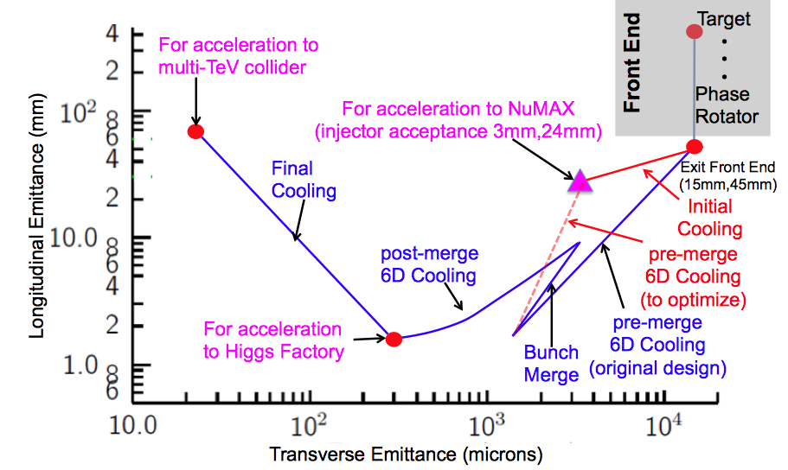
MAP Cooling Targets

Slide 25
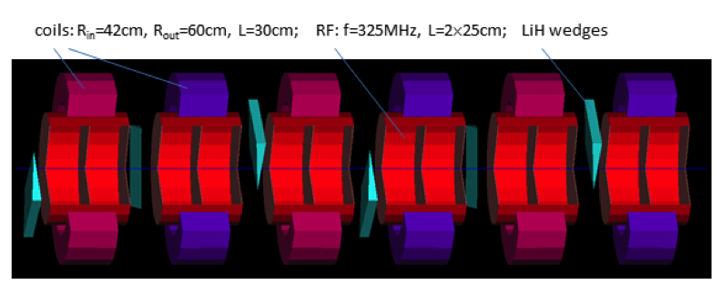
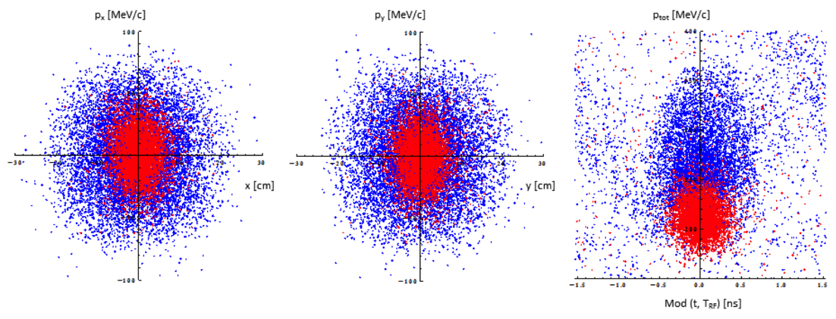
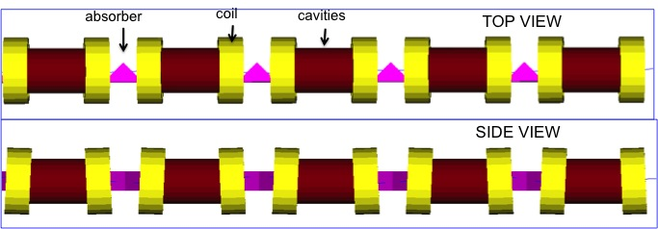
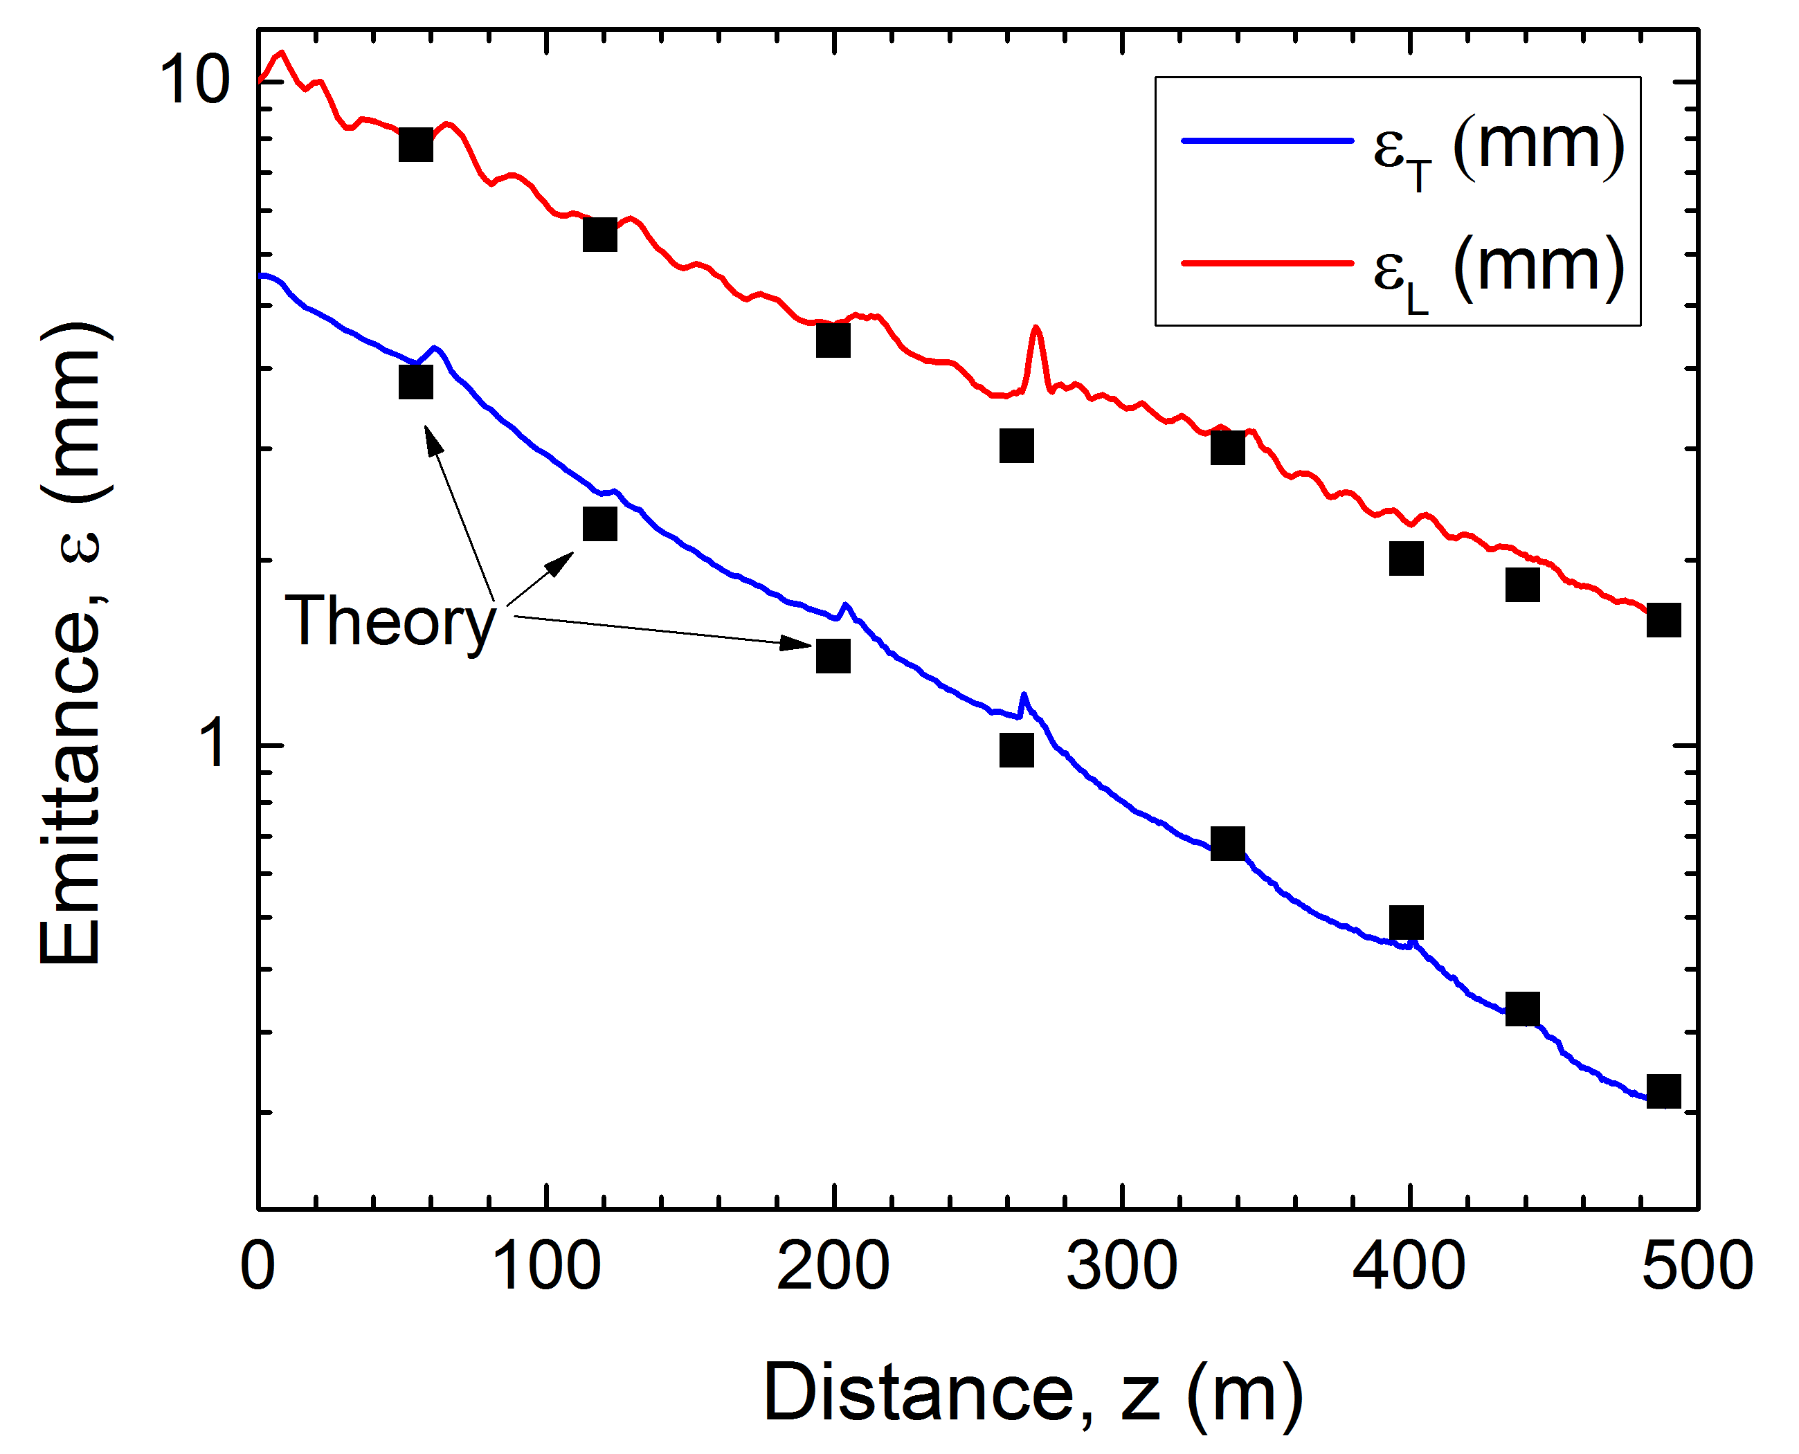
Muon Ionization Cooling (Design)
D. Stratakis, et al., PRSTAB 18 031003, 2015
D. Stratakis JINST 12 P09027, 2017
Y. Bao, et al., PRAB 19 031001, 2016
Bunch
Merge
Longitudinal Merge
Initial 6D Cooling: ε_{6D} 60 cm³ a ~50 mm³; Trans = 67%
Transverse Merge
ε_{T}
6D Rectilinear Vacuum Cooling Channel:
ε_{T} = 0.28mm, ε_{L} = 1.57mm @488m
Transmission = 55%(40%) without(with) bunch recombination
Hybrid Design: Equivalent performance with gas-filled cavity variant
Trans
σ_{t}

Slide 26
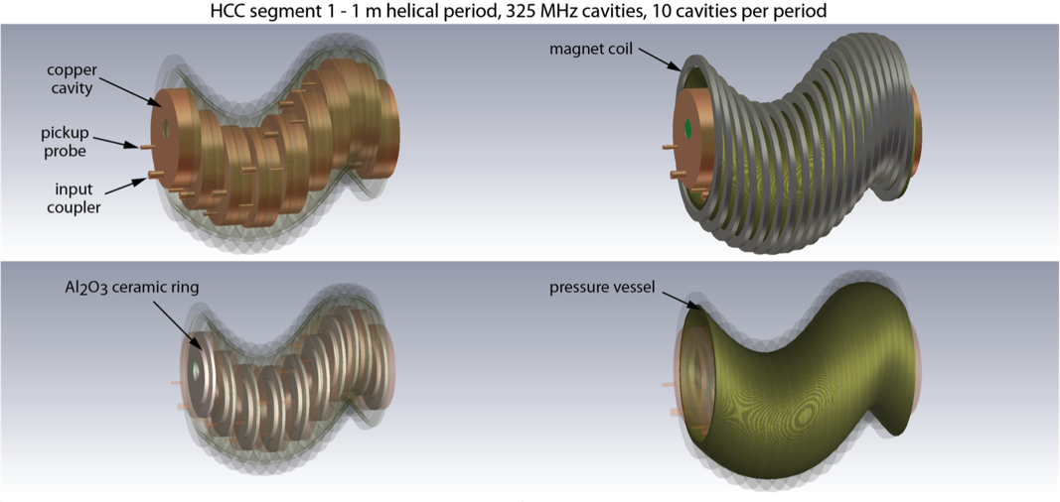
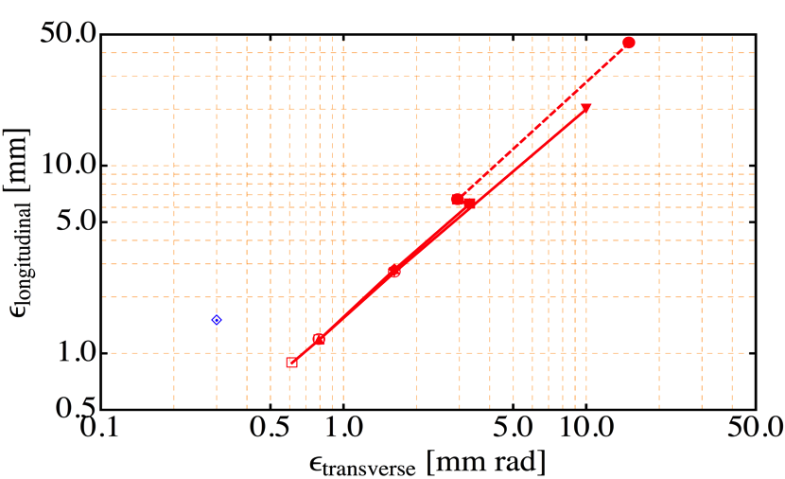
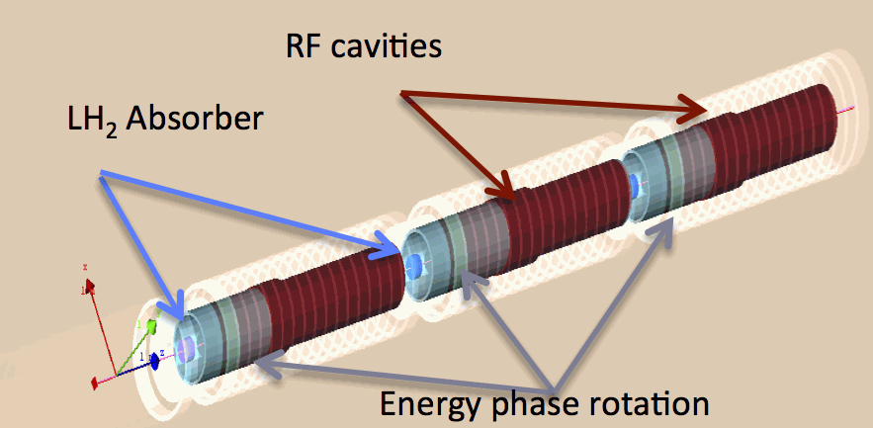
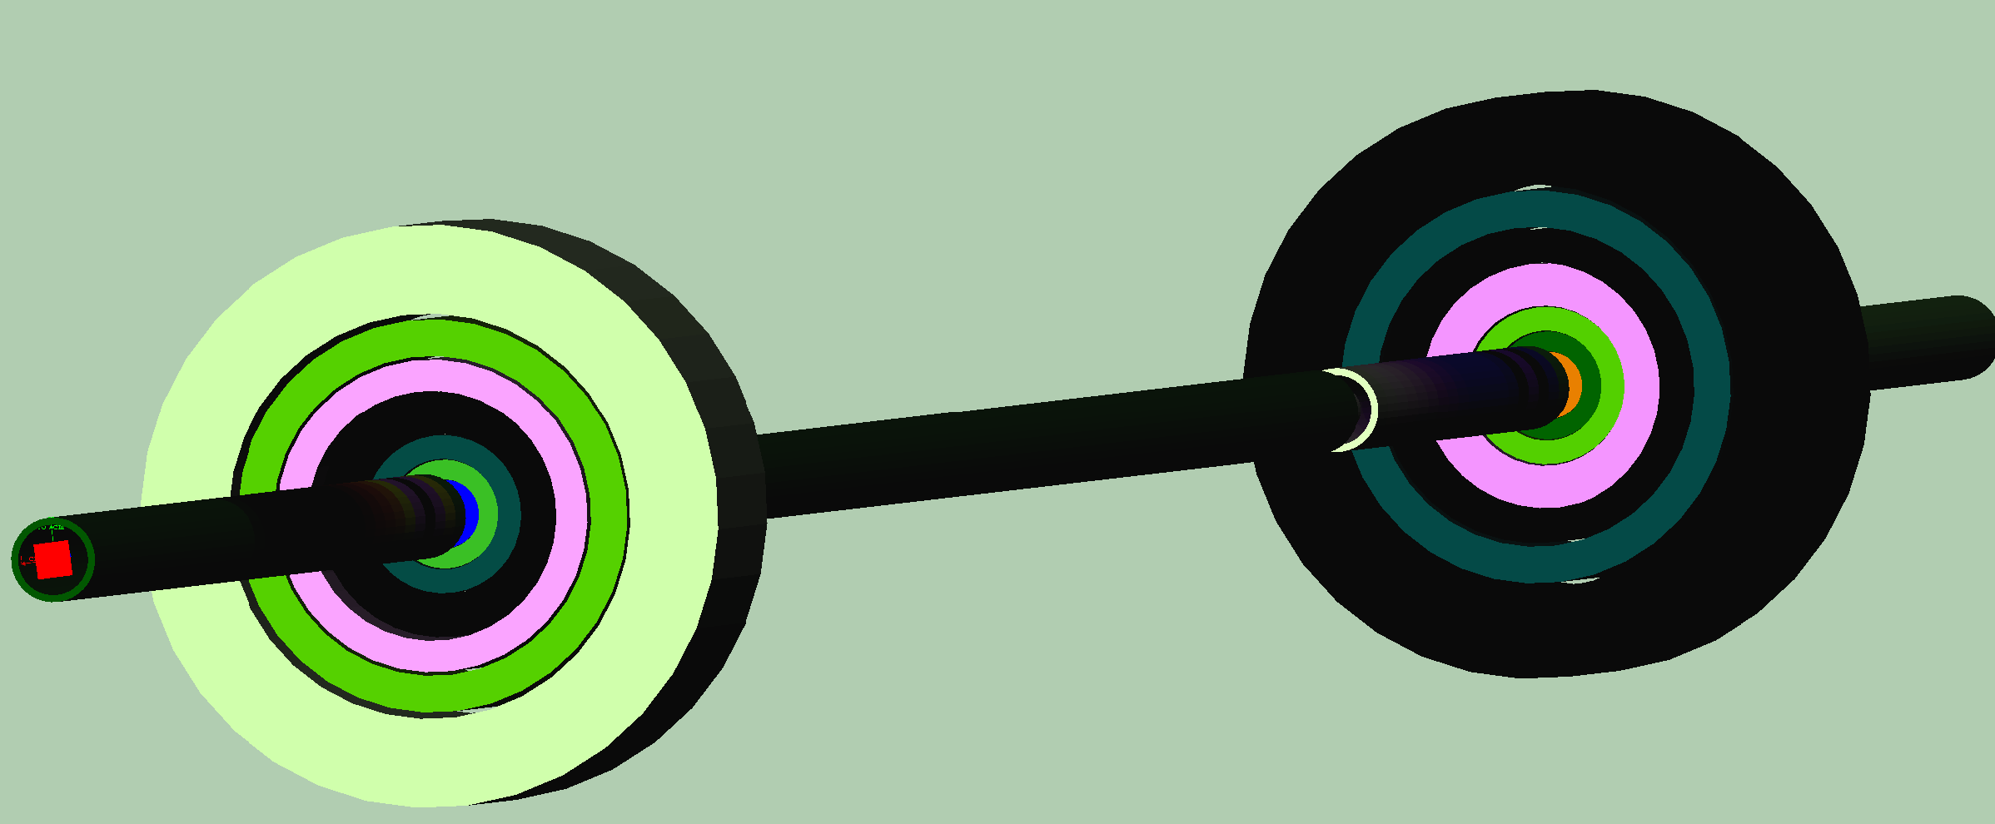
Muon Ionization Cooling (Design)
Initial 6D cooling
325 MHz cooling
Matching
650 MHz
Helical Cooling Channel (Gas-filled RF Cavities):
ε_{T} = 0.6mm, ε_{L} = 0.3mm
Late Stage w/ Induction Linac
World Record LTS-HTS Hybrid Magnet
32T on-axis field
NHFML
Final Cooling with 25-30T solenoids (emittance exchange):
ε_{T} = 55μm, ε_{L} = 75mm

Slide 27
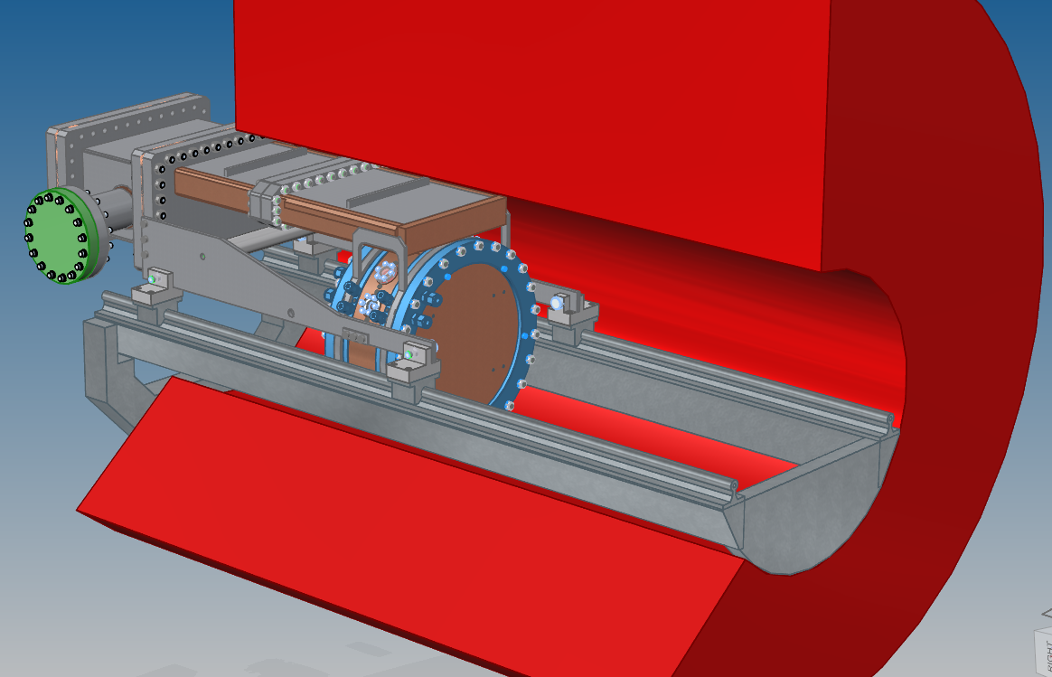
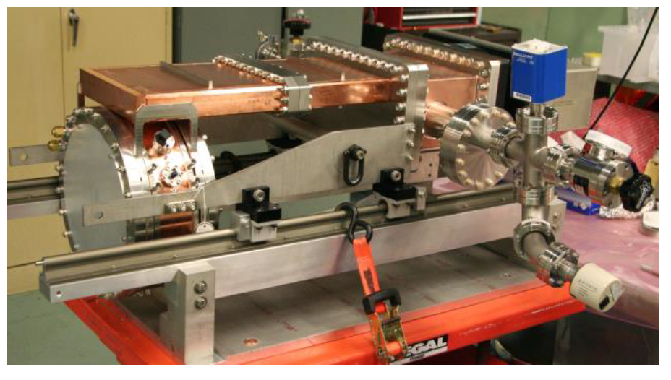
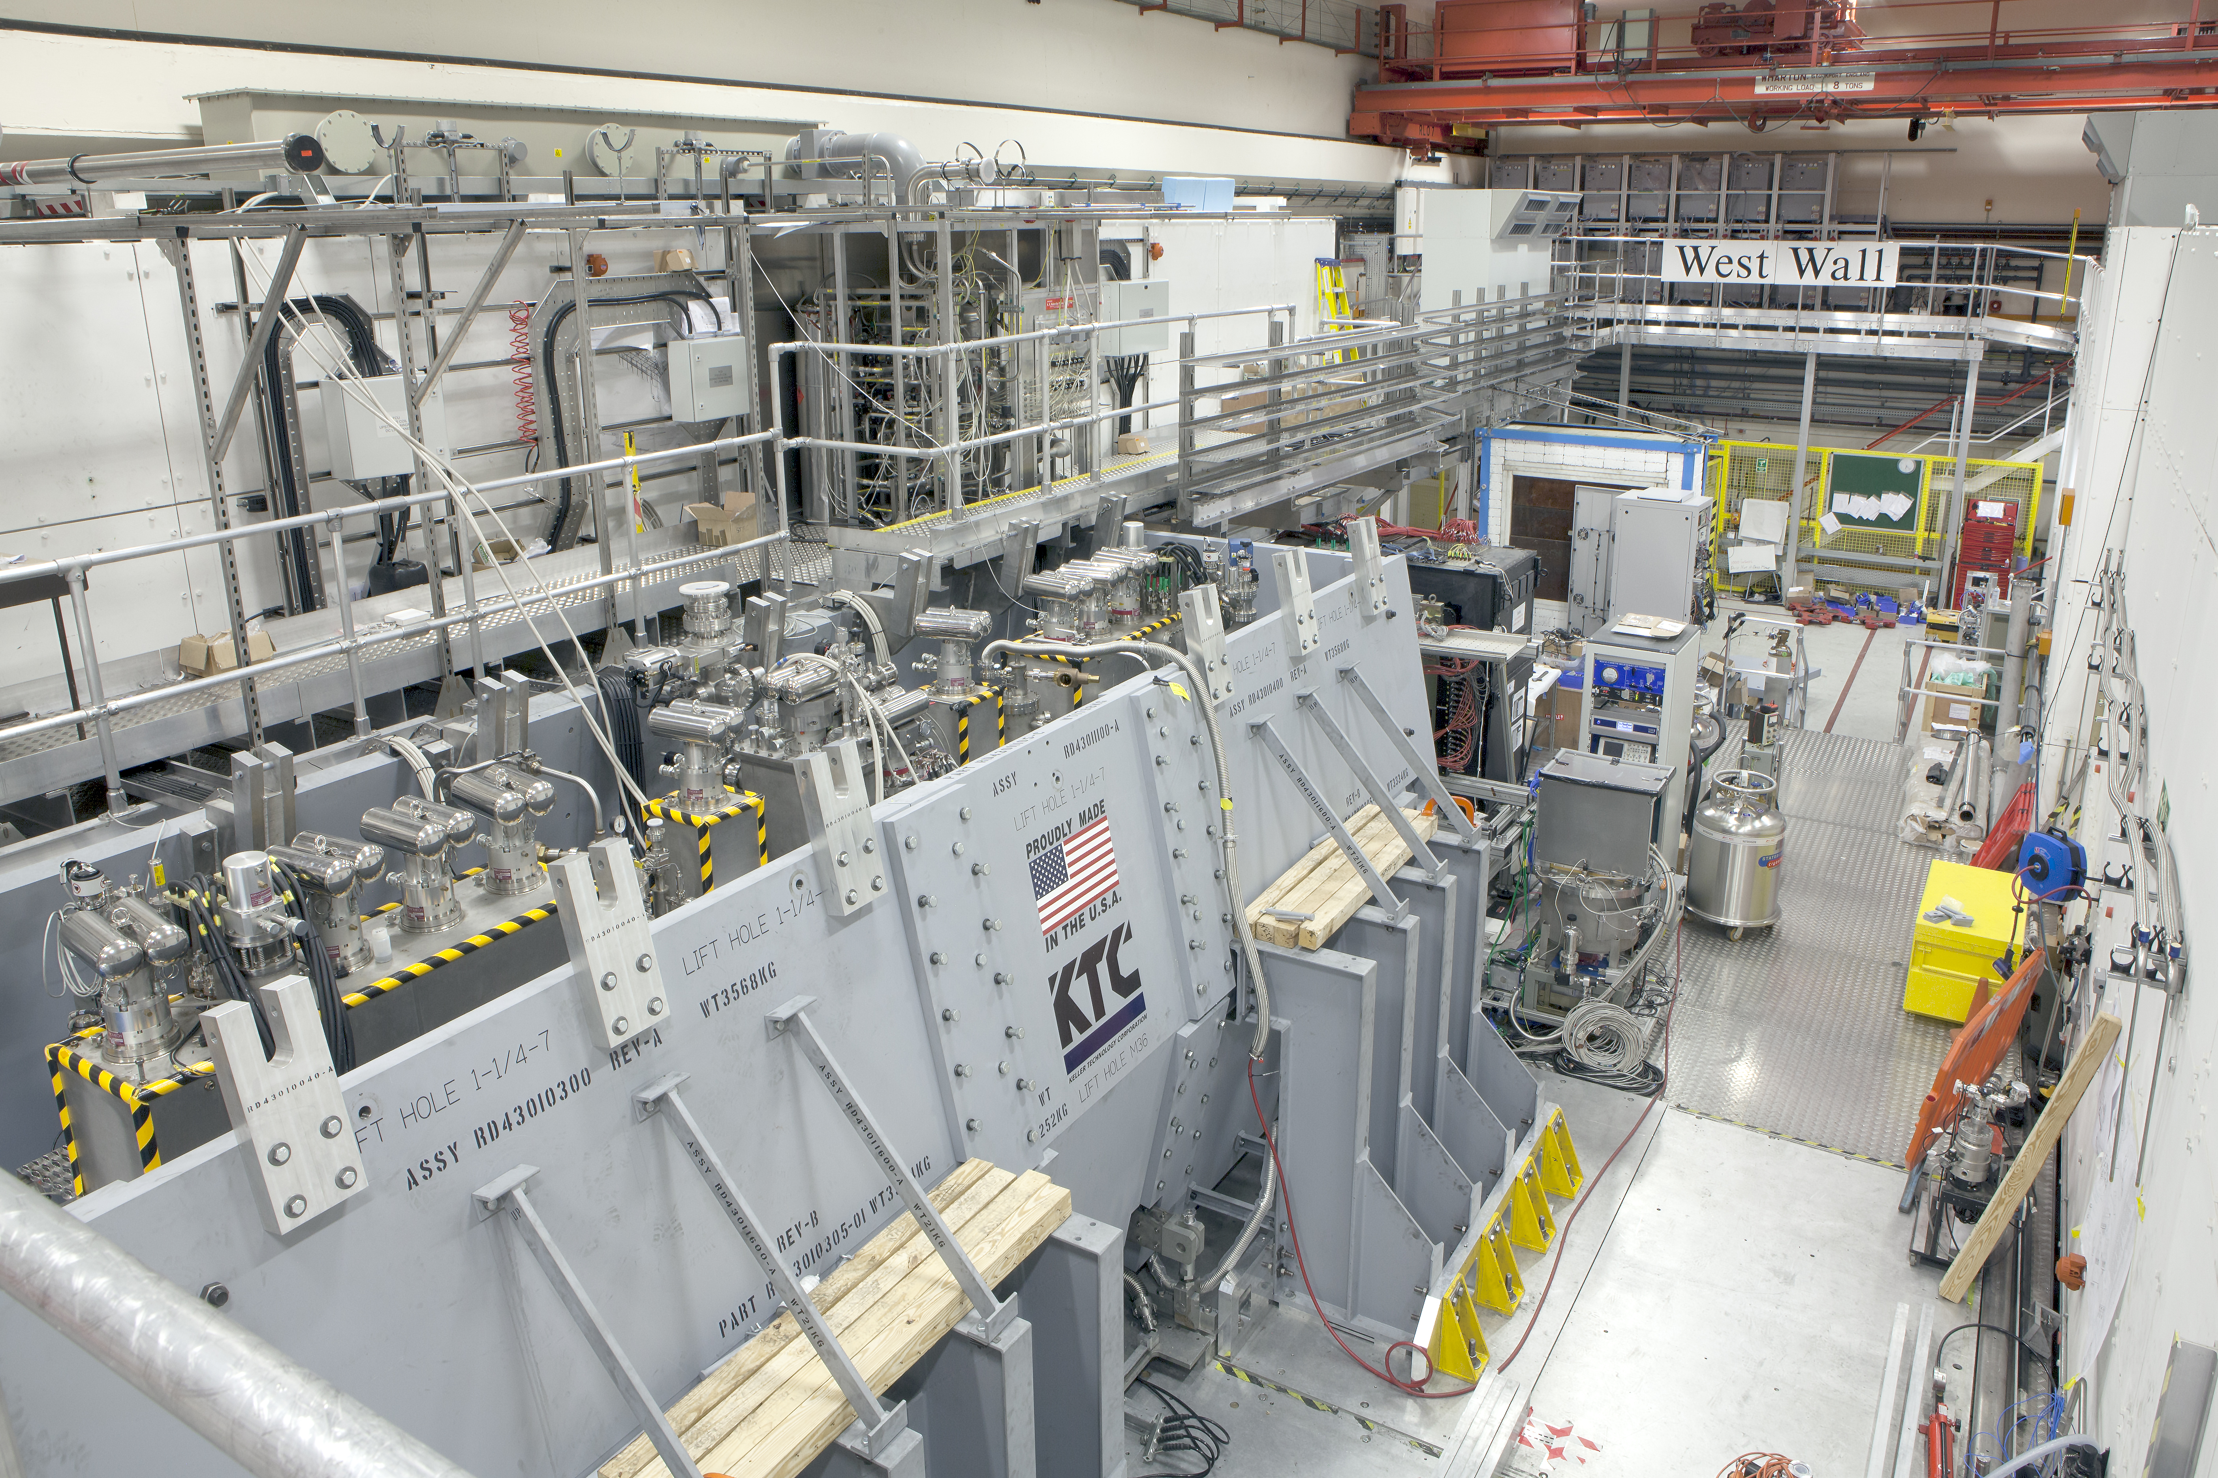
Ionization Cooling
>50MV/m operation
in up to 5 T B-field
Specification Achieved (simulations)
Final
MICE Cooling Channel
Initial
(X)
Initial
(Y)
VCC &
Hybrid
HCC
PIC assumed in Carlo
Rubbia’s Proposal
VCC HTS
Extrapolation
MAP Higgs
Factory Target
Advanced techniques a
Improved HF Luminosity
Simplified Final Cooling requirements

Slide 28
Some Cooling Comments
MICE confirms our understanding of the ionization cooling process for muons
MAP design studies and R&D provide a basis for the technologies in a complete cooling channel
  But only piece-wise studies completed
  Technology deliverables were achieved
  a now need to move to next-generation design effort
Cooling has huge leverage on the overall machine design
  What proton power is required on target?
  What luminosities can be envisioned?
A fully integrated design study is now warranted
A technology demonstrator would enable performance studies of the cooling concepts at high beam intensities

Slide 29
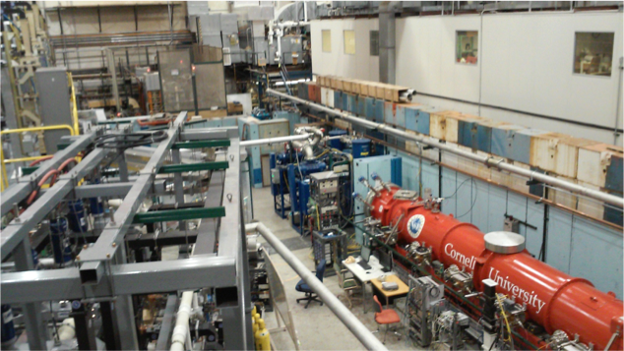
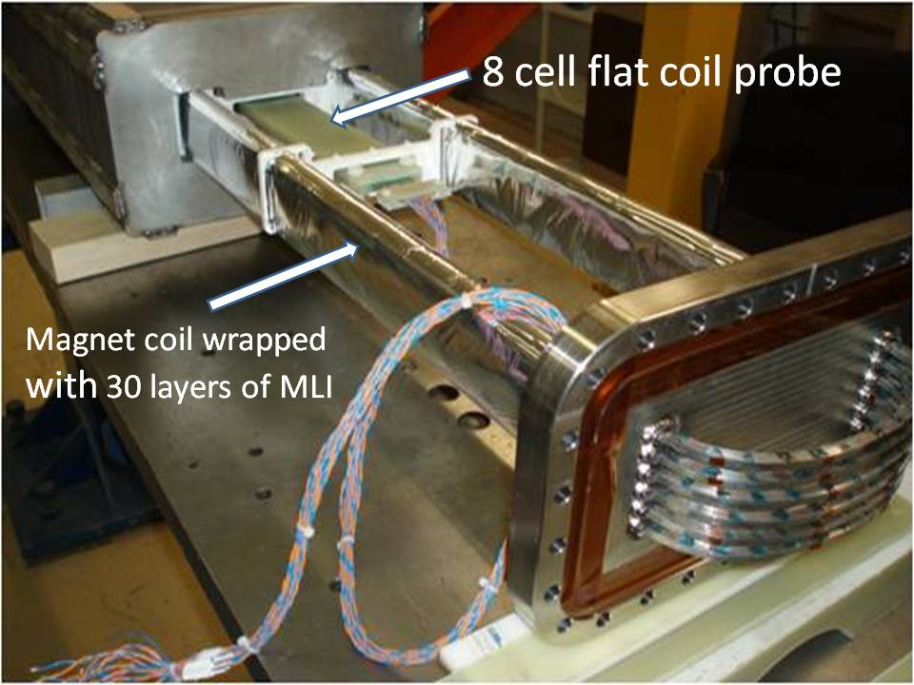
Acceleration
Technologies Include:
  Superconducting Linacs
  Recirculating Linear Accelerators (RLAs)
  Fixed-Field Alternating-Gradient Rings (FFAs)
  Hybrid Rapid Cycling Synchrotrons
Designs to
125 GeV CoM
Needed for
Multi-TeV Scale
EMMA
CBeta @ Cornell
Hybrid RCS
Accelerator suitable for
Neutrino Factory Applications

Slide 30
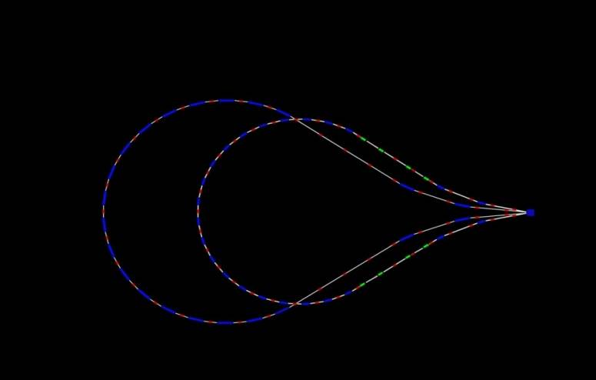
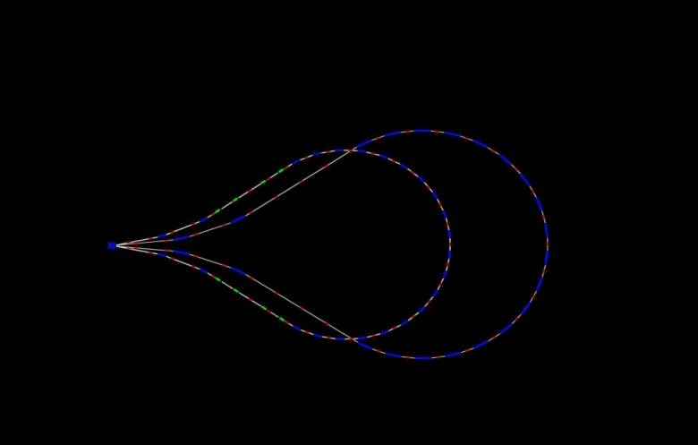
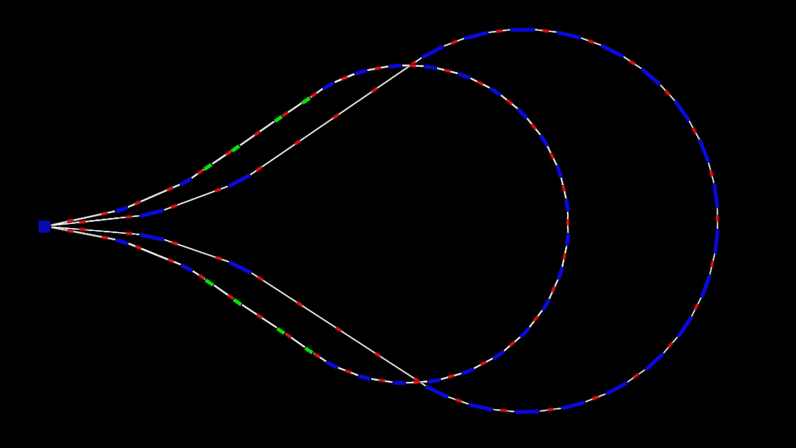
Acceleration to 125 GeV Center-of-Mass
5 GeV
28.2 GeV
16.6 GeV
51.4 GeV
63 GeV
39.8 GeV
829 m
11.6 GeV/pass
top view
E=5-63 GeV
16.6 GeV
39.8 GeV
RF: f = 650 MHz cells/cavity = 5 Gradient = 25 MV/m phase = 22∘

Slide 31
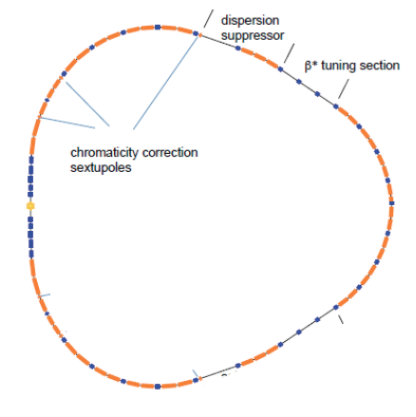
Higgs Factory (125 GeV) Lattice Design Alexahin, et al., JINST 13 P11002
MC Higgs Factory:
MAP design
with a single IP

Slide 32
Key Features/Challenges of MC Higgs Factory
Features:
  s-channel production
  Exquisite energy spread (δE_{b}/E_{b}~4x10⁻⁵)
  allows direct probe of Higgs line shape
  Spin precession of μ allows precise E calibration
  (Raja & Tollestrup, arXiv:hep-ex/9801004)
Challenges
  Higgs production rate with preliminary MAP assumptions (~13,500/Snowmass year) hasn’t been considered competitive
    However, VCC simulations already suggest we can do better than this
    Introduction of alternative techniques such as Parametric Ionization Cooling (PIC) offer the potential of further rate improvements
  Machine-Detector interface
    IR magnet aperture requirements
    Shielding detector from machine backgrounds
  Based on MAP R&D results, an updated design study is required to fully evaluate potential performance
Han & Liu, arXiv:1210.7803 [hep-ph]

Slide 33
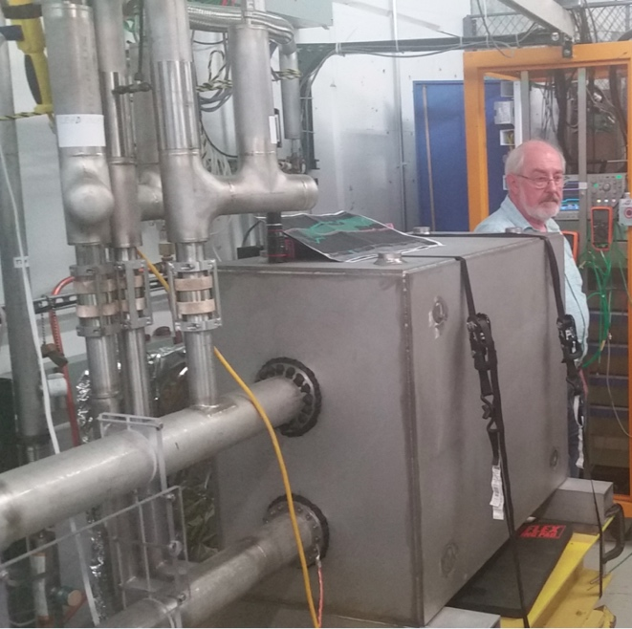
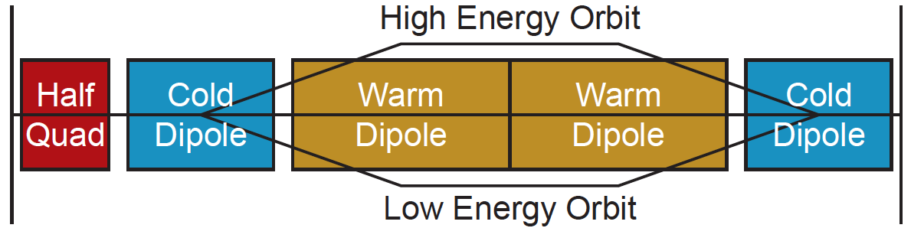
TeV-Scale Acceleration
H. Piekarz et al., Record fast-cycling accelerator magnet based on HTS conductor,
NIM A, Vol 943, 2019, 162490, https://doi.org/10.1016/j.nima.2019.162490
FNAL
12 T/s HTS
0.6 T max
MAP identified concepts
  Final designs are not in hand
Challenges:
  Large energy bandwidth lattice at high energies
  Fast-ramping magnets
    Grain-oriented silicon steel?
    HTS?
  Power supply system and efficiency will determine the viability and energy efficiency of the accelerator
  systems
Hybrid Rapid Cycling
Synchrotron Cell Concept

Slide 34
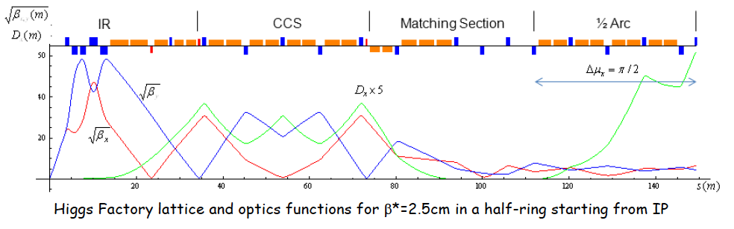
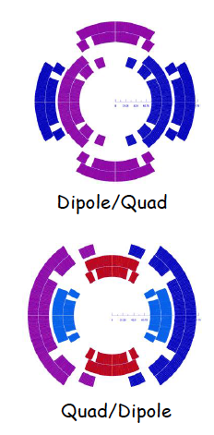
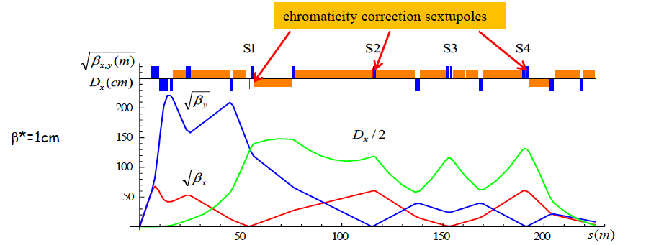
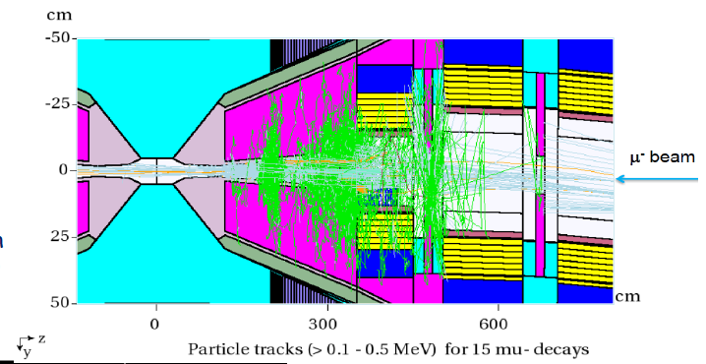
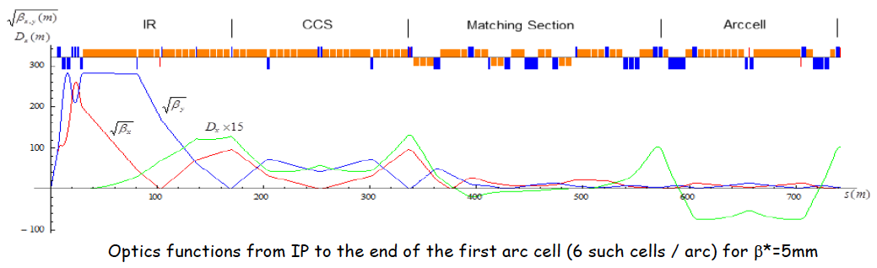
Collider Ring & Detector
MAP Optics Designs for
  Higgs Factory (125 GeV)
  1.5 TeV CoM
  3.0 TeV CoM
  6.0 TeV CoM [extrapolation]
Ring Magnet Designs
IR Design
Higgs
1.5 TeV
3 TeV

Slide 35
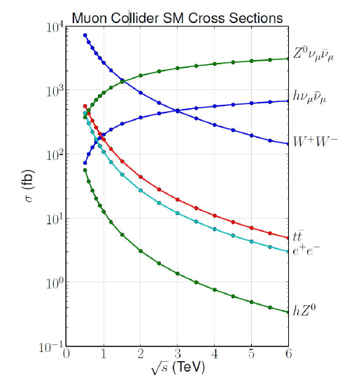
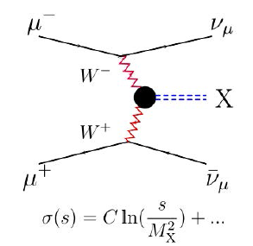
High Energy Muon Colliders
Physics Reach
  At √s > 1 TeV: Fusion processes dominate
  An Electroweak Boson Collider
  A discovery machine complementary to very high energy pp collider
  At >5TeV: Higgs self-coupling
  resolution <10%
Limitations
  Beam-induced Backgrounds
  Neutrino radiation -
    Dose at earth’s surface∝E_{μ}³
    B. King - https://arxiv.org/abs/hep-ex/0005006v1

Slide 36
Looking Forward...
Muon Colliders offer an energy-efficient path to multi-TeV CoM energies
Recent physics studies indicate that important collider physics is accessible
The MAP R&D Program has successfully demonstrated critical technologies for the cooling channel a Now ready for:
  Updated Cooling Channel Conceptual Design
  Demonstrator of a high intensity cooling cell
Other key developments to pursue for a TeV-class collider (move beyond the parameters and scope of MAP)
  Ongoing physics studies
  Detailed designs for TeV-class acceleration
  Full end-to-end conceptual design
  Mitigation approaches to minimize “ν Radiation” issues at the exit point on the surface
A new international design effort is timely and ready to evaluate an important option for the HEP community

