Slide 1
A Collaborative Science Platform developed by IDIES

Slide 2
Outline
Background
SciServer overview
Use case highlights
Architecture & Deployments
New/hidden features/accelerated computing
Future directions
Questions

Slide 3
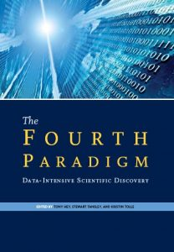
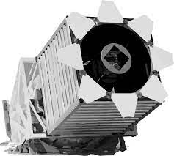
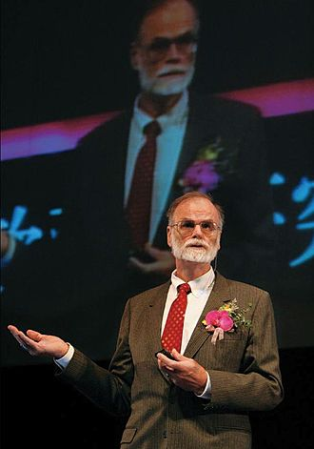
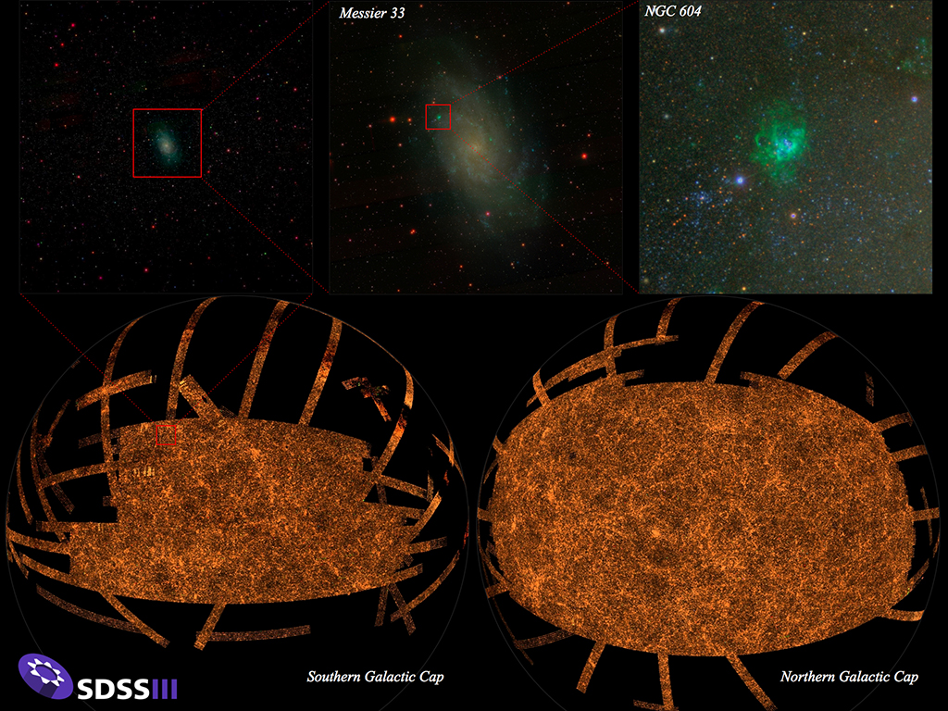
Beginnings
The fourth paradigm: Data exploration.
More data being produced than can be analyzed, increasing dependence on tools and machine learning to help make sense.

Slide 4
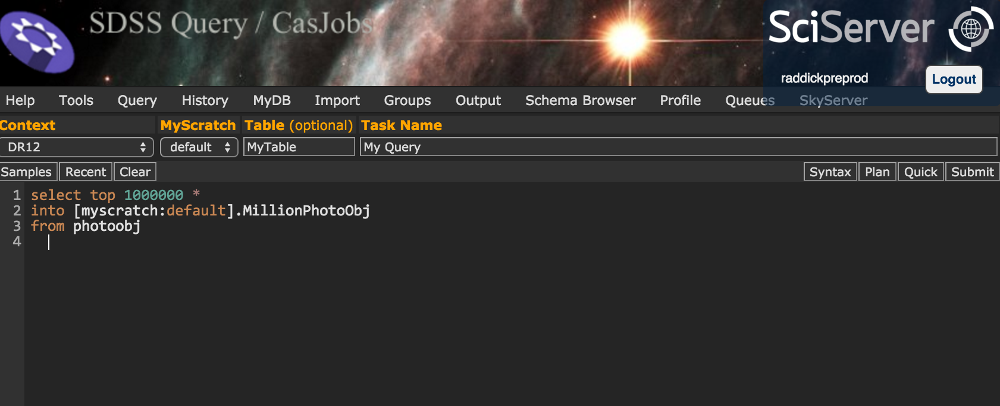
SDSS / CasJobs
SQL interface to large catalog of object data
Server-side execution, download small result-set of interest
Personal DB space
Sharing features

Slide 5
SDSS / CasJobs
SQL interface to large catalog of object data
Server-side execution, download small result-set of interest
Personal DB space
Sharing features
Still need to download
No solution for file-based data
limited/no visualization support

Slide 6
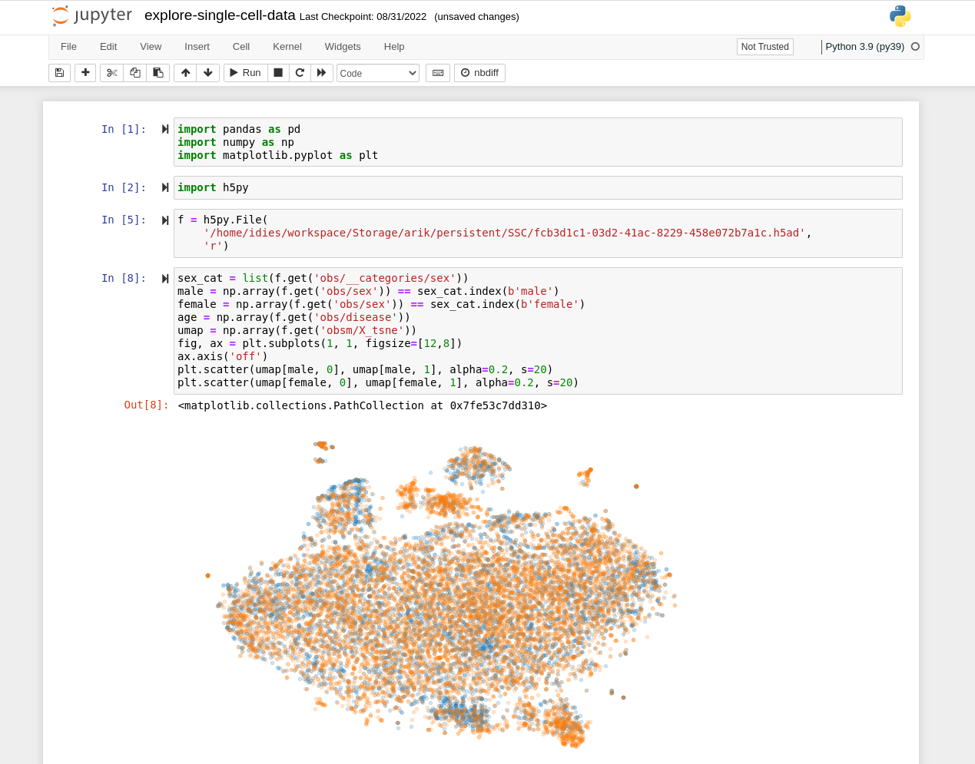
Beyond SQL
Add Jupyter
Docker makes scheduling simple
Jupyter can run arbitrary codes
Inline visualization
Common dependencies included
SDK for CasJobs (get a pandas DF)

Slide 7
Beyond SQL
Add Jupyter
Docker makes scheduling simple
Jupyter can run arbitrary codes
Inline visualization
Common dependencies included
SDK for CasJobs (get a pandas DF)
Server-side collaboration?
Expanding scope?

Slide 8
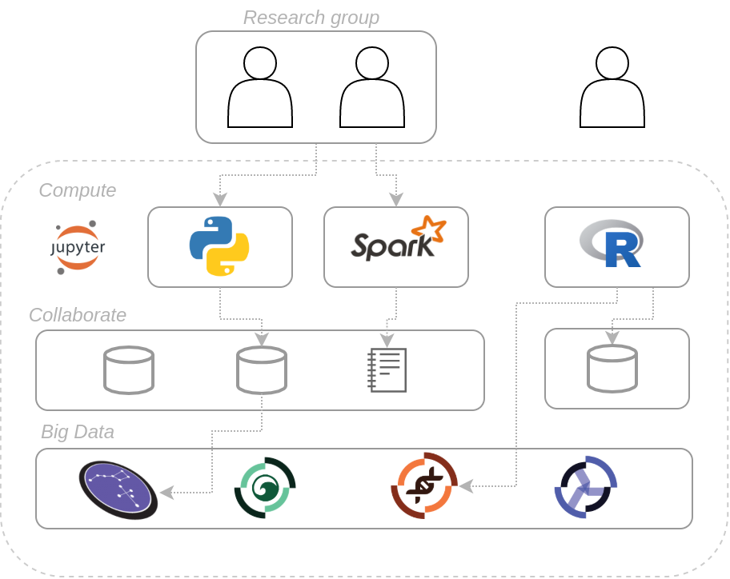
SciServer
Add in an ecosystem
Sharing/resource access control
Web based portals
Curated data
Astronomy
Genomics
Earth Science
Simulation data,...
A Science Platform

Slide 9
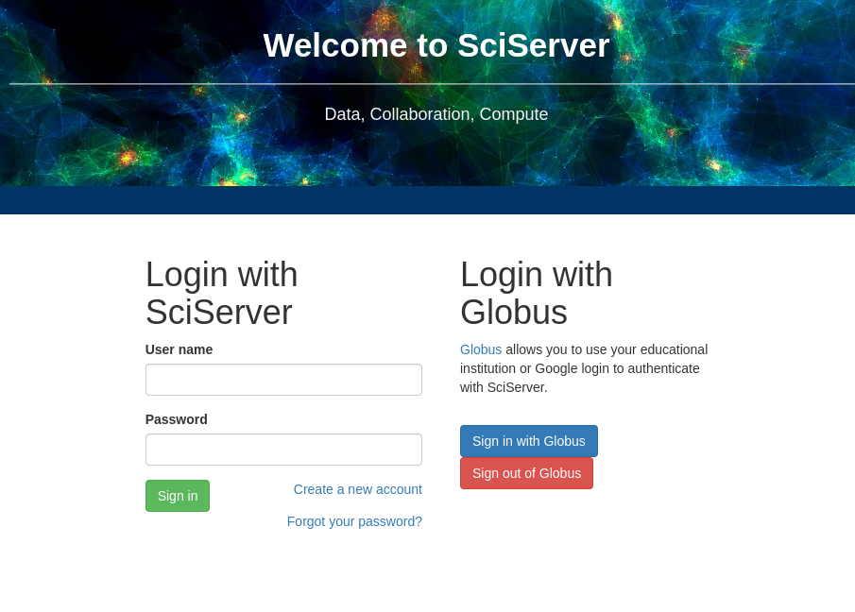
Basic Usage
Go to https://apps.sciserver.org
Create an account
You can sign in with your institution via globus, your google account or orcid by using “sign in with Globus”

Slide 10
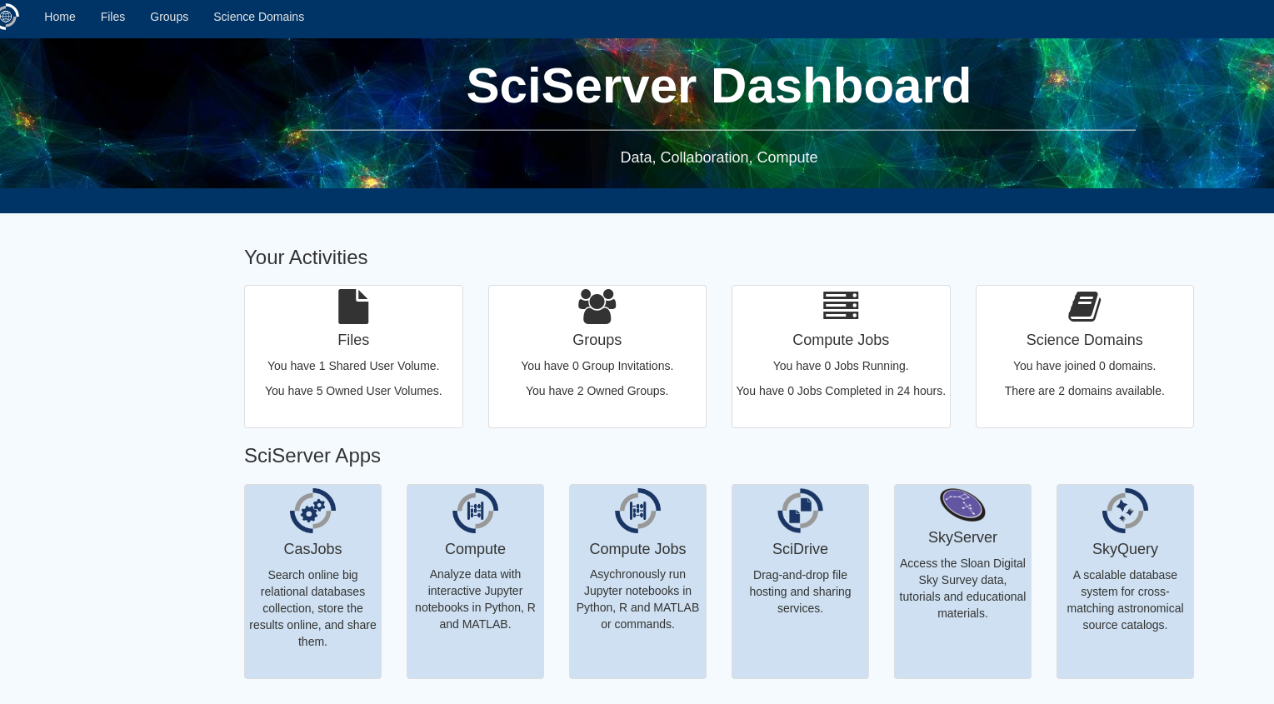
Basic Usage
Arrive at dashboard
A number of links to services
Files
Groups
Compute
Casjobs

Slide 11
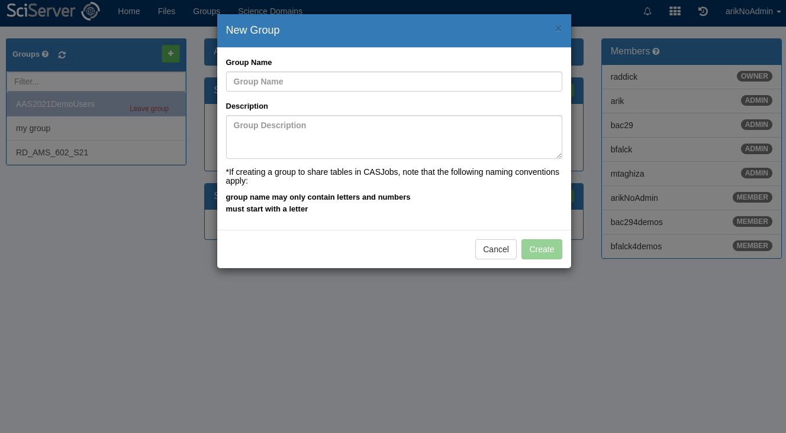
Basic Usage - Groups
Create groups
Groups are a unit of sharing
Invite other users

Slide 12
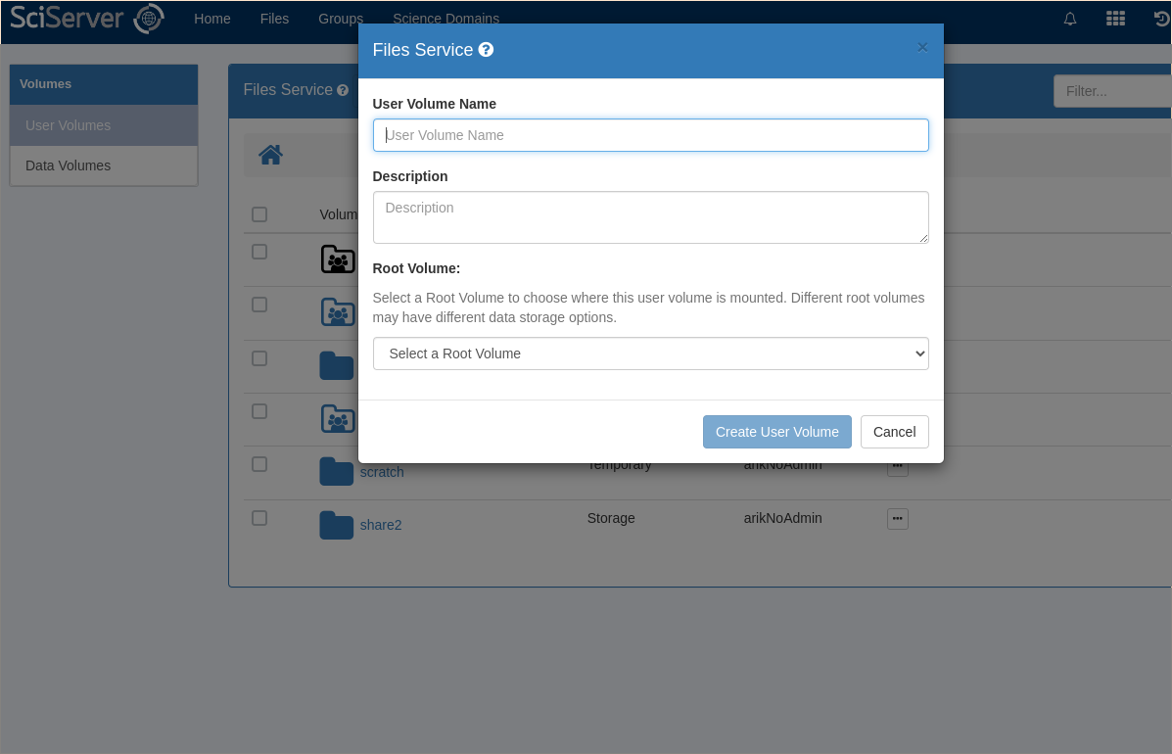
Basic Usage - User Volumes
Create “User Volumes”
Volumes can be shared
Store your own data
Default limited space
Temporary space:
For intermediate results
“Unlimited”
time-to-live

Slide 13
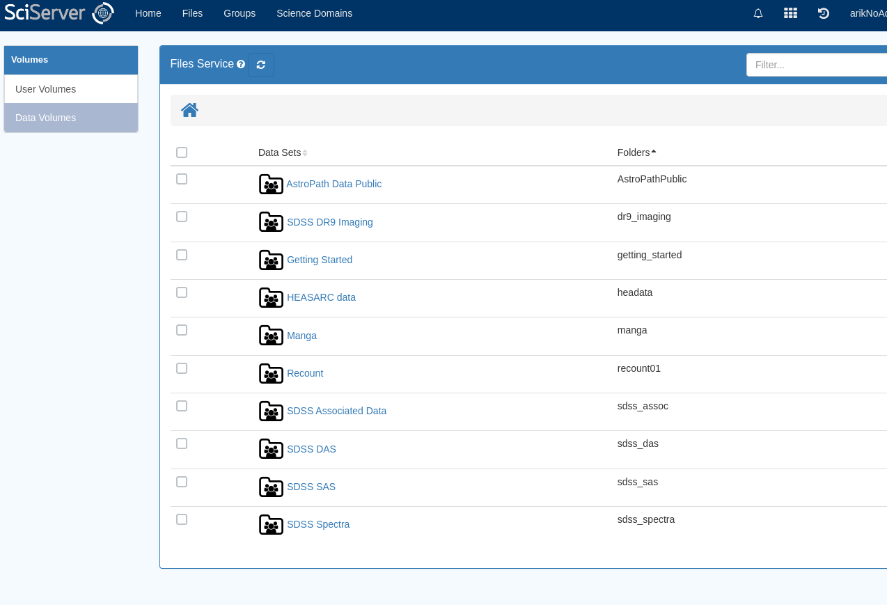
Basic Usage - Data Volumes
“Data Volumes”
Read-only
Curated data (typically)
Shared by “admins”

Slide 14
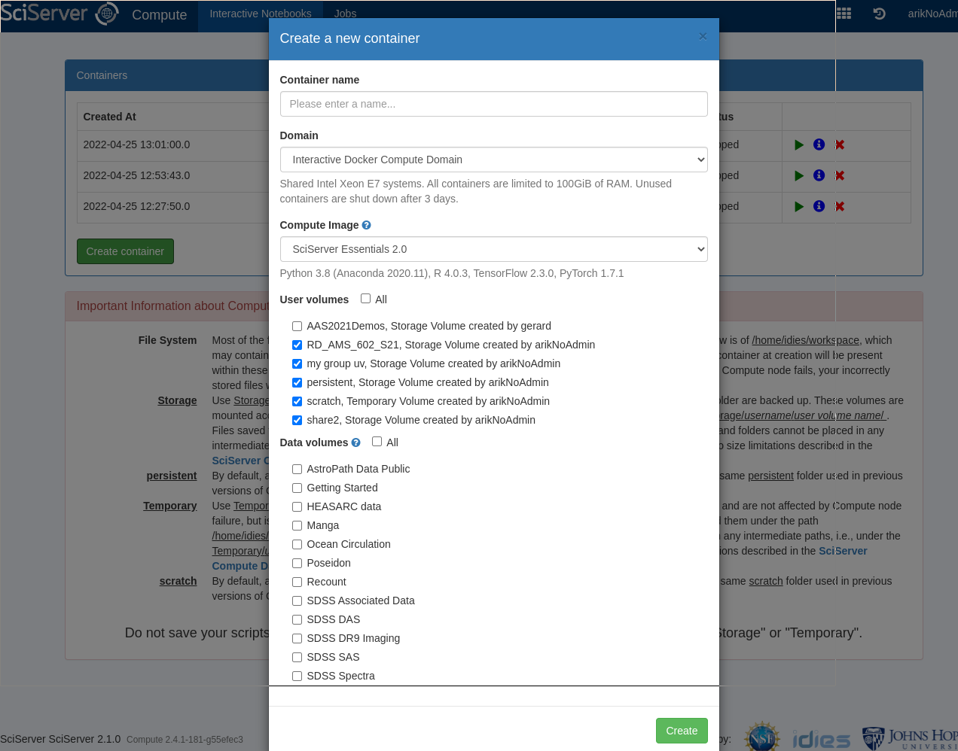
Basic Usage - Compute
Create a “container”
Backed by docker
Web service listening at specific port (Jupyter)
Mount volumes needed

Slide 15
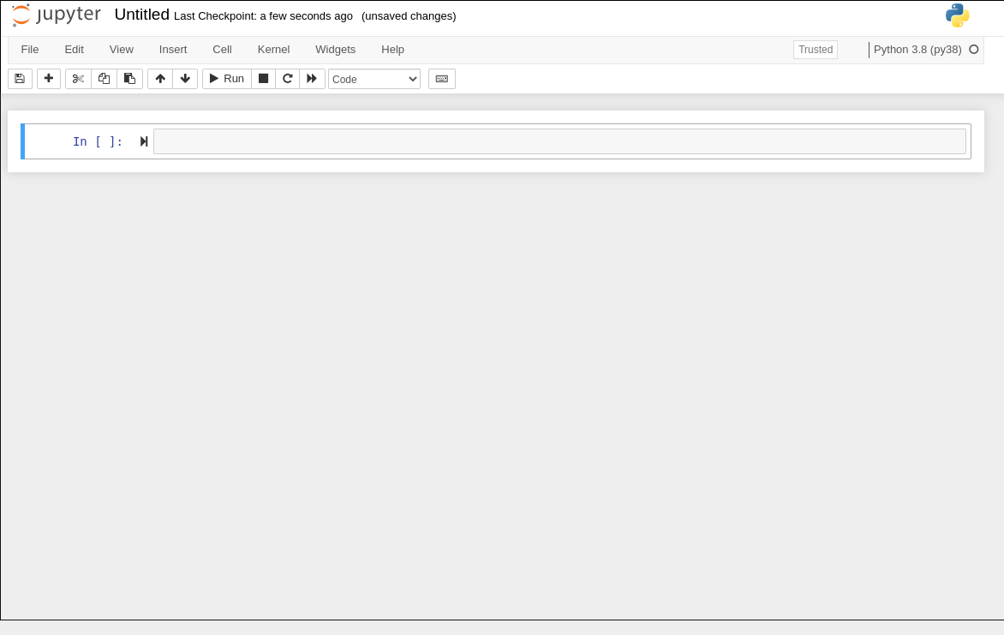
Basic Usage - Compute
Do analysis
Volumes are mounted
Posix access to regular files
Lots of software already included
Token “injected” for API access to SciServer and CasJobs

Slide 16
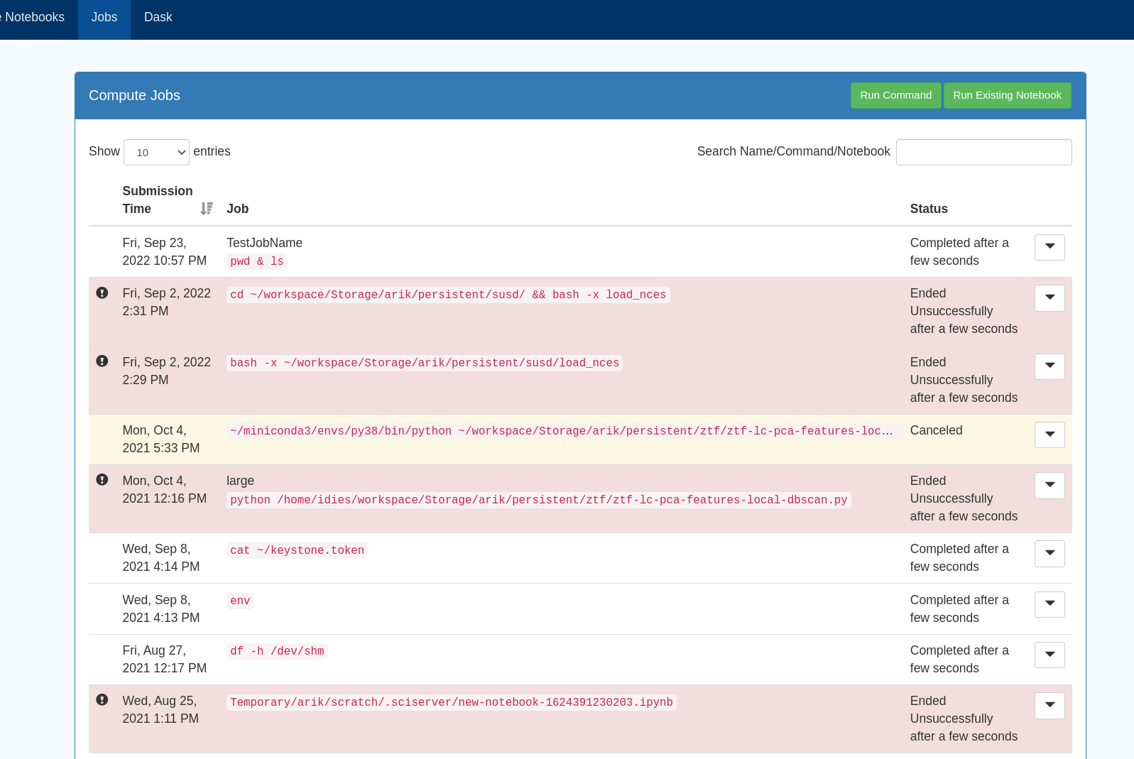
Basic Usage - Jobs
Asynchronous Jobs
Time-limited
Large/specialized resources
Queued, fair scheduling
Clearer provenance

Slide 17
Use Case Highlights

Slide 18
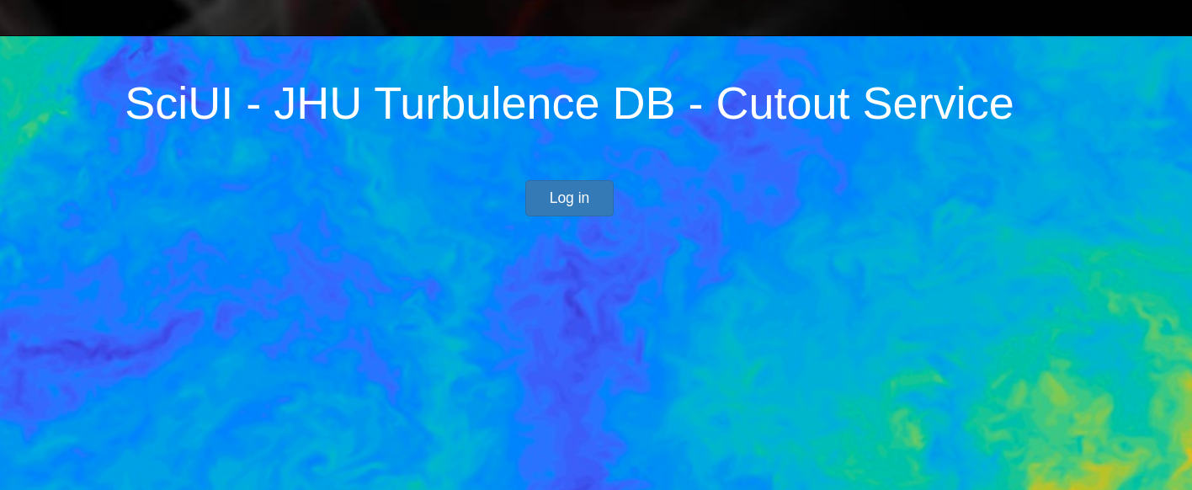
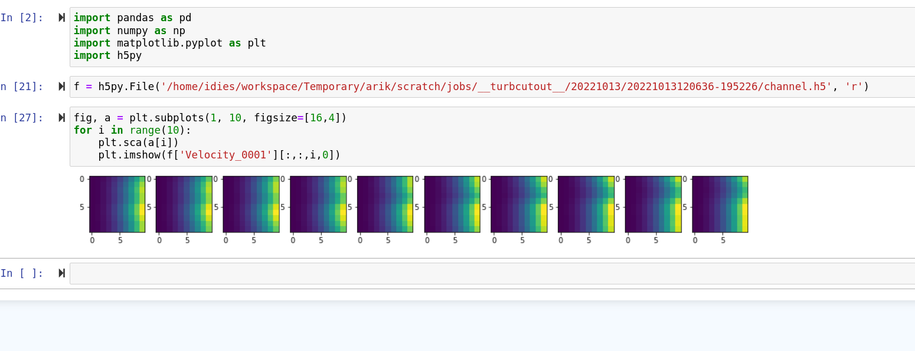
Use Case: Turbulence
Get cutouts of a large-scale turbulence simulation (~½ PB)
Web interface, actions backed by SciServer jobs
Use notebooks to analyze results
http://turbulence.pha.jhu.edu/

Slide 19
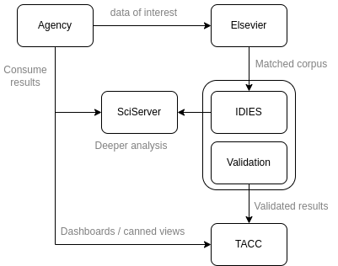
Use Case: Democratizing Data (Show Us The Data)
Context: track dataset usage for gov agencies
Rich data model, SQL backed
Simple APIs for Tableu (hosted at TACC), but…
SciServer enables deeper dive for those interested
See aso: Potok, N. (2022). Show US the Data. Harvard Data Science Review, 4(2). https://doi.org/10.1162/99608f92.9d13ba15

Slide 20
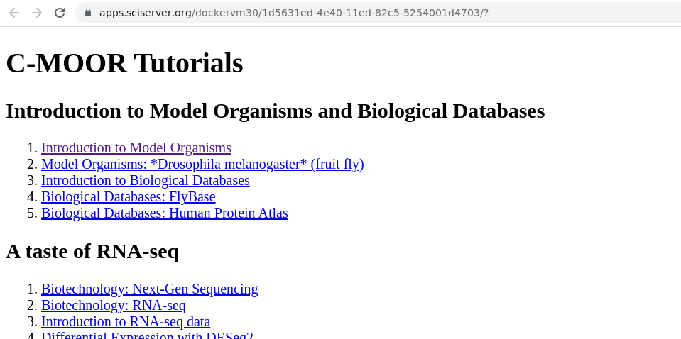
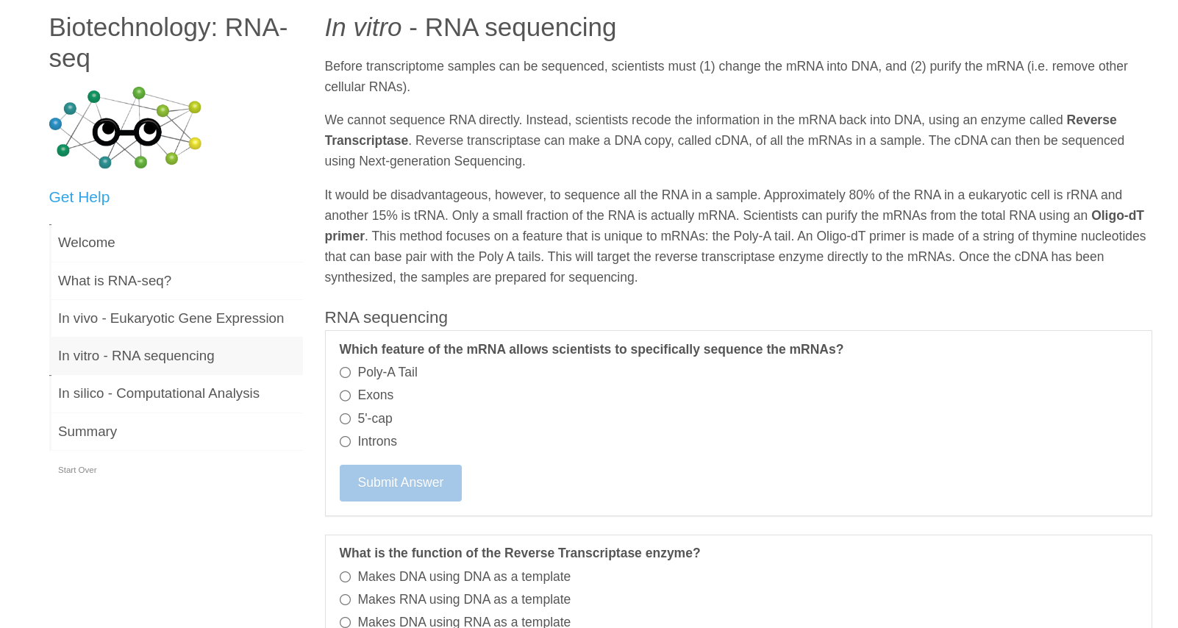
Use Case: Teaching
Focus on course materials, not setup
Share examples with students
Immediate feedback and experimentation
Collect materials via share

Slide 21
SciServer as a service

Slide 22
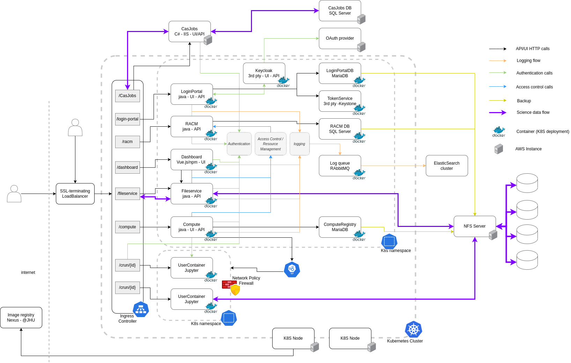
Architecture
Notes:
Test

Slide 23
Deployments
All the same features:
In another datacenter on own hardware
Behind a VPN
For specific insiders
In a HIPAA-safe environment
A number of partners
Active development
@JHU (sciserver.org)
On premise
@NIST
AWS VPC, k8s
@NAOJ
On premise, k8s
@MPE
On premise, k8s
@Precision-Medicine
Azure, secure-desktop

Slide 24
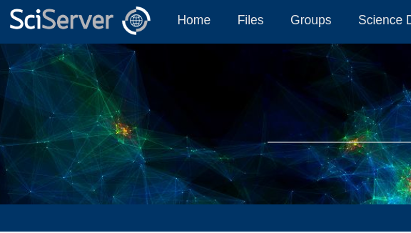
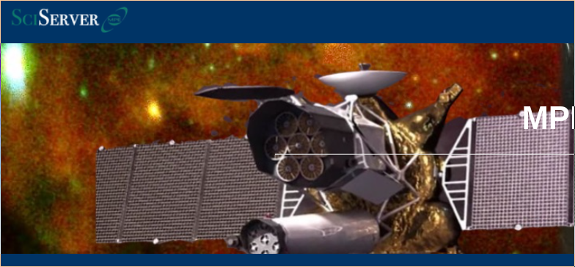
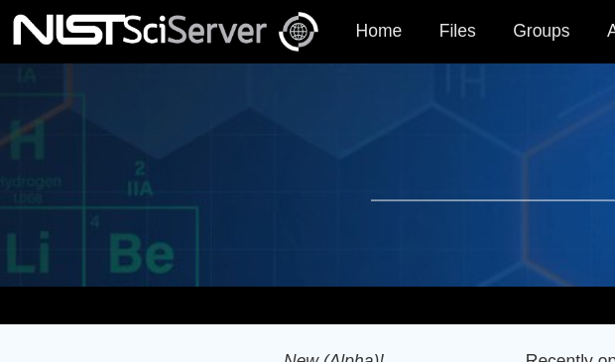
Deployments
Branding
Theme customizations
links
etc

Slide 25
Deployments
Leverage Kubernetes and helm
Bundle SciServer + 3rd party dependencies
Configurable with a single file
$ helm install sciserver -f config.yaml sciserver-k8s/charts/sciserver

Slide 26
Extra Features

Slide 27
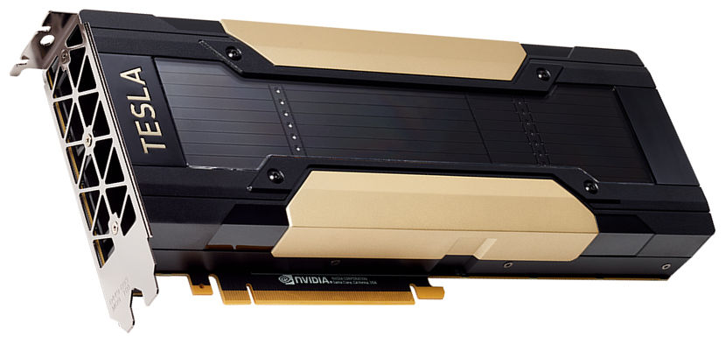
Extra features
Accelerated computing
GPU
Spark
Dask
Interactive and/or Jobs
SciServer Spark Gateway
Sparkmagic

Slide 28
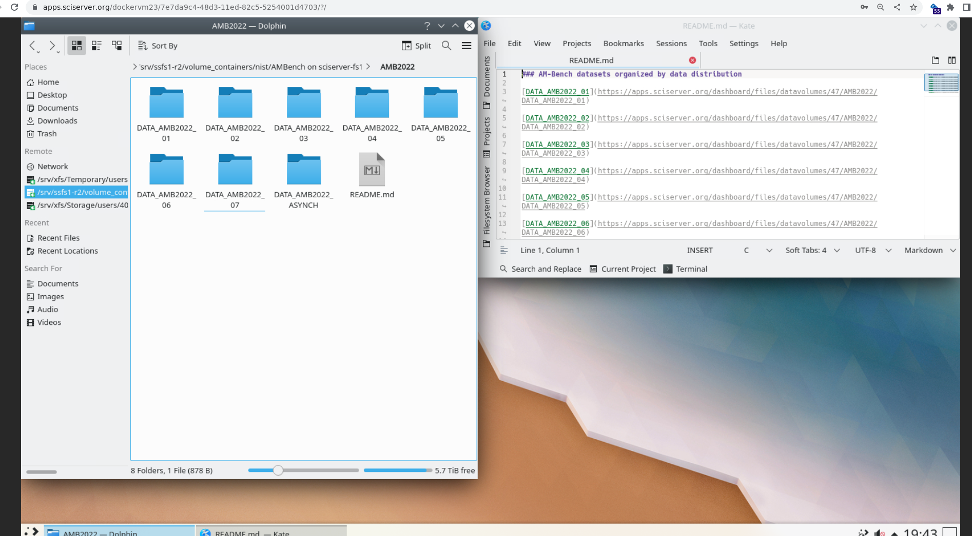
Extra Features
Not Just Jupyter
Compute exposes service that listens to single port
VNC, for example

Slide 29
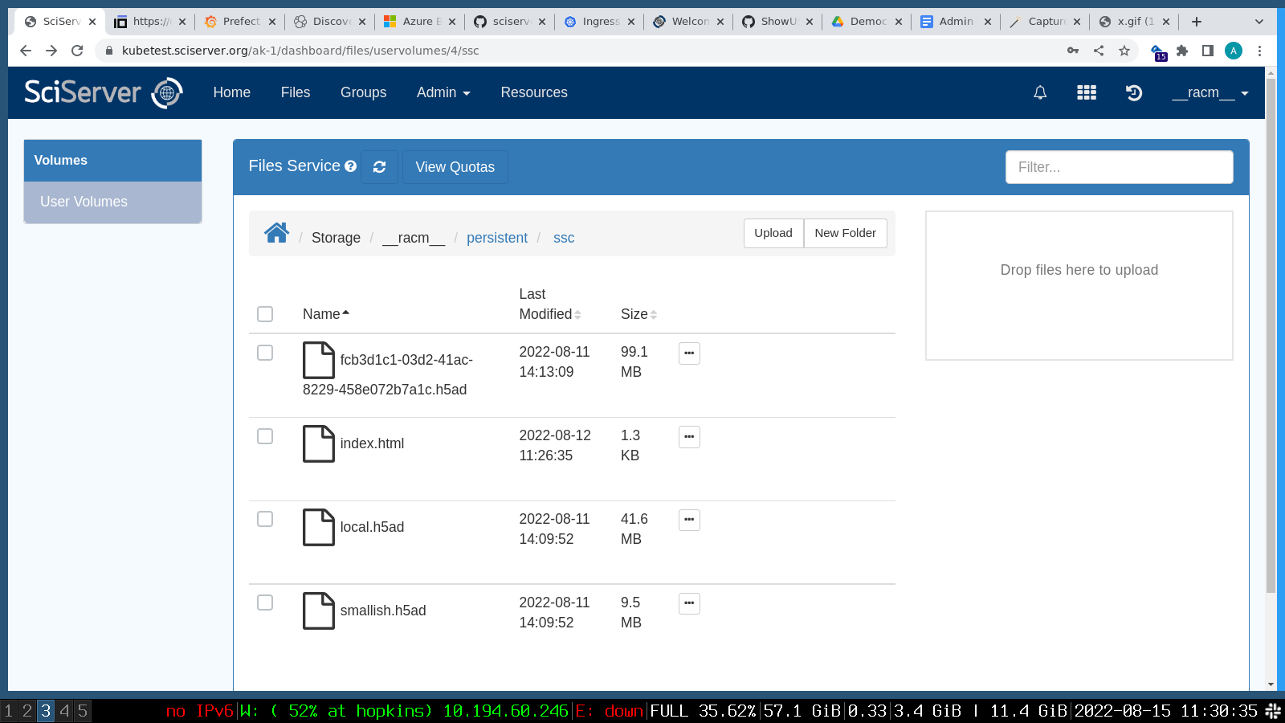
Extra Features
“One-click apps”
Shareable links
Argument passing
Can do in one-click what would take steps using generic compute containers
Operate on files
Embedded feel

Slide 30
Future Directions

Slide 31
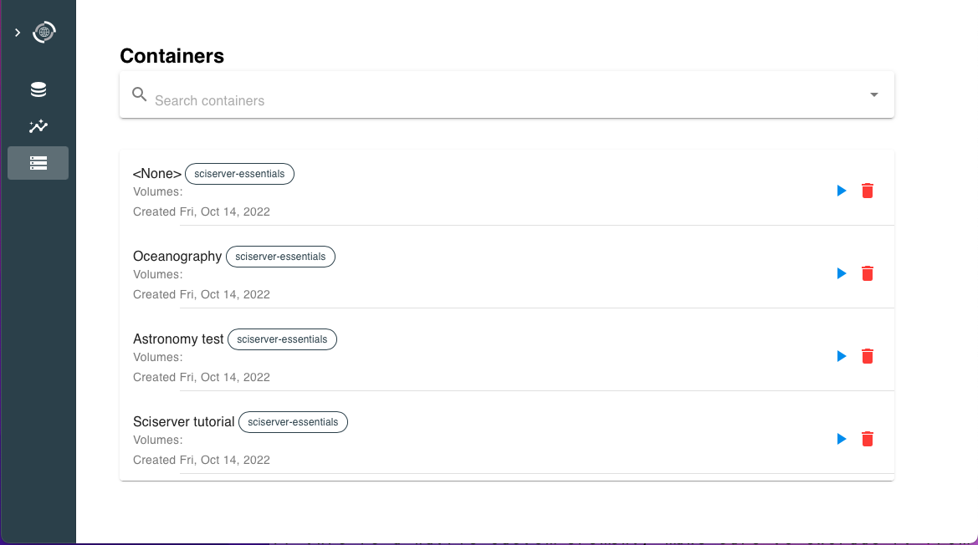
Future Directions
UI consolidation / improvements
Simplify development
Simplify branding and customizations
Improved layout and features

Slide 32
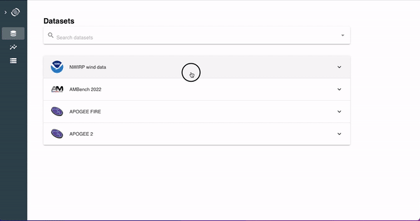
Future Directions
UI consolidation / improvements
Data discoverability
“Documents close to the data”
Leverage built-in access control
Human and machine writable
Just documentation, not full ontology

Slide 33
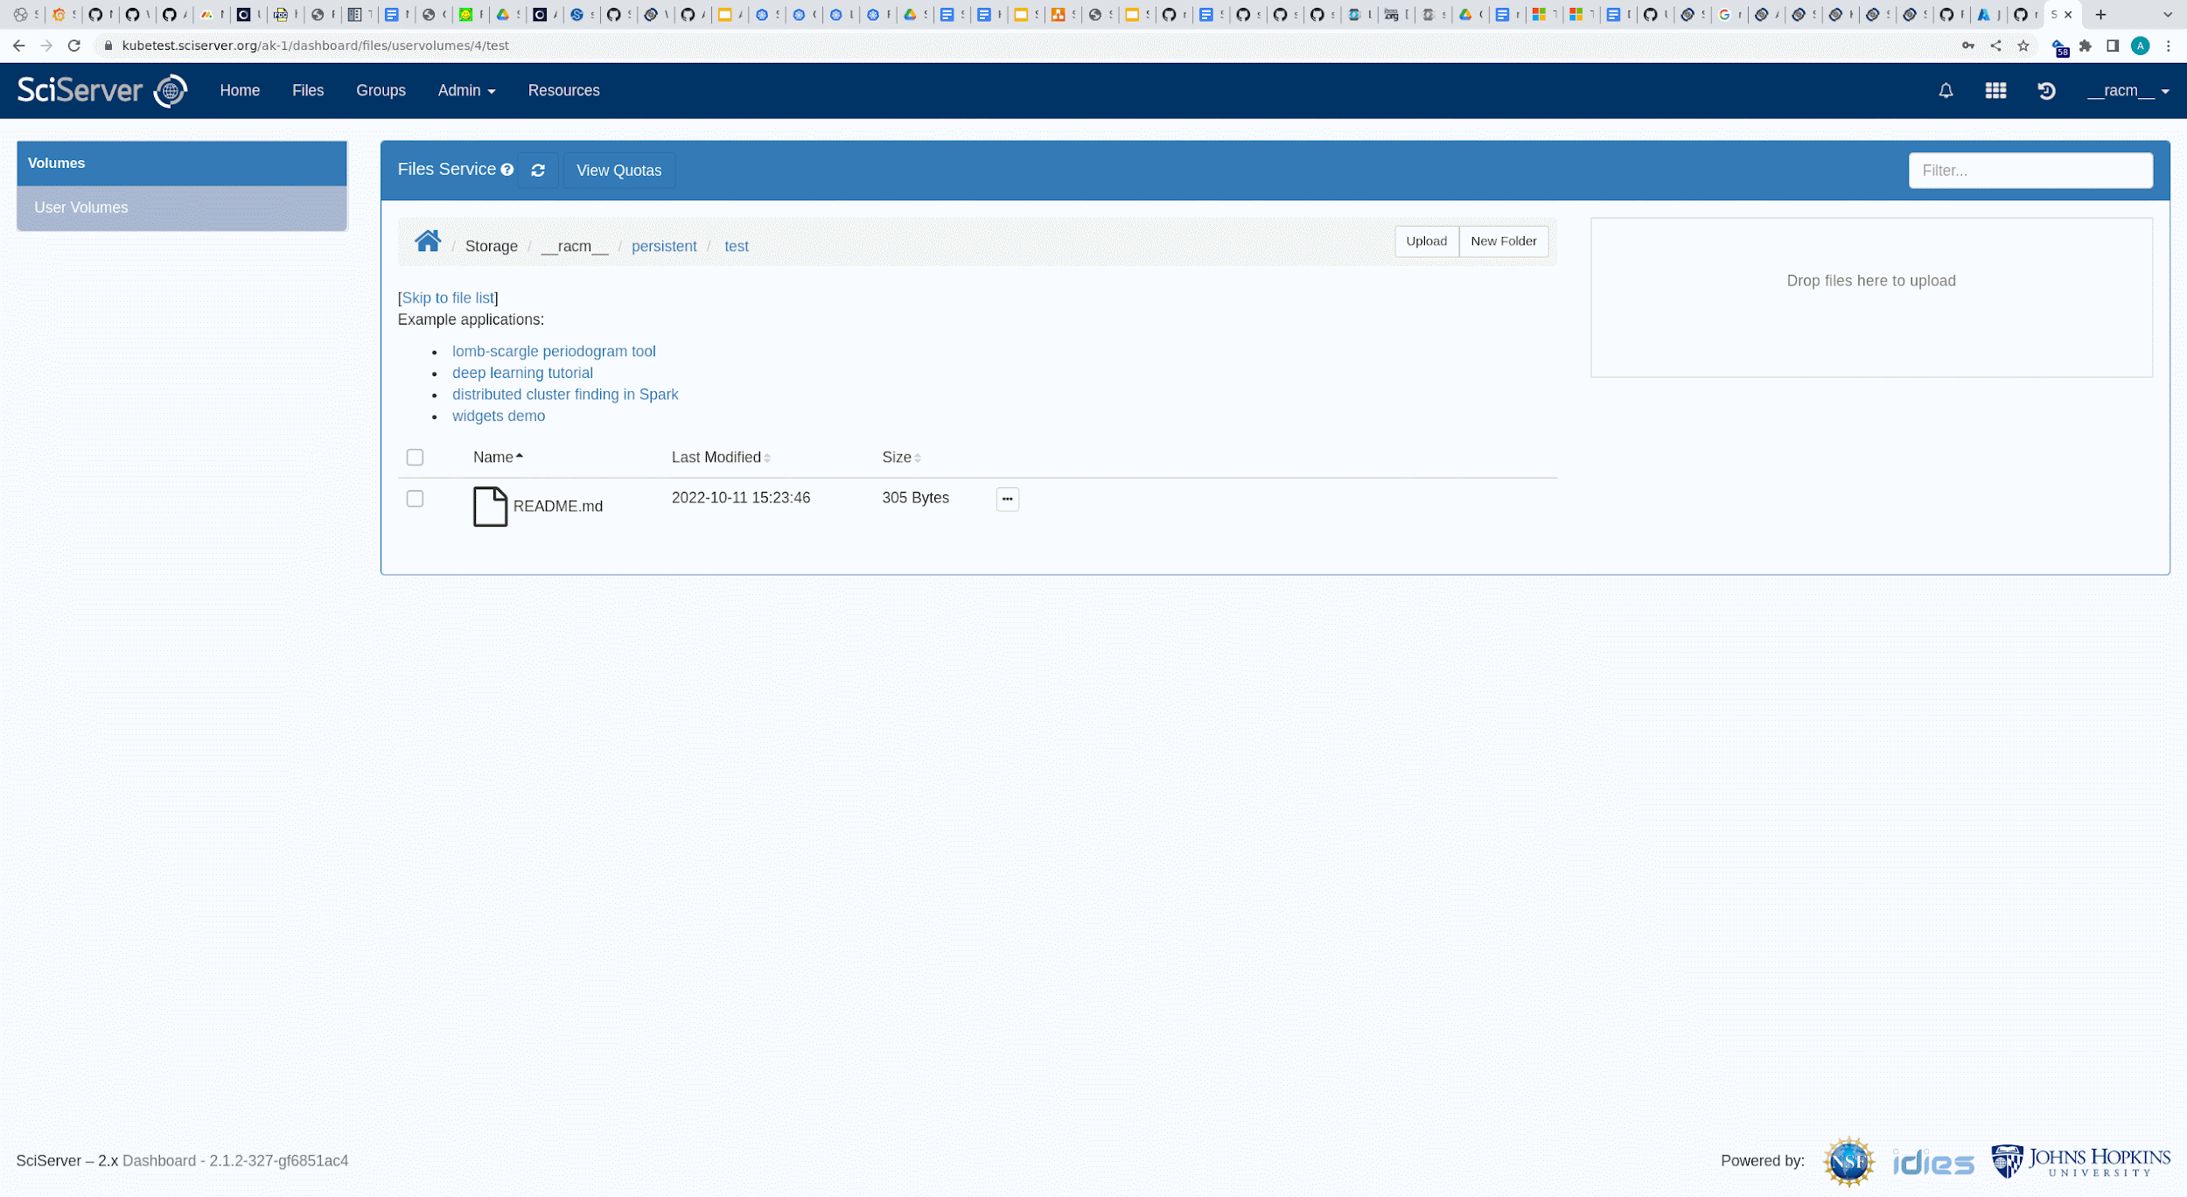
Future Directions
sciserver
UI consolidation / improvements
Data discoverability
One-click simplicity / link-share
Combine with data discoverability
Notebooks, quicker start
Jupyter widgets based apps
Sends links, not wordy instructions

Slide 34
Future Directions
Object Store
UI consolidation / improvements
Data discoverability
One-click simplicity / link-share
Cloud integrations
Object storage integration
Compute: site-wide? Research group? Bring-your-own? Etc.
Cloud-only datasets
Public Cloud

Slide 35
Future Directions
UI consolidation / improvements
Data discoverability
One-click simplicity / link-share
Cloud integrations
Others on the radar
Extended login sessions / api keys
Scheduled / cron-like jobs
Anonymous file sharing

Slide 36
Thanks!

