Slide 1
Lesson learned: ECCE software during proposal stage
Jin Huang
Brookhaven National Lab For ECCE Computing Team and Simulation WG

Slide 2
ECCE software strategy
Software is a tool to get physics, and it evolves with the experiment
During the proposal preparation, ECCE determined the best option for a software tool stack, given the schedule constraints and experience of the primary developers, was Fun4all-EIC
Fun4All-EIC was validated and widely used since early 2010s for EIC studies
Gluing together community-wide sim+reco packages: Geant4, ACTS, GenFit, FastJet, etc.; comprehensive truth evaluation chain; comprehensive CI quality checks
Post-proposal stage, ECCE will adopt and develop new tool/stack working toward the realization of the EIC detector and processing of the real data
Natural evolution of software for conceptual experiment. Expect ECCE software would look quite different in the next decade
Many opportunities to explore synergies in software development

Slide 3
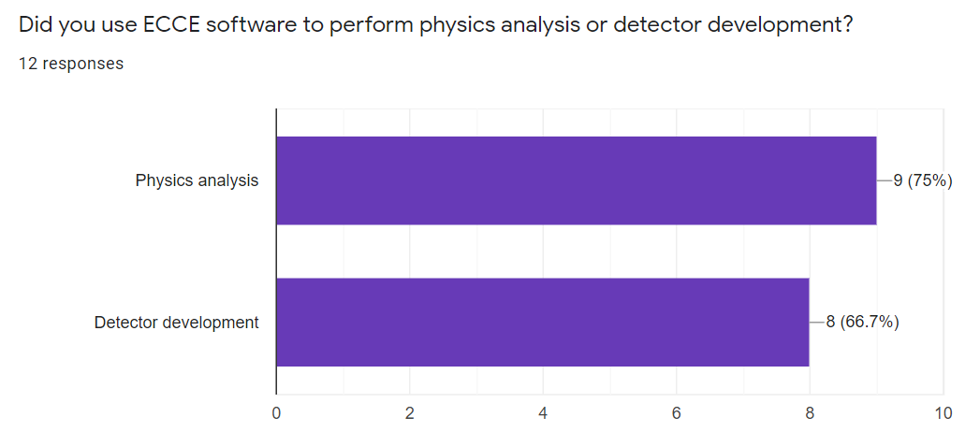
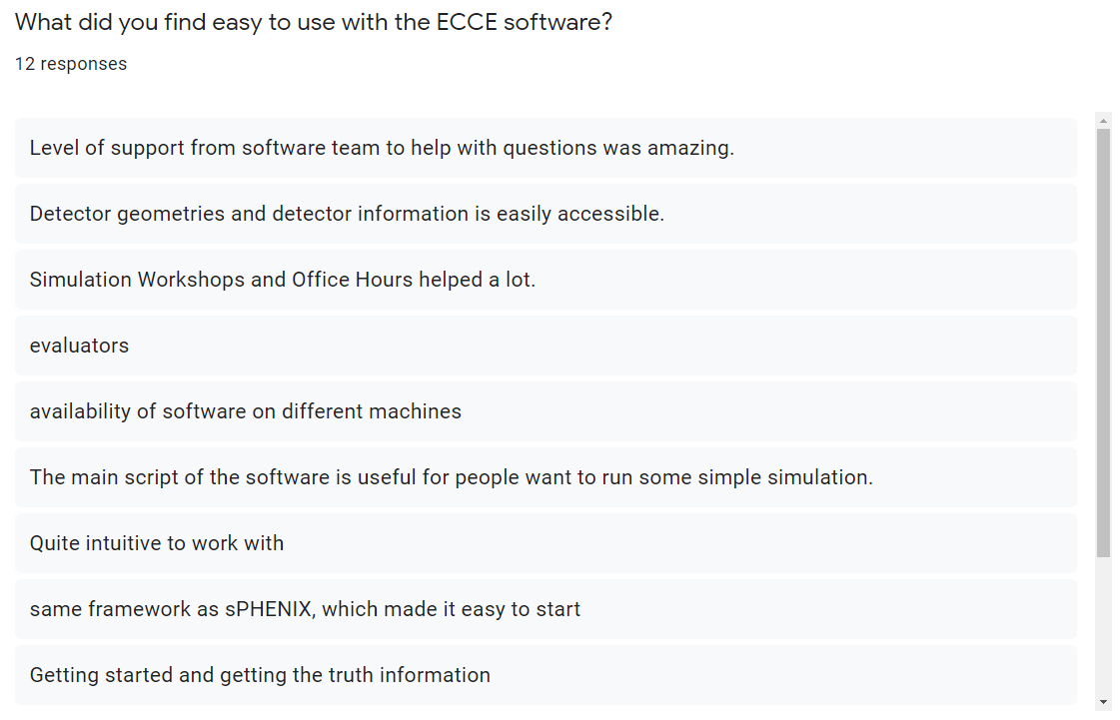
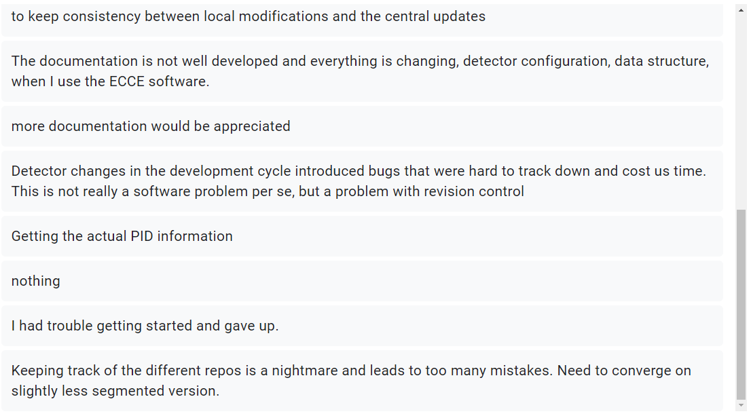
Software usages and survey
Built for full detector simulation + reconstruction studies
Foundation for ECCE proposal and 1000-page internal notes
This talk: lesson learned from the past months and user survey in Jan-2022 (continue from Dave’s talk)
Used in both detector development and physics benchmark, including many collaborators doing both

Slide 4
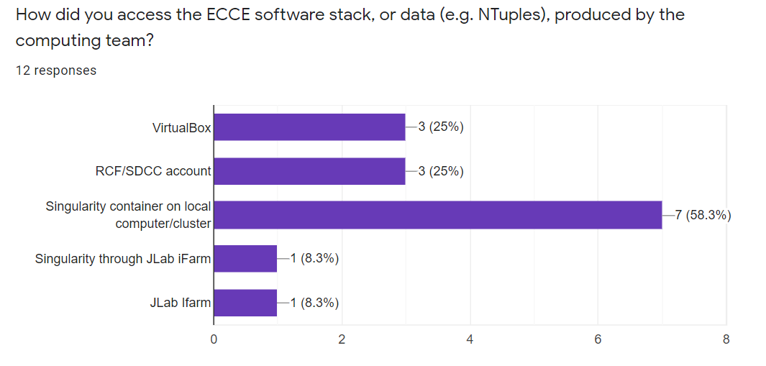
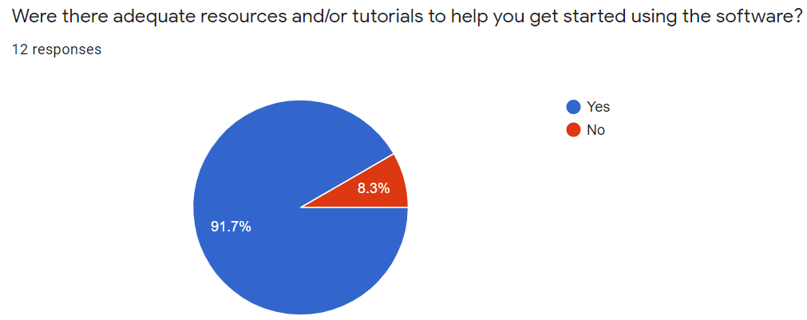
User involvement: what worked
Four simulation workshops (Apr, May, July, Sept), weekly software office hour, followed with email and chat communication tools
Support multiple computing sites & laptop use via containerization and Continuous Delivery via CVMFS & Web

Slide 5
User involvement : what is lacking
In general, needed more of:
User support
Communication
Documentation
In general lack of manpower and time for these tasks

Slide 6
Software organization: what worked
Single example steering macro handle Event-gen, beam effects →Simulation →Digitization →Reconstruction →Analysis interface.
Then user can custom to run part of full chain
Analysis either via evaluation NTuple generators or analysis modules (later slides)
Comprehensive Continuous Integration for the core-software
Ensure no warning from gcc, clang, scanbuild, cppcheck, and valgrind. QA plots check each stage of simulation and reconstruction
e.g. CI report for HCal light collection model

Slide 7
Software organization : what is lacking
We set out to maintain three ties ofr repositories and builds for EIC general use and for specific experiments: ECCE and sPHENIX.
Don’t have manpower to maintain three separate development, so some repositories are shared and mirrored
This leads to very complex repository structure cross three GitHub organizations.
Sources of many confusions
Preventing extending CI beyond Core-software
This is confusing and error-prone, we should avoid this post proposal stage

Slide 8
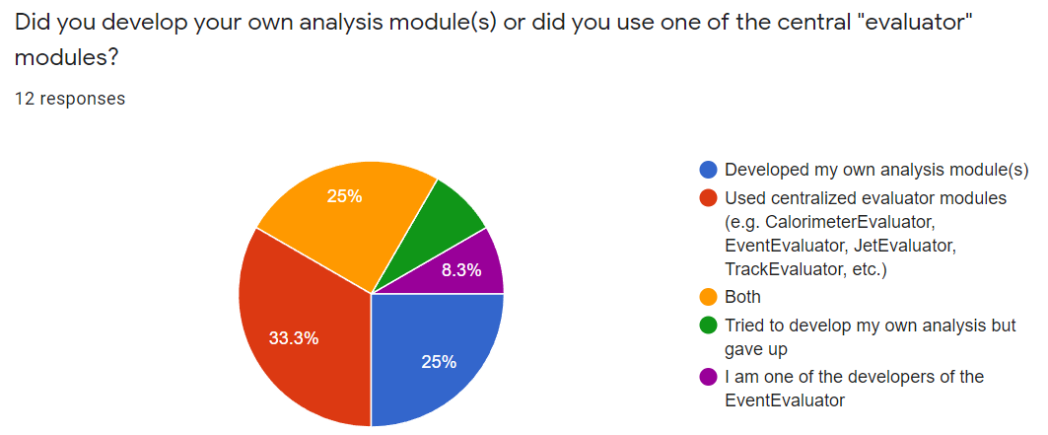
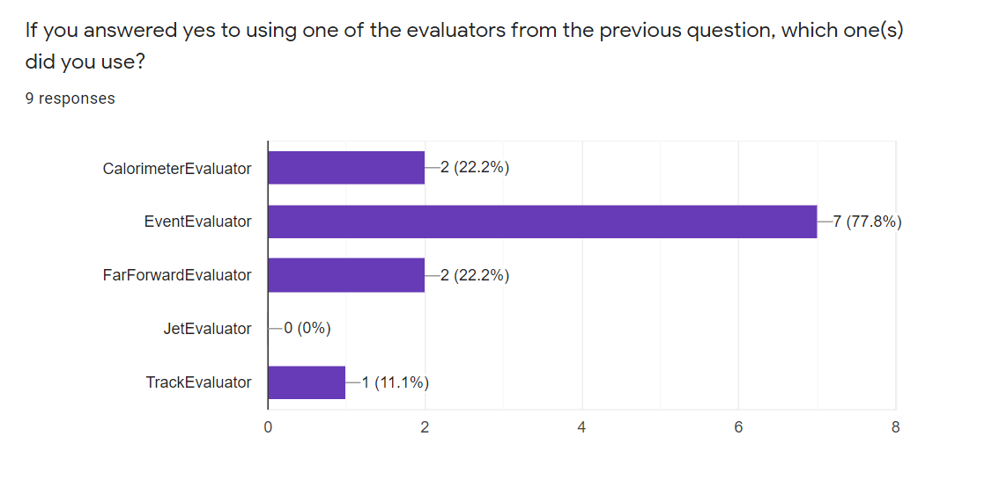
Analyzer interface
Analyzers could choose to use flat TTree (evaluators) or DST for full access using user-defined analysis modules, or both
Flat TTree
Easy for user to pick up, flexible and fast in post process
Hard to use a single tree to adapt for all analysis. External code to QC
User analysis modules
Allow access for all information available in sim+reco. Guaranteed reproducibility. Quick to make a task specific small TTree, e.g. ECCE Centauro jet, AI lepton ID
Some learning curve, and require use of one of the ECCE computing sites to process DSTs

Slide 9
Beyond this talk: software topics for future discussions
Validating simulation + digitization chain
Simulating hadron response in EIC calorimeters is non-trivial
Pooling community data for validation, e.g. arXiv:1704.01461v1
Tracking reconstruction
First large-scale application of ACTS outside ATLAS is in Fun4All [arXiv:2103.06703]
Adaptation to reliably use in EIC, e.g. curved tracker, pattern recognition tunes, alignment
Background and radiation field studies
EIC data is likely background/noise dominated, challenging to determine e.g. SynRad [CDR Chapter 8]
On-going engineering + detector studies
AI detector optimization, reconstruction, analysis
Hot topic these days, driven factor in the ECCE detector design
Analysis interface: flat tree and full accesses
What variable in flat tree would be sufficient for most analysis?
How to make the structure flexible for distinct requirement of different analysis, e.g. HF?

Slide 10
Continue to Bill’s talk on User experience
Remix credit: Dave Morrison

