Slide 1

Quark and gluon helicity evolution at small-x: revised and updated
Yuri Kovchegov
The Ohio State University
Based on work with F. Cougoulic, A. Tarasov, and Y. Tawabutr, arXiv:2204.11898 [hep-ph]

Slide 2
Preamble
We revisit helicity evolution at small x (compared to
D. Pitonyak, M. Sievert & myself, 2015-18).
Why? We found a new (sub-eikonal) operator that contributes to small-x helicity evolution. This operator was not present in helicity evolution in the shock wave picture until now.
How do we know we are not missing anything else? We have now included all sub-eikonal operators and ran a series of cross checks: calculated evolution in two different ways, agreed with spin-dependent DGLAP to 3 loops, and verified the contribution of ΔG to g₁ structure function (at DLA).

Slide 3
Preamble
The formalism that D. Pitonyak, M. Sievert and myself (KPS) have developed remains largely the same, with all the machinery developed (sub-eikonal dipole evolution, “neighbor” dipole, light-cone operator treatment (LCOTTM), large-N_{c}&N_{f} limit, analytic solution methods).
New operator introduces new terms in the helicity evolution equations, affecting its solution and intercept.
The flavor non-singlet helicity distribution evolution at large N_{c} from 2016 is not affected (→ I will not talk about it).

Slide 4
Outline
Introduction.
A full list of sub-eikonal operators. What was included and what was missing.
Spin-dependent quantities at small x: g₁ structure function, ΔΣ and ΔG. The expressions for the first two are modified.
New helicity evolution equations in operator form (not closed).
New helicity evolution at large-N_{c} and large-N_{c}&N_{f} (closed).
Cross-checks.
Solution of the large-N_{c} equations & the intercept.
Some small-x helicity phenomenology.

Slide 5
Eikonality
One can classify various TMDs by their small-x asymptotics.
Eikonal behavior corresponds to (up to ~α_{S} corrections in the power)
Examples: unpolarized TMDs, Sivers function for gluons and quarks.
Sub-eikonal behavior corresponds to
Example: helicity TMDs.
Sub-sub-eikonal behavior is
Example: transversity.
We’ve been calling the leading power of x “eikonality”.

Slide 6
Introduction and goals

Slide 7
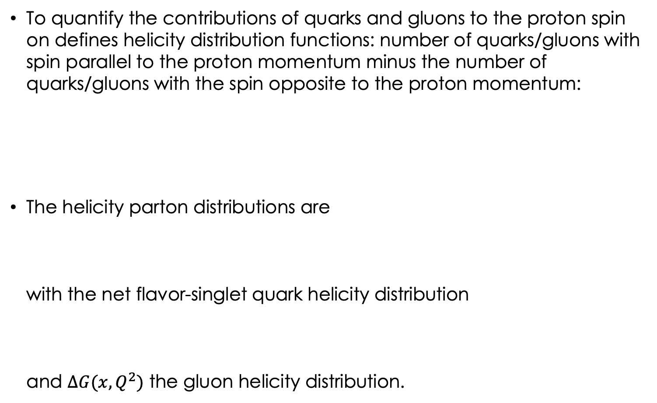
Helicity Distributions
To quantify the contributions of quarks and gluons to the proton spin on defines helicity distribution functions: number of quarks/gluons with spin parallel to the proton momentum minus the number of quarks/gluons with the spin opposite to the proton momentum:
The helicity parton distributions are
with the net flavor-singlet quark helicity distribution
and $∆G(x,Q^{2})$ the gluon helicity distribution.

Slide 8
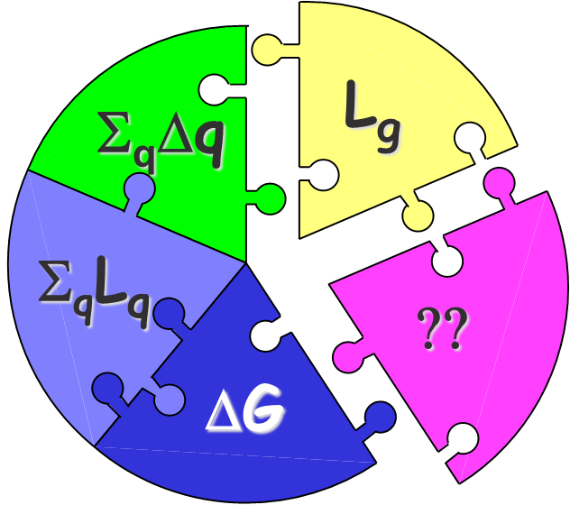
Proton Helicity Sum Rule
Helicity sum rule (Jaffe & Manohar, 1989):
with the net quark and gluon spin
L_{q} and L_{g} are the quark and gluon orbital angular momenta

Slide 9
Proton Spin Puzzle
The spin puzzle began when the EMC collaboration measured the proton g₁ structure function ca 1988. Their data resulted in
It appeared (constituent) quarks do not carry all of the proton spin
(which would have corresponded to ).
Missing spin can be
  Carried by gluons
  In the orbital angular momenta of quarks and gluons
  At small x:
  Or all of the above!
Can’t integrate down to zero, use x_{min} instead!

Slide 10
Current Knowledge of Proton Spin
The proton spin carried by the quarks is estimated to be (for )
The proton spin carried by the gluons is (for
, STAR+COMPASS+HERMES+…)
Unfortunately, the uncertainties are large. Note also that the x-ranges are limited, with more spin (positive or negative) possible at small x.

Slide 11
Our goal
The goal is to constrain theoretically the amount of proton spin and OAM coming from small x.
Any existing and future experiment probes the helicity distributions and OAM down to some x_{min} .
At very small x (for the proton), saturation sets in: that region likely carries a negligible amount of proton spin. But what happens at larger (but still small) x?

Slide 12
EIC & Spin Puzzle
Still, even with the EIC data
we need to extrapolate quark
and gluon spin down to smaller x.
Parton helicity distributions are sensitive to low-x physics.
EIC would have an unprecedented low-x reach for a polarized DIS experiment, allowing to pinpoint the values of quark and gluon contributions to proton’s spin:
ΔG and ΔΣ are integrated over x in the 0.001 < x < 1 interval.

Slide 13
Sub-Eikonal Operators

Slide 14
Dipole picture of DIS
“shock wave”
x⁻
x⁺
Large q⁻ → large x⁻ separation
Same is true for PDFs: small x means large x⁻ spread

Slide 15
Polarized Dipole: non-eikonal small-x physics
All flavor-singlet small-x helicity observables depend on one object, “polarized dipole amplitude”:
Double brackets denote an object with energy suppression scaled out:
unpolarized quark
polarized quark: eikonal propagation,
non-eikonal spin-dependent interaction

Slide 16
Polarized fundamental “Wilson line”
To complete the definition of the polarized dipole amplitude, we need to construct the definition of the polarized “Wilson line” V^{pol}, which is the leading helicity-dependent contribution for the quark scattering amplitude on a longitudinally-polarized target proton.
At the sub-eikonal order we can either exchange one non-eikonal t-channel gluon (with quark-gluon vertices denoted by blobs above) to transfer polarization between the projectile and the target, or two t-channel quarks, as shown above.

Slide 17
Old: Polarized fundamental “Wilson line”
In the end one arrives at (KPS ‘17; YK, Sievert, ‘18; Chirilli ’18; Altinoluk et al, ‘20)
We have employed an adjoint light-cone Wilson line
Note the simple physical meaning of the first term:

Slide 18
Sub-eikonal quark S-matrix in background gluon and quark fields
The full sub-eikonal S-matrix for massless quarks is (Balitsky&Tarasov ‘15; KPS ‘17; YK, Sievert, ‘18; Chirilli ’18; Altinoluk et al, ’20; YK, Santiago ‘21)
“helicity
independent”
“helicity
dependent”
“helicity
independent”
“helicity
dependent”

Slide 19
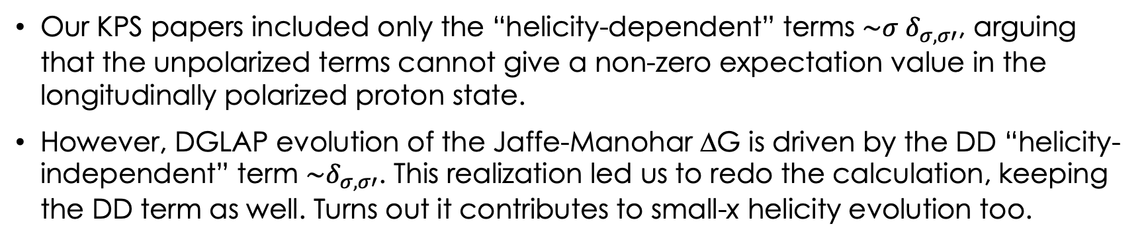
Sub-eikonal quark S-matrix in background gluon and quark fields
“helicity
independent”
“helicity
dependent”
“helicity
independent”
“helicity
dependent”
Our KPS papers included only the “helicity-dependent” terms $\sim σ δ_{σ,σ′}$, arguing that the unpolarized terms cannot give a non-zero expectation value in the longitudinally polarized proton state.
However, DGLAP evolution of the Jaffe-Manohar ΔG is driven by the DD “helicity-independent” term $\sim δ_{σ,σ′}$. This realization led us to redo the calculation, keeping the DD term as well. Turns out it contributes to small-x helicity evolution too.

Slide 20
Sub-eikonal quark S-matrix in background gluon and quark fields
“helicity
independent”
“helicity
dependent”
“helicity
independent”
“helicity
dependent”
At the same time, the helicity-independent term in the quark sector (γ⁺) still does not contribute to helicity evolution.
Why does DD contribute? We do not quite understand. There are two options:
  DD is non-local → like OAM?
  σ is not really helicity, rather projection of spin on the z axis (in LCPT).
It appears in such calculations all operators of a given eikonality should be considered.

Slide 21
Helicity Observables at Small x

Slide 22
Dipole Gluon Helicity TMD
We start with the definition of the gluon dipole helicity TMD, corresponding to the Jaffe-Manohar PDF ΔG,
Here U^{[+]} and U^{[-]} are future and past-pointing
Wilson line staples (hence the name
`dipole’ TMD, F. Dominguez et al ’11 – looks
like a dipole scattering on a proton):

Slide 23
Gluon Helicity: (mostly) old results
A calculation gives
Here we defined a new dipole amplitude G₂ (cf. Hatta et al, 2016; KPS 2017)
What is this D-D operator? Turns
out it is related to the DD operator
from before.

Slide 24
Quark Helicity PDF and TMD
The flavor-singlet quark helicity PDF and SIDIS TMD are
G₂ was defined before. Its contributions to quark helicity TMD and PDF are new (as compared to KPS work). This is the gluon admixture to quark helicity distributions.
The dipole amplitude Q is the ‘old’ KPS polarized dipole (F¹² & axial current).
The contribution of G₂ comes from the DD operator in the quark S-matrix.
Hence, the DD operator is related to the Jaffe-Manohar distribution.

Slide 25
Amplitude Q
The amplitude Q is defined by
with , where
This is the ‘old’ KPS polarized dipole amplitude.

Slide 26
g₁ structure function
g₁ structure function is obtained similarly, using DIS in the dipole picture:
One gets
such that one reproduces the standard result
new

Slide 27
Helicity Evolution

Slide 28
Evolution for Polarized Quark Dipole
One can construct an evolution equation for the polarized dipole:
Spin-dependent (non-eikonal) vertex
polarized
particle
similar to the
unpolarized
BK evolution
box =
target shock
wave (proton)

Slide 29
Evolution for Polarized Quark Dipole
Equation does not close!

Slide 30
Large N_{c}
At large-N_{c} the equations close (Q → G). Everything with 2 in the subscript (e.g., G₂ and Γ₂) is new compared to KPS papers.
KPS
KPS

Slide 31
“Neighbor” dipole
There is a new object in the evolution equation – the neighbor dipole amplitude.
This is specific for the DLA evolution. Gluon emission may happen in one dipole, but, due to lifetime ordering, may `know’ about another dipole:
We denote the evolution in the neighbor dipole 02 by
z’

Slide 32
Resummation Parameter
For helicity evolution the leading resummation parameter is different from BFKL, BK or JIMWLK, which resum powers of leading logarithms (LLA)
Helicity evolution resummation parameter is double-logarithmic (DLA):
The second logarithm of x arises due to transverse momentum (or transverse coordinate) integration being logarithmic both in the UV and IR.
This was known before: Kirschner and Lipatov ’83; Kirschner ’84; Bartels, Ermolaev, Ryskin ‘95, ‘96; Griffiths and Ross ’99; Itakura et al ’03; Bartels and Lublinsky ‘03.

Slide 33
Helicity Evolution Ingredients
Unlike the unpolarized evolution, in one step of helicity evolution we may emit a soft gluon or a soft quark (all in A⁻=0 LC gauge of the projectile):
When emitting gluons, one emission is eikonal, while another one is soft, but non-eikonal, as is needed to transfer polarization down the cascade/ladder.

Slide 34
Helicity Evolution: Ladders
To get an idea of how the helicity evolution works let us try iterating the splitting kernels by considering ladder diagrams (circles denote non-eikonal gluon vertices):
To get the leading-energy asymptotics we need to order the longitudinal momentum fractions of the quarks and gluons (just like in the unpolarized evolution case)
obtaining a nested integral

Slide 35
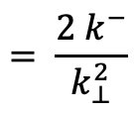
Helicity Evolution: Ladders
lifetime
$$= \frac{{2 k}^{−}}{k_{⊥}^{2}}$$
However, these are not all the logs of energy one can get here. Transverse momentum (or distance) integrals have UV and IR divergences, which lead to logs of energy as well.
If we order gluon/quark lifetimes as (Sudakov-β ordering)
we would get integrals like
also generating logs of energy.

Slide 36
Helicity Evolution: Ladders
To summarize, the above ladder diagrams are parametrically of the order
Note two features:
  1/s suppression due to non-eikonal exchange
  two logs of energy per each power of the coupling!

Slide 37
Large-N_{c}&N_{f}
Equations also close in the large-N_{c}&N_{f} (Veneziano) limit.
This is more realistic as it includes quarks.
Everything with 2 in the subscript (e.g., G₂ and Γ₂) is new compared to KPS papers.

Slide 38
Cross Checks

Slide 39
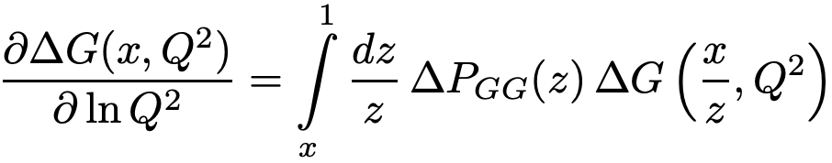
Cross Checks: spin-dependent DGLAP
Our evolution at large Q² can be cross-checked against the small-x limit of the spin-dependent DGLAP equation.
At DLA, ΔG is simply proportional to G₂:
We solved our large-N_{c} equations iteratively, comparing ln(Q²) terms with small-x spin-dependent DGLAP evolution.
We obtained a complete agreement with LO+NLO+NNLO DGLAP at small x
(R. Mertig, W.L. van Neerven ‘95; S. Moch, J.A.M. Vermaseren, A. Vogt, ‘14).
We can
predict
higher orders.

Slide 40
Cross Checks: two methods, ΔG in g₁
We rederived our evolution equations using the background field method.
This is in addition to a blend of Brodsky & Lepage’s LCPT and background field method-inspired operator treatment which I presented above. We refer to the latter as the light-cone operator treatment (LCOT).
Finally, one can even verify that ΔG enters the expression for g₁ with the right coefficient using ΔG ~ G₂ and

Slide 41
Solution of the Large-N_{c} Equations

Slide 42
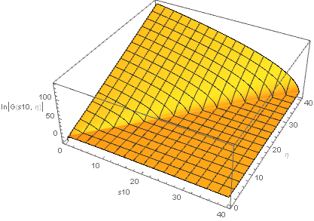

Solution of the Large-N_{c} Equations
The large-N_{c} equations for G and G₂ can be solved
numerically (and, possibly, analytically).

Slide 43
Small-x Asymptotics
Fitting the slope of the log plots of G and G₂ vs e we can read off the small-x intercept:

Slide 44
Small-x Asymptotics for Helicity
The resulting small-x asymptotics for helicity PDFs and the g₁ structure function is
This intercept is in complete agreement with the work by J. Bartels, B. Ermolaev, and M. Ryskin (1996) using infrared evolution equations (with the analytic intercept constructed by KPS in 2016):
“Peace in the valley.”

Slide 45
Helicity at Small x:
Preliminary Phenomenology
D. Adamiak, W. Melnitchouk, D. Pitonyak, N. Sato, M. Sievert, YK, 2102.06159 [hep-ph]

Slide 46
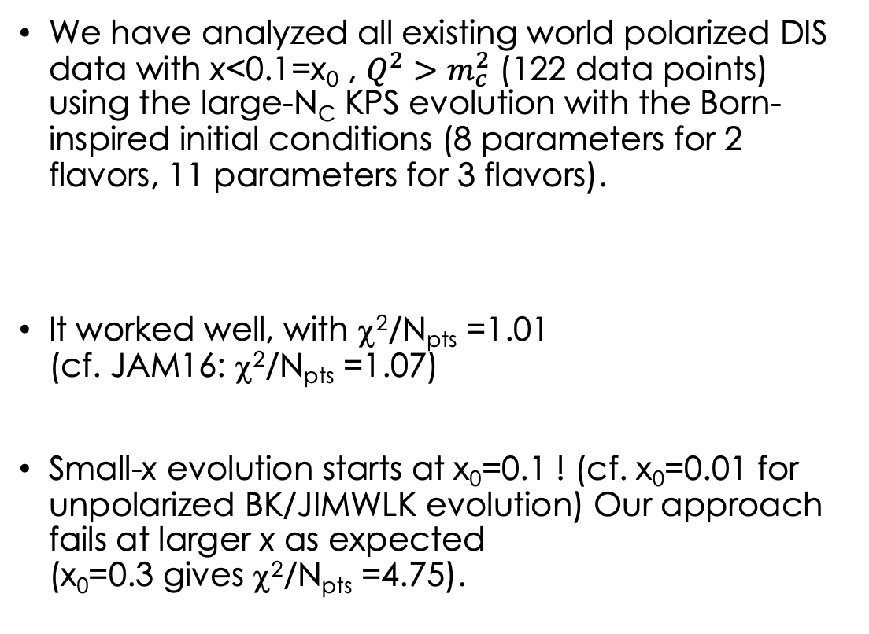
Small-x Polarized DIS Data
(Adamiak, Melnitchouk,
Pitonyak, Sato, Sievert,
YK, 2102.06159 [hep-ph]
= JAMsmallx)
We have analyzed all existing world polarized DIS data with x<0.1=x₀ , $Q^{2}>m_{c}^{2}$ (122 data points) using the large-N_{C} KPS evolution with the Born-inspired initial conditions (8 parameters for 2 flavors, 11 parameters for 3 flavors).
It worked well, with χ²/N_{pts} =1.01
(cf. JAM16: χ²/N_{pts} =1.07)
Small-x evolution starts at x₀=0.1 ! (cf. x₀=0.01 for unpolarized BK/JIMWLK evolution) Our approach fails at larger x as expected
(x₀=0.3 gives χ²/N_{pts} =4.75).

Slide 47
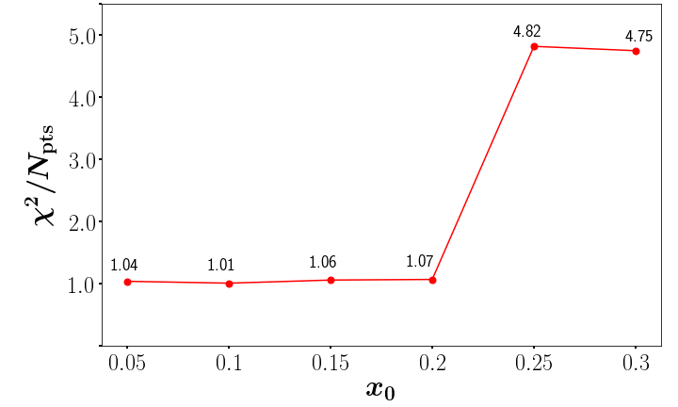
Where to start small-x evolution
The evolution starts at x=x₀, and continues toward smaller x.
The quality of our fit rapidly deteriorates for x₀>0.2, as expected from a small-x approach.
In unpolarized BK/JIMWLK evolution, typically x₀=0.01, so the fact that our fit works up to such a high x₀ is quite remarkable.

Slide 48
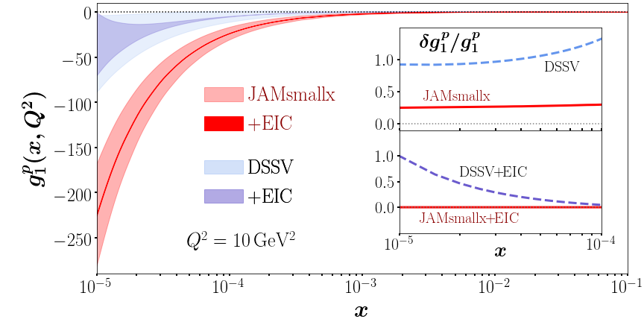
Prediction for g₁ structure function
g₁ structure function $≈$ spin-dependent part of $σ^{e+p}$
Thick band: 1σ CL; thin band: impact of EIC data. With the EIC pseudo-data we have 1096 data points.

Slide 49
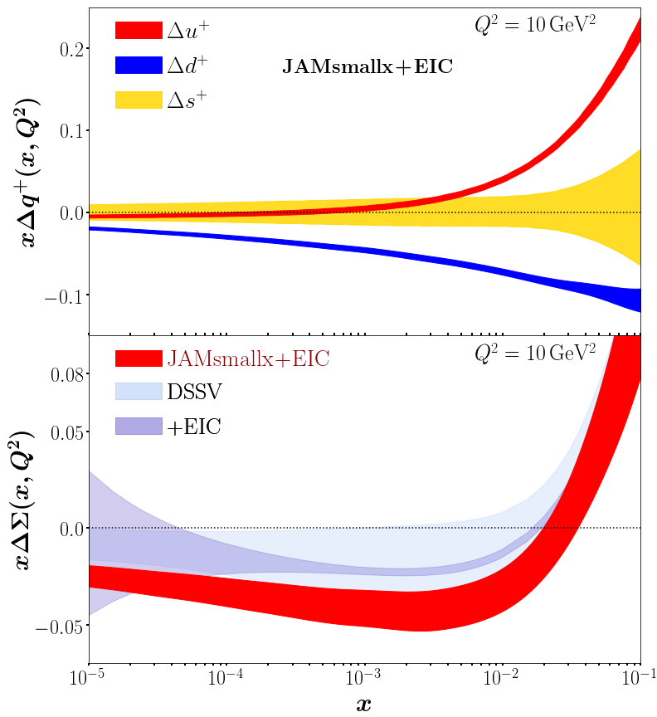
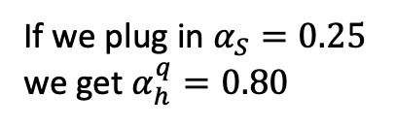
Predictions for helicity PDFs
D. Adamiak, W. Melnitchouk,
D. Pitonyak, N. Sato, M. Sievert & YK,
2102.06159 [hep-ph], in the
JAM Collaboration framework.
Our (red) error
band does not
explode in the
unmeasured
region. We can
predict spin at small x.
If we plug in $α_{S}=0.25$
we get $α_{h}^{q}=0.80$
old intercept!

Slide 50
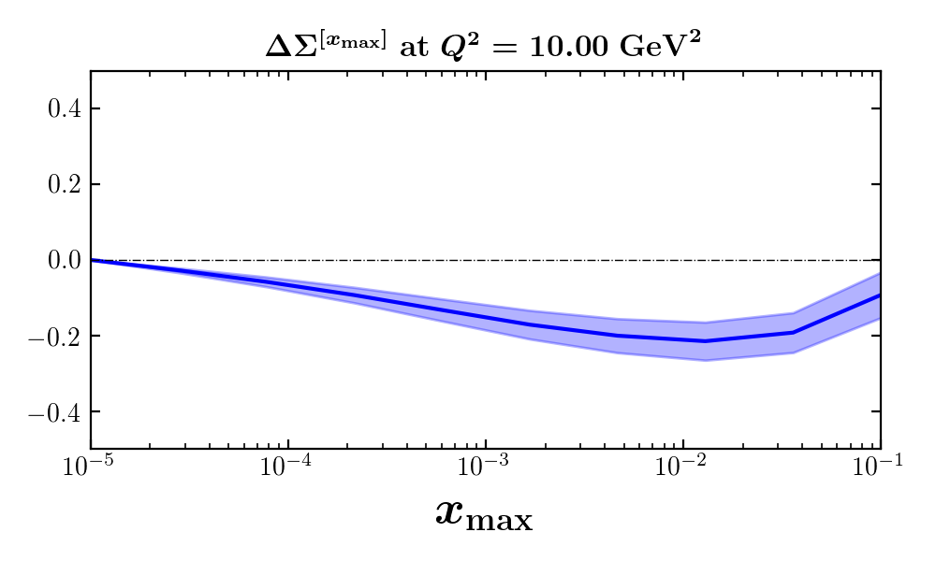
Small-x quarks impact on the proton spin
Potentially negative 10-20% of the proton spin may be carried by small-x quarks (JAMsmallx, preliminary):

Slide 51
Speculation on a path to resolving the spin puzzle
Above we discussed quark helicity at small x. Let’s add the orbital angular momentum (OAM) (Hatta & Yang, ’18; YK ‘19):
So, the net quark (1/2) helicity+OAM = (-1/2) helicity.
For x<0.001 we thus expect (preliminary!)
Add to this the larger-x numbers
We get
JAMsmallx, preliminary,
Adamiak, Melnitchouk,
Pitonyak, Sato, Sievert, YK

Slide 52
A warning
Note that the above phenomenology was done using the old version of the evolution equations. Consider it a proof of principle. (Most data was described by the Born-inspired initial conditions for the dipole amplitudes, that is, without evolution.)
Phenomenology with the new corrected evolution equations is being developed as we speak.

Slide 53
Conclusions
Small-x helicity evolution equations have been updated due to the mixing of the amplitude G₂ with the previously known (KPS) evolution.
The physical reason behind the mixing is not clear.
The new equations pass many independent cross checks.
The solution of the large-N_{c} equations agrees with the result by Bartels, Ermolaev & Ryskin (1996).
Small-x OAM asymptotics, helicity JIMWLK & MV model, single-logarithmic evolution, and phenomenology must be updated too. Stay tuned.

