Slide 1
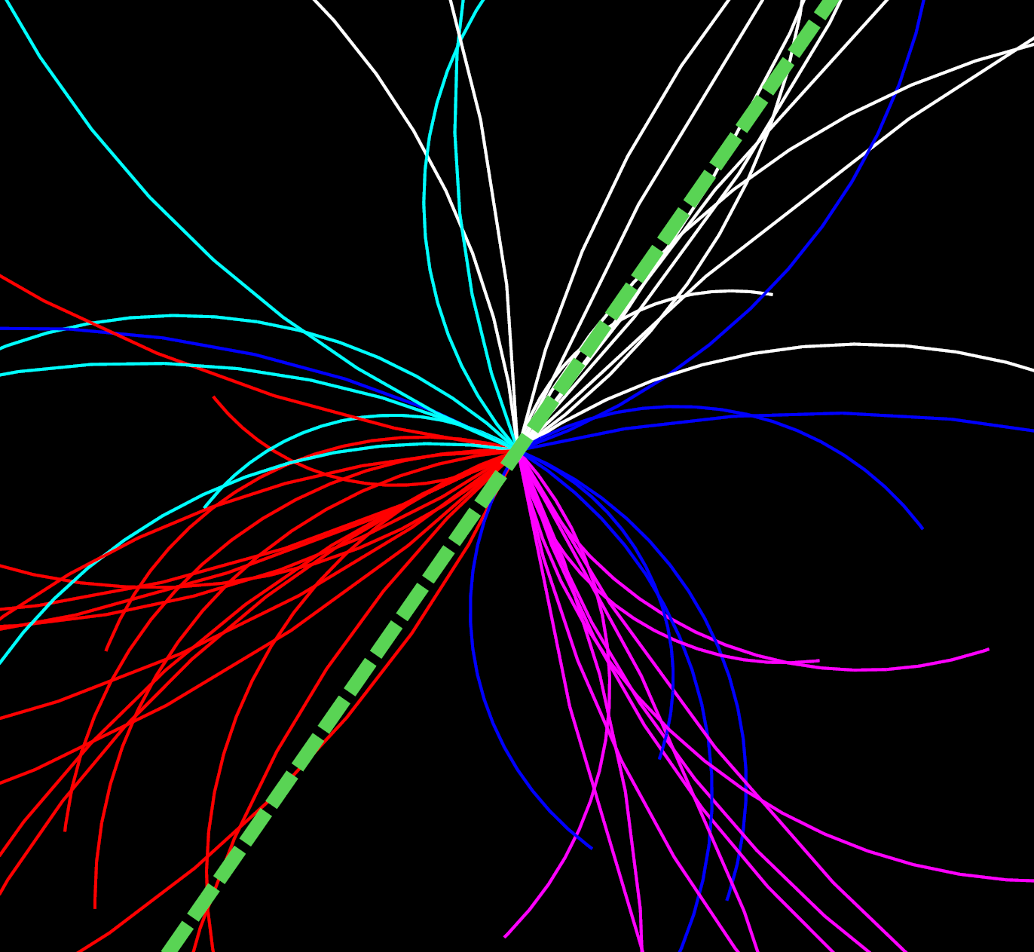
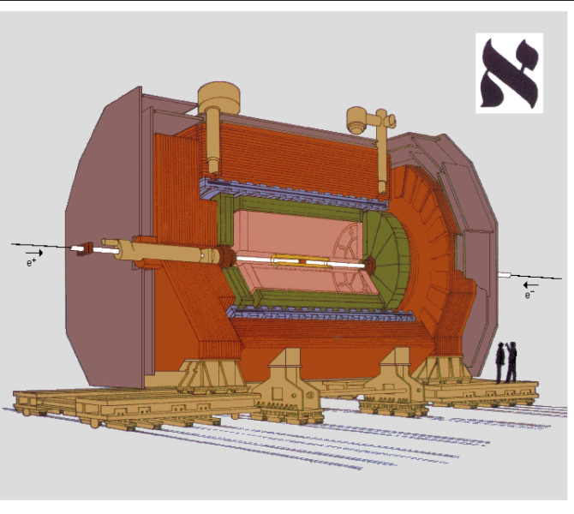
Jet substructure form ALEPH archived e⁺e⁻ data
Yi Chen, Yen-Jie Lee,
Massachusetts Institute of Technology
Paoti Chang
National Taiwan University
Christopher McGinn, Dennis Perepelitsa
University of Colorado Boulder
Marcello Maggi
Universita degli Studi di Bari
Yang-Ting Chien
Georgia State University
Jet Physics: From RHIC/LHC to EIC 30 June, 2022

Slide 2
Motivation
Jets are some of the most powerful tools for the study of Quantum Chromodynamics
Since the end of LEP operation, significant progress has been made in jet definition and jet algorithms:
Jet substructure observables have been widely explored in pp and HI collisions
Novel tools for jet flavor identification, EW boson & top tagging and studies of QGP*
However, those techniques are not yet used in e⁺ e⁻ annihilation data
Monte Carlo generators such as SHERPA, PYTHIA 6, PYTHIA 8 and HERWIG are tuned with hadronic event shape observables and hadron spectra in e⁺ e⁻
Then used to predict the jet spectra and substructure in more complicated hadron collisions
* H. Andrews et al. J. Phys. G, 47(6) 065102, 2020
A
A
A
p
p
p

Slide 3
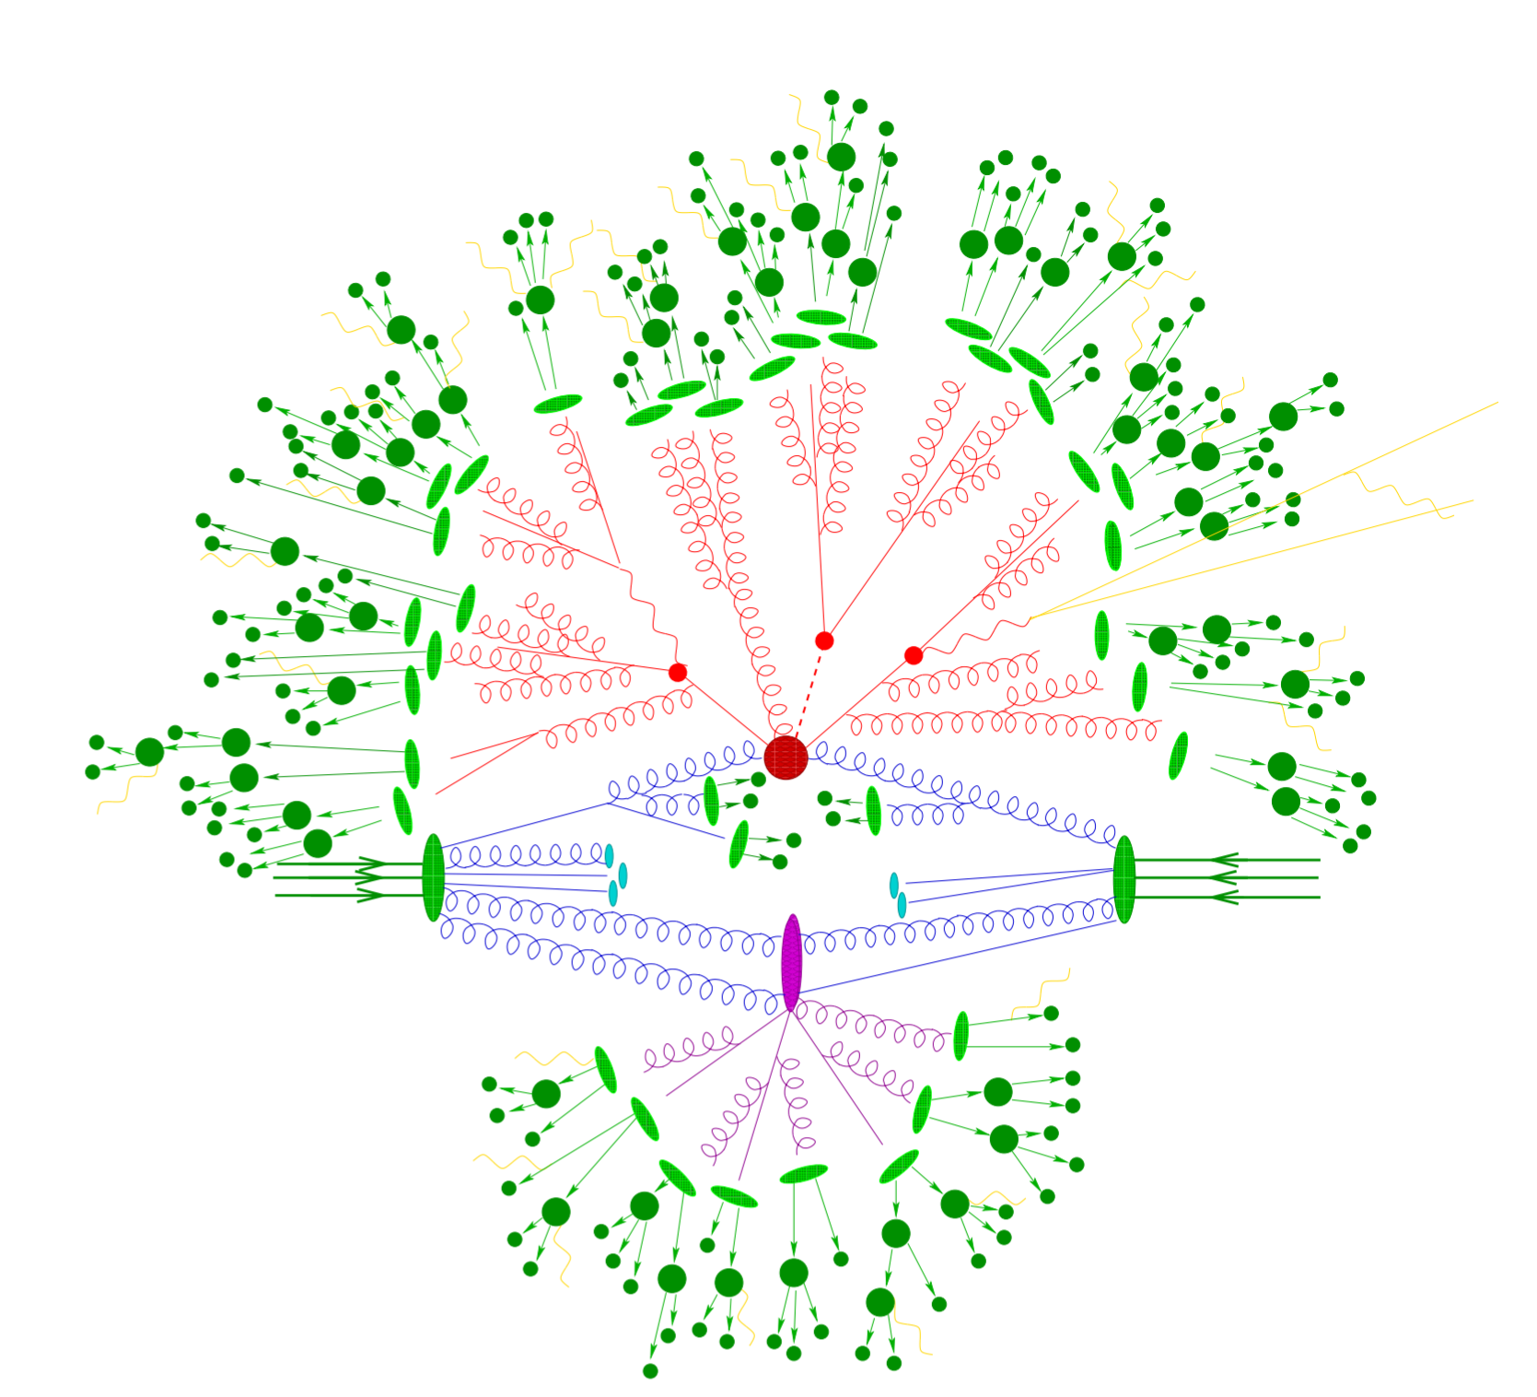
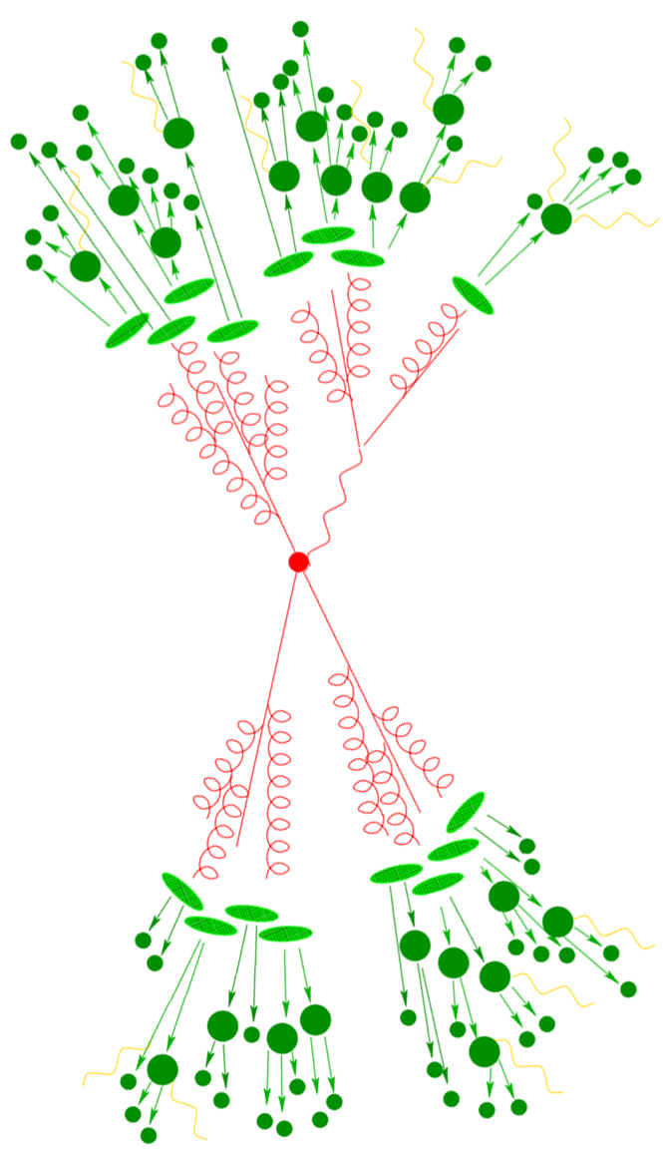
Jets in Electron-Positron Annihilation
Jets in e⁺e⁻ with identical algorithms as those used in hadron colliders are of great interest
No gluonic initial state radiation
No complications of parton distribution functions
No beam remnants and multi-parton interactions
→ Cleanest test of pQCD and phenomenological models
Serve as a reference for the pp and future EIC measurements
Inform the QCD studies at the future FCC.
pp
e⁺e⁻
e⁻
p
A
A
A
A
e⁻
e⁺
e⁻
p
p
p

Slide 4
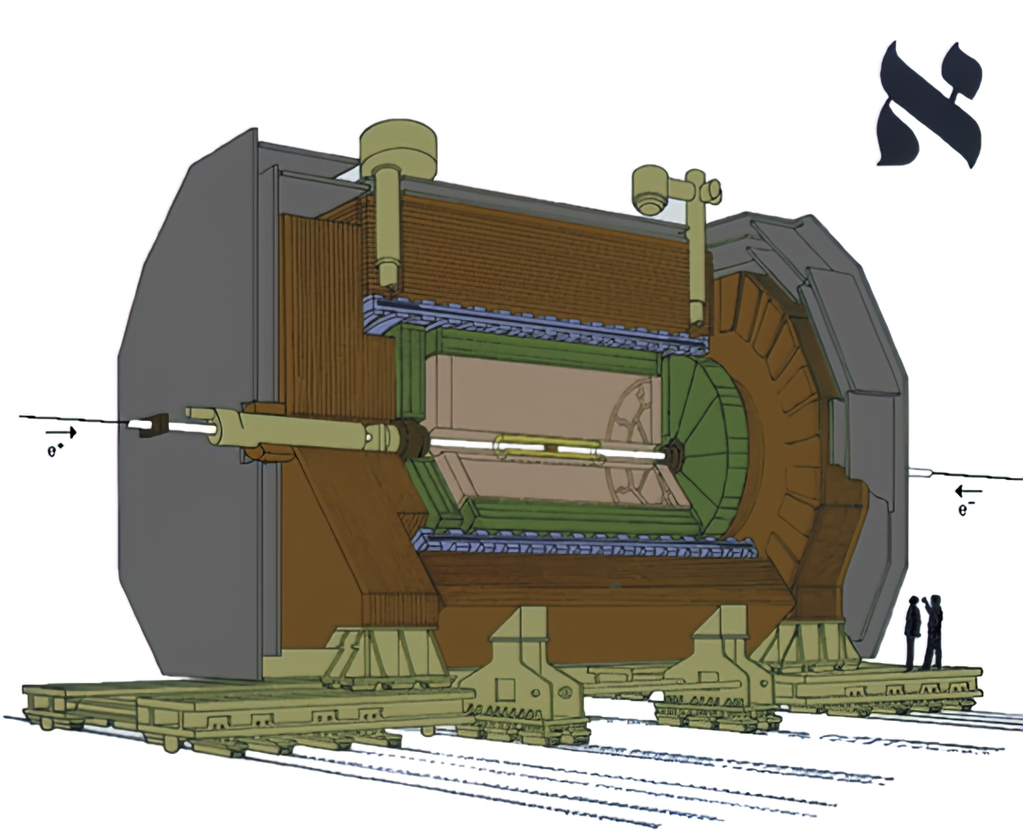
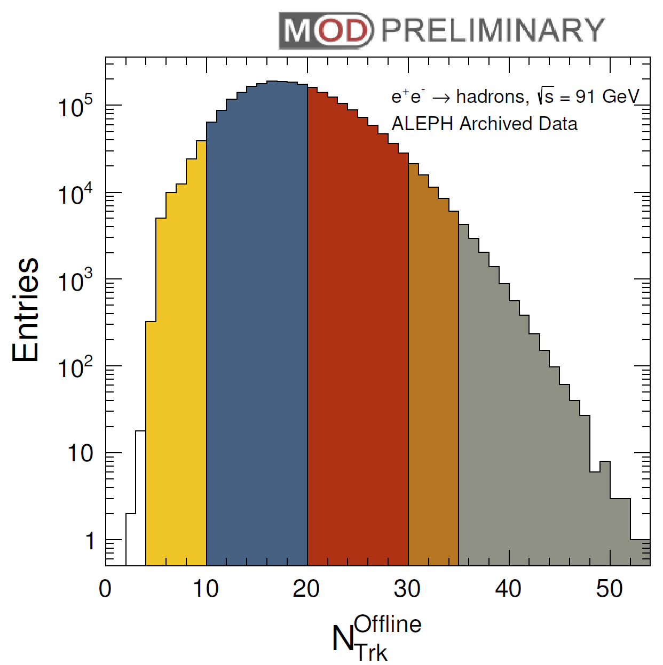
The ALEPH Detector
Hadron Calorimeter
Charged Particle Multiplicity
Superconducting Magnet (1.5T)
Electromagnetic Calorimeter
Muon Chamber
θ=0.5π
>30
10-20
Time Projection Chamber
<10
20-30
>35
Inner Tracking Chamber
$$e^{+}$$
$$\overline{q}$$
LEP1 e⁺e⁻ data at Z pole (91 GeV) taken between 1992-1995
Approximately 2.5 million hadronic events are recorded
$$Z^{0}/γ$$
$$e^{−}$$
$$q$$

Slide 5
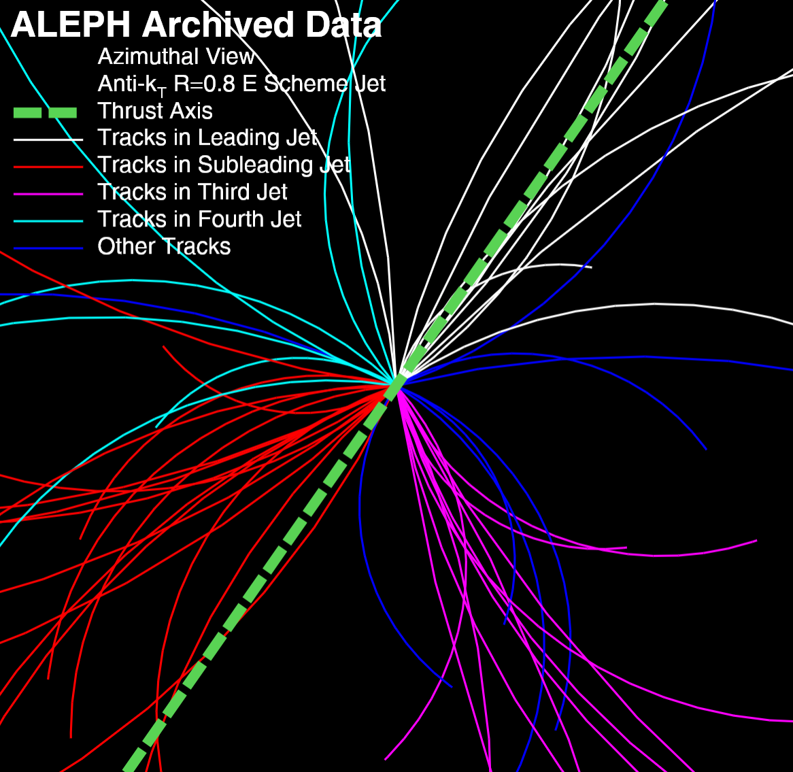
High Multiplicity Event in e⁺e⁻ Collisions
Highest multiplicity event in ALEPH LEP1 data
Collision Energy = 91 GeV
$$e^{+}$$
$$\overline{q}$$
$$Z^{0}/γ$$
$$e^{−}$$
$$q$$
Anthony Badea
Austin Baty
Chris McGinn
Michael Peters
Jesse Thaler
Gian Michele Innocenti
Paoti Chang
Tzu-An Sheng
+ YJL
arXiv: 1906.00489 PRL 123, 212002 (2019)
55 Charged Particles
Thrust T=0.71

Slide 6
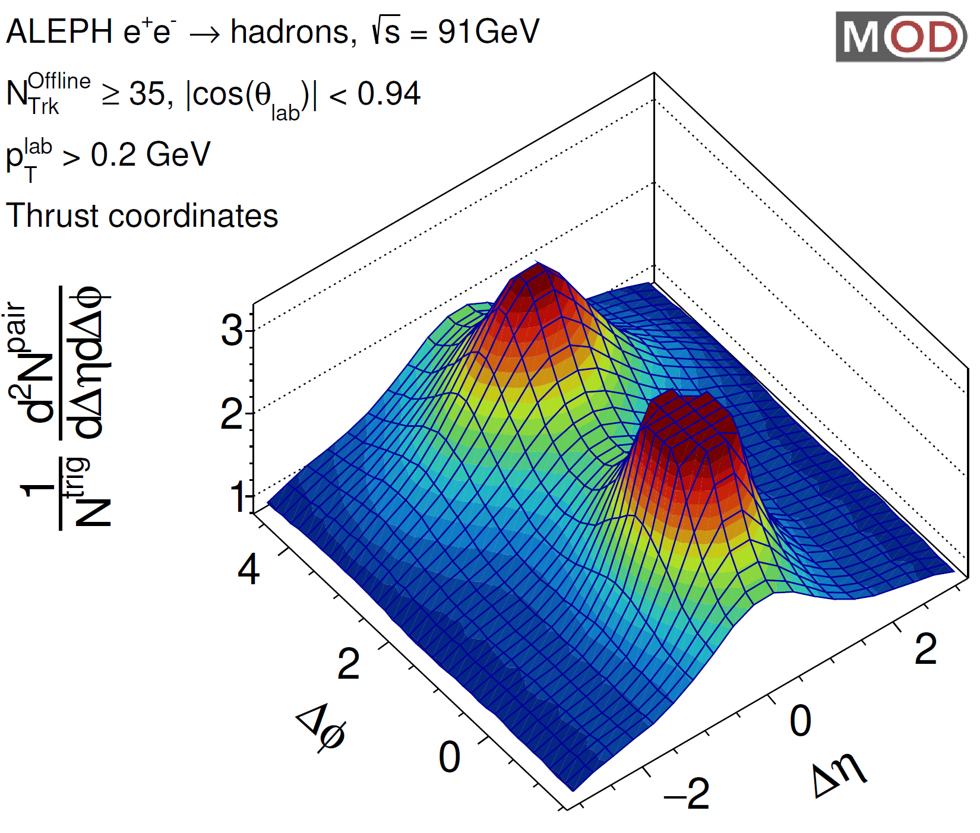
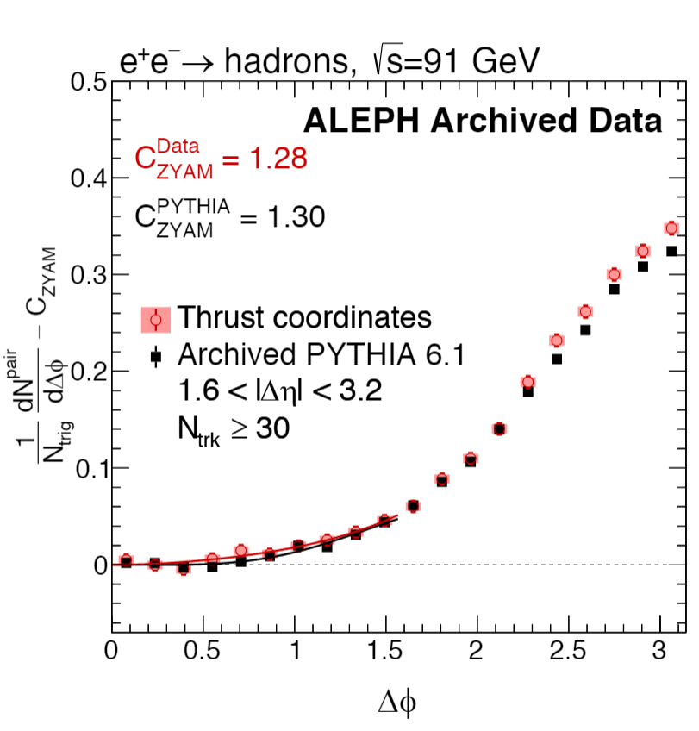
Two-Particle Correlation Function from ALEPH e⁺e⁻ at 91 GeV
e⁺e⁻
pp
pPb
PbPb
No sign of ridge signal in electron-positron collisions up to ~ 55 charged particles per event
New reference to the collective behavior in small collision systems!
arXiv: 1906.00489 PRL 123, 212002 (2019)
Anthony Badea
Austin Baty
Chris McGinn
Michael Peters
Jesse Thaler
Gian Michele Innocenti
Paoti Chang
Tzu-An Sheng
+ YJL

Slide 7
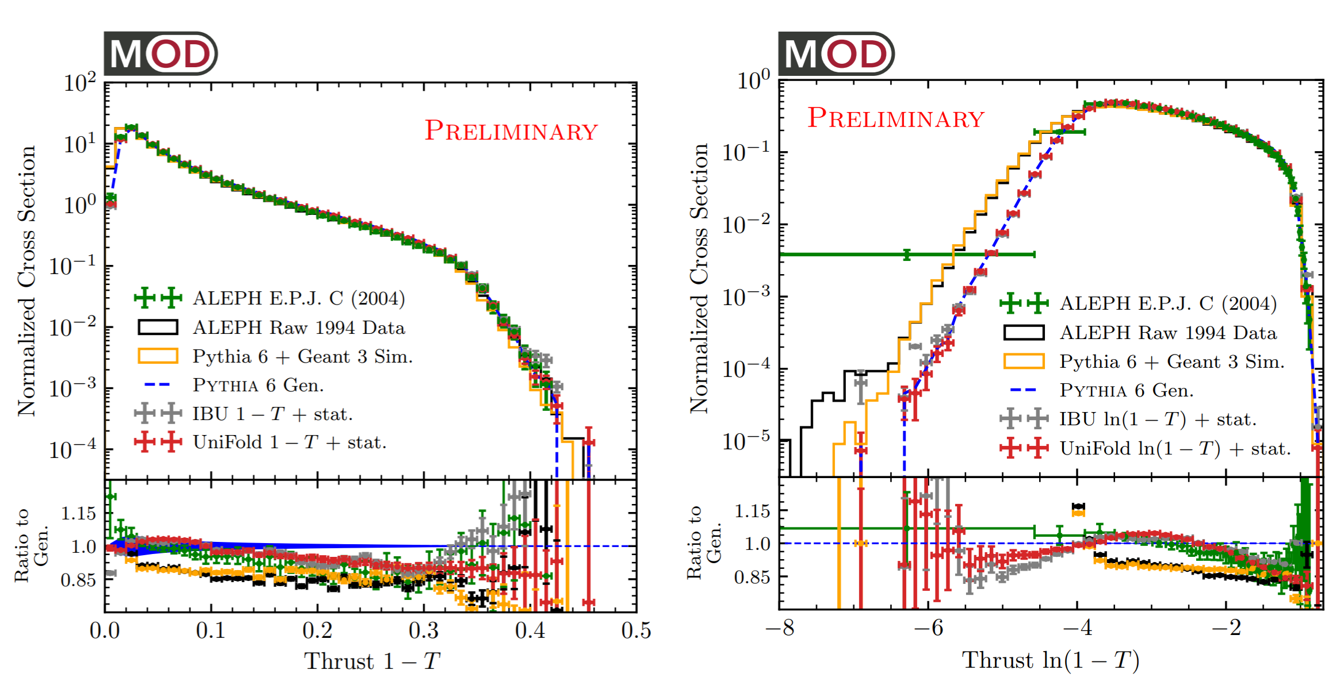
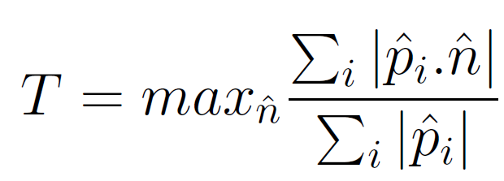
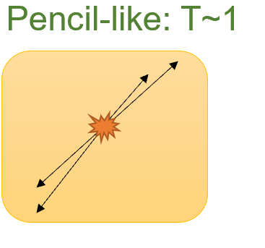
Unfolded Thrust Distribution
Thrust Axis $\hat{n}$
e⁺
e⁻
Unfolded results consistent with ALEPH publication in 2004
New differential measurement in the small 1-T region (pencil-like event)
OmniFold algorithm: PRL 124, 182001 Andreassen, Komiske, Metodiev, Nachman, Thaler
EPJC 35 (2004) 456
Paper in preparation
Anthony Badea
Patrick T. Komiske III
Eric Metodiev
Jesse Thaler
Ben Nachman
+ YJL

Slide 8
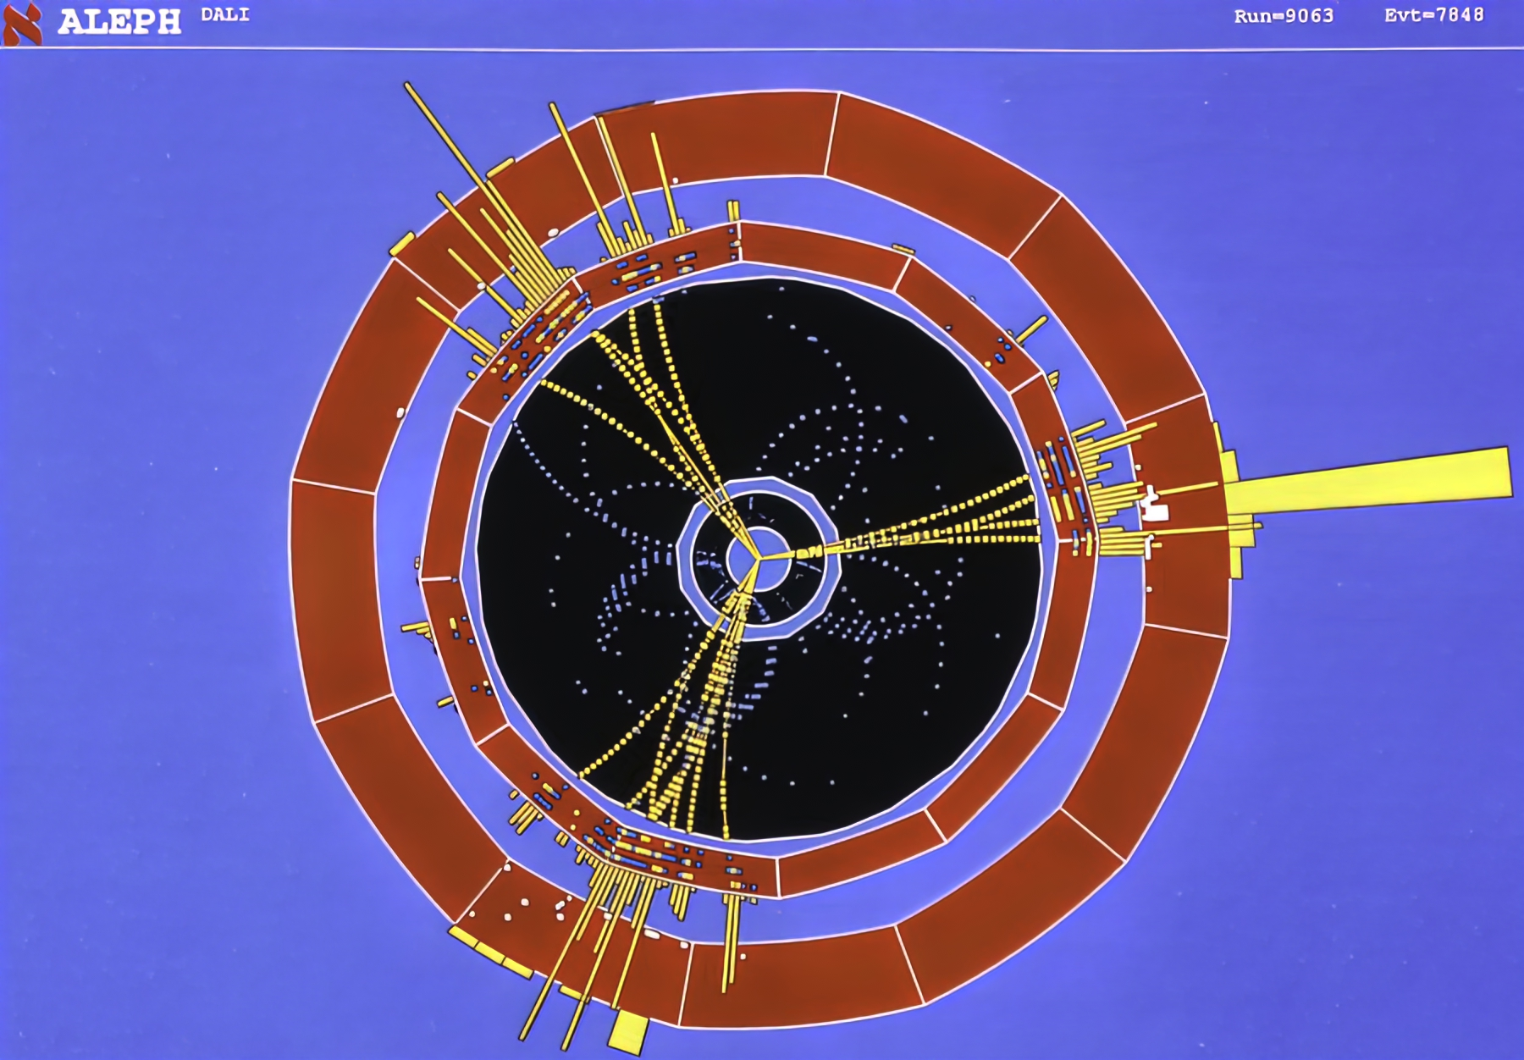
Jet Reconstruction
ALEPH archived data and MC from 1994 is used for this analysis
Identical hadronic Z⁰ decay selection as the correlation function paper and ALEPH QCD papers
Jets are reconstructed with an “anti-k_{T}” algorithm with R₀=0.4 using energy-flow objects identified with trackers, calorimeters and muon chambers.
Note that the distance metric is defined by jet energy (E) and jet angle (θ): where θ_{ij} is the actual opening angle between i^{th} and j^{th} pseudojets
ALEPH Event Display
Anti-k_{T} :JHEP 04 (2008) 063
TPC paper: PRL 123, 212002 (2019)
QCD paper: EPJC 35 (2004) 456

Slide 9
Jet Events at LEP

Slide 10
Jet Analysis with Archived ALEPH data
ALEPH Hadronic Events
Archived PYTHIA 6.1 MC
Jet Reconstruction
MC Jet Energy Correction
Resolution Unfolding, Efficiency Correction
Corrected Results
Data-based Correction: Remove +/- Side Difference
Absolute Energy Scale Correction using Multi-Jet Mass
Energy Corrected Jet Data
Event generators
PYTHIA, HERWIG, SHERPA, PYQUEN
Compare

Slide 11
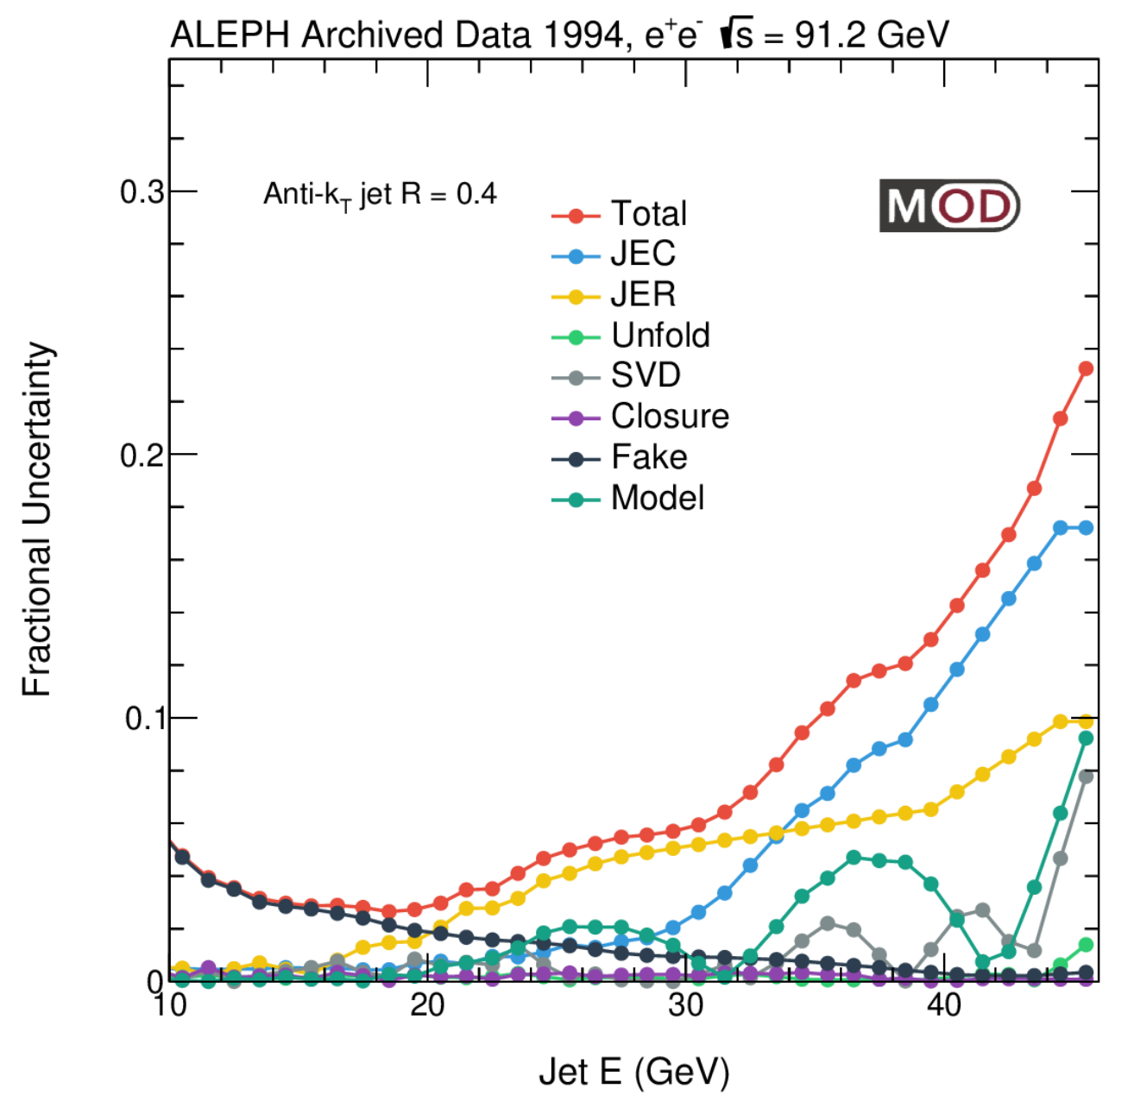
Systematic Uncertainties
For inclusive jet analyses:
Jet energy scale: vary the energy scale by ±0.5%
Jet resolution: vary the resolution scale factor by ± 2.5%
“Fake jets”: accidental clusters of energy in the final state that do not correspond to an initial high energy parton
Unfolding: choice of prior, regularization and unfolding method
Variation of Models: data-driven reweighting & subjet angle and energy smearing
Any non-closure in MC studies
For leading dijet analysis: following additional items:
The total energy selection (to ensure both jets are in the acceptance) is varied to change the purity between 98%- 99.5%.
Efficiency correction factor on jet spectrum are derived using a reweighted MC and the difference is quoted as systematics
MITHIG-MOD-21-001
arXiv:2111.09914
JHEP 06 (2022) 008

Slide 12
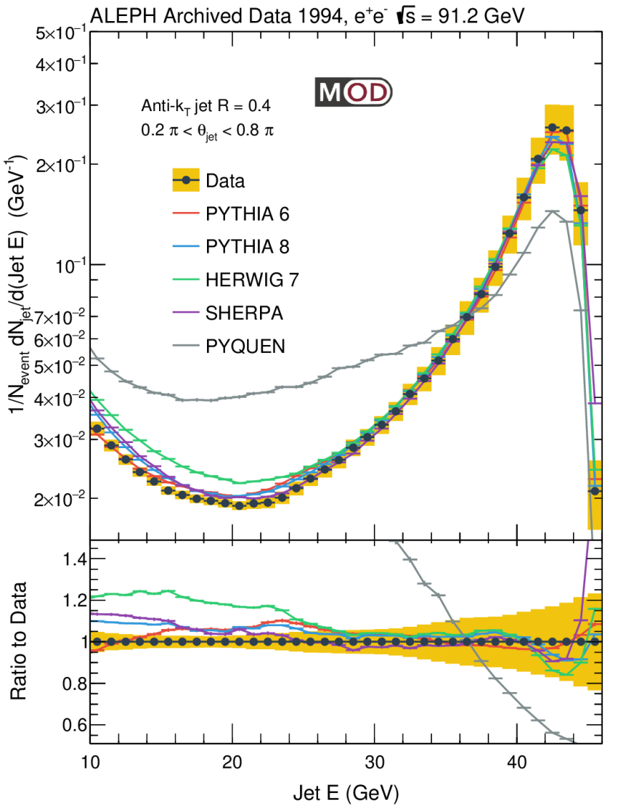
Inclusive Jet Spectrum vs. Generators
The closest observable to the jet spectra analyses in hadron-hadron collisions!
Peak at around 43 GeV: from and parton shower of the (anti-)quark almost fully captured by the jet clustering
Minimum at around 20 GeV
At low E: increase due to a large number of jets from soft emissions or combinatorial
SHERPA, PYTHIA 6, PYTHIA 8 and HERWIG capture those general features, overpredict the data at low jet E
PYQUEN (with energy loss in minimum-bias PbPb at 5.02 TeV) produce a lot more low energy jets
$$e^{+}$$
$$\overline{q}$$
$$Z^{0}/γ$$
$$e^{−}$$
$$q$$
e⁺
e⁻
MITHIG-MOD-21-001
arXiv:2111.09914
JHEP 06 (2022) 008

Slide 13
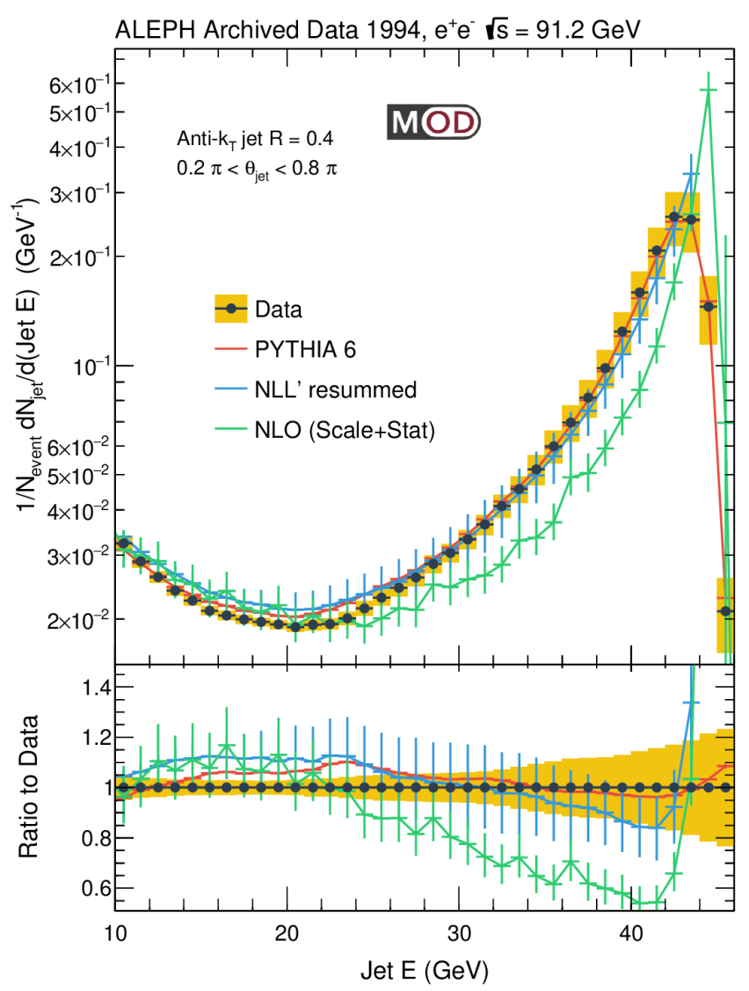
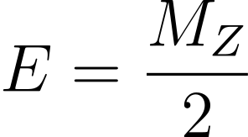
Inclusive Jet Spectrum vs. NLO Calculation
LO calculation in parton level gives trivial result: a delta function at
The experimental data is wider than predictions from an NLO calculation in parton level*
Next-to-leading logarithmic (NLL’) threshold and jet radius resummation** give a reasonable description of data
$$e^{+}$$
$$\overline{q}$$
The same data as previous slide
e⁺
e⁻
$$Z^{0}/γ$$
$$e^{−}$$
$$q$$
*NLO calculation from João Pires (LIP)
**NLL’+R calculation from Duff Neill, Felix Ringer, Nobuo Sato

Slide 14
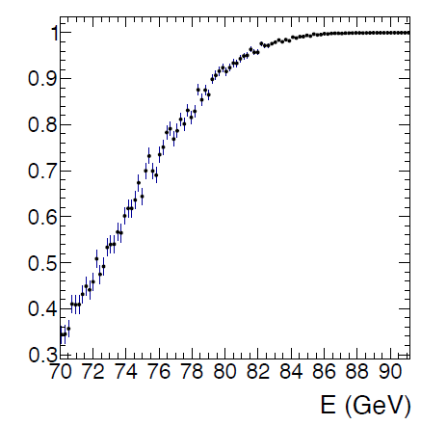
Leading Dijet Selection
When the global leading jets overlap with the dead region (close to beam), some of the jet energy will not be detected and they may appear as low energy jets.
A hybrid total energy observable is constructed to select events which have both leading jets in the acceptance:
The nominal selection cut is >83 GeV with a purity of 99% with both leading and subleading jet in the acceptance
A correction on the hybrid total energy selection is later applied to the unfolded leading dijet spectrum.
e⁺
e⁻
= Energy sum of {Particles within acceptance 0.2π<θ<0.8π}
υ { Particles with angle < 0.4 to axes of any jet above 5 GeV in the acceptance }
Purity

Slide 15
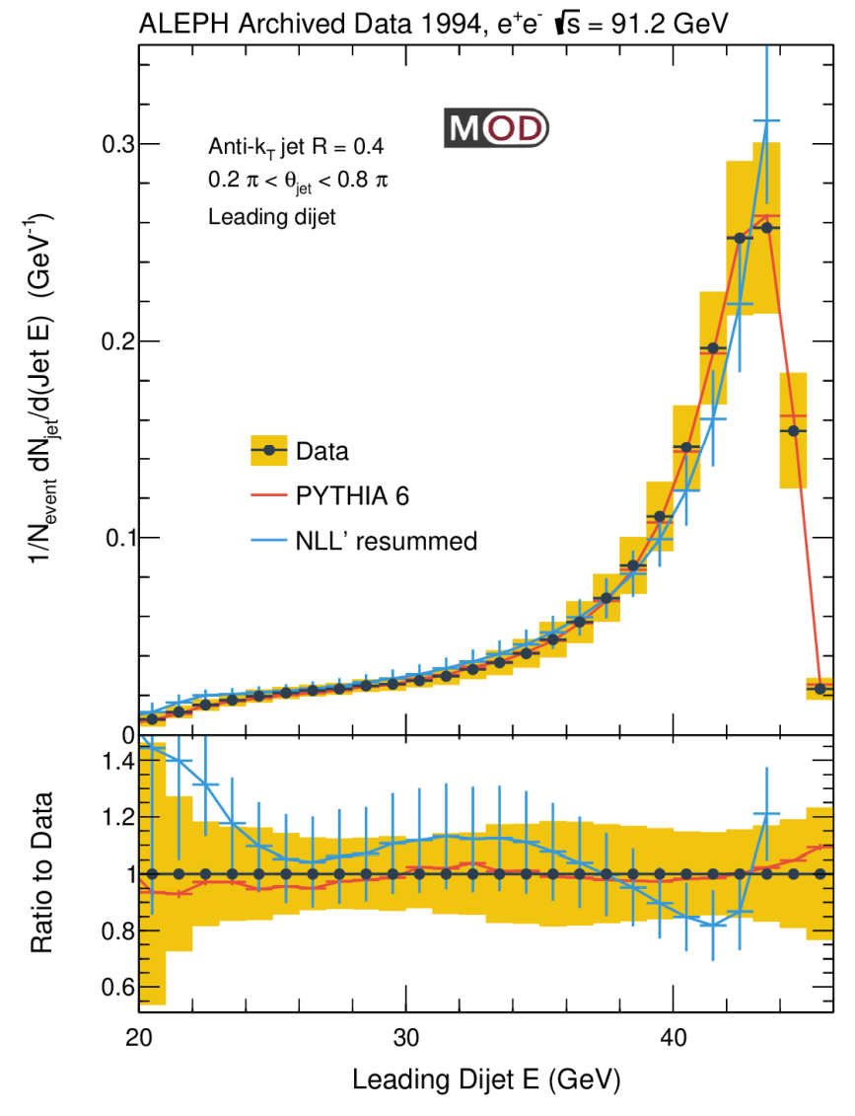
Leading Dijet Spectrum vs. Generators
Leading dijet energy spectrum: only include leading and subleading jets in the event (exclude other jets in the plot)
Suppress jets from soft emissions and combinatorial jets
A measurement of “energy loss” of (anti-)quark out of the jet cone due to parton shower
Next-to-leading logarithmic (NLL’) threshold and jet radius resummation gives a reasonable description of data
$$e^{+}$$
$$\overline{q}$$
e⁺
e⁻
$$Z^{0}/γ$$
$$e^{−}$$
$$q$$
**NLL’+R calculation from Duff Neill, Felix Ringer, Nobuo Sato

Slide 16
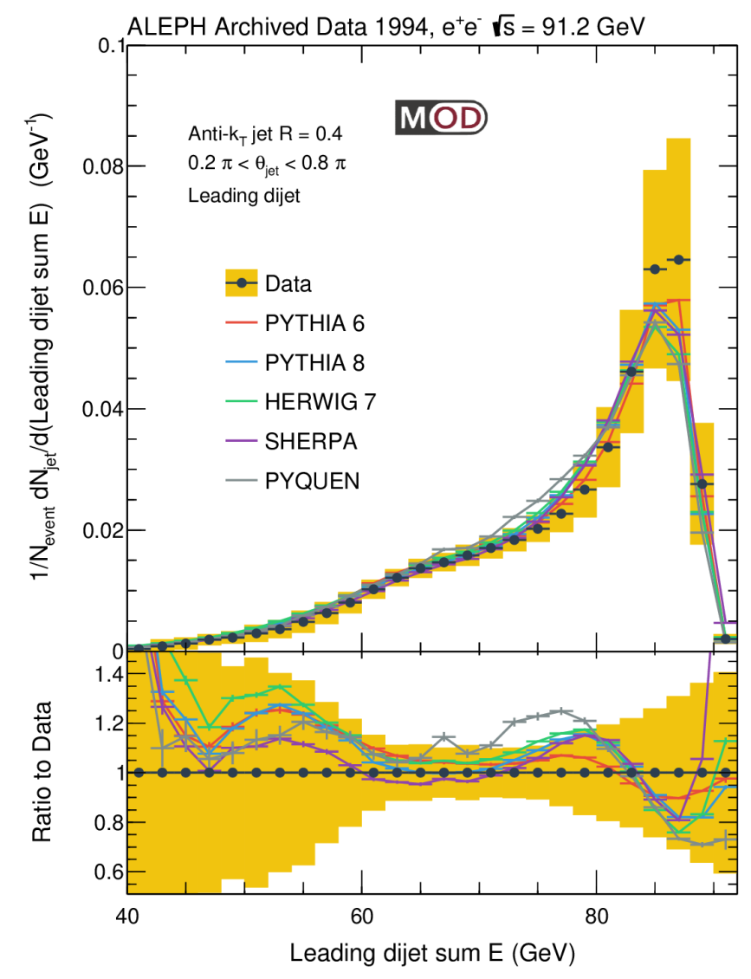
Leading Dijet Energy Spectrum
Sum of leading dijet energy (sum E = E₁+E₂)
Suppress jets from soft emissions and combinatorial jets
A measurement of “energy loss” of (anti-)quark out of the jet cone due to parton shower
Generators capture general features of data
E₂
$$e^{+}$$
$$\overline{q}$$
e⁺
e⁻
$$Z^{0}/γ$$
$$e^{−}$$
$$q$$
E₁

Slide 17
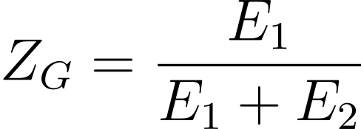
Groomed Jet Substructure with Soft Drop
Jet grooming: design observables sensitive to different phase space
Re-clustering with Cambridge-Aachen algorithm and grooming with a soft drop algorithm:
θ₁₂ is the actual opening angle between 1st and 2nd subjets
Soft drop setting: Z_{cut}=0.1 and β=0, identical to what are used in CMS pp and PbPb analyses
β=0 → grooming independent of θ
$$≥$$
“Anti-k_{T}“ clustering
Cambridge-Aachen re-clustering
Grooming
Subjet
R_{G}
e⁺
e⁻
Soft Drop:
JHEP 1405 (2014) 146
Anti-k_{T} jet

Slide 18
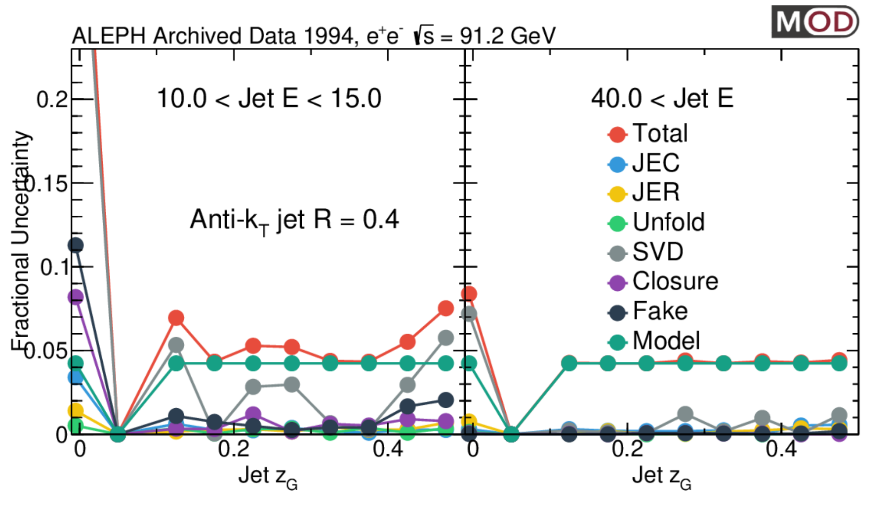
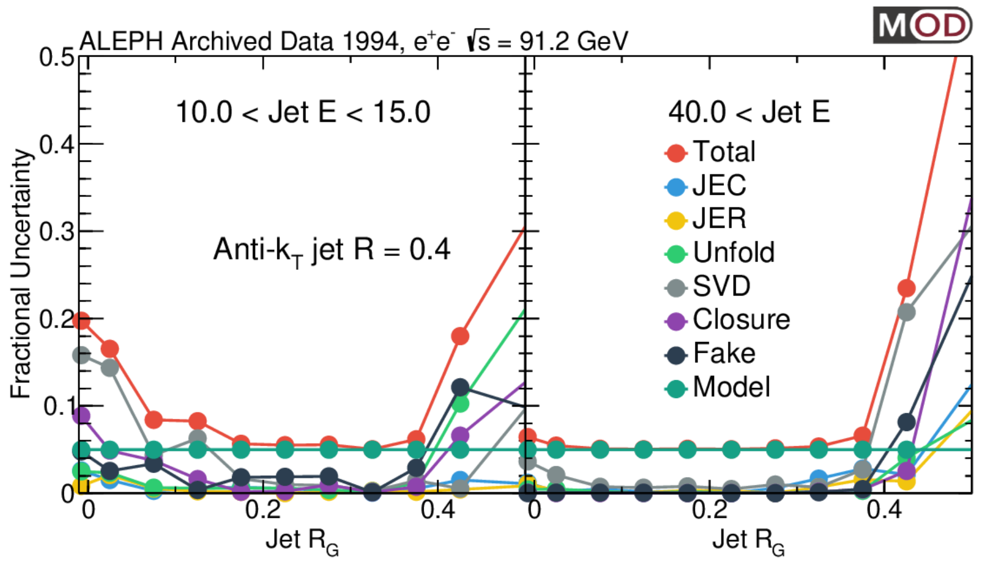
Systematics: Jet Substructure
Z_{G}
R_{G}
R_{G}
Main uncertainty: Model dependence
Compare unfolded data with nominal and reweighted MC
Smear the subjet energy (3% on leading subjet and 6% on subleading subjet)
Smear the angle of subjets (by 0.002)

Slide 19
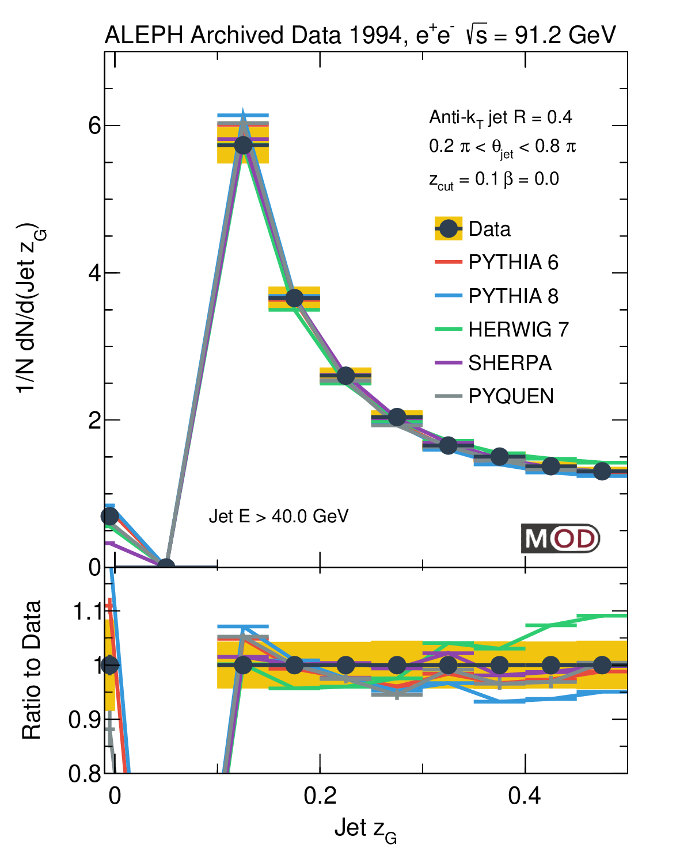
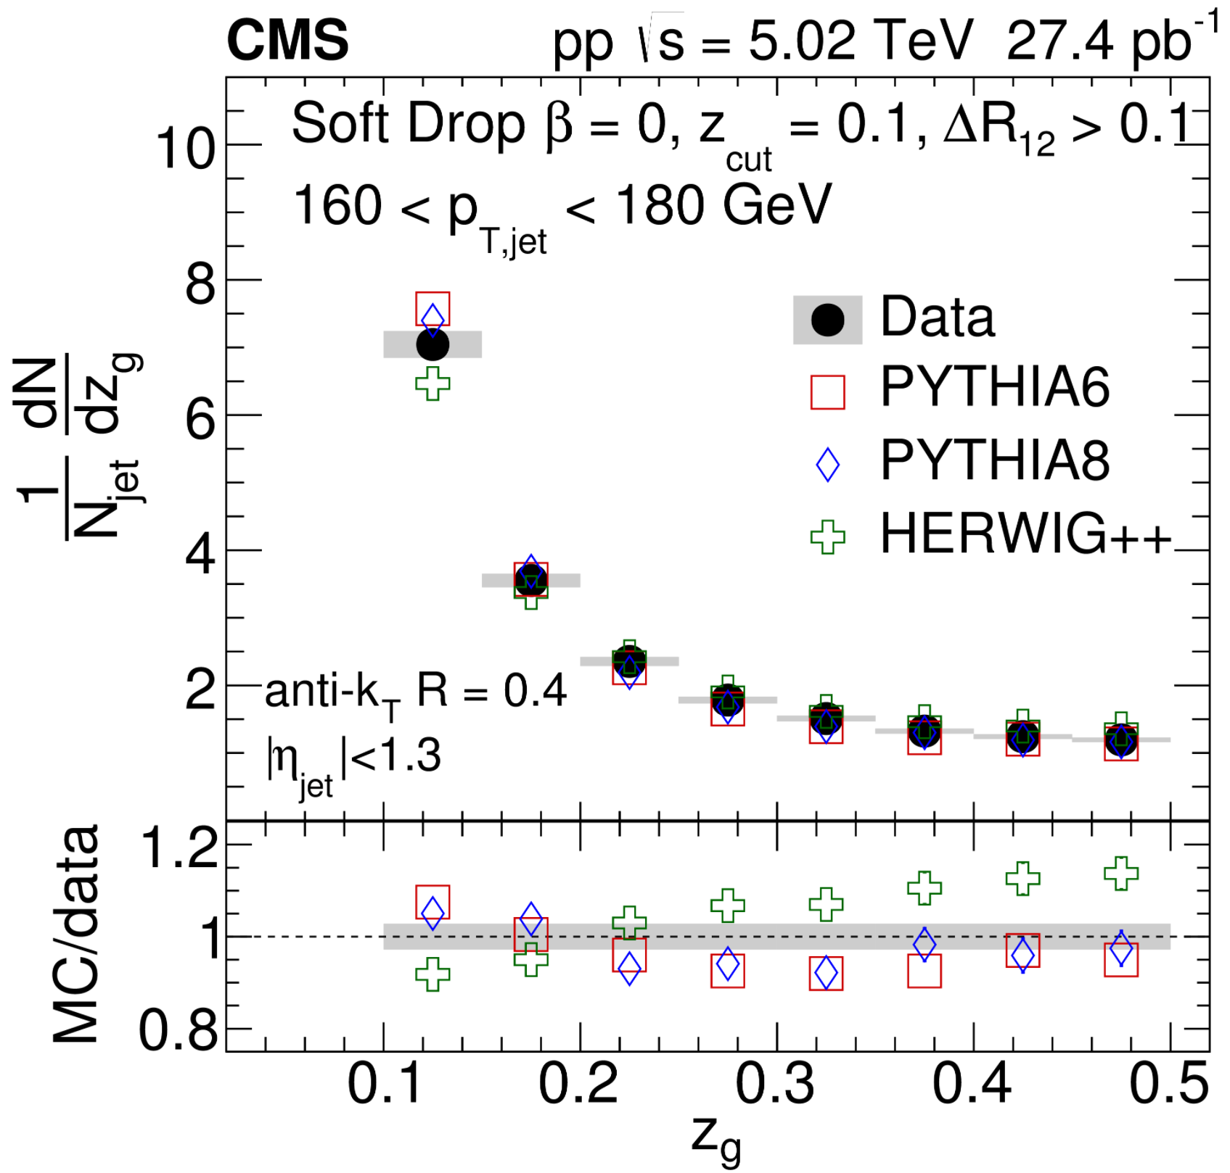
Groomed Momentum Sharing Z_{G}
E₁
E₂
PRL 120 (2018) 14, 142302
At high jet energy, data wider than PYTHIA 8, narrower than HERWIG
Similar to the conclusion from pp data
MITHIG-MOD-21-001
arXiv:2111.09914
JHEP 06 (2022) 008

Slide 20
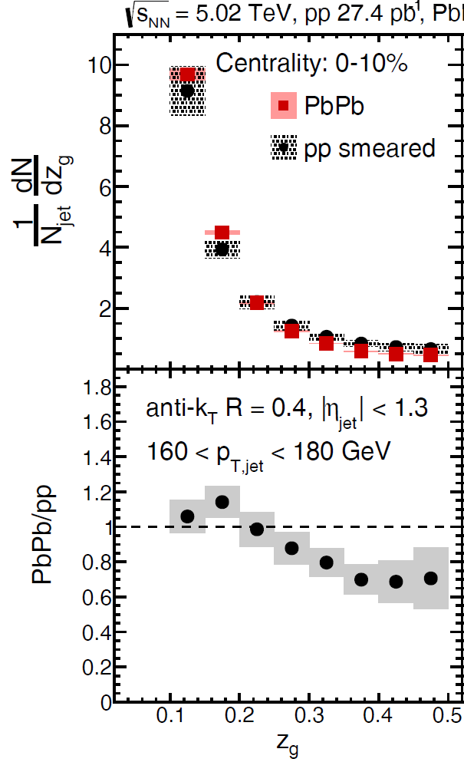
Groomed Momentum Sharing Z_{G}
E₁
E₂
(z_{cut},β) = (0.1,0.0)
ΔR>0.1
PRL 120 (2018) 14, 142302
MITHIG-MOD-21-001
arXiv:2111.09914
JHEP 06 (2022) 008
In PbPb collisions, modification of Z_{g} for jets with R_{g}>0.1
Size of the medium effect ~ discrepancy between pp (ee) data and event generators

Slide 21
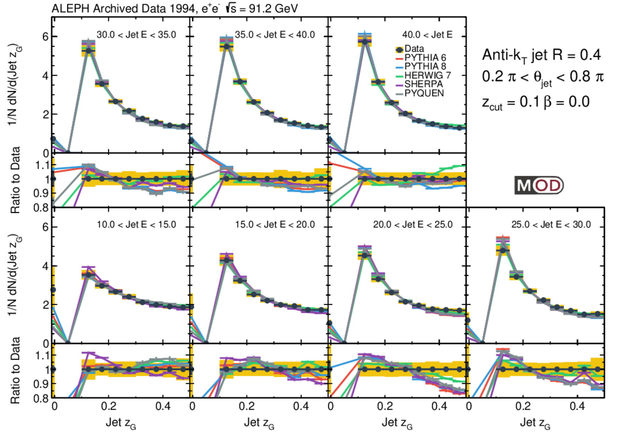
Groomed Momentum Sharing Z_{G} vs Jet E
The results are compared to SHERPA, PYTHIA 6, PYTHIA 8, HERWIG, and PYQUEN
Most of the event generators describe the general trend (wider Z_{g} spectra as we go to lower E)
None of the event generators provide full description of data (discrepancy up to around 15%)
MITHIG-MOD-21-001
arXiv:2111.09914
JHEP 06 (2022) 008

Slide 22
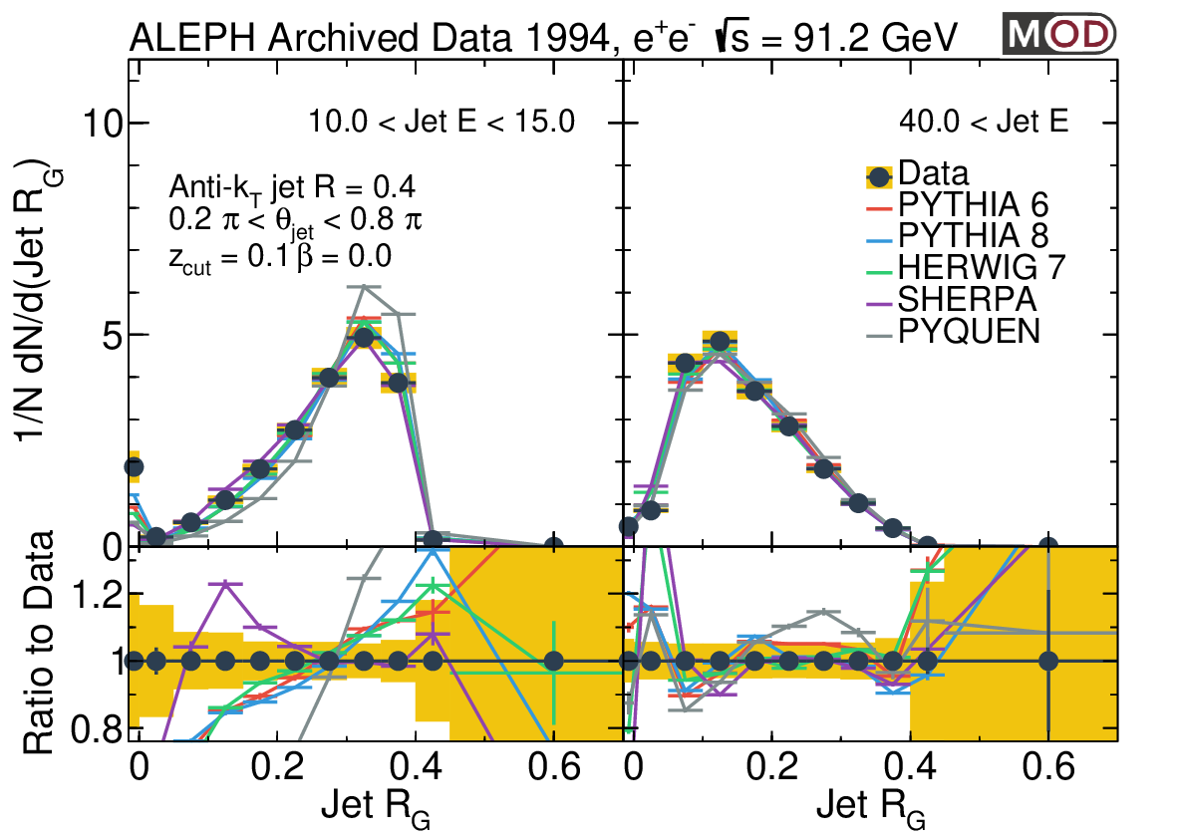
Groomed Jet Radius R_{G} vs. Event Generators
R_{G}
MITHIG-MOD-21-001
arXiv:2111.09914
JHEP 06 (2022) 008
High jet E (mainly quark jets):
Peak at smaller R_{G} value
Generators give a better description of the data
Low jet E (mainly from soft emissions and combinatorial):
Peak at larger R_{G} value as one would expect
SHERPA gives a better description of the data
PYTHIA 6, PYTHIA 8, HERWIG, and PYQUEN overpredict the R_{G}
Low jet E
High jet E

Slide 23
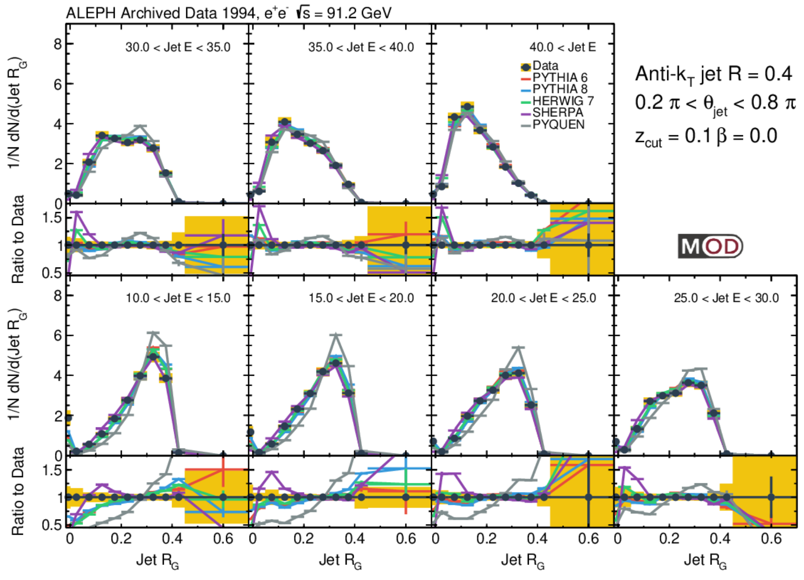
Groomed Jet Radius R_{G} vs. Event Generators
R_{G}
MITHIG-MOD-21-001
arXiv:2111.09914
JHEP 06 (2022) 008
The results are compared to SHERPA, PYTHIA 6, PYTHIA 8, HERWIG, and PYQUEN
Groomed jet radius decreases as a function of jet energy
Archived PYTHIA 6.1 is closer to the data
None of the event generators provide full description of data (discrepancy up to ~50%)

Slide 24
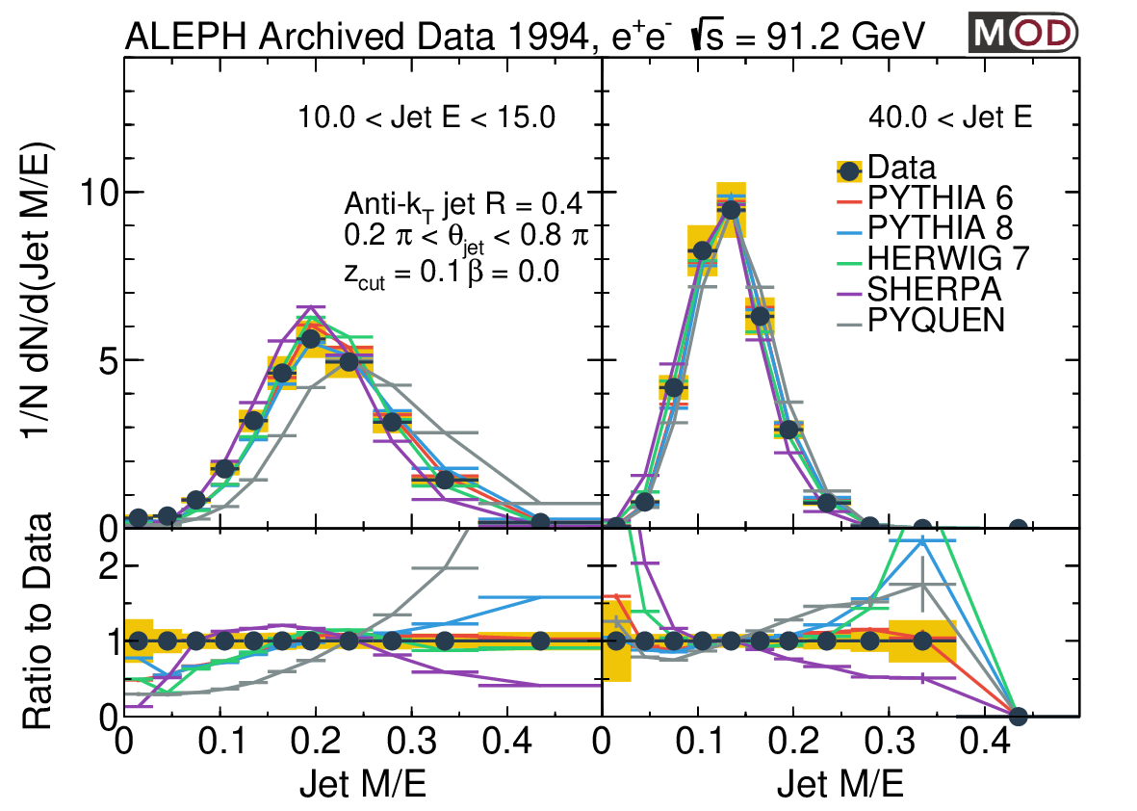
Jet Mass / Energy Ratio
Jet M/E:
SHERPA, PYTHIA 8, HERWIG, and PYQUEN don’t describe the distribution well.
Archived PYTHIA 6.1 is closer to the data
SHERPA: lower mass than other generators
MITHIG-MOD-21-001
arXiv:2111.09914
JHEP 06 (2022) 008
Low jet E
High jet E

Slide 25
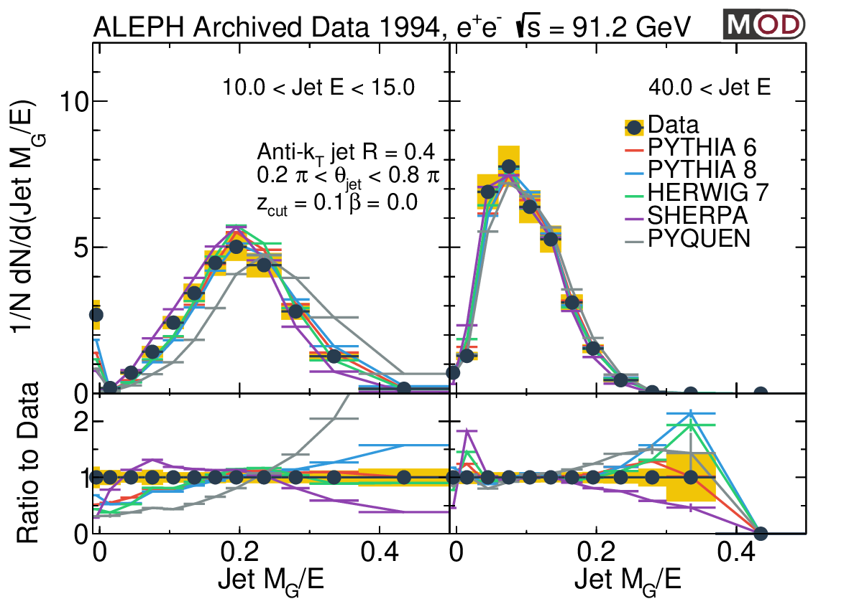
Groomed Jet Mass / Energy Ratio
Groomed Jet M_{G}/E:
Reduce the impact of soft radiation in the jet cone
Jet mass becomes smaller after grooming
Similar discrepancies seen between data and generators as the ungroomed mass
To enhance the sensitivity to soft emissions: Follow up with (M-M_{G})/E and collinear drop observables in the future
MITHIG-MOD-21-001
arXiv:2111.09914
JHEP 06 (2022) 008
Low jet E
High jet E

Slide 26
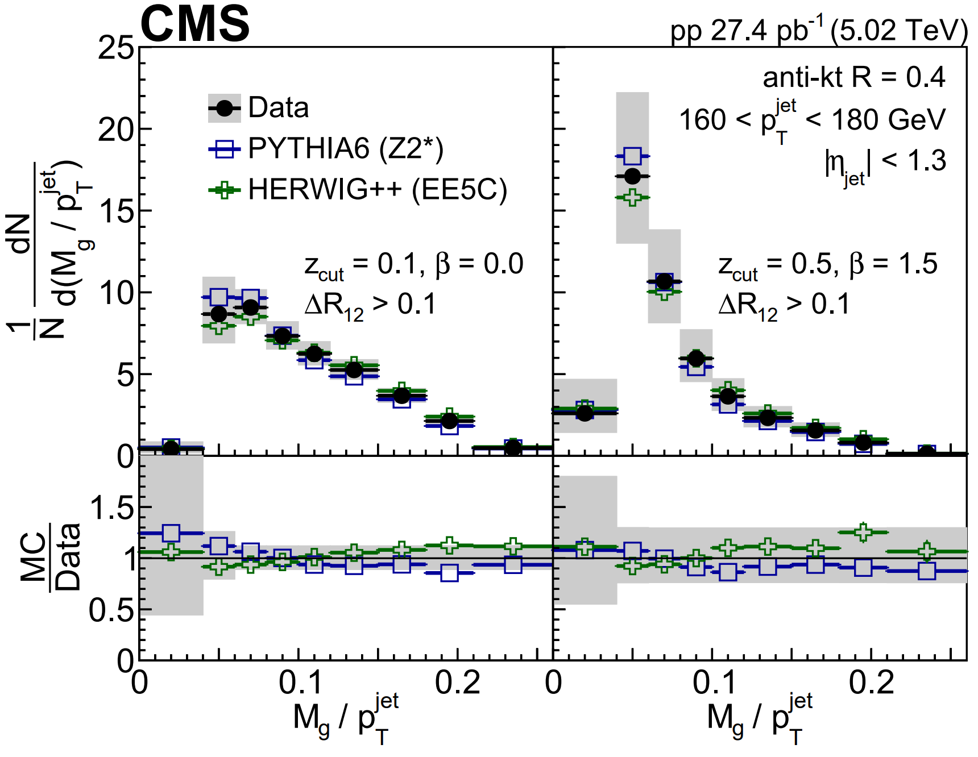
Groomed Jet Mass in e⁺e⁻ and pp
MITHIG-MOD-21-001
arXiv:2111.09914
JHEP 06 (2022) 008
JHEP 10 (2018) 161
Large difference between e⁺e⁻ data and event generators
Within the experimental uncertainties, event generators agree with pp data
Cancellation of effects from MPI and shower?

Slide 27
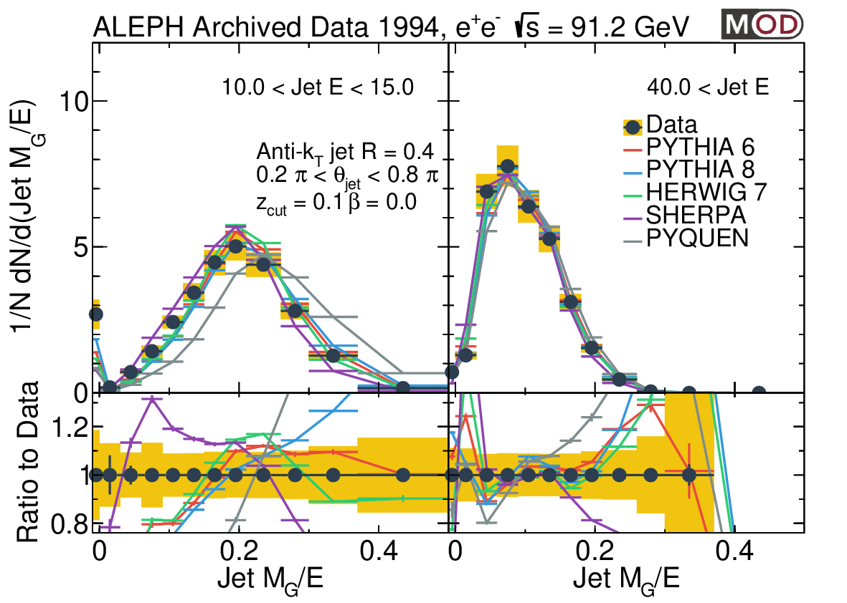
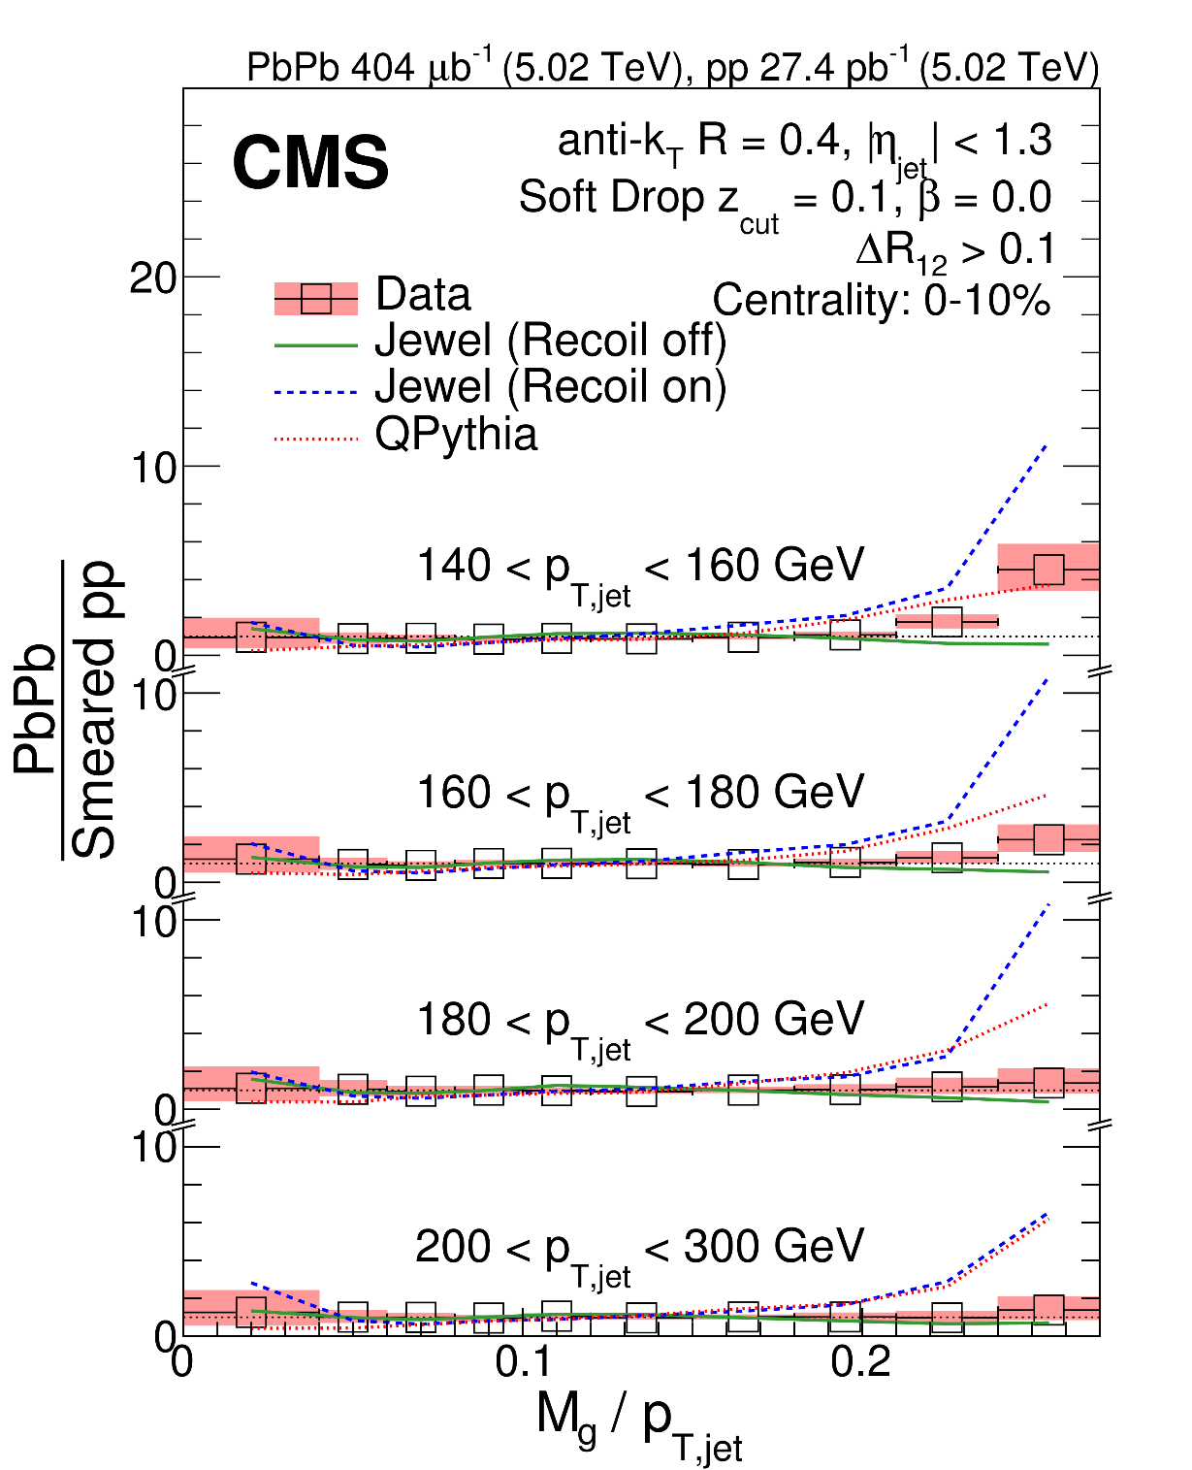
Groomed Jet Mass in e⁺e⁻ and PbPb
MITHIG-MOD-21-001
arXiv:2111.09914
JHEP 06 (2022) 008
PbPb: modification mass spectra
In particular, at high and low M_{g}/p_{T} regions
Also the phase space where e⁺e⁻ data is poorly described by event generators
JHEP 10 (2018) 161

Slide 28
From e⁺e⁻ to EIC
e⁺e⁻ jet data provide opportunities to validate theoretical approaches and tuning of event generator
High accuracy pQCD calculations
Hadronization
Provide tests on EIC-inspired jet algorithms
For instance, Centauro
Provide tests on the new observables
Such as EC and CF
Reference for ep and eA data at EIC
e⁺e⁻

Slide 29
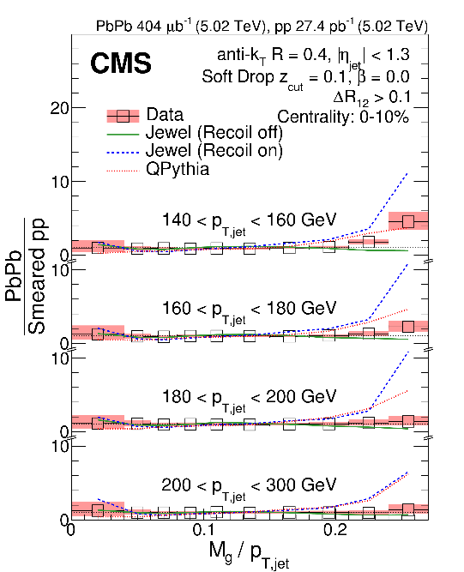
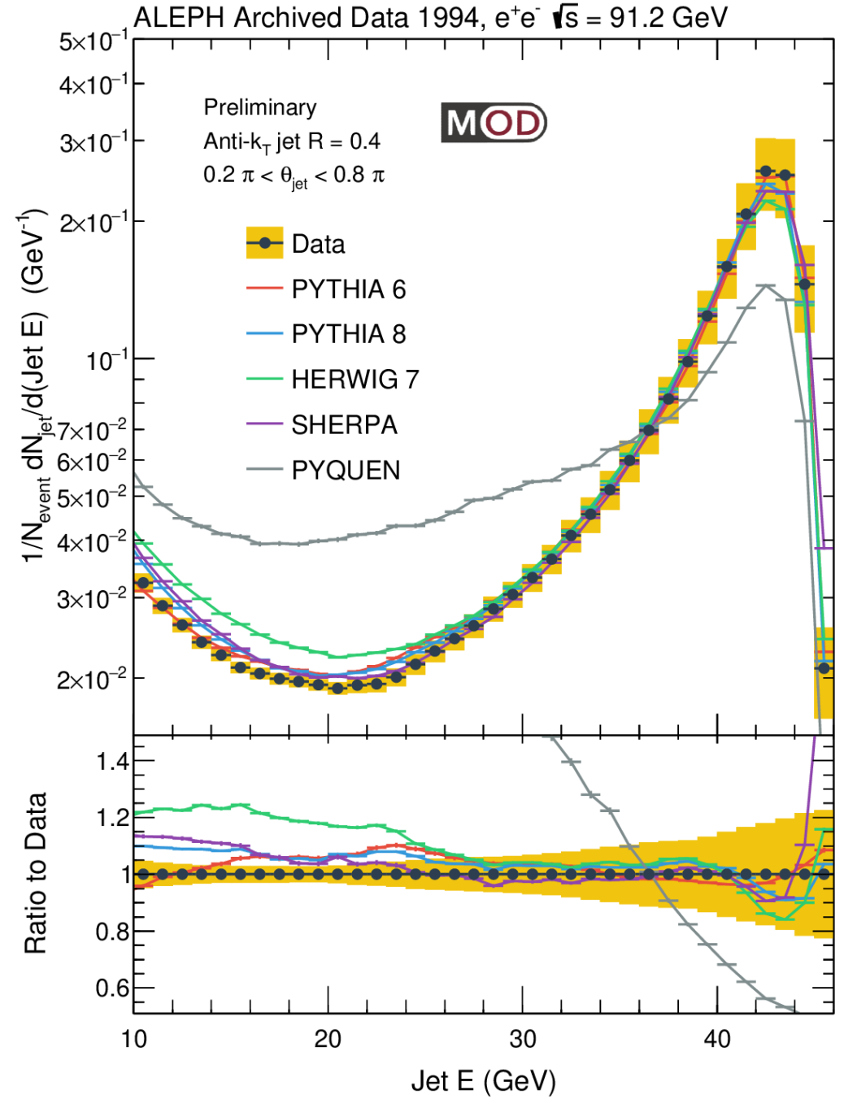
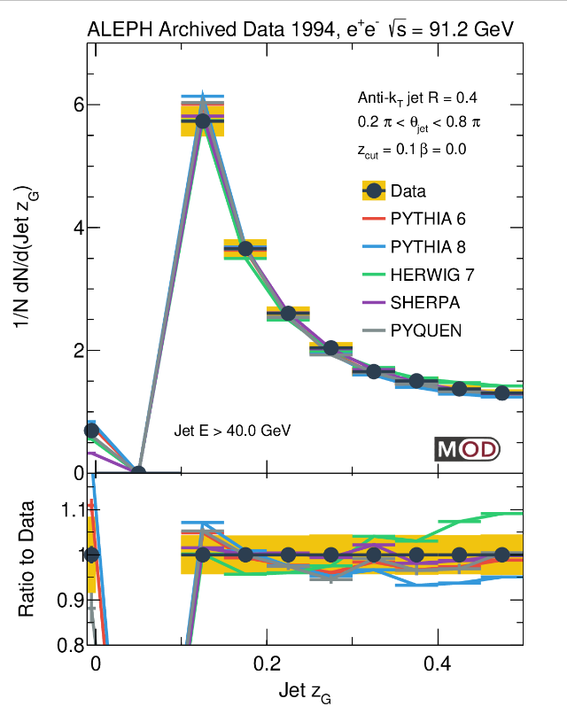
Summary
The first measurement of anti-k_{T} jet energy spectra and substructure in hadronic e⁺e⁻ collisions
None of the event generators gives full description of the e⁺e⁻ data (discrepancy as large as 10-50%)
Discrepancy between data and generators in e⁺e⁻ is as large as the difference between pp and PbPb in places
Provide new inputs to event generators and hadronization models
We look forward to more future analyses with this dataset such as:
Jet substructure vs. event multiplicity
Jet fragmentation function
Strangeness content
EIC jet algorithm and observables
… stay tuned!
(z_{cut},β) = (0.1,0.0)
CMS Z_{G} PRL 120 (2018) 14, 142302
ALICE R_{G} arXiv:2107.12984

Slide 30
Acknowledgement
We would like to thank Roberto Tenchini and Guenther Dissertori from the ALEPH collaboration for the useful comments and suggestions on the use of ALEPH archived data.
We would like to thank Felix Ringer, Jesse Thaler, Andrew Lakoski, Liliana Apolinário, Ben Nachman, Camelia Mironov, Jing Wang for the useful discussions on the analysis.
The MIT group's work was supported by US DOE-NP

Slide 31
Thank you!
Janice Chen
(MIT, BELLE/CMS)
Dennis Perepelitsa (CU Boulder, ATLAS)
Yang-Ting Chien (GSU)

Slide 32
Backup Slides
e⁺
e⁻

Slide 33
Z⁰ Hadronic Decay Event Selection
Track Selection:
Particle Flow Candidate 0, 1, 2
Number of TPC hits for a charged tracks >= 4
|d0| < 2 cm
|z0|< 10 cm
|cosθ|<0.94
p_{T}> 0.2 GeV (transverse momentum with respect to beam axis)
N_{TPC} >=4
x²/ndf < 1000.
Neutral Hadron Selection:
Particle Flow Candidate 4, 5 (ECAL / HCAL object)
E> 0.4 GeV
|cosθ|<0.98
Event Selection:
Number of good charged particles >= 5 (including charged hadrons and leptons)
Number of good ch+neu. Particles >= 13
E_{charged} > 15 GeV
|cos(θ_{sphericity})|<0.82

Slide 34
Jet Energy Correction Steps
In order to inspect the event in a shower-by-shower basis, we need to perform jet reconstruction
Jet analysis workflow:
ALEPH Hadronic Events
Archived PYTHIA 6.1 MC
Jet Reconstruction
MC Jet Energy Correction
Resolution Unfolding, Efficiency Correction
Corrected Results
Data-based Correction: Remove +/- Side Difference
Absolute Energy Scale Correction using Multi-Jet Mass
Energy Corrected Jet Data

Slide 35
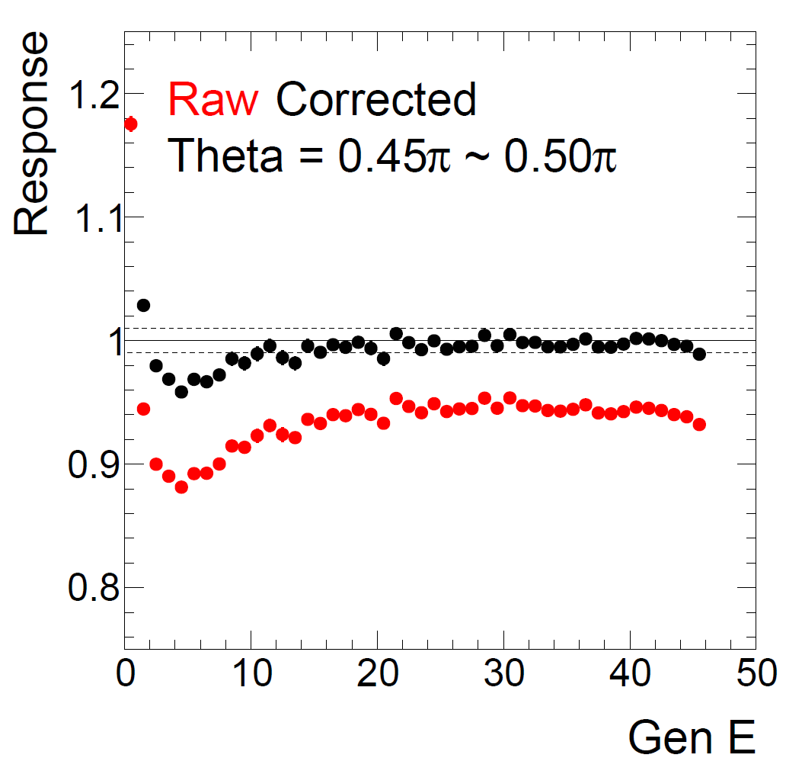
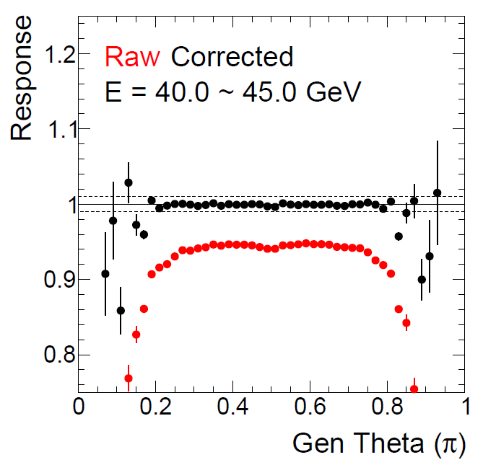
MC Jet Energy Correction
(GeV)
Archived PYTHIA 6.1 MC (tuned to describe ALEPH hadron spectra) was used for jet energy calibration
Response = (Raw or Corrected) Reconstructed jet energy / “Generated jet energy” in truth level
Good closure was achieved for E>10 GeV and 0.2π<Jet θ<0.8π

Slide 36
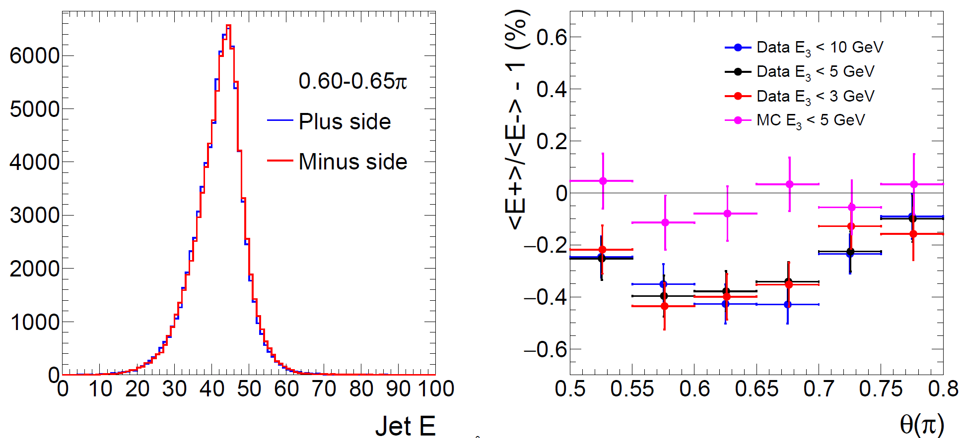
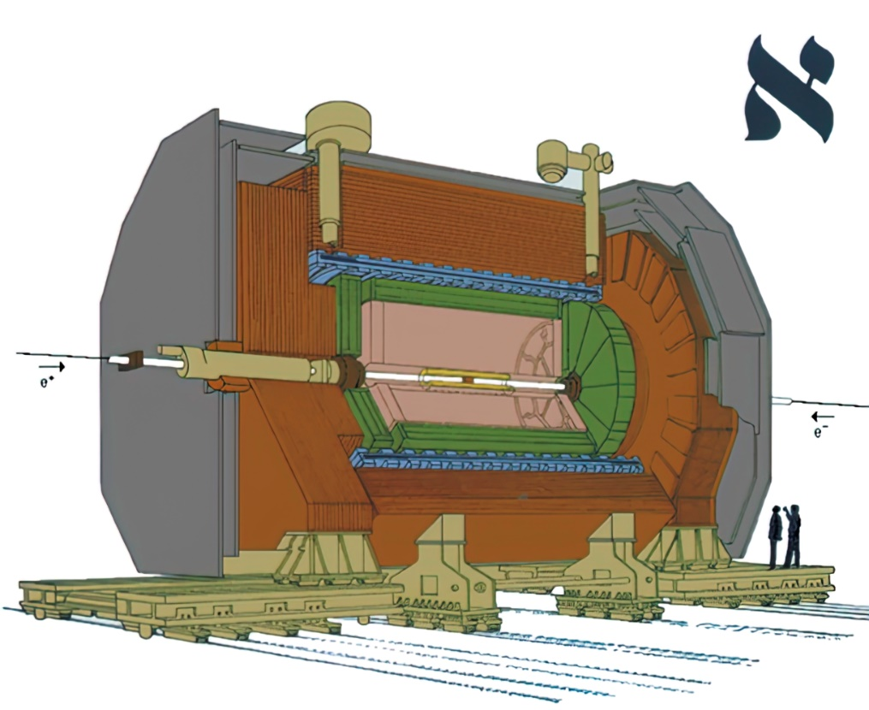
Data-based Calibration: Relative Plus/Minus Difference
θ=0.5π
- side
+ side
(GeV)
The second step is to remove the difference in jet energy scale between the + side and – side
Differences in average jet energy in the + side <E+> and – side <E-> is corrected

Slide 37
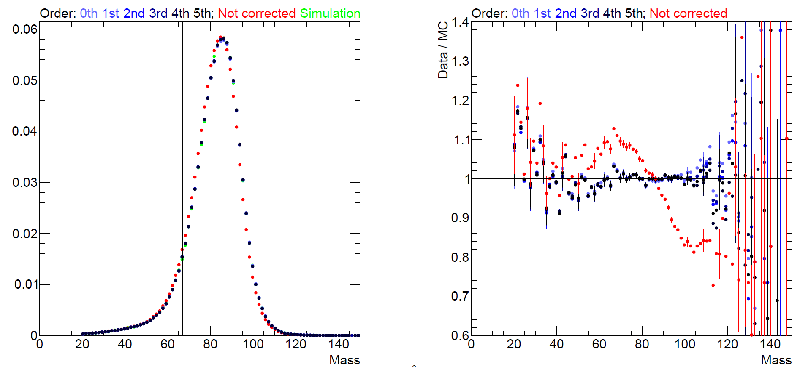
Data-based Calibration: Absolute Scale
Multi-jet invariant mass M_{J} method
Peak at M_{J} = Z⁰ mass
N=9
$$e^{+}$$
$$\overline{q}$$
$$Z^{0}/γ$$
$$e^{−}$$
$$q$$
M_{J}
(GeV)
M_{J}
(GeV)
Performance with up to N=9 leading jets is presented (ranked by energy)
Require (N+1)^{th} jet energy < E_{cut} to reduce the sensitivity to soft jets, where E_{cut} is set to 3 GeV
N and E_{cut} are varied for systematical uncertainty checks
Jet energy correction is modeled by n^{th} order polynomial of the jet energy f(E_{jet})
Minimize the χ² difference in mean mass between MC and data in 2% quantile ranges (slicing the mass spectrum)
0-10% and 90-100% are removed to minimize impact of outliers
n=1 chosen as the nominal correction
MITHIG-MOD-NOTE-21-001
arXiv:2108.04877
Notes:
Then the second step in the data-based calibration is the absolute scale
First, we take at most N leading jets in the event and require N+1 jet to be smaller Ecut to reduce the sensitivity to soft jets.
If an event has smaller N jet, for instance, 2 jets, they are included in the analysis.
N and Ecut are varied so that we can understand the associated systematics. In the nominal analysis we used N=9 and Ecut to be 3 GeV
Jet energy correction is then modeled by Nth order polynominal of the Jet energy
Then, we determine the parameters by minimizing the x^2 difference in mean mass between MC and data. This is done in 2% quantile ranges, slicing the mass spectrum
We avoid 0-10% and 90-100% to minimize the impact of outliers
1st order polynomial is chosen for the final analysis

Slide 38
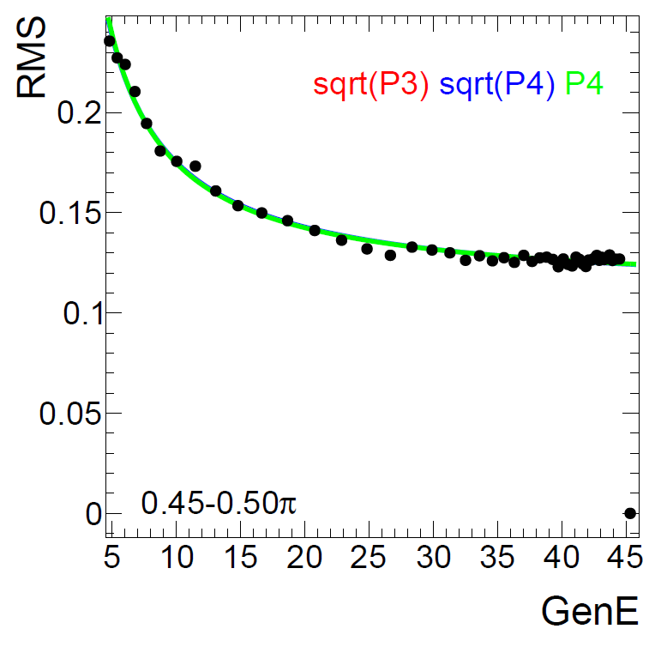
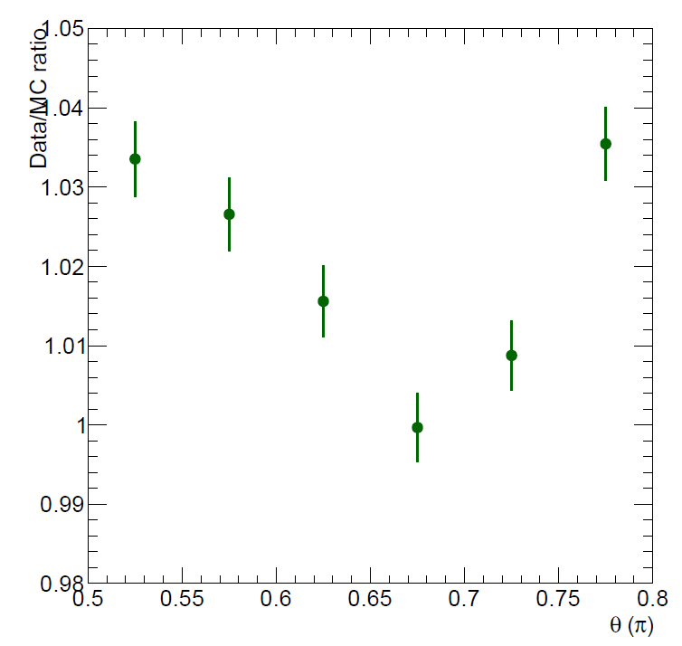
Jet Energy Resolution
Data Resolution / MC Resolution
Archived PYTHIA 6.1 Simulation
Generated Jet Energy (GeV)
Jet θ (π)
Jet energy resolution is around 15-25%
Difference between data and MC are studied by leading dijet ( 0% ~ 4%)
MITHIG-MOD-NOTE-21-001
arXiv:2108.04877

Slide 39
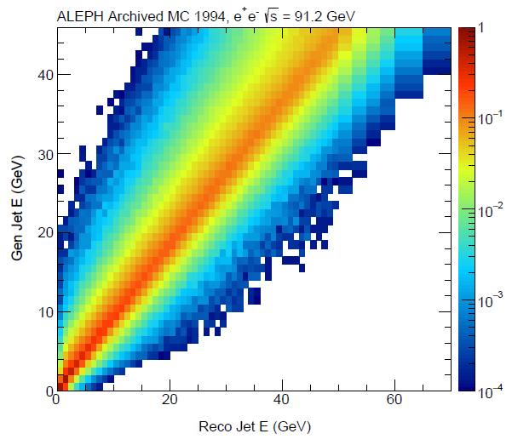
Unfolding
Performed using the ROOUNFOLD package (v2.0.0). Bayes Unfold method as the nominal result and SVD as systematics check
A flat prior is used in Bayes Unfold (PYTHIA 6.1 MC spectra used as prior for systematic check)
1D unfolding is performed for jet energy, leading dijet energy spectra.
For jet mass, Z_{G}, R_{G} and groomed mass, 2D unfolding of the observables in bins of jet energy is performed
MITHIG-MOD-NOTE-21-001
arXiv:2108.04877

Slide 40
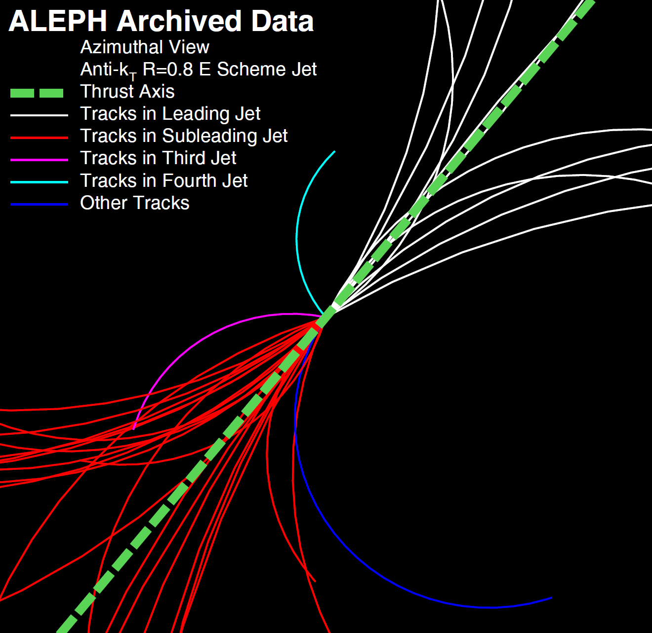
High Multiplicity Event in e⁺e⁻ Collisions
39 Tracks
T=0.98

Slide 41
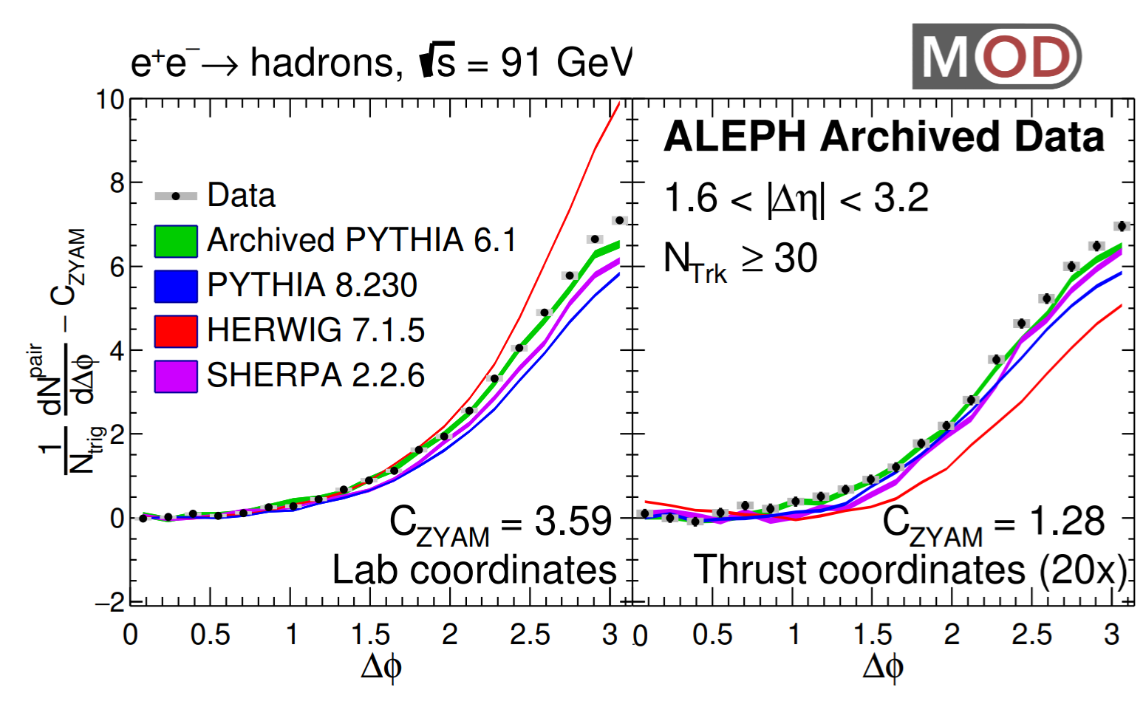
Correlation Function vs. Generators

Slide 42
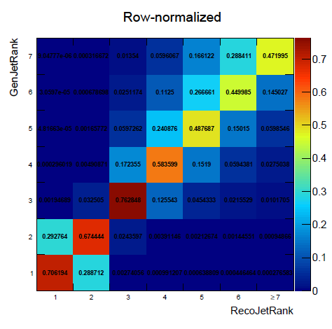
Unfolding

Slide 43
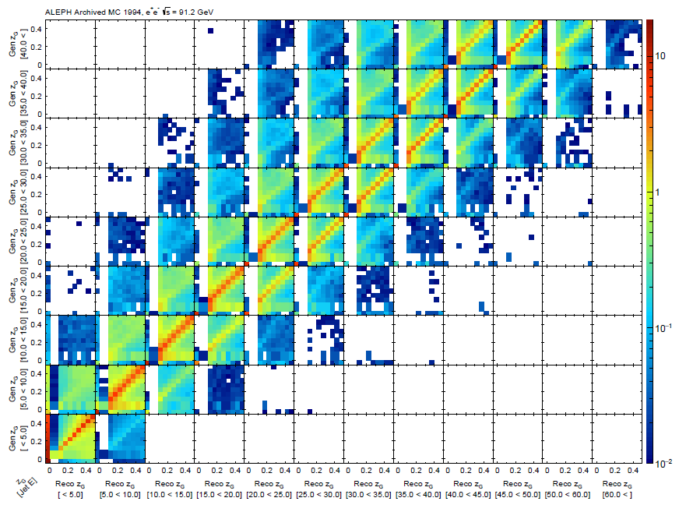
Response Matrix for Z_{G}

Slide 44
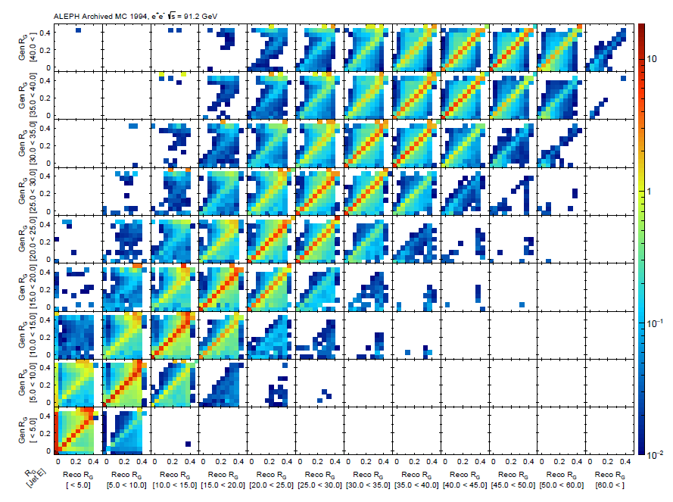
Response Matrix for R_{G}

Slide 45
Systematics: Leading Dijet Energy

Slide 46
Summary of M_{J} studies

